Slide 1
Central Training: General Professional Studies
Behaviour Management (Session 1)
Thursday 29 September 2022

Slide 2
Training Overview
This session will aim to…
A
Part 1: Introduction - To understand expectations and the importance of behaviour management;
Part 2: Research & Recommendations - To examine some strategies to support behaviour.
B
Behaviour Management

Slide 3
Core Content Overview • High Expectations (TS1)
Evidence Statements: Learn that…
1.1
Teachers have the ability to affect and improve the behaviour and motivation of their pupils.
1.4
Setting clear expectations can help communicate shared values that improve classroom and school culture.
1.2
Teachers are key role models.
1.5
A culture of mutual trust and respect supports effective relationships.
Teacher expectations can affect pupil outcomes.
1.3

Slide 4
Core Content Overview • Behaviour Management (TS7)
Evidence Statements: Learn that…
Routines can help create an effective learning environment.
Building effective relationships is easier when pupils believe that their feelings will be considered and understood.
7.1
7.5
7.2
A predictable and secure environment benefits all pupils, but particularly SEN.
Pupils are motivated by intrinsic and extrinsic factors.
7.3
The ability to self-regulate affects pupils’ ability to learn, success in school and future lives.
7.6
Pupils’ investment in learning is also driven by their prior experiences and perceptions of success and failure.
7.7
7.4
Teachers can influence pupils’ resilience and beliefs about their ability to succeed.

Slide 5
Core Content Overview • Classroom Practice (TS4), TS8
Evidence Statements: Learn that…
4.9
Paired and group activities can increase pupil success, but to work together effectively pupils need guidance, support and practice.
Building effective relationships with parents, carers and families can improve pupils’ motivation, behaviour and academic success.
8.4
How pupils are grouped is also important.
4.10
See full detail in the ITT Core Content Framework.
https://assets.publishing.service.gov.uk/government/uploads/system/uploads/attachment_data/file/843676/Initial_teacher_training_core_content_framework.pdf

Slide 6
Core Content Overview • High Expectations (TS1), TS7
Practice Statements: Learn how to…
1
Demonstrate consistently high behavioural expectations.
7
Develop a positive, predictable and safe environment for pupils.
1
Communicate a belief in the academic potential of all pupils.
7
Build trusting relationships.
7
Establish effective routines and expectations.
7
Motivate pupils.

Slide 7
Core Content Overview • Professional Behaviours (TS8)
Practice Statements: Learn how to…
8
Build effective working relationships.
8
Manage wellbeing by understanding the importance of the right to support.
See full detail in the ITT Core Content Framework.
https://assets.publishing.service.gov.uk/government/uploads/system/uploads/attachment_data/file/843676/Initial_teacher_training_core_content_framework.pdf

Slide 8
Academic Reading
Bennett, T. (2007), Beginning Teacher’s Behaviour Toolkit: Summary
Willingham, D. T. . (2012) Why Don’t Students Like School?
The trainee teacher behavioural toolkit: a summary - GOV.UK (www.gov.uk)
See ITT Core Content Framework for full bibliography.
https://assets.publishing.service.gov.uk/government/uploads/system/uploads/attachment_data/file/843676/Initial_teacher_training_core_content_framework.pdf

Slide 9
Introduction
Part 1

Slide 10
Thinking Back • School & Discipline
Reflection: Watch the following video and jot down your thoughts.
Consider the representation of the teachers, the students, the behaviour management.
How does it reflect your personal experience of school?
How does it compare with your personal values and beliefs on behaviour management?

Slide 11
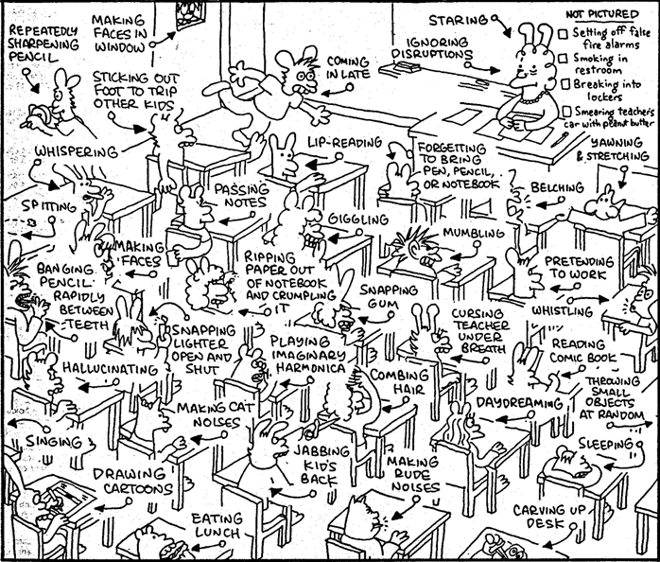
Thinking Back • You as a Student
Activity 1: Circle on the picture everything you remember doing as a student yourself.
Activity 2: Which of them would you now:
Encourage
Tolerate
Address as low-level disruption
Deem unacceptable?

Slide 12
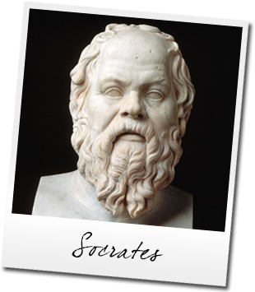
Thinking Back • Children & Behaviour
Question: Who said this?
“
Our youth now love luxury. They have bad manners, contempt for authority; they show disrespect for their elders and love chatter in place of exercise; they no longer rise when elders enter the room; they contradict their parents, chatter before company; gobble up their food and tyrannize their teachers.
”
469-399 BC

Slide 13
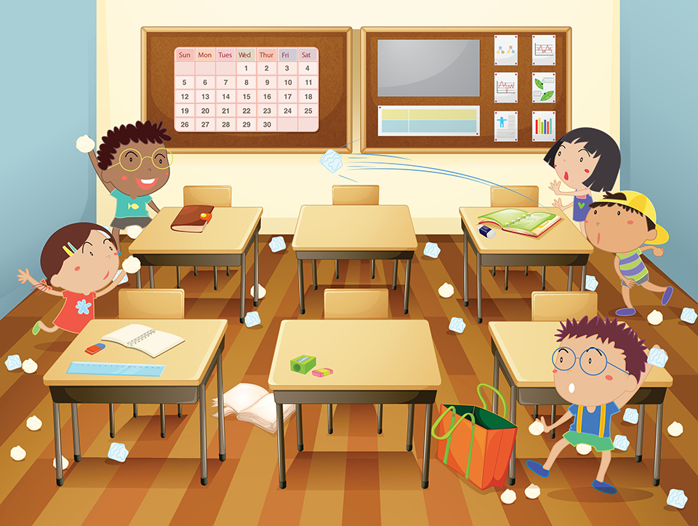
Introduction • Definitions
Defining “Good Behaviour”
Reflection:
What does a conducive learning environment look like, sound like, feel like (& smell like)?
Reflection: Is quieter always better?

Slide 14
Introduction • Definitions
Defining “Disruptive Behaviour”
High-Level
Activity: List examples of low-level disruptive behaviour. Repeat the activity
with high-level disruption.
Low-Level

Slide 15
Introduction • Frameworks
DfE’s Teachers’ Standards
Ofsted
Framework
The Law
Your school’s behaviour policy

Slide 16
Introduction • Frameworks
Behaviour Policies
Activity: Explain in your own words what you know of your school policies on Behaviour.

Slide 17
Central Training: General Professional Studies
Research & Recommendations
Part 2

Slide 18
Research •Influences
In School
Aspirations
Perception of
consequences
Intellectual ability
Attitudes to learning
Self-evaluation
Motivation
Labelling
Emotional
regulation
Happiness
Nutrition
Out of School
Relationship with teacher
Teacher interest
Relationship with peers
Educational opportunities
Behaviour management approach
Curriculum and T&L
School ethos & policies
Expectations
School transitions
Class sizes
Family relationships
Relationship with others/choice of peers
Stress at home
Adverse life events
Discipline at home
Parental involvement
in homework
Culture
Abuse
Parental view of
education
Activity:
1. List in and around the silhouette the various factors that can impact on pupils’ behaviour.
2. Which factors do schools have little influence over ?
Adapted from
EEF, Improving Behaviour in Schools

Slide 19
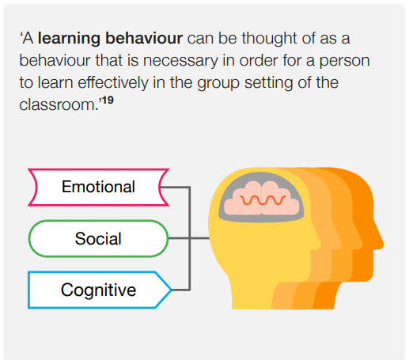
Research • Management
Adapted from
EEF, Improving Behaviour in Schools
Managing misbehaviour and teaching behaviour for learning can be achieved by developing and strengthening pupil’s relationships with:
○ themselves
○ others
○ the curriculum

Slide 20
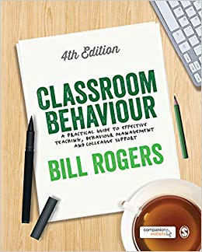
Research • Management
Principles of Behaviour Management - Bill Rogers
Behaviour is learned – but not instantly and does take time
Behaviour is conditioned – why do some children behave for some teachers and not others?
Behaviour is purposeful
Behaviour is chosen
Behaviour communicates about needs
Behaviour can be the result of BDS (Bad Day Syndrome)
Behaviour can be changed
Behaviour can be taught
Behaviour Management: A Bill Rogers Top 10 – teacherhead

Slide 21
Recommendations & Strategies
3
Use classroom management strategies to support good classroom behaviour
Rewards & sanctions
Praise
Empowerment
Use simple approaches as part of your regular routine
Controlled entry & start
Seating plans
Use targeted approaches to meet the needs of individuals in your school
Asking for help
Whole-school interventions
Consistency is key
Know and understand your pupils and their influences
Relationships
Presence & "withitness"
Non-verbal communication
Teach learning behaviours alongside managing misbehaviour
Planning
Contracts
1
4
5
2
6

Slide 22
Strategies • T-P Relationship
1
“Don’t smile until Christmas”?
Question:
Do you agree or not with this advice?

Slide 23
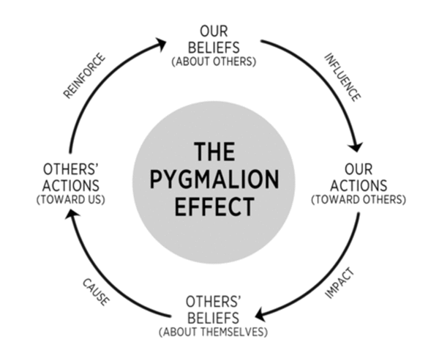
Strategies • T-P Relationship
1
The Importance of Having High Expectations
Pygmalion effect is the phenomenon whereby others' expectations of a target person affect the target person's performance (Rosenthal-Jacobson)

Slide 24
Strategies • T-P Relationship
1
Reflection:
Which of these did you witness during last week’s observations?
Establish
Maintain
Reconnect
Repair & Restore
Be available
Inquire about their interests
Communicate positively
Reference student info
Deliver constructive feedback wisely
5-1 ratio positive to negative interactions
Positive notes home
Greeting students at the door
Relationship check-in
Random, special activities
Take responsibility for negative interaction
Deliver an empathy statement
Let go of previous incidents/Start fresh
Communicate you care
Engage in mutual problem-solving
Adapted from
EEF, Improving Behaviour in Schools

Slide 25
Strategies • T-P Relationship
1
The Importance of Communicating Positively
“Listen now please”
“Don’t come in so noisily”
“Sit down”
“Why haven’t you got your book?”
“You have a lot to do today”
“I’m sick of having to raise my voice above you”
“Stop talking at the back”
Open-ended questions
Affirmations
Avoidance of Don’t
Reflexive listening
Validation
Activity:
Subtle changes to language are of HUGE importance. Can you improve the following sentences?

Slide 26
Strategies • T-P Relationship
1
The Importance of Being the Expert
Expert teachers identify the most effective ways to represent the subject.
Expert teachers create an optimal classroom climate for learning, a climate of Trust and Positivity.
Expert teachers monitor learning, while providing and using feedback.
Expert teachers believe all students can reach the success criteria. They are passionate and enthusiastic.
Expert teachers influence a wide range of student outcomes not solely limited to test scores.
Adapted from
J. Hattie, Visible Learning, 2008

Slide 27
Strategies • T-P Relationship
1
The Importance of being a role model
“The teacher is not only a communicator but a model.”
J. Bruner, The Process of Education, 1977
As a teacher, you will be modelling the behaviour traits that you want to see in your students. So:
Dress appropriately (teachers’ dress code in school policies)
Follow the school’s Use of Technology guidance and policies
Be punctual to your lessons
Be prepared and take responsibility
Be open & enthusiastic
Be fair and respectful
Respond calmly
Do not let external factors cloud your own behaviour.
Activity – Diamond 9 – which is top and which is bottom ?

Slide 28
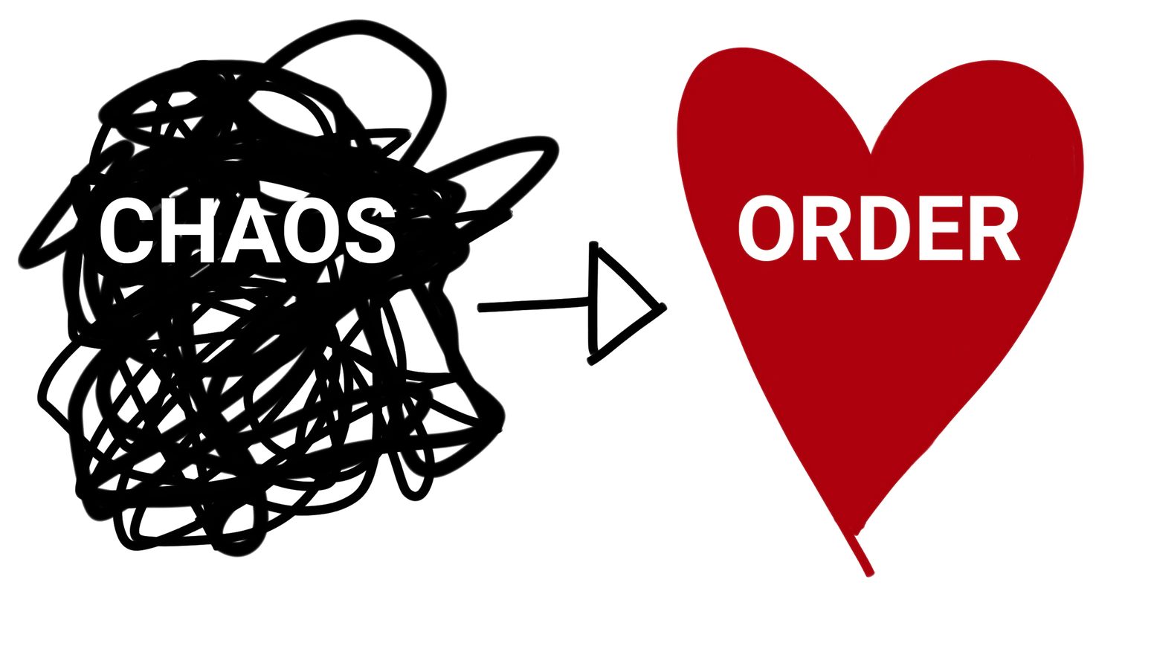
Strategies • T-P Relationship
1
The Importance of Rules & Boundaries
Pupils like to know where they stand
“Pupils are typically reported as liking teachers who can keep order (without being too strict) are fair (that is, are consistent and have no favourites), can explain clearly and give help, give interesting lessons, and are friendly and patient”
Kyriacou, 1986

Slide 29
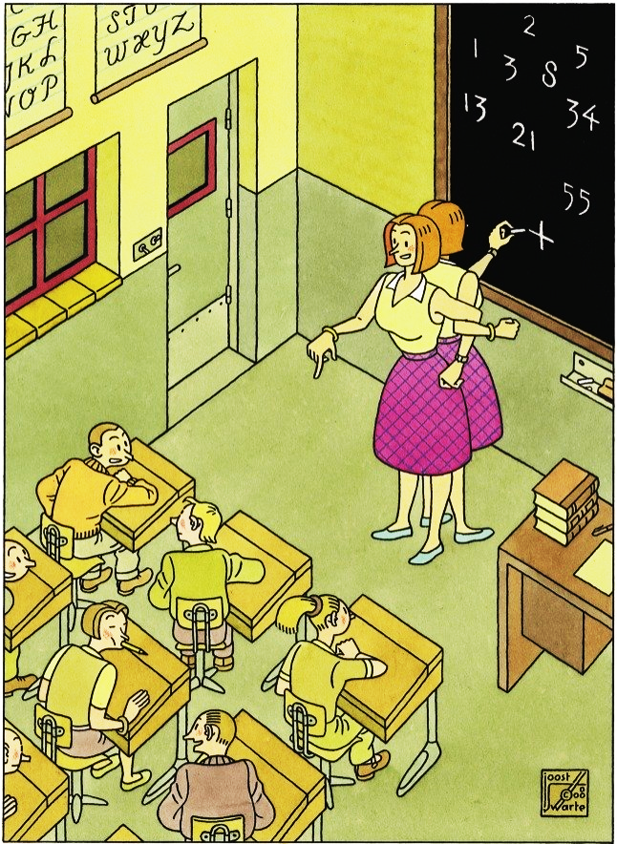
Strategies • Presence & Withitness
1
"Withitness" is a term created by Kounin to describe the teacher's awareness of what is going on in all parts of the classroom at all times. We commonly refer to this as, "having eyes in the back of the head.”
Be alert & focused – Have the stare !
Be mobile: move around the classroom. Change your own perspective and scan the whole room.
Angle your stance rather than turning your back completely.
Use your other senses.
Kounin, J. (1977). Discipline and group management in classrooms. New York: Holt, Rinehart, and Winston.

Slide 30
Strategies • Non-Verbal Communication
1
Tone
Excuse-me
Sure
Christopher
Listen
Activity:
In pairs, say the following phrases, varying your tone of voice. Your partner needs to try and guess the message you were trying to convey.
Can I help you?
Turn around please
No

Slide 31
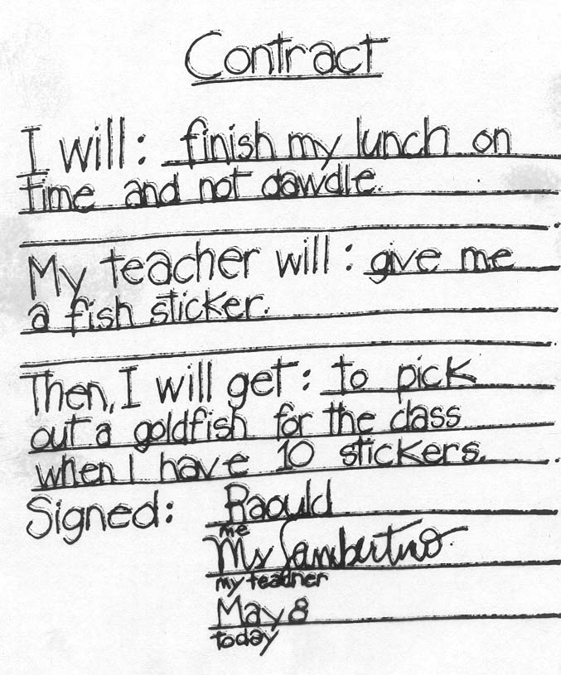
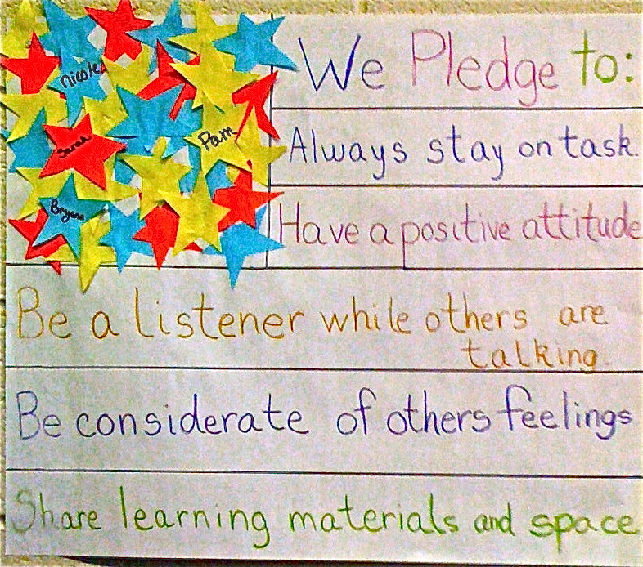
Strategies • Contracts
Encourage students to take responsibility for and reflect on their own behaviour, through the use of visuals (displays, contracts in exercise books, etc.)
Activity:
With your table, come up with and design a classroom contract. You must be selective and remember to use pupil-speak.

Slide 32
Strategies • Rewards & Sanctions
The carrot & stick
Consequences
Verbal and written warnings
Changes in seating plans
Notes in planner
Verbal reprimand from teacher
Meeting with CL, MLP or headteacher
Extra work
Written tasks (lines, essays)
Community service
Loss of privileges
Phone calls to parents/carers
Behaviour reports
Lawful confiscations
Detentions & isolations
Temporary & permanent exclusions
Rewards
Encouragements
Verbal praise
Merit points
House points
Certificates & trophies
Stickers, Vouchers
Raffle tickets
Early lunch passes
Reward trips
Postcards home
Positive note in planner
Honours board
Assemblies
Behaviour modification
is a balancing act
Be positive but don’t be afraid to use sanctions for the few children this positive approach does not work for

Slide 33
Strategies • Resolving Disputes
De-escalation

Slide 34
Strategies • Top Tips
Tip #1
Always wait for silence when talking to the whole class (no matter how long it takes). Develop strategies for getting silence (visual signal, auditory signal, position in the room, etc.)

Slide 35
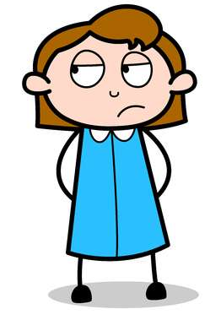
Strategies • Top Tips
Tip #2
Learn to focus on primary and not secondary behaviours like muttering, tutting and over exaggerated movements.
Tip #3
Always separate the behaviour from the person

Slide 36
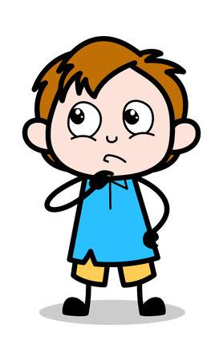
Strategies • Top Tips
Tip #4
Be consistent but not rigid. Apply rules fairly
Tip #5
Set clear boundaries and warn students before they reach them

Slide 37
Strategies • Top Tips
Tip #6
Give a clear, short and explicit instruction with eye-contact. Drop eye-contact and immediately walk away and continue with the lesson (or, more powerfully, praise another student for compliance)

Slide 38
Strategies • Top Tips
Tip #7
Use “thank you”, “thanks” or “cheers” instead of “please” at the end of any directions. Believe that the student is going to comply with the direction.

Slide 39
Strategies • Top Tips
Tip #8
Give short, simple directions (simply describe the problem), focus on the key issue (primary behaviour), identify the problem (the behaviour not the person) and resolve the problem (give a choice)

Slide 40
Strategies • Top Tips
Tip #9
Shouting is always a deadend
Tip #10
Use “do” rather than “don’t” in any student interactions. Practise rephrasing your directions so that they are positive “do”s

