Slide 1
Applications and Interviews
16th December 2022

Slide 2
How do we find out about jobs ?

Slide 3
Looking for a Job
Department for Education Teaching Jobs Portal https://teaching-jobs.service.gov.uk/
TES https://www.tes.com/jobs/
Union Websites- National Education Union / NASUWT
Local Authority Lists eg.Durham http://www.durham.gov.uk/article/2087/Newly-qualified-and-supply-teacher-services - North East Jobs - Gateshead Council - About Us - All Jobs at Newcastle City Council | Newcastle City Council
The Universe https://universecatholicweekly.co.uk/category/education/
Northern Cross and local papers
Diocesan website https://diocesehn.org.uk/education/job-vacancies/
School Trust websites:Bishop Hogarth Catholic Education Trust https://bhcet.org.uk/vacancies/
Word of mouth/ emails from CTTP

Slide 4
LinkedIn/ Social Media
Follow teaching jobs platforms on:
LinkedIn- TES, Connections, Local Authorities, Jobs In Schools North East, Local Ed Trusts
Facebook- TES Jobs, Teaching Unions Section, Local Schools Pages, North East Jobs.
Twitter- Teaching Jobs Tags, VocatEd, Jobs In School North East.

Slide 5
LinkedIn
It’s not just about what you know but also who you know too…Connect, Connect, Connect.
Be visible to possible future employers.
Keep your profile updated and strictly professional.
Don’t be afraid to blow your own trumpet.

Slide 6
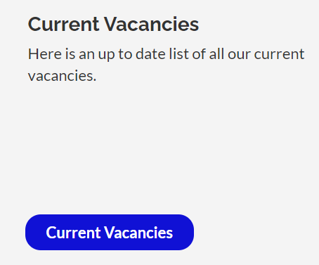
Teaching Pools
Local Authority Teaching Pools
Durham LA, Newcastle LA
https://www.durham.gov.uk/article/2087/Newly- qualified-and-supply-teacher-services
https://www.newcastle.gov.uk/services/jobs-and-careers
School Trusts
Bishop Hogarth Catholic Education Trust Teaching Pool Carmel College, The Headlands, Darlington
https://bhcet.org.uk/vacancies/

Slide 7
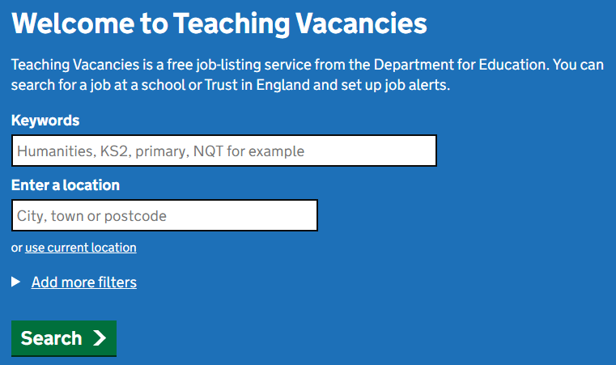
DfE Website
Find a job in teaching — Teaching Vacancies (teaching-vacancies.service.gov.uk)

Slide 8
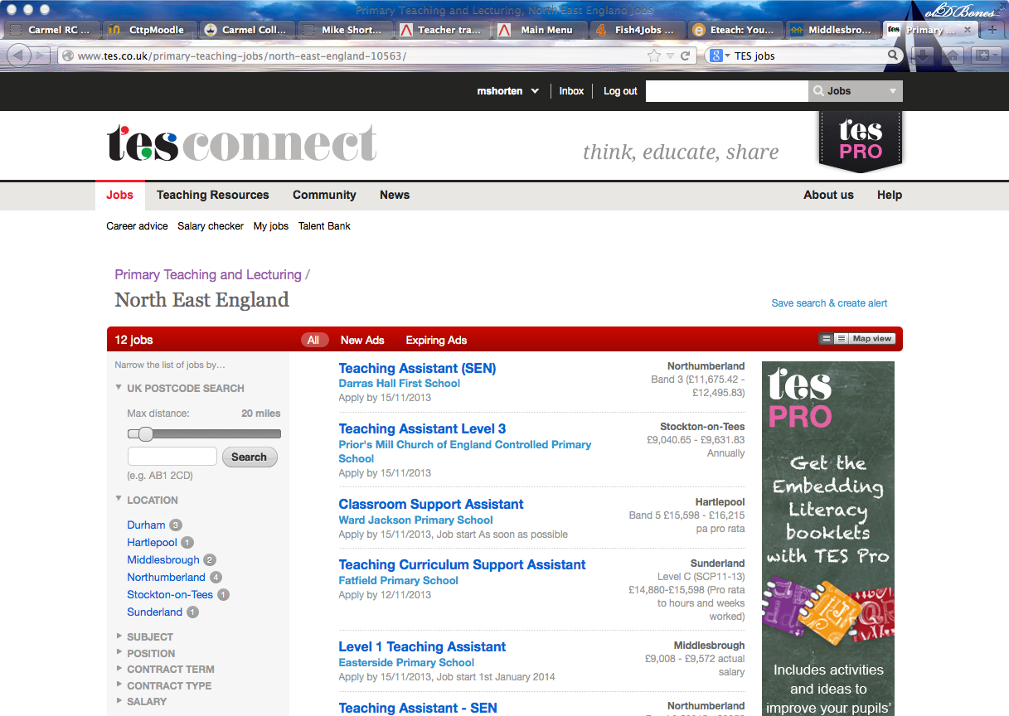
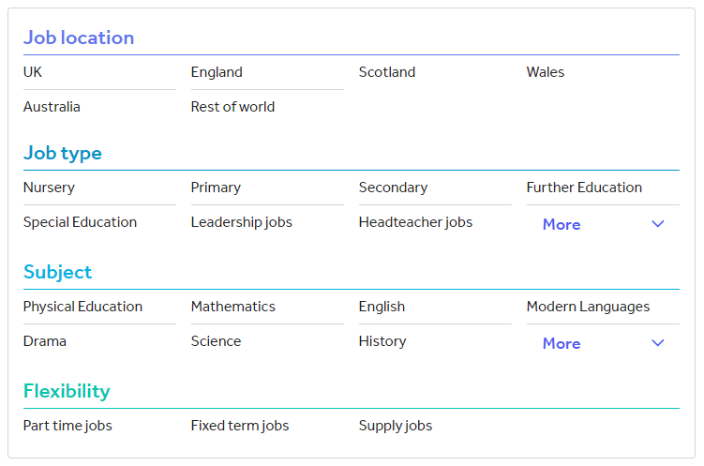
TES

Slide 9
Looking for a job in a Catholic School in the NE?
There are four large trusts in the RC Diocese of Hexham and Newcastle:
North – Bishop Bewick Catholic Education Trust (5 secondaries 34 primary):
St. Cuthbert's Newcastle), Sacred Heart (Newcastle), St. Mary's (Newcastle), St. Thomas More (North Shields) and St. Benedict Biscop (Bedlington).
South – Bishop Hogarth Catholic Education Trust (5 secondaries 30 primary):
Carmel College (Darlington), St. John's (Bishop Auckland), Our Lady and St. Bede (Stockton), St, Michael's (Billingham) and English Martyrs (Hartlepool).

Slide 10
Looking for a job in a Catholic School in the NE?
East – Bishop Chadwick Catholic Education Trust (5 secondaries, 34 primary ):
St. Aidan's (Sunderland), St. Anthony's (Sunderland), St. Wilfrid's (South Shields), St. Joseph's (Hebburn) and St. Bede's (Peterlee).
West – Bishop Wilkinson Catholic Education Trust (5 secondaries 38 primary):
Cardinal Hume (Gateshead), St. Thomas More (Blaydon), St. Leonard's (Durham), St. Bede's (Lanchester) and St. Robert's (Washington).

Slide 11
When?
Vacancies can occur at any time so start looking now.
Most posts are advertised in May and June.
Most trainees secure their teaching post during the summer term.
Posts continue to be advertised well into the Autumn term.
Supply is a definite route into education.

Slide 12
Applying for a teaching post
Register interest by phoning / writing a letter / email
Complete the application form and supporting statement
Get the application to the school in plenty of time
Arrange a pre-visit (if possible )…surrounding area
Is the job right for you?

Slide 13
Applications

Slide 14
What do we need to consider ?

Slide 15
Do your homework
Exact title
Job description and person spec
-Essentials and desirables (see exemplar)
School characteristics
Is it where you want to be?
Is it main scale? Induction period?

Slide 16
Applications get you the interview!
DO
Treat it with respect
Write in rough first
State the obvious
Focus on the job in question- essentials and desirables
Check if available online
Keep CV updated and concise, include only if asked
DON’T
Use different colour pens
Cross out
Leave blanks
Tell lies
Use a small envelope (A4)
Miss deadlines

Slide 17
Application forms
Biographical detail…get it right!
Referees- who?
Person specification- essentials and desirables
Qualifications- be consistent
Supporting statement /Letter of application
Neat - Planned
Grammar - Appropriate
Spelling - Confident
Personality - What attracted you

Slide 18
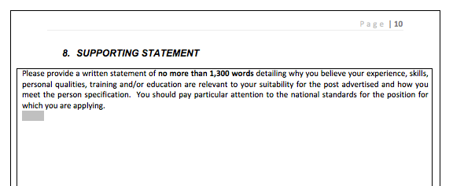
Application Practice
Model Application Forms (catholiceducation.org.uk)

Slide 19
Interviews

Slide 20
What to do and what not to do …… !
https://www.youtube.com/watch?v=fipSEmdj3i0

Slide 21
Interviews
Be yourself
Be confident but not over confident
Give yourself thinking time
Portfolio?
Positive body language
DO NOT LOSE THE JOB IN THE INTERVIEW

Slide 22
Preparing for the interview - handout
Interview ripple effect… pebble into water…answers/dialogue grow
Think positively
Background information
Prepare your questions for interviewers
Strategies for interview
Be positive
Accept feedback

Slide 23
The Interview Day
What to wear?
Think about dress code
Breath / ironing / smoke / cleanliness
Hair? Nails? Tattoos?
Keep accessories to a minimum
Welcome
Tour
Staff visit
Lunch
Interviews
Panel made up of Headteacher, SLT, Directors, Governors, LA rep

Slide 24
Interview questions ?

Slide 25
Questions at interview
Often an opener!
About your teaching
About the school
About your contributions to the general school life

Slide 26
Questions at interview
A particular lesson, child, day, achievement
About your understanding of . . . .
Safeguarding / Equality / Diversity / Behaviour
Where will you be in 5 years . . . ?
Interview
questions
handout

Slide 27
Interview activities

Slide 28
In tray activity

Slide 29
Lesson Observation What to do / not to do ?
Teaching Interview Trial Lessons: Best Practice - Your School Jobs

Slide 30
Group Activity What to do / not to do ?

Slide 31
Accepting a job offer
A spoken offer is a legal contract
Once you have accepted an offer, you will be sent a letter confirming your appointment.
Make sure you respond promptly to this letter to confirm your acceptance of the post.
Keep a copy of your reply.

Slide 32
Do you want the job?
You will be asked if you would accept the job if offered! This is not an offer of a job…
If you have another interview for a post you would prefer in a few days' time, you could ask the panel if they will hold a job offer open until after the other interview. They will almost certainly ask you to make up your mind immediately.
It is unprofessional to accept a job at the interview and then renege on this acceptance later.

Slide 33
If you are not successful?
Make sure you accept your non-appointment gracefully.
If offered the chance of a debriefing, take it.
Spend some time on your analysis of how you performed.
Discuss this with your tutors and any headteachers or experienced teachers you know and take the opportunity to attend any training sessions in interview techniques

