Slide 1
How children learn to read
Supporting children’s reading

Slide 2
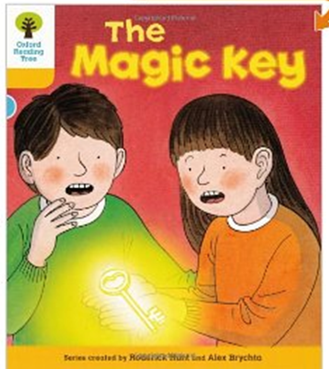
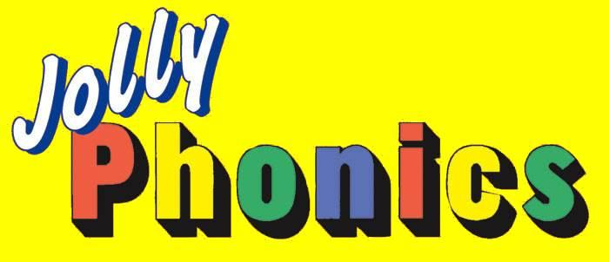
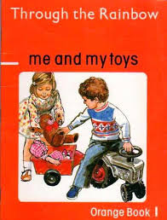
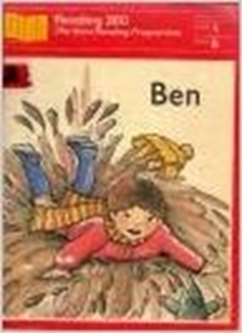
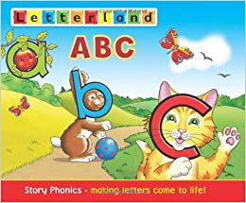
Discussion
How did you learn to read?

Slide 3
Can you remember not being able to read?

Slide 4
Why does it matter?
What are the potential implications of not being able to read well?

Slide 5
Teaching of Reading
Ofsted report: Reading by six – summary of findings.
The best primary schools in England teach virtually every child to read, regardless of the social and economic circumstances of their neighbourhoods, the ethnicity of their pupils, the language spoken at home and most special educational needs or disabilities.
Their success is based on a determination that every child will learn to read, together with a very rigorous and sequential approach to developing speaking and listening and teaching reading, writing and spelling through systematic phonics.

Slide 6
The approach is applied with a high degree of consistency and sustained.
Central to the success is the teaching of phonics in a concentrated and systematic way.
Pupils are given opportunities to apply what they have learnt through reading – including time to read aloud to adults to practise their decoding skills – writing and comprehension of what they are reading.
The best phonics teaching is characterised by planned structure, fast pace, praise and reinforcement, perceptive responses, active participation by all children and evidence of progress.

Slide 7
There is a strong focus on developing the children’s capacity to listen, concentrate and discriminate between sounds.
Phonics teaching is monitored to ensure consistency and steps are taken if improvement is called for.
The assessment of individual pupils’ progress, phonic knowledge and skills is sufficiently frequent and detailed to identify quickly the pupils who are failing, or in danger of failing, to keep up with their peers.
The Phonics Screen at the end of Y1 checks whether pupils are reading at the expected standard.

Slide 8
“The teaching of structured phonics is helpful for all children, harmful for none and crucial for some.”
(quoted Quigley, 2020)

Slide 9
What do children need to know in order to become a confident reader?
Discuss

Slide 10
Children need to understand the concept that writing is an invented form of the spoken word.....that the symbols represent the sounds in words, and in English are read left to right.
They need to know that each sound can be spelled by one or more letters, and that each spelling can represent more than one sound.
Spelling <ea>
Sound /e/ head
/ee/ seat
/ay/ break
.....but more of this, this afternoon!

Slide 11
As adults we often forget how complex the task of learning to read is.
In skilled readers the reading process has become automatic.
Reading is when you engage with a text, relating and responding to it.
Notes:
Give them Reading Experience handout. Discuss how they felt. Remind them of the approaches to teaching reading Look and say: Phonic: Psycholinguistic etc. Talk about strengths and weaknesses.

Slide 12
Every teacher is of course an expert reader, but that does not necessarily mean we are experts in how to teach reading successfully.
Consider the mental effort you has to exert to comprehend the above sentence. Learning to read for those pupils who don’t easily map sounds onto letters, who don’t cohere patterns, follow reading conventions or speedily draw upon a vast wealth of background knowledge, becomes an arduous task.

Slide 13
Research has shown us that an integrated approach to the teaching of reading is essential.
Children need both word recognition processes and language comprehension processes.
Organisation, timing and relevance of a variety of approaches characterises a good reading curriculum.

Slide 14
Emergent Literacy
During this phase children learn that:
When we read we rely on print to carry the message;
We read and use books in a particular order – from front to back;
We follow the print in a certain order: line by line, word by word;
Books and print have a particular orientation;

Slide 15
Print is made up of letters, words, punctuation and spaces;
There are relationships between words spoken and the print observed;
Print is different from pictures;
There is a language associated with the activity of reading books: front, back, page, word, letter, etc.

Slide 16
To become a good reader children need:
Print awareness
To be able to distinguish the sounds of speech
Phonemic awareness -the understanding that the sounds of spoken language work together to make words.
Phonics - the understanding that there is a relationship between letters and sounds through written language.
Fluency
Vocabulary
Text comprehension

Slide 17
Young children need to understand what reading is all about.
A high degree of ‘thinking aloud’ by the adult is essential for young children during reading activities.
Sharing books allows us to make explicit to the children the processes we go through in order to read.
We need to play games which engage children in wanting to read.

Slide 18
Vocabulary plays an important part in learning to read. Beginning readers must use the words they hear orally to make sense of the words they see in print.
Vocabulary also is very important to reading comprehension. Readers cannot understand what they are reading without knowing what most of the words mean.

Slide 19
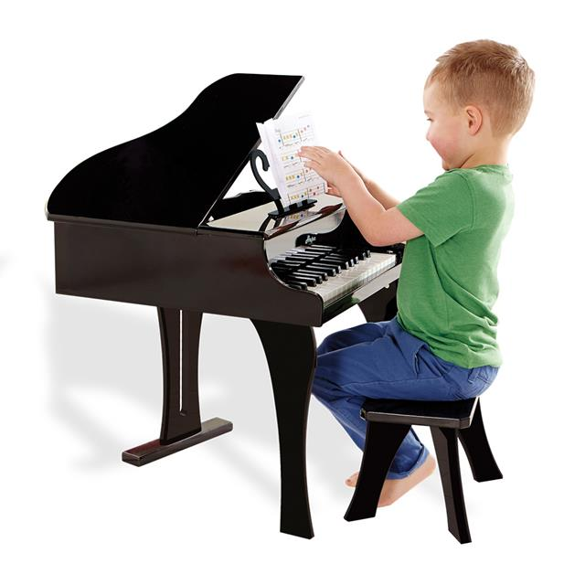
Reading and writing require lots of practise in order to develop proficiency, in exactly the same way as leaning to play the piano!

Slide 20
Why Phonics?
Research shows that when phonics is taught in a structured way – starting with the easiest sounds and progressing through to the most complex – it is the most effective way of teaching young children to read. It is particularly helpful for children aged 5 to 7.
Almost all children who receive good teaching of phonics will learn the skills they need to tackle new words. They can then go on to read any kind of text fluently and confidently, and to read for enjoyment.
Children who have been taught phonics also tend to read more accurately than those taught using other methods, such as ‘look and say’. This includes children who find learning to read difficult, for example those who have dyslexia.

Slide 21
The Simple View of Reading
Word-level reading and language comprehension are both necessary to reading
Neither is sufficient on its own
This is formalised in “The Simple View of Reading”
Reading comprehension is a product of word recognition and language comprehension

Slide 22
Successful reading demands both word level reading and the ability to comprehend what has been read.
This is formalised in …
“The Simple View of Reading”
Word Recognition
Language Comprehension

Slide 24
The Simple view of Reading
Reading to learn for purpose and pleasure
Learning to read
Different kinds of teaching are needed to develop
word recognition skills from those that are needed to
foster the comprehension of written and spoken language
Notes:
The searchlights model – based on research to date – recent research recommends a new conceptual framework – the simple view of reading – to improve- focus teaching
The two dimensions of reading – replacing the searchlights model – word recognition and language comprehension-we would agree that both are necessary to achieve fluent reading -
Its important that we understand how these two sets of skills develop as in order to be developed each requires a different kind of teaching once children can recognise and understand words they then need to activate their listening – oral comprehension –to understand what the author is trying to convey – tension excitement – The comprehension processes are the same for spoken and written words – they are just accessed – through yes or ears -in both hearing / seeing word we develop our lang comp the more speaking and listening we do the more we enhance reading comprehension- we also need to teach specific strategies for reading comp – use of illustrations – focus frames
Need to practise skills – importance of phase 1 - growth of vocab – listening comp – a good predictor of differences in lang comprehension -depends upon knowledge of words -
Once children are fluent and accurate decoders of words then they are more able to concentrate on the meaning of the text – the high ground of reading – comprehension
We need to have a systematic approach to recognising and understanding the words and understanding and interpreting texts and to the development of spoken and written language comprehension
Children need both – if can’t read words you’ll obviously be denied access to the text – even if you can read the words you still might not understand the text – barking at the print -
IMPLICATIONS
need a systematic phonics curriculum – broad and rich language curriculum- develop both skils
Be clear about which one we are focusing on in our guided shared + discrete teaching of reading
as children develop as readers the weightings shift – word recognition - is time limited– language comprehension – ongoing throughout life- secure decoding access understanding – so we need a
High quality phonic work should be the key approach when teaching beginning readers – and spellers- has to be the initial focus – to develop automaticity in word reading
We can probably think of children who would fit into any one of the quadrants – word recognition and Language comprehension are seen as a continuum and children’s abilities may develop in parrallell at different rates
NB On tables have simple view and 4 children’s reading pofiles – read and deceide in groups of 4 where you would place them on the grid -
What might we do to support and develop their skills as readers ?

Slide 25
I like listening to stories and can tell you what has happened in the right order and which parts I like and why. I can talk about the characters and pretend to be them. I find it hard to read books for myself - the words and letters get muddled and it doesn’t make sense. I don’t know how to work it out. Sometimes this makes it hard to understand what I’m reading.
I love reading and read lots of interesting books. I like to talk about the stories I’ve read with my friends. I can read lots of short easy words and some words I know straight away. When I see longer words I don’t know I look at the letters and say the sounds aloud in the right order to help me read it.
I like books and I can read words by looking at the pictures and having a go. I know some letters and their sounds – like in my name – but not all of them. Sometimes I know the first letter and guess the rest. My favourite books are information books and I like using the computer. I like it when the teacher reads to us and looking at the big books.
I am a very good reader. I can read all the words on the page- some I have to work out and some I just know. I find it hard when the teacher asks me questions about what I’ve read- like when things happened or what I thought about the characters and how I felt. I don’t really think like that when I’m reading – it confuses me.

Slide 26
Language Comprehension
Comprehension occurs as the listener builds a mental representation of the information contained within the language that a speaker is using… the listener's general knowledge and level of cognitive development will have a bearing on the comprehension of the message. To generate an accurate mental representation… the listener has to process the language and the concepts.

Slide 27
The Balance
Both are important – recognising and understanding words alone does not guarantee that text is understood.
Equally, understanding what is being said does not guarantee that words are recognised.
So, different kinds of teaching are needed to develop word recognition skills from those needed to foster comprehension of written and spoken language.

Slide 28
Skilled reading entails a set of processes by which:
Words are recognised and understood
and
Language comprehension is developed

Slide 29
Learning to read involves setting up processes by which the words on the page can be recognised and understood, and continuing to develop the language comprehension processes that underlie both spoken and written language comprehension.
Both sets of processes are necessary for reading, but neither is sufficient on its own.
Children who cannot adequately recognise the words on the page are by that fact alone prevented from fully understanding the text; however, recognising and decoding the words on the page is no guarantee that the text will be understood.

Slide 30
An extract taken from a computer manual
According to the previous ATA/IDE hard drive transfer protocol, the signalling way to send data was in synchronous strobe mode by using the rising edge of the strobe signal. The faster strobe rate increases EMI, which cannot be eliminated by the standard 40-pin cable used by ATA and ultra ATA.

Slide 31
Implications for teaching
Staff need to be aware that different skills and abilities contribute to development of word recognition skills from those that contribute to comprehension.
Staff need therefore to keep these two dimensions of reading separate in their minds when they plan their teaching.

Slide 32
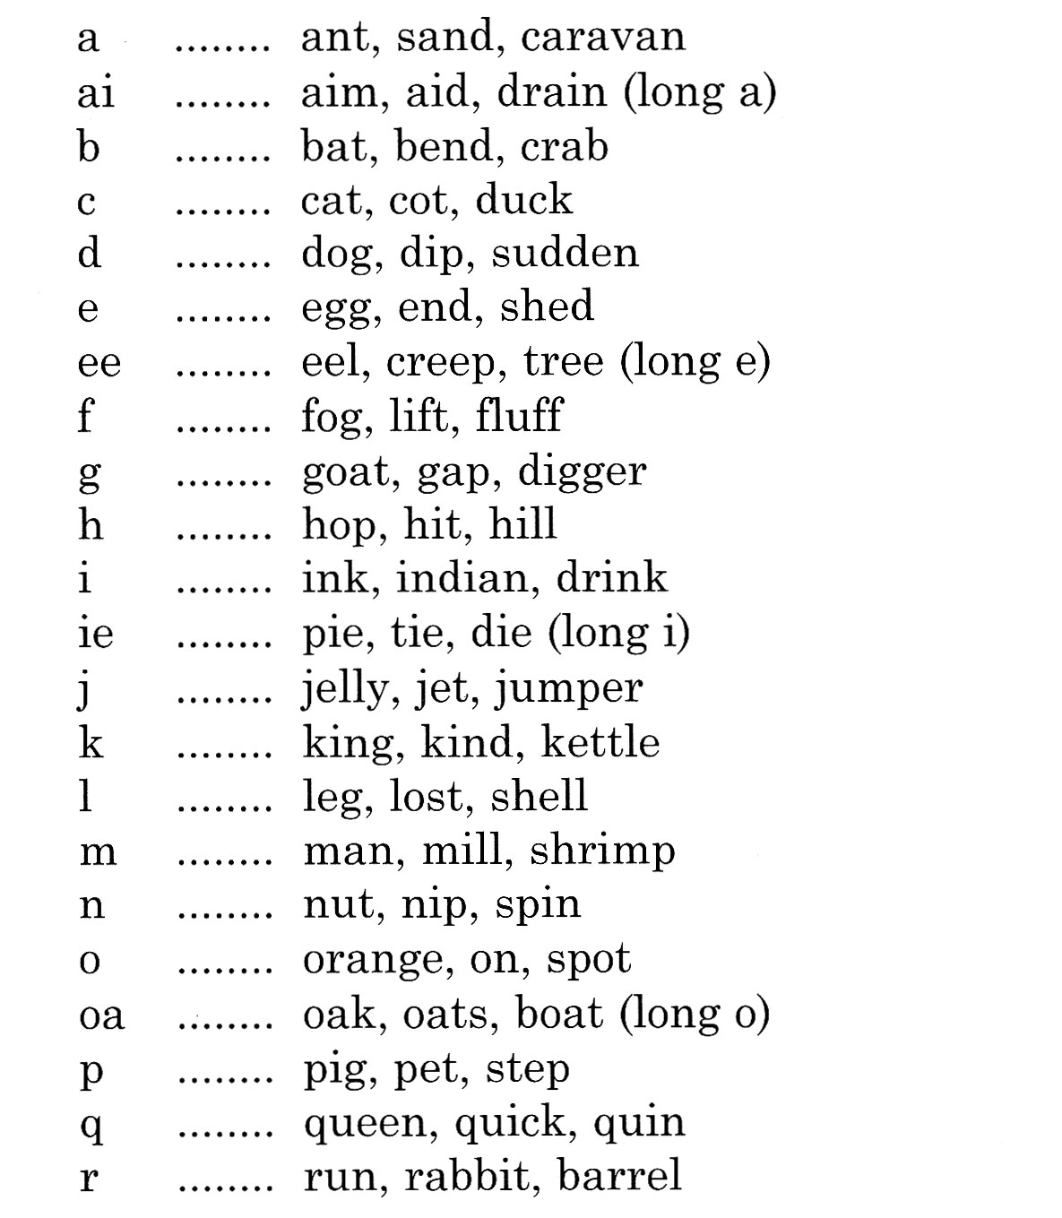
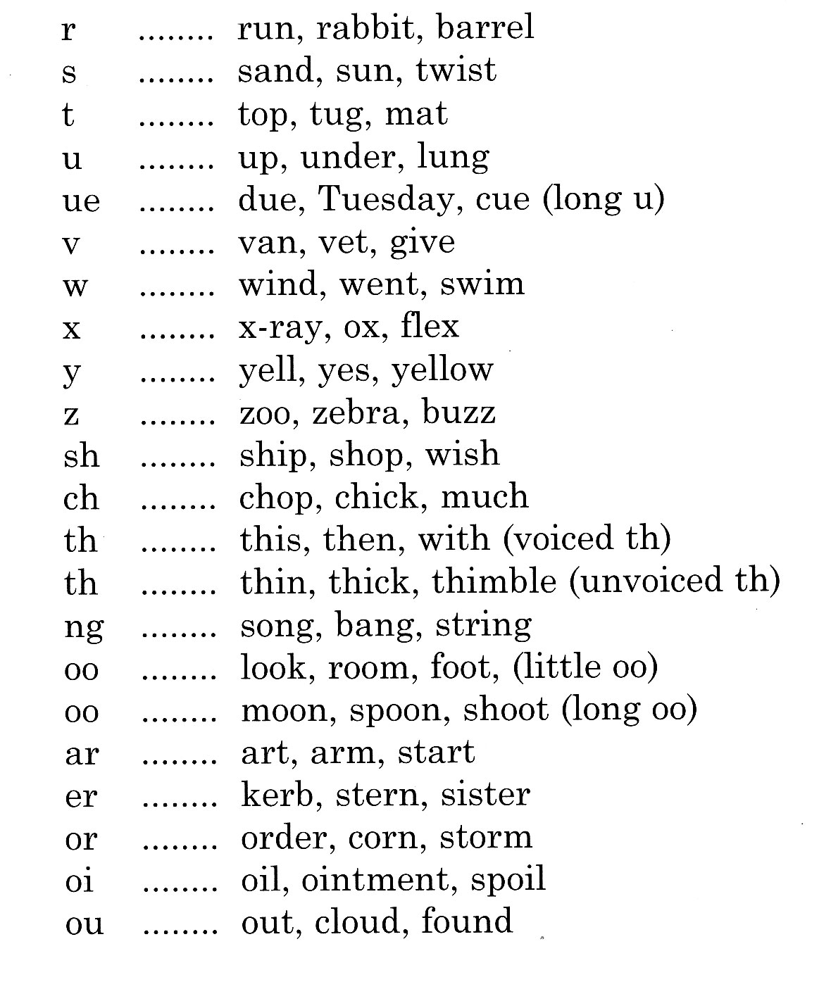
26 Letters – 40+ Sounds

Slide 33
Activity
Can you think of boys/girls names that have the <ee> sound in them?
For example – Nellie!
Note how many different spellings of the <ee> sound you make.

Slide 34
Language Development
Spanish
24 speech sounds
26 letters to make up those sounds
29 graphemes
English
44 speech sounds
26 letters to make up
those sounds
150+ graphemes
eg. 9 different ways to write ‘or’ !
Add to this that the English has three times as many word as the German language and six times as many as in French!

Slide 35
Enunciation
Teaching phonics requires a technical skill in enunciation
Phonemes should be articulated clearly and precisely
Notes:
Most consonants should be pronounced in a continuous manner – e.g. ssssss mmmmmm llllllll nnnnnn shshshsh rrrrrrr zzzzzzzz vvvvvvv
Some can’t be said like this (e.g. /c/ /t/ /p/ /b/ /d/ and /g/) but /c/, /t/ and /p/ should be enunciated without the voice.
Phonemes wwwwww and yyyyyyyy are not easy but can be attempted.
Many errors spring from incorrect enunciation e.g. teachers reporting that children confuse ‘ch’ and ‘tr’. If the ‘ch’ is enunciated correctly, as one phoneme, rather than ‘chur’and ‘tr’ clearly as 2, there is far less likelihood of confusion.
Regional pronunciation could be a factor here. The PNS states in a position paper on teaching phonics that -
Many of the sounds (particularly vowel sounds) can vary slightly according to accent, but they are generally consistent within the speech of an individual and recognisable by others who may pronounce them slightly differently.
ACTIVITY
Take time in your group to agree the correct pronunciation of phonemes. It is important that all phases represented here have a shared and common understanding of this factor.

Slide 36
f

Slide 37
j

Slide 38
l

Slide 39
m

Slide 40
n

Slide 41
r

Slide 42
s

Slide 43
v

Slide 44
w

Slide 45
x

Slide 46
y

Slide 47
Schwa
An unstressed (weak) vowel sound. It is the most common sound in spoken English. It sounds like an undifferentiated blowing out of breath, such as: ‘the’, ‘about’, ‘fountain’, and ‘moment’.

Slide 48
A phonics quiz
What is a phoneme?
How many phonemes are in the word ‘strap’?
a) What is a digraph? b) Give an example
a) What is a CVC? b) Give an example
What is a grapheme?
What is a pure sound?
a) What is a ‘trigraph’? b) Give an example
How many phonemes are in the word ‘twenty’?
Write down at least four different ways of representing /ae/
What is the best guess when you write /ae/ at the end of a word?
Notes:
Go through the quiz quickly.
Note your responses and in particular any uncertainties you have about questions in the quiz. Discuss these with your colleagues. It is highly likely that practitioners within your school will have similar uncertainties. Consider using a similar test at the beginning of your own training sessions to enable you to monitor levels of subject knowledge locally.
While teachers need more than this – training on structuring and linking teaching sessions, for example – core subject knowledge provides a critical foundation.
When this quiz has been used by a literacy consultant with teachers and TAs the average scores to date are 7/10 for literacy co-ordinators, 4/10 for teachers and 2/10 for TAs. Individual scores vary from 0 to 9. Scores have been close to the average in all groups tested, so subject knowledge is likely to be an issue in your own school.

Slide 49
Some definitions
A phoneme is the smallest unit of
sound in a word
Notes:
The following eight slides illustrate the phonic vocabulary that should be used by practitioners in their teaching sessions.

Slide 50
Some definitions
Grapheme
Letter(s) representing a phoneme
t ai igh
Notes:
Letter or letters that make one phoneme

Slide 51
Some definitions
Blending
Recognising the letter sounds
in a written word, for example
c-u-p, and merging or synthesising
them in the order in which they
are written to pronounce the
word ‘cup’
Notes:
Blending is a phonics skill and as such this needs to be explicitly taught.
Blending and segmenting are reversible skills and this should feature highly in phonic teaching.

Slide 52
Some definitions
Segmenting
Identifying the individual sounds in a spoken word (e.g. h-i-m) and writing down or manipulating letters for each sound to form the word ‘him’

Slide 53
Some definitions
Digraph
Two letters, which make one sound
A consonant digraph contains two consonants
sh ck th ll
A vowel digraph contains at least one vowel
ai ee ar oy
Notes:
The following two definitions are key – digraph and trigraph.
Adjacent consonants are often incorrectly classified as digraphs and trigraphs e.g.
tr as in trap
sp as in spin
str as in string
spl as in splash
Some still teaching CLUSTERS STR words!!!!!!!!!!!!!!
Must teach sounds in order they occur s-t-r.
NOT list all the words you can that begin with sp

Slide 54
Some definitions
Split digraph
A digraph in which the two letters are not adjacent (e.g. make)
Notes:
ACTIVITY
How can you deliver this message about using correct terminology to less experienced practitioners who may find this challenging?

Slide 55
Some definitions
Trigraph
Three letters, which make one sound
igh dge

Slide 56
CVC words – clarifying some misunderstandings
p i g chick
church car
boy down
ship song
thorn f o r
fight dear
head shirt
Notes:
This slide is designed to act as a check of understanding of which words are CVC words and which are not.
Which of the above are not CVC words?
Segment the phonemes.
Some words contain a vowel digraph and are therefore not a CVC word.

Slide 57
CVC?
ship

Slide 58
CVC?
boy

Slide 59
CVC?
song

Slide 60
Spelling
There are patterns or regularities that help to determine choices or narrow possibilities – for example for each vowel phoneme some digraphs and trigraphs are more frequently used before certain consonants than others
Children need to explore these patterns through word investigations
Teachers need to understand these patterns in order to structure their teaching and design or select appropriate activities
Notes:
Letters and Sounds excellent spelling rule resource
Eg why is was spelt with an a not an o?
When o sound follows a w sound will probably be grapheme a

Slide 61
Reducing uncertainty
Certain representations of a phoneme are more likely in initial, medial and final position in monosyllabic words

Slide 62
The best bets for representing /ae/ at the beginning and in the middle of a word are a-e and ai
The best bet for representing /ae/ at the end of a word is ay

Slide 63
Kate & Jade

Slide 64
Grapheme choices
strou strow
sproat sprowt
dryt dright
smayn smain
groy groi
Notes:
Animated slide. Put up title but not grapheme choices until after this activity.
Vowel digraphs followed by a consonant or in a final position
Tell delegates that you are going to ask them to write down a selection of nonsense words.
We are using nonsense words to deskill them and to highlight how, when you are not familiar with a word, you need to use all your listening skills to tune into the sounds in the word, and that delegates will need to focus on your mouth as you articulate the word. Essential strategies to apply when working with children.
There are no wrong or right answers.
We are investigating where graphemes are most likely to occur – followed by a consonant or in final position.
You will use what phonic knowledge you have. Adults will have no problem with finding a reasonable choice.
Children will apply what they know. Useful assessment of phonic acquisition.
As they are nonsense words, clear enunciation is crucial.
Observe how they really do have to fix their sight on your mouth and listen very carefully to lock into the phonemes within the words. The word will need to be articulated several times for them to be able to remember.
Worth commenting on your observations of how they do the above.
Feedback possible choices on slide. There will be others, eg. split-digraphs often offered.

Slide 65
We need to understand…
Same Sound > Different Spellings
oa - boat
o – old
ow – snow
oe – toe
ough – dough

Slide 66
We need to understand…
A sound can be written using 1, 2, 3 or 4 letters.
dog > d o g
boat > b oa t
light > l igh t
dough > d ough

Slide 67
And also…
Same Spelling > Different Sound
e.g. <ow> can spell the sound ‘oe’ as in ‘grown’
- Or the sound ‘ou’ as in ‘brown’.

Slide 68
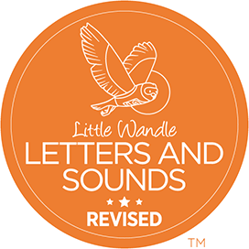
There are different approaches to the systematic teaching of synthetic phonics, including –

Slide 69
Questions
Helen.Mulholland@.bhcet.org.uk

