Slide 1
History training
Session 1 –
Unpicking the curriculum and skills and concepts in history

Slide 2
Housekeeping
There will be a break half way through
Switch phones onto silent

Slide 3
Glenn Carter
Humanities lead at Ingleby Mill Primary School
www.history-rocks.com
HA Primary Committee member
Specialist Associate Adviser for Education Durham

Slide 4
2 minutes
What is your favourite topic/person/event in history and why?

Slide 5
Agenda
EYFS
What is ‘history’ in the EYFS framework?
What should a 4 year old know about history?
Things to do and not to do in EYFS
KS1
What does the National Curriculum say about KS1?
What kind of topics are covered in KS1?
Keeping KS1 relevant
KS2
What does the National Curriculum say about KS2?
How is KS2 different from KS1?
Developing a coherent KS2 curriculum

Slide 6
Agenda
Break
Skills and Concepts in history
What are they?
Substantive and disciplinary – what do these mean?
Breaking the concepts down

Slide 7
EYFS
The EYFS curriculum is largely about the child and their place within the world, past and present
EYFS is the starting point for children being introduced to history as a concept and is the perfect opportunity to start introducing historical concepts that will be useful in future topics
EYFS is the chance to explore concepts BEFORE they become misconceptions

Slide 8
EYFS – the framework
New framework makes history a bit more explicit than in the past
Offers opportunities to explore people’s roles in the past and today
Explore similarities and differences between the past and now
Use stories and characters encountered in books to help shape concepts

Slide 9
EYFS – the framework
‘The power of stories to support children to access unfamiliar content is also well established. This might include fictional stories that can develop knowledge of concepts (such as ‘monarch’ or ‘government’) even when these are not tied to specific historical contexts.’
(Ofsted Research Review: History, 2021)
Spotting historical concepts in simple stories is essential in exploring them to provide a background for future learning
Look through the books on your table and see if you can spot any of the following ideas:
family changes toys society power

Slide 10
EYFS – expected to know
Children should be able to START understanding the concept of the past, in that events have happened long before they were born and shortly before they were born
That their families are a part of history and that some things will have been the same but a lot will be different
Basic understanding of concepts like chronology, cause and effect, continuity and change, similarity and difference and significance

Slide 11
EYFS – what to do
Allow children to experiment with role-play
Use artefacts to bring the past to life
Give a variety of different sources to strengthen their understanding of the past – artefacts, books, videos, music
Compare the past with the present
Link learning back to their own experiences
Explore historical language and meanings

Slide 12
EYFS – what NOT to do
Don’t refer to the past as ‘the olden days’
Don’t allow misconceptions about what is real and what is fiction
Don’t assume that they understand everything
Don’t make concepts too abstract – make them concrete
Don’t let them think that history is all ‘just in the past’

Slide 13
EYFS – Notes sheet
Explain what the EYFS framework focuses on
What purpose does history in EYFS serve?
What SHOULD we be doing?
What SHOULDN’T we be doing?

Slide 14
The National Curriculum

Slide 15
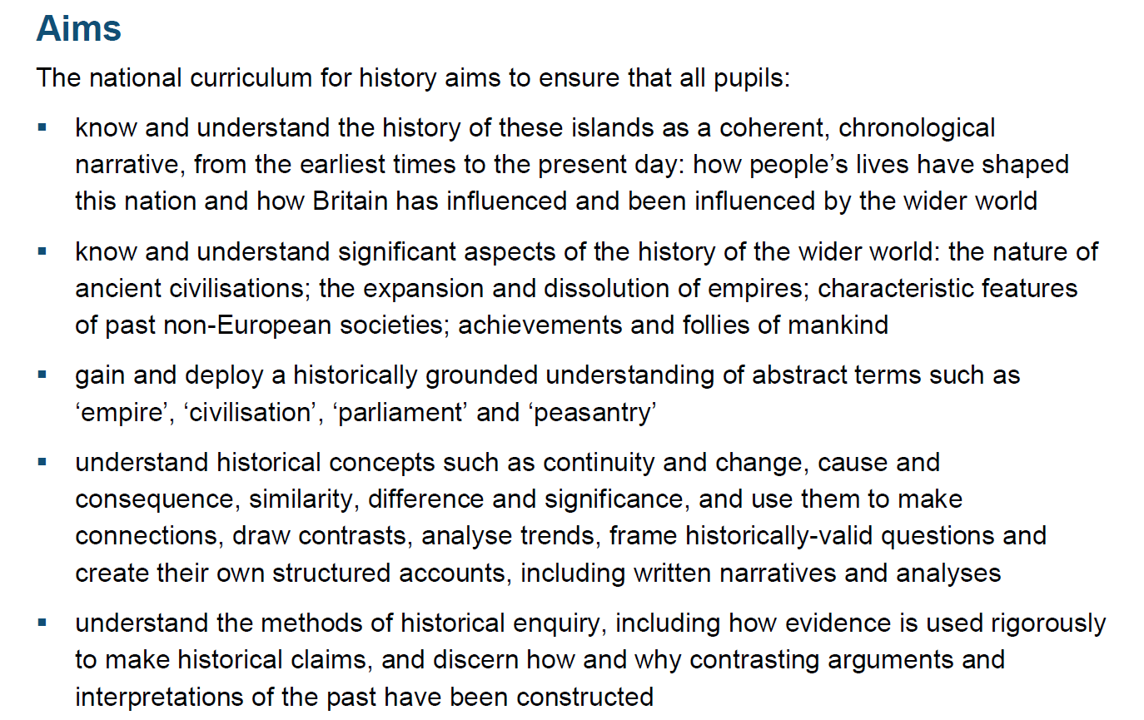
The National Curriculum

Slide 16
KS1
‘In England, pupils begin their formal history education at key stage 1. What children learn in the early years foundation stage (EYFS) is crucial knowledge for them to build on in the future. The knowledge and vocabulary that children develop, particularly through the ‘understanding the world’ area of learning, enable them to access history content at key stage 1.’
(Ofsted Research Review: History, 2021)

Slide 17
KS1

Slide 18
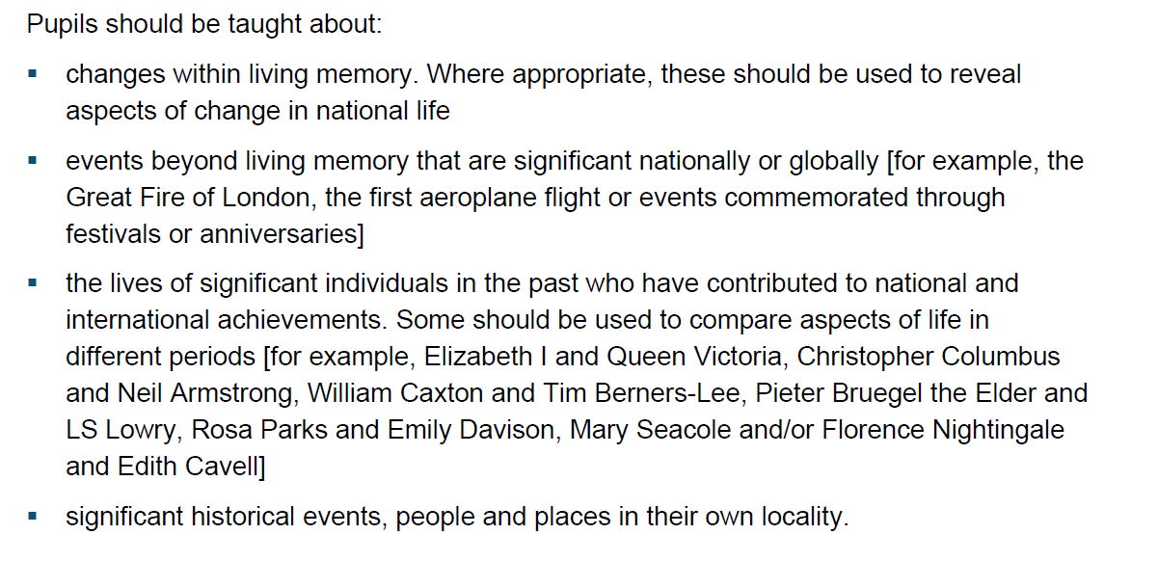
KS1

Slide 19
KS1 – Changes within living memory
Should be within the last 60-70 years
Keep it focused – don’t overload with what you cover
Sensible approach might be to look at a decade per lesson
Typical choices are: toys, technology, shopping or schools
5 minutes – think about a series of lessons for a topic like this – what have you chosen and have you kept it focused?

Slide 20
KS1 – Events beyond living memory
A very wide-open statement
Needs to be linked to impact – think about local, national or international impact
Think carefully about WHY that event
Typical choices are: GFoL, first flight, Titanic, Gunpowder Plot
5 minutes – think about a series of lessons and think WHY that topic

Slide 21
KS1 – Significant People
Another wide statement
SOME people should be used to compare lives in different periods
Think carefully about WHY those people
Typical choices are: Columbus/Armstrong, Elizabeth II/Victoria, Nightingale/Seacole
5 minutes – who would you choose and why?

Slide 22
KS1 – Significant Local History
Can be a place, event or person
Think about whether the impact was just local or wider
Again, WHY that element?
Typical choices are: Railways, Country Estates, George Stephenson, Mining, Captain Cook
5 minutes – what would you choose and why?

Slide 23
KS1 - Curriculum
The EYFS curriculum is all about the child – why should KS1 then send us off around the world?
Keeping a ‘local’ theme is important to relate back to children’s experiences
Having a reason or a rationale for why they study each element is essential
Think about how KS1 content is preparing the children for KS2

Slide 24
KS1 – Notes sheet
What are the 4 main strands for KS1?
Why should we think carefully about these topics?
What should we think about when choosing these topics?

Slide 25
KS2 - Curriculum
KS2 provides the opportunity to build on KS1 and set up life-long learning in KS3 and KS4
The ‘themes’ that have been highlighted in KS1 should continue where possible into KS2 to provide coherence
Referring back to KS1 is important so that they see the interconnectivity of history
Lots of consideration has to be put into the structure and content of KS2 topics

Slide 26
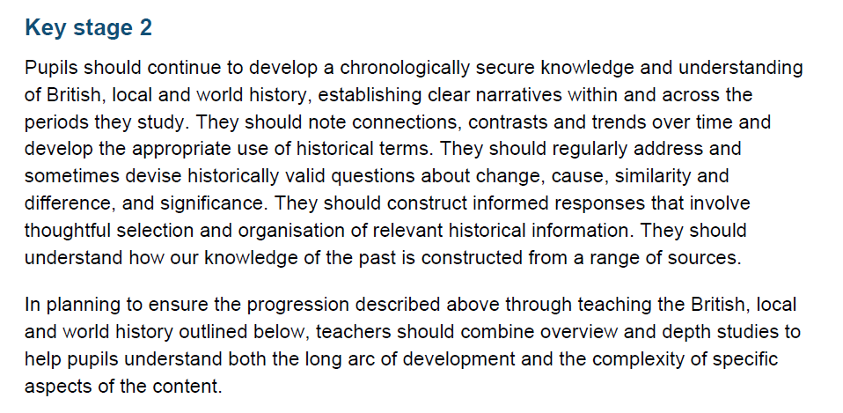
KS2 - Curriculum

Slide 27
KS2 – What is different from KS1?
The focus now shifts from single events, people or places to entire periods or civilisations
The aim is to see how these people fit into the narrative of history as a whole, not in isolation
The scope of each topic that can be covered is much larger which needs even more careful consideration
Clear links between each topic need to be made to ensure there is coherence

Slide 28
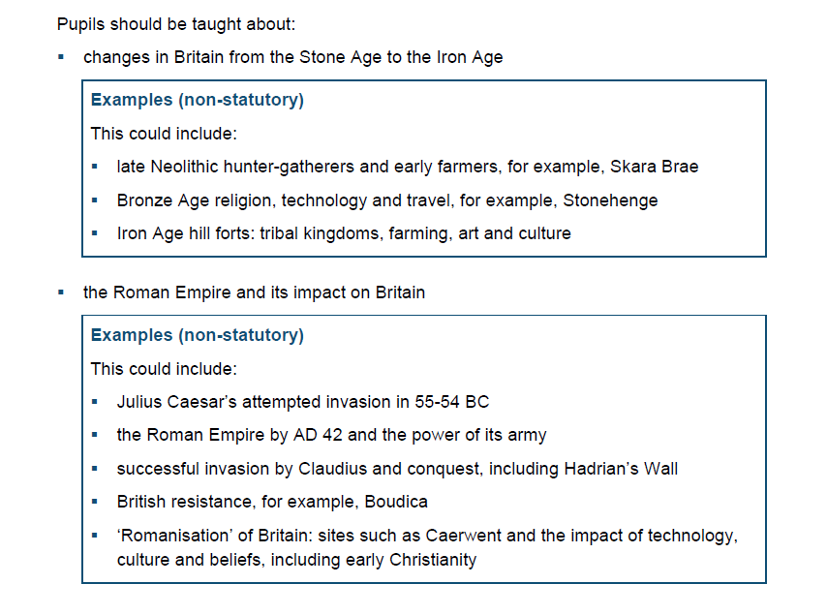
KS2 - Curriculum
CHANGES is the key term
All 3 ages should be taught
NOT just Roman Britain – also Empire – key word is IMPACT
Don’t generalise the ‘Roman’ experience as the same everywhere

Slide 29
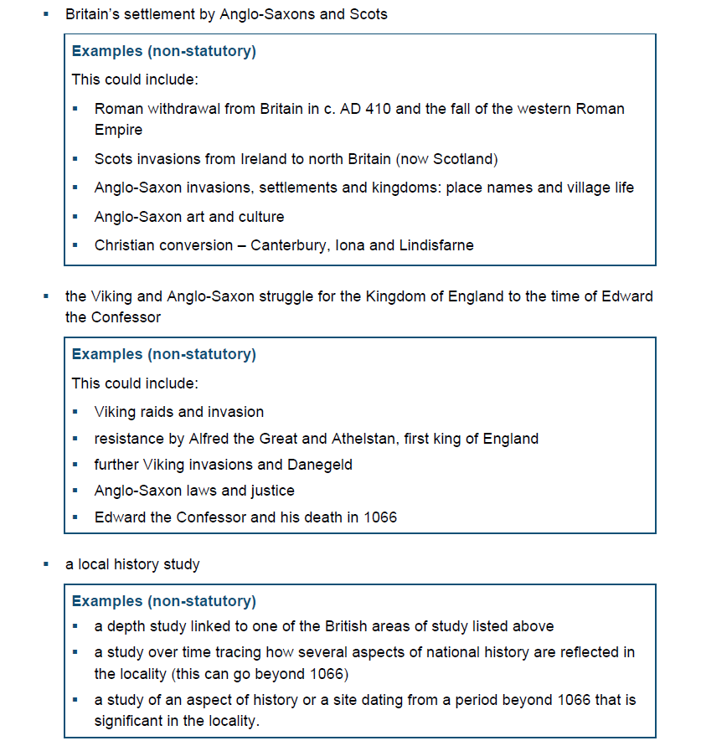
KS2 - Curriculum
Revisit Roman Britain and its impact to note the contrasts between the Romans and the Anglo-Saxons
Give sufficient coverage of AS and Scot struggle
Can be linked with Anglo-Saxons above if done clearly or can be done separately
Ensure that the STRUGGLE between AS and V is clear, not just study of the Vikings

Slide 30
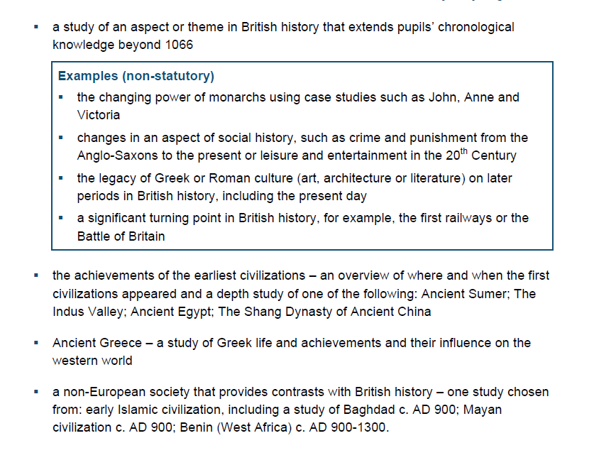
KS2 - Curriculum
DEPTH is the key word
Can go before or beyond 1066
Main focus is impact on local area
Main themes are that of CHANGE and IMPACT
Studying a period like the Tudors or the Victorians doesn’t hit that unless you are investigating their impact on today, their legacy or as a significant turning point

Slide 31
KS2 - Curriculum
OVERVIEW is the key term – all 4 should be taught briefly BEFORE one in-depth
ACHIEVEMENTS and INFLUENCE are the key terms – not just generally the Greeks
CONTRASTS is the key word – provides comparison with a different civilisation, not just an isolated study

Slide 32
KS2 – Creating coherence
Given the chronological distances and geographical distances, we need to keep the curriculum coherent
We can do this through themes that help provide a spine for topics – opportunities to revisit prior learning
Concepts like tax, trade, power, government, empire etc. feature in most topics, so link them together
Other themes like achievements, beliefs, society, housing, food, entertainment etc. are good too

Slide 33
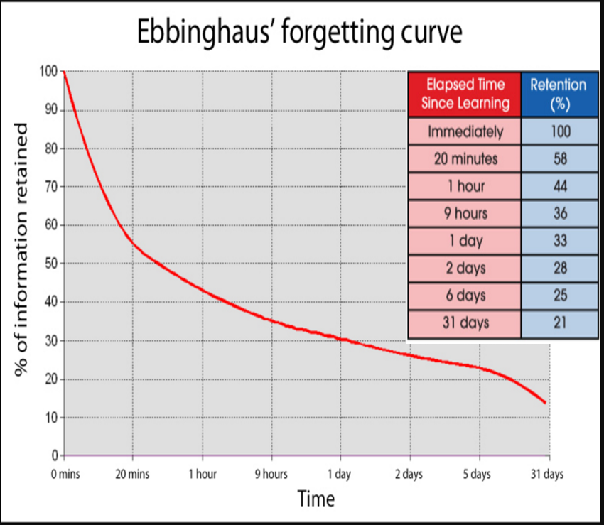
Curriculum coherence
Revisiting prior learning is crucial for the children to retain what they have learnt
Having key themes and concepts threaded throughout helps with this

Slide 34
Time for a break
10 minutes
Then we’ll look at skills and concepts in history

Slide 35
Historical skills and concepts
Let’s start off simple
2 minutes
List as many different skills as you can for:
PE, English, Maths, Art

Slide 36
Substantive and Disciplinary
What do these mean?
History is a ‘discipline’ and has its own set of ‘skills’ and methodology, which means that we need to develop these in children throughout school
These ‘skills’ can be broken down into Substantive and Disciplinary :
Substantive refers to the knowledge about history such as dates, events and people etc. – First order concept (the knowledge you encounter first)
Disciplinary refers to the methodology of understanding history and the processes involved in it, i.e. the way a historian works. – Second order concept (what you DO with the first order knowledge)

Slide 37
Substantive and Disciplinary
Rising Stars Progression Framework – Disciplinary Skills
Constructing the past
Sequencing the past
Change and development/Continuity and change
Cause and effect
Significance and interpretation
Planning and carrying out historical enquiry
Using sources as evidence
Vocabulary and communication

Slide 38
Substantive and Disciplinary
Substantive (stuff) concept examples
Trade
Empire
Tax
Power
Religion/Beliefs
Legacy

Slide 39
Skills and concepts
Constructing the past
NC - Establish clear narratives within and across the periods they study.
Note connections, contrasts and trends overtime.
Combine overview and depth studies to help pupils understand both the long arc of development and the complexity of specific aspects of the content.
This element can be two-fold:
Opportunity to underpin the concepts that are vital to understanding the entire topic
Developing and deepening understanding through connections and relationships
Make sure learning is linked to previous topics
Make sure there are plenty of comparisons in topics, not just new learning

Slide 40
Skills and concepts
Sequencing the past
NC - Develop chronologically secure knowledge and understanding of British, local and world history.
Chronology – isn’t just the topic you’re studying
Make sure children understand concurrence
Why are certain periods ‘capped’ by certain dates?
Ensure chn know certain ‘orders’ of history

Slide 41
Skills and concepts
Continuity and Change
NC - Address and devise historically valid questions about change, similarity and difference.
Note connections, contrasts and trends over time.
Cohesive structure
Children can take the lead if they can BUILD on prior learning
Ensure they aren’t JUST making comparisons – make judgements and give reasons for changes
Try to get them to illicit whether this was specific to a certain period or civilisation

Slide 42
Skills and concepts
Cause and effect
NC - Address and devise historically valid questions about cause.
Links inherently to continuity and change
WHY did something happen and what was the outcome?
‘Impact’ – a huge focus of the NC, especially for British history
Start to understand that there are a variety of factors, not just one

Slide 43
Skills and concepts
Significance and interpretation
NC - Address and devise historically valid questions about significance.
Understanding what is important in each topic
Identifying WHY something is significant – who is it significant for? Is it the same level of significance?
Identifying why HISTORIANS find something significant – what does it tell us about entire civilisations?
Was the shift from hunter-gatherer to farming significant?
Was the unification of Egypt significant in any way?
NC - Understand how our knowledge of the past is constructed from a range of sources.
Ensure that children use appropriate primary sources
Introduce idea of bias
Understand WHY viewpoints might be skewed
Draw their own conclusions from evidence

Slide 44
Skills and concepts
Historical Enquiry
NC - Construct informed responses that involve thoughtful selection and organisation.
Develop appropriate use of historical terms.
Guidance or freedom?
Both – children need to understand what historical enquiry is – an investigation into a question that gives a satisfactory conclusion relating to history
Can take various forms – macro or micro?
Did the Romans really do that much for Britain?
What was the biggest impact of the Romans on Britain?
Did Roman public health help Britain?

Slide 45
Skills and concepts
Sources as evidence
NC - Understand how our knowledge of the past is constructed from a range of sources.
Children should be given access to a range of sources
Primary and secondary sources – understanding the importance/shortfalls of both
Identifying bias, viewpoints and have a critical awareness of sources
Mix secondary sources – books, websites, videos, music etc.

Slide 46
Skills and concepts
Vocabulary and communication
NC - Gain and deploy a historically grounded understanding of abstract terms such as ‘empire’, ‘civilisation’, ‘parliament’ and ‘peasantry’
Children should be given access to and taught a range of historical vocabulary
Vocabulary can be taught in lessons and explicitly
Repetition of phrases and terminology is key
Opportunities to use the vocabulary

Slide 47
Skills and concepts
Considerations
When planning ANY history topic, think about the PROGRESSION of skills and concepts and NOT just the content of what you teach
Look back at what has been taught before and how you can BUILD on that learning
Think carefully about which skills are involved in that topic and how you will execute them – are you being explicit with them?
How are you tying the disciplinary skills with the substantive content?
Are you giving the children the OPPORTUNITIES to engage with disciplinary skills?

Slide 48
Close
What are the key messages that you have taken from this session?
How is this similar or different to what you have already seen on placement?
If you’re asked to plan a history topic/lesson, don’t worry about trying to fit ALL of this in straight away – ask for any existing planning and see if you can identify any points listed today that you can work on or towards
Most importantly – ENJOY TEACHING HISTORY!

