Slide 1
Primary Geography
Date: 2nd December 2022

Slide 2
Aims of the session…
To understand the requirements of the primary geography curriculum
To gain a better understanding of how geography is planned and delivered
To know how to plan a series of lessons

Slide 3
The national curriculum for geography aims to ensure that all pupils:
develop contextual knowledge of the location of globally significant places – both terrestrial and marine – including their defining physical and human characteristics and how these provide a geographical context for understanding the actions of processes
understand the processes that give rise to key physical and human geographical features of the world, how these are interdependent and how they bring about spatial variation and change over time
are competent in the geographical skills needed to:
collect, analyse and communicate with a range of data gathered through experiences of fieldwork that deepen their understanding of geographical processes
interpret a range of sources of geographical information, including maps, diagrams, globes, aerial photographs and Geographical Information Systems (GIS)
communicate geographical information in a variety of ways, including through maps, numerical and quantitative skills and writing at length.

Slide 4
KS1 – What do pupils need to know?
Pupils should develop knowledge about the world, the United Kingdom and their locality. They should understand basic subject-specific vocabulary relating to human and physical geography and begin to use geographical skills, including first-hand observation, to enhance their locational awareness.
Pupils should be taught to:
Locational knowledge
• name and locate the world’s 7 continents and 5 oceans
• name, locate and identify characteristics of the 4 countries and capital cities of the United Kingdom and its surrounding seas

Slide 5
Place knowledge
• understand geographical similarities and differences through studying the human and physical geography of a small area of the United Kingdom, and of a small area in a contrasting non-European country
Human and physical geography
• identify seasonal and daily weather patterns in the United Kingdom and the location of hot and cold areas of the world in relation to the Equator and the North and South Poles
• use basic geographical vocabulary to refer to:
• key physical features, including: beach, cliff, coast, forest, hill, mountain, sea, ocean, river, soil, valley, vegetation, season and weather
• key human features, including: city, town, village, factory, farm, house, office, port, harbour and shop

Slide 6
Geographical skills and fieldwork
use world maps, atlases and globes to identify the United Kingdom and its countries, as well as the countries, continents and oceans studied at this key stage
use simple compass directions (north, south, east and west) and locational and directional language [for example, near and far, left and right], to describe the location of features and routes on a map
use aerial photographs and plan perspectives to recognise landmarks and basic human and physical features; devise a simple map; and use and construct basic symbols in a key
use simple fieldwork and observational skills to study the geography of their school and its grounds and the key human and physical features of its surrounding environment

Slide 7
TASK - 10 minutes
Use your copy of the National Curriculum for KS1.
What key information are KS1 children required to know by the end of Year 2?
What is the key vocabulary to learn?
How will you ensure they retain the knowledge?

Slide 8
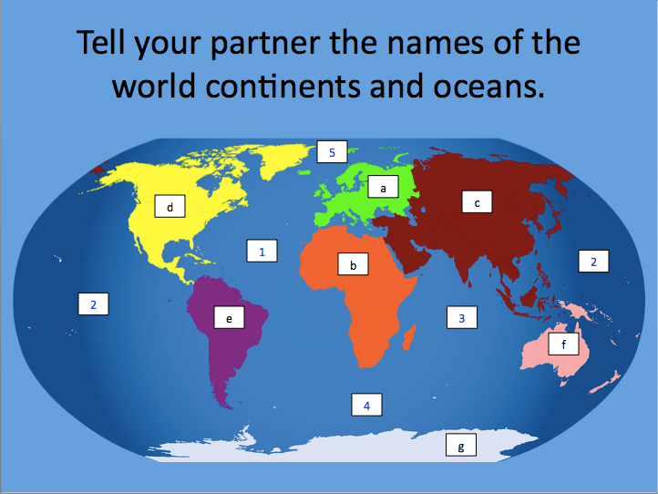
Can you name the continents and oceans?

Slide 9
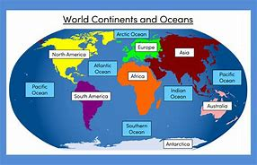

Slide 10
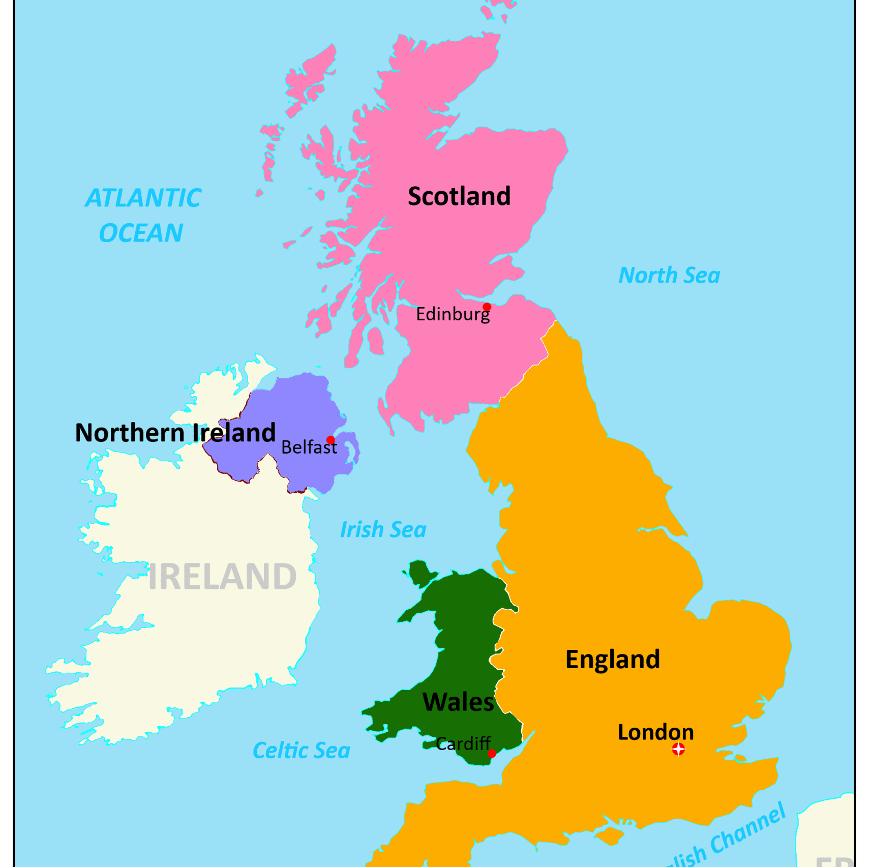
Could your class label this accurately?
Year 1?
Year 3?
Year 6?

Slide 11
Year Group Progression of Skills
Does your school have a document like this?
It is important to understand what has gone before and what comes after in all areas of study.

Slide 12
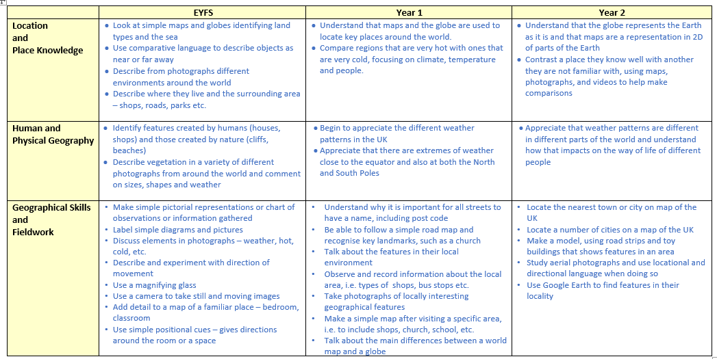

Slide 13
Key stage 2
Pupils should extend their knowledge and understanding beyond the local area to include the United Kingdom and Europe, North and South America. This will include the location and characteristics of a range of the world’s most significant human and physical features. They should develop their use of geographical knowledge, understanding and skills to enhance their locational and place knowledge.

Slide 14
Locational knowledge
locate the world’s countries, using maps to focus on Europe (including the location of Russia) and North and South America, concentrating on their environmental regions, key physical and human characteristics, countries, and major cities
name and locate counties and cities of the United Kingdom, geographical regions and their identifying human and physical characteristics, key topographical features (including hills, mountains, coasts and rivers), and land-use patterns; and understand how some of these aspects have changed over time
identify the position and significance of latitude, longitude, Equator, Northern Hemisphere, Southern Hemisphere, the Tropics of Cancer and Capricorn, Arctic and Antarctic Circle, the Prime/Greenwich Meridian and time zones (including day and night)

Slide 15
Place knowledge
understand geographical similarities and differences through the study of human and physical geography of a region of the United Kingdom, a region in a European country, and a region in North or South America
Human and physical geography
Describe and understand key aspects of:
physical geography, including: climate zones, biomes and vegetation belts, rivers, mountains, volcanoes and earthquakes, and the water cycle
human geography, including: types of settlement and land use, economic activity including trade links, and the distribution of natural resources including energy, food, minerals and water

Slide 16
Geographical skills and fieldwork
use maps, atlases, globes and digital/computer mapping to locate countries and describe features studied
use the 8 points of a compass, 4- and 6-figure grid references, symbols and key (including the use of Ordnance Survey maps) to build their knowledge of the United Kingdom and the wider world
use fieldwork to observe, measure record and present the human and physical features in the local area using a range of methods, including sketch maps, plans and graphs, and digital technologies

Slide 17
TASK - 5 minutes
Use your copy of the National Curriculum for KS2.
What key information are KS2 children required to know by the end of Year 6?
What is the key vocabulary to learn?
How will you ensure they retain the knowledge?
Are there any obvious cross curricular links?
How can you show progression?

Slide 18
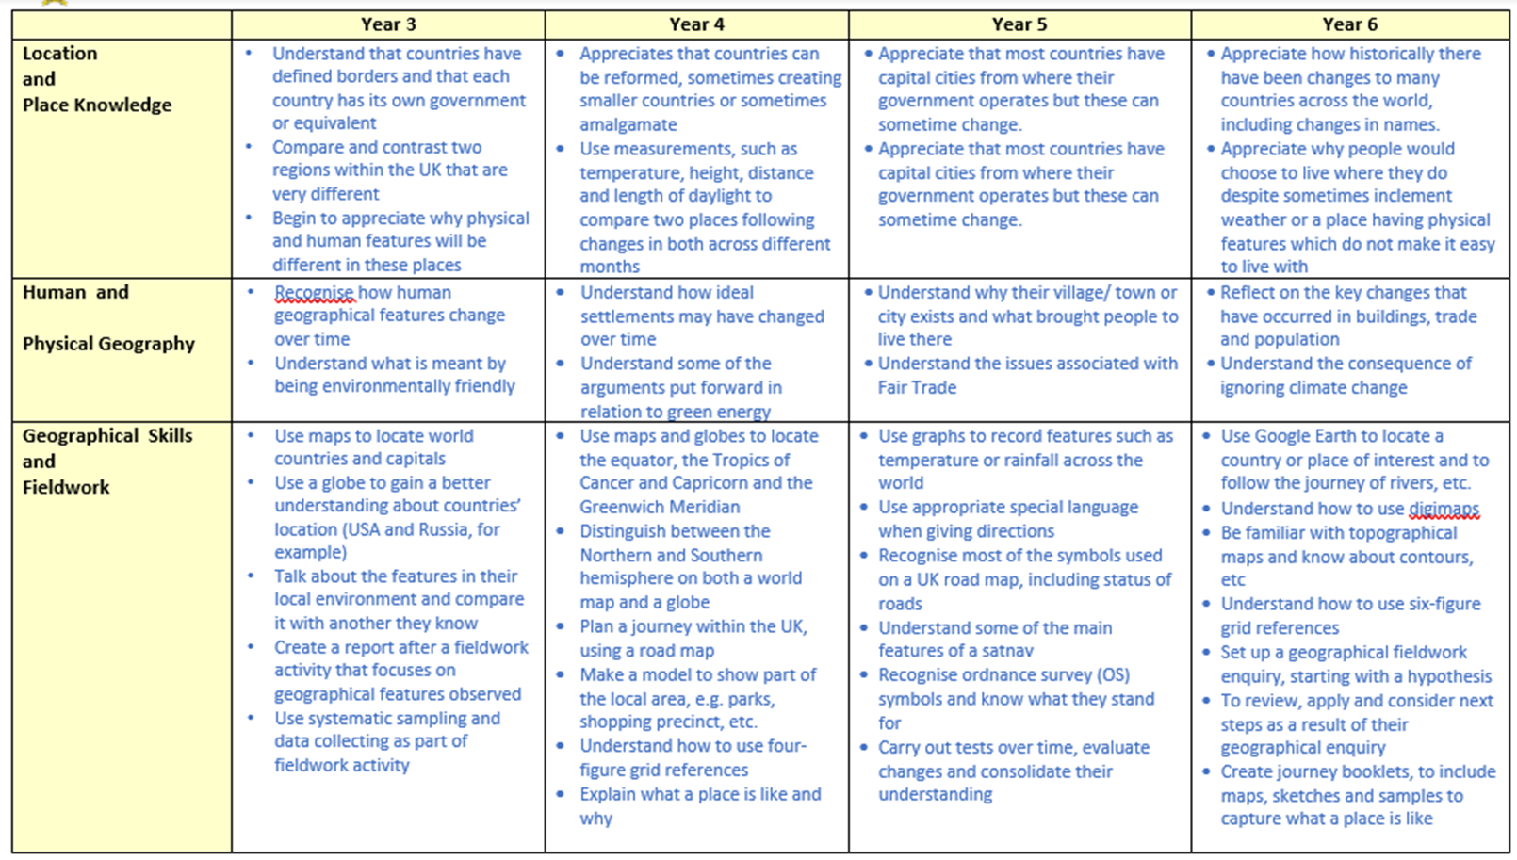
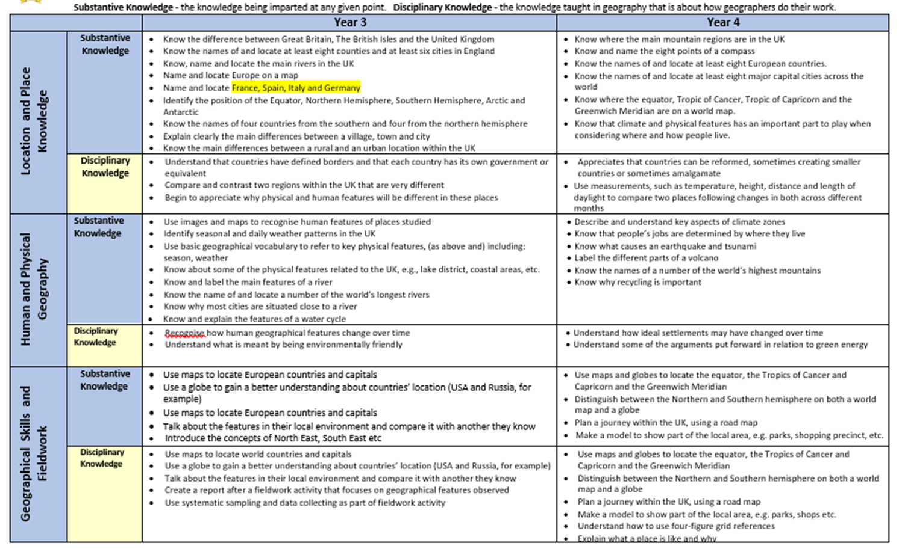
Year Group End Points
Take a look at these two documents

Slide 21
TASK
Take some time to look at the NC documents and the progression of knowledge and skills documents.
Identify where the elements of the NC are addressed within each year group and how the NC ‘outline’ for geography has been developed so that pupils have a deeper understanding of the subject.
Could you group any together to make a 6 week unit?
Thoughts?

Slide 22
From your Audits…
Significant UK Places and environments
Significant world places and environments
Physical and human geography
Physical and human processes
Linking English and Geography

Slide 23
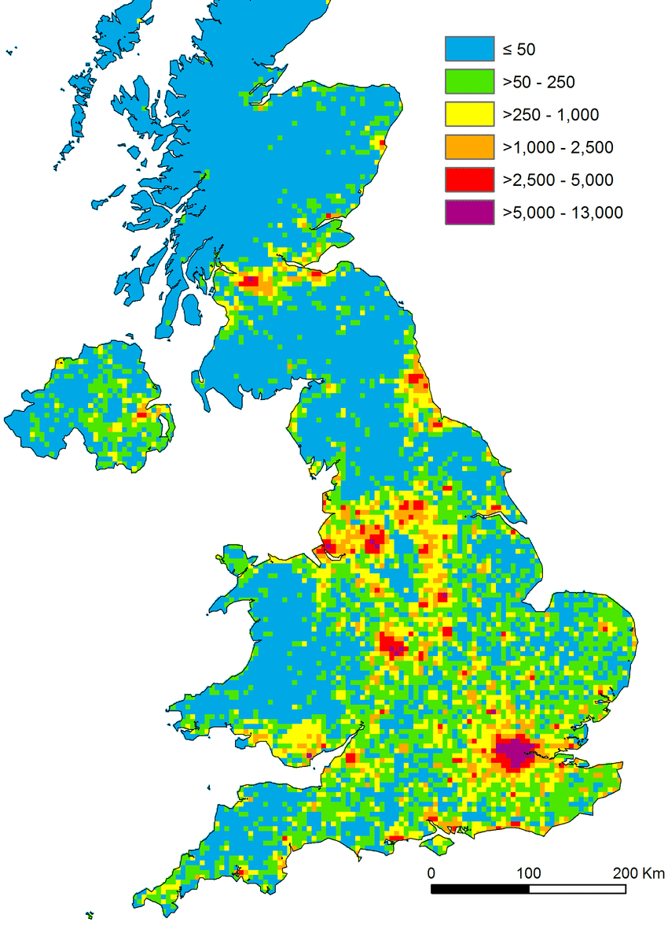
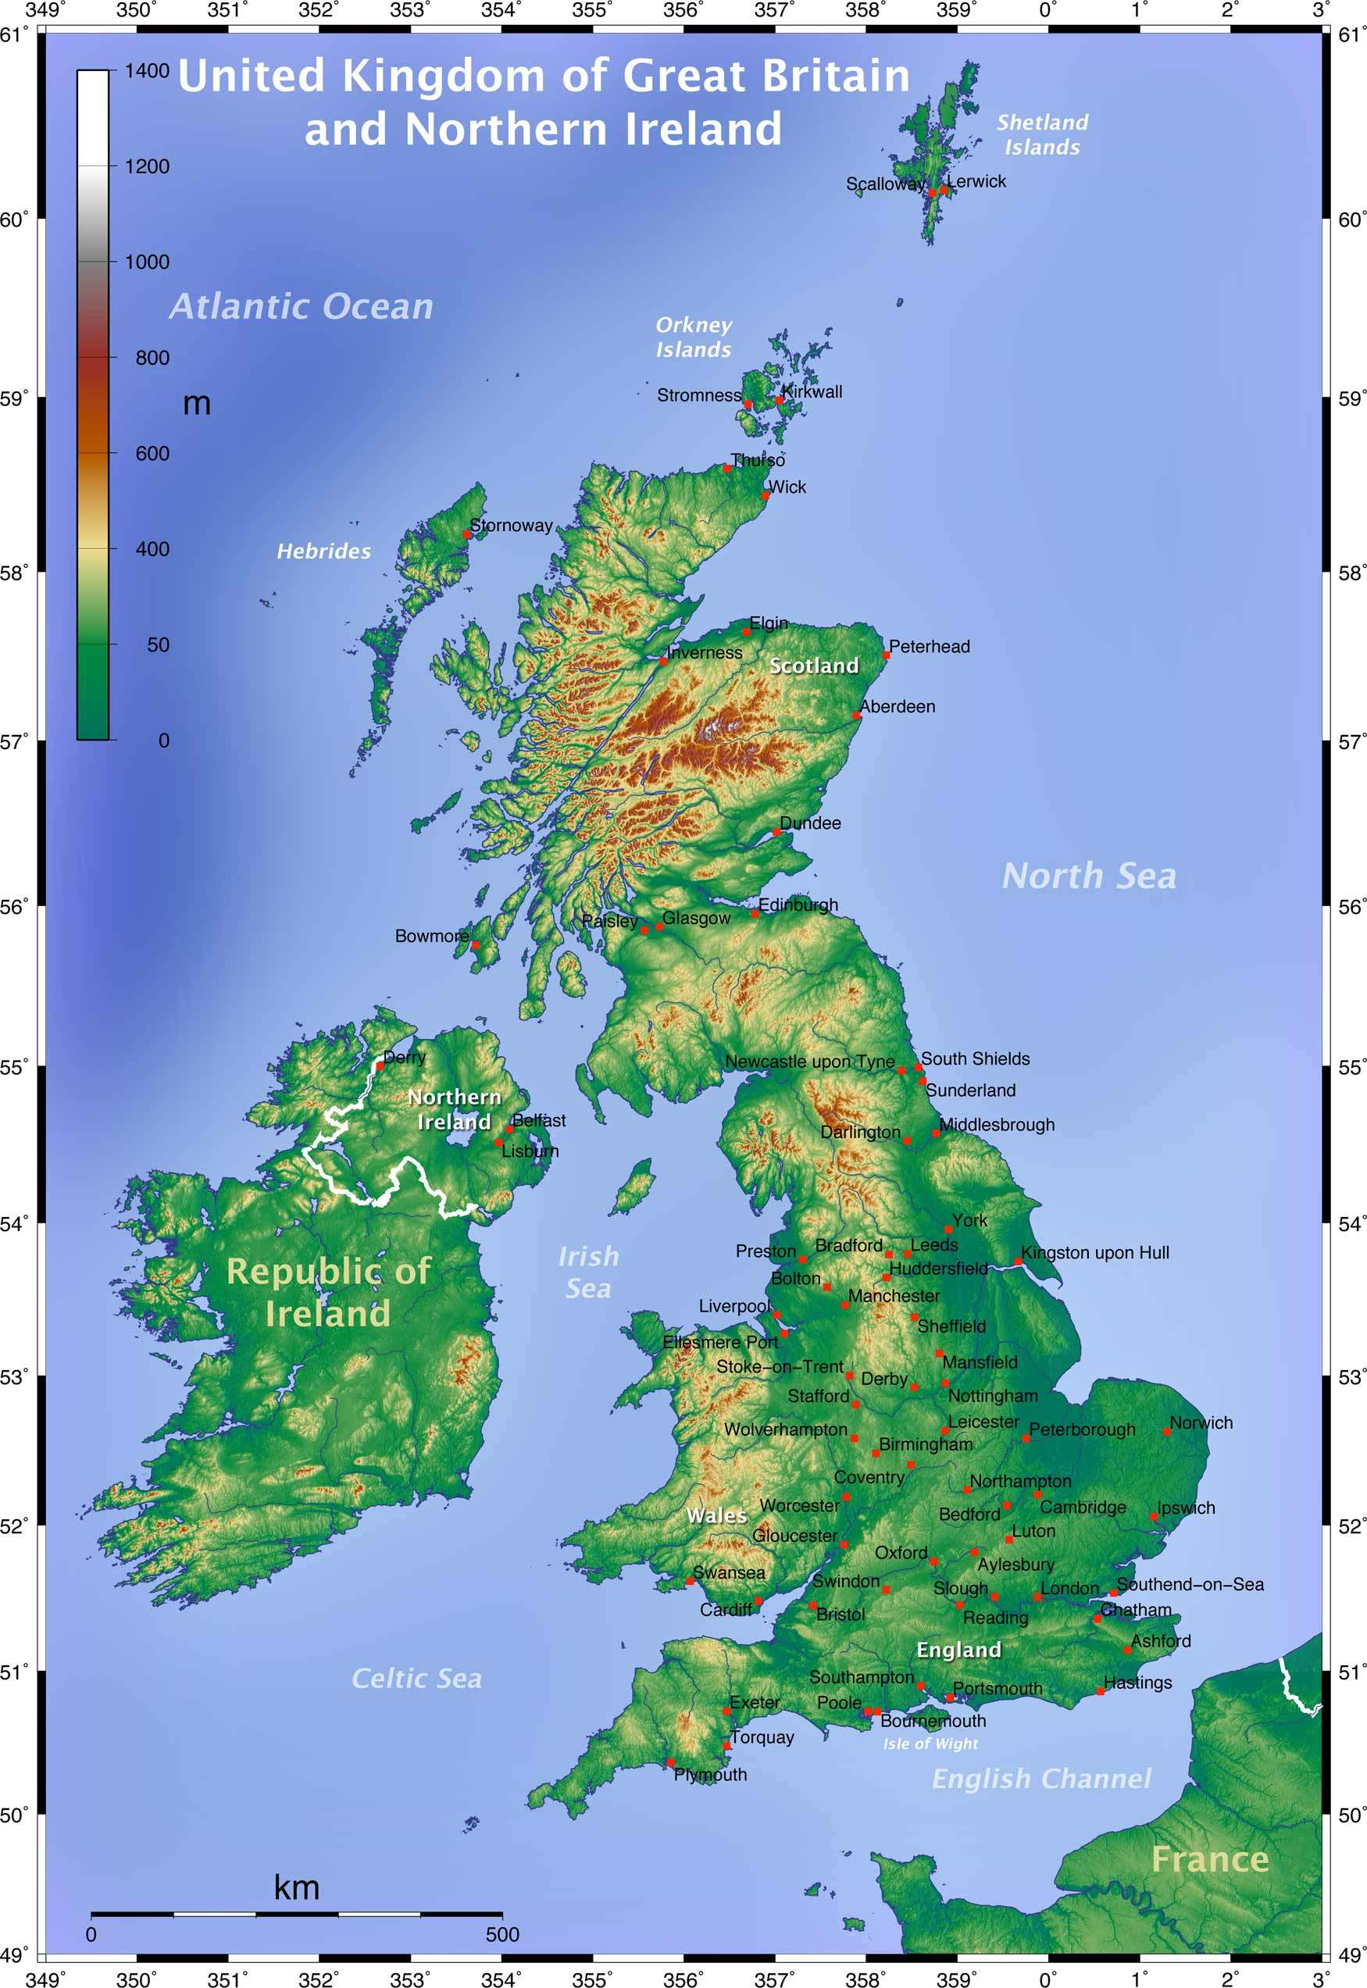
Significant UK places and environments
What do we class as significant places and environments?
UK Rivers
UK Mountains
Major Cities
Flat and hilly land areas
What questions can we ask about these maps?

Slide 24
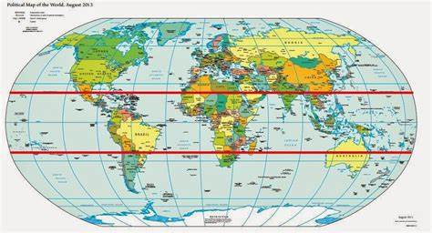
Significant world places and environments
North and South America
Russia
Europe
Rainforests
Deserts (hot and cold)
Major world rivers
Mountains and mountain ranges
Warmest/coldest areas/tropics

Slide 25
Human and Physical Geography
Human and physical features are things that you can see all around you.
Physical features like seas, mountains and rivers are natural. They would be here even if there were no people around.
Human features are things like houses, roads and bridges. They have been built by people.

Slide 26
Human and Physical Processes
Physical processes in geography looks at the natural processes of the Earth, such as climate (links to science – Earth and Space) and plate tectonics.
Human processes in geography looks at the impact and behaviour of people and how they relate to the physical world. This will link to PSHE and Eco clubs.

Slide 27
Linking Geography and English
Which genre lend themselves to geography writing?
Explanation texts
NC reports
Journalistic
Avoid diaries and postcards etc. Writing like a geographer means choosing appropriate genre.

Slide 28
Plan ahead
Look at the geography topic that you are doing and plan your English around it.
Find or write a WAGOLL with all of the features you would like to see. You can then use this as a comprehension in your English lessons which means extra exposure to the content.
Which punctuation, sentence types, grammar would you need to include in the English unit? Can you use the topic to write your expanded noun phrases or embedded clauses etc. Pupils can then use this later in their writing.

Slide 29
Planning a 2 week English unit…
Monday Comprehension | Tuesday Structure and Features | Wednesday Sentence Types | Thursday Grammar | Friday Spelling/SPaG
Planning | Shared Write | Draft | Write | Edit
All schools will have a different approach but this is what I use and it works well.
You would then continue with teaching the content in your geography lessons so pupils have more detail and knowledge to include.

Slide 30
Planning for SEND
If we get it right for our SEND children, we get it right for everyone.
5 a Day

Slide 31
5 a Day

Slide 32
TASK
Think of a child in your class who needs extra support.
If you are asking them to label a map, how could you scaffold this task?
Are there any of these techniques which would help?
Ipads/voice recordings/templates/pictures/scaffolding/grouping
What about writing a newspaper article?

Slide 33
Planning a sequence of lessons
What to consider…
How many weeks do you have?
What do you want the children to know at the end of the unit?
What prior learning have they had which will feed into this unit?
What is the key vocabulary?
Can you make any cross curricular links?
Which tasks will you choose to achieve the objective? It does not always have to be a writing task.

Slide 34
Earthquakes example planning

Slide 36
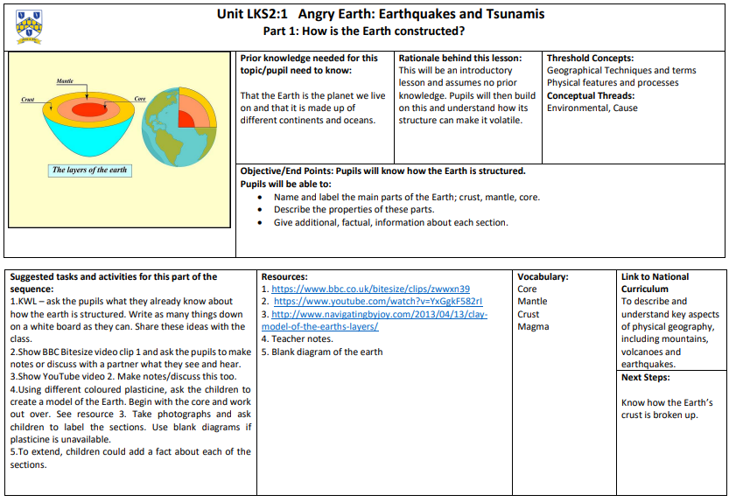

Slide 39
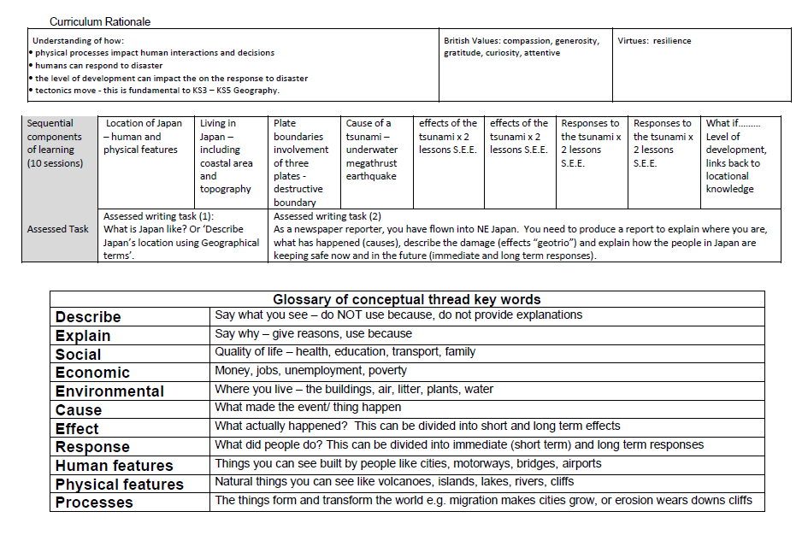

Slide 41
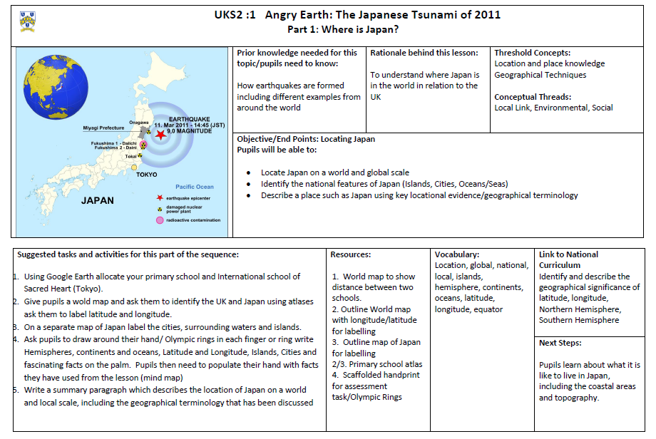

Slide 43
Your turn… Look on your school website at the long- term plan for geography. Pick a topic to plan a sequence of lessons. Failing that, use the year group endpoints to plan a unit of your choice for a class you will each after SSP.

Slide 44
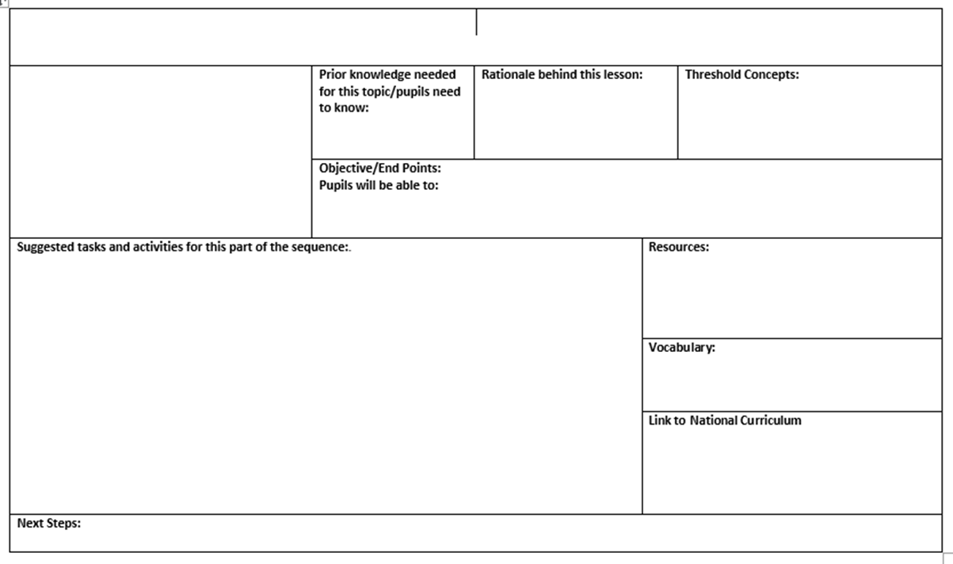

Slide 45
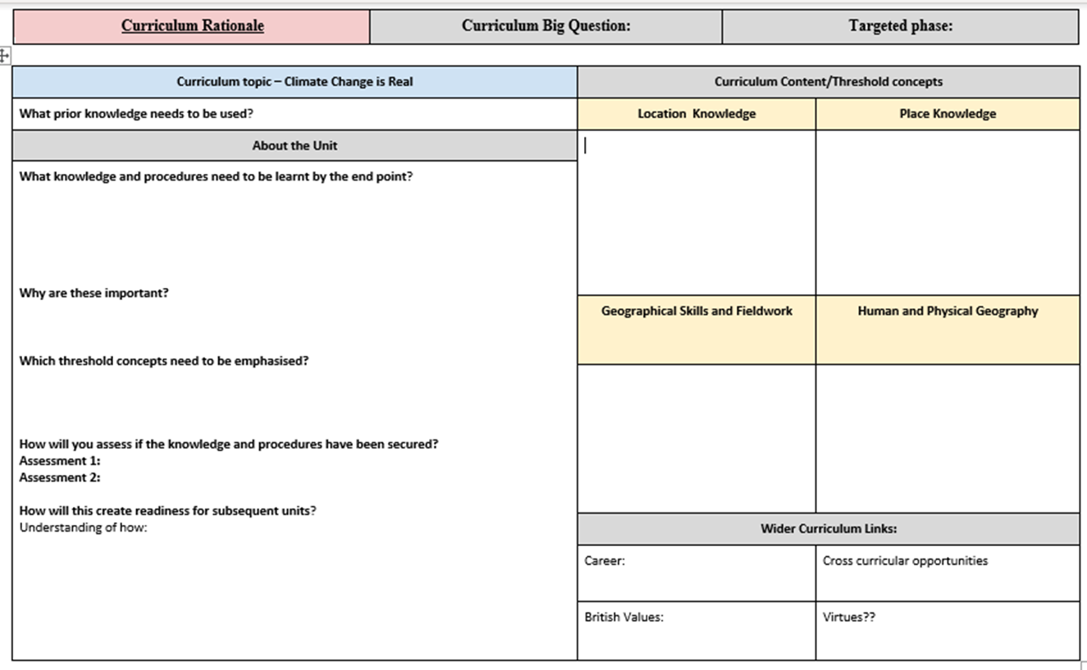

Slide 46
Planning a sequence of lessons
What to consider…
How many weeks do you have?
What do you want the children to know at the end of the unit?
What prior learning have they had which will feed into this unit?
What is the key vocabulary?
Can you make any cross curricular links?
Which tasks will you choose to achieve the objective? It does not always have to be a writing task.

Slide 47
Any questions?
Email me at clair.bingham@stjosephsnorton.bhcet.org.uk

