Slide 1
PLT 4 / Evidence File

Slide 2
PLT3
S1
S7
PLT 4
S4
S8
PLT5
S2
S3
Part 2
S5
S6
Discuss S6
Gateway 2
Reference standards not Gateways

Slide 3
Standards
Evidence
Sheet
One for each
standard and
Part 2
Intent – plan
Impact - evidence

Slide 4
Presentation File: Key Dates 2023
Monday 15th May- Thursday 25th May: PLT 5 visits. Presentation File must be ready for PLT5 (final assessment) visit.
Friday May 26^{th:} Presentation File to be submitted.
Monday June 5^{th:} CTTP moderation of Presentation files.
Tuesday June 6th- Thursday June 20th: External Verifier school visits. Trainees chosen by External Verifiers and schools will be notified directly.
Monday 26th June: Exam Board meeting.
Tuesday 27th June: End of ITT course and notification of completion.
Thursday 29th June: 6.30pm Awards Ceremony at Carmel College – trainee + 2 guests.

Slide 5
What you will need:
1 lever-arch
folder
10 Dividers
Highlighter and Post-it Notes to annotate evidence
Table of Contents document
Evidence Sheets

Slide 6
How to set up the file:
Please make sure that you have copies of all elements within the file as the file needs to be retained by CTTP.
Table of Contents
Key Documentation
Matrix
PLT4 TPR and Final Trainee Progress Report
All PLT reports (1-5)
Standard 1 (PLT3)
Standard 2 (PLT5)
Standard 3 (PLT5)
Standard 4 (PLT4)
Standard 5 (PLT5)
Standard 6 (PLT5)
Standard 7 (PLT3)
Standard 8 (PLT4)
Part 2 (PLT4)
10 Sections

Slide 7
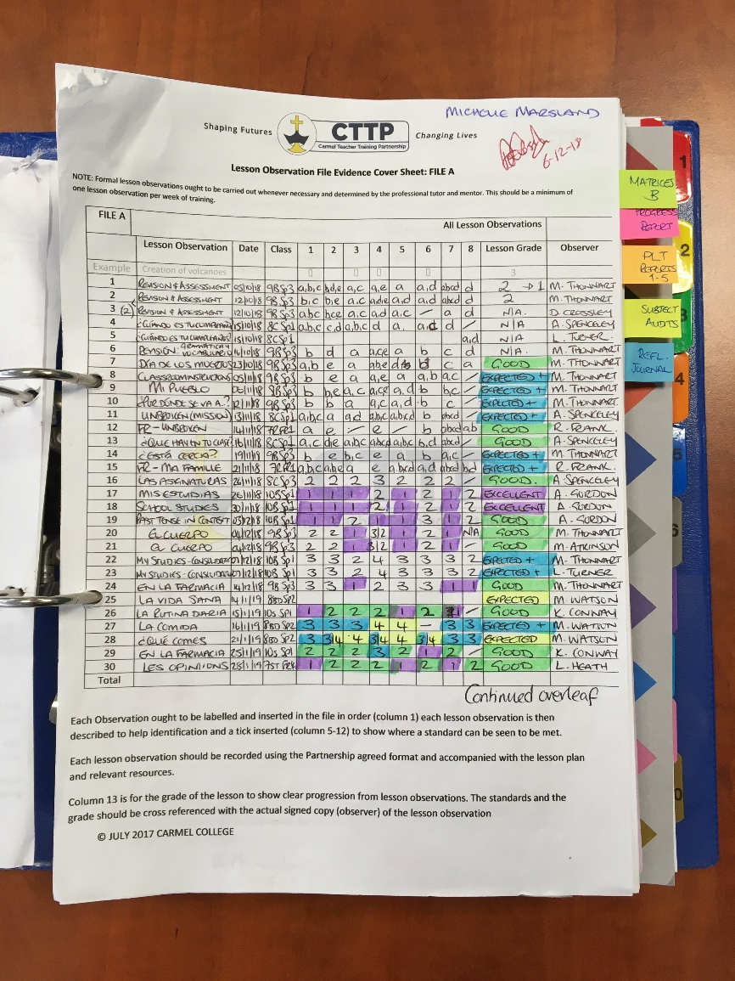
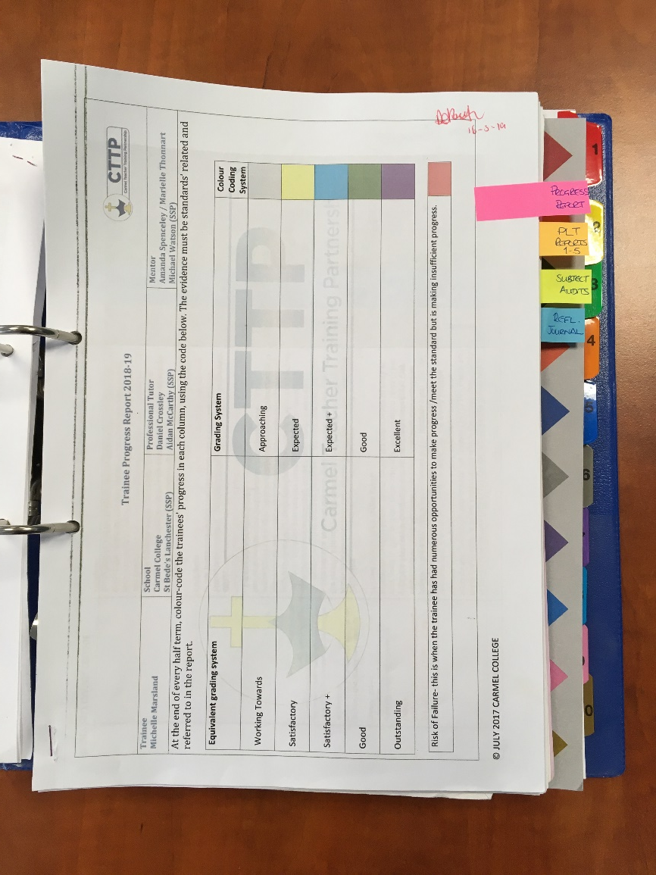
Example
Matrix A
Final TPR
Final TPR
Key Documentation
Matrix
PLT4 TPR and Final Trainee Progress Report
All 5 PLT reports
Standard 1
Standard 1 Evidence sheet
Evidence
Etc.

Slide 8
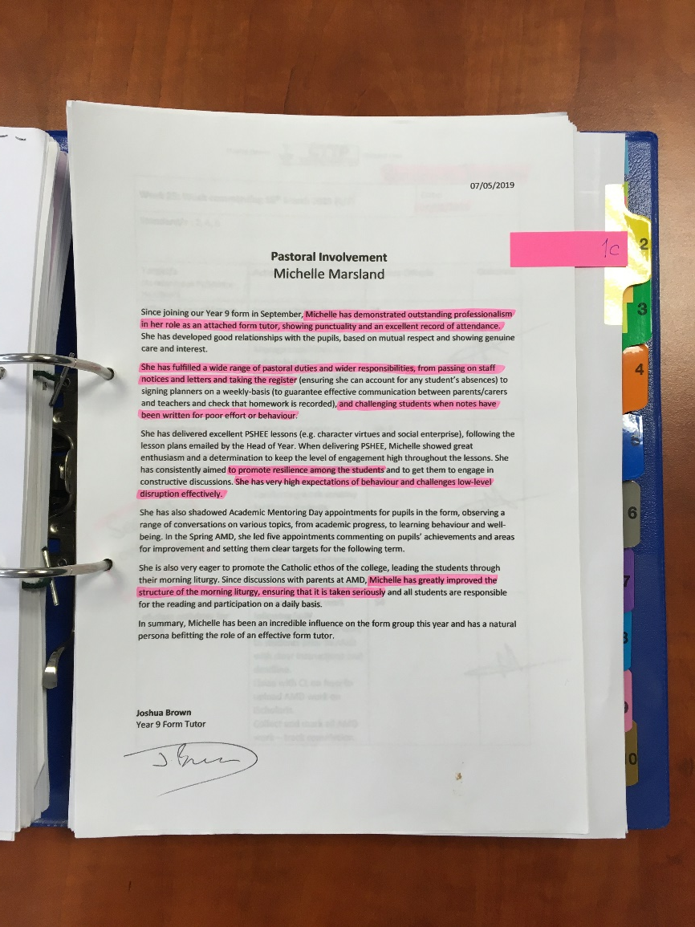
Example
Standard 1
Pieces of Evidence
Standard 1
Evidence Sheet
Key Documentation
Matrix
PLT4 TPR and Final Trainee Progress Report
All 5 PLT reports
Standard 1
Standard 1 Evidence sheet
Evidence
Etc.

Slide 9
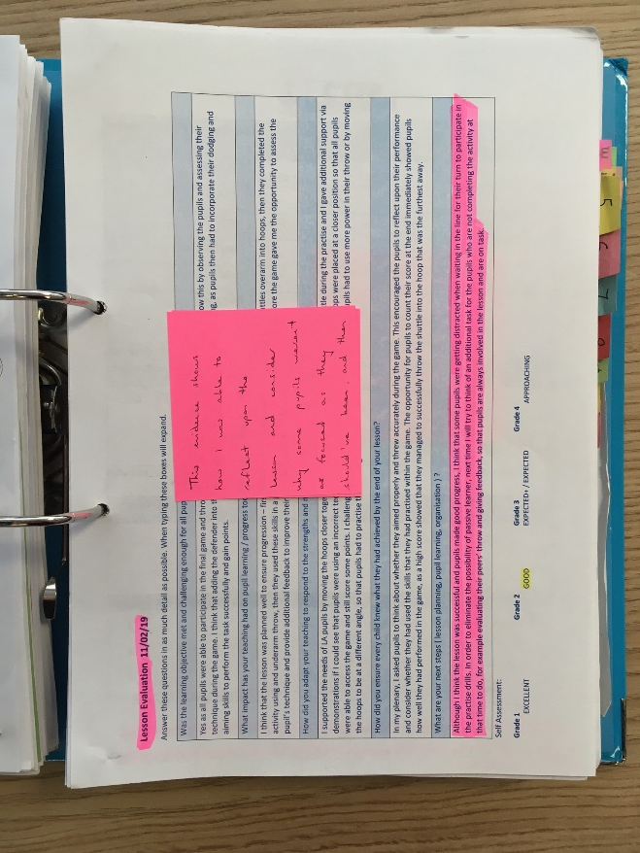
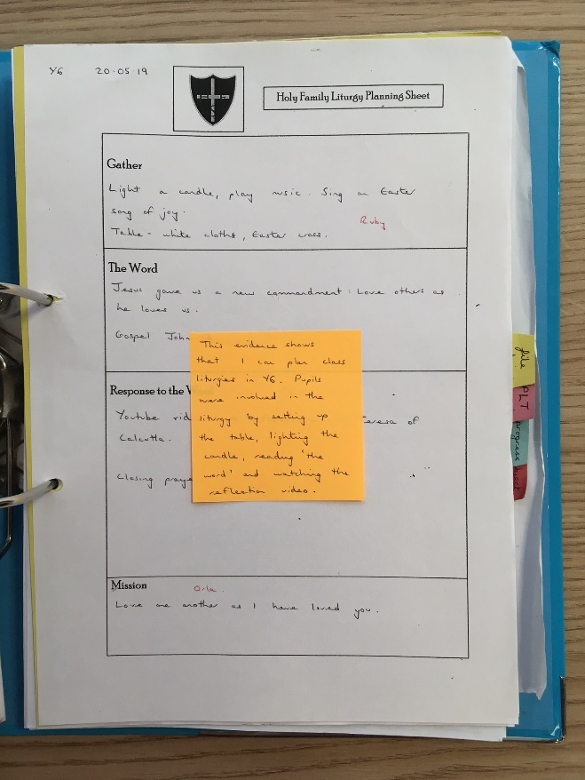
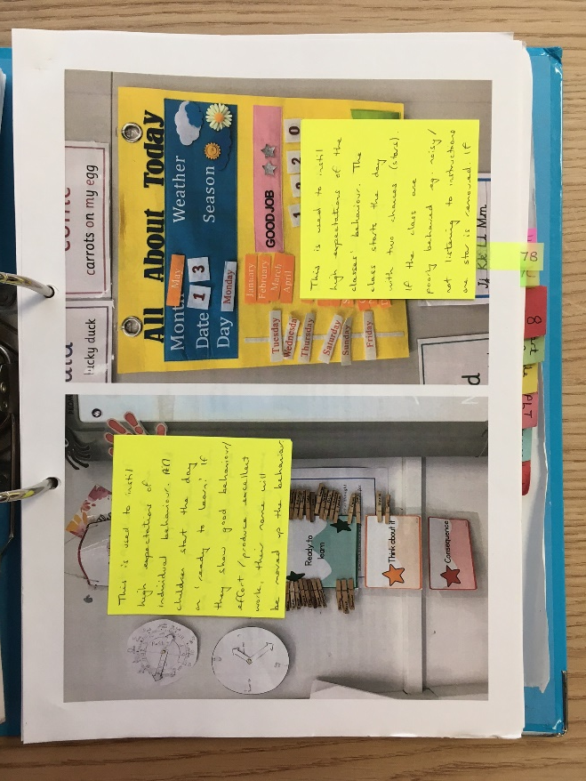
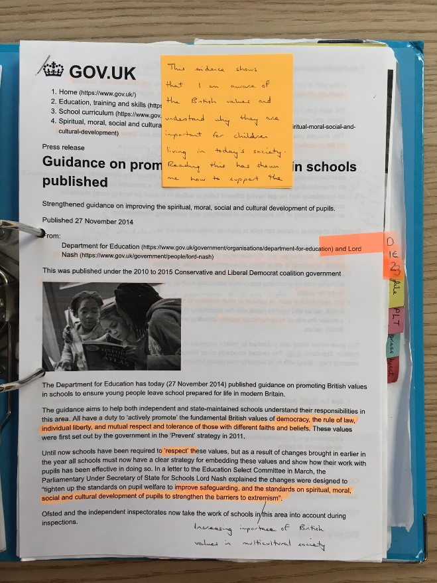
Do
Use one piece no more than twice – Lesson plan is different to lesson observation, evaluation, resources, marked work etc
DO
Annotate your evidence.

Slide 10
Do
Use a range of evidence – Key Stage - SSP
Use different types of evidence

Slide 11
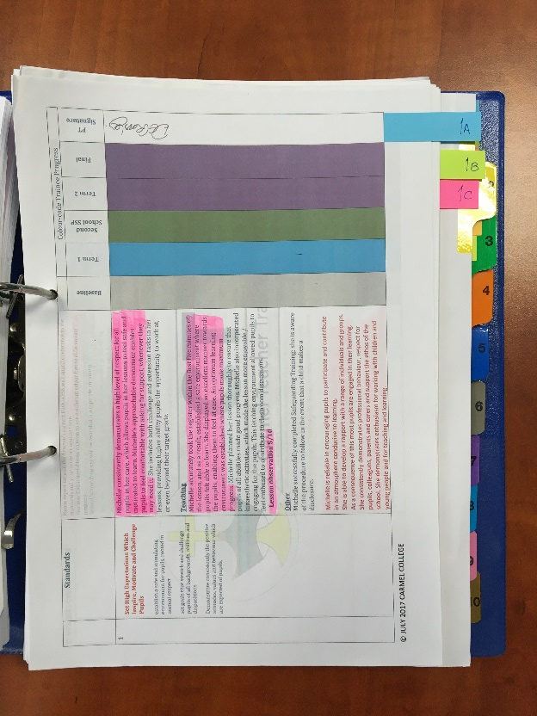
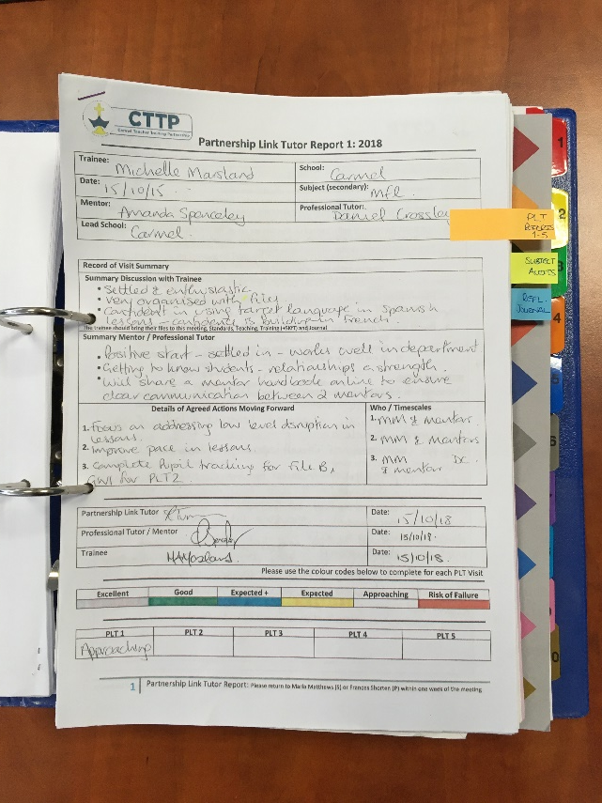
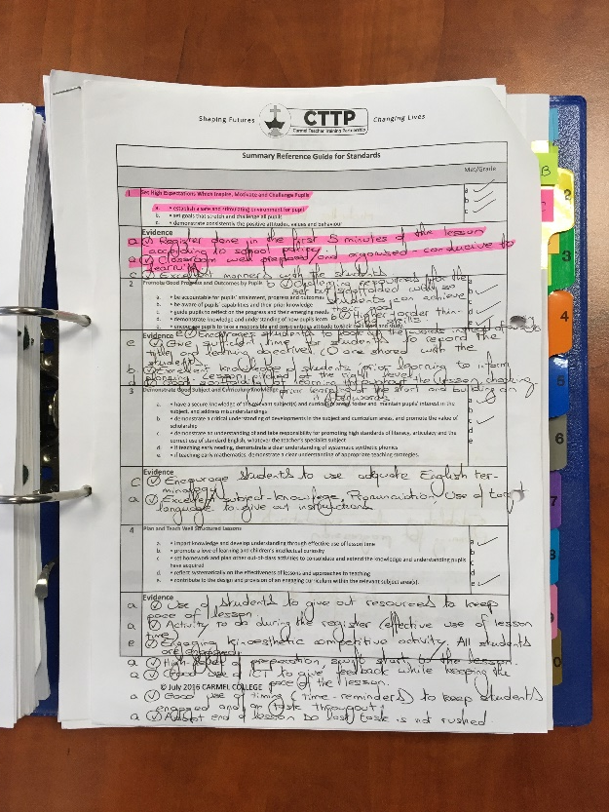
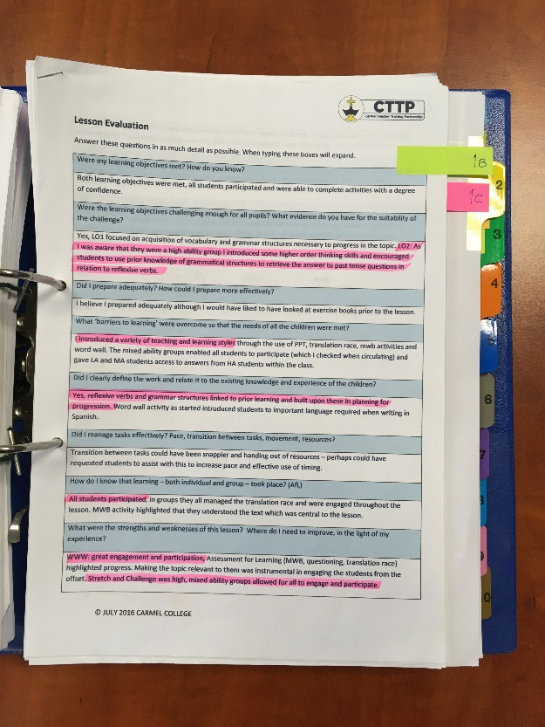
Think outside the box, but select your BEST piece of evidence!
Examples of sources of evidence
TPR
PLT Reports
Lesson Observations
Lesson Evaluations

Slide 12
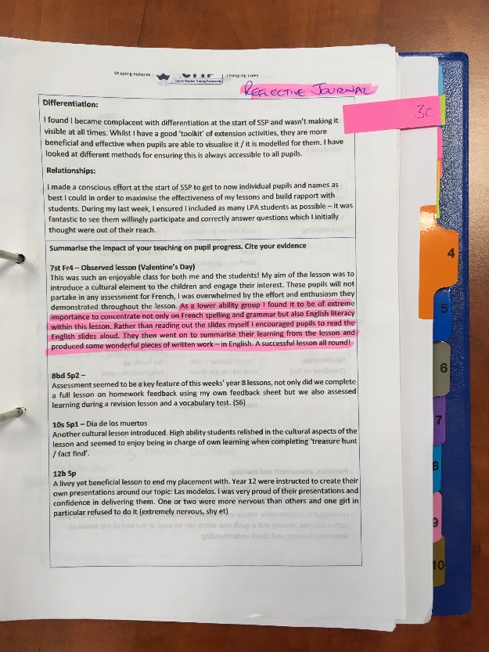
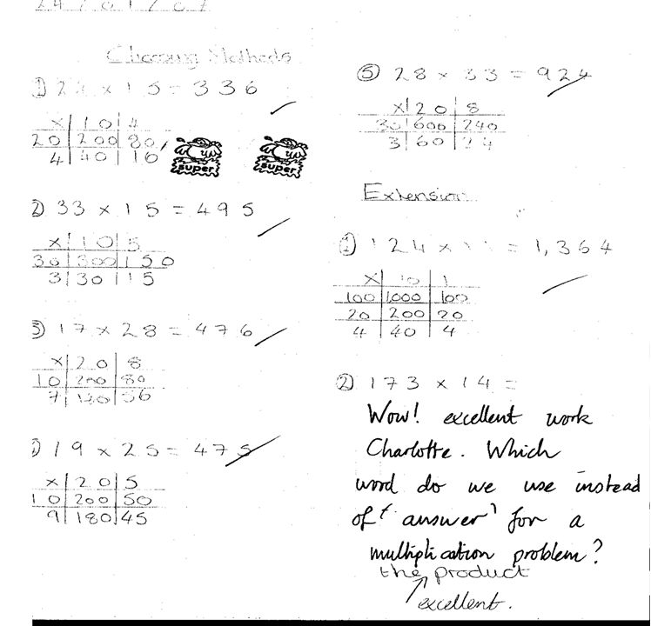
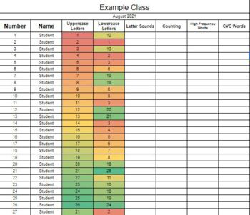
Case study – research / impact
Anonymised pupil progress data
Marked pupils work (with pupil feedback)
Reflective Journal Entries

Slide 13
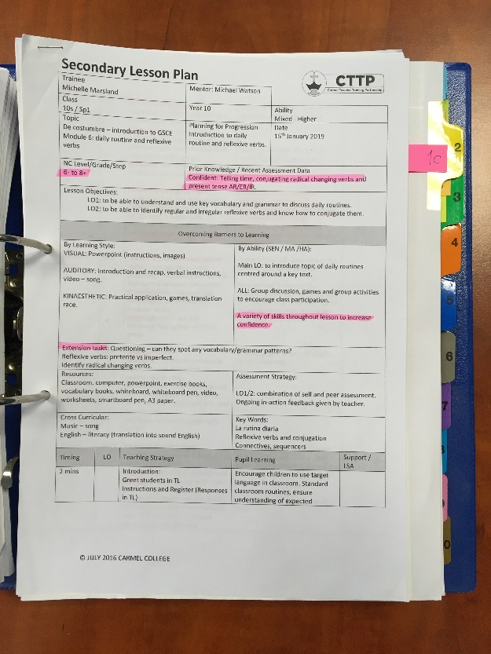
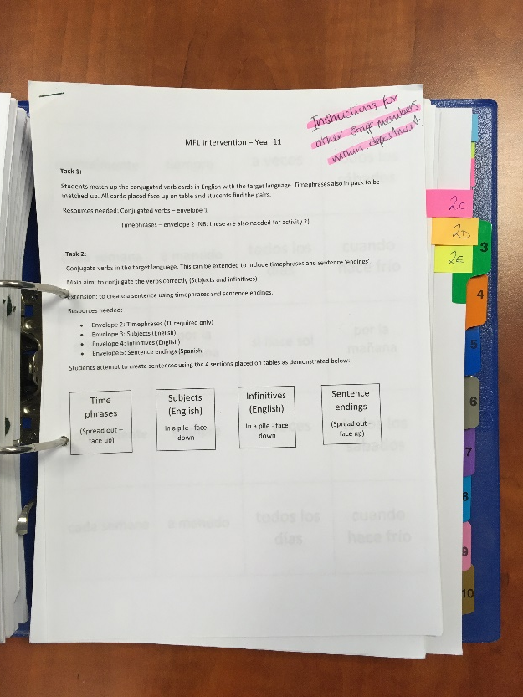
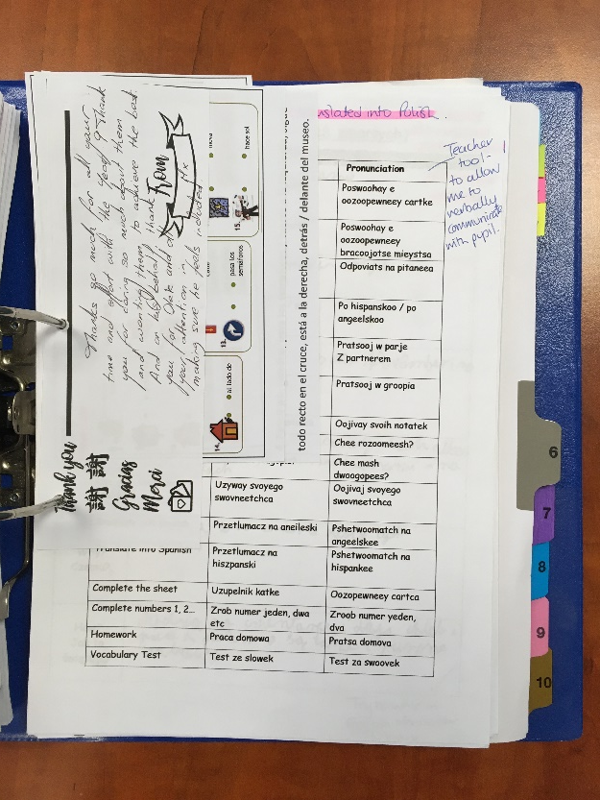
Differentiated resources
Lesson Plans
Resources
Verified evidence

Slide 14
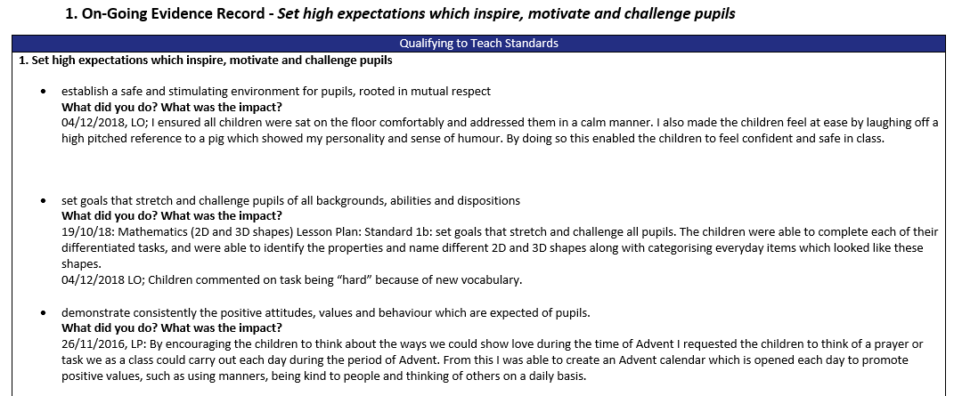
Additional documents for PLT5 final assessment visit
The following documents will need to be available electronically or physically for PLTs in their final visit:
Subject Audits
Gateway 1
Gateway 2
Completed Subject Audits
These do not need to go into the Presentation File.
Gateway 1 and Gateway 2

