Slide 1
Central Training: General Professional Studies
Science 2 Thursday 2nd March 2023
Ailidh McAllister

Slide 2
Review of current Science teaching
Have a think about your Science teaching so far …
Have you taught Science on your previous placements?
If so, what topics/year groups have you taught?
What topic is being taught on your current placement?
Is there anything specific you would like more support with?
Science

Slide 3
Recap of Science 1
Last session we …
Thought about Science within Primary Schools
Examined progression documents from EYFS to Y6
Identified areas around school that Science could take place
Observed Science across the school
Science

Slide 4
Training Overview
This session will aim to…
1
Introduction - To understand how working scientifically looks across the primary curriculum
Progression- To explore enquiry types and key skills within science
Practical investigations - To conduct an investigation with a group of pupils
Summary – To consolidate learning
2
3
Science
4

Slide 5
National Curriculum: Science Programmes of Study
The national curriculum for science aims to ensure that all pupils:
develop scientific knowledge and conceptual understanding through the specific disciplines of biology, chemistry and physics
develop understanding of the nature, processes and methods of science through different types of science enquiries that help them to answer scientific questions about the world around them
are equipped with the scientific knowledge required to understand the uses and implications of science, today and for the future

Slide 6
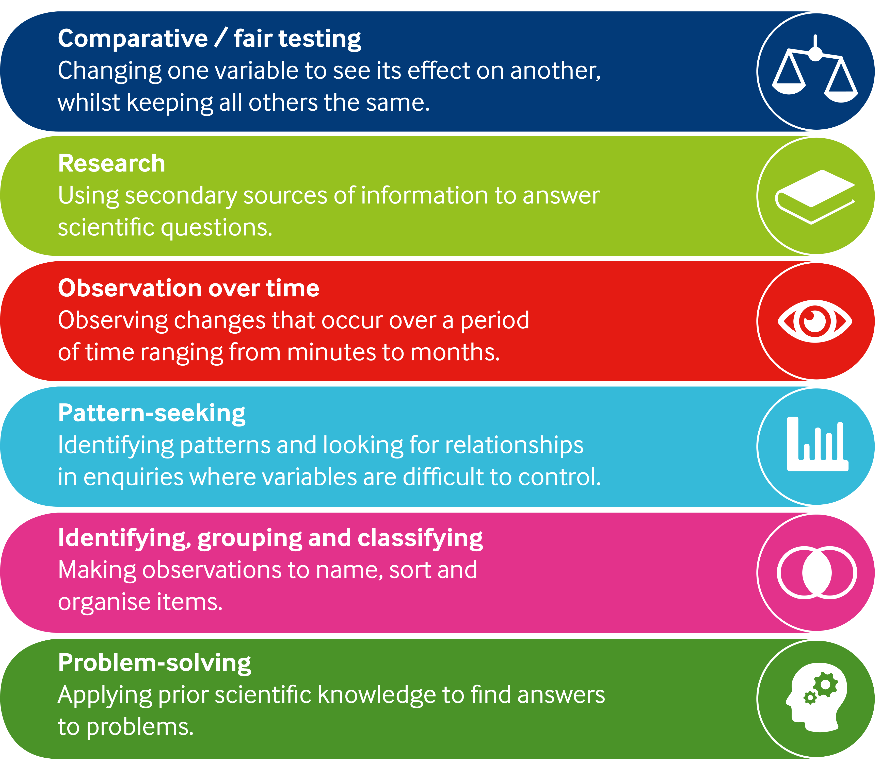
Working Scientifically
The nature, processes and methods of Science
Working Scientifically
Should not be taught as a separate strand
Pupils should learn to use a variety of approaches to answer relative scientific questions
Pupils are not expected to cover each aspect for every area of study

Slide 7
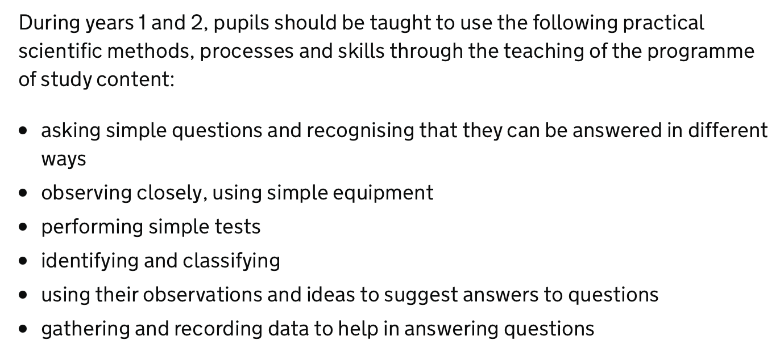
Working Scientifically KS1

Slide 8
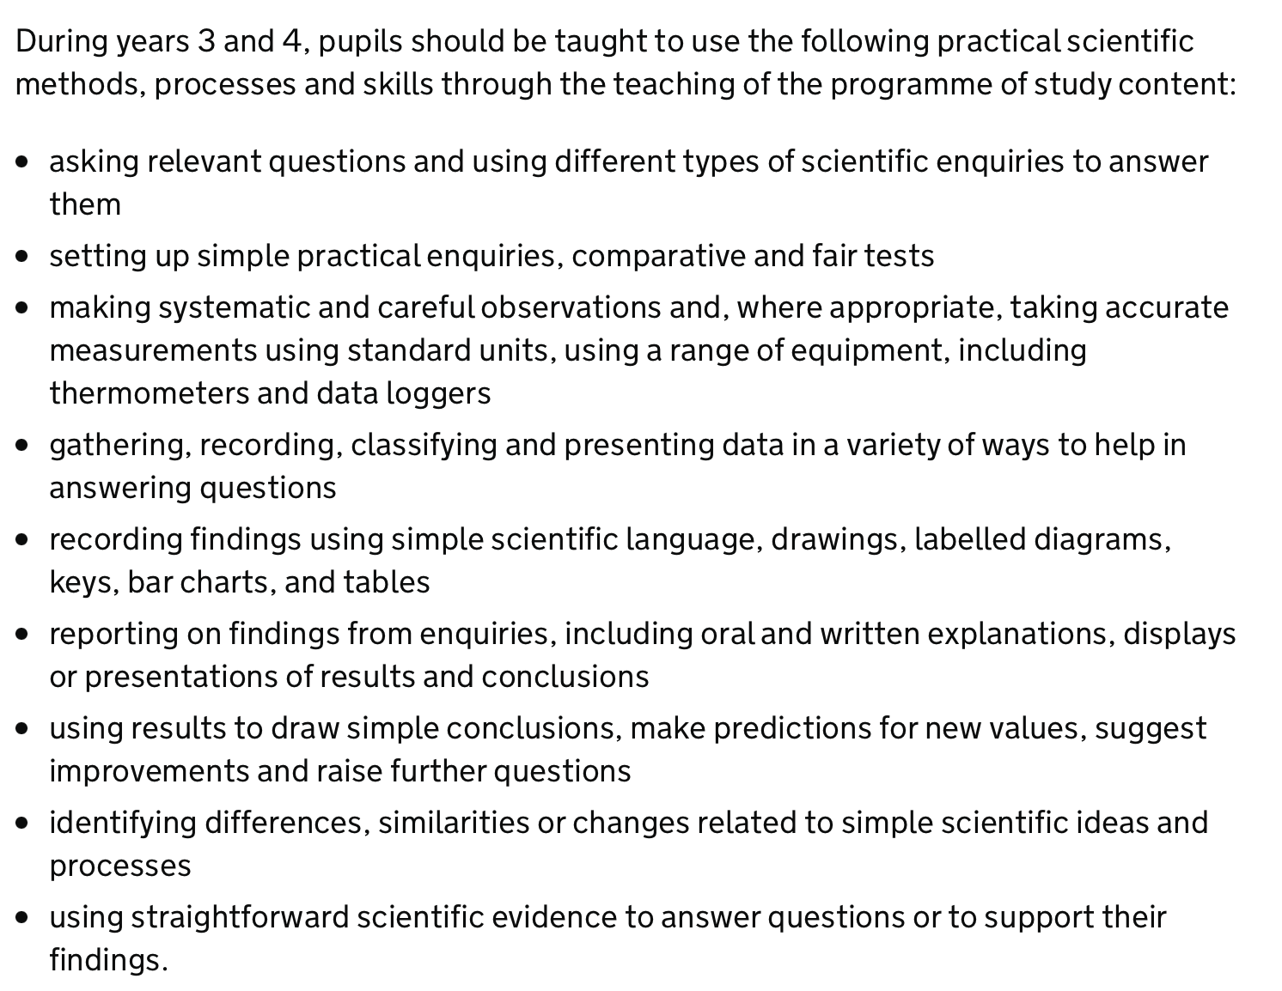
Working Scientifically LKS2

Slide 9
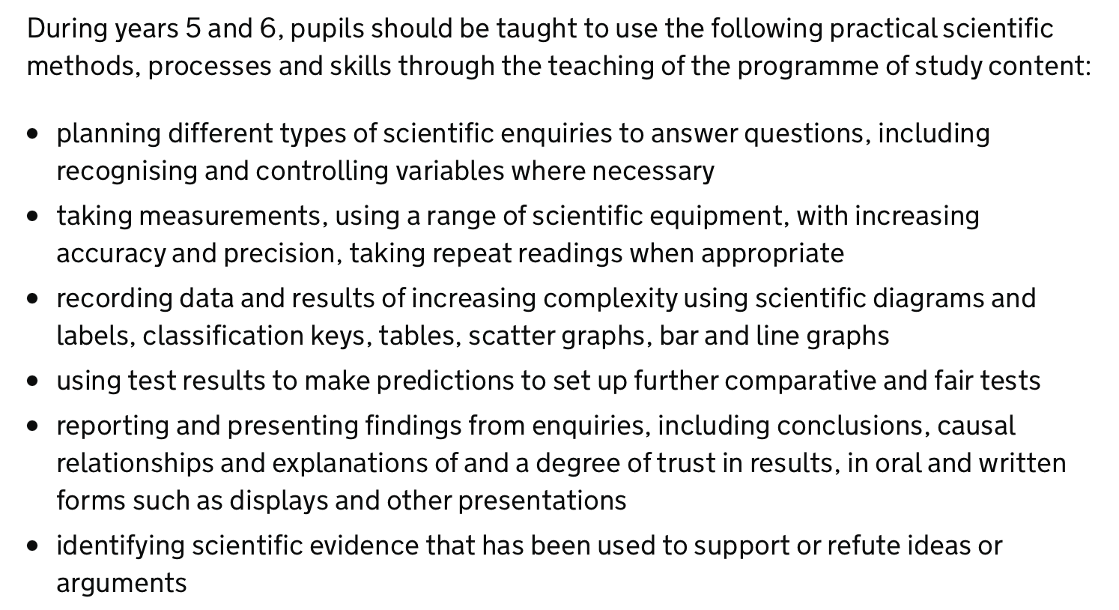
Working Scientifically UKS2

Slide 10
Working Scientifically
Explaining Science
Classification
Data, Tables and Graphs
Designing Experiments
Making Conclusions

Slide 11
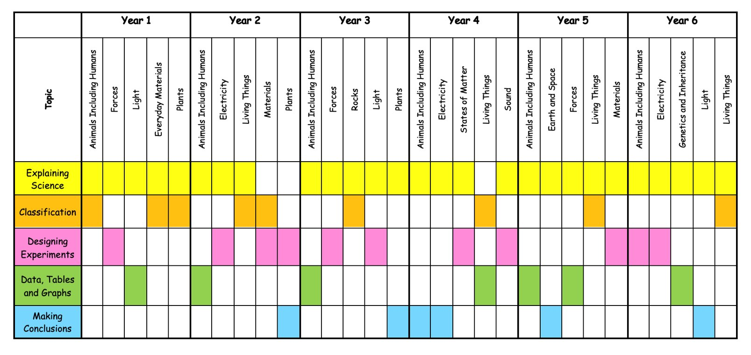
Working Scientifically

Slide 12
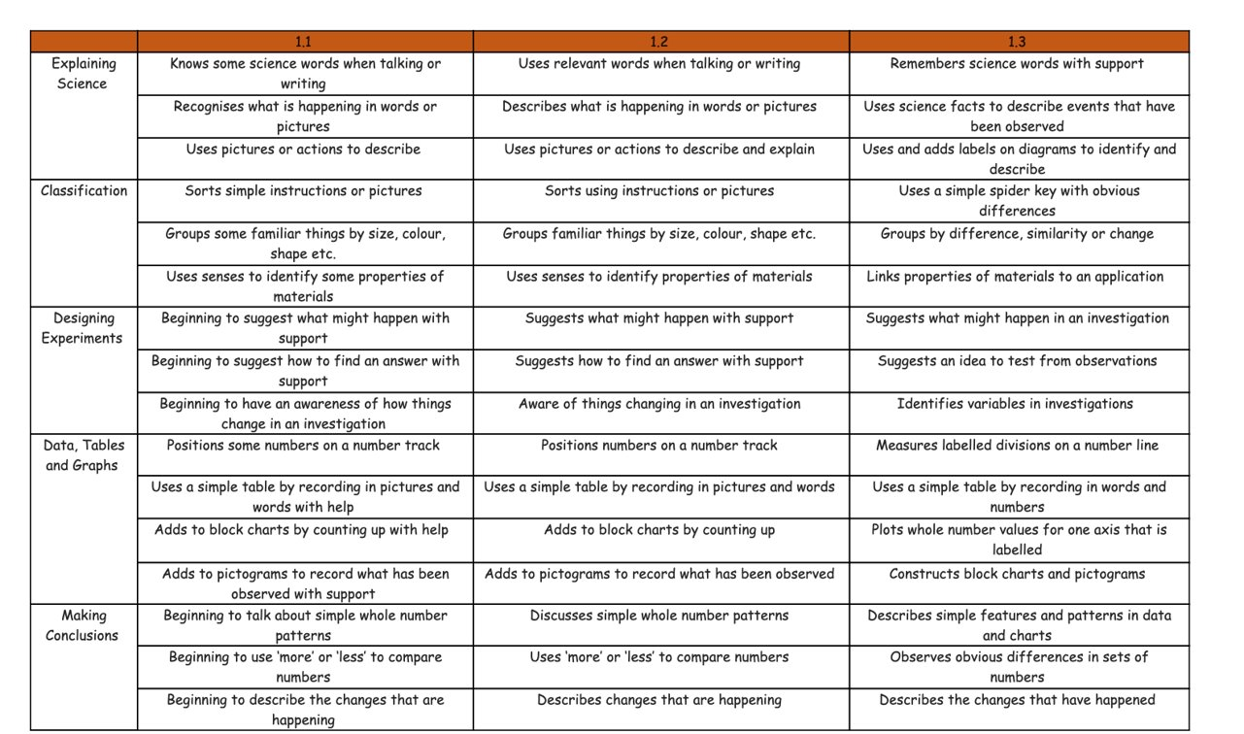
Working Scientifically Assessment Profiles

Slide 13
Planning a Scientific Enquiry – Ideas

Slide 14
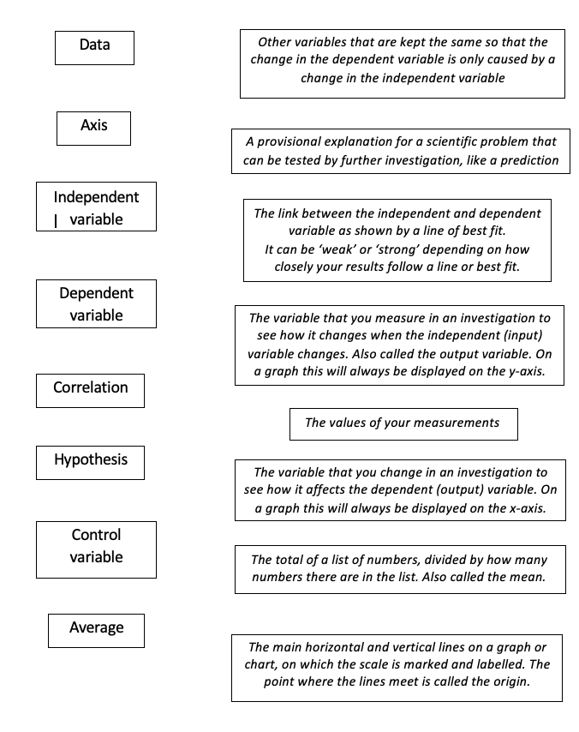
Planning a Comparative/Fair Test - Vocabulary

Slide 15
Planning Scientific Investigations
1. Ideas (What variables could we change? What variables could we measure or observe?)
2. Method (We will change… we will measure … we will keep … the same)
3. Question (When we change … what will happen to…?
4. Prediction (We think … because …)
5. Table of results
6. Graph of results
7. Conclusions (… happened, when we changed …. We think this is because …)
8. Evaluation (How fair was he investigation? How accurate were your results? What could you do next time?

Slide 16
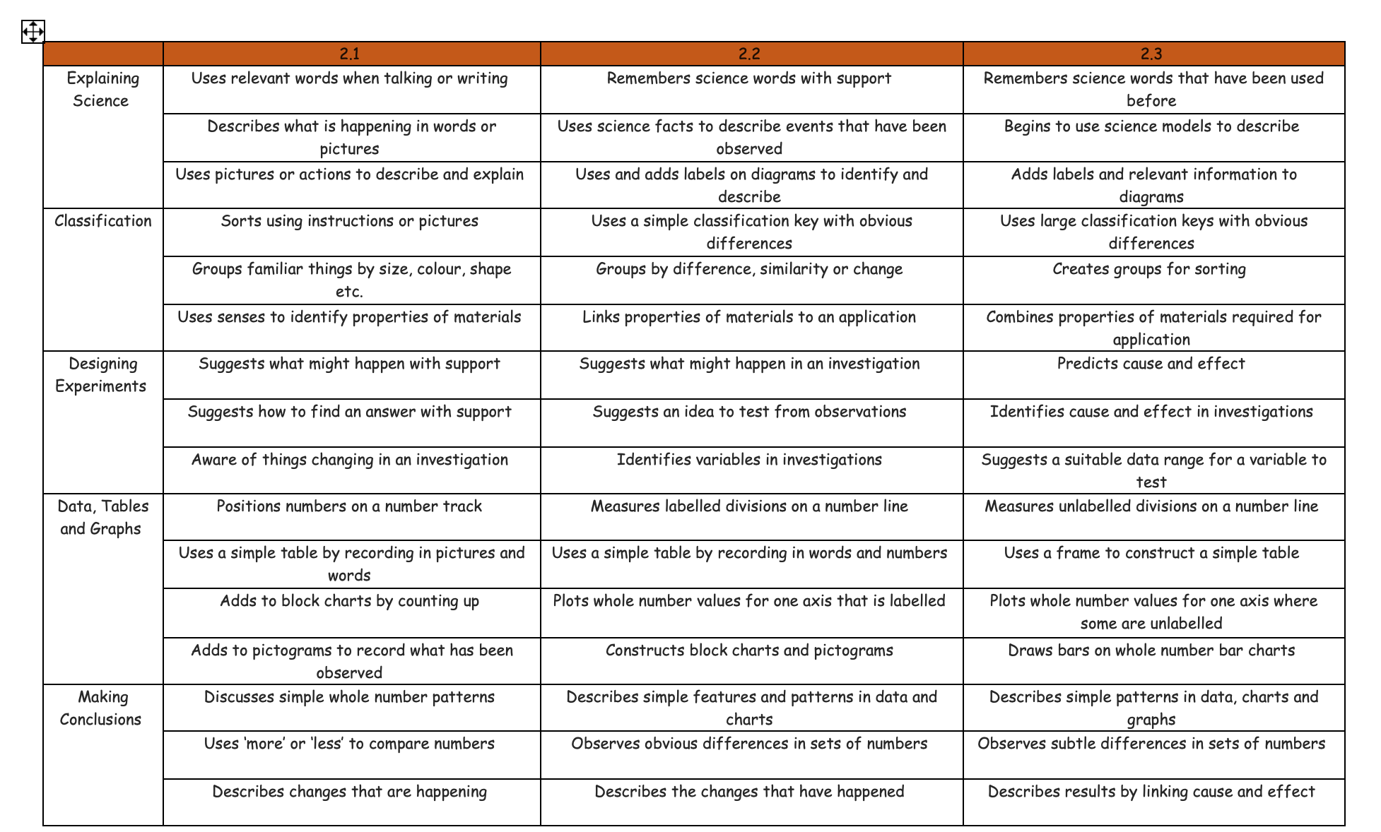
Planning Scientific Investigations
Y2 Plants: find out and describe how plants need water, light and a suitable temperature to grow and stay healthy
What do plants need to grow?

Slide 17
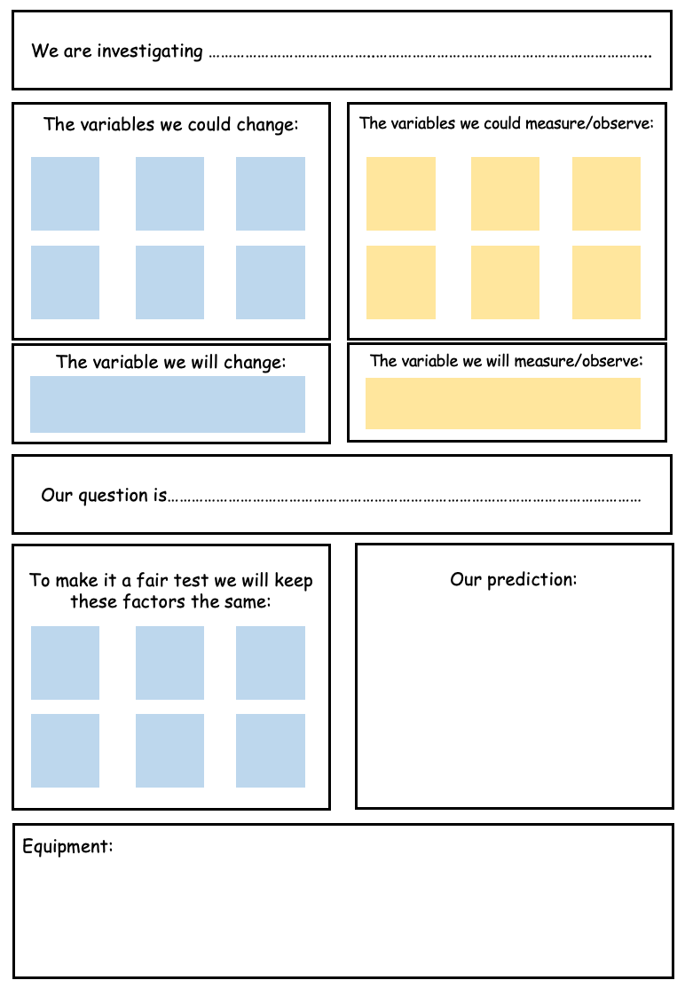
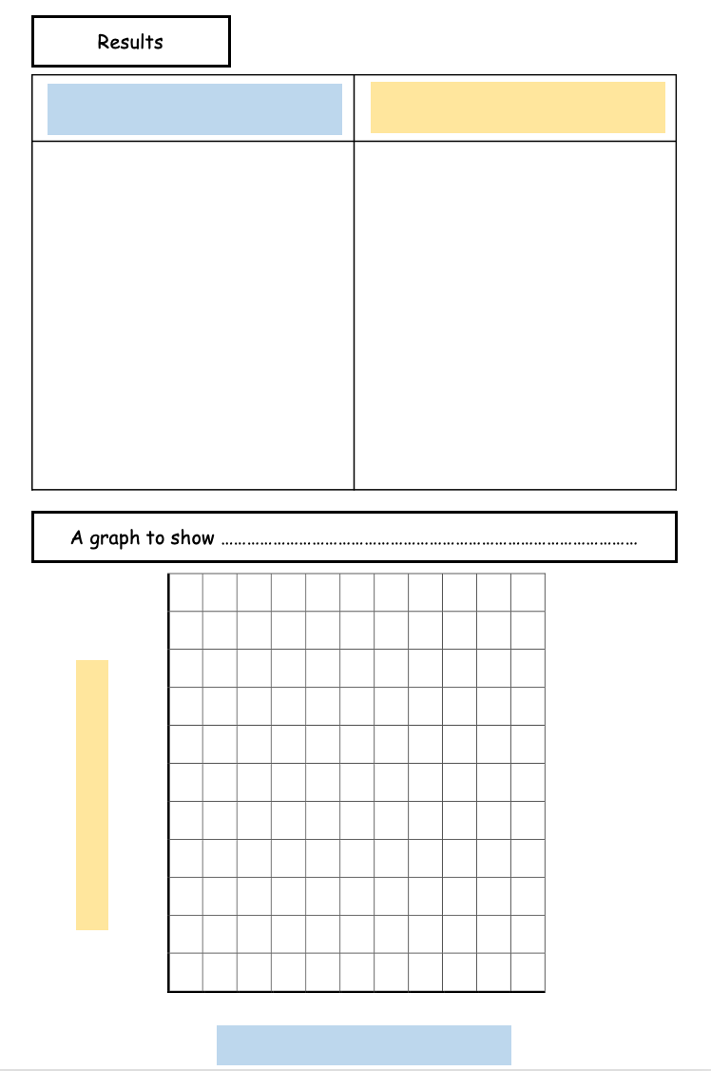
Planning Scientific Investigations

Slide 18
Planning Scientific Investigations – Health and Safety

Slide 19
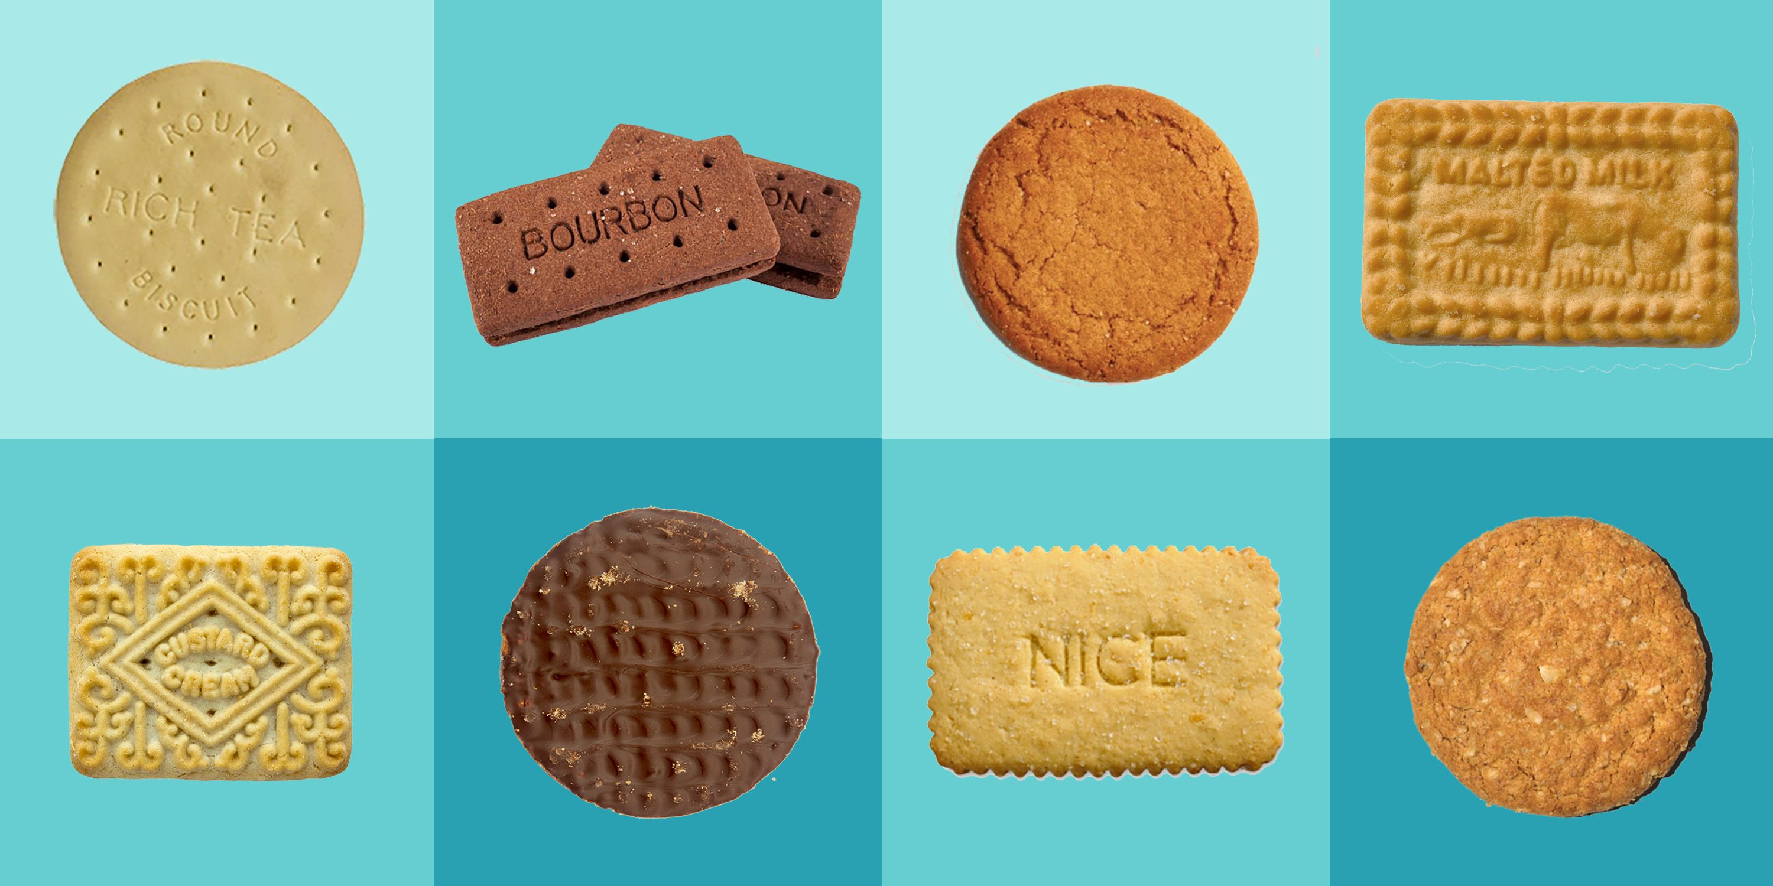
Planning a Scientific Investigation

Slide 20
Core Academic Reading • Assigned Bibliography
Pre Reading
Follow-Up Reading
3
EYFS curriculum document- birth to 5 matters
Science programmes of study: key stages 1 and 2 and 3 DfE, 2013
3
Science Knowledge For Primary Teachers, Linda Gillard, 2005
3
2/3
Primary Subjects Science: Making every child matter, Subject Associations, 2008

