Slide 2
PART 1: HOW TO THRIVE AS A TEACHER
PART 2: ECF & INDUCTION IN A SCHOOL
ECT
Induction Tutor
Mentor

Slide 3
WHAT I WISH SOMEONE HAD TOLD ME ABOUT HOW TO THRIVE AS A TEACHER

Slide 4
1. UNDERSTAND YOURSELF AND MAKE ADJUSTMENTS!

Slide 5
PUT THE 6 BLOCKS IN A COLUMN
CHALLENGE

Slide 6
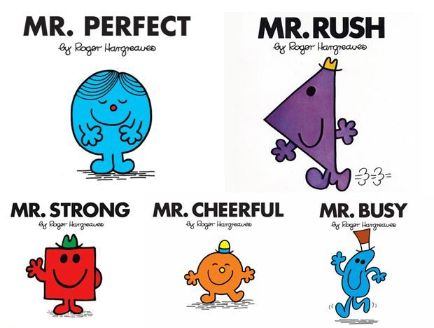
INVEST SOME TIME IN KNOWING YOURSELF… WHAT DRIVES YOU?
MR BE PERFECT
MR HURRY UP
MR BE
STRONG
MR PEOPLE PLEASER
MR TRY HARD

Slide 7
WHAT DRIVES YOU?
PUT 6 BLOCKS IN A COLUMN
"I'll sit on the floor rather than sit at a table"
"I'll have to square up the blocks exactly"
"I'll try it out horizontally first“
"I'll have to see how fast I can build the column"
"I'll look around to see who is watching me"
MR BE PERFECT
MR HURRY UP
MR BE
STRONG
MR PEOPLE PLEASER
MR TRY HARD

Slide 8
WHAT DRIVES YOU?
PUT 6 BLOCKS IN A COLUMN
"I'll have to see how fast I can build the column"
"I'll have to square up the blocks exactly"
MR BE PERFECT
MR HURRY UP
MR BE
STRONG
MR PEOPLE PLEASER
MR TRY HARD
"I'll sit on the floor rather than sit at a table"
"I'll look around to see who is watching me"
"I'll try it out horizontally first“

Slide 9
2. LOOK AFTER YOURSELF AND ESTABLISH GOOD HABITS
AT HOME AND IN YOUR HEAD

Slide 10
LOOK AFTER YOURSELF AND ESTABLISH GOOD HABITS PART 1: AT HOME AND IN YOUR HEAD
J _ _RN_ L/REFL_ _T
_AT, _LEEP, _OVE, _ELAX
CONTROL YOUR T______
“Y_ _”

Slide 11
LOOK AFTER YOURSELF AND ESTABLISH GOOD HABITS PART 1: AT HOME AND IN YOUR HEAD
JOURNAL/REFLECT
EAT, SLEEP, MOVE, RELAX
CONTROL YOUR TIME
“YET”

Slide 12
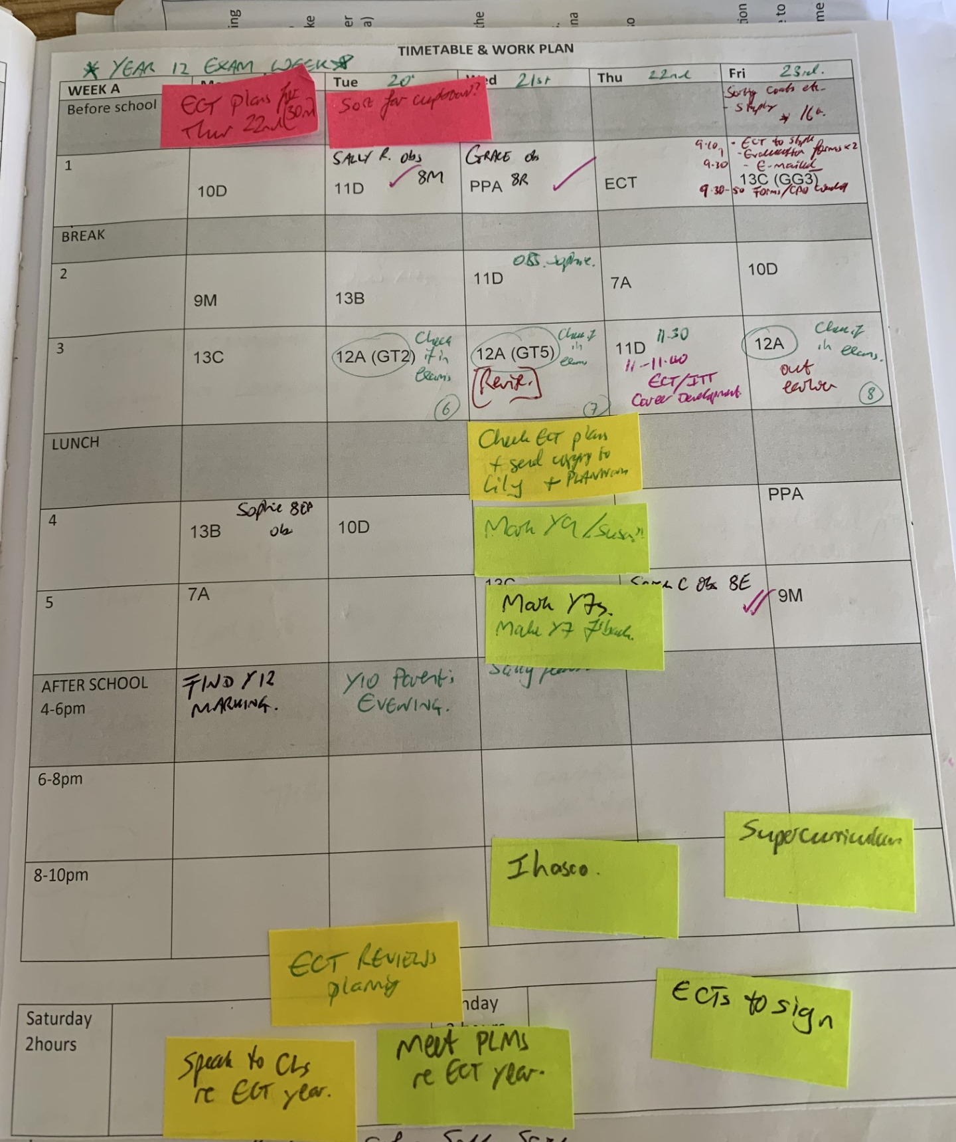
WORK PLANNER - Marking -Planning - Whole school calendar – find out when and where the ‘pinch points’ are and plan for them. - Plan when you are NOT going to work

Slide 13
LOOK AFTER YOURSELF AND ESTABLISH GOOD HABITS IN SCHOOL
INVEST IN R___________
DO THE B _ _ _ _ S WELL
DON’T TRY TO DO _ _ERY_ _ _ _G
BE CONSISTENTLY G_OD

Slide 14
LOOK AFTER YOURSELF AND ESTABLISH GOOD HABITS PART 2: IN SCHOOL
INVEST IN RELATIONSHIP
DO THE BASICS WELL
DON’T TRY TO DO EVERYTHING
BE CONSISTENTLY GOOD

Slide 16
List as many Disney Characters as you can…

Slide 17
Appropriate Body
ECT
Induction Tutor
Mentor

Slide 18
Induction
All qualified teachers who are employed in a relevant school in England must, by law, have completed an induction period satisfactorily.
Statutory induction is not a legal requirement to teach in FE or the independent sector, academies, free schools and BSOs, but may be served in these settings.
Early Career Framework (ECF) based training is expected to be embedded as a central aspect of induction.
An appropriate body (AB) has the main QA role within the induction process. The AB is responsible for checking schools have put in place an induction programme based on the ECF.
Monitoring and support throughout induction should be sufficient that there are no surprises when an ECT reaches a formal assessment point.
Find the full Induction Guidance for Early Career Teachers :
https://assets.publishing.service.gov.uk/government/uploads/system/uploads/attachment_data/file/972316/Statutory_Induction_Guidance_2021_final__002_____1___1_.pdf

Slide 19
Early Career Framework
The Early Career Framework consolidates the…
Evidence Statements: Learn that…
Practice Statements: Learn how to…
…of the ITT Core Content Framework.
It includes sections on…
Behaviour Management
Pedagogy
Curriculum
Assessment
Professional Behaviours

Slide 20
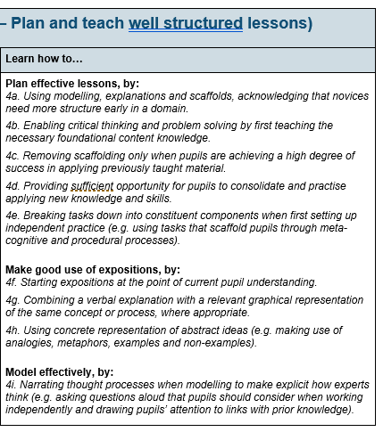
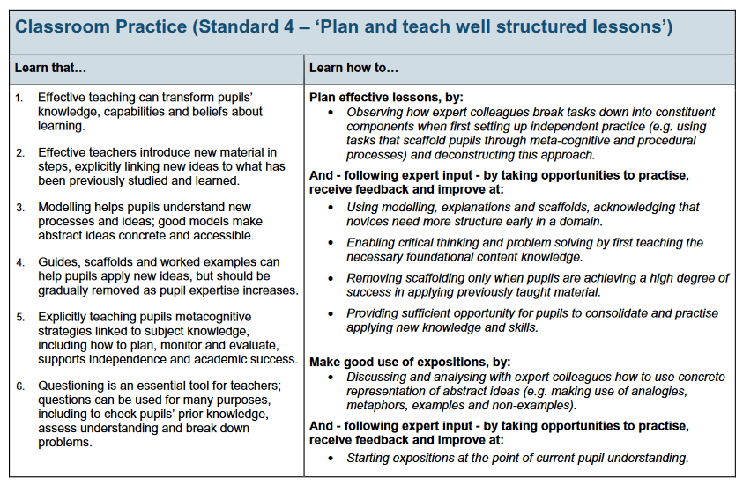
Spot the difference?
Understanding the Early Career Framework
Notes:
Opportunity to look at one standard and identify the difference – there isn’t much – part of a three year cycle of becoming increasingly confident and adept with all of these core skills.

Slide 21
Spot the difference?
ECF
ITT
Understanding the Early Career Framework
Notes:
Opportunity to look at one standard and identify the difference – there isn’t much – part of a three year cycle of becoming increasingly confident and adept with all of these core skills.

Slide 22
A typical Year 1 ECT half-term at Carmel
Week 1
Week 7
Weeks 2-6
1 hour self-directed study
1 hour mentor meeting – protected timetabled time for ECT and Mentor
2 hour ECT training provided by UCL/NETSP
Module Audit
2 hour self-directed study for Mentor training
Online Learning Community
1 hour mentor meeting
Lesson observation – teacher standards
Review with induction tutor against teacher standards
Prepare
Explore
Deliver
Critically reflect
Lesson observation
Review with induction tutor against teacher standards

Slide 23
BEING AN EARLY CAREER TEACHER
INDUCTION TUTOR
LINE MANGERS
PASTORAL CURRICULUM
MENTOR
EACH OTHER
SUPPORT
EARLY CAREER FRAMEWORK
STANDARDS BASED
WHOLE SCHOOL
CPD & EARLY CAREER FRAMEWORK
REGULAR OBSERVATIONS
INDUCTION
&
ASSESSMENT
ECF MENTOR
4 x TERMLY REVIEWS
PEER SUPPORT
2 x FORMAL ASSESSMENT REPORTS
YOUR ROUTE TO A SUCCESSFUL ECT INDUCTION

Slide 24
Impact on Early Career Teachers
BEING AN EARLY CAREER TEACHER
Comprehensive support
‘The right thing at the right time’
Opportunities to share experiences as part of a wider community
Developing career long habits and mind-sets
Acknowledges and addresses work-load concerns

Slide 25
May your work excite your heart, Kindle in your mind a creativity
To journey beyond the limits of all that has become wearisome
May your work challenge you towards new frontiers that will emerge
As you begin to approach them,
Calling forth from you the full force and depth of your undiscovered gifts.
May your work fit the rhythms of your soul,
Enabling you to draw from the invisible new ideas and a vision that will inspire.
Remember to be kind to those who work with you,
Endeavour to remain aware of the quiet world that lives behind each face.
Be fair in your expectations, Compassionate in your criticism,
May you have the grace of encouragement to awaken the gift in the other’s heart,
Building in them the confidence to follow the call of the gift.

