Slide 1
What to expect from your ECT years?

Slide 2
Our UCL ECF Programme is…..
Knowledge and research-informed
Drawn from expert theory and current practice
Designed to be experienced as a spiral curriculum
Situated in the context of the ECT
Inquiry-focused
Flexible
Delivered through communities of learning
Notes:
Our values have influenced the design of our programme in the following ways......
Our programme writers and leaders draw on their own school experience and UCL’s deep well of research into the professional learning and development needs of teachers and school leaders.
Our materials were written by UCL experts and enhanced by case studies and examples from our school-based partners. Our programme leaders, partners and training facilitators are all experienced school teachers and leaders.
We make our resources available so that ECTs and their mentors can look back and look forward. Year One covers the whole of the ECF; in Year Two, participants revisit the parts that matter most to them.
Situated in the context of the ECT
Our preferred models of mentoring – ONSIDE and educative mentoring – enable our ECTs to interpret the ECF for their own contexts, for the curricula they teach and the pupils they have. We share examples from all phases and educational settings and we are constantly working with our partners to grow this resource.
We share research summaries with participants and constantly invite them to reflect upon these in light of their own practice. In Year Two, we show our ECTs how to conduct practitioner inquiries, so they look more systematically at the impact of their teaching. Inquiry becomes how a teacher teaches, and not an additional burden.
We have scheduled the professional learning across 9 modules. The materials are open, so ECTs and their mentors can access them when they need them. Our Delivery Partners run live training sessions for us, but recorded versions are always available for anyone who needs to access the learning in that way. There are no requirements for ECTs to upload assignments to us, there are no deadlines, but we do mandate that you feed back to us at the end of each module.
UCL has built close professional partnerships with over twenty Teaching School Hubs and other ‘Delivery Partners’ across the country. We are a ‘community of learning’. ECTs and Mentors experience these communities in their clusters, where facilitators lead the training and online learning communities. UCLeXtend, our VLE, is a virtual learning community – hosting our materials, our announcements, podcasts and blogs.

Slide 3
What is the Early Career Framework?
It is an entitlement to additional support and training
A framework to support evidence-informed professional development for early career teachers
You will receive weekly training, a wealth of materials, research and guidance linked to developing your practice around the teachers’ standards
UCL (University College London) is a national provider and used by BHCET schools for their Early Career Training. Other providers such as Ambition, Teach First and EDT also provide Early Career Training.
Notes:
AMG Slide

Slide 4
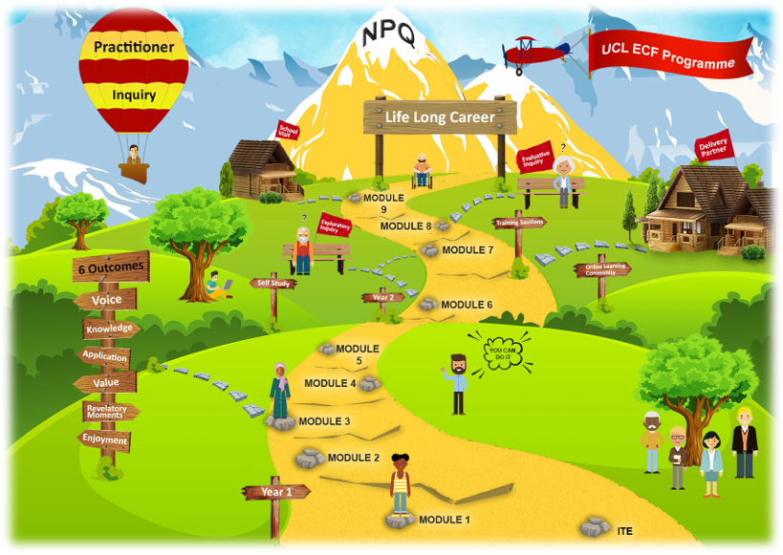
Notes:
Presented on this slide is our curriculum map
This curriculum map will be very familiar to you by the end of the programme.
It is present on UCL Extend, the VLE for this programme and on the UCL ECF webpage. It has interactive components to give participants sense of the bigger picture, the centrality of the golden thread, and of the core components of the curriculum and what they involve for the stage of programme journey.
Let’s start on the ITE stone in the bottom right of the screen-where your ECTS currently are-about to make the step into their first full year of teaching. Like you, we recognise that our ECTS join us from a variety of different starting points and know that every ECT is an individual. We would strongly encourage you to draw on the flexible nature of the programme to help your ECT build on their own development needs. I will explain more about that later on in the conference
Let’s move onto Year 1 in the bottom left of the screen
In Year 1, our ECTs build and apply their knowledge with our first five modules. Each module consists of self-study, mentor meetings, training sessions and online learning community sessions. Because we recognise that our ECTs bring a wealth of knowledge from ITE, we have provided an audit at the start of every module to help them personalise their route.
They complete the following modules:
Module 1: Enable pupil learning
Establish an effective learning environment and manage behaviour. Understand pupils as learners.
Module 2: Engage pupil learning
Appreciate the importance of prior knowledge, memory, and literacy. Expand your curriculum knowledge and subject expertise.
Module 3: Develop quality pedagogy
Plan more effective lessons. Learn how to address the needs of all pupils.
Module 4: Make productive use of assessment
Investigate the application of assessment. Learn how to give high quality feedback.
Module 5: Fulfil professional responsibilities
Explore and apply skills in working with others.
Let’s move on to Year 2
In Year 2 our ECTs deepen their knowledge through a spiral curriculum. They revisit previous content, this time personalising and extending their learning by co-creating their own questions to investigate. We call this a practitioner inquiry approach.
They complete the following modules:
Module 6: Enable pupil learning
Working with your mentor, co-create a question to investigate such as: what are the most effective non-verbal signals to help me manage behaviour? We call this an exploratory inquiry.
Module 7: Engage pupil learning
Working with your mentor, co-create a question to investigate such as: to what extent do regular quizzes help my students remember key vocabulary? We call this an exploratory inquiry.
Module 8: Evaluative inquiry focusing on ECF standards 4, 5 and 6
Select a specific area of practice to investigate in more detail. Wow your colleagues with your evaluation.
Module 9: School visits
Expand your horizons by visiting two different settings to compare with your current context.
You will note that the curriculum is designed to be a spiral curriculum. This means you will encounter the same content but increasingly complex ways. It is important to recognise that at every stage of your development as a teacher and leader will revolve around the teaching standards. This may on the surface feel like a ‘repeat’, but actually as we said earlier it is about continually developing your knowledge practice and habits in regard to these. Even the most seasoned teacher would not claim to have mastered these.
Furthermore, the education profession is constantly evolving. There is a world of pupils who will benefit from research yet to be completed by teachers like you. Take the practitioner inquiry approach with you beyond the ECT (Early Career Teacher) programme and help us to discover new ways of improving pupil outcomes.
And finally, as I said earlier the UCL ECF Programme is part of a golden thread of development, emphasised by the golden path here. It looks backwards to ITE and forward to NPQS
You can find the curriculum map on our website and UCL eXtend where you can explore it in more detail

Slide 5
Year 1.
Module 1: Enable pupil learning (Teachers’ Standards 1 and 7)
Module 2: Engage pupil learning (Teachers’ Standards 2 and 3)
Module 3: Develop quality pedagogy (Teachers’ Standards 4 and 5)
Module 4: Make productive use of assessment (Teachers’ Standard 6)
Module 5: Fulfil professional responsibilities (Teachers’ Standard 8)
Notes:
In Year 1, our ECTs build and apply their knowledge with our first five modules. Each module consists of self-study, mentor meetings, training sessions and online learning community sessions. Because we recognise that our ECTs bring a wealth of knowledge from ITT and we provide an audit at the start of every module to help ECTs liaise with their mentor to personalise and contextualise the generic aspects of the programme to each specific context.
Module 1: Enable pupil learning
Establish an effective learning environment and manage behaviour. Understand pupils as learners.
Module 2: Engage pupil learning
Appreciate the importance of prior knowledge, memory, and literacy. Expand your curriculum knowledge and subject expertise.
Module 3: Develop quality pedagogy
Plan more effective lessons. Learn how to address the needs of all pupils.
Module 4: Make productive use of assessment
Investigate the application of assessment. Learn how to give high quality feedback.
Module 5: Fulfil professional responsibilities
Explore and apply skills in working with others.
Each Module relates to content strands of ECF and to the Teacher Standards that are applied to your induction under Statutory Guidance.

Slide 6
Becoming a wonderful teacher, or a great or awesome teacher, is a lifetime affair. This is because good teaching is forever pursuing better teaching; it is always dynamic and in motion, always growing, learning, developing, searching for a better way. Teaching is never finished, never still, never easily summed up. “Wonderful Teacher” might be inscribed on someone’s lifetime achievement award, printed on a retirement party banner, or etched on a tombstone, but it is never right for a working teacher. (Ayers, 2010, p.160)
Notes:
The Early Career Framework is part of a golden thread of professional growth from initial teacher training to executive headship. Features such as the Teachers’ Standards will reoccur during the period of induction, as part of the National Professional Qualifications and in annual performance management.
At each point when you re-encounter a familiar aspect you will be at a different stage of your professional growth. You should ask yourself how that professional growth has changed your understanding and application of the feature.
We have a responsibility to engage with professional curiosity, recognising that, as teachers we are never the finished article but are learning and developing in the same way as we expect our pupils to reflect, apply and reencounter their learning.

Slide 7
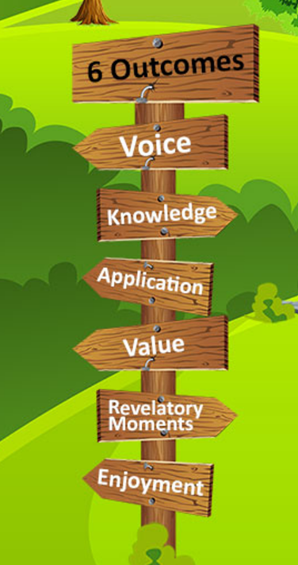
Confidence in professional voice and persona.
A strong knowledge of the evidence underpinning the ECF (Early Career Framework).
The capacity to apply research judiciously to different contexts
An appreciation of the value of engaging in professional development.
New ways of thinking and a sense of professional curiosity.
A sense of fulfilment from developing as a professional.
Notes:
There are six things we want our ECTs to take away from our programme - outlined below. We believe these six outcomes will optimise the potential of our ECTs enjoying a long and happy career in teaching. They will develop them throughout our programme and take them with them on their journey.
We call them the 6 high quality outcomes of the programme
The first outcome is that you develop a strong knowledge of the ECF framework and the research that sits behind it. The ECF framework has been designed to ensure all ECTS benefit form a shared body of knowledge that is firmly grounded in evidence based practice
The second outcome focuses on how you apply that knowledge. We are aware that the contexts of your own classrooms and students which will be very different and we are sure that in your career you may also experience lots of different settings in education, therefore, we want you to develop into reflective practitioners who can evaluate your own practice and engage in continual improvements. We focus particularly on this skill in year 2 when you do a practitioner inquiry that asks you to draw on the knowledge you have acquired in Year 1 of the programme to solve a problem of practice in your classrooms
The third outcome is that we want you to experience revelatory moments. This means we want you to open yourself up to new ways of thinking about your teaching. As Dylan Willian says, teaching is a profession that you will never perfect-but that is the beauty of it, and we want you to enjoy that challenge and the experience of learning
The fourth outcome is that we want you to see the value of professional learning. The ECF is only 2 years for full time participants but of course we hope that through the programme, you will have both the desire and skills to continue to engage in reflective practice
The fifth outcome is that we want you to enjoy developing as a profession and learn to appreciate the beauty of the craft
Lastly, and perhaps most importantly, we want you to develop your teacher persona, be surer of your purpose and be confident that the work you do is professionally, morally, and emotionally rewarding and deeply valued.

