Slide 1
Voice coaching and developing a classroom presence
Thursday 28th September 2023

Slide 2
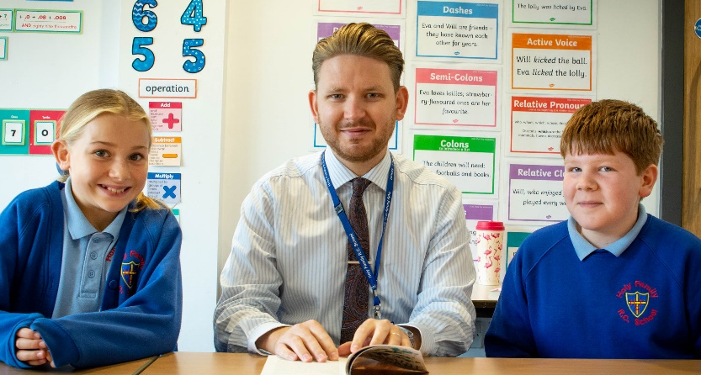
Aims:
to understand the importance of your voice in teaching and learning
to develop and use strategies to protect your voice​
to develop a more effective body language and classroom presence

Slide 3
Links to the Core Content Framework for ITT and The Teacher's Standards.
Standard 7.
Manage classes effectively, using approaches which are appropriate to pupils needs in order to involve and motivate them.

Slide 4
Please note voice and body language strengths and areas for development within your group.

Slide 5
Practice using your voice – activity 1.
Off stage - prepare to read a 2 minute script – 5 minutes
On stage - read the prepared script to the audience – 2 minutes
Off stage - analyse – your strengths and weaknesses – 3 minutes

Slide 6
Remember effective communication is:
Enthusiastic and authentic
non-verbal as well as verbal​
delivered with confidence and well prepared
clear, purposeful​ and honest
expressive, varied in format and revisits the key message(s)
avoids, "erm...","...like" and colloquialisms
Notes:
Useful activity – record/film yourself – critical friend – yourself or a family member

Slide 7
Voice exercises.
Close your mouth and start with a low hum, gradually building up to a loud hum with a wide open ‘mah’ sound. Repeat this a few times.​
Repeat these phrases in a row: unique New York; round and down; red rubber baby buggy bumpers; eee-yaaa; red leather, yellow leather.​
Pick up the newspaper, choose a story and read it aloud, to yourself, in front of a mirror.​

Slide 8
Voice exercises.
Take a clean pencil or wine cork and hold it between your teeth try these tongue twisters:​
Peter Piper picked a peck of pickled peppers.​
I slit the sheet, the sheet I slit, and on the slitted sheet, I sit.​
The sixth sheep’s sixth sheep’s sick.​
Betty Botter bought a bit of bitter butter.​
Round and round the rugged rock the ragged rascal ran.​
Sally sells seashells by the seashore​
A big black bug bit a big black bear, made the big black bear bleed blood.​
The bootblack bought the black boot back.​
Cows graze in groves on grass which grows in grooves in groves.​
Crisp crusts crackle crunchily.​
Fat frogs flying past fast.​
Fred fed Ted bread, and Ted fed Fred bread.​
Freshly fried flying fish, freshly fried flesh.

Slide 9
Forget speed and focus on articulation.
Warm up your voice.
Use proper breath support.
Do not strain your voice.
Use facial expressions.
Gesture naturally.
Make eye contact.
Use pauses effectively.
Vary your vocal pitch.
Use volume strategically.

Slide 10
Articulation or diction.
Articulatioin or diction is important as it is crucial to ensuring the listener understands and does not just hear.
Clear pronunciation is needed.
Pace needs to be slow.

Slide 11
Pitch.
Your voices has many notes called pitches.
Vocal variety is important.
Use higher and lower notes.

Slide 12
Rate of speech.
If you speak too quickly the audience may well tune out.
Take breaths.
Pause, add suspense and silence as required.

Slide 13
Try again to deliver your two minute speech activity 1 (try 2).
Have you noticed any improvement in the delivery of your two minute speech, having taken note of suggested ways to improve delivery?

Slide 14
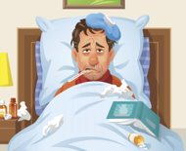
Consequences of mis-using your voice.
Notes:
Absence - £15m​
Loss of Voice​
Permanent damage to the vocal cords​
Destroys your effectiveness as a teacher​
Microphone​

Slide 15
https://www.vocalzone.com/the-record-blog/v-team-vocal-care/vocal-exercises-teachers/#:~:text=Close%20your%20mouth%20and%20start,%3B%20red%20leather%2C%20yel​

Slide 16
2. Classroom presence.
Video can be useful.
How you think you present yourself may not be how others see you.
enter the corridor, the room or the building with confidence
be aware of your stature, stand tall, hold your head high and smile
make eye contact with those you meet
use the space effectively, "walk the room" purposefully
if the above does not come naturally - practice, model yourself on those who do this well etc.

Slide 17
Practice (during break/lunch).
walking into the hall
taking a seat
walking on to the stage
relaying instructions to your peers

Slide 18
The power of body language and use of voice.

Slide 19
Benjamin Franklin (1706-1790).
"If you fail to prepare, you are preparing to fail".
Franklin was a polymath, writer, scientist, inventor, statesman, diplomat, printer, publisher and political philosopher.

Slide 20
An example of highly effective use of voice.

Slide 21
Body language signals.
Crossing your arms.
Defensive?
Annoyed?
Closed off?
Insecure about the situation?

Slide 22
Body language signals.
Head tilt.
Listening?
Interested?
Concentrating?

Slide 23
Body language signals.
Standing straight.
Confident?
Self-assured?
If you are tall and do not stand straight you may appear unconfident, trying to disappear.....
If you are small and you don’t stand up straight you may be missed.....

Slide 24
Body language signals.
Tapping fingers/pencil/other fidgeting behaviours:
Nervous?
Impatient?
Annoyed?

Slide 25
Body language signals.
Walking briskly.
Confident?
Purposeful?
Self-assured?
Avoiding something? If the pace is very brisk?
Walking very quick – uninterested, avoidance, not my responsibility etc?
Headphones on, hood up, mask when not required....?

Slide 26
Body language signals.
Looking down.
Unconfident?
Avoiding the situation?
Unsure?
Submissive?

Slide 27
Body language signals.
Eye contact (apparently 3 seconds with a stranger/longer with someone you have met is the norm).
Comfortable?
Want to engage?
If you find it hard to maintain eye contact then look to the side rather than down.
Staring may seem aggressive unless accompanied by a smile and other positive gestures.

Slide 28
Body language signals.
Breathing.
Rapid – Rushing? Fear? Unfit? Reactive?
Slow and controlled – In control? Weighing up the situation? Not reacting?

Slide 29
Undertake your own personal analysis.
Are there any of the previously noted body language signals that would I benefit from possibly working on?

Slide 30
The importance of body language and the use of voice in behaviour management.
If you are able to manage body language, and the use of your voice, effectively it will enable you to manage situations well and also to defuse any challenging situations that may occur.
These skills can be acquired!

Slide 31
Managing stressful situations.
Take deep, controlled breaths, practice meditation etc.
Stretch, exercise etc.
Sleep and regularity of sleep.
Healthy eating.
Connect with others and plan ahead.
Avoid excess (alcohol/substance abuse).
Unwind and timetable some, "time out".

Slide 32
Managing pupil behaviour well to reduce stressful situations developing.
Do not over-react.
Do what feels correct.
Be consistent.
Be fair and explain.
Be positive about the good things.
Use rewards and sanctions appropriately.
Move on.

Slide 33
De-escalation techniques.
Neutral body language and voice.
Move ... if possible?
Avoid judgement, be empathetic.
Avoid over-reaction , drama etc.
Respect personal space.
Ignore challenging questions.
Set clear boundaries but choose them wisely - if this happens X will happen ….
Allow time and allow silence.

