Slide 1
Welcome and Professionalism
September 2023

Slide 2
Outline of the day
9.30 – 10.45 – Induction
10.45 – 11.00 – Diocesan Deputy Director
11.00 – 11.30 – Photographs and networking
11.30 – 12.15 – Induction 2
12.15 - 13.00 – Lunch
13.00 – 13.30 – NASUWT
13.30 – 15.00 – Statutory Training

Slide 3
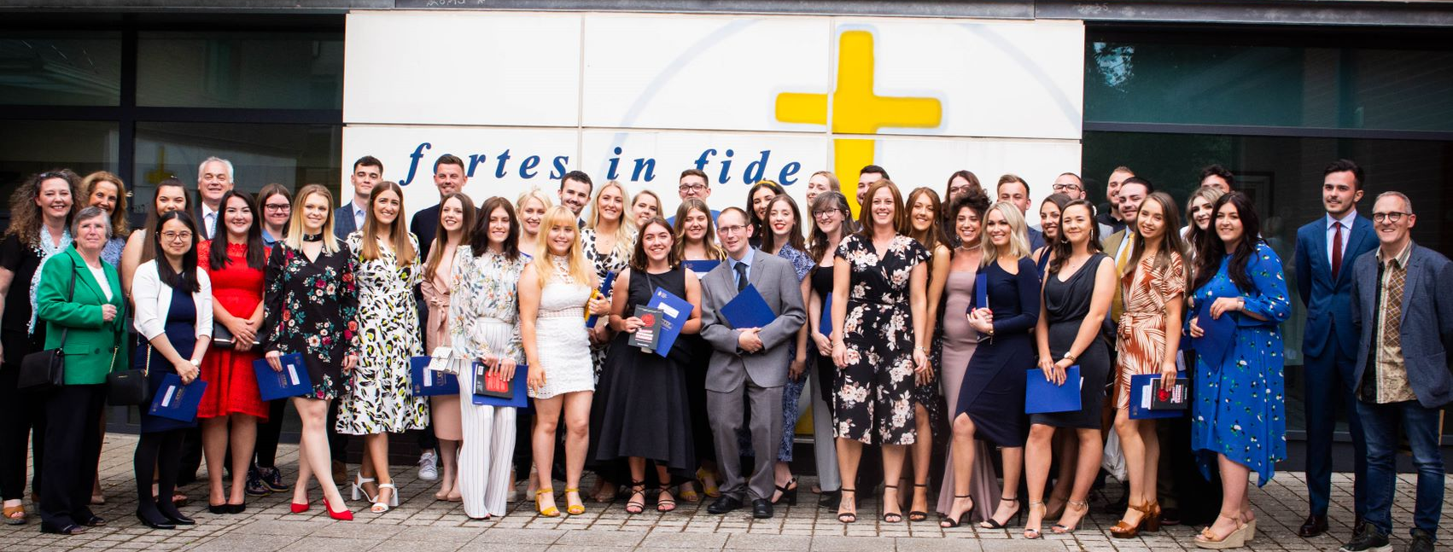
Meet the Central Team
Monica Shepherd CTTP Director / Secondary Lead
mshepherd@carmel.bhcet.org.uk 01325 523460
Iain Knox Primary Lead
iknox@carmel.bhcet.org.uk 01325 523460
Lily Bonas CTTP Admin
lbonas@carmel.bhcet.org.uk
01325 523474
Mike Shorten Deputy CEO of Bishop Hogarth Catholic Education Trust
Monita Atkinson Director of Teaching School matkinson@carmel.org.uk
Marielle Thonnart ITT Lead mthonnart@carmel.org.uk
Frances Shorten Primary Lead fshorten@carmel.org.uk 01325 523460
Claire Hutton TS Admin Manager chutton@carmel.org.uk 01325 523474
Tyler Holmes Trust Project Manager tholmes@carmel.org.uk 01325 523474

Slide 4
Documentation
Pink forms – Safeguarding checklist
Qualifications etc
Contact information

Slide 5
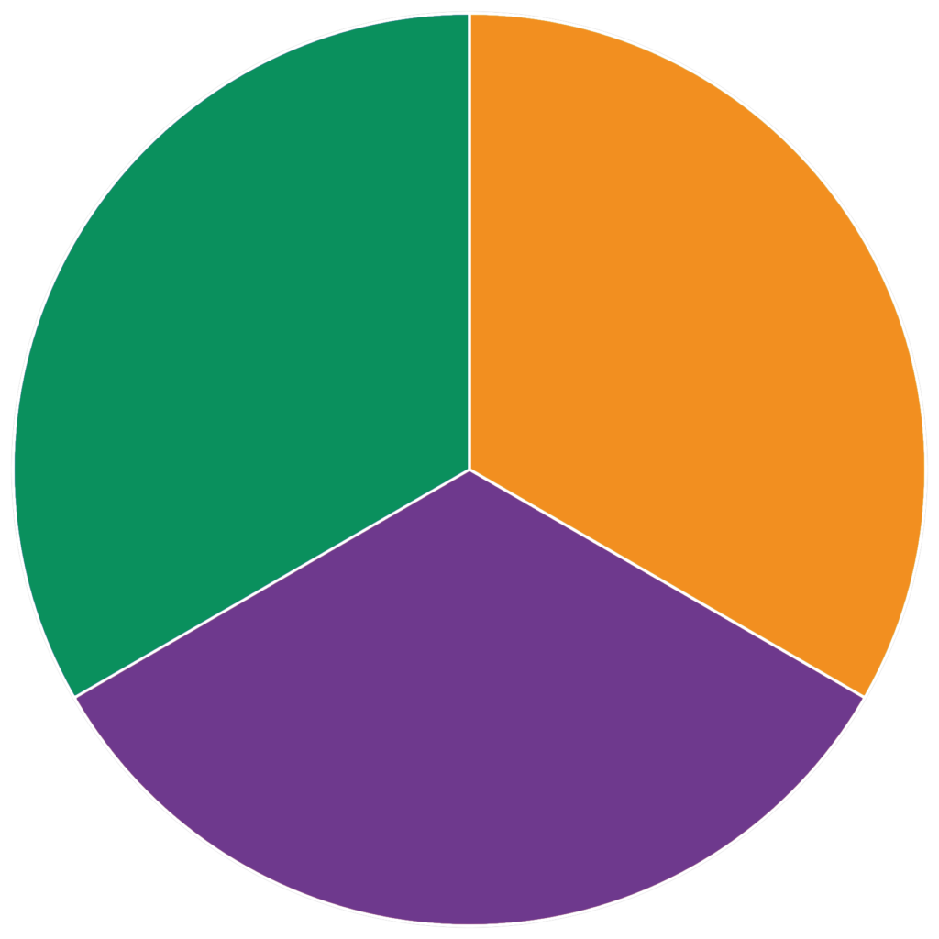
A year in CTTP
Across the year . . .
Main school Placements
Second School Placement
June 25th finish
SSP
Term 2
CTTP
Term 1
CTTP
For each half term . . . .
Central Training
School Based training
1 Partnership Link Tutor visit
1 Trainee Progress Report
QA in schools
Evidence Presentation
Bench Mark
Term 3
June 25th 2024
Final Assessment
Notes:
Take us through till lunch 12.00 – 12.30pm

Slide 6
For each half term:
1: Weekly Mentor / PT meetings
2: Weekly personalised targets - Reflective Journal/Training Handbook
3: Lesson observations of you teaching -minimum 1 a week.
4: Professional discussions to meet the Teaching Standards.
5: Focusses observations – Training Handbook
6: Subject audits updated and task banks completed
7: School Based training including observations of colleagues.
8: Academic study-PGCE and MASTERS
9: A Partnership Link Tutor (PLT) visit
10: Trainee Progress Report (TPR) updated

Slide 8
https://carmelteachertraining.com/documents/
cttp2324

Slide 10
6 Layers of Support
“
”
Support
Trainees say mentors, PTs and PLTs are ‘incredible’, ‘outstanding’ and ‘brilliant’. OFSTED Report, 2018
Guide
Nurture
CTTP Central Team
Advise
Partnership Link Tutor
Trainers & Subject Tutors
Motivate
Lead School
Professional Tutor
Mentor
Help

Slide 11
Who to go to . . .
1 - You were off sick ?​ 2 - You disagreed with your mentor ?​ 3 - You were finding things difficult in school ?
4 - You didn’t think the school were fulfilling your training requirements ?​
CTTP Central Team
Partnership Link Tutor
Trainers & Subject Tutors
Lead School
Professional Tutor
Professional Tutor
Mentor
Mentor

Slide 12
Documentation
Initial Needs Analysis
Audits

Slide 13
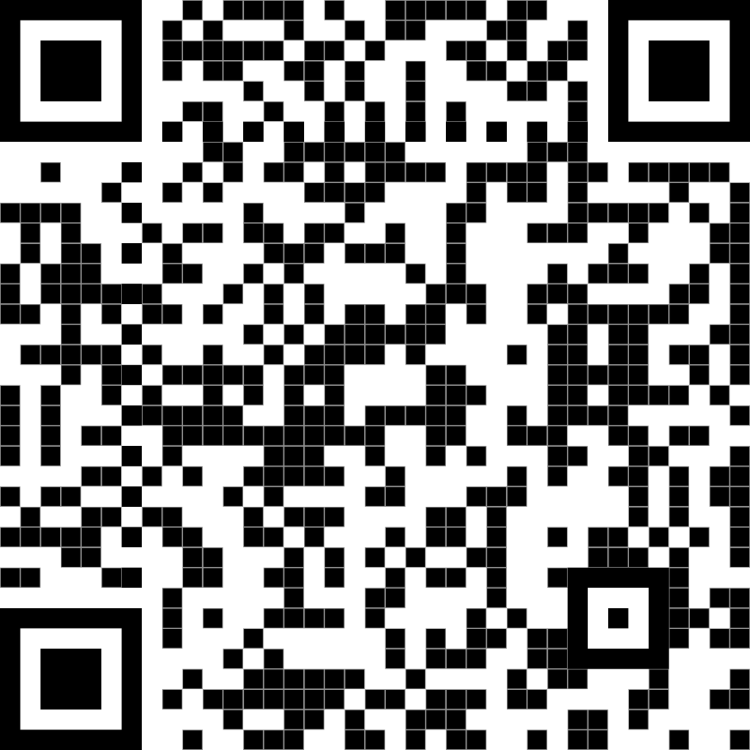
Library Registration online
- If required
https://forms.office.com/r/d3NX7CE5ed

Slide 14
Central Training
Centrally based
Whole cohort
PGCE
Cluster based

Slide 15
Stages of Learning ?
Conscious Incompetence
Unconscious Competence
Unconscious Incompetence
Conscious Competence
Notes:
Novice, Advanced beginner, proficient - expert

Slide 16
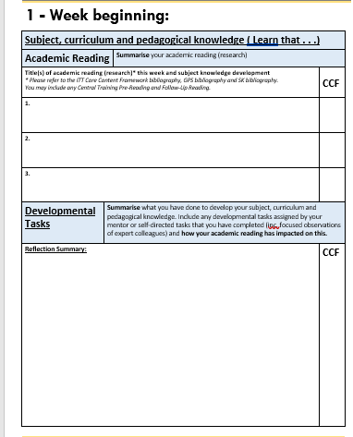
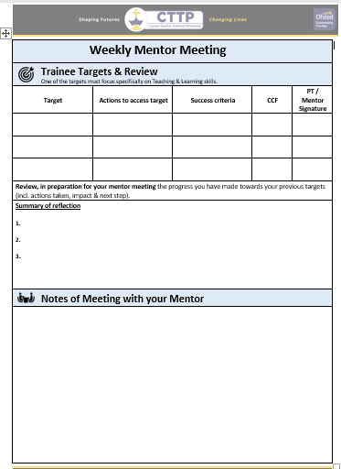
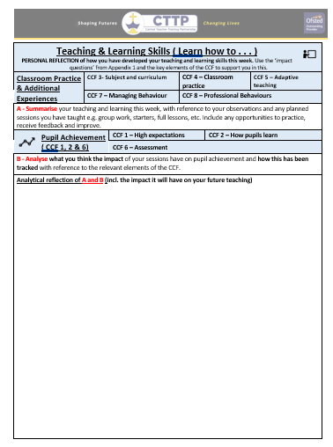
Reflective Journal
Analytical reflections
Linked to academic reading
Showing impact
Showing progression
Linked to CCF

Slide 20
Targets to be transferred to the Training Handbook.
Initially from Audits and INA.

Slide 22
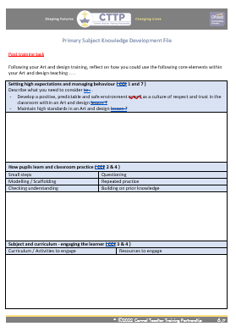
Audits . . .
Pre course task
Pre training task
Post training task

Slide 23
Professionalism

Slide 24
Role of the Teacher
Teaching & Learning
Pastoral Role
Educational
Enrichment
Role
Model
Planning and preparing lessons.
Supporting the hidden curriculum- emotional, social, moral development
Delivering the wider curriculum -PSHE, extra-curricular activities etc
Demonstrating positive attitudes, values and behaviours
Teaching pupils- meeting educational needs
Assessment of pupil progress​.

Slide 25
Part Two of the Teaching Standards: Personal and professional conduct
Upholding the level of professional practice –be mindful of your own use of language.
Part Two: A teacher is expected to demonstrate consistently high standards of personal and professional conduct. The following statements define the behaviour and attitudes which set the required standard for conduct throughout a teacher’s career.
Teachers uphold public trust in the profession and maintain high standards of ethics and behaviour, within and outside school, by:
treating pupils with dignity, building relationships rooted in mutual respect, and at all times observing proper boundaries appropriate to a teacher’s professional position
having regard for the need to safeguard pupils’ well-being, in accordance with statutory provisions
showing tolerance of and respect for the rights of others
not undermining fundamental British values, including democracy, the rule of law, individual liberty and mutual respect, and tolerance of those with different faiths and beliefs
ensuring that personal beliefs are not expressed in ways which exploit pupils’ vulnerability or might lead them to break the law.
Scenarios

Slide 26
Teachers' Professional Duties ? ? ? ? ?
Make a list of the top 9 professional duties of a teacher.

Slide 27
Teachers' Professional Duties
https://www.gov.uk/government/publications/school-teachers-pay-and-conditions
Teaching:
Planning and preparing courses/lessons
Promoting the development of abilities and aptitudes of pupils
Teaching pupils according to educational needs (including setting and marking work)
Assessing, recording and reporting on the development, progress and attainment of pupils
Working Time:
In maintained schools be available to work 195 days of which 190 are days when you are required to teach in addition to carrying out other duties, in any school year.
Be available to perform such duties at the times and in the places as prescribed/directed by the Head for 1265 hours in any school year. Time spent travelling to and from the place of work does not count against the 1265 hours.

Slide 28
Professionalism
The same expectations as a member of staff.
Dress Code​
Hours on site​
Duties​
Meetings​
Request for absence​
Emails​
Contacting Parents​
Registers​
Events​
Ethos
Social Media

Slide 29
Social Networking
Public profile
Privacy setting
Applying for jobs
Professionalism e.g. school absence
Contact with pupils – misconstrued grooming

Slide 30
We are all teachers of literacy- how well do you speak?
Accent is acceptable
YOUS
ALOT
REDCHESTER
LIKE
SHOULD OF
WRITTEN/WROTE
TAKEN/TOOK
THEIR/THERE
WHERE/WERE/WEAR

Slide 31
The first week- school induction information
The school day- lesson and break times, start and end of day protocols etc
Meeting colleagues…. names and responsibilities (Staff Handbook)
School context​
Policies ​and procedures
Health and Safety​
Fire drills​
Do’s and don’ts
Do you know . . . .???

Slide 32
First half term: September – October
Early training experiences across the school R-Y6 / Department KS3-4
Observations of teaching staff (focused-observations to complete)
20%- 30% teaching: 1-to-1, small group, team teaching, whole class...
School-based training - 1 hour weekly meeting with Mentor and PT
Weekly timetabled lesson observation.
Central training – mainly Thursdays (S) / Fridays (P) but some Wednesdays.
Review of subject audits with Mentor.
Agree training schedule- teaching in 2/ 3 age ranges over the year (R-Y6) (KS3 – 4)
Partnership Link Tutor first school visit to review your progress.
One day a week release ( or equivalent, separate to Central Training ) for academic study ( min. 2 hours ) and planning, preparation and assessment (PPA)

Slide 33
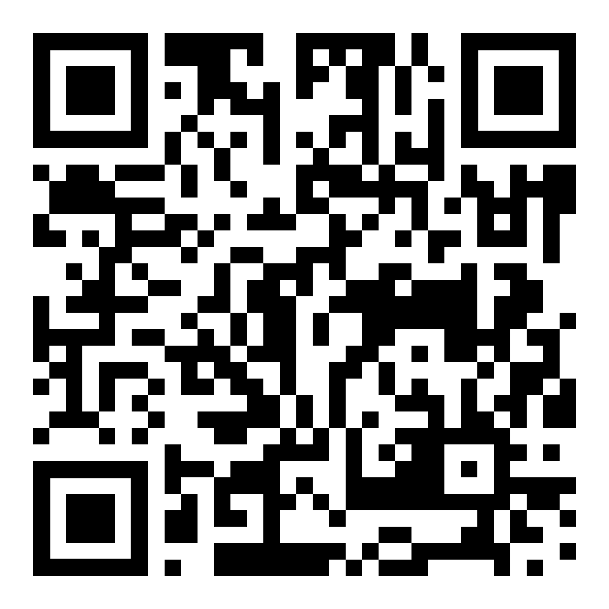
Chartered College
https://chartered.college/join/student-membership/
Coe, R., Aloisi, C., Higgins, S., & Major, L. E. (2014) What makes great teaching. Review of the underpinning research. Durham University: UK and the EEF Teaching and learning Toolkit : *Education Endowment Foundation (2018) Sutton Trust-Education Endowment Foundation Teaching and Learning Toolkit

Slide 34
Post Graduate Certificate of Education Modules Level 7
Training:
Module 1
Module 2
Supporting Individual Needs
Planning for Progression
1 full-day induction day at Carmel College, including academic writing training
2 full-day training days at Carmel College.
Online tutorial.
2 full-day training days at Carmel College.
Online tutorial.
Notes:
Kiranshastry
Srip

Slide 35
Unions
You must be a member of a union – free to trainees
Legal Support
NASUWT – National Association of Schoolmasters and Union of Women Teachers www.nasuwt.org.uk/WhyStudentsShouldJoin
National Education Union https://neu.org.uk/contact-us

Slide 36
Keeping Children Safe in Education – KCSIE 2023

Slide 37
KCSIE
Everyone who comes into contact with children and their families has a role to play in safeguarding children
All should ensure that their approach is child-centered/best interests of the child
Everyone has a role to play in identifying concerns, sharing information.
Early Help – early identification of emerging problems and assessment
Notes:
No single professional can have a full picture of a child’s needs and cicumstances

Slide 38
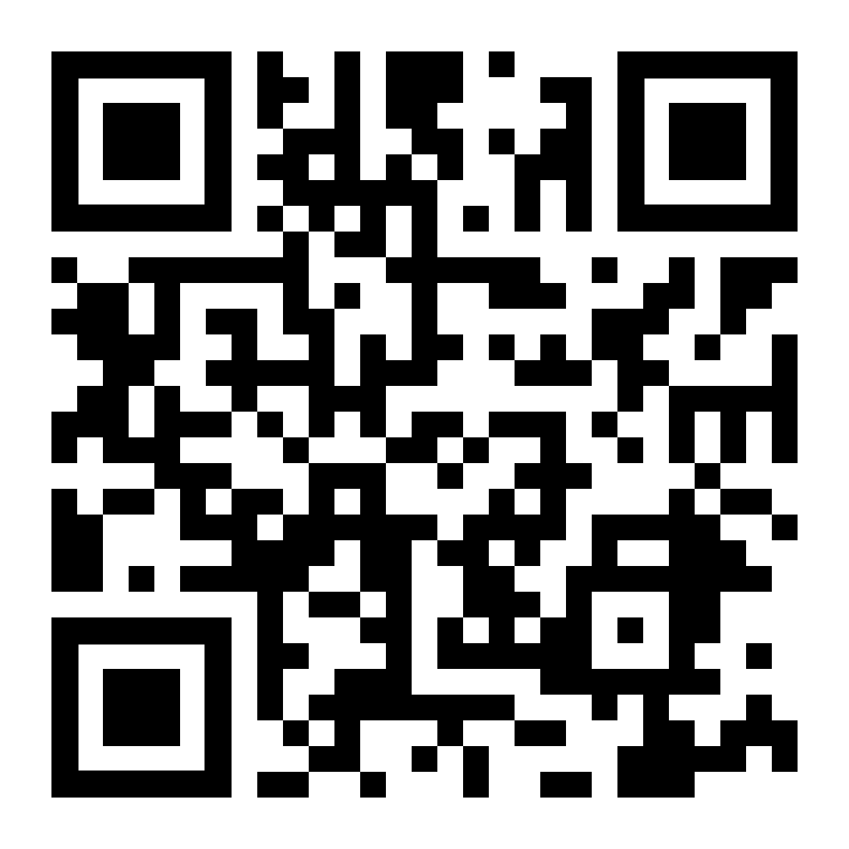
IHASCO
Please complete 1 and 2 by Monday 11th September.
Please complete 3,4 and 5 by Monday 18th September.
Links to new email
Safeguarding Children (KCSIE)
Prevent
GDPR
Health and Safety Essentials
Cyber Security
https://app.ihasco.co.uk/30lyyz

