Slide 1
Crisis Management Training
Tom Shorten
BHCET Student Engagement Lead
(Previous AP Manager)
Advanced Attachment and Trauma Trained
Advanced Team Teach Trained
Advanced Knifecrime and Weaponry Trained
Advanced Child Exploitation and Trafficking Trained
Advanced Behaviour Management Trained

Slide 2
confidentiality
Anything we discuss is with confidence, and does not leave the room.
You may leave the room at any point.

Slide 3
About me
Special School Team
Secure Unit Team Member
CLA Team Member
Alternative Provision Manager
Crisis Team Manager
Trust Student Engagement Lead

Slide 4
What will we cover today?
What is Attachment?
Attachment Styles
Attachment Behaviour within a school setting
Behaviour Management
Crisis Behaviour
Life Threatening Behaviour
Keeping ourselves safe

Slide 5
What is attachment?

Slide 6
What is attachment?
Attachment is a clinical term used to describe "a lasting psychological connectedness between human beings” (Bowlby, 1997).
In particular, attachment theory highlights the importance of a child’s emotional bond with their primary caregivers. Disruption to or loss of this bond can affect a child emotionally and psychologically into adulthood, and have an impact on their future relationships.

Slide 7
Why is attachment important?
Only specially trained and qualified professionals should assess a child’s attachment style. However, it’s important for all adults working with children to understand what attachment is and know how to help parents and carers become attuned to their child’s needs.
You might do this by working with them directly, or by signposting families to other appropriate services. In the long term, this can help improve wellbeing and provide positive outcomes for both the child and their caregivers.

Slide 8
Stages of attachment

Slide 9
Stage 1 – before birth
During the time before birth, parents and carers can form a bond with their child.
Any bonds formed before birth can have a positive impact on the relationship between babies and their caregivers once the child is born (Condon and Corkindale, 1997).

Slide 10
Stage 2 – birth until 6 weeks
This is sometimes referred to as the pre-attachment phase because the baby doesn’t appear to show an attachment to any specific caregiver.
However, parents and carers who provide a nurturing environment and are responsive to their babies needs can lay the foundation for secure attachments to form (Bowlby, 1997).

Slide 11
Stage 3 – 6 weeks until 6-8 months
During this stage of their development, a baby might start to show a preference for their primary and secondary caregivers (often the mother and father).
Who would the primary caregivers be?
Who would the secondary caregivers be?

Slide 12
Stage 4 – 6-8 months until 18 months – 2 years
During this period a child begins to show a strong attachment to their primary caregivers.
Babies start to develop separation anxiety during this phase and can become upset when their caregiver leaves, even for short periods (Bowlby, 1997).

Slide 13
Stage 5 – 18 months – 2 years onwards
At this point children are likely to become less dependent on their primary caregiver.
Particularly if they feel secure and confident the caregiver will return and be responsive in times of need (Bowlby, 1997).

Slide 14
TYPES OF ATTACHMENT

Slide 15
What does secure attachment look like?
In secure caregiver-child relationships, the caregiver is usually sensitive and tuned in to the child’s needs. They are able to provide care that is predictably loving, responsive and consistent.
Young children who have formed a secure attachment to their caregiver may display the following patterns of behaviour during times of stress or exploration:
proximity maintenance – wanting to be near their primary caregiver
safe haven - returning to their primary caregiver for comfort and safety if they feel afraid or threatened
secure base – treating their primary caregiver as a base of security from which they can explore the surrounding environment. The child feels safe in the knowledge that they can return to their secure base when needed
separation distress - experiencing anxiety in the absence of their primary caregiver. They are upset when their caregiver leaves, but happy to see them and easily comforted when they return
(Ainsworth et al, 2015)¹⁰.

Slide 16
Benefits of secure attachment
When caregivers react sensitively to ease their child’s distress and help them regulate their emotions, it has a positive impact on the child’s neurological, physiological and psychosocial development (Howe, 2011)¹¹.
Children with secure attachments are more likely to develop emotional intelligence, good social skills and robust mental health (Howe, 2011)¹².

Slide 17
Effects of insecure attachment
Not receiving comfort and security in the early years can have a negative effect on children’s neurological, psychological, emotional and physical development and functioning (Newman, 2015)¹³.
Babies and young children who have attachment issues may be more likely to develop behavioural problems such as attention deficit hyperactivity disorder (ADHD) or conduct disorder (Fearon et al, 2010)¹⁴.
Children who have attachment issues can have difficulty forming healthy relationships when they grow up. This may be because their experiences have taught them to believe that other people are unreliable or untrustworthy (Bowlby, 1997)¹⁵.
Adults with attachment issues are at a higher risk of entering into volatile relationships and having poor parenting skills, behavioural difficulties and mental health problems (Howe, 2011)¹⁶.

Slide 18
How do childhood experiences affect brain development?
Our brains develop from before birth and into adulthood (Siegel and Bryson, 2012). But there are key ‘sensitive periods’ during early childhood and adolescence where children and young people’s brains are more affected by positive or negative experiences (Shonkoff et al, 2008).
What happens in a child or young person’s life during these periods can have a significant effect on their brain development.
Positive experiences throughout childhood help to build healthy brains, while experiencing childhood trauma and abuse can harm a child’s brain development (Shonkoff et al, 2015).
But our brains always have the potential to change and grow. It’s never too late to give a child or young person positive brain building experiences.
Having caring relationships and access to support services can reduce the harmful effects of negative experiences and help a child’s brain develop in a healthy way (Shonkoff et al, 2015).

Slide 19
Understanding attachment in the early years
Children can form attachments with more than one caregiver, but the bond with the people who have provided close care from early infancy is the most important and enduring (Bowlby, 1997)².
It’s important that parents and carers are attuned and responsive to their baby’s needs and are able to provide appropriate care. This includes recognising if their baby is hungry, feeling unwell or in need of closeness and affection (Howe, 2011)³.
Forming an attachment is something that develops over time for a child, but parents and carers can start to form an emotional bond with their child before they are born. Sometimes a parent or carer may have difficulty forming this bond, for example if they are experiencing mental health issues or don’t have an effective support network.

Slide 20
Factors affecting attachment
Some circumstances can make it more challenging for a child and their caregivers to form a pattern of secure attachment. These may include:
abuse, maltreatment and trauma experienced by the parent or child
parental mental health difficulties
parental substance misuse
the child having multiple care placements
parents being separated from their baby just after birth, for example if the baby is receiving neonatal care
stress such as having a low income, being a single parent, or being a young parent
bereavement or loss of another caregiver that a child had an attachment with
(Bowlby, 1989)¹⁷.

Slide 21
Signs that a child may have attachment issues – stage 1 out of 2
Children’s behaviour can be influenced by a wide range of circumstances and emotions.
Indicators that a baby or toddler might not have a secure attachment with their caregiver will emerge as a pattern of behaviour over time, particularly during moments of stress or exploration. This pattern might include:
being fearful or avoidant of a parent or carer
becoming extremely distressed when their carer leaves them, even for a short amount of time
rejecting their caregiver’s efforts to calm, soothe, and connect with them
not seeming to notice or care when their caregiver leaves the room or when they return
being passive or non-responsive to their carer
seeming to be depressed or angry
not being interested in playing with toys or exploring their environment

Slide 22
Signs that a child may have attachment issues – stage 2 out of 2
As children with attachment issues get older, these behaviour patterns might evolve. As well as being evident during times of stress, some behaviours may start to become obvious at other times. These may include the child:
finding it difficult to ask for help
struggling to form positive relationships with adults and peers
struggling to concentrate
struggling to calm themselves down
both demanding and rejecting attention or support at the same time
becoming quickly or disproportionately angry or upset, at times with no clear triggers
appearing withdrawn or disengaged from activities
daydreaming, being hyperactive or constantly fidgeting or moving
(Mentally Healthy Schools, 2020)¹⁹.
If you think a child may have attachment issues, you should refer them to a suitably trained health and social care professional for a full assessment. You should follow your organisation’s procedures to make a health and social care referral, or contact your local authority children’s social care services.

Slide 23
trauma
WHAT IS TRAUMA?

Slide 24
TRAUMA AND ATTACHMENT
The signs of attachment issues can be similar to indicators that a child is experiencing other challenges, such as:
mental health problems
additional needs
abuse and neglect.
This means it’s important to consider everything that’s going on in a child’s life and make sure they and their family are provided with appropriate support.
Think about all your previous experiences with the child and their caregivers, to help you build a clear picture of their relationships and recognise any concerning patterns of behaviour.

Slide 25
THE IMPACT OF TRAUMA AND ATTACHMENT
Children who have experienced abuse, neglect and trauma might develop coping strategies that can make it more complicated to recognise attachment issues.
For example, one sign of secure attachment is that children see their caregiver as a secure base to explore from. But children who have experienced neglect, for example, might display independent behaviour in order to protect themselves from the emotional pain of not having their needs met (Marvin et al, 2002)²⁰.
It is also possible for a child to develop an attachment to someone who is maltreating them (Blizard & Bluhm, 1994)²¹.
As well as affecting attachment, experiencing trauma can have an impact on a child’s brain development. Children might need extra support to help strengthen the architecture of their brain.

Slide 26
What to do if you’re worried that a child is experiencing or at risk of abuse or neglect
If a child is in immediate danger, call the police on 999.
If you’re worried about a child but they are not in immediate danger, you should share your concerns.
Follow your organisation’s child protection procedures without delay. These should provide clear guidelines on the steps you need to take if a child discloses abuse. They will state who in your organisation has responsibility for safeguarding or child protection and who you should report your concerns to.
Contact your local child protection services. Their contact details can be found on the website for the local authority the child lives in.
Contact the police. They will assess the situation and take the appropriate action to protect the child.
Contact the NSPCC Helpline on 0808 800 5000 or by emailing help@nspcc.org.uk. Our trained professionals will talk through your concerns with you, give you expert advice and take action to protect the child as appropriate. This may include making a referral to the local authority.

Slide 27
SUPPORTING CHILDREN AND FAMILIES
Building positive relationships
It’s important for anyone who works with children and families to support parents and carers in building positive relationships with their child. Having positive interaction and play with caregivers can help a child’s brain to develop healthily.
> See our early years resources which you can share with parents and caregivers
Video feedback programmes can also be used by specially trained social care professionals to help caregivers improve their interactions with their child. This involves caregivers being filmed when they are interacting with their child and then watching the recording with a trained practitioner, who gives them feedback and helps them build on their strengths.

Slide 28
SUPPORT FOR PARENTS AND CARERS
If parents are struggling with their own issues, it may make it harder for them to bond with their child and provide consistant and responsive care. They may have:
experienced abuse of trauma themselves
drug and/or alcohol dependencies
mental health issues.

Slide 29
SERVICES FOR CHILDREN AND FAMILIES
The NSPCC has many services that children and families can be referred to, from supporting parents and carers in taking care of their children to preventing sexual abuse and overcoming abuse.
Our services might be suitable for children and families you are working with:
Pregnancy in Mind helps parents who are at risk of or experiencing mild to moderate anxiety and depression during pregnancy. The service helps build parents’ capacity to provide sensitive, responsive care to their babies and keep these skills developed postnatally and as their children develop

Slide 30
Stakeholders and orders to consider
LA
HEALTH
POLICE
VEMT
SEN
CLA
CIN
CP
CGL
YOS
LADO
PEP
EHCP
IRO
Section 38 – Interim Care Order
Section 31 – Supervised Order
Section 20 – Accomodation Order
Section 47 – Suspect Significant Harm

Slide 31
break

Slide 32
Behaviour management

Slide 33
classroom Management
What difficulties/barriers are you currently facing within a classroom environment?

Slide 34
Classroom management
What interventions are you currently using to overcome these barriers?
Are SEN / Behaviour support plans in place?

Slide 35
Building Relationships
Picking Battles Wisely

Slide 36
SEL LINKS
Other Local Authorities
SEND (Special Educational Needs Department)
PRU (Pupil Referral Unit)
Primary Mainstream Schools
Secure Units
Specialist Provisions
SEMH Provision (Social and Emotional Mental Health)
Secondary Mainstream Schools
Alternative Education Provisions
OOA (Out of Area)
Primary Caregiver

Slide 37
INTIMIDATION TOWARDS MEMBER OF STAFF
RUDENESS TO STAFF
MOVED BACK INTO AREA
SCHOOL CANT MEET NEED (PHYSICAL ASSAULT)
PHYSICAL ASSAULT
SCHOOL CANT MEET NEED (PHYSICAL ASSAULT)
SCHOOL CANT MEET NEED (PHYSICAL ASSAULT)
VERBAL ABUSE TOWARDS STAFF
PHYSICAL ASSAULT
MOVED BACK INTO AREA
RISK OF PEX
PHYSICAL ASSAULT
NO SCHOOL ROLL
FLIGHT RISK / RISK TO HIMSELF AND OTHERS
RELEASED FROM SECURE
PHYSICAL ASSAULT
PLACMENT BREAKDOWN
ALT P BREAK DOWN
MOVED INTO MIDDLESBROUGH FROM OOA
PHYSICAL ASSAULT
TRUANCY
BROUGHT DRUGS (SPICE) INTO SCHOOL
REFUSING TO FOLLOW INSTRUCTIONS
SAFEGUARDING
REFUSAL / VERBAL ABUSE
VERBAL ABUSE (THREATENING TO KILL)
PLACEMENT BREAKDOWN
PHYSICAL ASSAULT
PHYSICAL ASSAULT & KNIFE CONCERNS
PEX
ANXIETY WITHIN SCHOOL / PHYSICAL ASSAULT
PHYSICAL ASSAULT AND VERBAL ABUSE
TRUANCY
PHYSICAL ASSAULT / RISK TO HIMSELF AND OTHERS / TRUANCY / SELF HARM
PLACEMENT BREAKDOWN / KNIFE CONCERNS / DRUGS / RISK TO HIMSELF AND OTHERS
MOVED BACK INTO AREA
DEFIANT / REFUSAL
TRIED TO SET PREVIOUS PRU ON FIRE
TRUANCY
VERBAL ABUSE TOWARDS STAFF
TRUANCY AND VERBAL ABUSE TOWARDS STAFF & KNIFE CONCERNS
PHYSICAL ASSAULT
TRUANCY / VERBAL ABUSE

Slide 38
Behaviour management and de-escalation
SEN – Special Educational Needs
Challenging Behaviour
SEMH – Social Emotional Mental Health
The Choice..
Attachment Disorder / Tendencies

Slide 39
Policies and procedures
Safeguarding and GDPR
What are the main procedures?
What are the main concerns that we look out for in terms of safeguarding?

Slide 40
cRISIS

Slide 41
What is crisis?

Slide 42
What is crisis?
A crisis situation exists any time that your child is no longer safe to him/her self or others or when there is a need for immediate action or intervention. It is usually a time when all of your energies are being demanded in order to care for your child.

Slide 44
CRISIS
Heightened fight or flight behaviour – Absconding / Scaling Fences / Confrontation
Verbal Abuse – Swearing / Calling Names / Abuse regarding appearance
Physical Crisis Elements – Throwables / Tables / Chairs / Rocks / Slates / Stones / Metal Pole / Wooden Truck / Knives
Scenarios I have de-escalated

Slide 45
Student in crisis
Task – How does the student feel when they are in crisis?

Slide 46
Staff dealing with a crisis
Task - How do staff feel when dealing with a crisis?

Slide 47
3 Key points
Confrontation
Eye Contact
Confidence

Slide 48
Recognising Triggers / SELf regulation: Discussion
What are triggers?
How do we recognise triggers in the classroom?
How do we manage a student in crisis?
How do we help the students self-regulate?
How do we support the students overcome their barriers?
Aspects that work well – Calm Box, 5 mins, Activity Change, Change of Face.

Slide 49
What to do / not to do
What do you do if the student becomes heightened?
Do not raise your voice unless you or the student is in danger.
Do not stand in front of the their exits (doors).
Do remove all throwables.
Do remove any loose clothing / accessories worn.
Do not repeat the crisis situation in front of the student after it has taken place.
Do not show that you are vulnerable – be confident in every decision.
Do change the topic of conversation
Do have plenty of options you can use
Do change the activity
Do change the location, take them to a different room – remove the student from the scenario
Do have a change of face
Do always have someone with you.

Slide 50
Self-Regulation
How do we help the child self-regulate leading up to crisis?
How do we help the child self-regulate after crisis?

Slide 51
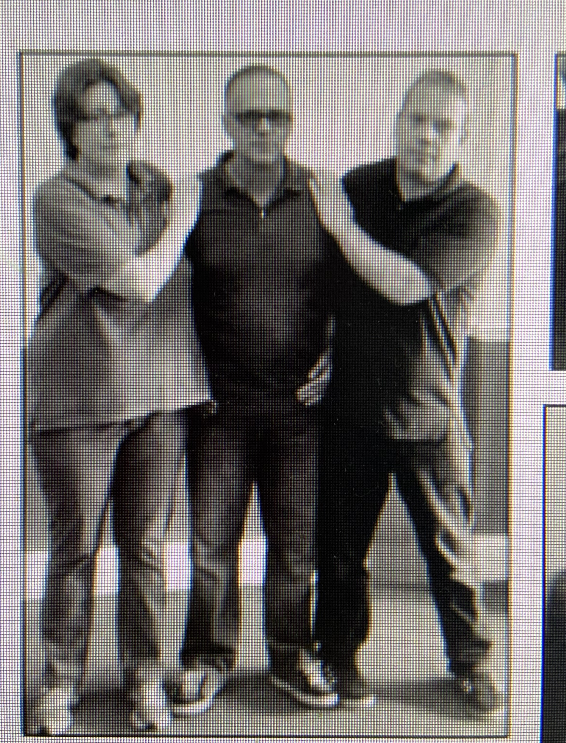
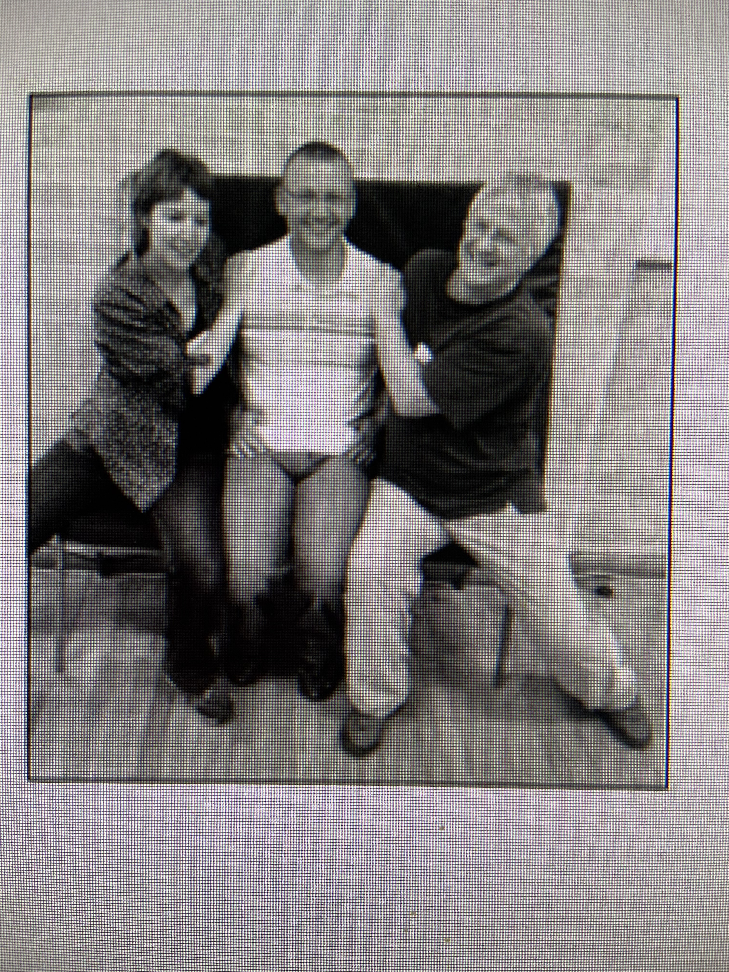
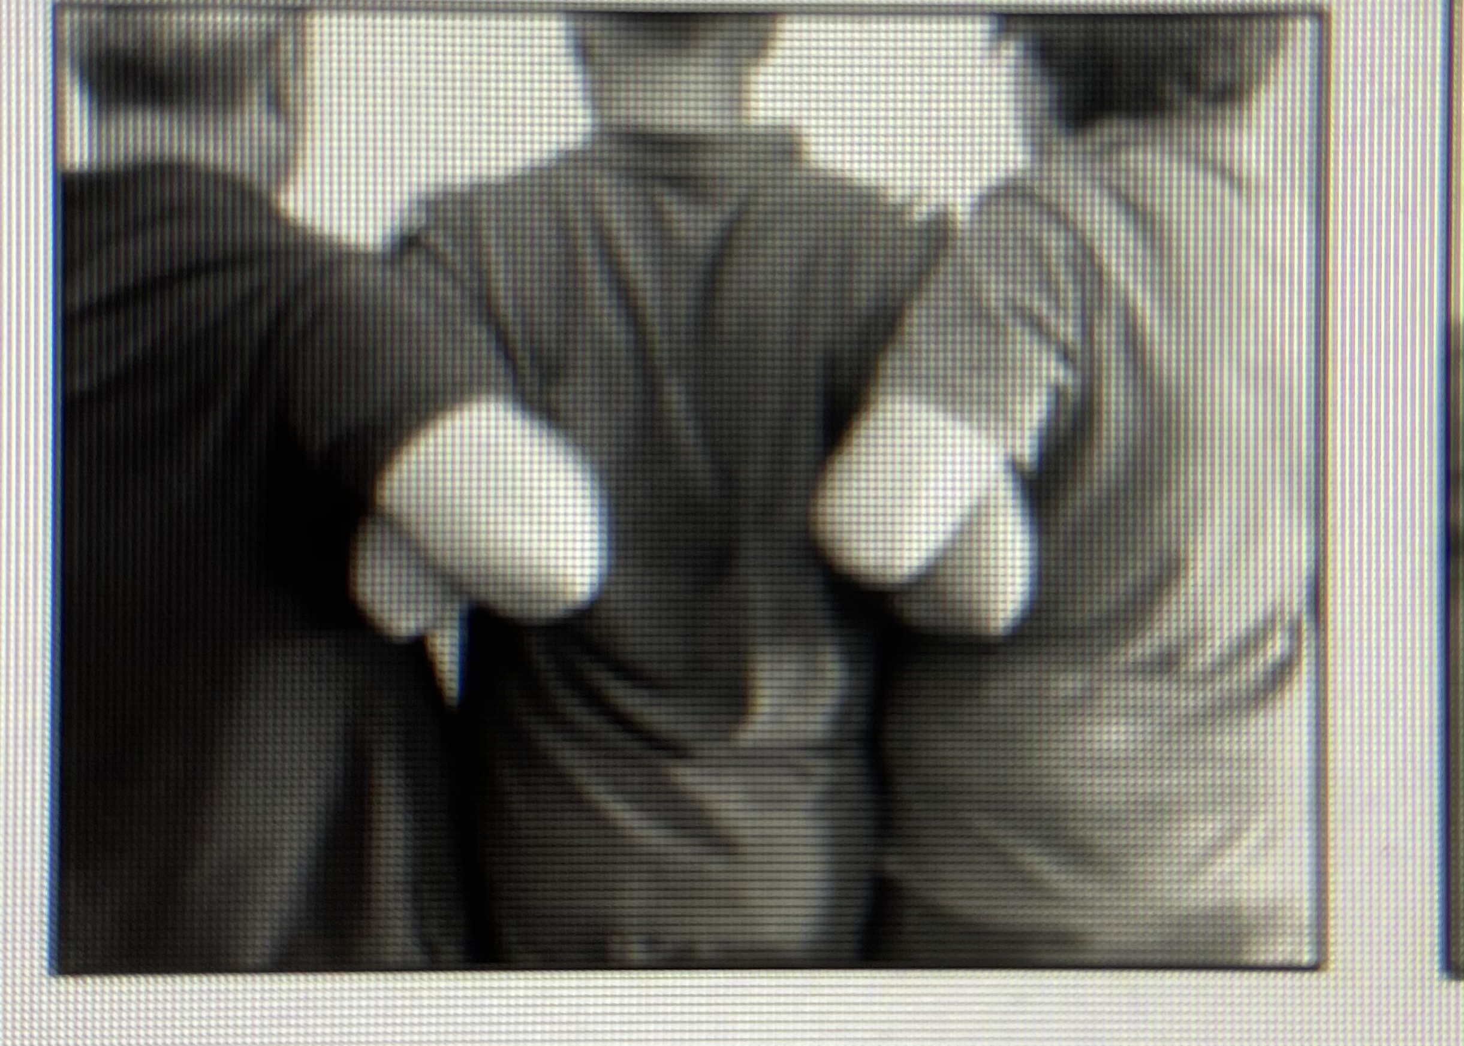
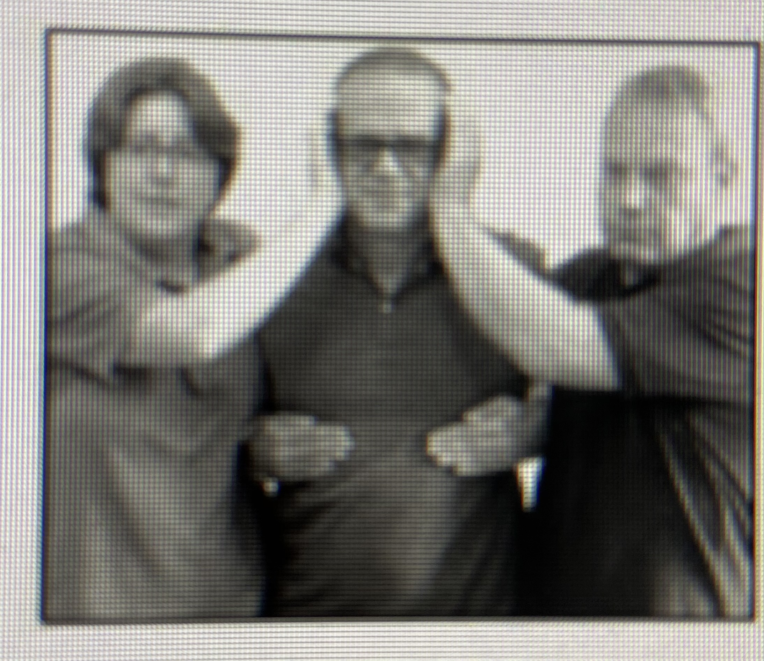
TEAM TEACH HOLDS
Caring C’s
Guiding Hand
Single Elbow
High Elbow
Double Elbow
Chair Hold
Changing face.
Team Teach does not deliberately cause pain.
Always keep in mind the reason why you are restraining.
If you are NOT Team-Teach trained you may be asked to help with moving things or opening doors. You may also be asked to help restrain a child, which you are allowed to do if a Team-Teach trained member of staff asks you, as long as they are present.

Slide 52
Knife crime
‘Middlesbrough is the knife crime capital of the UK’

Slide 53
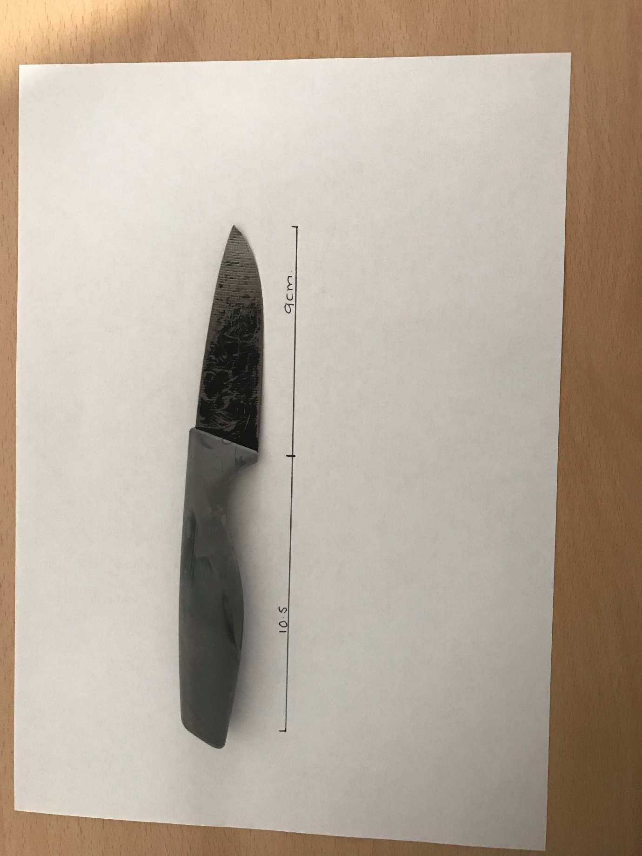

Slide 54
Child, 4, among 1,383 pupils found carrying weapons into class
Task – what do you think of this statement?

Slide 55
‘I would be dead in 2 days if I didn’t carry a knife’
Task – What do you think of this statement?

Slide 56
Dealing with a knife within an educational placement
The 5 Positions
Move Away
Guide Away
Take Away
NOW (No Other Way) Distance is the length of arm or weapon.
Only TAKE AWAY if there is NO OTHER WAY (NOW)
Task: How would we deal with this in a classroom?
Policies in your placement?

Slide 57
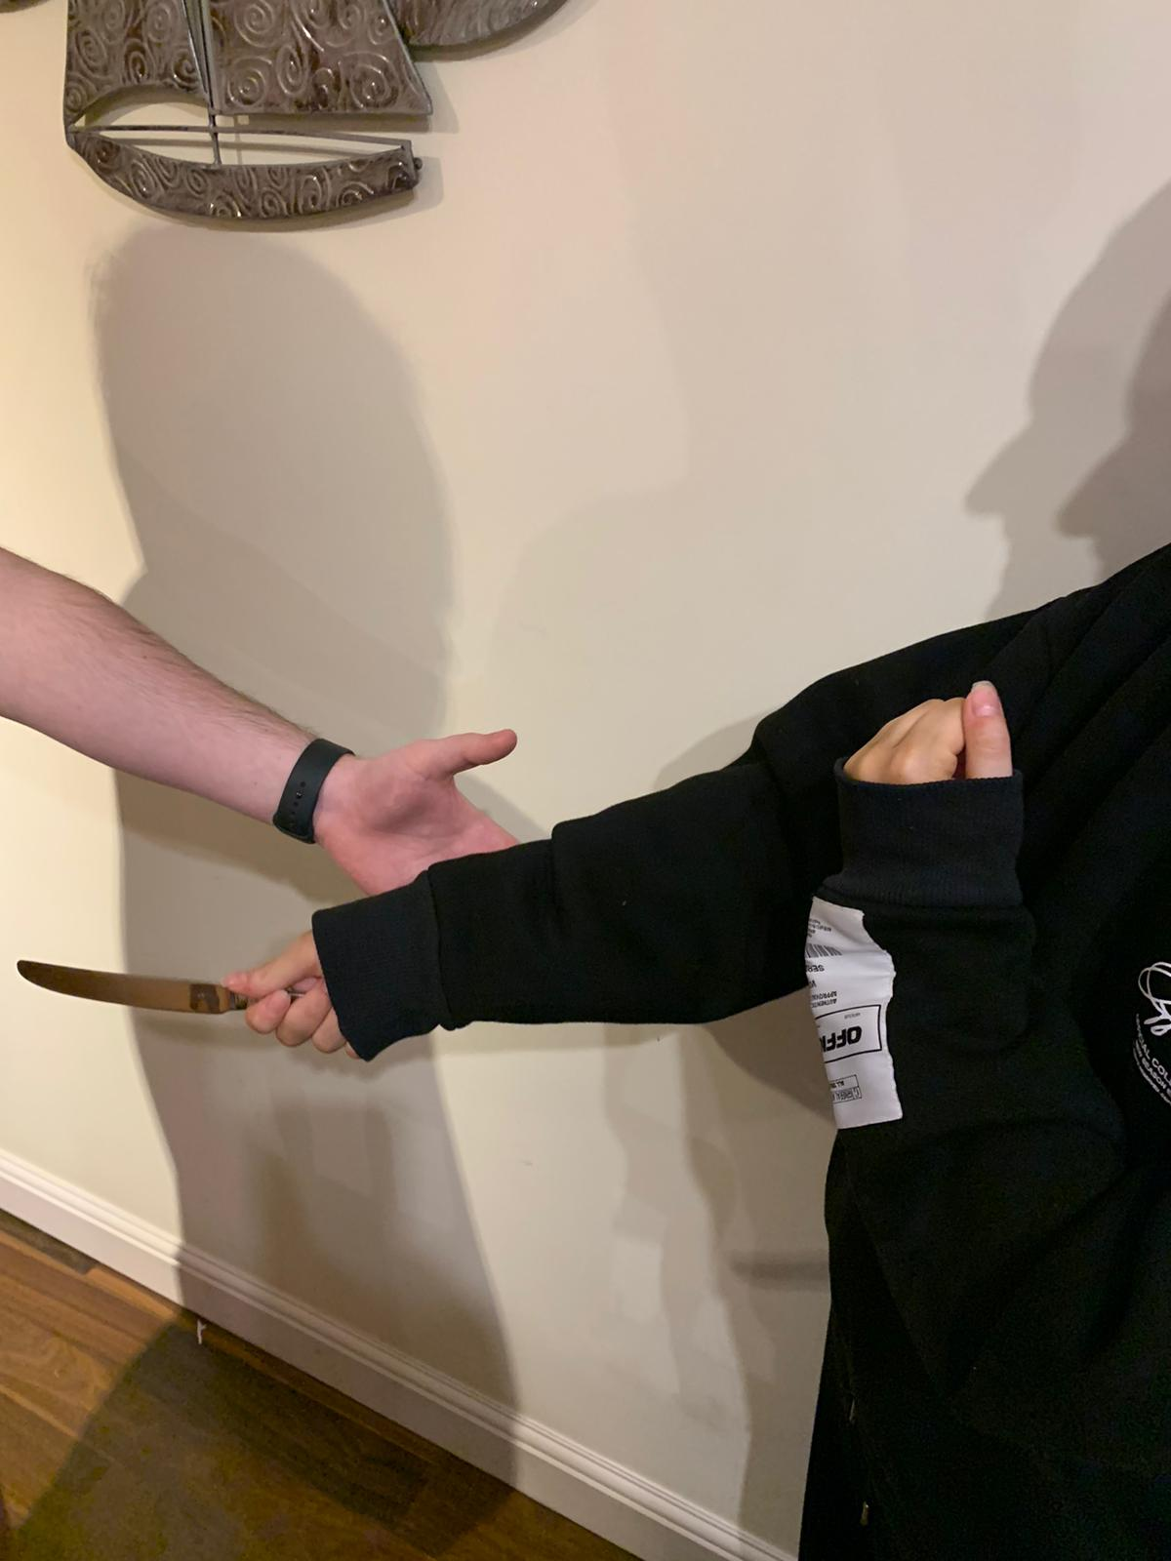
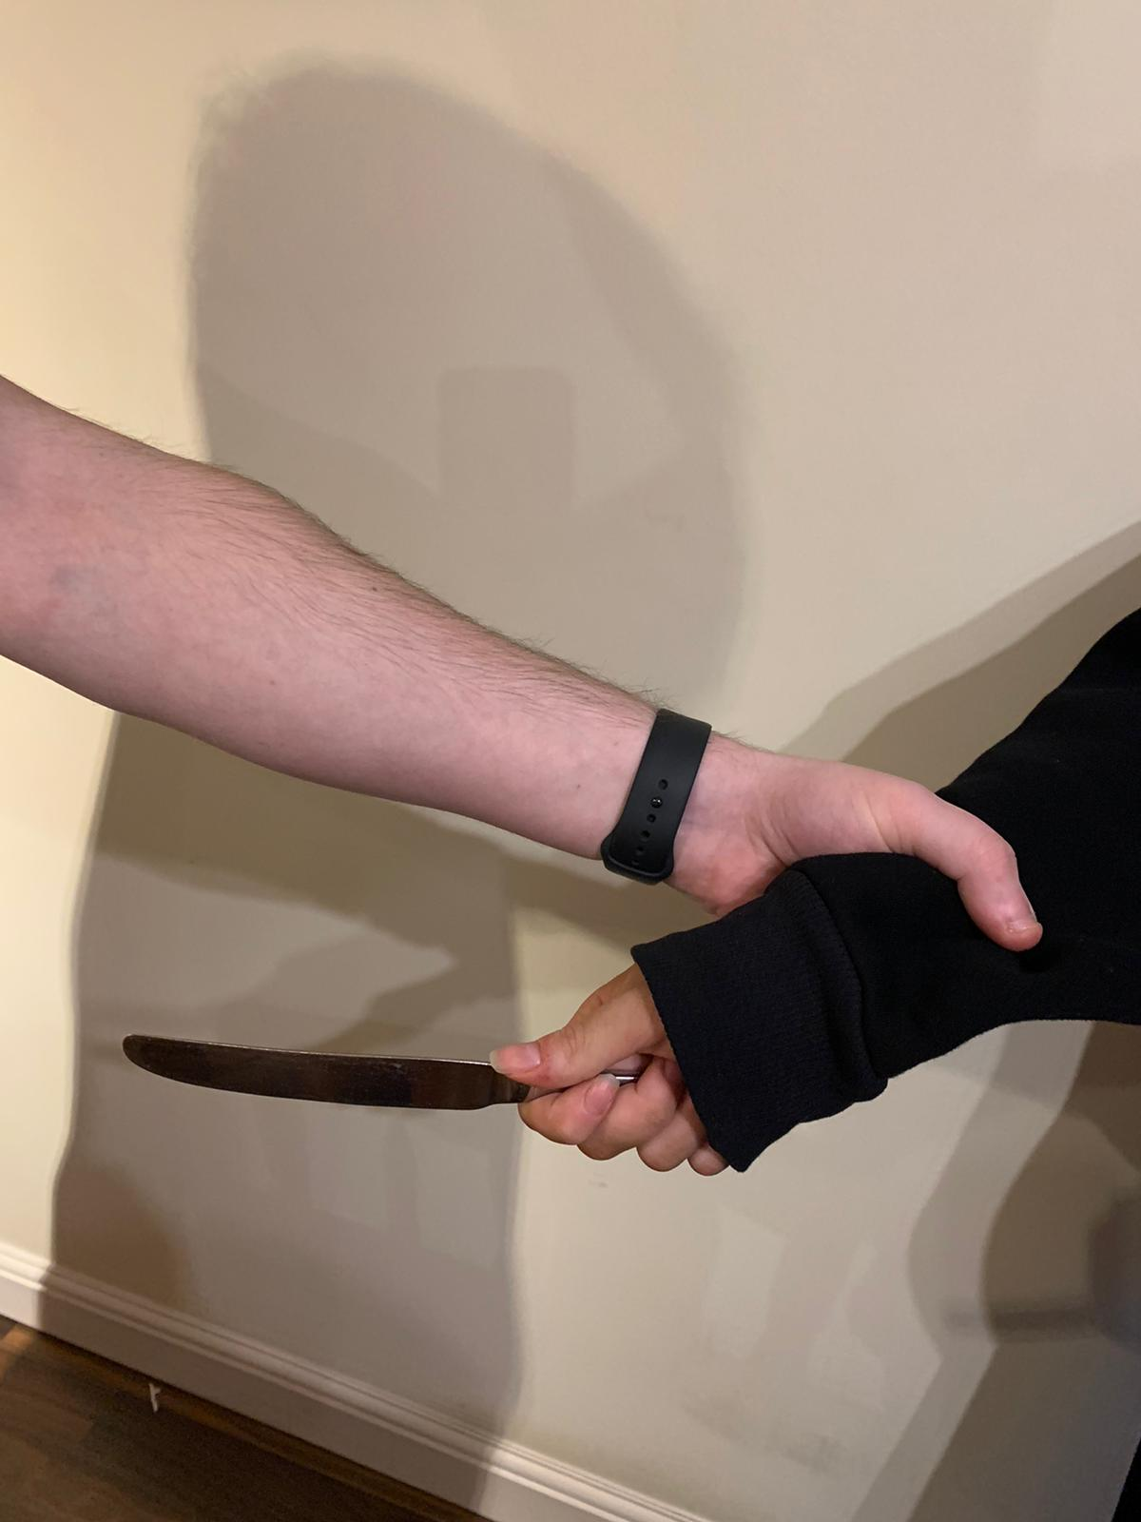
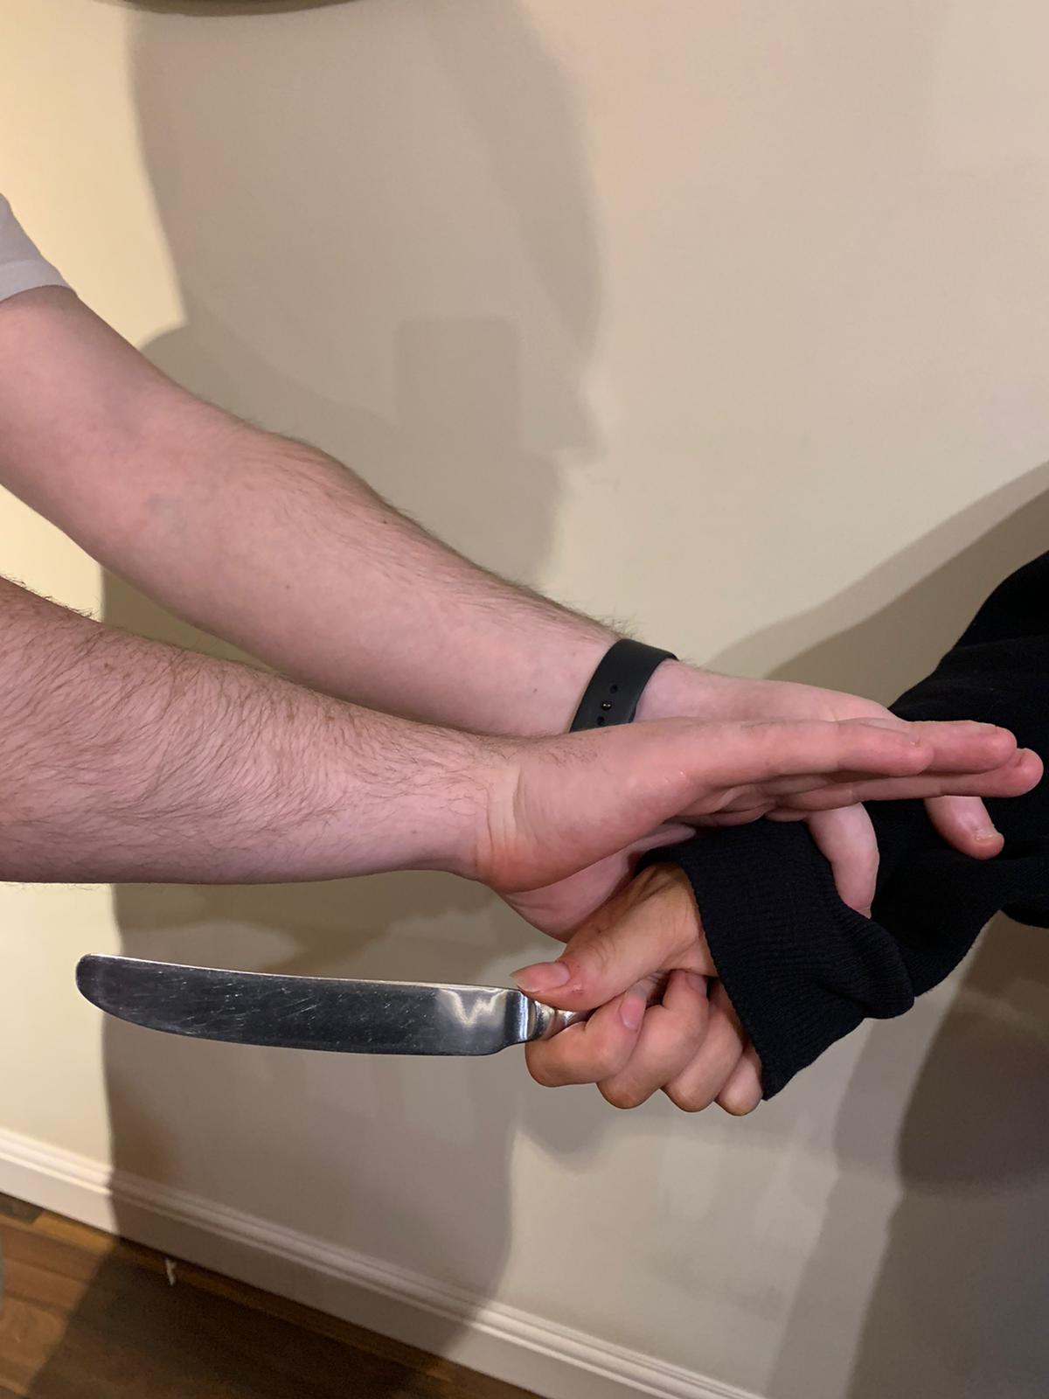
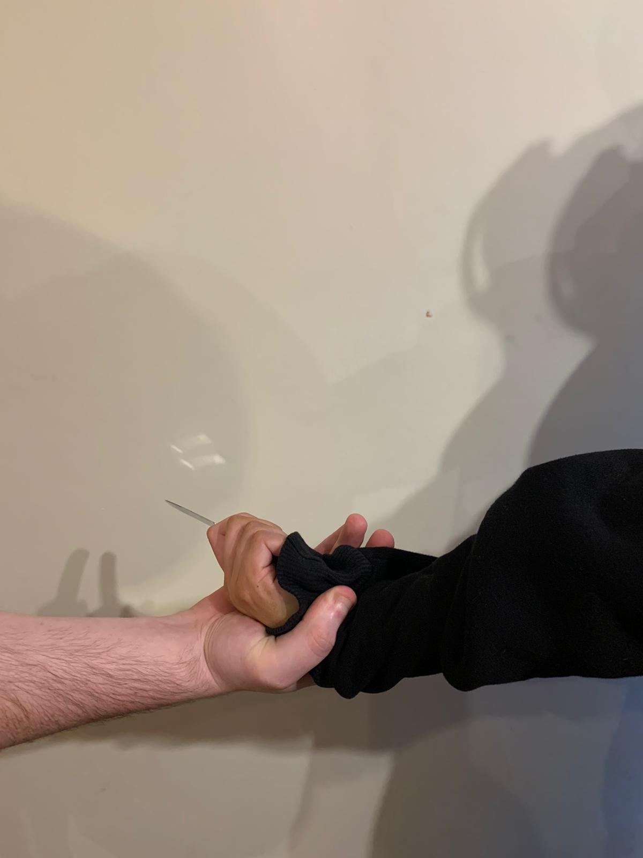
TAKE AWAy – WORST SCENARIO

Slide 58
To conclude
Students will always remember a teacher who helped them along the way.
Do not feel as if you will be able to change and turn their life around every time.
A small win is a win
Put the student first – What is best for the student in the long-run

Slide 59
QUESTIONS

