Slide 1
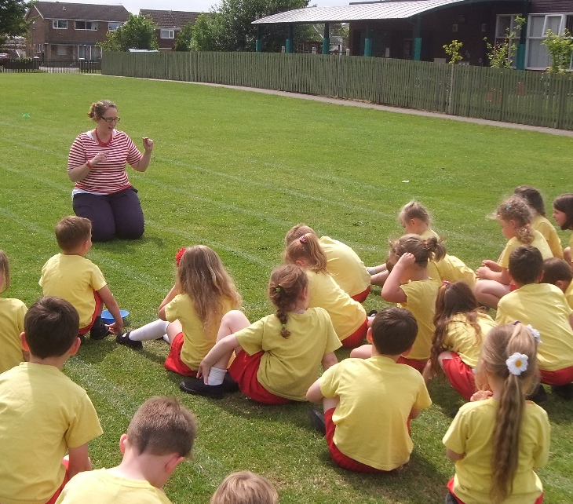
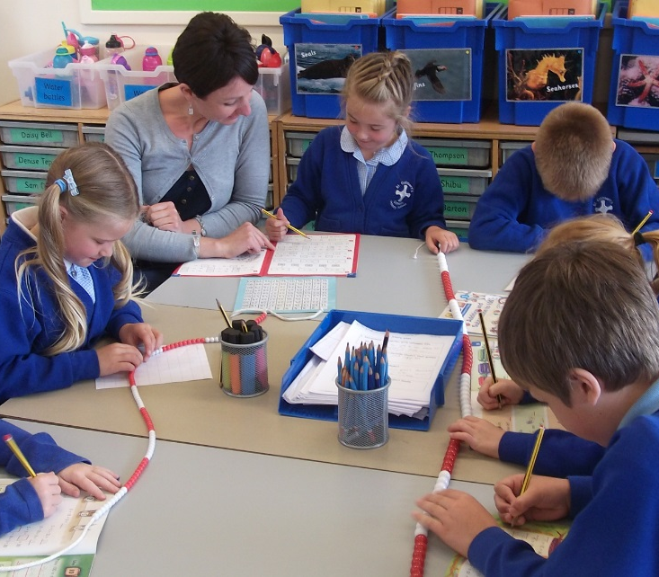
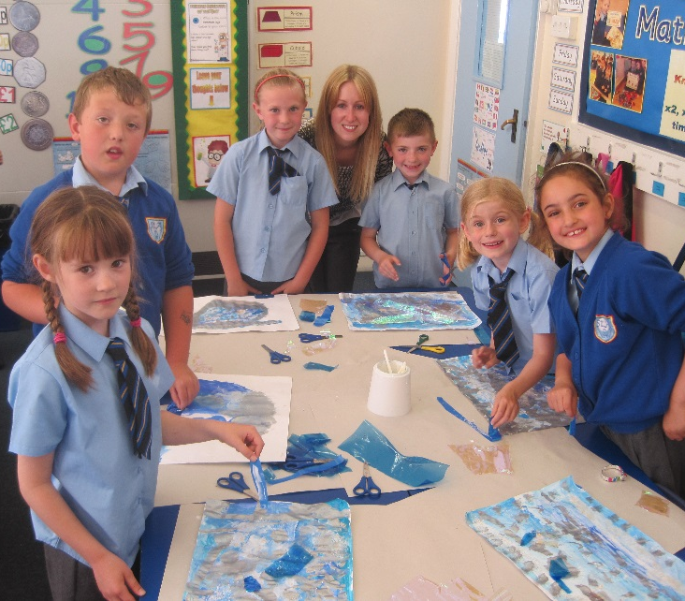
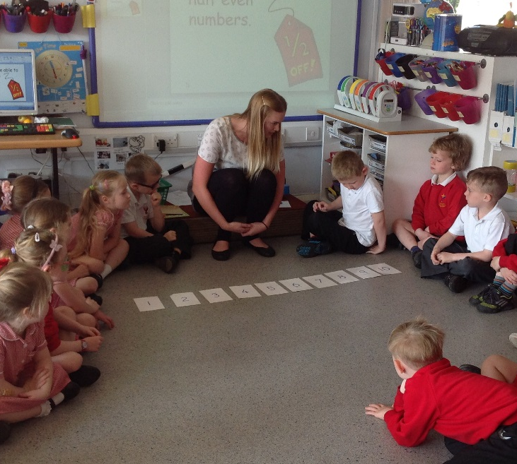
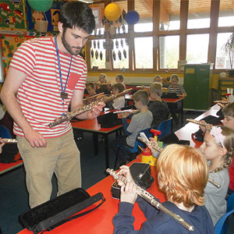
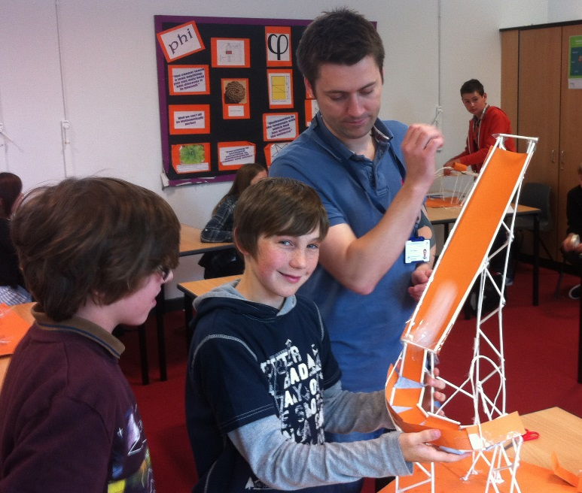
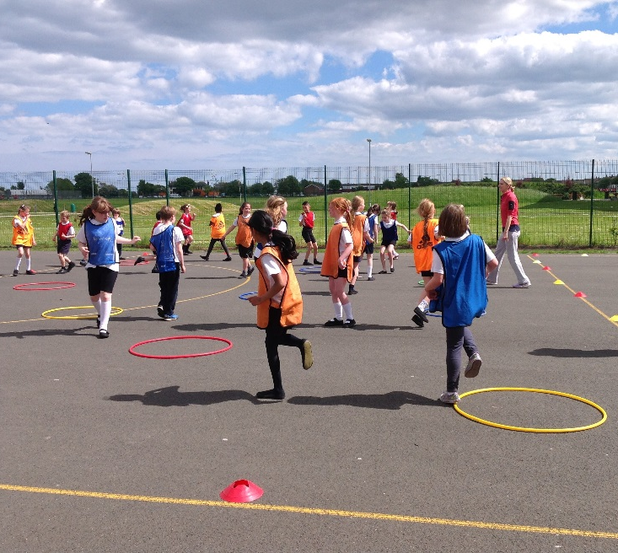
Primary Training 2023/24
www.inspiringteachers.me

Slide 2
English Training
Carmel College
Brigit Kinsey
Friday 6th October
www.inspiringteachers.me

Slide 3
Areas to cover today
Session 1
The English curriculum
Assessment and Planning
Session 2
The Early Years and preliteracy skills
Session 3
Reading Progression Key Stage 1 and 2
Putting the Skills into Practice
Next Time ……..
Read as Writers, write as readers
Audience and Purpose in Writing
VGP
Transcription
Spoken Language

Slide 4
What does English look like in my school? What do I know already? What do I want to know? Make notes
English in my school
Curriculum Areas | Assessment | Teaching

Slide 5
Remind yourself/Introduce yourself to the NC programmes of study Note the key statutory requirements What do you notice? Any surprises?

Slide 6
English Curriculum
Spoken language (previously ‘speaking and listening’).
Reading (word reading and comprehension).
Writing transcription (spelling and handwriting) and composition (articulating ideas and structuring them in speech and writing).
‘Pupils should be taught how to plan, revise and evaluate their writing.’
VGP - Vocabulary, grammar, punctuation and glossary.
Notes:
New curriculum – more focus on speaking and listening. Learn poetry by heart. Spelling, punctuation and grammar. Old literacy strategies still available in archives for detail around genres.
New curriculum is less prescriptive – lots of scope for teachers to be creative. Allows the school to decide what they will cover and when. No set time that you should spend teaching English.

Slide 7
English Curriculum
The New Curriculum has been in force since September 2014. https://www.gov.uk/government/publications/national-curriculum-in-england-english-programmes-of-study/national-curriculum-in-england-english-programmes-of-study
Whilst it is not the most entertaining read it is certainly important to be familiar with the document!!
Can still access old National Literacy Framework documents via National Archives: http://webarchive.nationalarchives.gov.uk/20131216163513/https://www.education.gov.uk/schools/toolsandinitiatives/nationalstrategies
Old National Literacy Strategy documents can be found on TES: http://www.tes.co.uk/teaching-resource/National-Literacy-Strategy-1999-6078593/
Notes:
New curriculum – more focus on speaking and listening. Learn poetry by heart. Spelling, punctuation and grammar. Old literacy strategies still available in archives.
New curriculum is less prescriptive – lots of scope for teachers to be creative. No set time that you should spend teaching English.

Slide 8
Statutory Assessment

Slide 9
Statutory Assessment – when does it happen?
Reception baseline
Year One – phonics test in June
Year Two – Reading SATs in May/June and writing Teacher Assessment (TAF)
Year Six – Reading SATs and SPaG Tests in May and writing Teacher Assessment in June (TAF)

Slide 10
Baseline
The assessment consists of:
• mathematics tasks
o early number
o early calculation (early addition/subtraction)
o mathematical language o early understanding of pattern
• LCL tasks
o early vocabulary
o phonological awareness
o early comprehension
First six weeks
Short practical activities
Physical Resources
Not all areas of EYFS learning covered
Reported by early Nov
Forms a basis for measuring progress from entry to Key Stage 2

Slide 11
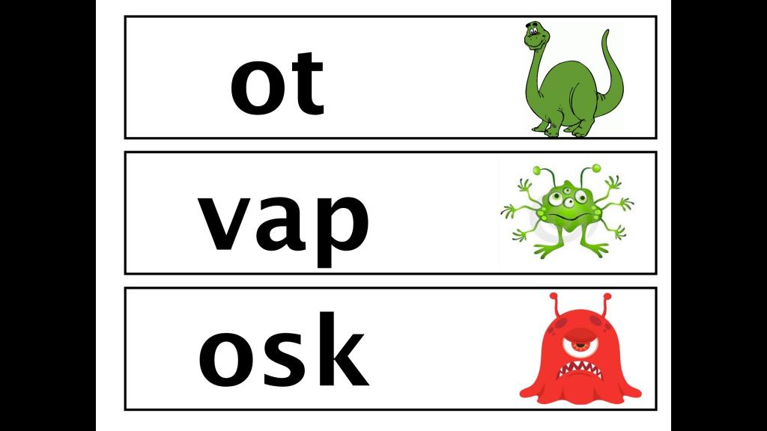
Year One - Phonics Screening Check
The phonics screening check contains 40 words divided into two sections of 20 words (real and pseudo-words).
It is designed to identify the children who need extra help so they are given support by their school to improve their reading skills. Children who do not reach the expected pass mark will retake the test in Year 2.
Have a look at a section from the 2019 test for two minutes (next slide)
What issues might arise for MA learners?

Slide 12
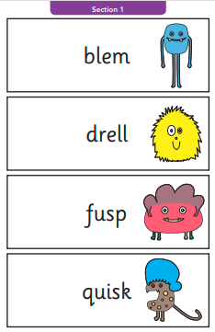
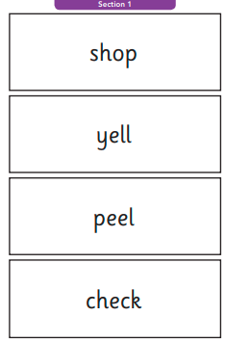
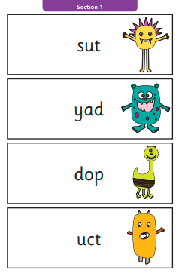
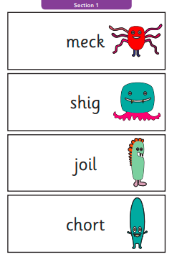
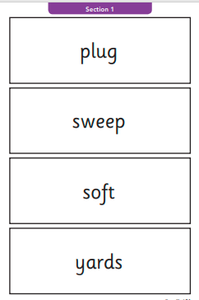
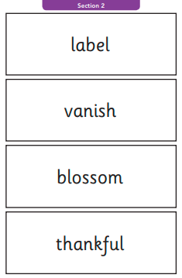

Slide 13
Key Stages 1 and 2
Year 2
KS1Reading Paper
TAF for reading and writing
GPS
Year 6
KS2: Reading – fully external
TAF for writing
SPaG
Let’s look at a selection of reading papers now. What do you notice?
1Points - paper, lasts 1 hour. Fiction, non-fiction, poetry. Questions in order of difficulty.

Slide 14
Summative Assessment – Formative Assessment
Termly Yearly End of Key Stage End of Unit Evaluates competency/learning Assessment of learning
Ongoing Informing next steps in planning Individual to child/groups Informing targets Monitors progress Assessment for learning

Slide 15
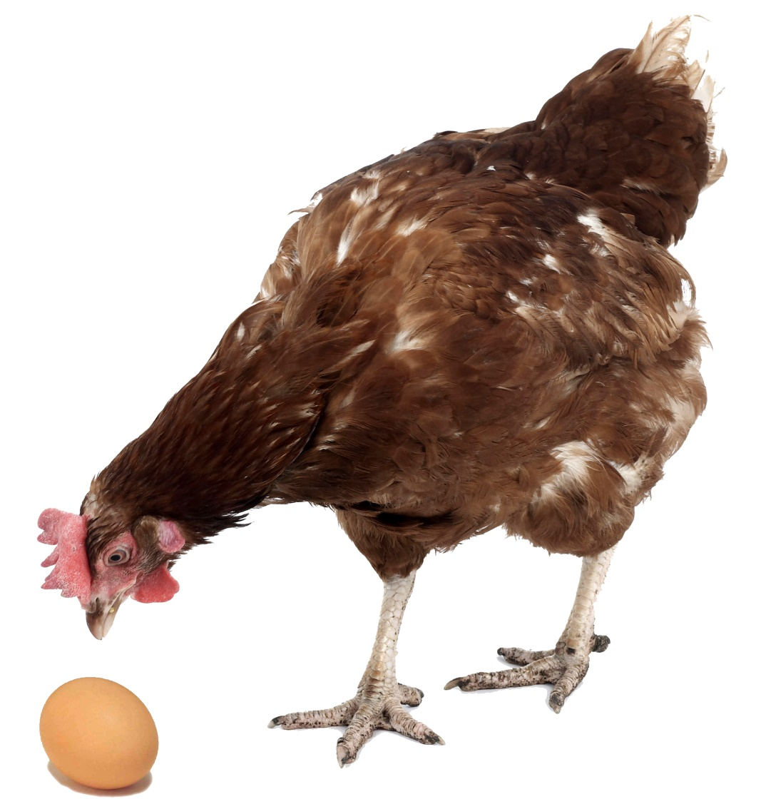
Assessment and Planning: Inseparable
Planning and assessing for progress - setting targets

Slide 16
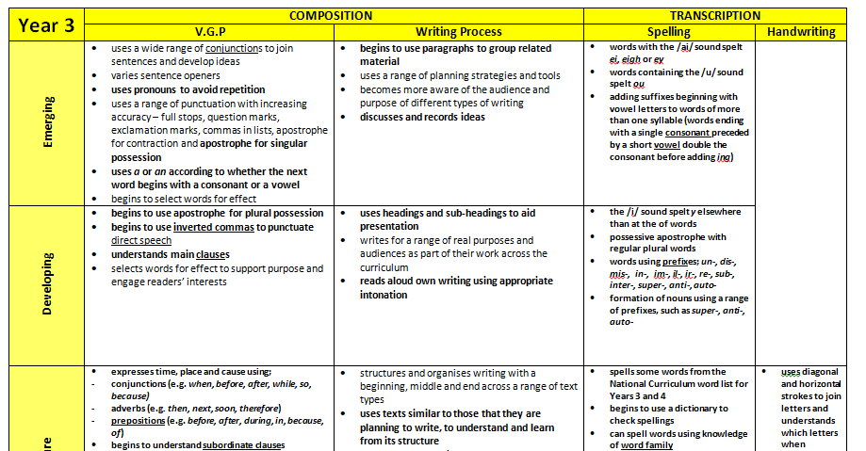
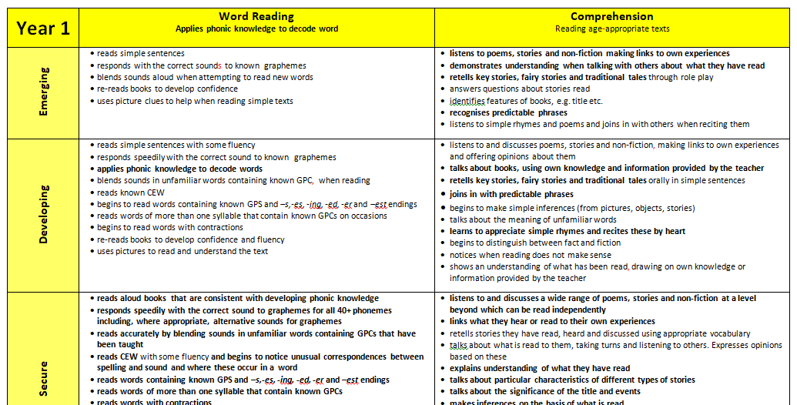
Formative Assessment and Planning materials in practice – Reading & Writing
Our books

Slide 17
Planning
Long term
A list of books (stimuli for writing outcomes)
Programmes of study
Stranded Sheets
Medium term
Texts identified
Narrative and non-fiction opportunities
Skills and outcomes identified and timetabled
More detail
Short Term
Daily lessons, including learning objectives for reading, writing, spelling and VGP
Build skills through a unit/series of lessons to achieve outcomes
Notes:
Long term plans – a brief overview of what you will cover in the autumn, spring, summer terms. High level. Identify the key texts you will use and genre (e.g. fiction, non-fiction, poetry).
Medium Term – identifies objectives – spoken language, reading, writing
Short term – daily objectives, activities, detail about what you are going to teach, differentiation.

Slide 18
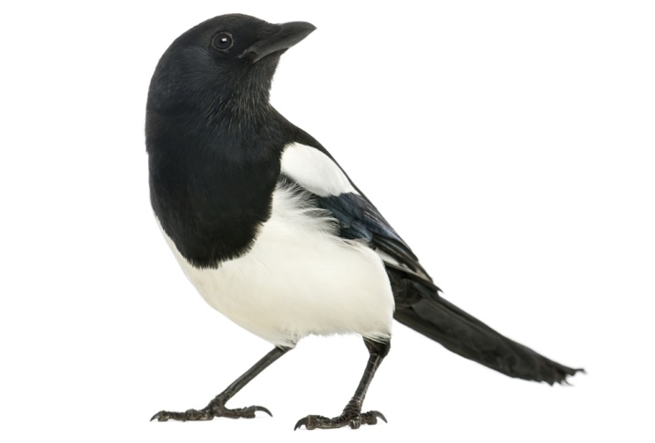
Read as writers
Write as readers

Slide 19
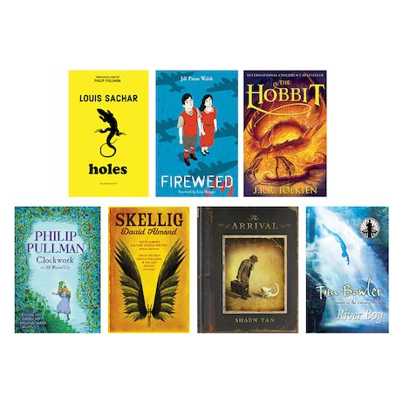
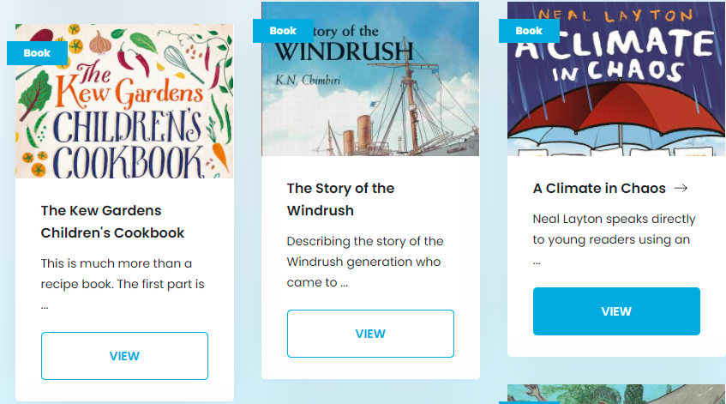
Pie Corbett Reading Spine

Slide 20
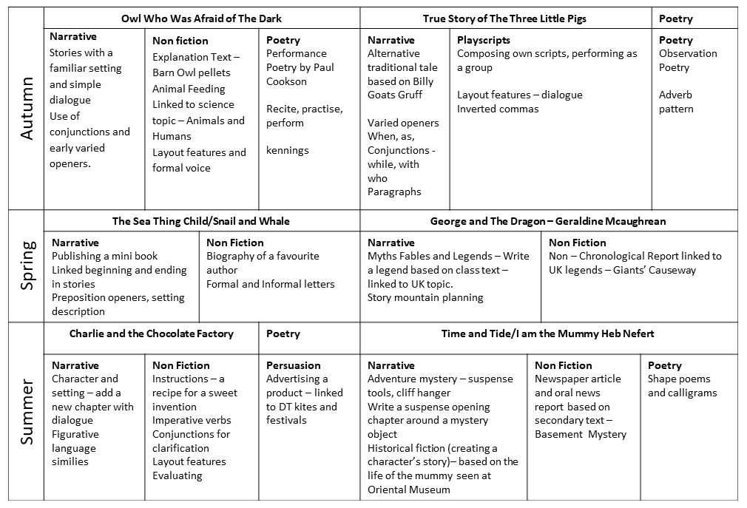
Narrative
An adventure sequel – learning from focus text structure.
Linked beginning and ending.
To be read aloud to younger audience
Non Fiction
Formal letter to an author
Using paragraphs, formal tone, and layout conventions

Slide 21
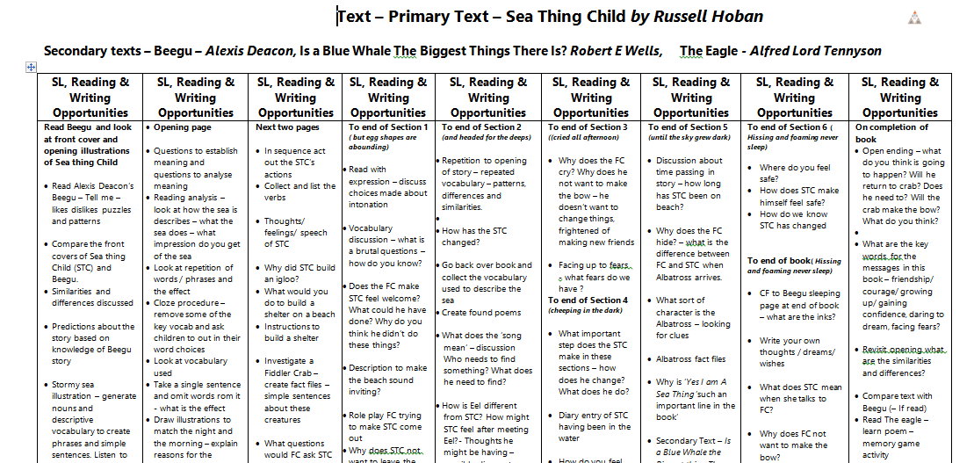

Slide 22
 | Year 1 | Year 2 | Year 3 | Year 4 | Year 5 | Year 6
Instructions A recipe An instruction poster (e.g. instructions on how to make a computer) An instruction leaflet (e.g. how to make something or safety procedures) Instructions for a game Map directions These are ones that do not to be in order: A list of school rules or guidelines A poster showing general advice on an issue (e.g. water safety)
Report An information leaflet A newspaper or magazine article A letter A non-fiction book An encyclopaedia entry A catalogue A school website
Discussion An leaflet explaining both sides of an issue A newspaper article Information in non fiction books A write up of a debate

Slide 23
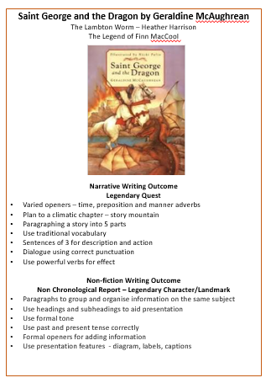
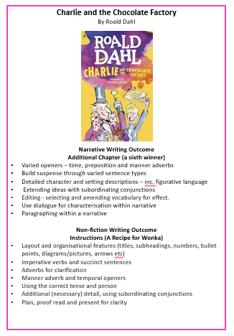

Slide 24
 | Year 1 | Year 2 | Year 3 | Year 4 | Year 5 | Year 6
Recount | Recount of visits, events or observations. | Biography or autobiography – book character. 1st person (character) recount from a story. | Recount of a holiday/event as a postcard and diary entry. | Newspaper article, recounting an event in school or from a story. | Comparative recount. Formal and informal on single topic/event. (News report/diary) | Biography writing in role- Write a CV, school report, obituary, police description about one character. Jounalistic writing for publication- school webpage/news letter.
Instructions | Simple lists for planning and reminding. Signs and labels for equipment/ display/ role play area etc. | Simple set of rules or guidelines. route/map instructions. | Oral and written instructions - TV style make and a written recipe. | Instruction page to swap, follow and evaluate within class. Instructional/ safety/advice poster. | Instructional leaflet (how something is done/made) for other pupils/classes to attempt. A recipe | Safety/advice guide. Instructions for a game.
Report | Simple information texts A class book using features of simple non chron reports. | Non chronological encyclopaedia page, using headings, subheadings, captions etc. | Non chronological oral and written report for other children, using a range of sources . | Concise non chronological report-poster/wall chart. A non-fiction book. | Newspaper/magazine article, focussing on clarity, conciseness and impersonal style. | Orally presented news style report. School website page.
Explanation | Captions for a display/books, including questions. (Parts of the body, a plant) Simple dictionary (word lists) | Simple flow chart or diagram that explain a process. Class dictionary and glossary, with definitions. | Formal and informal letter. Wikipedia page based on author/character. | A non-fiction book. A manual | Explanation of a process, system or operation. Eg How....works | Section of explanation from a newspaper/magazine article.
Persuasion |  |  | A flier for a destination. A book blurb | A letter giving a point of view. Advertising poster. | A structured leaflet giving a personal view. Protest, criticise, object, support etc. | Leaflet giving two sides of an issue. Persuasive newspaper or magazine article.

Slide 25
Pie Corbett Reading Spine

Slide 26
Over break
Have a look at some of the assessment and planning resources for reading.

Slide 27
Reading

Slide 28
Skills for success?
Discuss and make notes - what you think children need in order to be successful readers?
Think about the full primary age range.

Slide 29
The Simple View of Reading
+
Comprehension
“Reading to Learn”
-
+
Word Recognition – “Learning to read”
-

Slide 30
Good language comprehension, poor word recognition
+
Good word recognition, good language comprehension
-
+
Poor word recognition, poor language comprehension
Good word recognition, poor language comprehension
-

Slide 31
Progression in Word Reading
The Early Years

Slide 32
Word Reading/Decoding
saying the sounds corresponding to the letters in the words and then blending the sounds together, either aloud or silently
• reading familiar words accurately and silently ‘at a glance’, that is, no longer saying the sounds consciously.
For children who begin school with a poor understanding of language, being able to decode words is essential for equality, because their understanding of language, their vocabulary and their knowledge of the world will expand rapidly when they can read for themselves.
Decoding and encoding can be taught through a systematic synthetic phonics (SSP) programme
+
Comprehension/language comprehension
When children start learning to read, the number of words they can decode accurately is too limited to broaden their vocabulary. Their understanding of language should therefore be developed through their listening and speaking.
However, when they can read most words ‘at a glance’ and can decode unfamiliar words easily, they are free to think about the meaning of what they read. They can then begin to develop their understanding of language through their reading.
-
+
Reading Framework – July 2021
-

Slide 33
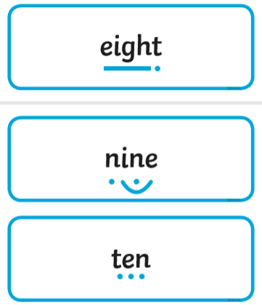
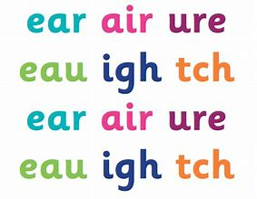
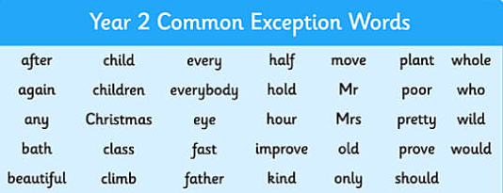
Terminology first
Phoneme
Grapheme
GPC
CEW
Digraph
Trigraph
Blend
Segment

Slide 34
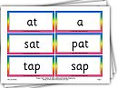
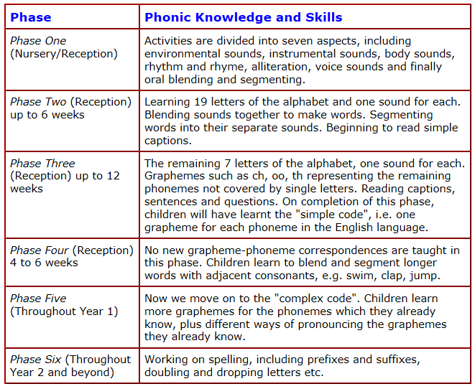
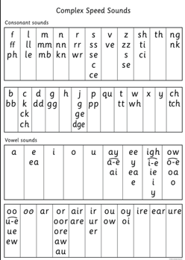
Phonics

Slide 35
Decodables
The national curriculum says that pupils should be taught to: … read aloud accurately books that are consistent with their developing phonic knowledge and that do not require them to use other strategies to work out words.

Slide 36
When are they ready for phonics? What are the skills needed for early reading?
Pre - Literacy skills
A Launchpad for Literacy

Slide 37
Visual Auditory
Can hold?
An animal noise
An environmental sound
A phoneme
Can hold?
A picture
A shape
A grapheme

Slide 38
attention, discrimination and memory
Discrimination
Auditory discrimination is the ability to recognise differences between sounds.
Auditory discrimination allows a person to tell the difference between words and sounds that are similar, as well as words and sounds that are different.
A child who has trouble with auditory discrimination may have difficulty telling the difference between words such as "sister" and "sitter" or "cat" and "cot." Overall, the children can't distinguish between the slight differences in the sounds of words.
his problem can make it hard for children to understand what people are saying.
Auditory

Slide 39
Auditory Memory and Sequential Memory
Auditory memory is the ability to hold chunks of information ready to process. It allows a person to follow instructions, stories and conversations.
A child who has difficulties with auditory memory will have difficulties blending sounds in words to read as they cannot hold the information to process. They may appear to recognise graphemes and make phoneme correspondences however they can not say the word. A child may say ‘c’ ‘a’ ‘t’ repeatedly but does not move on to say ‘cat.’

Slide 40
Impact upon Literacy skills
Auditory skills play an important role in both a child's language and literacy skills.
In order to achieve literacy, children must have phonemic awareness,
so trouble with auditory discrimination can pose challenges to early readers.
Children with auditory memory difficulties may have trouble remembering
the sequences and may become disordered.
When writing, they might write words in the incorrect sequence.
An auditory discrimination problem may be found if the child has lasting
problems with language and reading. Early intervention is key to getting
these children back on track.

Slide 41
Visual
Visual discrimination is the ability to identify differences in visual images.
Visual memory focuses on the ability to recall visual information that has been seen.
In order to read, children must distinguish between subtle symbols that represent sounds – graphemes
They must also remember the phoneme that matches this grapheme
To blend, they need to remember the previous graphemes they have read, and build them into a word
The implication for spelling is obvious!

Slide 42
Activities to Work The V and A Muscles
Next there are number of tasks that we can use to check a child’s visual discrimination and memory.
We can use these to work these muscles – the visual and auditory muscles!
This mirrors the reception baseline assessment for LCL!

Slide 43
Assessment of Auditory skills
The main considerations when working on auditory skills is to remove the visual.
With out removing the visual children will use visual skills to complete the task.
Visual also include practitioners non verbal gestures.
For example do not over emphasis words with expressions.
All of the assessment activities can be used as intervention games too, as they work the right V and A muscles!

Slide 44
Visual Activities
Shapes - Use shapes (same colour) Pull out 2 – leave for 5 secs Could they find them? If not – give another go – if still no – then try 1 shape. Move onto using letter shapes – the name isn’t needed.
(no auditory clue at all)
Word sort - give 2 sets of words (cat cat sit sit) Can they group them? Try upto 5 different pairs – can they see initial/medial/end sounds?
Sit like in a game of battle ship with a barrier. Reveal a choice or a sequence, lift your WB to reveal – Can they copy? Build up. Use lots of different types of apparatus/objects to match topics or interest
Silent lotto – have a picture board. Hold up a picture (use topic/interest pictures or even objects), then hide it – have they got it on their board? Make the objects similar if they find it easy – then grapheme lotto – then word lotto. Mix up by dipping back to easier versions (could use shapes with no colour etc) Make the discrimination harder as you go)
Long lotto – like a phoneme frame with pics/objects then graphemes. Hold up a matching object - If you’ve got * cover it. If you’ve got * or # cover it – get a point if correct. To make trickier/easier lengthen or shorten the board, hold up the objects/pics for longer/shorter.
Sequence – have a phoneme frame type board. Show a sequence of three objects (photos). Cover, then they make it on their board. Build up. If they can’t do this, don’t cover – just copy. Also if can’t, discuss as you place – what can we see? Where is it?
Put out graphemes ch sh th (3 or 4 copies of each. Children stand away from the table – Hold up ch. They collect and bring it to you/collect. Then show two in sequence. If they copy each other, make them turn their backs and show each person in turn. Or show each child a different sound.
Kim’s game with topic objects, pictures – then graphemes – then words
Let’s have a go at some on our tables

Slide 45
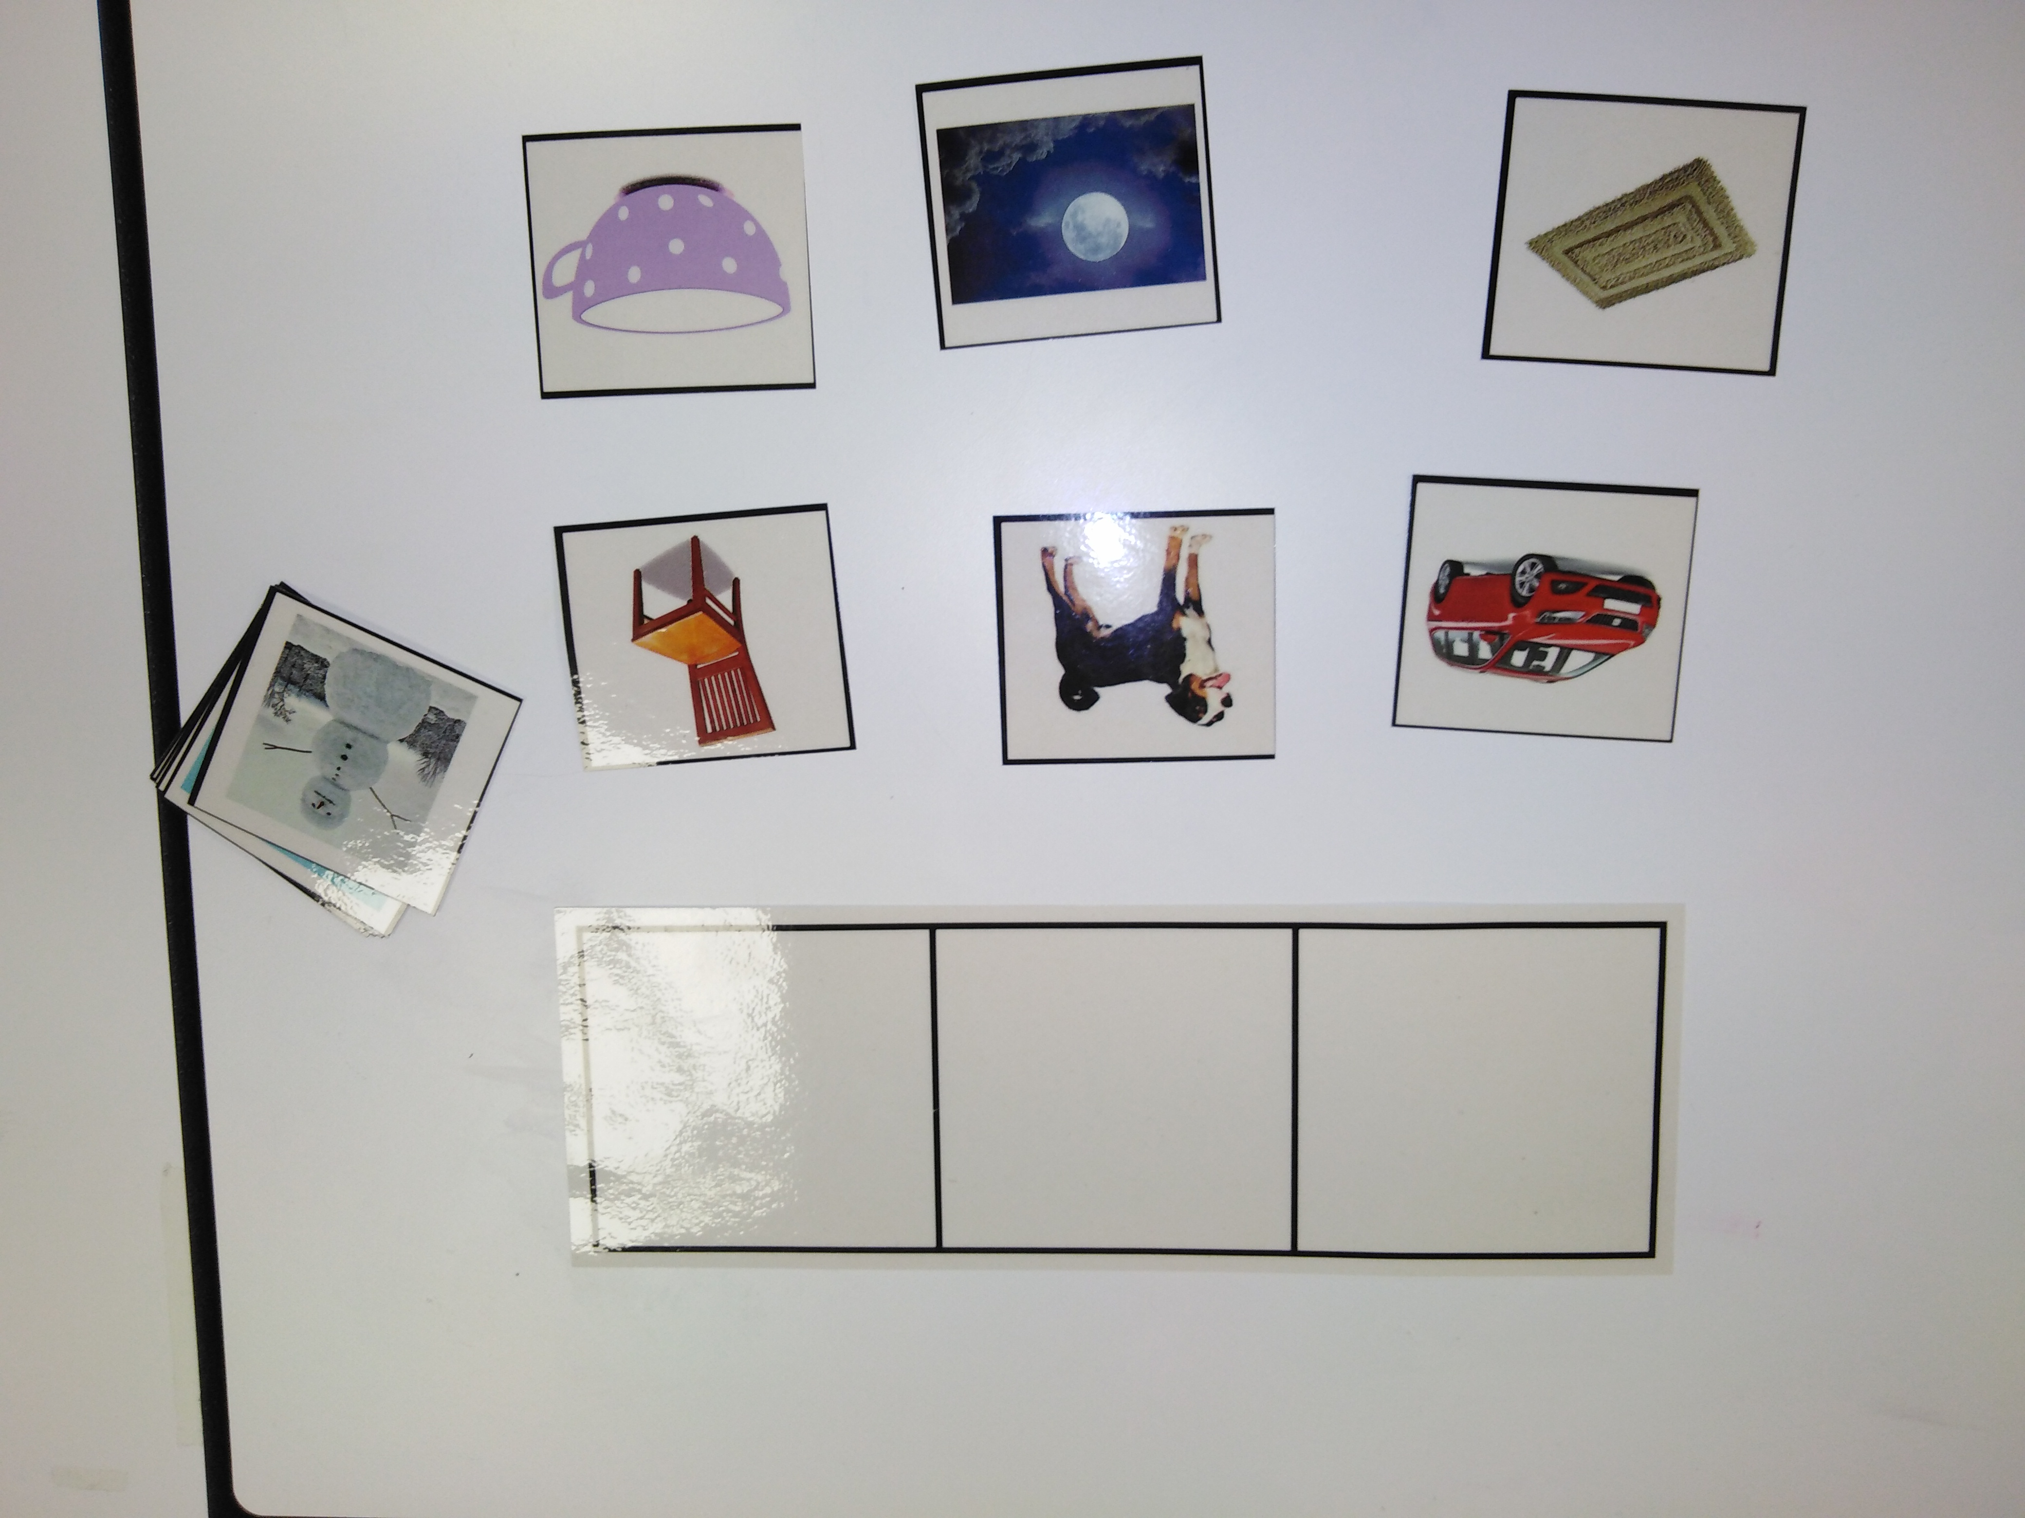
Auditory Activities
Sound lotto – environmental sounds, animal sounds (youtube for sound files)
Long lotto (play two or three sounds and put in order)
I’m thinking of….. Fred talk the sounds / Syllable chunk the sounds. Is it the first or last part that they can’t hear or remember? (Have a lotto board with pictures to choose from, collection of objects, corners) Remove pictures when done, and ask children to tell you what you are blending. Make this harder with objects that have same medial, initial or end sounds.
Object lotto – familiar objects spoken. Make it trickier with similar words to discriminate (a frog, a flag) but keep the objects easy to recognise. Focus on initial medial end sounds or clusters (heard!!!) Long lotto again
I packed a suitcase – went to the zoo orally (this can be done visually too with a sequence frame)
Oral blending - I am going to Fred/robot. Say the sounds i n a s k Can they say the word? Build up to five sounds
Play pen pattern sequence with orally – like battleship. I’m choosing the blue one and then the green one – can they copy? Play with shapes, topic objects etc.

Slide 46
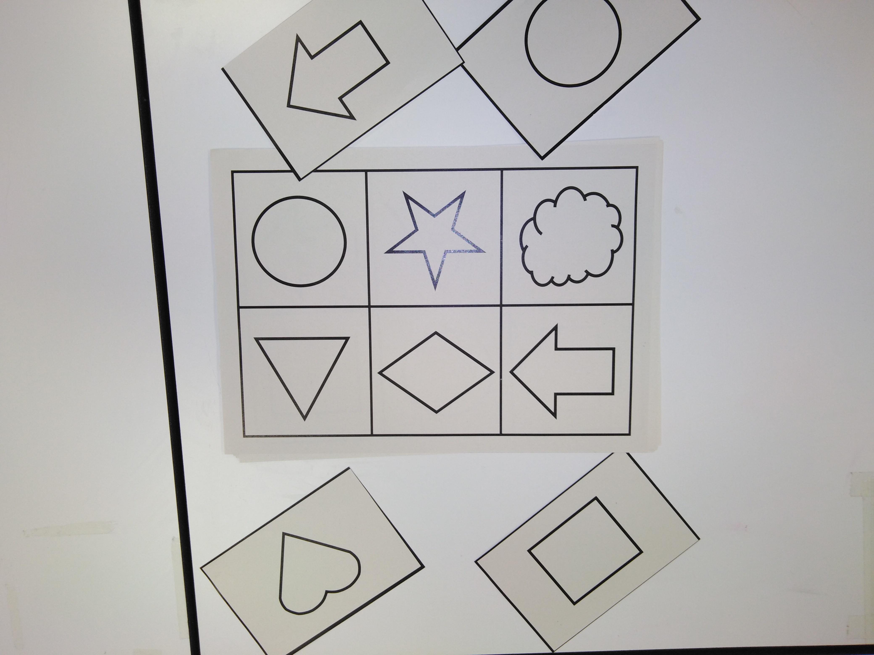
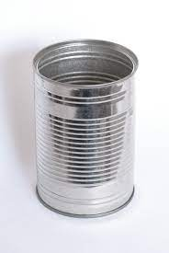
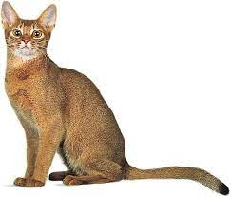
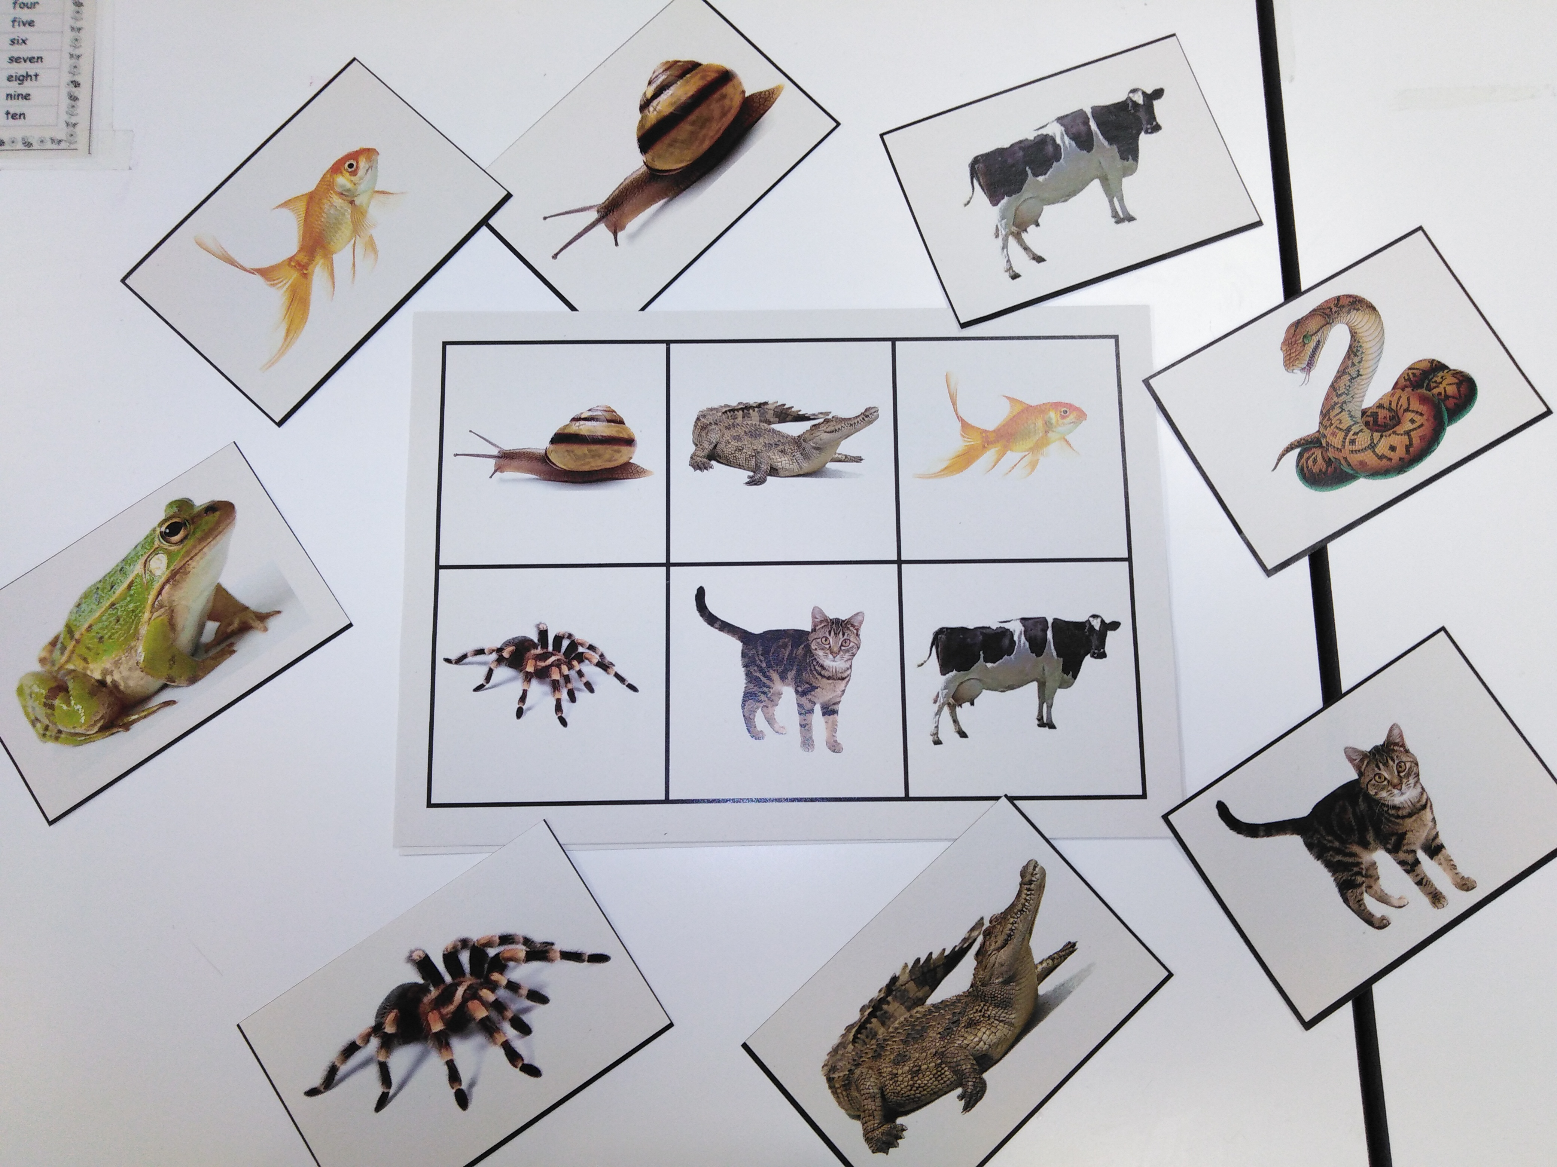
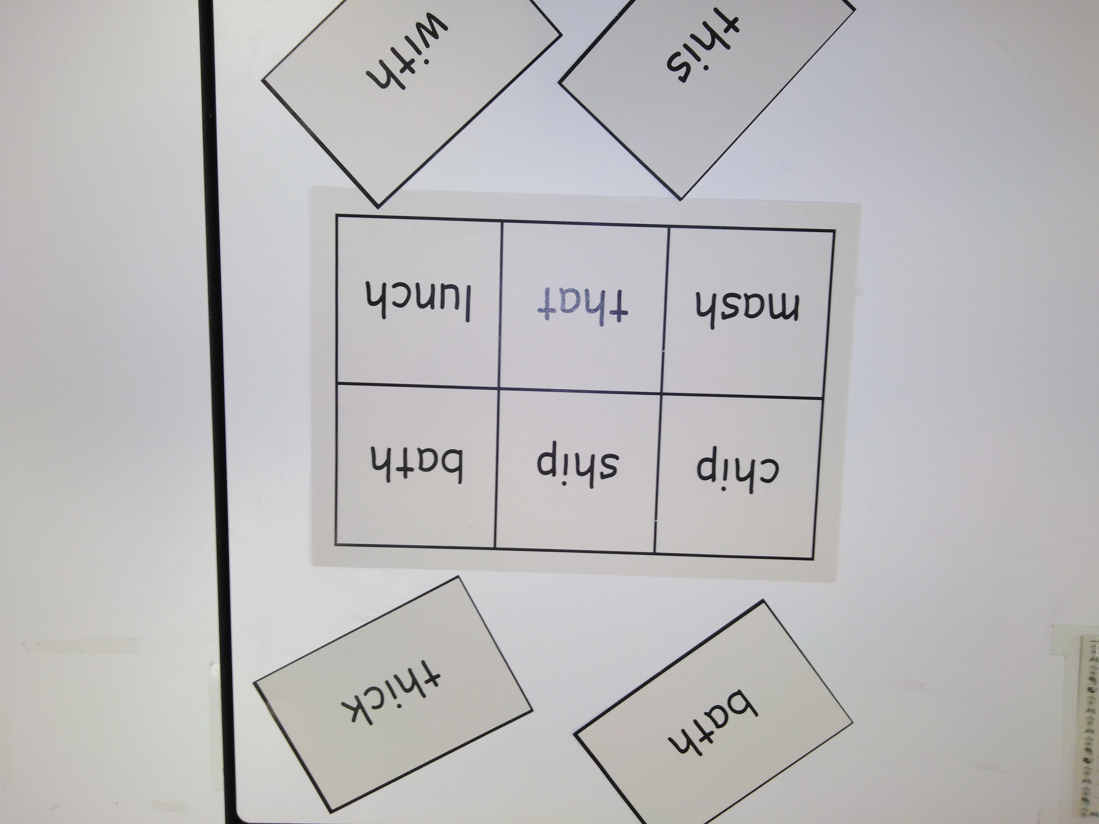
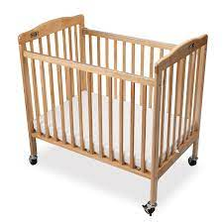
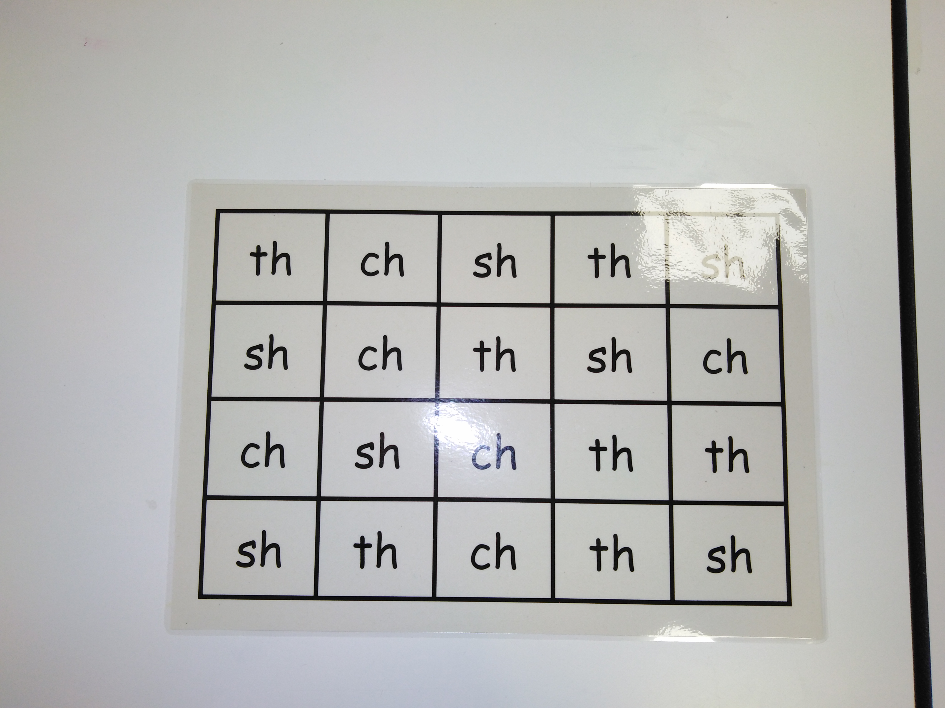
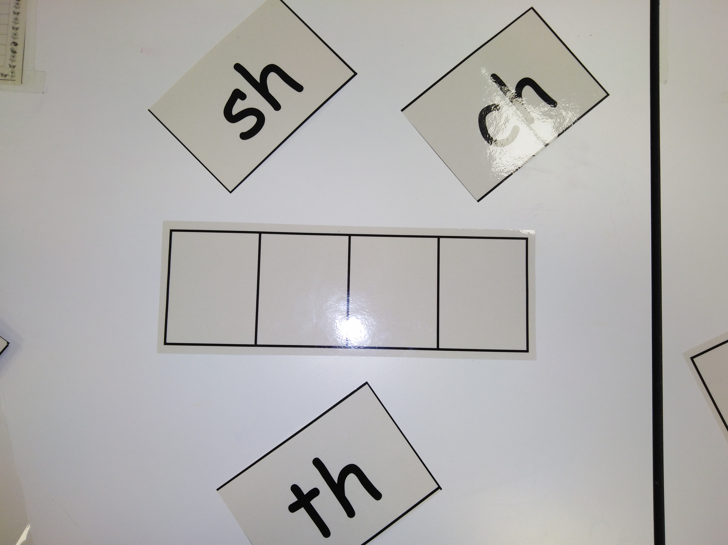

Slide 47
The early stages of language comprehension - Early years
Developing talk Young children typically gain several new words a day, acquiring vocabulary at an ‘astonishing rate’. Yet by the time they start school, some children will have heard millions more words than others. The number of words a child has heard and can speak by the age of three is a predictor of later language development, so these early vocabulary gains are critically important.33
gap

Slide 48
Back and Forth Talk Across the Curriculum • thinking out loud, modelling new language for children • paying close attention to what the children say • rephrasing and extending what the children say • validating the children’s attempts at using new vocabulary and grammar by rephrasing what children say if necessary • asking closed and open questions • answering the children’s questions • explaining why things happen • deliberately connecting current and past events (‘Do you remember when…?’) • providing models of accurate grammar • extending children’s vocabulary and explaining new words • connecting one idea or action to another • helping children to articulate ideas in well-formed sentences.

Slide 49
This Needs Careful Planning – A Fire Station Visit
• What do we want children to know and think about?
• What vocabulary is associated with this knowledge and thinking?
• How can we engage the children in back and forth talk that supports their knowledge and thinking?
• What photos could we take that would reinforce the vocabulary and language after an activity or visit?
• Which books could be read aloud and shared before and afterwards?
• Which songs might introduce or reinforce the vocabulary?
Activity -Take a look at the example given in the latest Reading Framework document.

Slide 50
Progression in Reading National Curriculum Y1 - 6

Slide 51
Activity
Look at the stranded sheets for assessing reading – word reading
What skills are included?

Slide 52
Word Reading Skills – applying phonic knowledge to decode words
Decoding
Phonics – blending sounds
Segmenting
Identifying root words, suffixes and prefixes
Using punctuation
Pace for fluency (re-reading)
CEWs
Using picture clues
Context clues
Alternative GPCs
Self correcting

Slide 53
Comprehension Responding to the text!

Slide 54
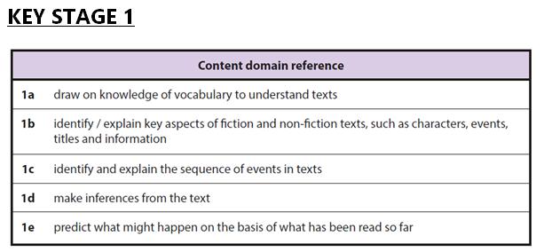
Reading Domains
Notes:
When you are reading with, or listening to, children read, you are continuously assessing their ability to meet these assessment focuses.

Slide 55
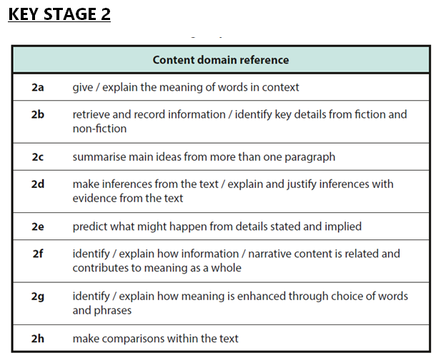

Slide 56
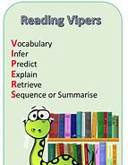
www.literacyshed.com
www.literacyshedplus.com
What questions do we ask?

Slide 57
TASK

Slide 58
In St. Wilfrid’s, we use VIPERS when it comes to reading. These help us improve our reading skills. At home, when you hear your child read their phonic or accelerated reader book, use some of the questions or talking points from the six sections below, to help them develop as readers.
Vocabulary | Inference | Predicting | Explain | Retrieve | Sequence
New words that help you understand the text. | Work out answers from the text. | Predict what might come next and explain why. | Explain what you like or don’t like, and your own opinions. | Find and take answers from the text. | Put things in order.
What does …. mean? Which word describes how he looks/is feeling? Find a word that means the same as…. Can you think of another word the author could have used there? | What was …. feeling? Why did … say that? Why did that happen? Can you explain why….happened? | Look at the cover, what is this book about? What do you think will happen next? Why? What might …. say or do? | Who is your favourite character? Why? Is there anything you would change about this story? Explain what you liked about this book or story. | What kind of book is this? Who is the main character? What did they do? What happened to …? When did they.? | Can you tell me what happened after…..? What was the first thing that happened in the story? Can you put the key events in order?
Developing Reading Skills

Slide 59
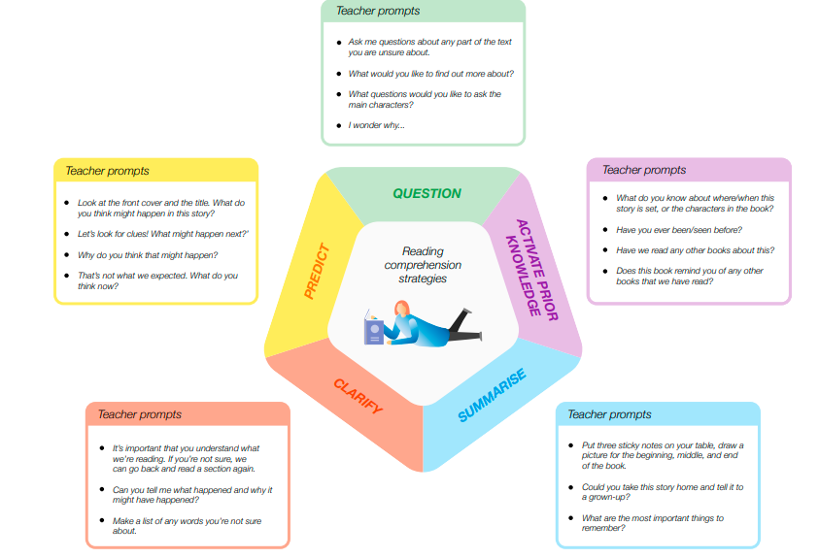
reciprocal

Slide 60
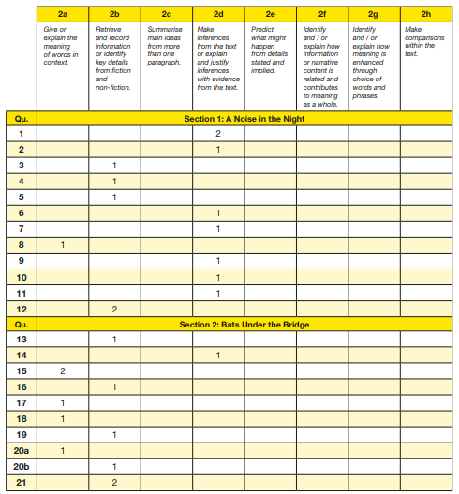
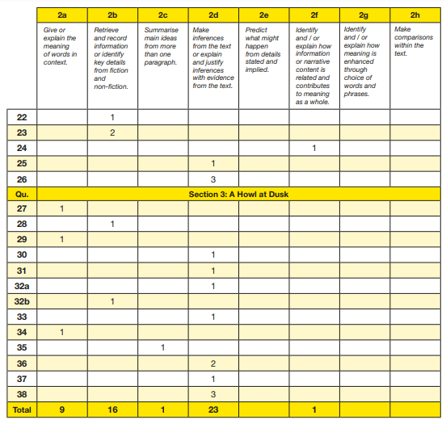
Which skills are assessed?
Summative Assessment of Reading – SATs and Termly Tests
Assess to plan – analysis needed look at the wierghting of q type60% I 30%R

Slide 61
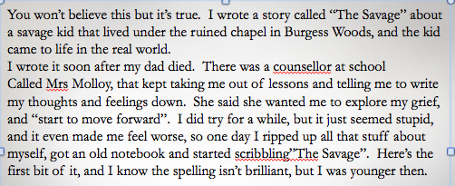
Retrieval
Key words - Q and A
Skimming and scanning
Synonyms
Read around the word
Fluency – model it
Punctuation/expression
Repeat
Answer matches the question?

Slide 62
Inference and Summary
Teacher modelling (think aloud)
Make links to prior knowledge own experiences
Make links within the text and plot (cause and effect)
Predict
Model fluency and expression
Repeat
Summarise
Paraphrase
Small chunks to discuss
Kate grabbed her heavy backpack and charged out of the door to her family waiting in the car.
When they eventually reached the beach, eager crowds gathered around the ice cream van, multi-coloured kites hovered in the air, as happy faced children played joyfully in the sand.
Contentedly, the parents were sunbathing, seagulls flew over head, children’s laughter floated through the air, but where was Kate?

Slide 63
Shared reading – part of a lesson – whole class
Guided reading – whole class/a group of around six children of similar ability with shared targets – weekly or fortnightly
Individual reading – from school reading scheme – at home and in school, reading record
Cross curricular reading – topic areas, subject research, fact pages
Reading for Pleasure – stories, fun, interest, topics, inspiring!

Slide 64
Shared Reading
Whole class shares the same/differentiated version of the same text
Text shared in class readers, on IWB or extracts
The shared reading skills feed into or form the learning outcome of the lesson
Text can be read by teacher, independently, or by individuals (audio)
Encourages book talk
Development of comprehension skills VIPERS
New vocabulary – learn and apply
MODELLING

Slide 65
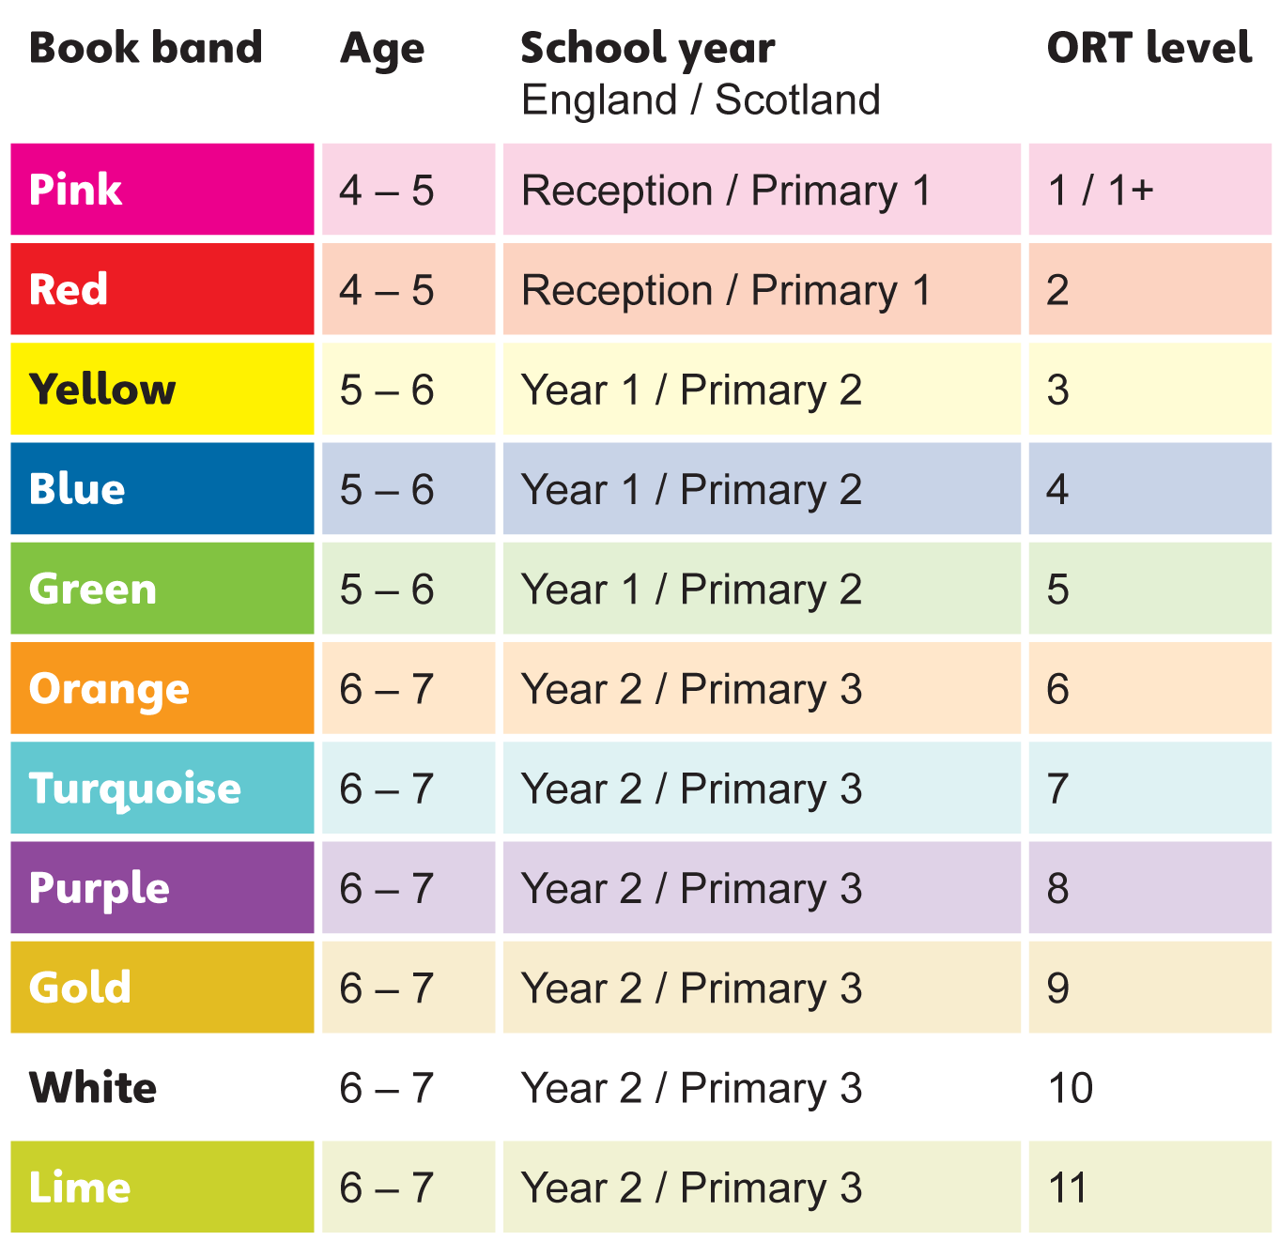
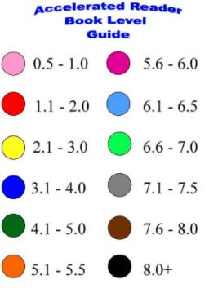
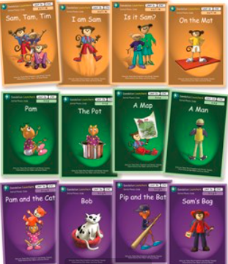
Individual Reading
Progressive
Decodable initially
Scheme?
With teacher, TA or parent
A chance to focus on individual targets
Less can be more
When to move on?
MODELLING
We are going to hear a partner read and use the questioning/VIPERS booklets to help us to initiate comprehension skills.

Slide 66
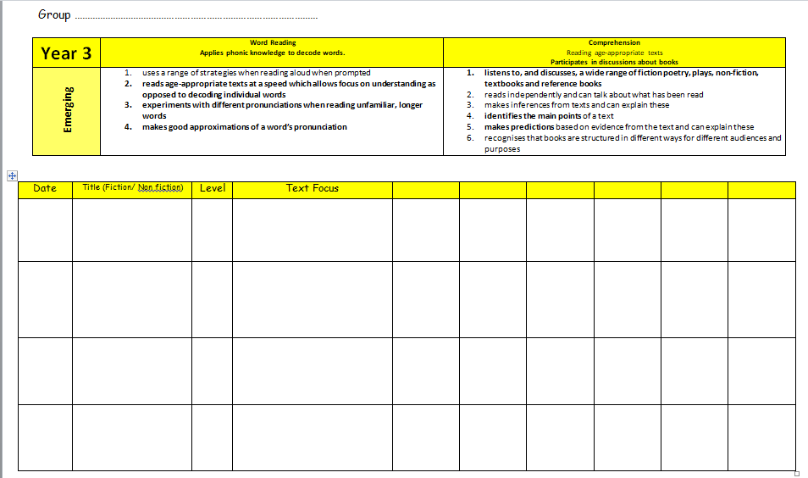
Guided Reading
The National Literacy Strategy
Encourage book talk and response to texts
New Vocabulary - learn and apply
Read as a writer - Choose texts or extracts that match the class focus (secondary texts)
Groups of children work together on the same/similar text towards shared outcomes
Texts match the reading ability of the group/class
Use questioning to develop VIPERS (domains) skills
The teacher leads or guides the session, guiding the children to focus on word reading and comprehension skills.
Use text books and reference pages to support non-fiction research and the wider curriculum
MODELLING
www.literacyshed.com www.dkfindout.com
www.classroomsecrets.com
Discuss- group or whole class

Slide 67
Shared reading and guided reading
Remember – read as writers!
Book Talk - Discussion
Tell me grid
Box it up
Comprehension
Annotate it
What I know | What I think | What I want to find out
Notes:
Give out handout.
Shared reading provides opportunities for chn to access a range of text types and genres beyond the independent reading level. Provides opportunities for teachers to model fluent, expressive reading.
Guided reading lies at the heart of the reading curriculum – monitor progress, focus on objectives, extend range of reading strategies, support to critically read and evaluate a range of texts. Should do regularly (every week).
Independent reading – pupils work individually or in pairs. Opportunity for teacher to assess.
As a teacher you need to provide as many opportunities as you can for this.

Slide 68
Before During After
Book Talk Explore the cover Predict characters, setting plot Pre read (them or modelled), and point out tricky V Outline the story Make links with other stories Model fluency and expression | Book Talk Monitor understanding, using all of the strategies mentioned Keep updating predictions Record CEW or expected words they find difficult (CUL) Model fluency and expression – rehearse and reread (reading theatre FFT F into C) Model answering questions Sequence/summarise | Book Talk Clarify their understanding Revisit predictions Visit phonic or CEW words they found difficult Discuss preferences Make links to real life/experiences Summarise
Make the point NF is essential – what would we be inc/changing layout, tense, sentence struc, V

Slide 69
Task
Plan a guided reading session (15/20mins) for a group of Y4 children Autumn Term, focussing upon retrieval and inference.
Consider
Who will be reading?
Skills to be covered and how you present these?
Modelling?
Developing fluency
Response and recording?

Slide 70
Formative Assessment of Reading

Slide 72
In all sessions:
Have a focus/noted on the child’s/group’s class’ next step or target.
Model – share your thinking actively
decoding strategies – blending, breaking into syllables, trying different GPCs
Model the reading skills – how did you find the answer ---supported practice ---independent
Fluency and expression – model, rehearse, reading theatre
Finding key words/phrases to retrieve
Finding quotes/text for inference or predicting
Model summarising or sequencing texts as you read, picking out key events.

Slide 73
How to organise guided reading

Slide 74
Global OUP Webinar from James Clements
https://www.brainshark.com/1/player/oup?region=uk&fb=0&r3f1=aa90eebdb1bce4f6a6fc94f5aba0a3f0b6fcebd6f9a6ace0&custom=blendedlearning
LaunchPad for Literacy
https://www.launchpadforliteracy.co.uk/
The Reading Framework – Teaching the Foundations of Literacy
The reading framework - teaching the foundations of literacy (publishing.service.gov.uk)
EEF Improving Literacy at Key Stage 1
https://educationendowmentfoundation.org.uk/tools/guidance-reports/literacy-ks-1/
EEF Improving Literacy at Key Stage 2
https://educationendowmentfoundation.org.uk/tools/guidance-reports/literacy-ks-2/
Fisher Family Trust – Reciprocal Reading and Fluency into comprehension
https://fft.org.uk/fft-literacy/reciprocal-reading/

Slide 75
QR Code?

