Slide 1
English Training 1
(Emphasis on Reading)

Slide 2
Curriculum Coverage

Slide 3
Reflection
What are your experiences of teaching reading within a school setting?
Have you got any outstanding questions regarding reading to be addressed within the session?

Slide 4
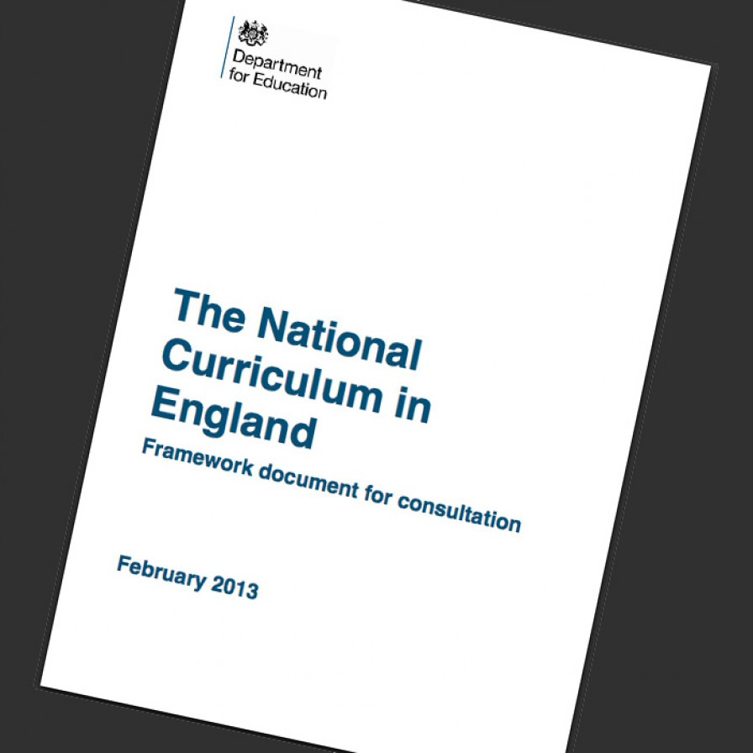
English Curriculum - KS1
The New National Curriculum has been in force since September 2014.
It is broken down into programmes of study. The programmes of study include:
Year 1 Programme of Study
Year 2 Programme of Study
Year 3 and Year 4 Programme of Study
Year 5 and 6 Programme of Study
The purpose of study for the English Curriculum explains that ‘A high-quality education in English will teach pupils to speak and write fluently so that they can communicate their ideas and emotions to others, and through their reading and listening, others can communicate with them. Through reading in particular, pupils have a chance to develop culturally, emotionally, intellectually, socially and spiritually.’

Slide 5
English Curriculum
The English Curriculum for each year group is split into four main sections:
Spoken Language
(Speaking and Listening)
Reading
(Word Reading and Comprehension)
Writing Transcription and Composition
(Spelling and Handwriting)
(Articulating ideas and structuring them in speech and writing)
G.P.S
(Vocabulary, Grammar and Punctuation)

Slide 6
Assessment of English

Slide 7
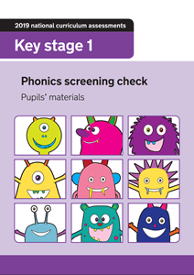
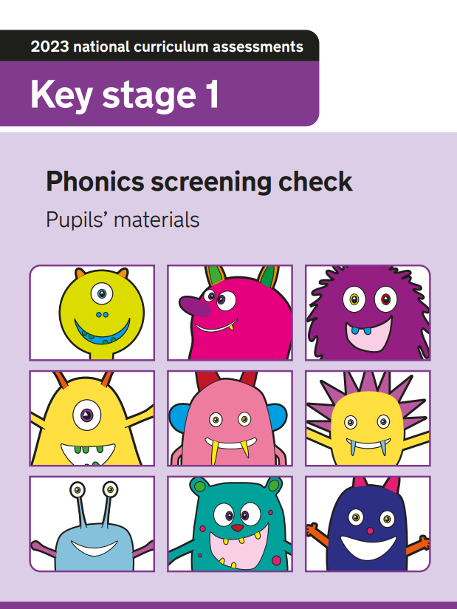
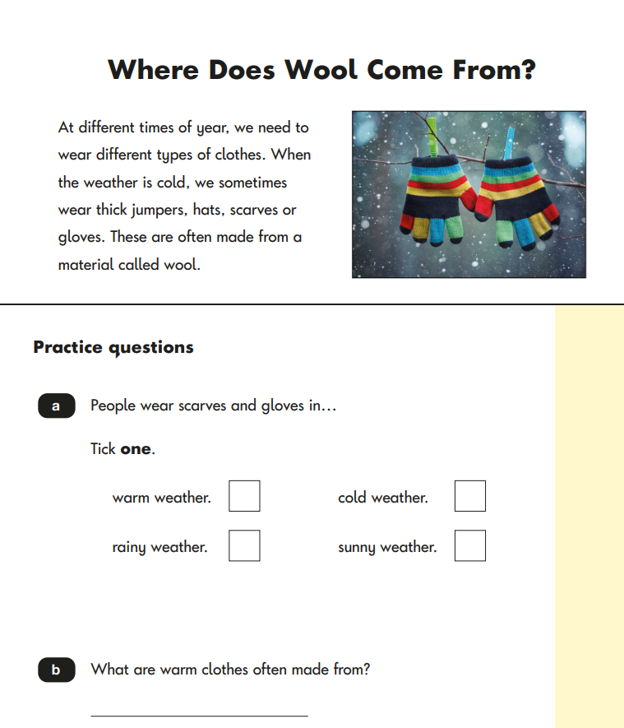
Statutory Assessment
The summative assessment carried out within English includes:
Year One - Phonics Screening Check at the end of June
Year Two - Reading SATs and SPAG paper in May/June
Year Six - Reading SATS and SPAG paper in May

Slide 8
Formative Assessment within English
Formative assessment is carried out consistently throughout the day.
Some examples of formative assessment strategies are:
Assessment Tracking Sheets
Effective feedback - verbal or written
Individual Targets
Questioning
Whiteboard Work

Slide 9
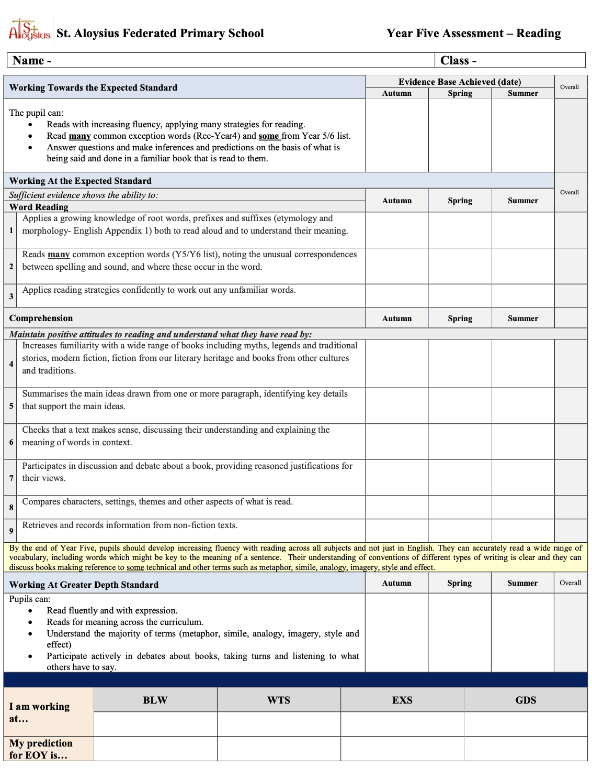
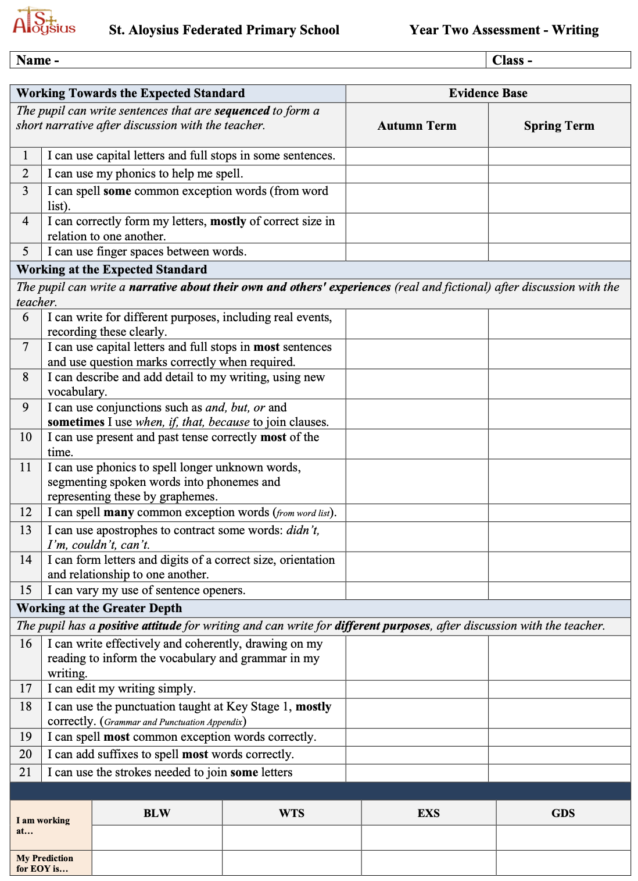
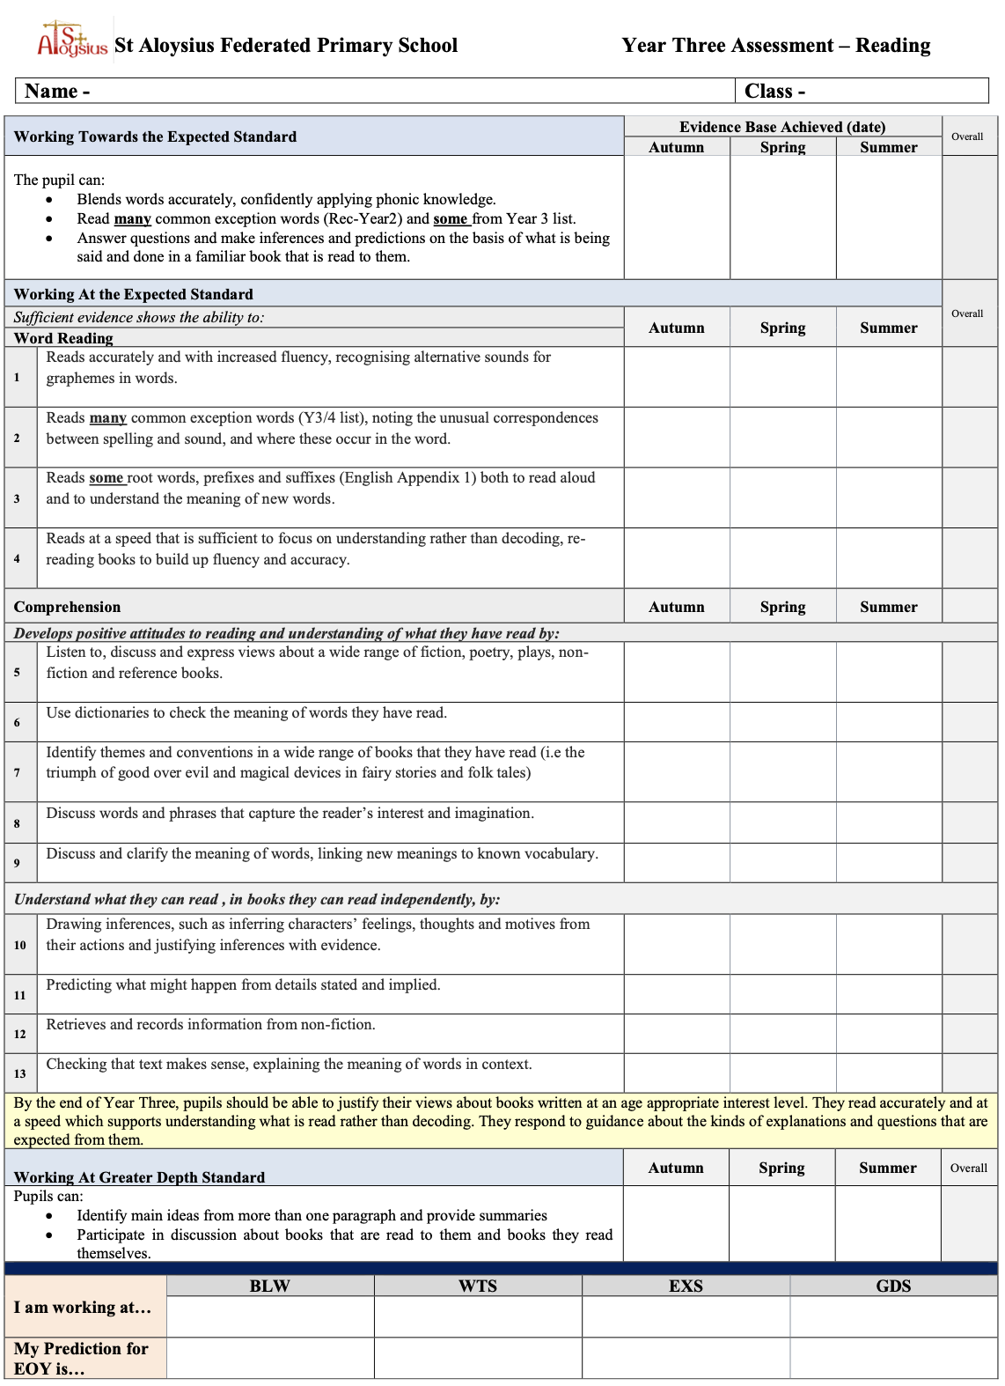
Assessment of Progress

Slide 10
Assessment of Progress - Reading
Assessing a child’s progress in Reading is subdivided into two key areas; word reading and comprehension.
Each school will have different methods/systems of assessment so it is worth familiarising yourself with your school’s chosen approach but also observing how others also approach this so that you are aware of multiple methods before entering the profession.
In Key Stage One and into lower Key Stage Two, focus is placed upon developing a child’s phonological awareness to help them to become fluent, independent readers who possess strong comprehension skills. Whilst less focus is placed upon discrete phonics teaching moving into Key Stage Two, it is important to still identify those pupils who lack general phonetic awareness or comprehension skills.
A great way to do this is to use the Simple View of Reading which we will discuss further on the next slide.

Slide 11
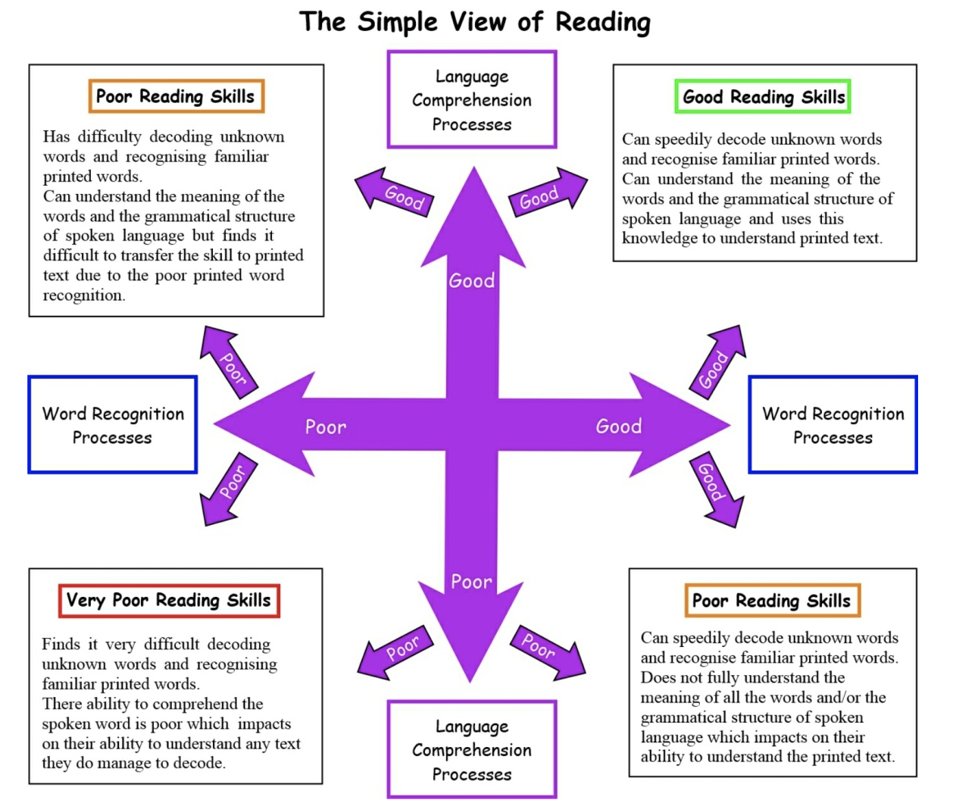
Assessment of Progress - Reading
In 1986, Gough and Tunmer proposed the Simple View of Reading to clarify the role of decoding in reading.
The term ‘Simple View of Reading’ seems abstract as reading is an extremely complex process when broken down.
However, this view was adopted by the Government in 2007 and now underpins the English National Curriculum programmes of study for reading at Key Stage 1 and 2.
It has been fundamental in changing the debate about the teaching of reading over at least the last 20 years. It is frequently displayed as a diagram like the on in front of you.
The national curriculum programmes of study for reading reflect the model, presented as two dimensions: ‘word reading’ and ‘comprehension’.

Slide 12
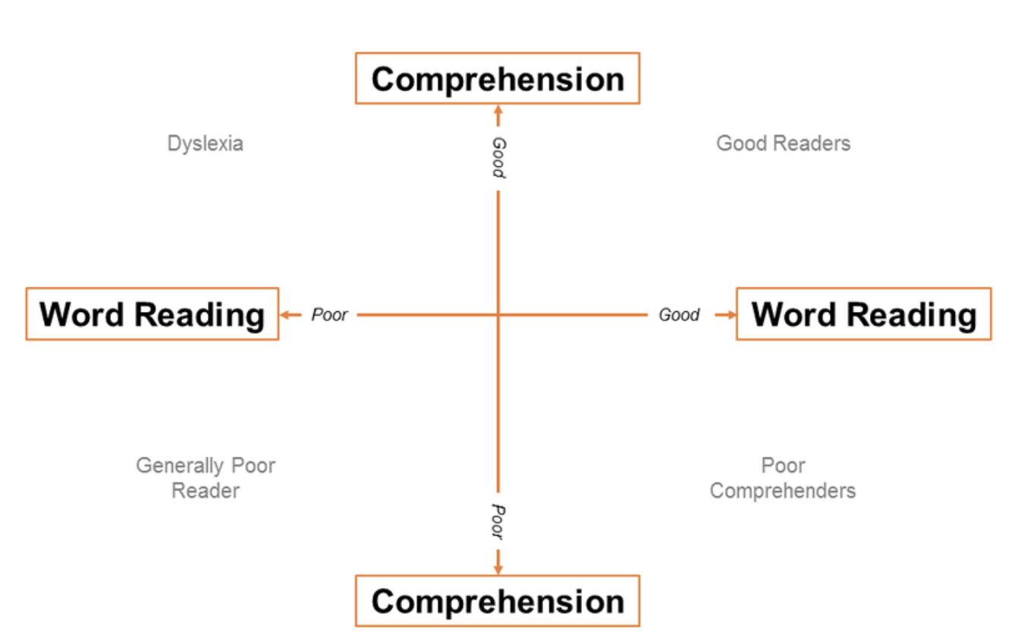
Assessment of Progress - Reading

Slide 13
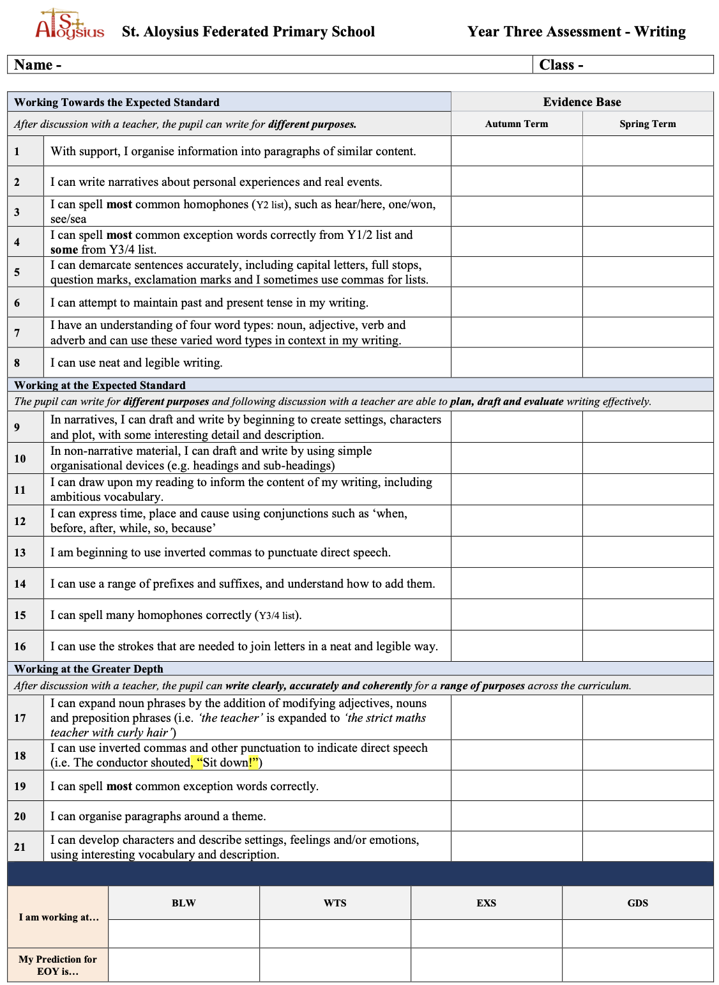
Assessment of Progress - Writing
Assessing primary writing will differ on a school to school approach.
Schools will assess pupil’s writing skills as either working towards the expected standard, working at the expected standard or working at a greater depth within the expected standard.
The programmes of study for writing at Key Stage 1 and 2 are constructed similarly to those for reading:
Transcription (spelling and handwriting)
Composition (articulating ideas and structuring them in speech and writing).
Vocabulary, grammar and punctuation.
All schools will assess pupils against these strands as they move through school.
The end of year expectations for each of these strands can be viewed within the English national curriculum under the relevant strands and it would be worthwhile to familiarise yourself with the expectations of both above and below and within your given year group.

Slide 14
Planning

Slide 15
Planning
Long Term Plan: Summary of what will be covered throughout the whole year. Often it is referred to as ‘The Programmes of Study’ from the National Curriculum.
Medium Term Plan: Using the programmes of study, each year group has a plan for the year which explains what will be covered in each half term. During this stage, there is a focus on a clear grammar focus to show progress across the year which informs the text you choose to focus on.
Short Term Plan: A weekly plan to cover the objectives which need to be taught to ensure that the children are on track to reach their outcomes.

Slide 16
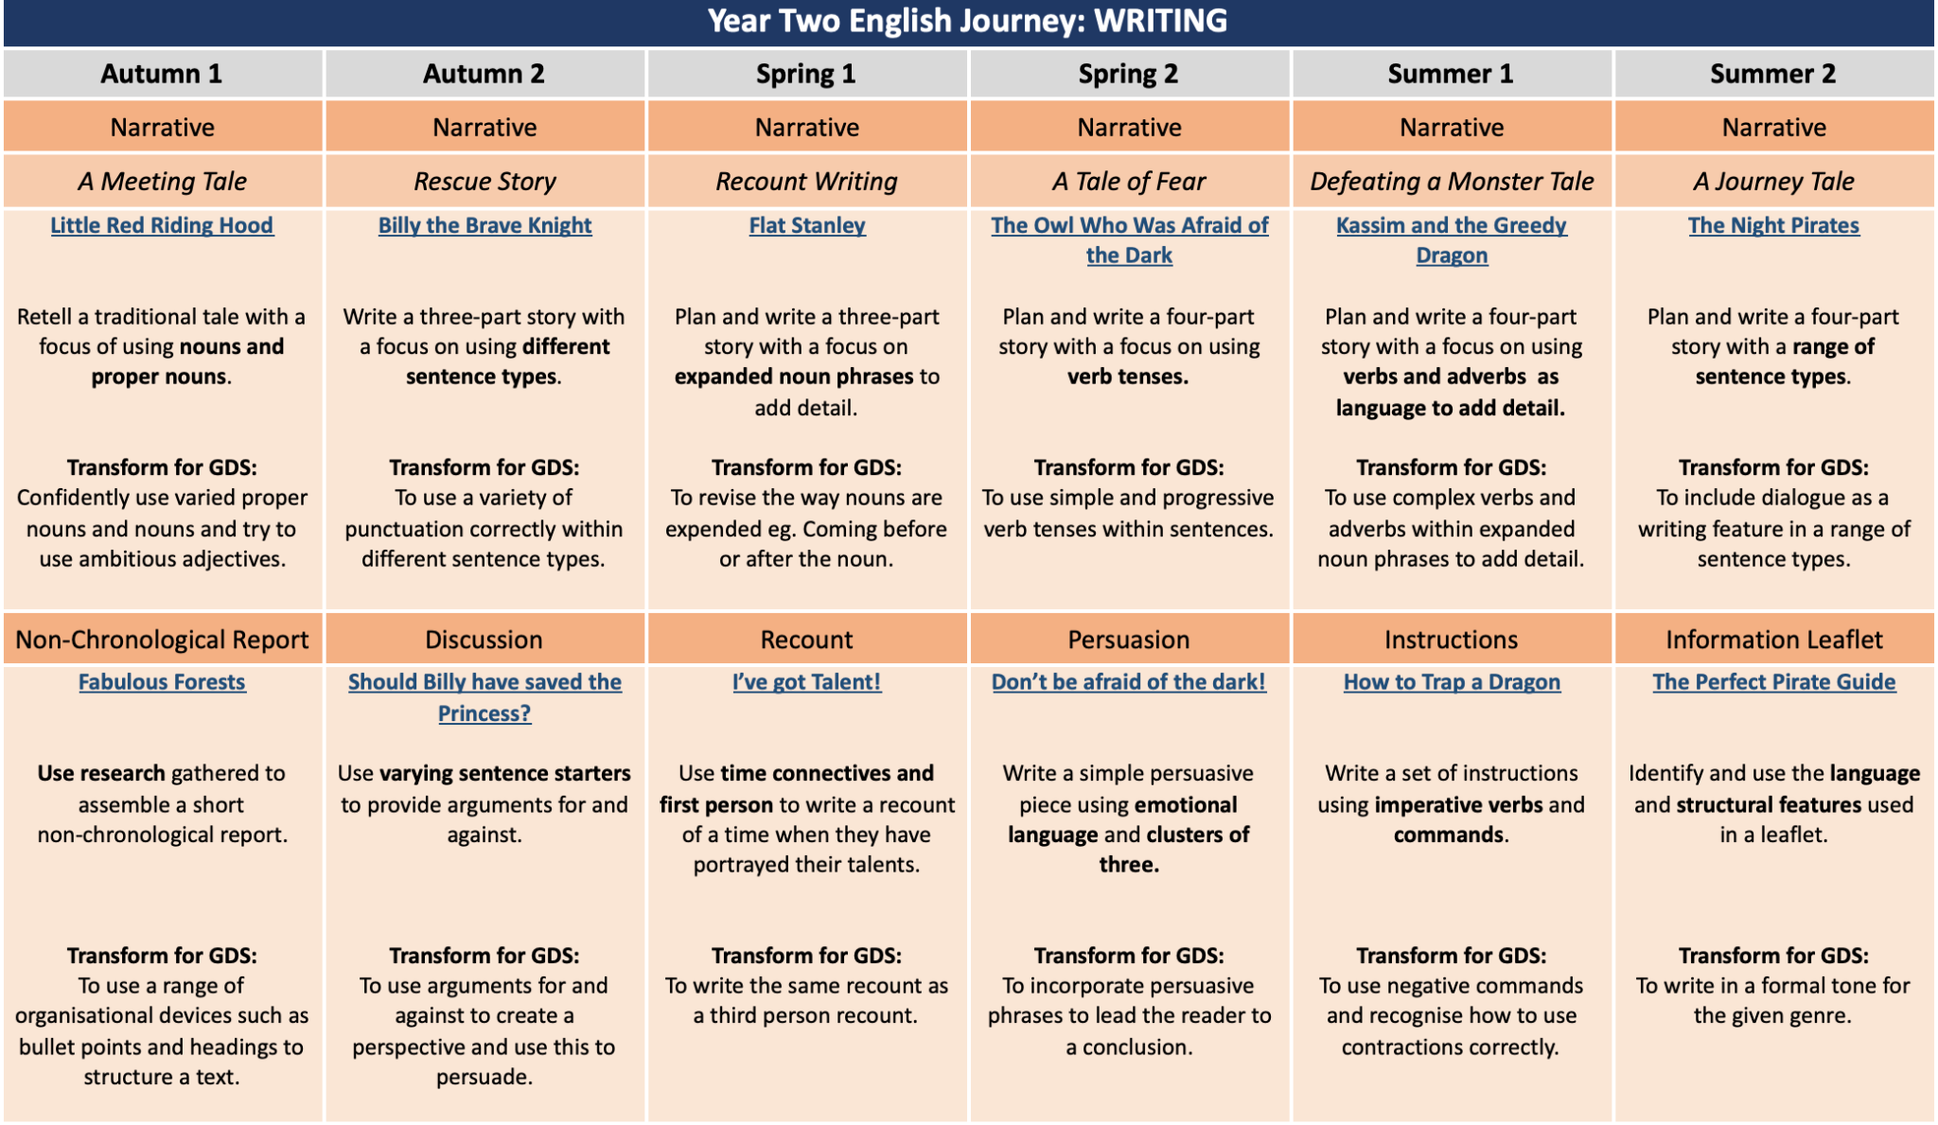
Long Term Plan

Slide 17
Medium Term Plan

Slide 18
Short Term Plan
When short term planning, it is important to consider the following things:
What are the children going to be learning? (The learning objective). A helpful tip would be to use Bloom’s Taxonomy words to help frame this.
What do you want the children to achieve and what steps do they need to take to meet this? (Success criteria)
What resources am I going to provide to scaffold?
How are all children going to achieve? (Differentiation)
What will happen at each stage in my lesson? (Lesson timings)
How will my lesson end? (Plenary task)

Slide 19
The Implementation of English in our School

Slide 20
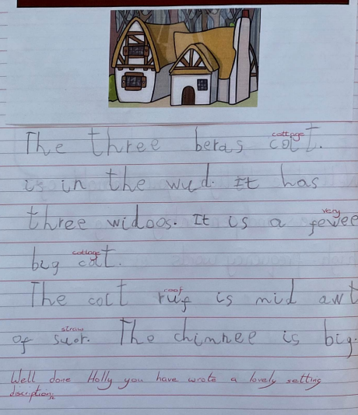
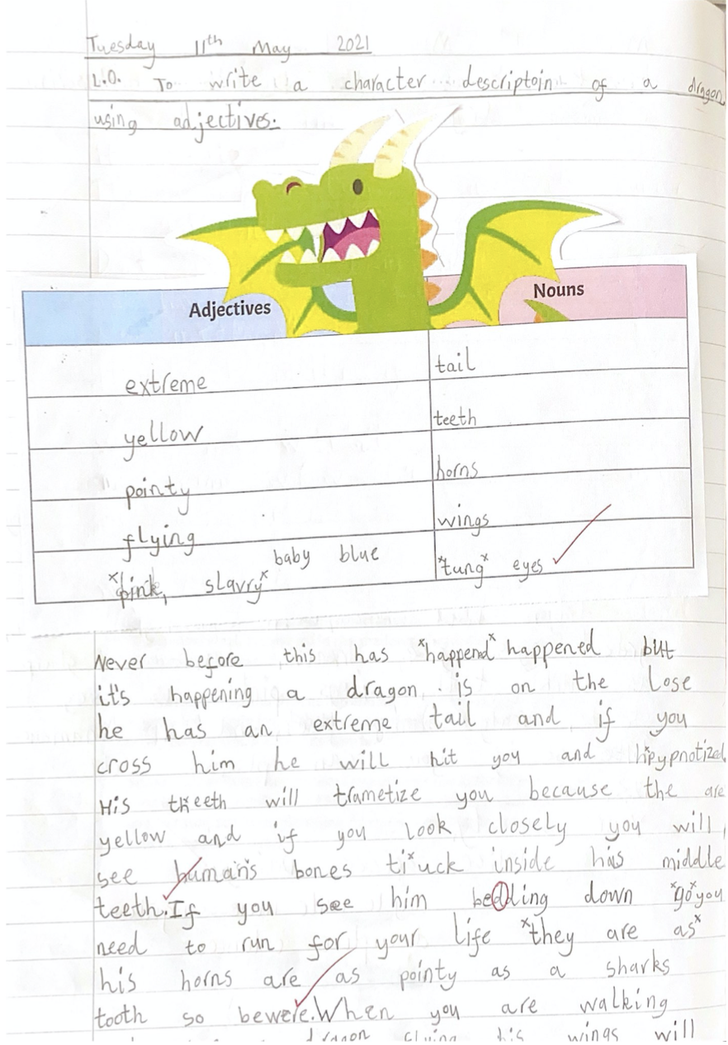
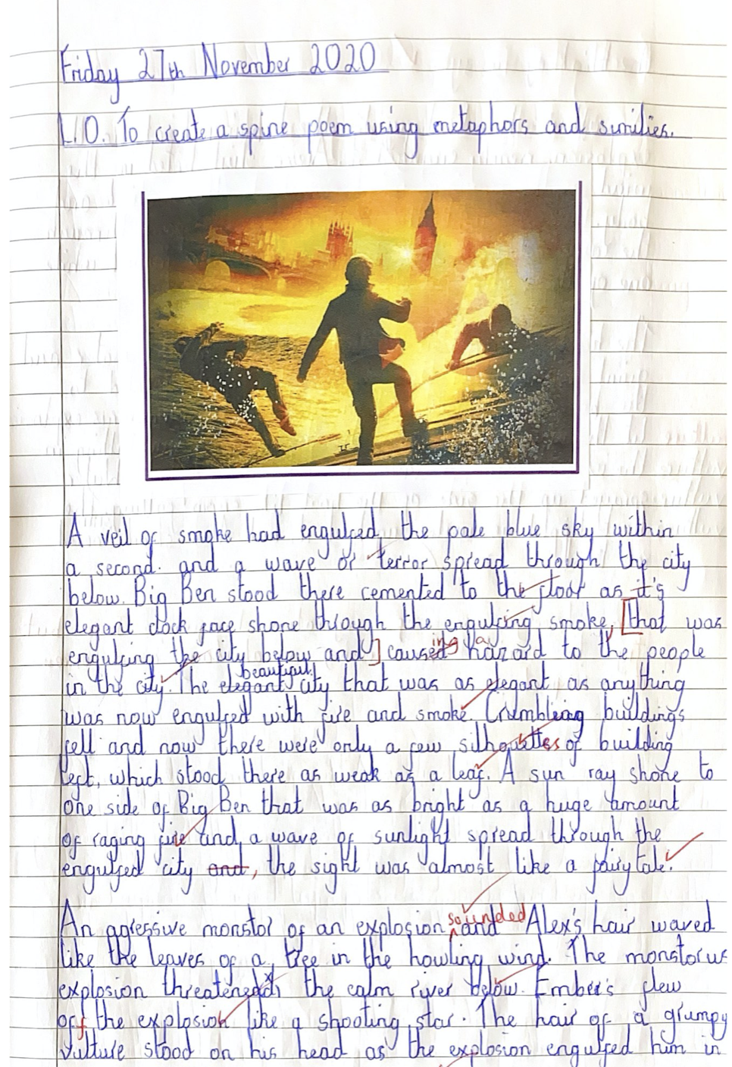
The Primary Writing Project
In 2017, we became part of the Primary Writing Project. The vision was to implement a whole-school approach to the teaching of English, by providing support and training over a sustained period of time.
As a school we passionately believe that we must make the following investments:
In the children: We acknowledge that it is the child who is at the centre of education, it is them doing the learning. Therefore, we must engage, motivate and excite the child.
In the profession: We attribute a very high status to the teaching profession itself; We recognise that we can’t improve education and advance achievement without great teachers and therefore we are committed to investing a lot of time and energy into making great teachers even better. This is not a cost but an investment.
In what works best: We must keep our teaching and learning provision rooted in the question of what works best and what is having the biggest impact? Legislation and policy can advise and give us direction but education fundamentally happens through our school and not in a committee room where policy and legislation are formed. Therefore, we must be confident to invest in what works for us as a school and for our children.
Based on the idea of deepening language understanding, we aim to motivate children and teachers as readers and writers with a systematic focus on securing the basics of handwriting, phonics, spelling and grammar.

Slide 21
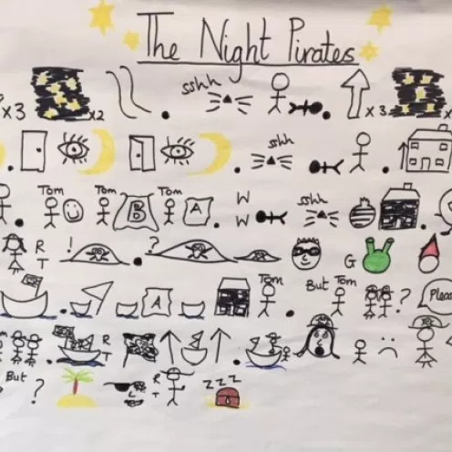
The Process of Talk4Writing
A typical Talk 4 Writing unit begins with an exciting hook into learning and some engaging activities to help children internalise the pattern of the language required and to get to know the text type really well. This includes:
Oral retelling supported visually by a story map. This is accompanied by physical movements
or actions to help the children recall the story or nonfiction piece.
Once they have internalised the language of the text, they are in a position to read the text and start to think
about the key ingredients that help to make it work.
This stage includes:
A range of reading as-a-reader and as-a-writer activities which help the children to pull the text apart and explore the content and structure.
Delivery of grammar based activities to be planned for purpose in order to be incorporated into the innovated written piece.

Slide 22
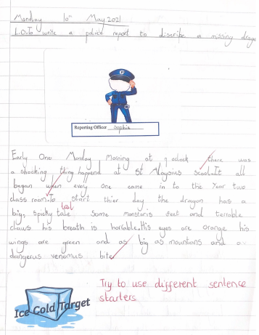
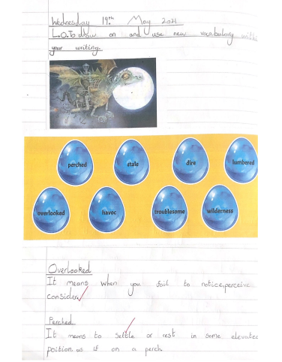
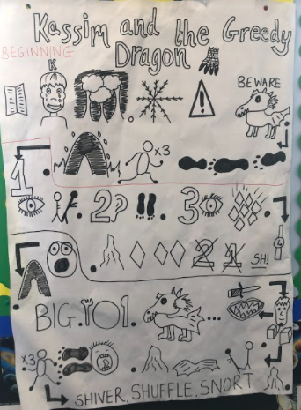
Imitation Stage - KS1
Cold Task
Grammar Based Lessons
Story Map

Slide 23
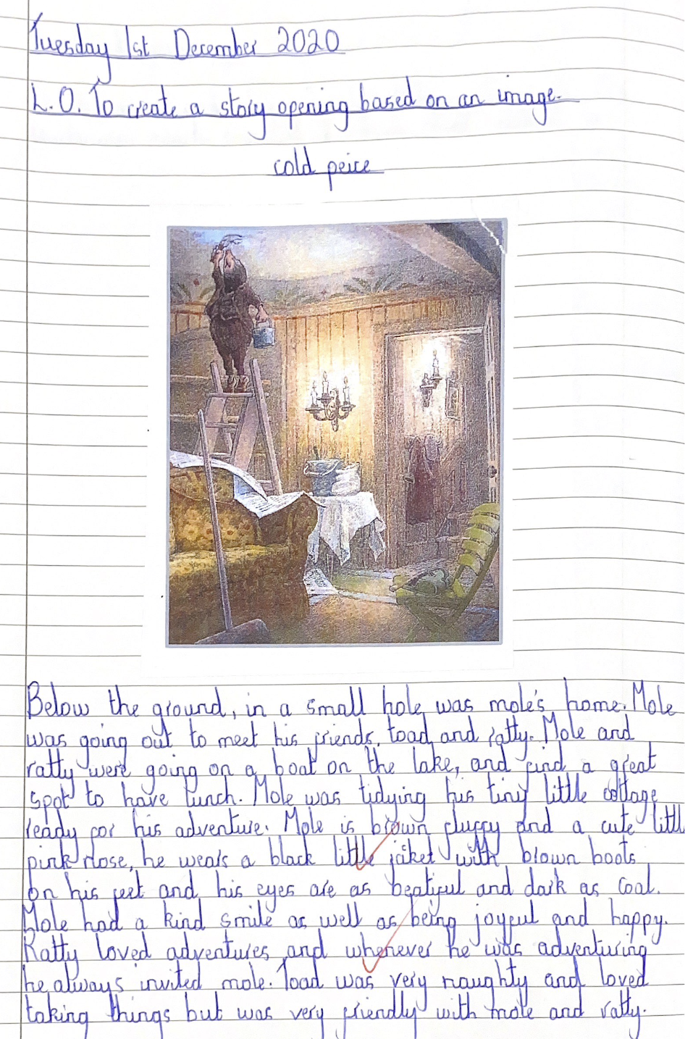
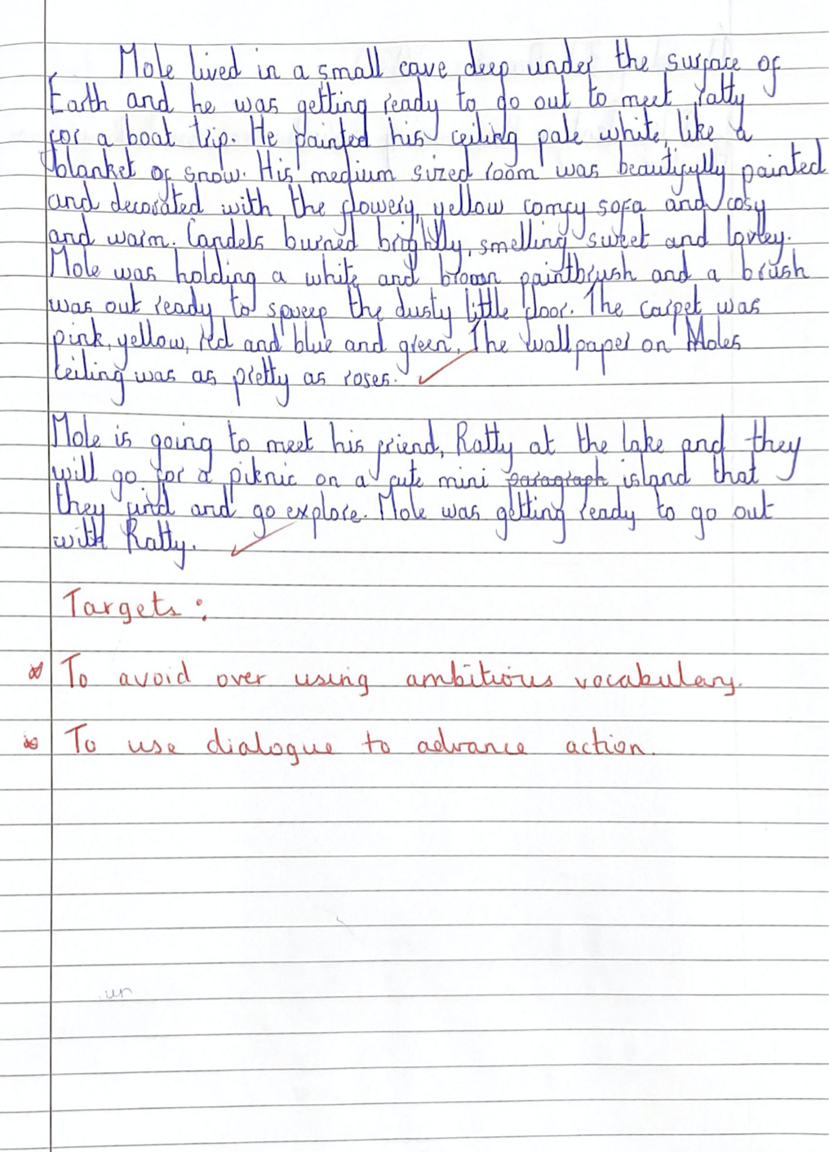
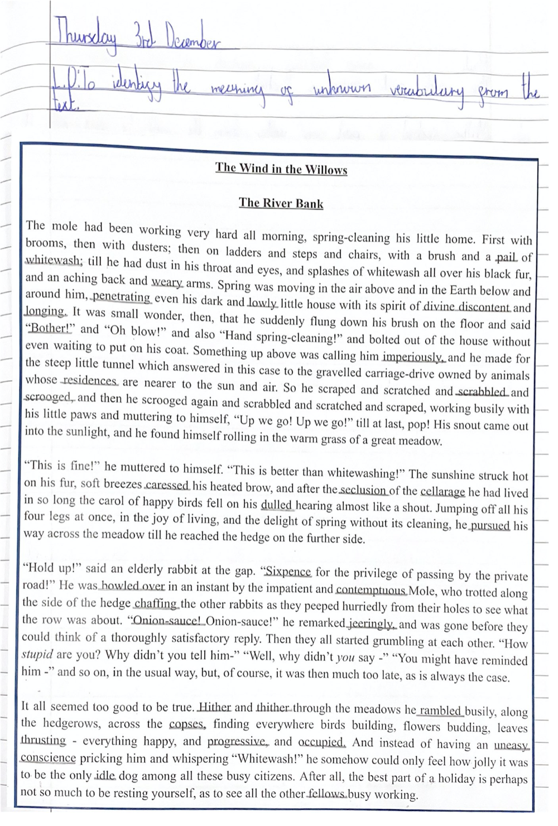
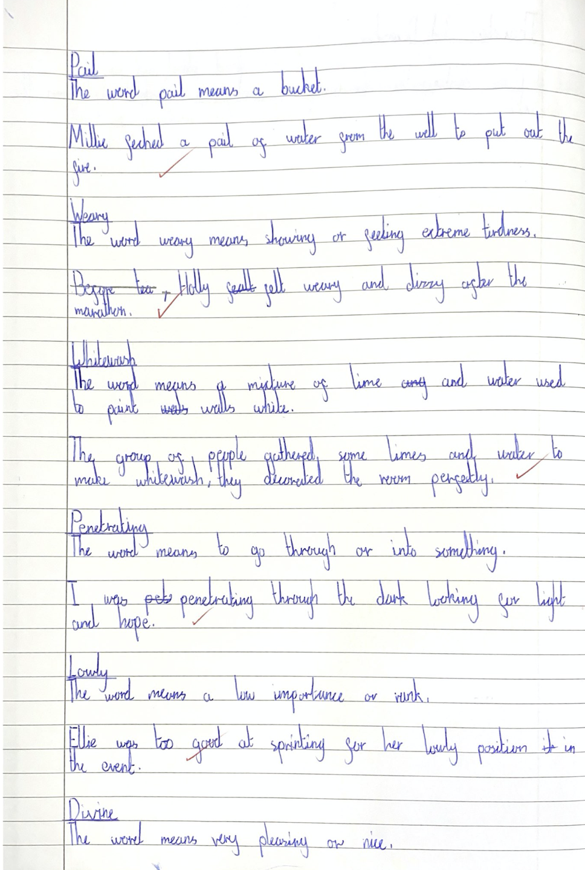
Imitation Stage - KS2
Cold Task
Exploring new vocabulary

Slide 24
Innovation Stage
Children begin to explore their own ideas while sharing with the teacher; they are ready to start innovating on the pattern of the text learned.
Shared writing is key to the success of this stage and children increasingly feel confident to move away slightly from the teacher and write their own. This allows the teacher to identify specific areas for learning and give the children the opportunity to explore different skills before they are expected to do it independently.
The teacher will also explore and demonstrate how to use ambitious vocabulary and sentence structures.
Marking and feedback is really important during this stage so that children can build upon the skills they have been learning and reflect upon it within their independent work.

Slide 25
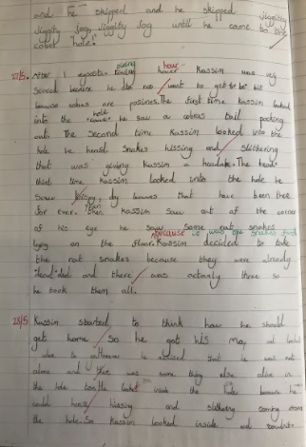
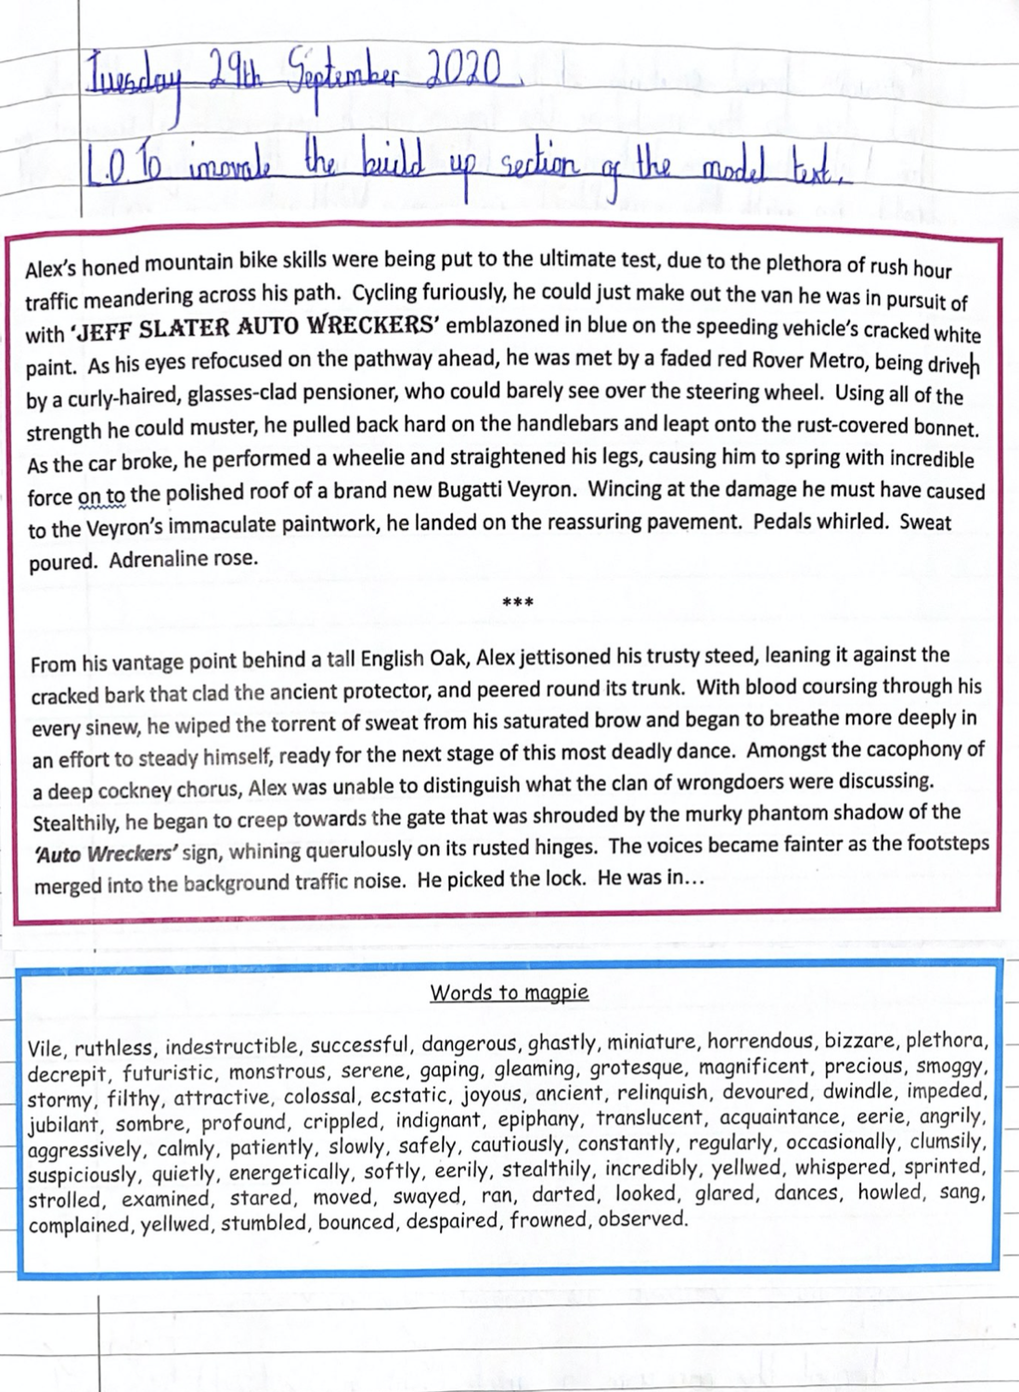
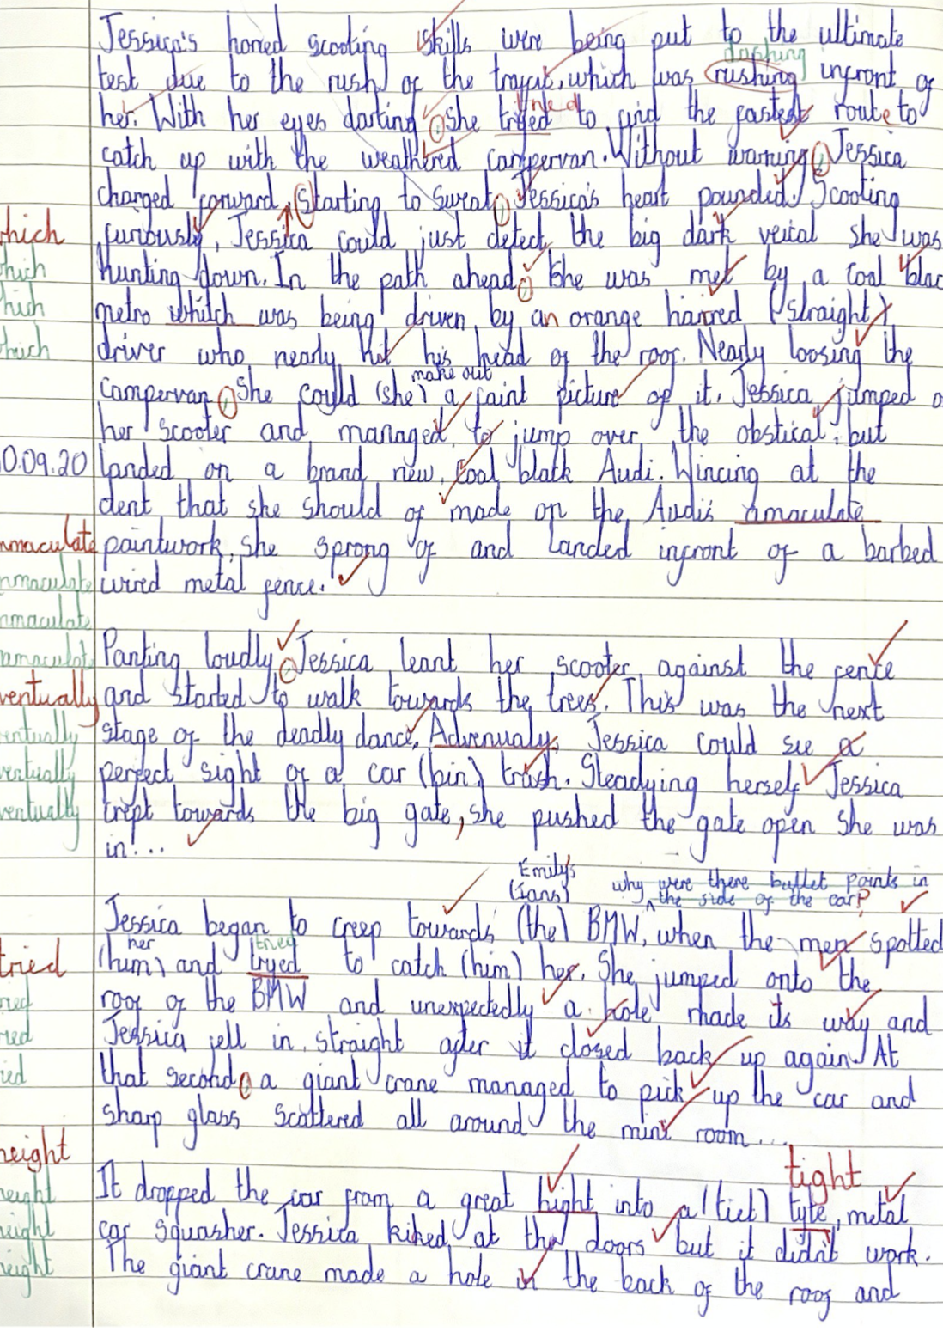
Innovation Examples
Key Stage 1 Examples
Key Stage 2 Examples

Slide 26
Independent Application
During this final stage the teacher will assess what the children can do and adapt their planning in light of this. The children should produce a piece of writing which moves away from the original model text but sticks to the theme or structure of the genre of writing.
As teachers, we can give the children the general theme from the model text, but then they must use this to write their story independently, using all of their teaching from the previous weeks to support their writing.
During Independent Application Stage, we move away from providing the children with word banks and resources to get a true reflection of what the children can independently write. Greater depth children should be able to use tools from some of their favourite authors to support their writing.
Children use their co-constructed toolkit to aid their writing and teacher feedback and targets should reflect the genre of writing and teacher set targets from the beginning of the unit.

Slide 27
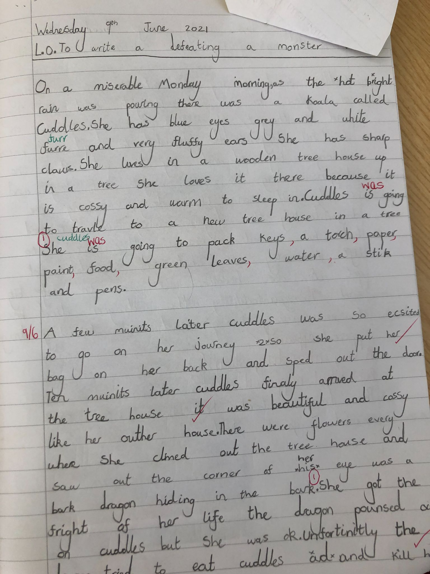
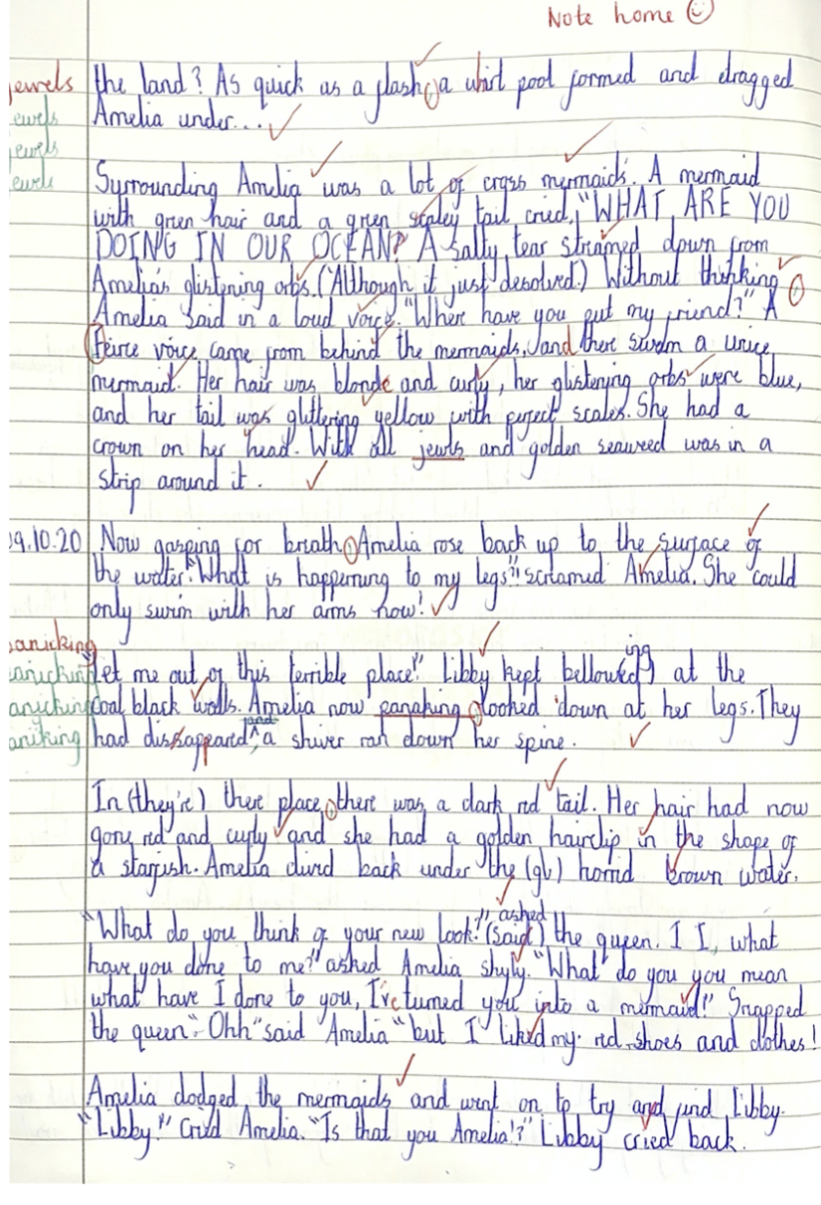
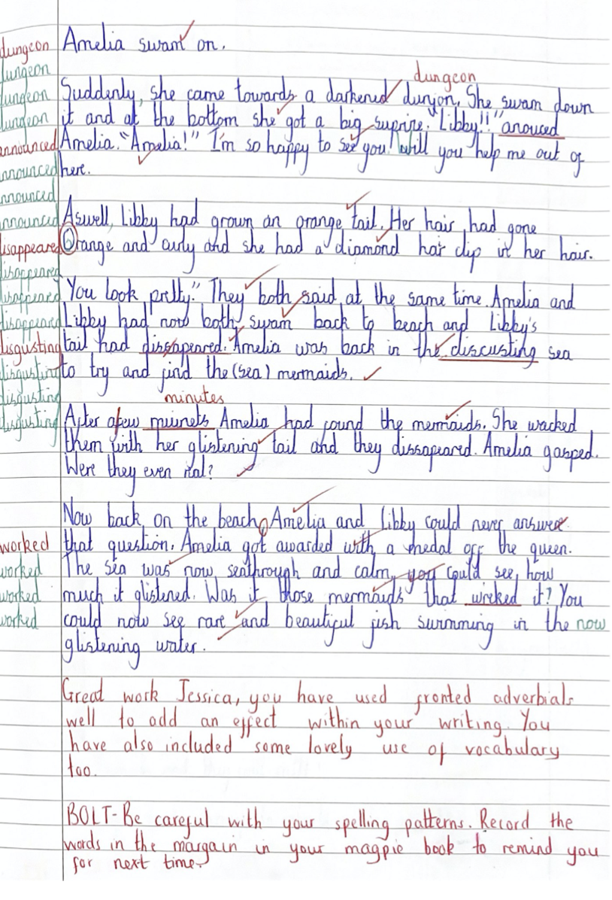
Independent Application Examples
Key Stage 1 Examples
Key Stage 2 Examples

Slide 28
Reading and Writing

Slide 29
The Relationship between Reading and Writing
If a child can write pages and pages of well-punctuated and perfectly spelt text, this does not mean that they are a greater depth writer.
According to Roach (2008), greater depth writing needs to include these three components:
Concision is key: The old adage ‘less is more’ can be applied to greater depth writers. If pupils
regularly don’t finish their stories, despite their writing being excellent, this may reveal areas of
concern around their forward planning skills. Excellent writers will naturally vary the length of their
sentences when the writing lends itself towards this. The ability to self-edit their writing and remove
extraneous context should not be underestimated.
Punctuation should be precise and controlled but also used for effect rather than an opportunity to shoehorn
examples of taught concepts.
Perhaps most importantly, there is evidence that they draw from their own reading of quality literature. In doing this, they demonstrate that they are a prolific reader.
“Greater depth writers manipulate grammar and vocabulary for effect and do so with assured and continuous control. These children draw on the style of the authors they read. They do this independently, but do not rely on a particular technique all of the time, but rather use a whole range of different techniques for a wide range of audiences and for a wide range of purposes. Children select their own form and use it with flair.” - Adam Bushnell - Mastering Writing Greater Depth (2020).

Slide 30
The Importance of Inspiring Reading
“Outstanding reading schools believe in both the importance of developing children’s discrete word-reading skills and comprehension, and the need to engender their love of books and reading. These schools recognise that the two elements are intertwined; each relies on the other if children are to become lifelong readers.” - James Clements
Outstanding reading schools:
Place reading and books at the centre of the curriculum
Recognise that being able to read well is a key life skill for children, whatever their background.
Believe that every child can learn to read with the right teaching and support.
Develop a coherent whole-school strategy for promoting reading for pleasure.
Acknowledge that not all children will have had the opportunity to develop a love of reading at home, so this has to be taught and encouraged at school.
Build time for all children to read independently, read aloud and reading during the school day.
Spend money and time to support reading, including buying books and developing the environment.
Devote time to training staff so that they are equipped to support children’s enjoyment of reading.
Believe that every teacher should be an advocate for reading.
Involve parents so that the reading culture extends to the home too.

Slide 31
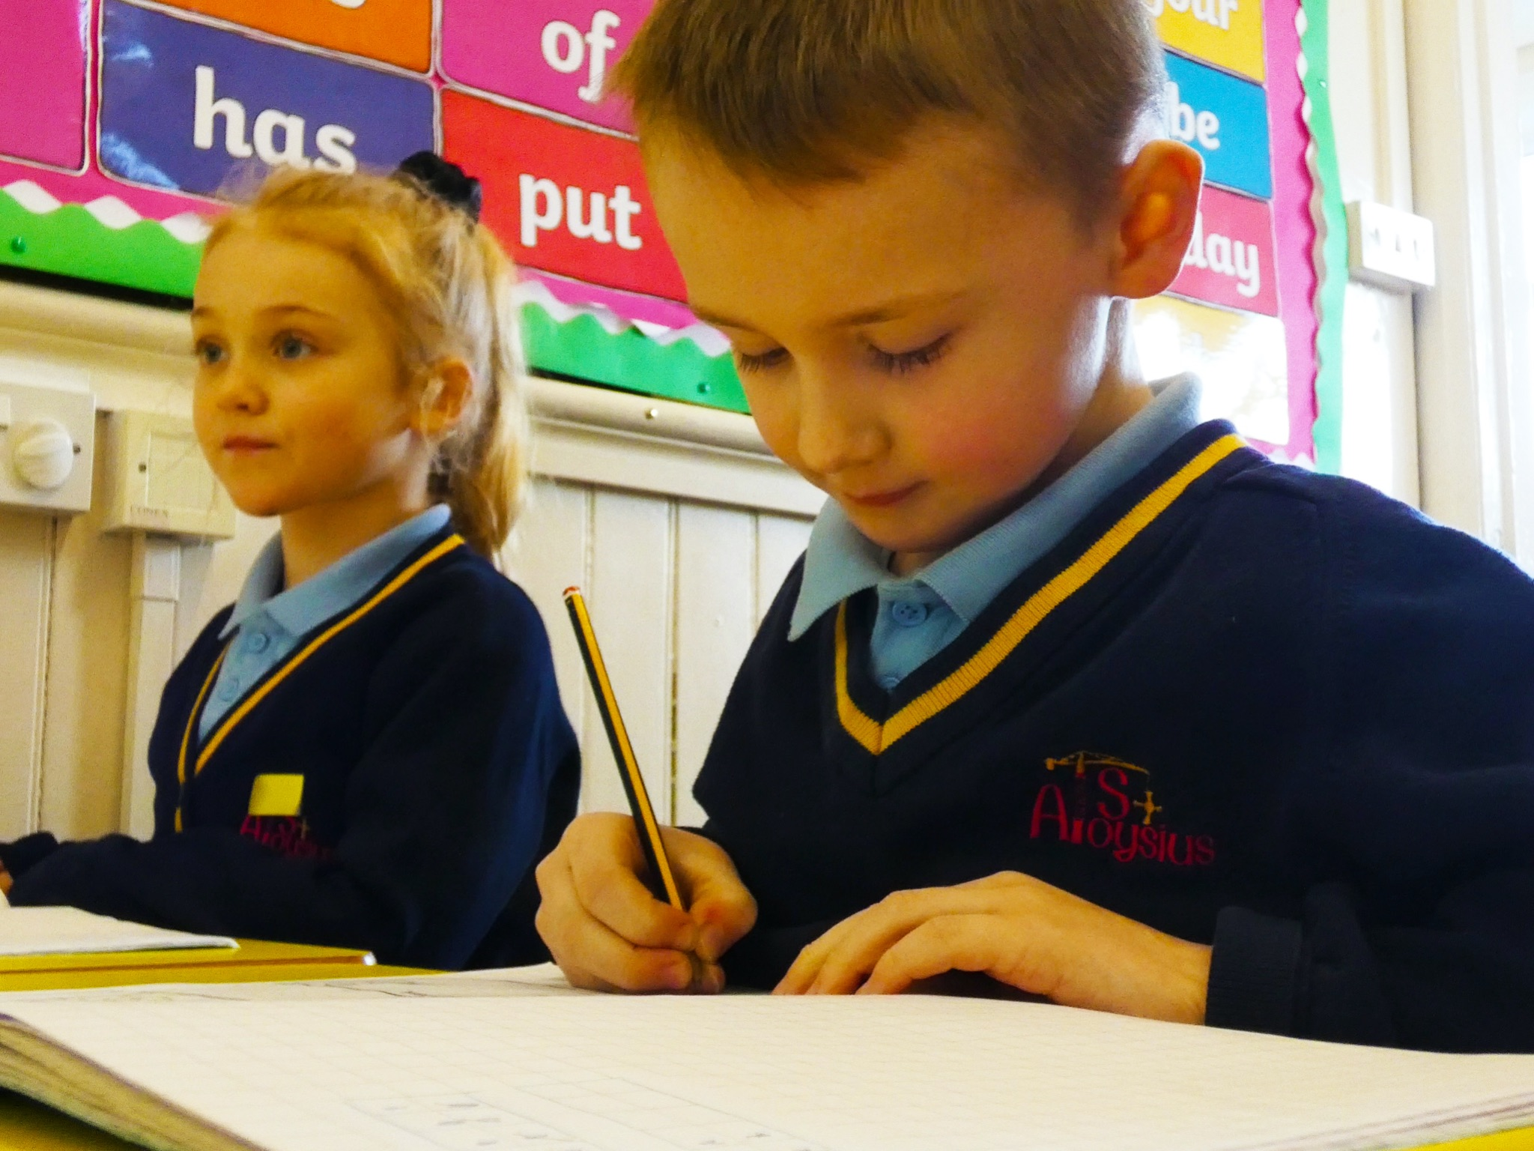
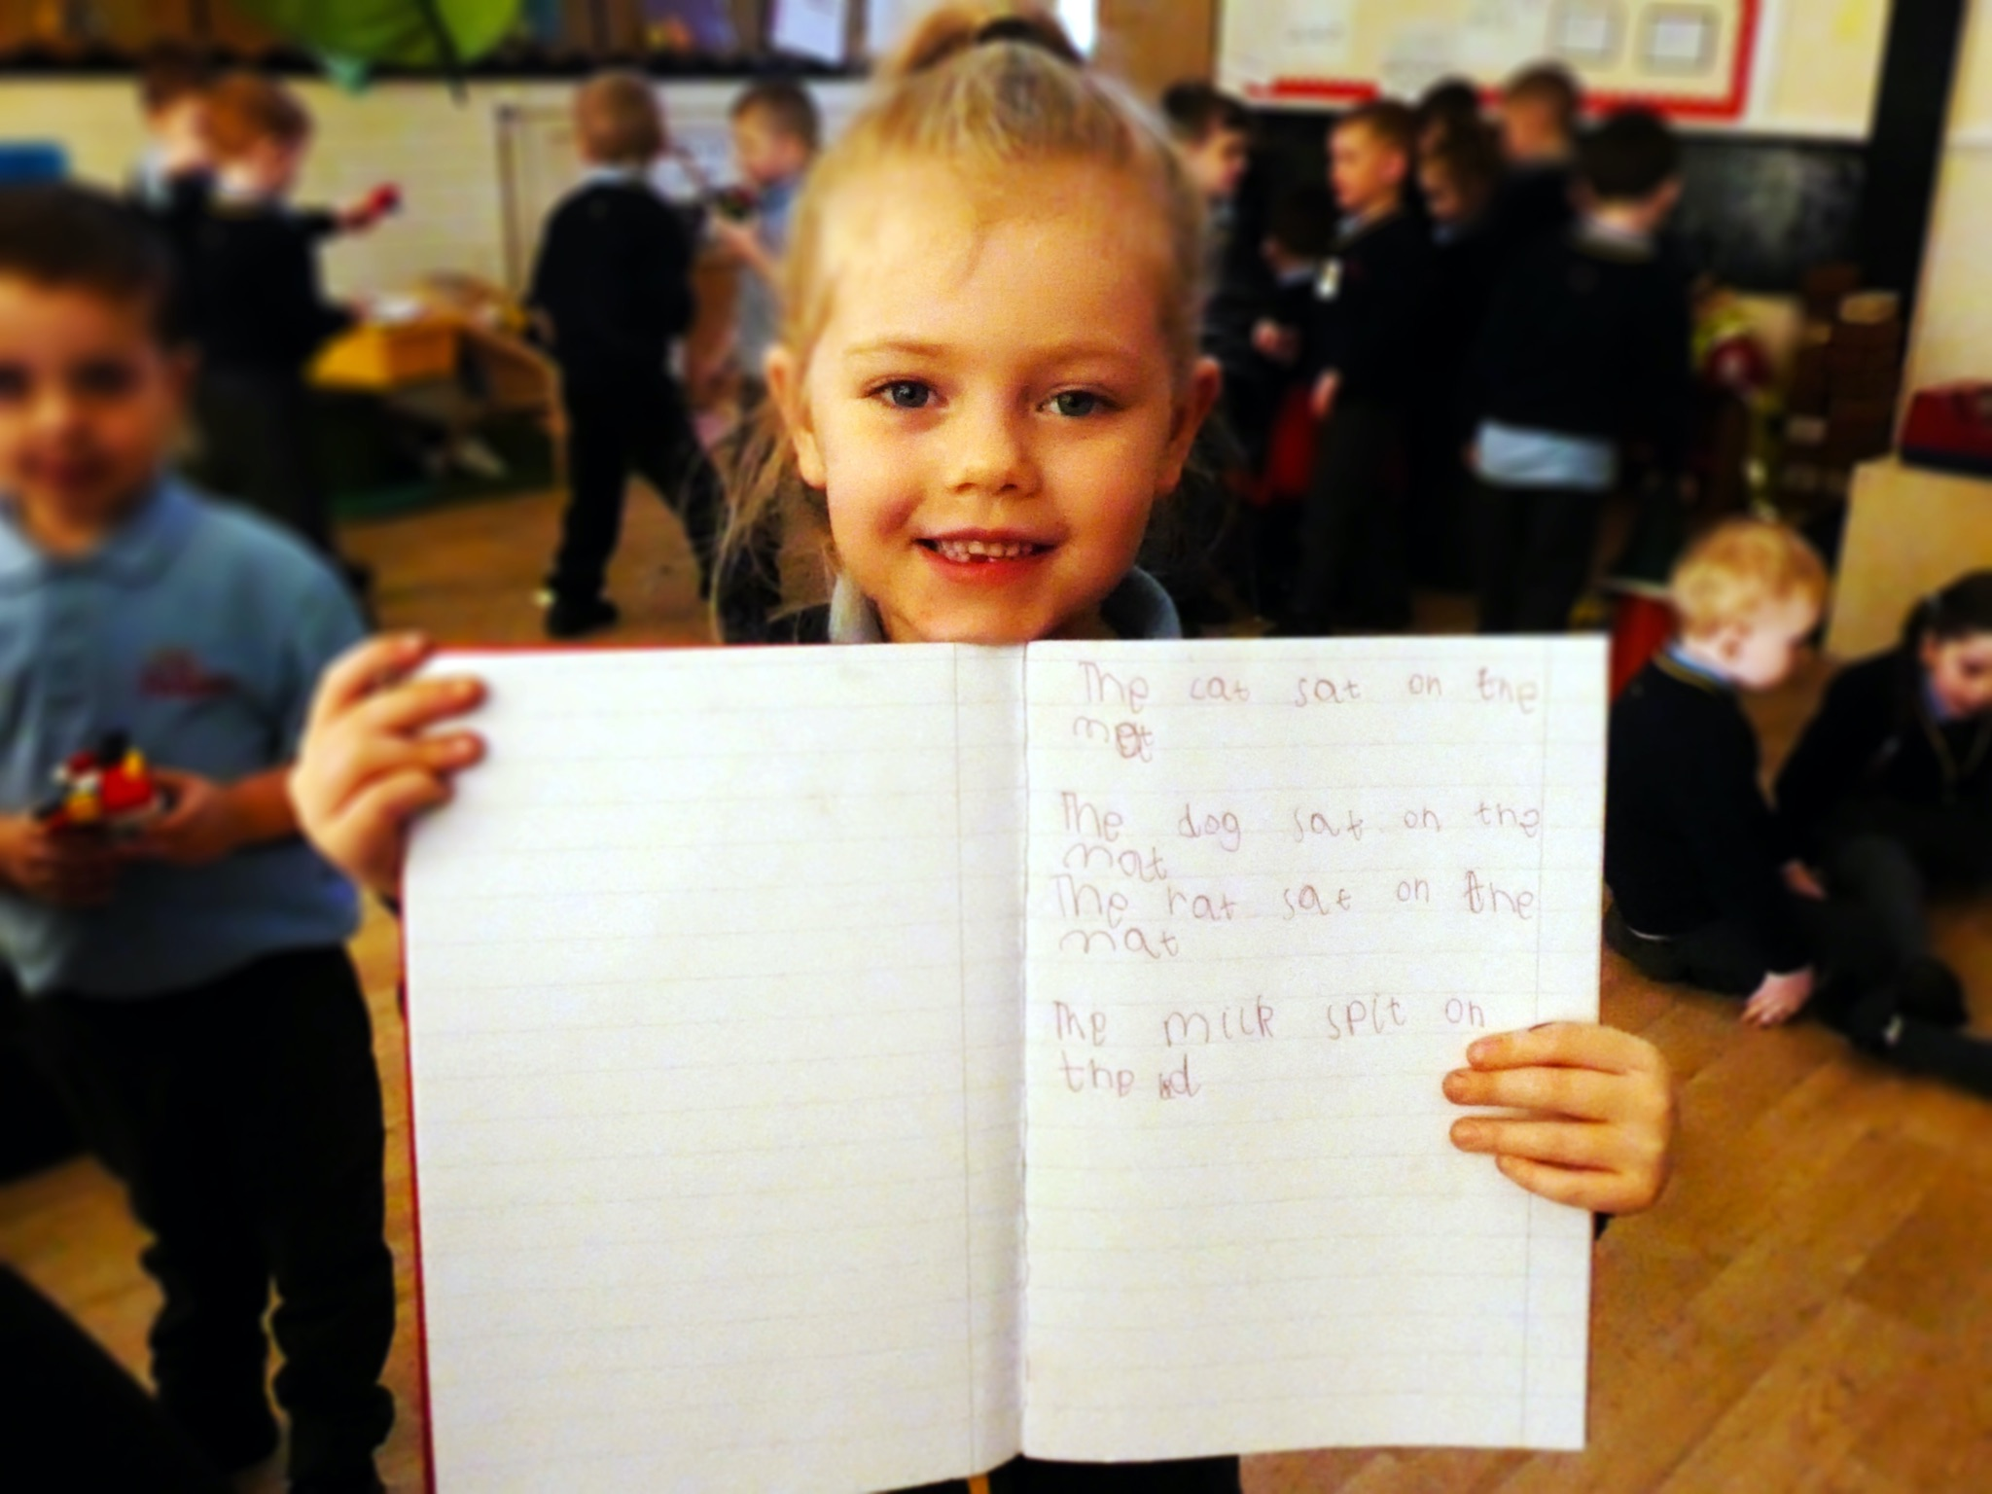
What is the impact of inspiring reading?
Prioritising reading at the heart of the curriculum has a direct correlation with improving the amount of children achieving greater depth writing. The more children read, including the variety in style, the more they will be able to draw on different writing styles to inspire their independent writing.
Achievement
Entitlement
Successful schools promote reading
Every child deserves the chance to become a reader. For many children, including those growing up in a household where reading is not valued, school will be the key place where they come into contact with books. Children who are not introduced to books are missing out on a lifetime of enjoyment. So, if families are unable or unwilling to introduce children to reading, it falls to schools to take responsibility. If schools fail to do this, the consequences for children are stark. We know that link can be demonstrated between, for instance, illiteracy and offending.
Research shows that children who enjoy reading achieve more highly right across the curriculum. Developing a love of reading is one of the most effective ways a school can raise attainment. Success in reading can improve national test results in all areas but, more importantly, it also sets children up as readers for life, with all the accompanying benefits that follow.
Schools that take the business of reading for pleasure seriously, where teachers read, talk with enthusiasm and recommend books, and where provision for reading is planned carefully, are more likely to succeed with their pupils’ reading. This success was seen in the survey schools, both in good test results and an enthusiasm for reading beyond the classroom.
Excellence in English , Ofsted, 2011

Slide 32
What is the impact of inspiring reading?
Prioritising reading at the heart of the curriculum has a direct correlation with improving the amount of children achieving greater depth writing. The more children read, including the variety in style, the more they will be able to draw on different writing styles to inspire their independent writing.
The National Curriculum
Expanding children’s experience
The new National Curriculum for english at Key Stages 1 and 2, which will become statutory for maintained schools in england in September 2014, places reading for pleasure at the heart of the english curriculum. Alongside the expectation that every school teaches children to read well, schools will be expected to develop a love of reading in every child.
Reading is a passport to the world. The benefits of reading go beyond the opportunities offered by being well-read with a good command of english. Reading great literature opens children up to ideas, experiences, places and times they might never otherwise experience in real life. Reading for pleasure gives opportunities to learn about a multitude of things that cannot be covered by a school curriculum.

Slide 33
Strategies for Teaching English in School
Reading Comprehension
DEAR Time
Phonics Interventions
Daily Reading - whole class across the week
Daily Phonics Sessions
Extra daily reading with lowest 20%
Guided Reading Sessions

Slide 34
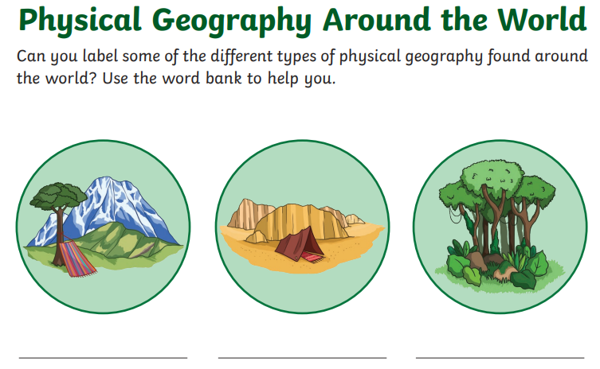
Importance of Reading to Children
Children need to be exposed to reading as it can enhance their imagination, develop their confidence, provide a deeper understanding of vocabulary and most importantly - READING IS EVERYWHERE!
Maths Problem
Geography Task
DT Recipe
National Literacy Trust states:
45% of 0-2s are read to daily
58% of 3-4s are read to daily
44% of 5-7s are read to daily
Daily Story Time in school as absolutely crucial!

Slide 35
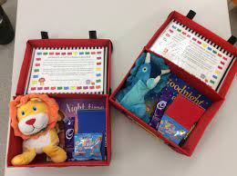
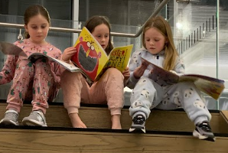
Engaging Home Support with Reading
Reading Reward Display to encourage the parents to support the children’s reading at home | Christmas Stories sent out onto social media for children to listen to with parents | Travelling Bedtime Story to engage younger readers | Reading events held in school where parents are invited | “Look Who Has Been Caught Reading” Display

Slide 36
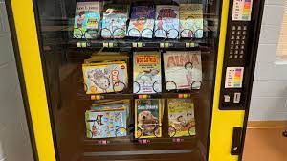
Reading for Pleasure in School
Book Fairs
Reading Vending Machine
Author Visits
Trip to Seven Stories

Slide 37
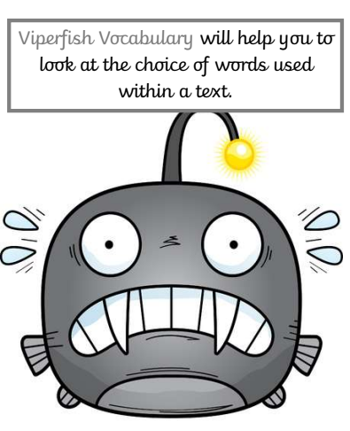
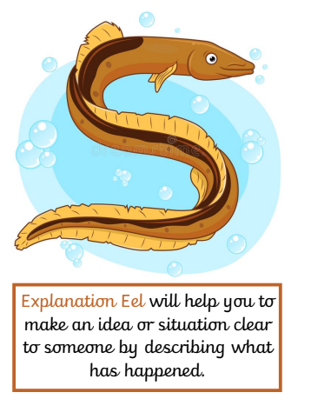
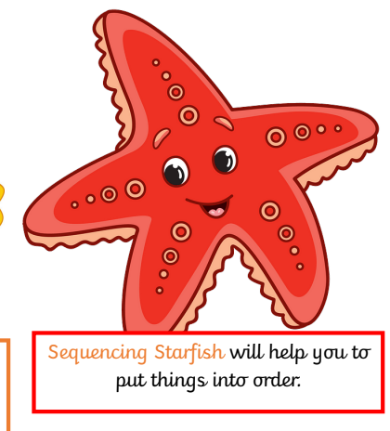
Reading Characters

Slide 38
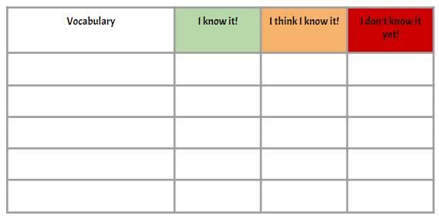
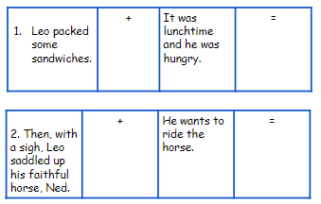
Reading Based Activities
Vocabulary Viperfish Lesson Idea
Inference Iguana Lesson Idea

Slide 39
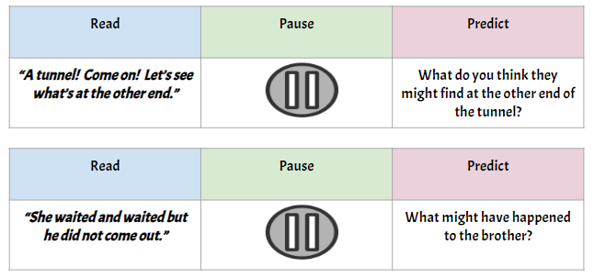
Reading Based Activities
Sequencing Starfish Lesson Idea
Prediction Pufferfish Lesson Idea

Slide 40
Useful Websites for Resources
Books for Topics
Once Upon a Picture
Literacy Shed

Slide 41
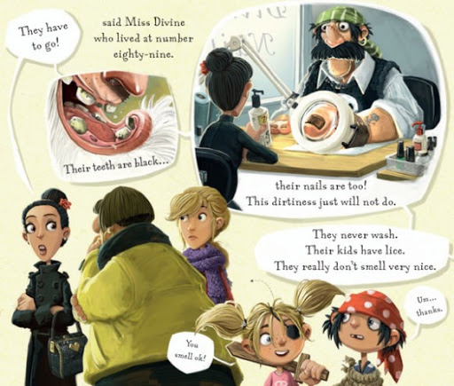
Planning a reading activity
We are going to plan a lesson for Year One. Using the reading character’s, we are going to plan out a short reading activity based on the following text:
The Pirates Next Door

Slide 42
Thank you and I hope this has been useful.
nstorey@st-aloysius.co.uk

