Slide 1
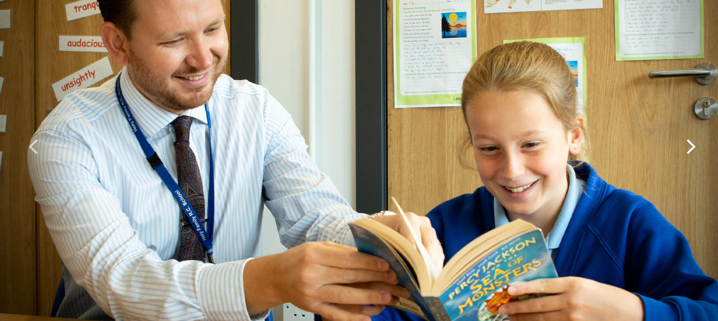
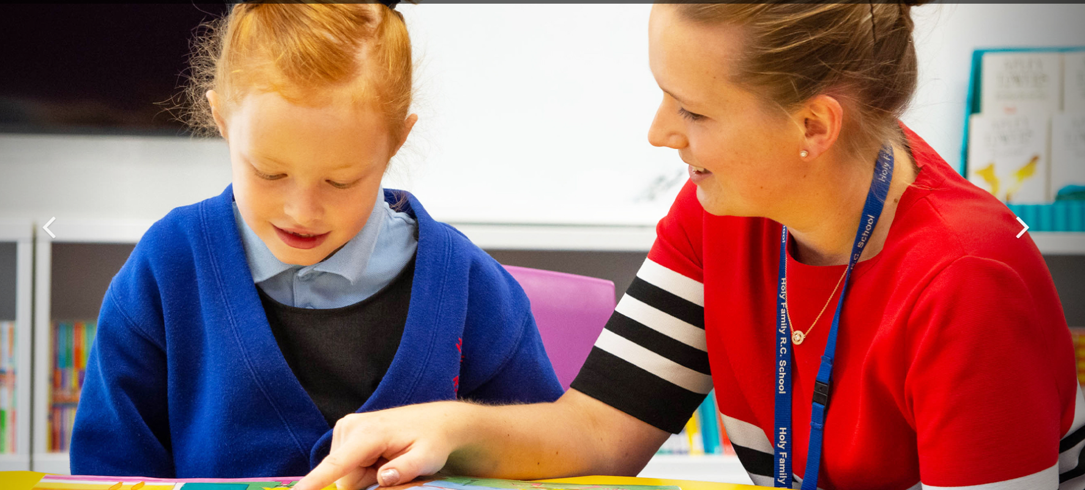
SEND
http://www.carmelteachertraining.org.uk/

Slide 2
Aims
I will be able to define the term SEND
I recognise the 4 broad areas of need
I will be able to consider my role as a teacher in supporting those with SEND
I will understand the term Quality First Teaching
I know how and when to speak to the SENCO
I am aware of some practical strategies I can implement
I have an awareness of some specific learning difficulties.

Slide 3
Day outline
Introductions and Housekeeping
Equality Vs Equity- inclusion
Who is responsible and common misconceptions
Common experiences of SEND so far
EEF: evidence based research into best practice
SEND Graduated Approach and Ordinarily Available Provision.
Action Planning and Pupil-centred Approach
Specific areas of need, classroom practice and implications
Enabling Environments: supporting working memory

Slide 4
Group Task: What is the difference between equality and equity?
Equality
Equity
Equality means that everyone has the same chances or gets the same treatment. Everyone is treated equally.
That’s fair… isn’t it?
Equity means that everyone has the same chances - just like equality - but equity also means considering different people’s situations so that they really are treated fairly.
Now that is fair!
Can you think about what equality or equity look like in your school

Slide 5
WHAT IS SEND?
Definition task

Slide 6
WHAT IS SEND
When a child or young person has Special Educational Needs
(1) A child or young person has special educational needs if he or she has a learning difficulty or disability which calls for special educational provision to be made for him or her.
(2) A child of compulsory school age or a young person has a learning difficulty or disability if he or she:
(a) has a significantly greater difficulty in learning than the majority of others of the same age, or
(b) has a disability which prevents or hinders him or her from making use of facilities of a kind generally provided for others of the same age in mainstream schools or mainstream post-16 institutions.

Slide 7
Four Broad Areas of Need
Cognition and Learning
Communication and Interaction
Social Emotional and Mental Health (SEMH)
Sensory and or Physical Needs
Discuss with the person next to you any types of SEN that you know and consider which category they may fit.
Notes:
Write on flipcharts

Slide 8
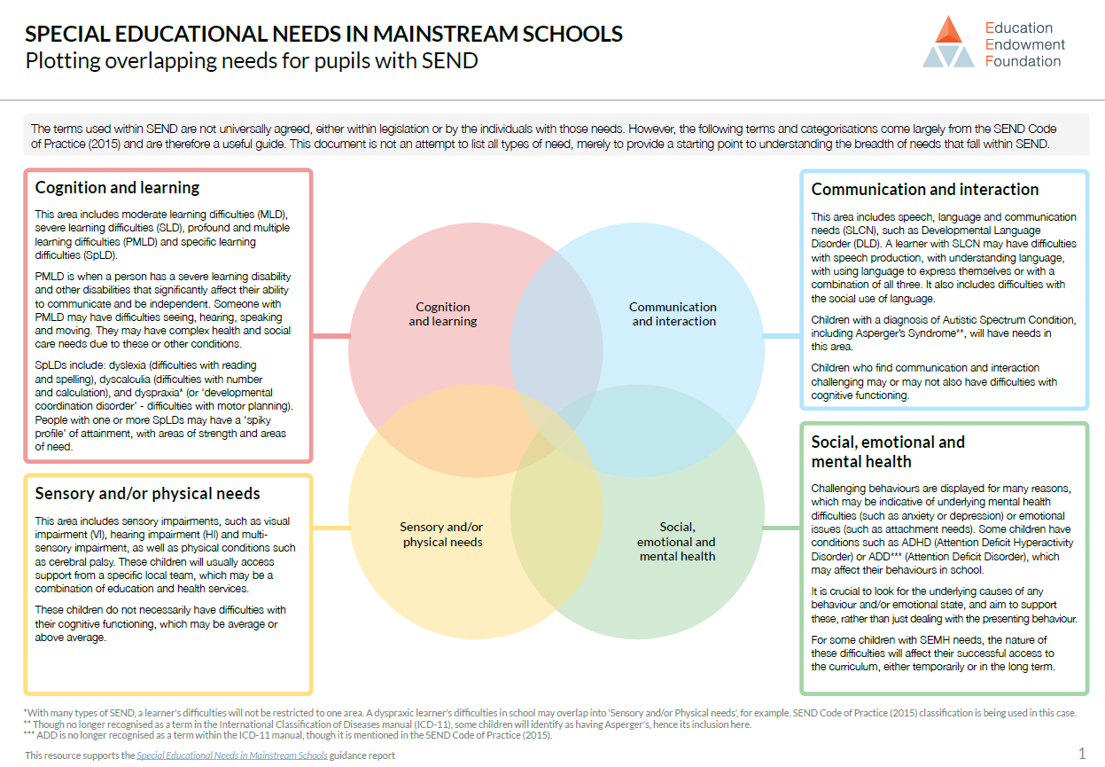
Notes:
https://saalma2014.files.wordpress.com/2014/11/4-areas.png

Slide 9
Code of practice
High quality provision to meet the needs of children and young people with
SEN 1.24 High quality teaching that is differentiated and personalised will meet the
individual needs of the majority of children and young people.
Some children and young people need educational provision that is additional to or different from this.
This is special educational provision under Section 21 of the Children and Families Act 2014.
Schools and colleges must use their best endeavours to ensure that such provision is made for those who need it.
Special educational provision is underpinned by high quality teaching and is compromised by anything less.
1.25 Early years providers, schools and colleges should know precisely where children and young people with SEN are in their learning and development. They should:
ensure decisions are informed by the insights of parents and those of children and young people themselves
have high ambitions and set stretching targets for them
track their progress towards these goals
keep under review the additional or different provision that is made for them
promote positive outcomes in the wider areas of personal and social development, and
ensure that the approaches used are based on the best possible evidence and are having the required impact on progress

Slide 10
Every Teacher…….
“Every teacher is responsible and accountable for all pupils in their class wherever or with whoever the pupils are working.”

Slide 11
Code of Practice 6.9
All schools have duties under the Equality Act 2010 towards individual disabled children and young people. They must make reasonable adjustments, including the provision of auxiliary aids and services for disabled children, to prevent them being put at a substantial disadvantage. These duties are anticipatory – they require thought to be given in advance to what disabled children and young people might require and what adjustments might need to be made to prevent that disadvantage. Schools also have wider duties to prevent discrimination, to promote equality of opportunity and to foster good relations.

Slide 12
CODe of Practice 6.12 Curriculum
All pupils should have access to a broad and balanced curriculum. The National Curriculum Inclusion Statement states that teachers should set high expectations for every pupil, whatever their prior attainment. Teachers should use appropriate assessment to set targets which are deliberately ambitious. Potential areas of difficulty should be identified and addressed at the outset. Lessons should be planned to address potential areas of difficulty and to remove barriers to pupil achievement. In many cases, such planning will mean that pupils with SEN and disabilities will be able to study the full national curriculum.

Slide 13
CODe of Practice 6.23
Slow progress and low attainment do not necessarily mean that a child has SEN and should not automatically lead to a pupil being recorded as having SEN. However, they may be an indicator of a range of learning difficulties or disabilities. Equally, it should not be assumed that attainment in line with chronological age means that there is no learning difficulty or disability. Some learning difficulties and disabilities occur across the range of cognitive ability and, left unaddressed may lead to frustration, which may manifest itself as disaffection, emotional or behavioural difficulties.

Slide 14
Experience of SEND so Far
What have you discovered or experienced – Chance to discuss
Notes:
Experience of QFT
Differentiation
SEND in the classroom
Adaptations
Support Plans
Intervention

Slide 15
ASD (ASC)
Autism Spectrum Condition
Autism spectrum condition (ASC) is a lifelong, developmental condition that affects how someone communicates with and relates to other people and how they experience the world around them, including impacts on interests and behaviour. Autistic students share certain difficulties which may include learning challenges, mental health issues, speech and communication issues and anxiety.
https://www.youtube.com/watch?v=Lk4qs8jGN4U
https://www.youtube.com/watch?v=aPknwW8mPAM
Strategies to support
-visual timetable
-routine
-use of rewards as motivators
-now and next
-choices within learning: boxes/boards
-in task scheduling
-check listing
-explicit teaching of social skills
scaffolding of interactions
circle of friends
Notes:
https://www.brightheart.co.uk/autism-spectrum-condition-asc-asd/
Circle of friends - http://www.complexneeds.org.uk/modules/Module-3.4-Emotional-well-being-and-mental-health/All/downloads/m12p050c/the_circle_of_friends_approach.pdf

Slide 16
ADHD
Attention-deficit hyperactivity disorder (ADHD) can be categorised as either inattentiveness or as hyperactivity and impulsiveness, although it is often the case that a student with ADHD may experience both these forms. With inattentiveness the student can still be quiet in class and it may go unnoticed for many years.
https://www.youtube.com/watch?v=CFknFT5kkl4
Signs of inattentiveness: | Signs of hyperactivity and impulsiveness:
Getting easily distracted Poor attention to detail, making careless mistakes Being forgetful or losing things Struggles to stick to tasks that are tedious or time-consuming Struggles to listen to or carry out instructions Constantly changing activity or task Having difficulty organising tasks | Struggles to sit still, especially in calm or quiet surroundings Constantly fidgeting Struggles to concentrate on quiet tasks, such as reading Excessive physical movement Excessive talking Being unable to wait their turn Acting without thinking Interrupting conversations Reduced sense of danger
Notes:
https://www.brightheart.co.uk/adhd/

Slide 17
Strategies
Be positive
Allow a sense of ownership and compromise (e.g. completing 2 of 3 given tasks)
If they need a movement break, build one in
Good relationships with behaviours
Provide some structure to breaktimes
Have hard limits (non negotiables)

Slide 18
Visual Impairment
Many people have some problems with their vision, but most can be corrected using glasses, contact lenses or through surgery, such as laser treatment.
Visual impairment refers to conditions which result in the person experiencing some degree of sight loss which cannot be corrected by these methods.
School staff must be given sufficient information about the VI pupil to understand how to support them- this should be provided by the family and VI service professionals. School staff can help the visually impaired pupil to feel included, be safe and to understand what is happening around him/her by being aware of appropriate strategies etc. Severely visually impaired pupils obtain much of the information about what is happening around them aurally. Many are frightened or confused by sudden loud noises or if the environment is generally noisy, i.e. a lot of people talking. Staff should always introduce themselves to the pupil and encourage other pupils to say who they are when they speak. Verbalize praise and disapproval as a severely visually impaired pupil will not see gestures, body language or facial expressions. Be specific with descriptive language and avoid using terms like “here” or “there” when describing the location of a person or an object. Talk directly to the pupil rather than through an accompanying person. Familiarise the pupil with the environment and keep classrooms, corridors and stairs free of clutter. Let the him/her know if the environment changes, e.g. furniture has been moved.
Notes:
http://www.visen.org.uk/Learningpage02.html

Slide 19
Hearing impairment
A child may have a problem with their hearing if they:
are slow to learn to talk, or aren't clear when they speak
don't reply when you call them
talk very loudly
ask you to repeat yourself or respond inappropriately to questions
turn up the volume of the TV very high
Hearing loss in children can be caused by a build-up of fluid in the ear (glue ear), which tends to get better over time and can be treated.
Strategies
-seating position
-low level noise
-specific instructions
-securing attention
Notes:
https://www.nhs.uk/conditions/hearing-loss/

Slide 20
Speech, Language and Communication
Notes:
Communication friendly school (resources roaming reporter, visual timetable, timers, visual supports, speaking and listening, questioning, team work, chance to speak)

Slide 21
DyslexiA-SpLD
The Sir Jim Rose report (2009) commissioned by the Secretary of State for Children, Schools and Families, described dyslexia as:
A learning difficulty that primarily affects the skills involved in accurate and fluent word reading and spelling.
Characteristic features of dyslexia are difficulties in phonological awareness (identifying and manipulating units of oral language), verbal memory and verbal processing speed.
Dyslexia occurs across the range of intellectual abilities. It is best thought of as a continuum, not a distinct category, and there are no clear cut-off points.
Co-occurring difficulties may be seen in aspects of language, motor coordination, mental calculation, concentration and personal organisation, but these are not by themselves markers of dyslexia.
Some signs or indications of dyslexia:
A family history of dyslexia
Confusion between directional words (e.g. up/down)
Confusion with sequences e.g. days of the week
Struggling with phonics
Jumbled phrases
Working memory difficulties
Notes:
https://www.brightheart.co.uk/dyslexia/

Slide 22
Strategies
Chunking information so as not to overwhelm with long passages to read
Spacing between lines
Use of fonts and colour changes between lines
Use of coloured backgrounds and overlays (reduce visual stress) – ask the pupil what works best
Use of bullet points to share key information
Shared reading (reading along with at the same time as an adult)
Use of word banks- particularly multi-sensory based ones
Key vocab mats using images or colours
Use of bold instead of italics to highlight important information
Speech to type software
IDL apps

Slide 23
What is working memory? Working memory is a type of short-term memory.

Slide 24
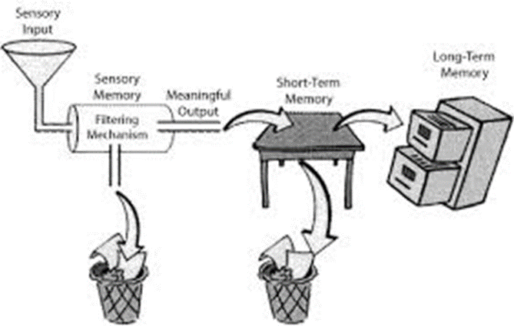

Slide 25
How many can you rememeber?

Slide 26
You have 20 seconds how many items can you memorise?

Slide 27
Children with working memory difficulties have a reduced capacity to temporarily store and process information in this short-term ‘mental workspace’. Try the ‘backwards digit span test’ with your partner. Who has the best working memory? E.g. one person says 2 numbers – 5,3 – the other repeats the number back, but backwards, i.e. 3, 5. then try sequences with 3, 5, 5, 6 (4,6,8,2,5 – 5,2,8,6,4) etc. Repeat with the other leader.

Slide 28
Characteristics of working memory
Its capacity is limited We are only able to store 5-9 elements at a time.
It is active. It doesn't only store information, it also manipulates and transforms it.
Its content is permanently being updated.
It is modulated by the dorsolateral frontal cortex.
Examples of working memory:
Working memory refers to the ability that allows us to retain the elements that we need in our brain while we carry-out a certain task. Thanks to working or operative memory, we are able to:
Integrate two or more things that took place close together. For example, remembering and responding to the information that was said during a conversation.
Associate a new concept with previous ideas. It allows us to learn
Retain information while we pay attention to something else. For example, we are able to prepare the ingredients that we need for a recipe while we talk on the phone.
We use our working or operative memory on a daily basis for a number of tasks. When we try to remember a telephone number before writing it down or when we are immersed in conversation: we need to remember what was just said, process it, and respond to it by giving our own opinion.

Slide 29
Useful Links
https://www.nhs.uk/conditions/attention-deficit-hyperactivity-disorder-adhd/
https://www.bdadyslexia.org.uk/
https://www.nhs.uk/conditions/dyslexia/
https://www.healthline.com/health/adhd/parenting-tips#what-not-to-do
https://www.ndcs.org.uk/
https://www.nhs.uk/conditions/hearing-loss/

Slide 30
What is SEN? Who is responsible for SEND?
https://www.youtube.com/watch?v=J7E8ouAeHsw&list=PLiTIWYO_hXdptzNuY7emiaNZaNoADKfDL&index=1

Slide 31
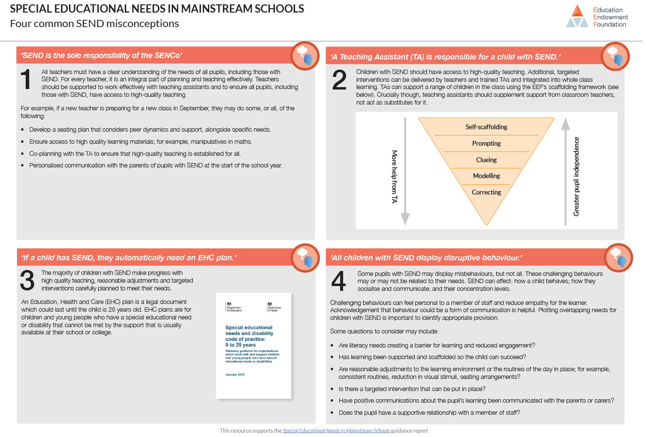

Slide 32
SEN in The classroom
All pupils should have access to a broad and balanced curriculum. Teachers should set high expectations for every pupil, whatever their prior attainment. Teachers should use appropriate assessment to set targets which are deliberately ambitious. Potential areas of difficulty should be identified and addressed at the outset. Lessons should be planned to address potential areas of difficulty and to remove barriers to pupil achievement. In many cases, such planning will mean that pupils with SEN and/or disabilities will be able to study the full national curriculum.
Notes:
SEN code of Practise 2015

Slide 33
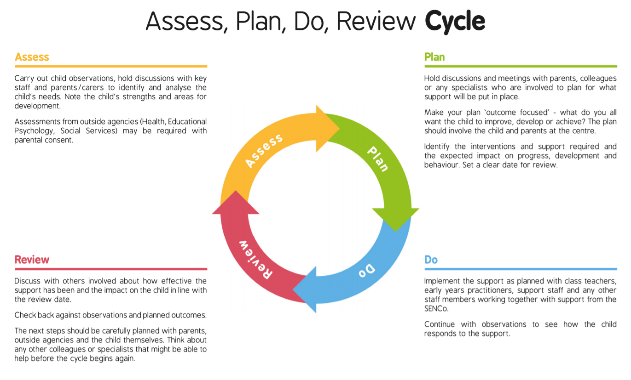
Notes:
https://content.twinkl.co.uk/resource/05/e8/T-S-2804-Assess-Plan-Do-Review-Cycle.pdf?__token__=exp=1582289986~acl=%2Fresource%2F05%2Fe8%2FT-S-2804-Assess-Plan-Do-Review-Cycle.pdf%2A~hmac=d489cce1ba9d284b63a260210b3291e72cd721e8afaeea9123b234e9c25f7791

Slide 34
Target setting
Notes:
https://www.toolshero.com/personal-development/smart-goals/

Slide 35
Quality First Teaching – What is it?
Quality First Teaching originated in the then ‘Department for Children, Schools and Families’ guide to personalised learning published in 2008.
The key characteristics are summarised as:
highly focused lesson design with sharp objectives
high demands of pupil involvement and engagement with their learning
high levels of interaction for all pupils
appropriate use of teacher questioning, modelling and explaining
an emphasis on learning through dialogue, with regular opportunities for pupils to talk both individually and in groups
an expectation that pupils will accept responsibility for their own learning and work independently
regular use of encouragement and authentic praise to engage and motivate pupils.
(DCSF, 2008) Personalised learning – a practical guide 00844-2008DOM-EN

Slide 36
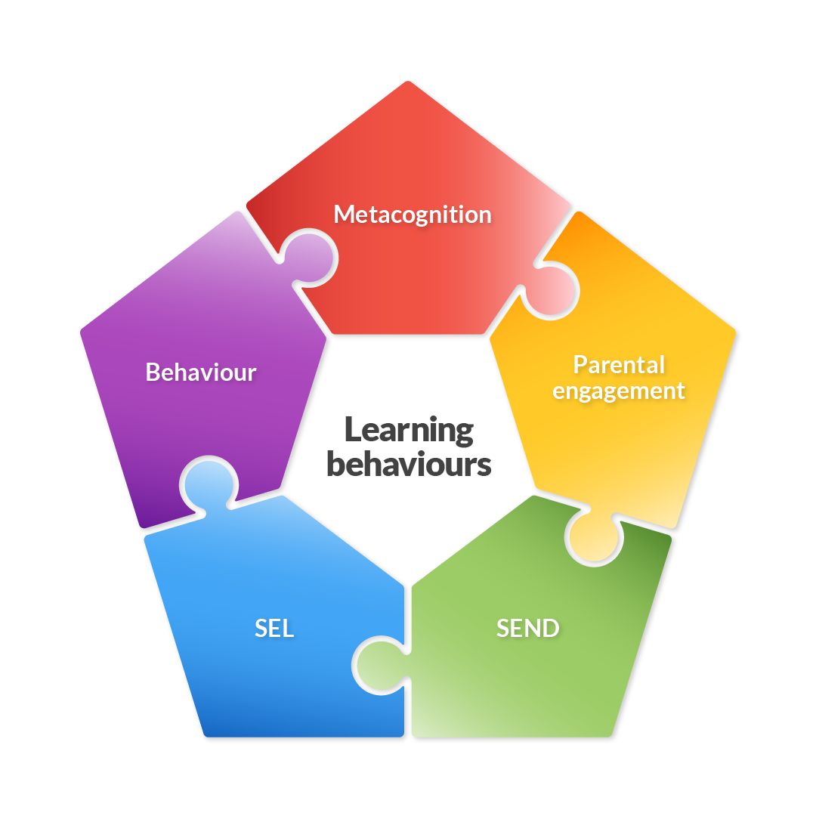
Effective Learning Behaviours
Notes:
Cannot see SEND in isolation…The aim is to give an overview of some key ‘best bets’ for improving special educational provision. In many cases, the advice here overlaps with other EEF guidance reports such as Metacognition and Self-regulated Learning. We strongly recommend that schools consider other EEF guidance reports when planning their SEND provision. This guidance is based on a focused review of the best available evidence on improving outcomes for pupils with SEND in mainstream schools.
Learning Behaviours background and link to animation. https://www.youtube.com/watch?v=J7E8ouAeHsw&feature=youtu.be
When we use the word behaviour we can quickly assume that it relates to strategies to manage misbehaviour in the classroom. It is of course important to have strategies to minimise this, but teachers can also explicitly support ‘learning behaviours’. As we teach, develop and strengthen these learning behaviours, young people become more motivated and determined to succeed.
So, what do we mean by learning behaviours?
A learning behaviour can be thought of as a behaviour that is necessary in order for a person to learn effectively in the group setting of the classroom. When we walk round a classroom, can we see these behaviours in action?
Effective learning behaviours can be helpfully defined using the rich and diverse evidence base represented in the EEF guidance reports on improving behaviour, metacognition and self-regulation, special educational needs in mainstream schools, working with parents, and social and emotional learning. Successful learning behaviours rely on layering all these areas to wrap around every child in our schools.
Each is part of a puzzle which makes best sense when all parts click together, building long-term protective factors for deeper learning.
There are times when effective learning behaviours are at risk. Independent learning that is scaffolded at school can become disrupted or less fluent at home at times of homework, school closures, or revision. Indeed, transition within and between schools, changes in home circumstances, low literacy or numeracy levels can all disrupt threads of effective learning behaviours.
If we imagine a child in the centre of this pentagon – what would it tell us about what is working well and challenges to face together? If one piece of the puzzle is not embedded, or at worst missing, this can disrupt learning. All strands need to stay intact.
To put all the pieces of the puzzle in place, will be working with schools to build on effective learning behaviours in their school context, with further training and resources to come. We will amplify voices from the classroom to share how teaching effective learning behaviours allow teachers to teach in safe classrooms, enabling self-regulated learning, whilst fostering positive, proactive relationships with pupils, teachers and families.
The upcoming Effective Learning Behaviours course developed by Research School Network will focus on Social & Emotional Learning and behaviour.

Slide 37
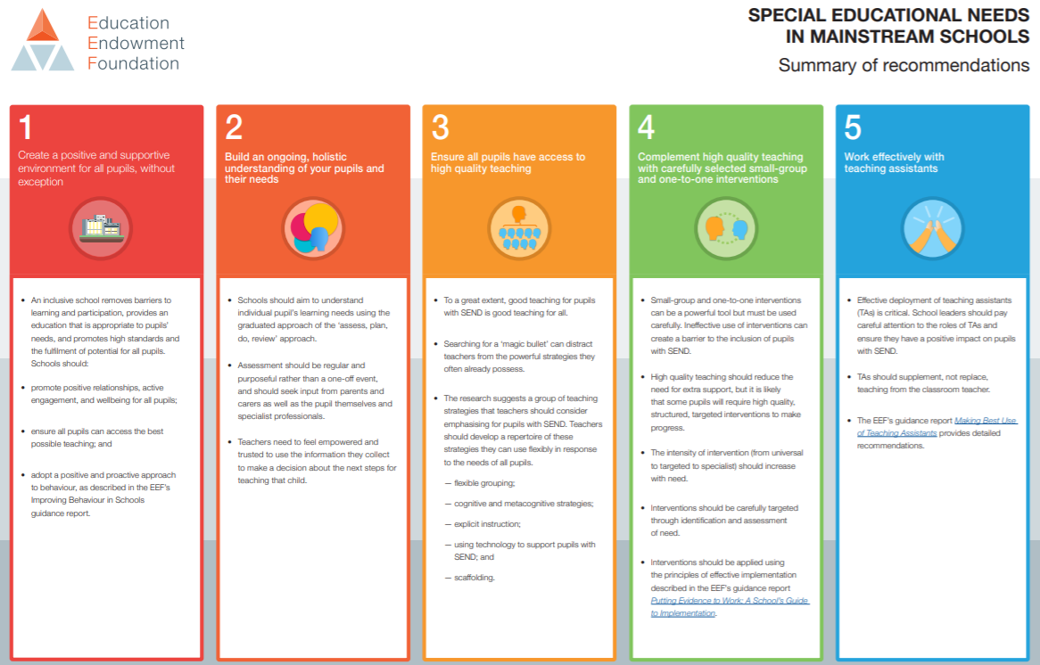
Notes:
Some recommendations here will be helpful to special schools although we recognise some may need to be adapted for those with profound learning needs.
The term SEND is used throughout the report to be inclusive of all pupils with these needs and in recognition of the fact that a disability will often overlap with special educational needs. However this report is about SEN and provision rather than any adaptations schools may need to make for pupils with a physical disability or long-term health condition.
The 5 recommendations that should be the focus for school improvement. The aim is to give some key ‘best bets’ for improving special educational provision. Advice here overlaps with guidance on Metacognition and Self Regulation, Improving Behaviour, Social and Emotional Learning and Working with Parents.
Note questions in chat as we go along and I will try to answer these at the end/as we go along.

Slide 38
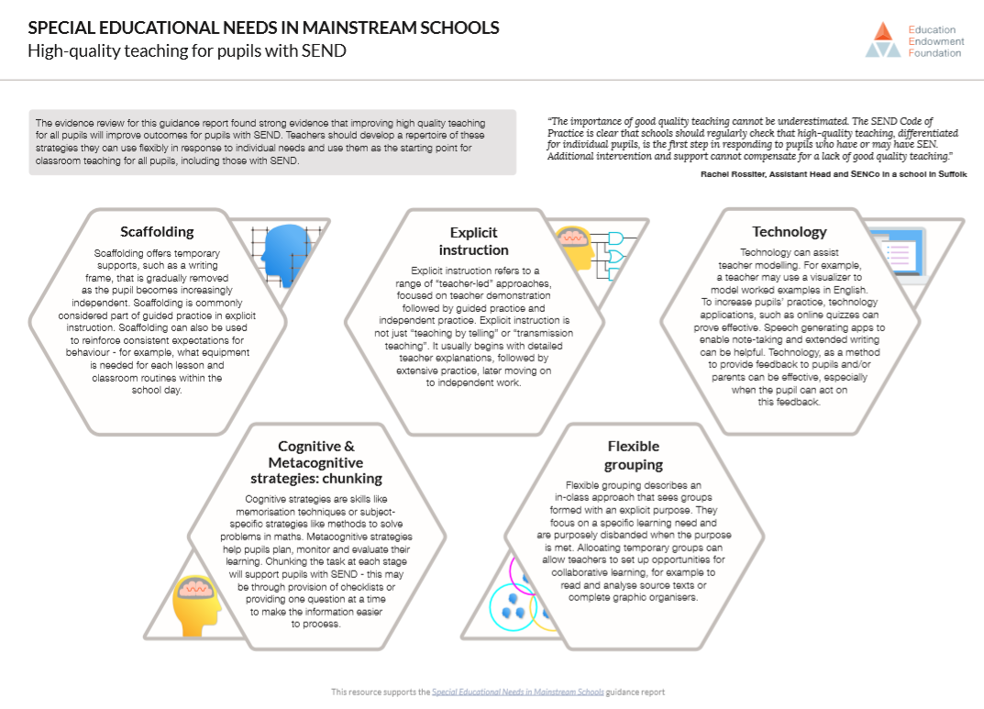
Notes:
Most important lever for disadvantaged. Most important for SEND?
But there will always be a need to targeted interventions…

Slide 39
The five strategies outlined here were identified as having relatively strong evidence for their effectiveness in supporting pupils with SEND:
1. Scaffolding
What is it?
‘Scaffolding’ is a metaphor for temporary support that is removed when it is no longer required. Initially, a teacher would provide enough support so that pupils can successfully complete tasks that they could not do independently. This requires effective assessment to gain a precise understanding of the pupil’s current capabilities.
Examples:
Support could be visual, verbal, or written.
Writing frames, partially completed examples, knowledge organisers, essay prompts, bookmarks, structure strips, sentence starters can all be useful.
Reminders of what equipment is needed for each lesson and classroom routines can be useful.
Scaffolding discussion of texts: promoting prediction, questioning, clarification and summarising

Slide 40
2. Explicit instruction
What is it?
Explicit instruction refers to a range of teacher-led approaches, focused on teacher demonstration followed by guided practice and independent practice. Explicit instruction is not just “teaching by telling” or “transmission teaching”.
One popular approach to explicit instruction is Rosenshine’s ‘Principles of Instruction’.
Examples:
Worked examples with the teacher modelling self-regulation and thought processes is helpful. A teacher might teach a pupil a strategy for summarising a paragraph by initially ‘thinking aloud’ while identifying the topic of the paragraph to model this process to the pupil. They would then give the pupil the opportunity to practise this skill.
Using visual aids and concrete examples promotes discussion and links in learning.

Slide 41
3. Cognitive and metacognitive strategies
What is it?
Cognitive strategies are skills like memorisation techniques or subject specific strategies like methods to solve problems in maths.
Metacognitive strategies help pupils plan, monitor and evaluate their learning.
Examples:
Chunking the task will support pupils with SEND - this may be through provision of checklists, instructions on a whiteboard or providing one question at a time. This helps reduce distractions to avoid overloading working memory.
Prompt sheets that help pupils to evaluate their progress, with ideas for further support.

Slide 42
4. Flexible grouping
What is it?
Flexible grouping describes when pupils are allocated to smaller groups based on the individual needs that they currently share with other pupils. Such groups can be formed for an explicit purpose and disbanded when that purpose is met.
Examples:
Allocating temporary groups can allow teachers to set up opportunities for collaborative learning, for example to read and analyse source texts, complete graphic organisers, independently carry out a skill, remember a fact, or understand a concept.
Pre-teaching key vocabulary, using the Frayer Model is a useful technique here.

Slide 43
5. Use technology
What is it?
Technology can assist teacher modelling. Technology, as a method to provide feedback to pupils and/or parents can be effective, especially when the pupil can act on this feedback.
Examples:
Use a visualizer to model worked examples.
Technology applications, such as online quizzes can prove effective.
Speech generating apps to enable note-taking and extended writing can be helpful.

Slide 44
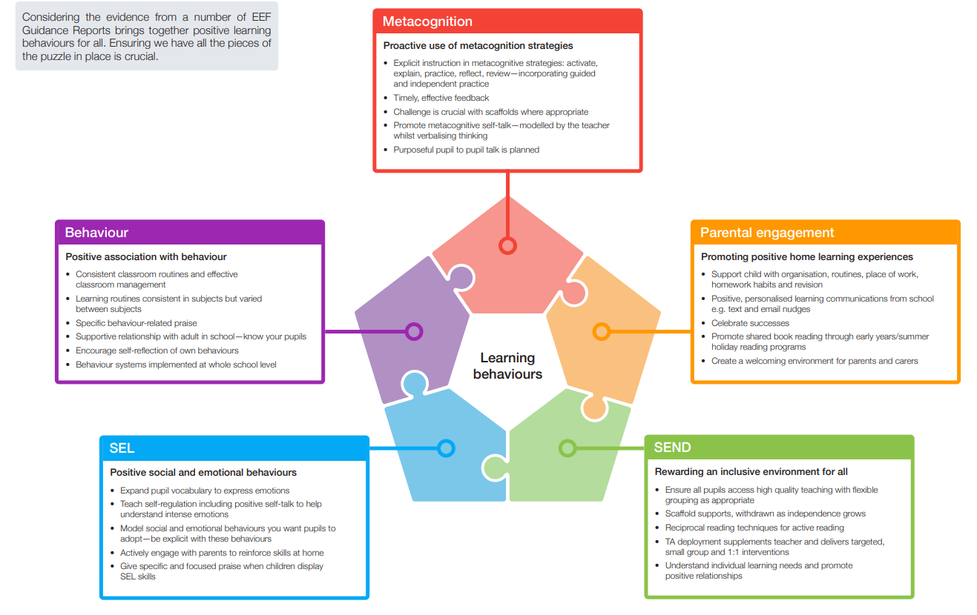

Slide 47
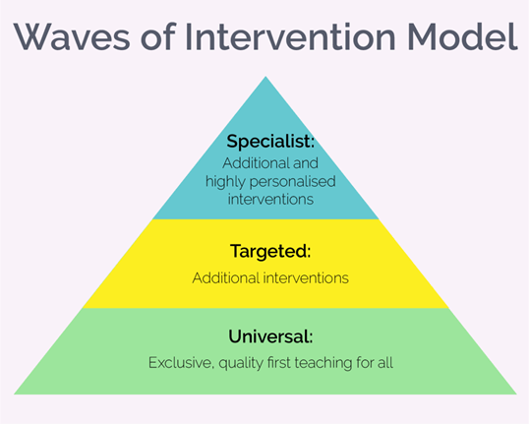
Waves model
Notes:
https://thirdspacelearning.com/blog/quality-first-teaching/

Slide 48
Wave 1 - Wave 1: Quality First Teaching The first of these was QFT. The reasoning behind this was that good planning of well-sequenced and manageable lessons coupled with effective pedagogical choices, effective and robust assessment for learning – which was used to change instruction so all learners could achieve – was the first step in reducing underachievement. | Wave 2 - Wave 2: Additional Interventions Wave 2 was meant to be delivered as well as Wave 1, not as a whole-sale replacement. The idea behind this was that those pupils who were just about falling behind could be identified and corrective instruction could take place in small groups that would quickly put the pupils back on track to meet age-related expectations. This would not have to take place outside of a whole-class maths lesson but could be part of guided work within a lesson. Interestingly, the National Strategies made the case that these interventions should ‘take the form of a tight, structured programme of small-group support that has an evidence base of impact on progress.’ | Wave 3 - Wave 3: Personalised Interventions The final Wave, Wave 3, was an ever-increasing personalised program to really help those learners struggling to keep up and to narrow the attainment gap. Again, this was not calling for the removal of children from Wave 1, the Quality First Teaching, but rather accepted that some pupils would require even more support than Wave 2 offered. Where Wave 3 differed from Wave 2 was the need to maximise and accelerate progress, perhaps through the use of specialist teachers or highly trained teacher assistants to achieve very specific targets.
Notes:
https://thirdspacelearning.com/blog/quality-first-teaching/

Slide 50
https://northumberlandeducation.co.uk/wp-content/uploads/2022/09/Northumberland-Ordinarily-Available-Provision-Guidance.pdf

Slide 56
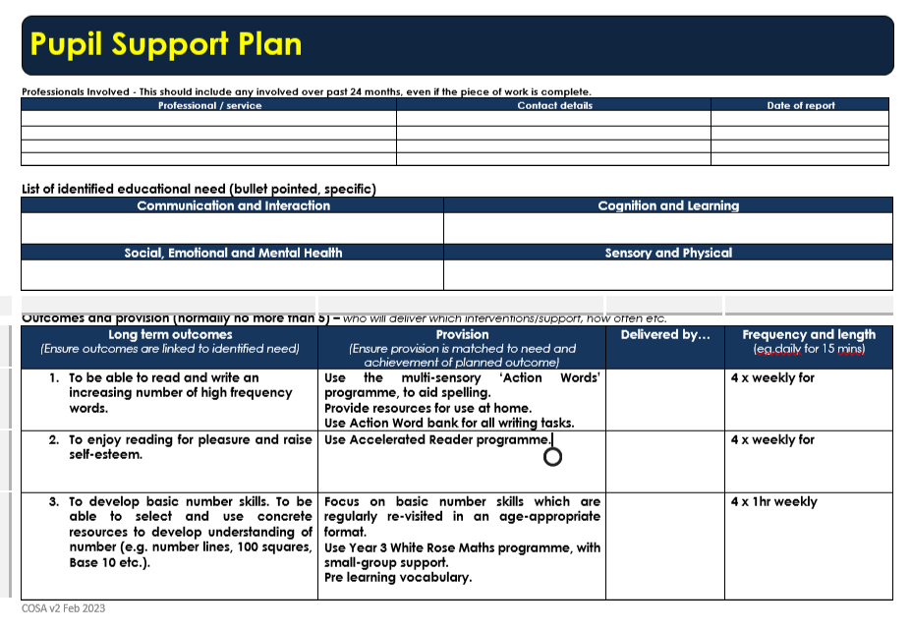

Slide 57
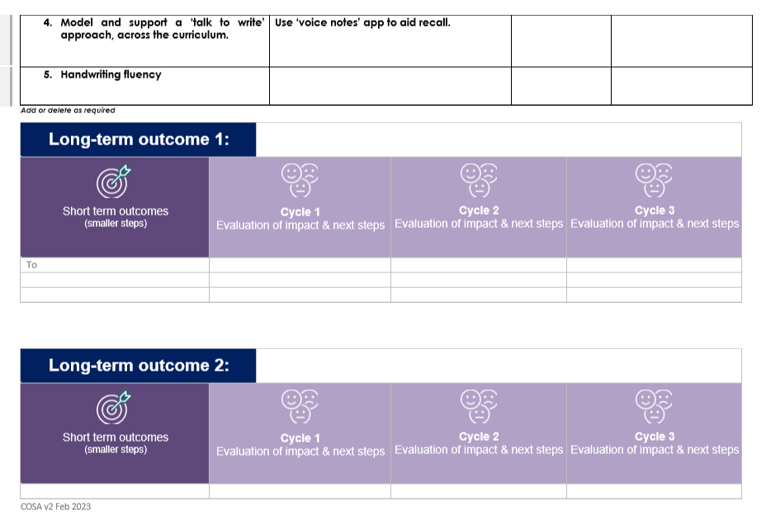

Slide 58
Task –Choose one of the pupil scenarios and create a list of QFT and support strategies.
1. This girl has difficulty spelling, she can spell phonetically but is in year 3 and does not know how to spell her common exception and high frequency words. She says she feels like the words move on her paper and she often writes letters backwards, she also appears very disorganized and finds it hard to follow instructions with more than one step.
2. This boy dislikes change in routine and experiences meltdowns when things in the environment change. He likes to know what is coming next, he tends to cover his ears when there are loud noises or when others are speaking. He appears bossy at playtimes as he likes to dominate and lead play.
3. This child struggles to sit still, is always out of their seat and wants to be moving around. Notices what everyone else is up to, appears disengaged and like they are not listening is impulsive.

Slide 59
Appropriate Assessment
Links to pre key stage standards:
2021 Pre-key stage 1 - pupils working below the national curriculum assessment standard (publishing.service.gov.uk)
2021 Pre-key stage 2 - pupils working below the national curriculum assessment standard (publishing.service.gov.uk)

Slide 60
What have I learnt today?
Questions and Answers……
Contact details: Diane Lakey diane.lakey@ellingham.northumberland.sch.uk

