Slide 1
Science CTTP Training
Day One
Ailidh McAllister Williams

Slide 2
Introductions
Where is your main placement?
What year group are you currently in?
Have you taught any Science lessons yet?
Do you have much science experience?

Slide 3
Overview of the Day
National Curriculum overview
Working Scientifically
Scientific Knowledge
CPD
Knowledge Organisers
Planning
Assessment
Supporting SEND pupils
Trips
Tour of the school
Planning an Investigation

Slide 4
Second Session:
Science in EYFS
Carry out investigations with children
Opportunity to observe science lessons at St. Aidan’s

Slide 5
Purpose of Study
A high-quality science education provides the foundations for understanding the world through the specific disciplines of biology, chemistry and physics.
Science has changed our lives and is vital to the world’s future prosperity, and all pupils should be taught essential aspects of the knowledge, methods, processes and uses of science.
Through building up a body of key foundational knowledge and concepts, pupils should be encouraged to recognise the power of rational explanation and develop a sense of excitement and curiosity about natural phenomena.
They should be encouraged to understand how science can be used to explain what is occurring, predict how things will behave, and analyse causes.

Slide 6
National Curriculum
The national curriculum for science aims to ensure that all pupils:
develop scientific knowledge and conceptual understanding through the specific disciplines of biology, chemistry and physics
develop understanding of the nature, processes and methods of science through different types of science enquiries that help them to answer scientific questions about the world around them
are equipped with the scientific knowledge required to understand the uses and implications of science, today and for the future

Slide 7
Where can science take place?

Slide 8
National Curriculum
Split into two parts:
Working scientifically
Pupils should be taught to ….

Slide 9
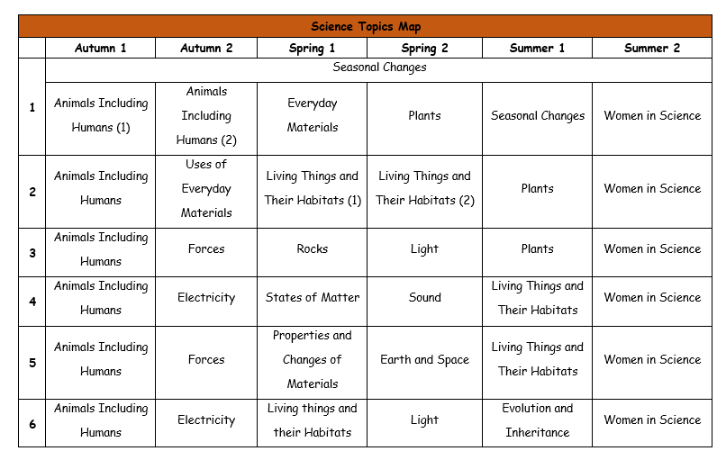
Long Term Overview
Things to consider:
Weather
Season
Length of term
Difficulty of concepts
What prior knowledge do the children need?
Cross curricular links

Slide 10
Medium Term Planning
Things to consider:
Have you got good coverage of scientific skills?
Are you meeting all of the national curriculum objectives?
Have you planned a range of activities which will excite and engage children?

Slide 11
Short Term Planning
Things to consider:
What is the scientific knowledge you would like children to have by the end of the lesson?
What scientific skills are they going to learn/practice in the lesson?
What steps will you need to take in order to get children there?
What resources will you need?
Have you thought about health and safety?

Slide 12
Acquiring Knowledge
How do you teach children facts in an interesting way?

Slide 13
Ideas
‘Each one, teach one’
Memory game – good for diagrams
Songs
TV clips – BBC & Cbeebies
Children to become experts
Fact hunt around school/room
Through discovery

Slide 14
Women in Science
“Women and girls represent half of the world’s population and, therefore, half of its potential. Gender equality, besides being a fundamental human right, is essential to achieve peaceful societies, with full human potential and sustainable development.” – United Nations.
Even though women have made huge gains towards increasing their representation in science in recent years, they are still significantly under-represented, both in the UK and globally.
According to a report carried out by UNESCO, only 33 per cent of the world’s researchers are women, despite the fact they represent 45 and 55 per cent of students at the Bachelor’s and Master’s levels of study respectively, and 44 per cent of those enrolled in PhD programmes.

Slide 15
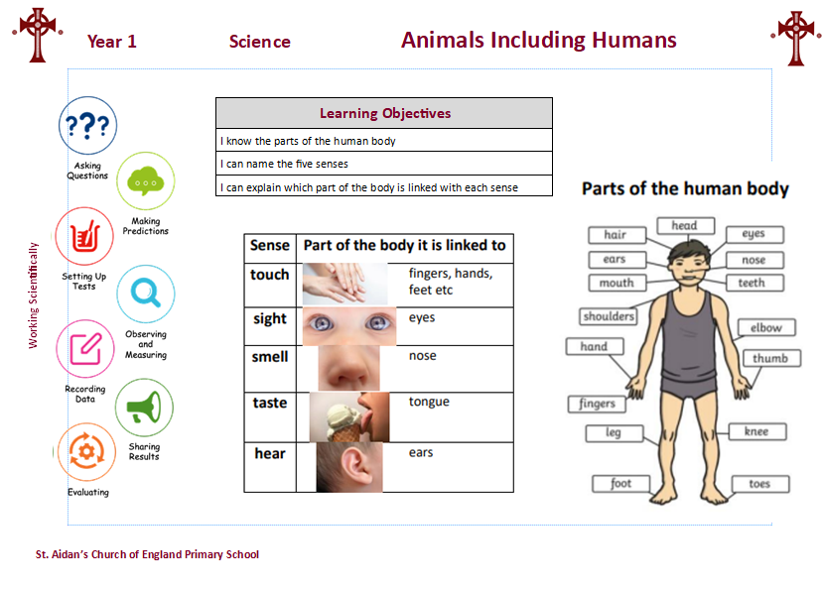
Knowledge Organisers

Slide 16
Let’s have a break!
Help yourself to tea/coffee and biscuits

Slide 17
Working Scientifically
The nature, processes and methods of Science
Working Scientifically
Should not be taught as a separate strand
Pupils should learn to use a variety of approaches to answer relative scientific questions
Pupils are not expected to cover each aspect for every area of study

Slide 18
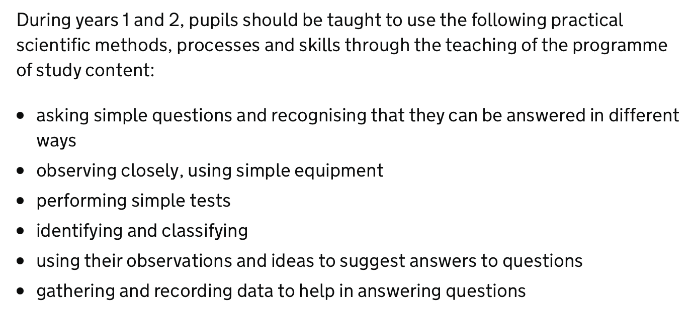
Working Scientifically

Slide 19
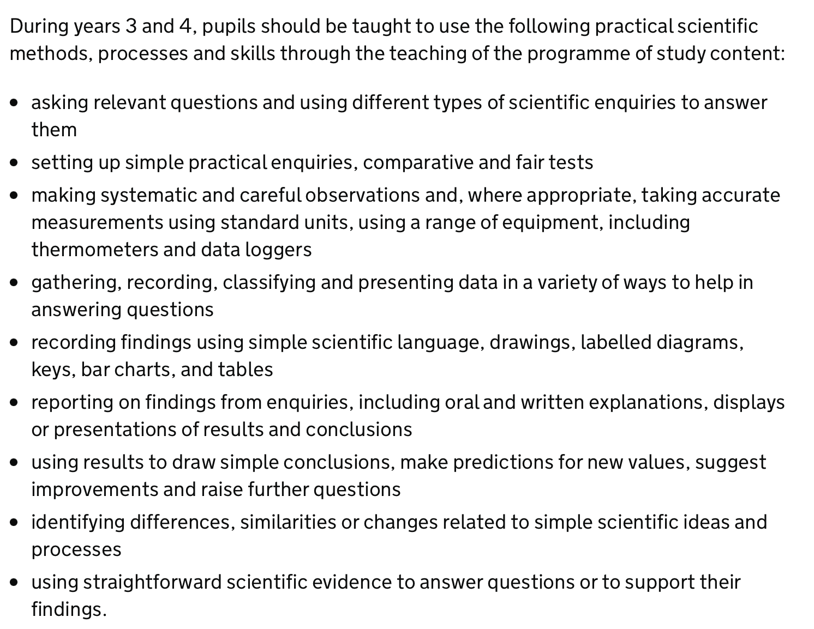
Working Scientifically

Slide 20
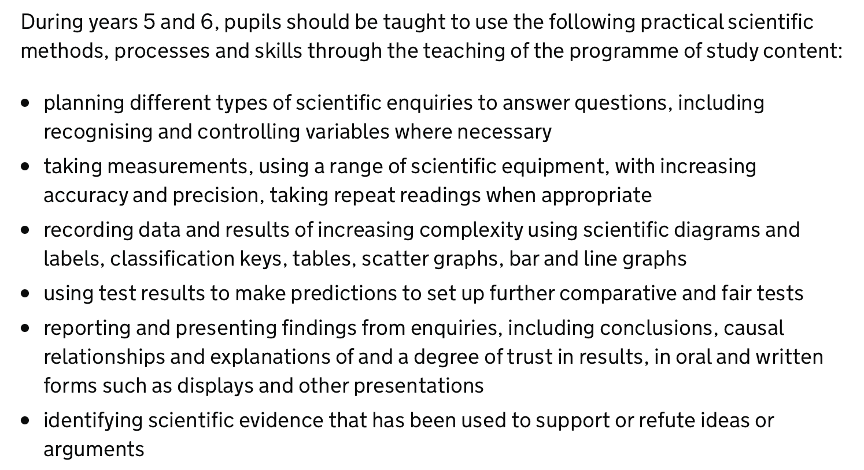
Working Scientifically

Slide 21
What are the potential barriers to working scientifically?

Slide 22
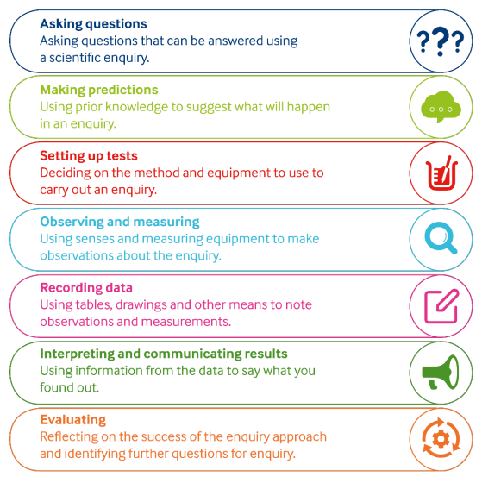
Working Scientifically

Slide 23
Working Scientifically

Slide 24
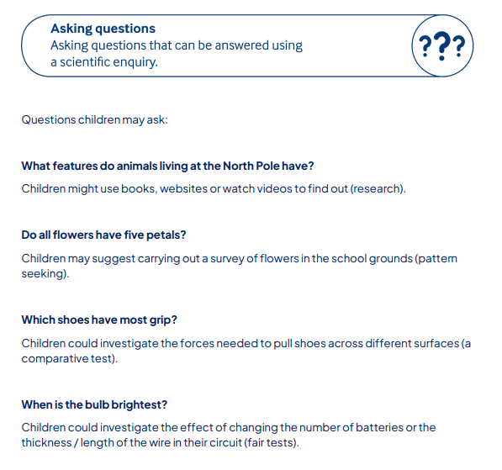
Asking Questions

Slide 25
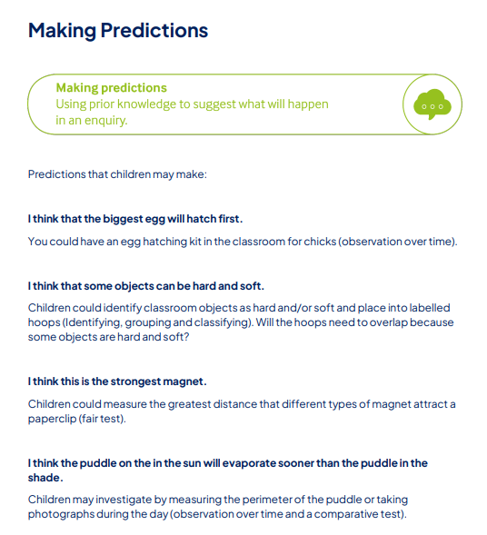
Making Predictions

Slide 26
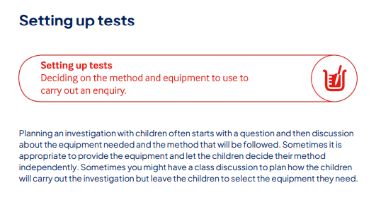
Setting Up Tests

Slide 27
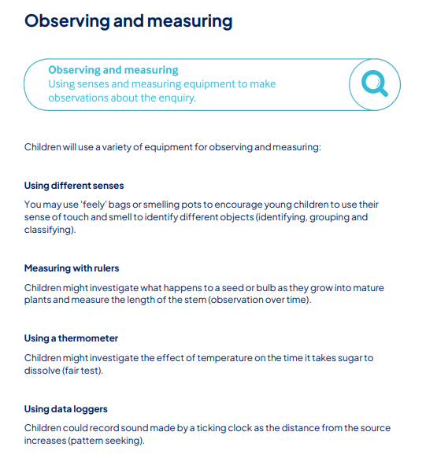
Observing and Measuring

Slide 28
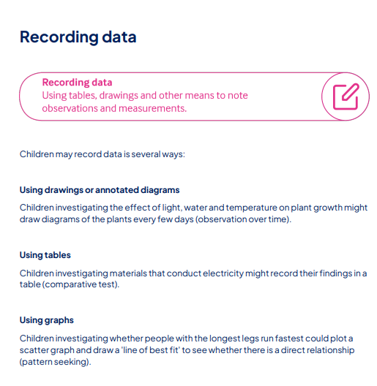
Recording Data

Slide 29
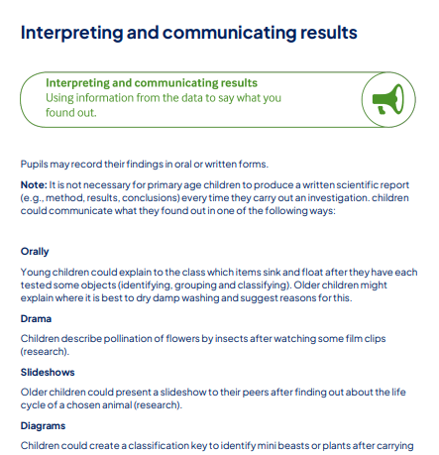
Interpreting and Communicating Results

Slide 30
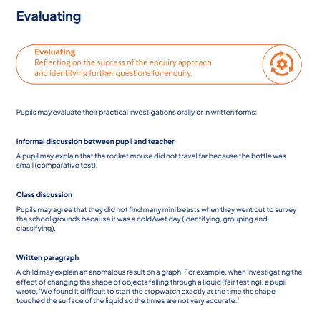
Evaluating

Slide 31
Working Scientifically

Slide 32
Working Scientifically

Slide 33
Working Scientifically - Ideas

Slide 34
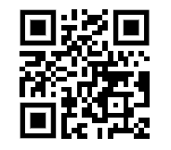

Slide 35
Lunch!

Slide 36
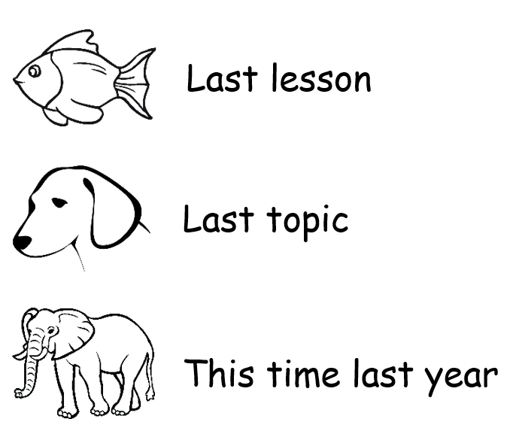
Recapping prior learning

Slide 37
Assessment

Slide 38
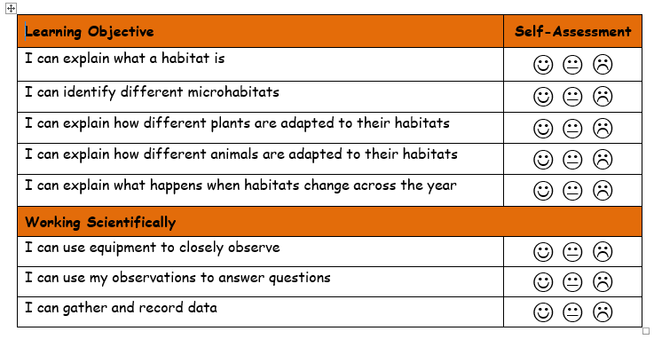
Self Assessment

Slide 39
Book Look

Slide 40
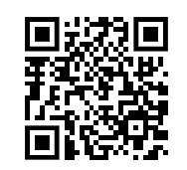
Supporting SEND pupils in Science

Slide 41
Teaching outside of the classroom
Has anyone been on any science trips?
Where could you go?
What would children get the most out of?

Slide 42
Planning a Scientific Investigation
Year 1
Everyday Materials
Year 2
Animals Including Humans
Year 3
Forces
Year 4
States of Matter
Year 5
Properties and Changes of Materials
Year 6
Electricity

