Slide 1
Welcome to maths!
Monday

Slide 2
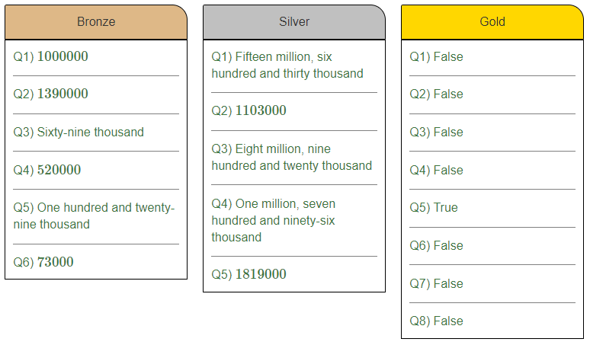
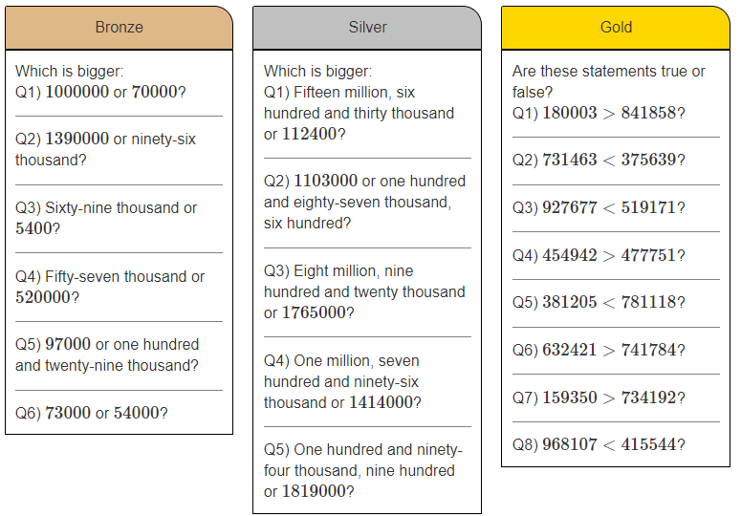

Slide 3
1. Show me how to work out the answers:
8 5 4
+ 7 8 9
7 6 . 3
+ 5 4 . 5
(c)
3.26 + 14.9
(d)
5.8 + 0.34
(a)
(b)
3 . 2 6
+ 1 4 . 9
0
5 . 8
+ 0 . 3 4
0
1
1
1
1 6
4
3
1 3
0
.
8
0
1
1
1
8
.
1
6
6
.
1
4
Pictorial
Show me using a bar model.
Show me using a part whole model
Concrete
Show me using counters.
Abstract
Show me using column method.

Slide 4
2. Show me the answers:
5 6 3
- 2 8 5
6
13.7 – 4.56
9 – 2.475
7 0 4
- 4 3 9
(d)
(a)
1
(b)
1
1
(c)
0
6
8
9
9
0
1 3 . 7
- 4 . 5 6
.
0
0
1
0
9
- 2 . 4 7 5
1
1
1
1
2
7
8
2
6
5
0
0
9
.
1
4
6
.
5
2
5
Pictorial
Show me using a bar model.
Show me using a part whole model
Concrete
Show me using counters
Abstract
Show me using column method.

Slide 5
3. Show me two numbers less than 10 with
a difference of 3.56
Pictorial
Show me using a bar model.
Show me using a part whole model
Abstract
Show me using column method.

Slide 6
4. Show me the answer to:
There are 7345 adults at a football match.
Altogether at the match, 9125 people are male and 1543 are female.
How many of the people at the football match are children?

Slide 7
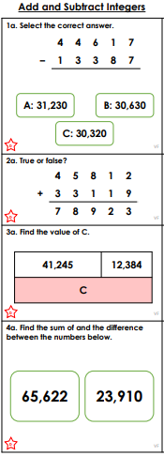
02.10.23
WALT: To add and subtract integers
Sum =
Difference =
Write out the calculation and answer.
Write this out and write underneath true or false.
Draw the bar model and work out.

Slide 8
Challenge

Slide 9
Welcome to maths!
Tuesday

Slide 10
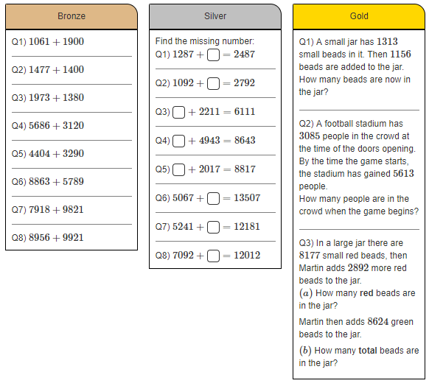
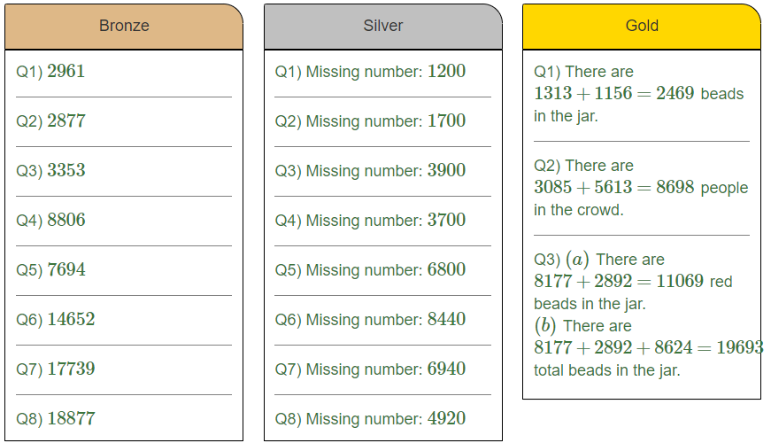

Slide 11
I do
Represent the problem as a bar model and solve them.

Slide 12
we do
Represent the problem as a bar model and solve them.

Slide 13
you do
Represent the problem as a bar model and solve them.

Slide 14
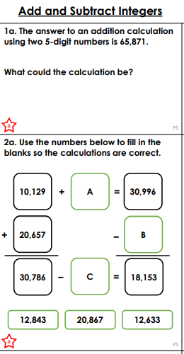
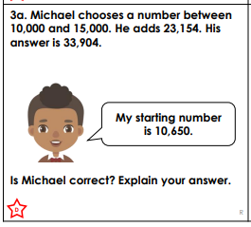
Date
WALT: To solve problem involving adding and subtracting integers
Write out this calculation.
Cut out this box
A=
B =
C =
3. Michael is ________, I know this because...

Slide 15
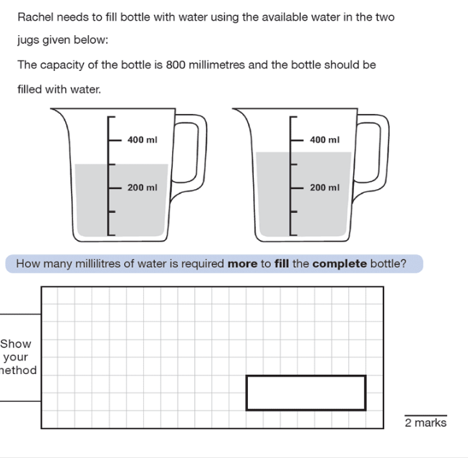
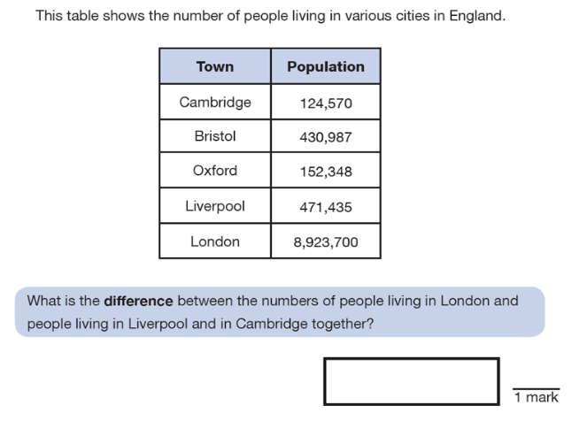
Challenge

Slide 16
Welcome to maths!
Wednesday

Slide 17
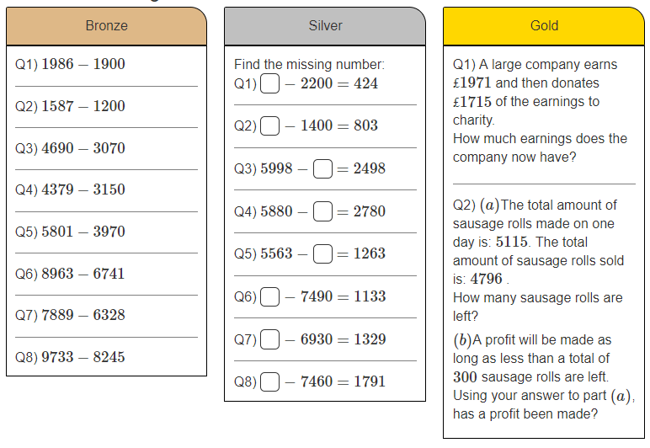
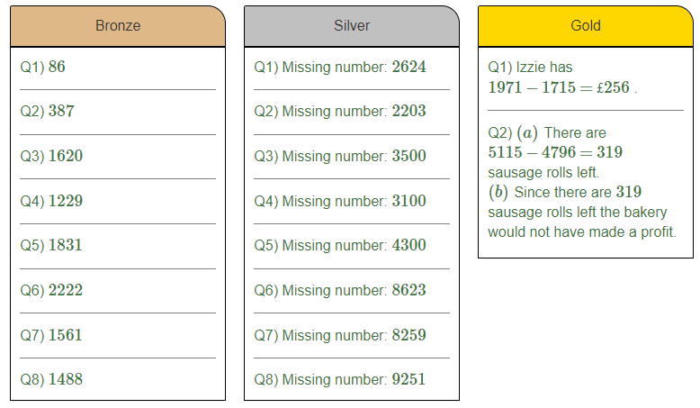

Slide 18
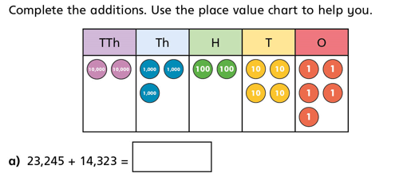
I/we do

Slide 19
you do

Slide 20
Think
Convince me that Eva’s number is 2756…
Method 1- calculation steps
Method 2- explanation

Slide 21
Date
WALT: Solve problems involving adding and subtracting integers.
Think
Method 1
What steps did you take?
Method 2
Mrs McDonald, I know that Eva’s number is … because…

Slide 22
Welcome to maths!
Thursday

Slide 23
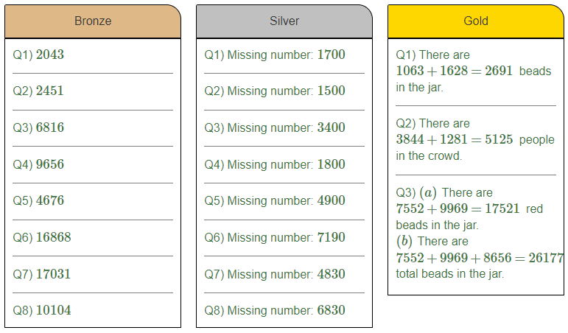
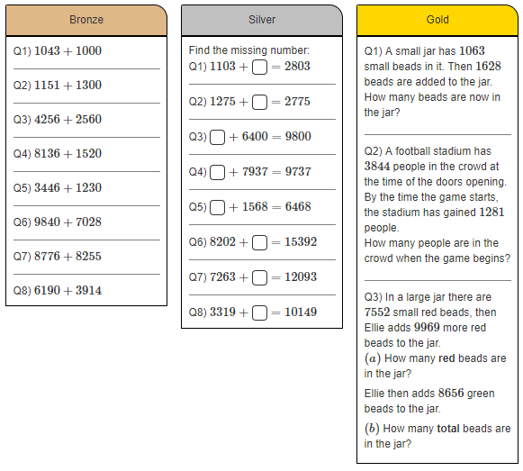

Slide 24
I do

Slide 25
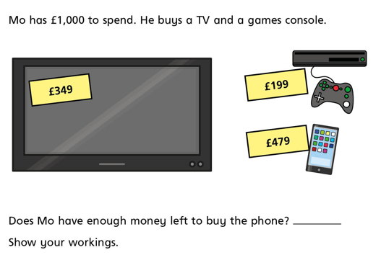
we do

Slide 26
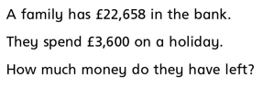
you do

Slide 27
Explain
What’s the same and what’s different?
a. 456,314 + 32,120
b. 41,527 + 635,850
c. 6,548,654 + 10,535,434
Work out answers- primes, odd, even, multiples, biggest, smallest, difference between, place value, digits.

Slide 28
Date
WALT: Solve problems involving adding and subtracting integers.
a. 456,314 + 32,120=
b. 41,527 + 635,850=
c. 6,548,654 + 10,535,434=
Similarities
-
-
-
Differences
-
-
-

Slide 29
Solve
Always, sometime, never…
When I add two 4-digit numbers together it will make a
5-digit number.

Slide 30
Date
Solve
Method 1
4-5 methods to prove/disprove.
Method 2
Miss McArthur, I know this is ____________ true because…

