Slide 1
Applications and Interviews
30th November 2023

Slide 2
Links to the Teachers Standards and the Core Content Framework.
Ensuring that you submit an application that pays cognizance to the Teacher's Standards with regard to professional expectations.
You need to pay close attention to professional literacy.
The panel have never net you and you and present yourself in the best possible light in written form to get to the next stage.
The application form is the first step towards getting to the shortlist.

Slide 3
PART I
Looking for a Job

Slide 4
Looking for a job: some examples of useful websites.
DfE (Department for Education) Teaching-vacancies.service.gov.uk
Schools North-East www.jobsinschoolsnortheast.com
TES (The Times Educational Supplement) www.tesjobs.co.uk
E-Teach www.eteach.com
Local Authority eg. County Durham www.durham.gov.uk/article/2087/Newly-qualified-and-supply-teacher-services
Word of mouth/ emails from CTTP

Slide 5
Looking for a job: newspapers/print media – less useful nowadays?
Examples:
The Universe (national Roman Catholic newspaper) - RC schools may use?
The Northern Cross (Roman Catholic Diocese of Hexham and Newcastle stretches from Berwick to Darlington) - RC schools may use?
Middlesbrough Catholic Voice​ (Roman Catholic Diocese of Middlesbrough which stretches from Middlesbrough and across North Yorkshire) - RC schools may use?
Local newspapers e.g. The Northern Echo, The Sunderland Echo etc. - all schools may use?

Slide 6
Looking for a job: local diocesan websites – less useful?
Examples:
RC Diocese of Hexham and Newcastle - Diocesan website www.rcdhn.org.uk
RC Diocese of Middlesbrough – Diocesan website www.middlesbrough-diocese.org.uk
Anglican Diocese of Durham – Diocesan website www.durhamdiocese.org.uk
Anglican Diocese of Newcastle – Diocesan website www.newcastleanglican.org.uk

Slide 7
Looking for a job: LinkedIn, social media etc.
Follow Teaching Job platforms on:
LinkedIn- TES, Connections, Local Authorities, Jobs In Schools North East, Local Education Trusts
Facebook- TES Jobs, NUT Section, Local Schools Pages, North East Jobs.
Twitter- Teaching Jobs Tags, VocatEd, Jobs in Schools North East.

Slide 8
LinkedIn.
It’s not just about what you know but also who you know too…connect, connect, connect.
Be visible to possible future employers.
Keep your profile updated and strictly professional.
Don’t be afraid to blow your own trumpet.

Slide 9
LinkedIn.

Slide 10
LinkedIn.

Slide 11
LinkedIn.

Slide 12
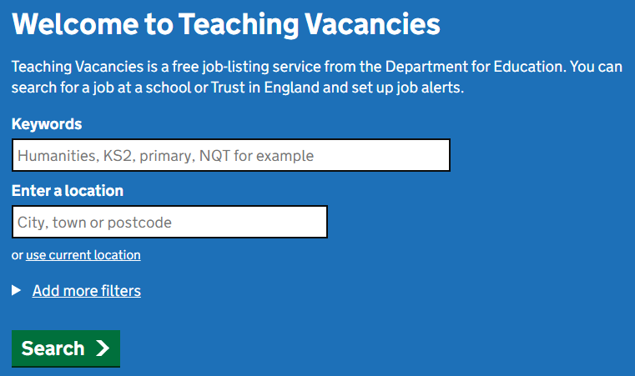
DfE website.
Find a job in teaching — Teaching Vacancies (teaching-vacancies.service.gov.uk)

Slide 13
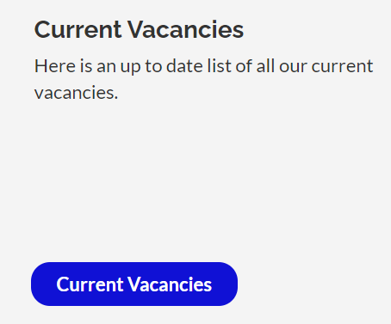
Teaching pools.
Local Authority Teaching Pools.
Durham LA, Newcastle LA or similar.
https://www.durham.gov.uk/article/2087/Newly- qualified-and-supply-teacher-services
https://www.newcastle.gov.uk/services/jobs-and-careers
Multi-Academy Trusts.
Bishop Hogarth Catholic Education Trust Teaching Pool Carmel College, The Headlands, Darlington
https://bhcet.org.uk/vacancies/

Slide 14
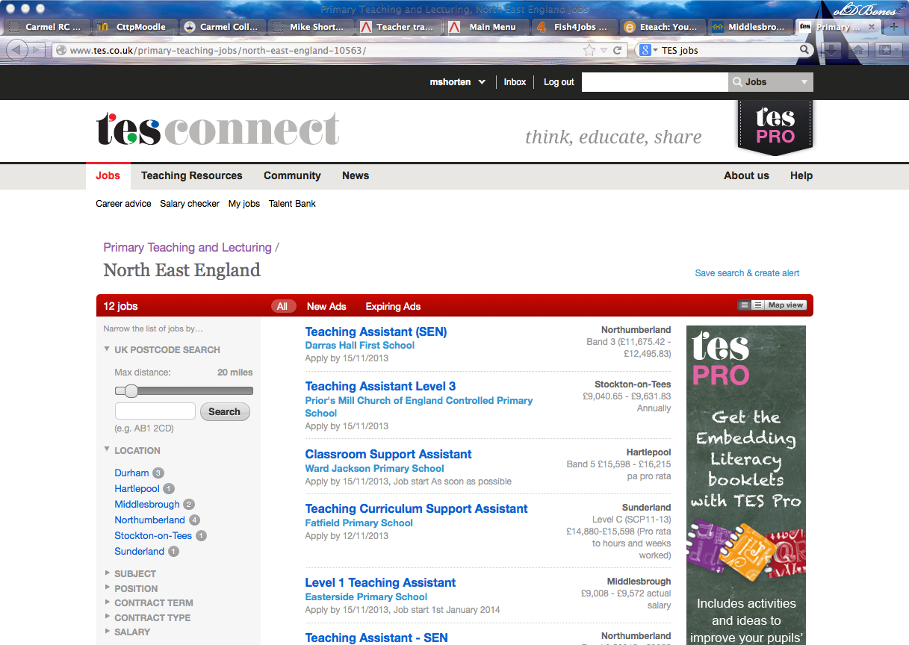
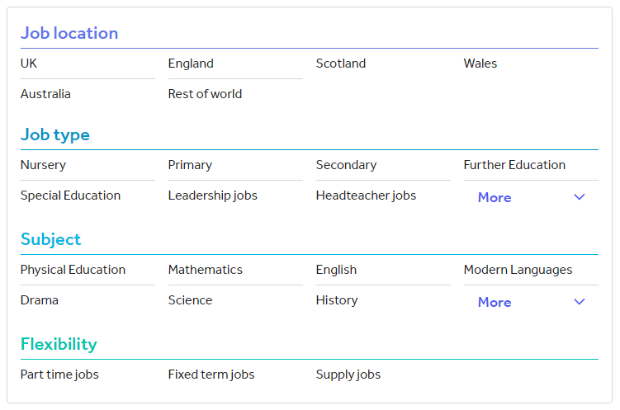
TES.

Slide 15
Looking for a job in an RC school in the North-East? Very useful for RC sector.
There are four large trusts in the R.C. Diocese of Hexham and Newcastle:
North – Bishop Bewick Catholic Education Trust (5 secondaries):
St. Cuthbert's (Newcastle), Sacred Heart (Newcastle), St. Mary's (Newcastle), St. Thomas More (North Shields) and St. Benedict Biscop (Bedlington).
South – Bishop Hogarth Catholic Education Trust (5 secondaries):
Carmel College (Darlington), St. John's (Bishop Auckland), Our Lady and St. Bede (Stockton), St, Michael's (Billingham) and English Martyrs (Hartlepool).

Slide 16
Looking for a job in an RC school in the North-East? Very useful for RC sector.
East – Bishop Chadwick Catholic Education Trust (5 secondaries):
St. Aidan's (Sunderland), St. Anthony's (Sunderland), St. Wilfrid's (South Shields), St. Joseph's (Hebburn) and St. Bede's (Peterlee).
West – Bishop Wilkinson Catholic Education Trust (5 secondaries):
Cardinal Hume (Gateshead), St. Thomas More (Blaydon), St. Leonard's (Durham), St. Bede's (Lanchester) and St. Robert's (Washington).

Slide 17
Academy Trusts..... thousands!
ALP (Advance Learning Partnership) (17 schools)
Ark (39 schools)
Aspire NE Multi- Academy Trust (2 schools)
Consilium (9 schools)
Delta
Dixons Academy Trust
Emmanuel Schools Foundation
Harris Federation
NELT (North East Learning Trust)
NEAT (North East Academy Trust)
NET (Northern Education Trust)
Oasis Trust
Ormiston Academies Trust
Outwood Grange Academy Trust)
United Learning Trust
WISE Academies
etc. etc.

Slide 18
When?
Vacancies can occur at any time, but do start looking for advertisements from January and February onwards at the latest. Many primary posts are advertised in May and June. Most primary trainees obtain their posts during the summer term and secondary much earlier.
Posts continue to be advertised well into the autumn term.

Slide 19
Thousands of Academy trusts.....
ALP (Advance Learning Partnership) (17 schools), Ark (39 schools), Aspire NE Multi- Academy Trust (2 schools), Consilium (9 schools)….... Delta. Dixons Academy Trust, Emmanuel Schools Foundation, Harris Federation, NELT (North East Learning Trust, NEAT (North East Academy Trust), NET (Northern Education Trust), Oasis Trust, Ormiston Academies Trust, Outwood Grange Academy Trust), United Learning Trust, WISE Academies etc. etc.

Slide 20
Applying for a teaching post.
Is the job right for you?
Register your interest by making contact, if that has been requested.
Complete the application form, accompanying letter etc.
Get the application to the school in plenty of time.
Arrange a pre-visit (if possible )… not always possible …...and you will be shown around on the day.

Slide 21
PART II
Applying for a teaching post.

Slide 22
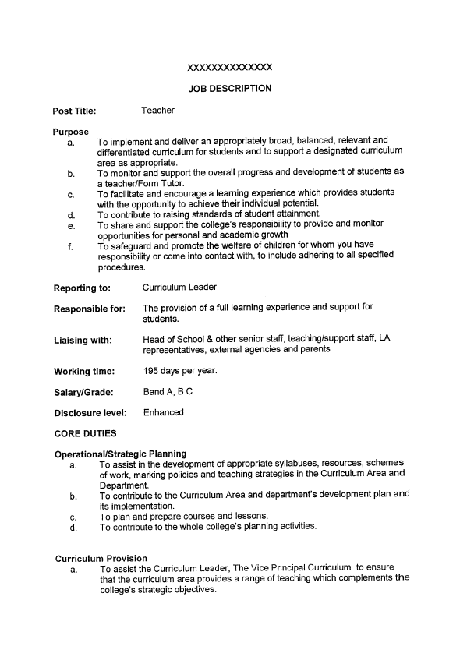
Do your homework!.
Exact title
Job description and person specification
- Essentials and desirables (see exemplar)
School characteristics
- Website, curriculum, extra curricular etc.
- OFSTED inspection report, Diocesan report?
Is it where you want to be?
Is it main scale?

Slide 23
Applications get you to interview!
DO
Treat the application with respect.
Write a draft first.
Check someone to read your application.
Focus on the job in question- the job description and person specification, the essentials and the desirables etc.
Check if applications are "online".
Keep CV updated and concise ready to inform applications.
DON’T
Use different colour pens
Cross out
Leave blanks
Tell lies
Use a small envelope (use A4)
Miss deadlines

Slide 24
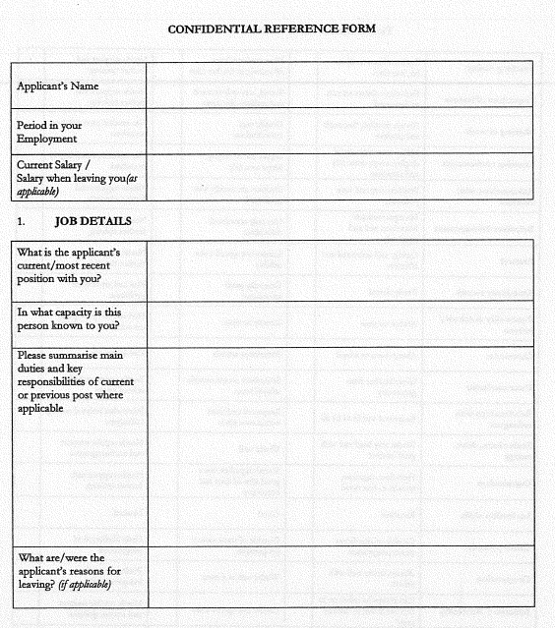
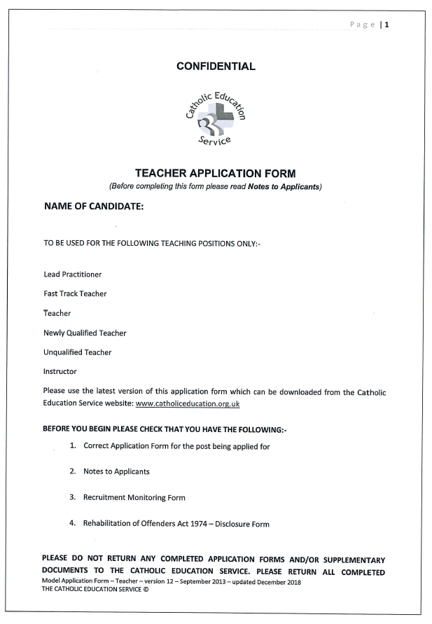
Application forms.
Biographical detail – ensure accuracy.
Referees - who? Please request a reference.
Do not omit information as it may create gaps.
Include grades/levels/dates re. qualifications
Supporting statement /letter of application
Syntax – check.
Spelling, grammar and punctuation – check.
Does the application reflect you?

Slide 25
PART III
The interview.

Slide 26
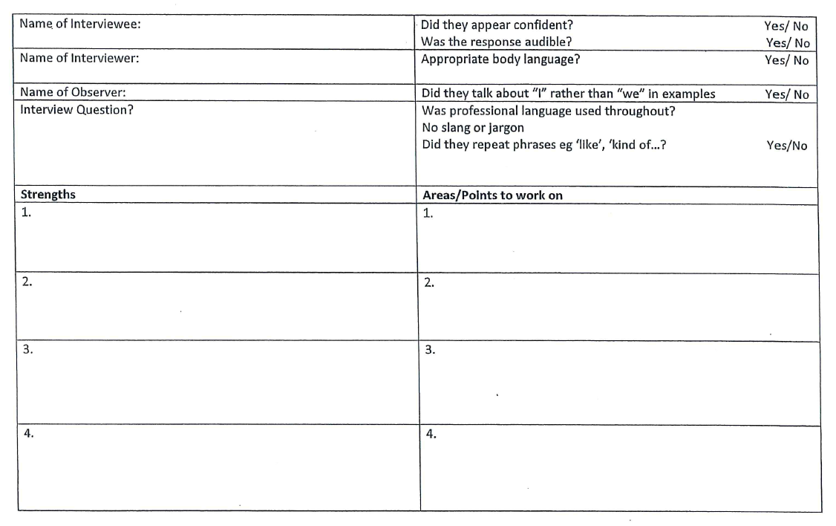
Interview.
Be yourself
Be confident, but not over-confident
Give yourself thinking time
Portfolio?
Positive body language
DO NOT LOSE THE JOB AT THE INTERVIEW
https://www.youtube.com/watch?v=fipSEmdj3i0

Slide 28
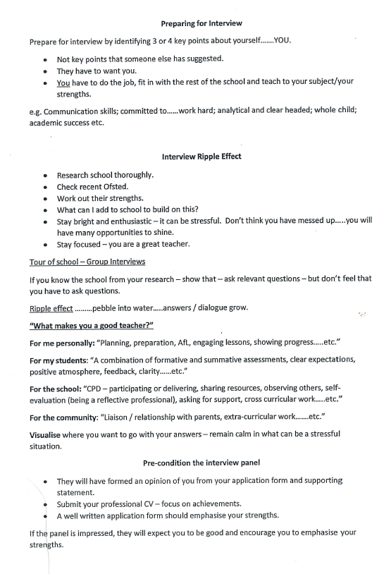
Preparing for the interview.
Identify 3 or 4 key points about yourself….YOU
Interview ripple effect… pebble into water… and dialogue expands
Pre-condition the interview panel
Think positively
Background information
Prepare your questions for interviewers
Strategies for interview
Be positive
Get feedback

Slide 29
Preparing.

Slide 30
The interview day.
What to wear?
Think about the dress code
Dress for the role above the job you are applying for
Ensure tip top presentation
Keep accessories to a minimum
Typical day/half-day
Welcome
Tour
Staff visit/meet
Lunch
Interviews
Panel - may be made up of people from the following groups - Headteacher, SLT/SL, Directors, Governors, LA representative in the case of maintained schools.

Slide 31
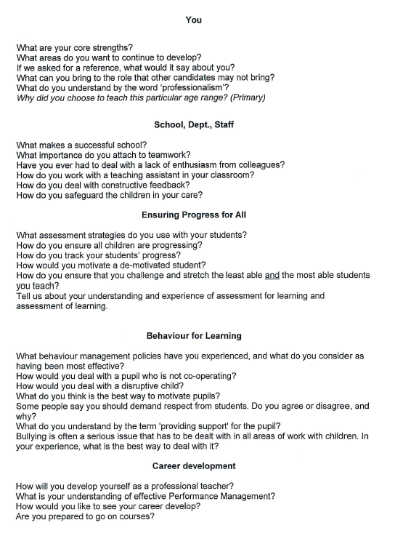
Questions at interview.
About yourself and your motiavtion?
Why do you want to teach/ be a primary teacher?
About your teaching, style of behaviour management or similar
Describe a good / bad lesson that you have taught recently…why was it good/bad?
In your opinion what are the benefits of .. data / tracking / AfL etc?
Safeguarding question?
Your subject/phase expertise and impact?
Why this school?
Why this school? Do your homework.
Your contributions to general school life
Other than … what else can you offer?

Slide 32
Remote interview tips.
1. Take some time to adjust the height of the camera.
Make sure that the screen and camera is at eye level when you’re sitting down.
2. Practice speaking into the camera.
Anyone who has done media training knows that the key to coming across as authentic on camera is to "look through the lens". When doing a Skype or Zoom interview, have the camera on a stand just in front of the screen so that when you’re looking at the interviewer’s eyes on screen, you are looking through the camera.
3. Don’t sit too close to the camera.
There is no reason to sit right at your desk, so push back a metre or so. This will mean that there is less of a sense of invading each other’s space, which will make the whole experience less intense.
4. Invest in an extension microphone.
A USB extension microphone will improve the sound quality and will allow you to sit further away from the camera. They are also very cheap to buy. Just don’t forget to test the sound levels.
5. Think about what’s behind you.
A good background can make a positive impression, while a busy or untidy one can be a distraction.
6. Avoid backlighting
Trust me, that angelic "halo" can be an off-putting look.
7. Never wear a headset.
Do I really need to explain why?
8. Take time to prepare for the interview.
There’s an element of ritual about face-to-face interviews that prepares candidates for what is to come: getting dressed, travel to the school, checking in with reception, waiting outside the interview room etc). Much of this can be lost when you are fitting in a quick interview between lessons or between breakfast and heading to school. To replicate the build-up period, try to arrange your online interview at a time when you know you will have the opportunity to prepare yourself physically and mentally.
9. Don’t put post-It notes around the screen.
You wouldn’t have notes at a face-to-face interview, so why do people think that it’s acceptable online? It’s so obvious and shows a lack of confidence.
10. And finally…make sure that you’re fully dressed.
You never know what might happen during the call. If you have to stand up suddenly for any reason, you don’t want to give your interviewer a shock.

Slide 33
Remote interviews tips.
5. Think about what’s behind you.
A good background can make a positive impression, while a busy or untidy one can be a distraction.
6. Take time to prepare for the interview.
There’s an element of ritual about face-to-face interviews that prepares candidates for what is to come (getting dressed; travel to the school; checking in with reception; waiting outside the interview room). Much of this can be lost when you are fitting in a quick interview between lessons or between breakfast and heading to school. To replicate the build-up period, try to arrange your online interview at a time when you know you will have the opportunity to prepare yourself physically and mentally.
7. Don’t put post-It notes around the screen.
It can be obvious and shows a lack of confidence.

Slide 34
Other Interview Tasks
Teaching a lesson or part of a lesson
Request the information that you need to prepare appropriately e.g. class information, prior knowledge, etc.
Check about the resources/IT equipment available e.g. how should you share PowerPoint or similar and any other practical information.
Be prepared for different scenarios e.g. students not having books and be flexible.
Meeting the students e.g. Student Council.
Subject Knowledge interviews e.g. MFL or pastoral and curriculum interviews.
Presentation e.g. how would you raise uptake/results at GCSE.
In-tray task e.g. data analysis.

Slide 35
Accepting a job offer.
A spoken offer is a legal contract.
Once you have accepted an offer, you will be sent a letter confirming your appointment.
Make sure you respond promptly to this letter to confirm your acceptance of the post.
Keep a copy of your reply.
Be aware of different contracts

Slide 36
Do you want the job?
You will be asked if you would accept the job if offered! This is not an offer of a job…
If you have another interview for a post you would prefer in a few days' time, you could ask the panel if they will hold a job offer open until after the other interview. They will almost certainly ask you to make up your mind immediately.
It is unprofessional to accept a job at the interview and then renege on this acceptance later.

Slide 37
If you are not successful.
Make sure you accept gracefully. Sometimes it is nothing to do with your performance. It does not mean that you will not be appointed at the same school if another vacancy occurs.
If offered the chance of a debriefing/feedback, take it.
Spend some time on your analysis of how you performed.
Discuss this with your tutors, headteachers or experienced teachers you know and take the opportunity to attend any training sessions in interview techniques.

Slide 38
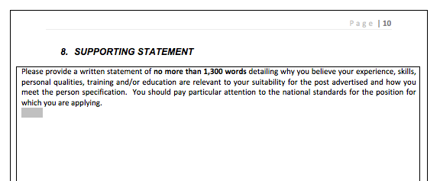
Application practice.
http://www.catholiceducation.org.uk/schools/application-forms

