Slide 1
Central Training: General Professional Studies
Assessment, progress and data
Thursday 5th October 2023

Slide 2
Training Overview – Part 1
This session will aim to…
Planning for Progress (Review) - to understand how children learn;
Understanding Data - to become aware of the various data available and how to interpret them (link to numeracy skills);
Tracking & Monitoring of Progress - to understand why we track, and how we track, data.
A
B
Data & Progress
(AM)
C

Slide 3
Training Overview – Part 2
This session will aim to…
A
Types of Assessment - to understand the difference between formative and summative assessment.
Assessment Strategies - to develop a toolkit of assessment strategies.
Feedback - to develop effective strategies for feedback.
B
Assessment Strategies
(PM)
C

Slide 4
Teachers’ Standards
2. Promote good progress and outcomes by pupils
be accountable for pupils’ attainment, progress and outcomes be aware of pupils’ capabilities and their prior knowledge, and plan teaching to build on these
guide pupils to reflect on the progress they have made and their emerging needs
demonstrate knowledge and understanding of how pupils learn and how this impacts on teaching
encourage pupils to take a responsible and conscientious attitude to their own work and study.
6. Make accurate and productive use of assessment
know and understand how to assess the relevant subject and curriculum areas, including statutory assessment requirements
make use of formative and summative assessment to secure pupils’ progress
use relevant data to monitor progress, set targets, and plan subsequent lessons
give pupils regular feedback, both orally and through accurate marking, and encourage pupils to respond to the feedback.
Covered in:
Part 1: Data and Progress
Part 2: Assessment Strategies
SK Training

Slide 5
Core Content Overview • Classroom Practice (TS4)
Evidence Statements: Learn that…
4.5
Explicitly teaching pupils metacognitive strategies linked to SK supports independence and academic success.
Questioning is an essential tool for teachers.
4.6
See full detail in the ITT Core Content Framework.
https://assets.publishing.service.gov.uk/government/uploads/system/uploads/attachment_data/file/843676/Initial_teacher_training_core_content_framework.pdf

Slide 6
Core Content Overview • Assessment (TS6)
Evidence Statements: Learn that…
6.1
Effective assessment is critical to teaching because it provides teachers with information about pupils’ understanding and needs.
6.3
Before using any assessment, teachers should be clear about the decision it will be used to support and be able to justify its use.
Good assessment helps teachers avoid being over-influenced by potentially misleading factors, such as how busy pupils appear.
6.2

Slide 7
Core Content Overview • Assessment (TS6)
Evidence Statements: Learn that…
6.4
To be of value, teachers use information from assessments to inform the decisions they make; in turn, pupils must be able to act on feedback for it to have an effect.
6.6
Over time, feedback should support pupils to monitor and regulate their own learning.
High-quality feedback can be written or verbal; it is likely to be accurate and clear, encourage further effort, and provide specific guidance on how to improve.
6.7
Working with colleagues to identify efficient approaches to assessment is important.
6.5

Slide 8
Core Content Overview • Pedagogy (TS2/4/5)
Practice Statements: Learn how to…
6
Check prior knowledge and understanding during lessons
5
Group pupils effectively by
ensuring that any groups based on attainment are subject specific.
6
Provide high-quality feedback
5
Develop an understanding of different pupil needs, by making use of formative assessment.
6
Make marking manageable and effective
6
Avoid common assessment pitfalls by choosing, where possible, externally validated materials, by planning formative assessment tasks and thinking ahead about what would indicate understanding (e.g. hinge questions) and by drawing conclusions about what pupils have learned by looking at patterns of performance over a number of assessments.
Notes:
EEF Setting – non judgmental (evidence-based)

Slide 9
Core Academic Reading • Assigned Bibliography
Pre Reading
Follow-Up Reading
6
Speckesser et al., Embedding Formative Assessment (Executive Summary 2 pages)
Black et al., Working inside the Black Box: Assessment for Learning in the Classroom
6
EEF, A Marked Improvement?
See ITT Core Content Framework for full bibliography.
https://assets.publishing.service.gov.uk/government/uploads/system/uploads/attachment_data/file/843676/Initial_teacher_training_core_content_framework.pdf

Slide 10
Central Training: General Professional Studies
Planning for Progress (Review)
Section A

Slide 11
Key Terminology: What is Progress?
What is Progress?
Progress means knowing more and remembering more.
Academic
Progress
Attendance
Other
Progress
Social Skills
Knowledge/Skills
(c.f learning = lasting change in long-term memory)
Emotional Intelligence
Attainment in tests, internal assessments, external examination
Learning Behaviour
(e.g. resilience, work ethic, organisation, presentation)
Behaviour
Etc.

Slide 12
Key Terminology: The Language of Data
Attainment: currently this means where you are in relation to criteria.
Progress: the movement between, beyond or before 2 attainment points (so you need the 2 points!)
Achievement: refers to both progress and attainment.

Slide 13
Key Principles to secure high quality assessment data
All teachers should have easy access to progress / performance data, in order to manage progress, identify underperformance and analyse their own performance.
Teachers must assess using clear, shared and objective criteria, providing clear written feedback to pupils.
All staff and pupils know what they are aiming for and have ownership and responsibility for their part in the journey.
Data must inform planning.
No pupil should fail to perform, without this being identified and the causes addressed.
Assessment must have a purpose.

Slide 14
Planning for Progress: Review
How do we achieve excellent progress over time?
Reflect on the training session on Effective Lesson Planning, on your academic reading, on your focused observations in school and on your own practice:
How do you effectively plan for short term progress?
How do you effectively plan for long term progress?
Notes:
In two groups – one long term, one short term the group record as many examples as they can. They can use post its to write down excellent examples for each one example per post it.
The group can then swap over and add any more ideas to the other group.

Slide 15
Planning for Progress: Review
Adapt plans to match
different needs
Share learning goals and success criteria
Know the starting points
Build on prior knowledge
Sequence learning to make progressive change
Be clear about the purpose of the learning
Timely review and assessment
Revisit concepts
Notes:
The next set of slides will contain some other examples of progress which can be used to ensure the basics have been covered!

Slide 16
Planning for Progress: Review
Plan homework to consolidate and extend
learning
Use a taxonomy to stretch and challenge
Time to improve and respond to feedback
Sharply focused
intervention and deadlines
Pupil premium, Sen, EAL,
G&T
Timely review and assessment against FFT
Questioning deepens learning
Good subject routines established
Notes:
The next set of slides will contain some other examples of progress which can be used to ensure the basics have been covered!

Slide 17
Planning for Progress: Review
Taking account of how knowledge is acquired
Reflect :
Do you take account of how knowledge is acquired in your planning?

Slide 18
Planning for Progress: Review
Taking account of how knowledge is acquired
40-50% of what we teach students they already know.
33% of what a student learns is unique to the student and based on their prior knowledge.
Learning is making connections between new information and prior knowledge.
Learning usually involves a progressive change in what a student knows and can do.
Single isolated experiences seldom give birth to learning.
Students need to experience at least 3 different sets of complete information about a concept before it is embedded in their network of knowledge, we need to give them opportunities to revisit concepts.

Slide 19
Planning for Progress: Review
Taking account of how knowledge is acquired
The more a piece of information is repeated or relearned the stronger the connection.
FREQUENCY and RECENCY.
You need to develop deeply imprinted lines and connections in the brain like skiers on a route.

Slide 20
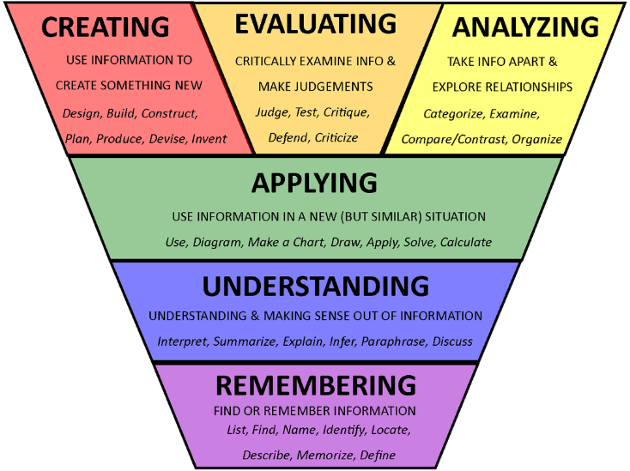
Planning for Progress: Review
Progress Taxonomies
Bloom's Taxonomy
Notes:
Input on models of learning to use for personal focus and development
Could use this model overtime or for one lesson to make progress visible

Slide 21
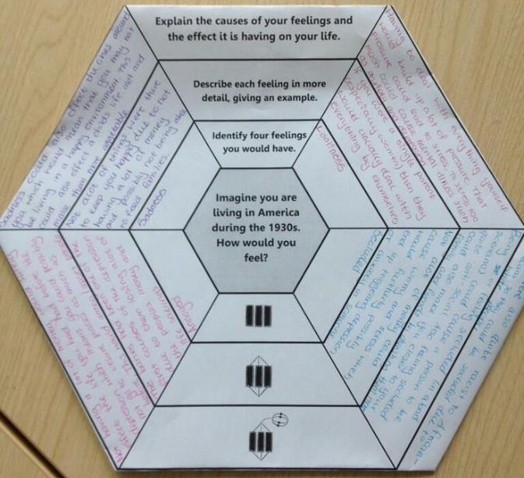
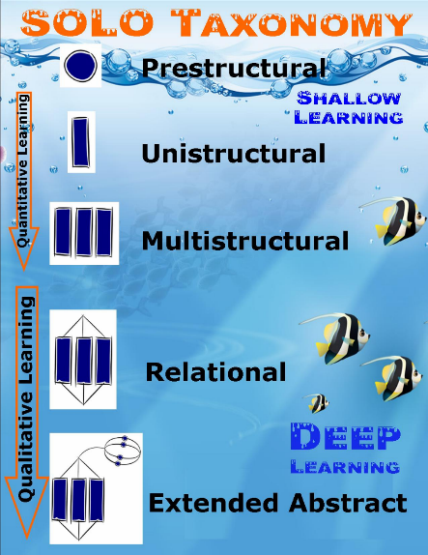
Planning for Progress: Review
Progress Taxonomies
Solo Taxonomy

Slide 22
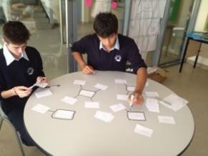
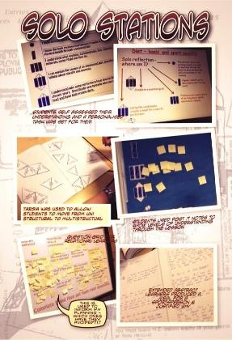
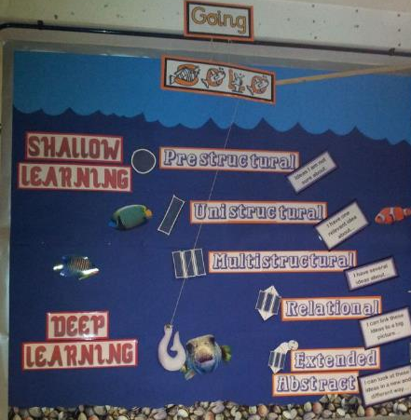
Planning for Progress: Review
Progress Taxonomies
Solo Taxonomy

Slide 23
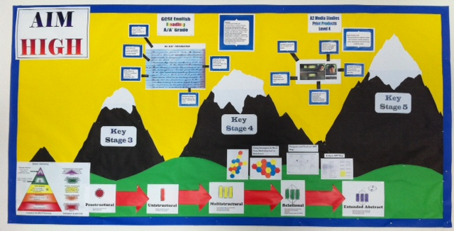

Slide 24
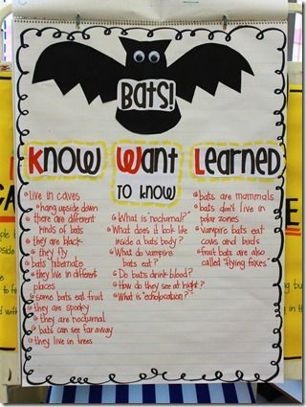
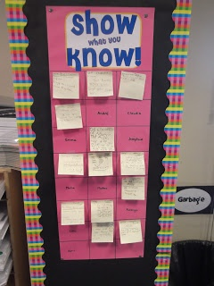
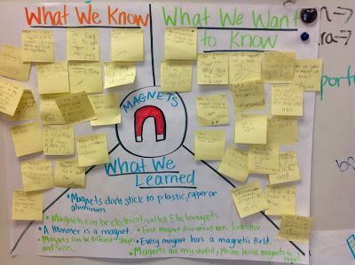
Planning for Progress: Review
Making Progress Visible in the Lesson

Slide 25
Planning for Progress: Review
Example: Homework Planning Sheets KS3 Medium Term
Researching
Analysing
Comparing
Designing
Evaluating
Creating a new product
Peer assessment
Teacher assessment
Parental comment
Illustrated with pupil examples
Sequence of homework tasks uses the design process and Bloom’s taxonomy to scaffold skills. This process is used from year 7 to 13

Slide 26
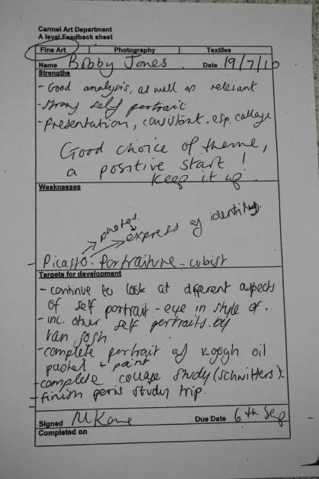
Planning for Progress: Review
Example: Homework Planning Sheets KS4 Medium Term
Links to similar structure from KS4 for 1st half term then the focus shifts to individual targets and feedback which is recorded and agreed by pupils. This creates a sense of ownership and motivates students to complete work.
Students need a clear learning journey to follow. If independent learning is linked to the big picture this sells the benefit of completing the work. Give students year plan.

Slide 27
Planning for Progress: Review
Example: Homework Planning Sheets KS4 Medium Term
Progression from KS3 to KS4: Builds on structures put in place at key stage 3.
For some subjects this needs to be less prescribed so that students can cope with controlled assessment and gain more independence with ideas.
Opportunity for student to reflect on the quality of the work before it is marked.

Slide 28
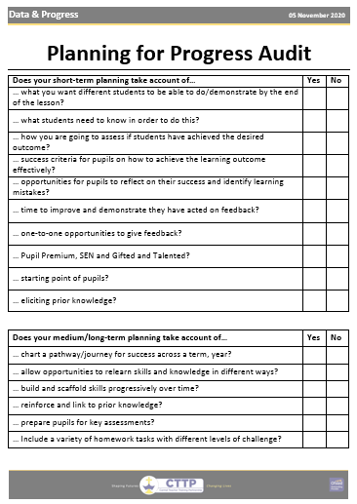
Planning for Progress: Review
Self-Evaluation: Evaluate your own practice to date
Notes:
Reflection and self evaluation

Slide 29
Some suggested reading and websites:
Visible Learning, John Hattie (2008)
Visible Learning:the sequel, John Hattie (2023)
The Hidden Lives of Learners, Graham Nuthall (2007)
www.educationendowmentfund
Closing the gap? The Education Policy Institute (2017)
Workless households and educational attainment statutory indicators (2023)
Notes:
Provide some other areas for research or ideas for the next lesson

Slide 30
Central Training: General Professional Studies
Understanding school data.
Section B

Slide 31
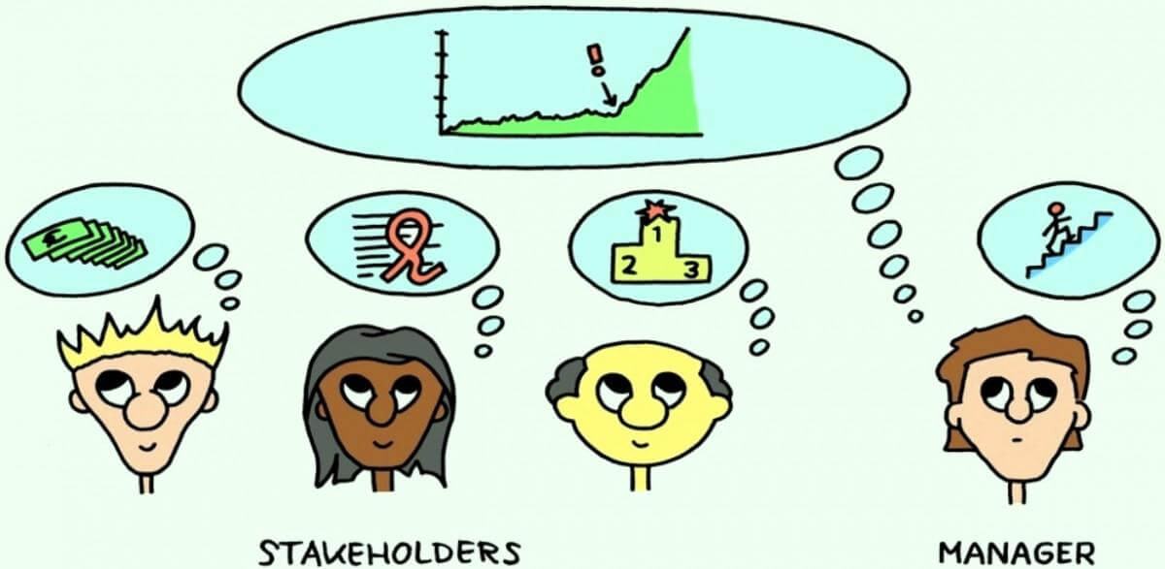
Data & Accountability
Teachers’ Standard 2: Promote good progress and outcomes by pupils.
Be accountable for pupil’s attainment, progress and outcomes.
Summative Assessment in the UK is inextricably linked to accountability.
Reflect:
Who wants to know and why?
Who is accountable for pupils’ progress during your ITT?

Slide 32
Types of Data
Class Teacher level
School level
National level
Internal assessment data
Retrieval test results
Homework record
Learning behaviour grades (behaviour, organisation, attendance etc.)
Attendance
Prior Attainment (KS2 SATS)
Cognitive Skills data (CATS, MidYIS/YELLIS and ALIS)
Reading Age
Pupils Characteristics (SEN, Pupil Premium, Gender, EAL)
External Examinations data
9-4 incl. English & Maths
E-Bacc
Attainment 8
Progress 8

Slide 33
1. School Level: Knowing your Pupils
1.1. KS2 SAT
1.2. CAT Test/MidYIS

Slide 34
Knowing your Pupils: KS2 SATs
Tasks and tests that the government sets for children aged 7 and 11
Designed to assess children's knowledge English (reading and SPAG) and maths.
Scaled Scores
A scaled score between 100 and 120 shows the pupil has met the expected standard in the test.
The lowest scaled score that can be awarded on a key stage 2 test is 80. The highest score is 120. Pupils need to have a raw score of at least 3 marks to be awarded the minimum scaled score.

Slide 35
Knowing your Pupils: CAT Scores
What are CAT Tests? (an introduction)
Cognitive
Ability
Tests
https://www.youtube.com/watch?v=U0DDUKuQtKc

Slide 36
Knowing your Pupils: CAT Scores
What are CAT Tests?
Verbal Reasoning: Thinking with Words
Designed to:
assess relational thinking when relationships are formulated in verbal terms;
assess a pupil's ability to use words as a medium of thought;
assess ability to reason with words.

Slide 37
Knowing your Pupils: CAT Scores
What are CAT Tests?
Quantitative Reasoning: Thinking with Numbers
Questions call for:
the perception of relationships using a basic store of quantitative concepts;
flexibility in using quantitative concepts;
the ability to reason with quantitative symbols.

Slide 38
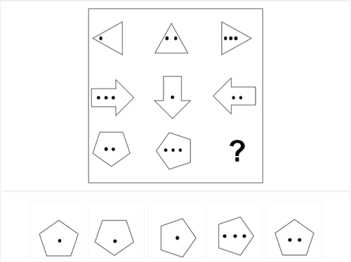
Knowing your Pupils: CAT Scores
What are CAT Tests?
Non-Verbal Reasoning: Thinking with Shapes
Examines:
Ability to think and reason with non-verbal material, to analyse figures made up of multiple elements and identify relationships.
The tests are particularly useful in identifying the reasoning abilities of students either with poor verbal skills or who are not fluent in English.

Slide 39
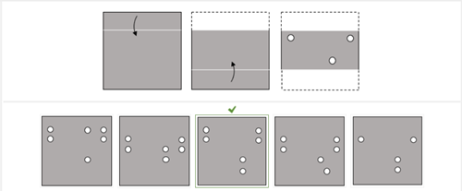
Knowing your Pupils: CAT scores
What are CAT Tests?
Spatial Reasoning: Thinking with Shapes
Examines:
This test assesses the ability to think in spatial terms, to create, maintain and manipulate visual-spatial images;
It may represent untapped potential not yet been fully expressed in verbal or quantitative tests.

Slide 40
Knowing your Pupils: CAT scores
Why do we use CAT Tests?
We use CAT data initially to identify
anomalies with KS2 SATs;
those who have performed well above their ability at KS2;
pupils who may be 'coasting';
and to…
alert SEN teams to pupil need where this may not have been identified at primary;
inform staff as to the nature of their teaching groups.

Slide 41
Knowing your Pupils: CAT Scores
How to interpret CAT Scores?
Stanine | % Pupils | Standard Age Score | Description
9 | 4 | 127+ | Very High
8 | 7 | 119-126 | Above Average
7 | 12 | 112-118 | Above Average
6 | 17 | 104-111 | Average
5 | 20 | 97-103 | Average
4 | 17 | 89-96 | Average
3 | 12 | 82-88 | Below Average
2 | 7 | 74-81 | Below Average
1 | 4 | 73- | Very low
Mean Standard Age Score (SAS)
Score of 133+  top 1%
Score of 120+  top 9%
Score of 100  average
Score of 97-103+  5+ GCSE

Slide 42
Knowing your Pupils: CAT Scores
How to interpret CAT Scores?
Stanine | % Pupils | Standard Age Score | Description
9 | 4 | 127+ | Very High
8 | 7 | 119-126 | Above Average
7 | 12 | 112-118 | Above Average
6 | 17 | 104-111 | Average
5 | 20 | 97-103 | Average
4 | 17 | 89-96 | Average
3 | 12 | 82-88 | Below Average
2 | 7 | 74-81 | Below Average
1 | 4 | 73- | Very low
Reflect: What information can you gather from the table below.
Pupil 1

Slide 43
Knowing your Pupils: CAT Scores
How to interpret CAT Scores?
Stanine | % Pupils | Standard Age Score | Description
9 | 4 | 127+ | Very High
8 | 7 | 119-126 | Above Average
7 | 12 | 112-118 | Above Average
6 | 17 | 104-111 | Average
5 | 20 | 97-103 | Average
4 | 17 | 89-96 | Average
3 | 12 | 82-88 | Below Average
2 | 7 | 74-81 | Below Average
1 | 4 | 73- | Very low
Reflect: What information can you gather from the table below.
Pupil 2

Slide 44
Knowing your Pupils: CAT Scores
How to interpret CAT Scores?
Surname Forename | CATS Verbal | CATS Quantitative | CATS Non-verbal | CATS Mean SAS | KS2 English | KS2 Maths | KS2 Science
Pupil 1 | 5 | 1 | 2 | 83 | 4B | 3B | 4B
Pupil 2 | 1 | 2 | 2 | 72 | 3B | 4C | 5C
Pupil 3 | 4 | 6 | 2 | 93 | 4B | 4A | 5C
Pupil 4 | 3 | 3 | 2 | 84 | 5C | 4A | 5B
Pupil 5 | 8 | 9 | 8 | 125 | 4A | 5A | 5A
Task: Identify in the table any anomalies.
Reflect:
What might be the reason(s)?
How could it be addressed?
How would that impact your teaching?

Slide 45
2. School Level: Attainment
2.1. KS3 progress and attainment – teacher assessed.
2.2. GCSE grades.

Slide 46
Attainment: KS3
Levels, which are broad descriptions of ability in each subject area, became redundant in September 2014, when the new curriculum was introduced for almost all children.
After the use of KS3 levels, it was left to schools to decide on how to track progress at Key Stage 3.
Many schools have formulated their own
approaches.
Reflect:
How does your school track progress at KS3 (steps, levels, tracking grades based on GCSE grading system, etc.)?
If using tracking grades, how are those subdivided?
Are each grade linked to specific grade descriptors in your subject?

Slide 47
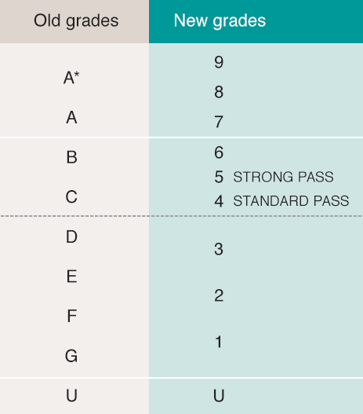
Attainment: GCSE Grades
What has changed in recent years?
https://www.youtube.com/watch?v=pgZYx_fycrM

Slide 48
Attainment: GCSE Grades
What changed in recent years?
Fewer grade 9s are awarded than A*s, and that anyone who gets a 9 has "performed exceptionally".
A 4 is broadly equivalent to a C grade, although Ofqual warns against "direct comparisons and overly simplistic descriptions".
Broadly, the same proportion of teenagers get a 4 or above as used to get a grade C or above.

Slide 49
Attainment: GCSE grades.
Why were the grades changed?
The numerical grading scheme is part of a curriculum introduced in England's schools in 2014 by then Education Secretary Michael Gove.
GCSE courses now include much less coursework than before, with grades in almost all subjects depending on exams.
Courses are designed to be more challenging, with exams taken after two years of study rather than in modules with exams along the way.

Slide 50
3. National Level: Attainment & Progress at GCSE
3.1. 9-4 incl. English and Maths
3.2. E Bacc
3.3. Attainment 8
3.4. Progress 8

Slide 51
School performance at KS4 is measured in 4 ways:
Progress 8
Progress 8
9-4 (9-5) including English and maths
Attainment 8
Ebacc – 5 passes in English, maths, science, a humanities subject and a language

Slide 52
Progress 8
The performance measures are designed to encourage schools to offer a broad and balanced curriculum with a focus on an academic core at key stage 4, and reward schools for the teaching of all their pupils, measuring performance across 8 qualifications.
Every increase in every grade a pupil achieves will attract additional points in the performance tables.

Slide 53
GCSE Attainment: 9-4 incl. English & Maths
What is a pass at GCSE?
There are two pass marks - 4 is a standard pass and 5 is a strong pass.
This means that a candidate who gets nine grade 4s has, technically, passed all their exams.
However, with the government's school league tables detailing what percentage of pupils achieved a 5 or above in English and maths and in the English Baccalaureate subjects, schools are pushing pupils for at least a Grade 5 and most sixth forms are looking for students with strong passes.

Slide 54
GCSE Attainment: EBacc (English Baccalaureate)
What is the E-Bacc?
The E-Bacc is a way to measure how many pupils in a school choose to take a GCSE in these core subjects:
English language & literature
Maths
Sciences
history or geography
a language
The EBacc is a set of subjects at GCSE that keeps young people’s options open for further study and future careers.

Slide 55
GCSE Attainment: EBacc.
What is the EBacc?
The EBacc is a performance measure for schools, not a qualification for pupils.
English
To count towards the English part of the EBacc, pupils need to take both English literature and English language GCSE exams.
Mathematics
GCSE Mathematics
Science
Pupils need to take one of the following options:
GCSE combined science – pupils take 2 GCSEs that cover the 3 main sciences, biology, chemistry and physics
3 single sciences at GCSE – pupils choose 3 subjects from biology, chemistry, physics and computer science
Languages
Taking any ancient or modern foreign language GCSE counts towards the languages part of the EBacc.
Humanities
Taking history, geography or ancient history GCSE counts towards th humanities part of the EBacc.

Slide 56
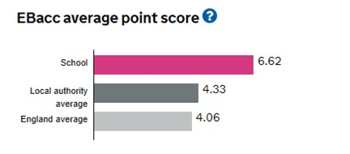
GCSE Attainment: EBacc.
How is the EBacc measured?
Secondary schools are measured on the number of pupils that take GCSEs in these core subjects. Schools are also measured on how well their pupils do in these subjects.
.
Pupils’ attainment is calculated as an average point score, meaning that all results at all grades count towards the EBacc.
To calculate a school’s EBacc average point score we:
add together the EBacc average point score for all pupils at the end of key stage 4
divide by the number of pupils in the group
To calculate a pupil’s average point score we take an average of the points scored in the 5 EBacc subject areas.

Slide 57
GCSE Attainment: EBacc
Why the EBacc?
The EBacc is made up of the subjects which are considered essential to many degrees and open up lots of doors.
Research shows that a pupil’s socio-economic background impacts the subjects they choose at GCSE, and that this determines their opportunities beyond school.
Studying subjects included in the EBacc provides students with greater opportunities in further education and increases the likelihood that a pupil will stay on in full-time education. (UCL)
Studying the EBacc can help improve a young person’s performance in English and maths. (Sutton Trust)
The government’s ambition in 2014 was to see 75% of pupils studying the EBacc subject combination at GCSE by 2022, and 90% by 2025.

Slide 58
GCSE Attainment: Attainment 8
What is Attainment 8? (an introduction)
https://www.youtube.com/watch?v=XWAV1WUbsLo

Slide 59
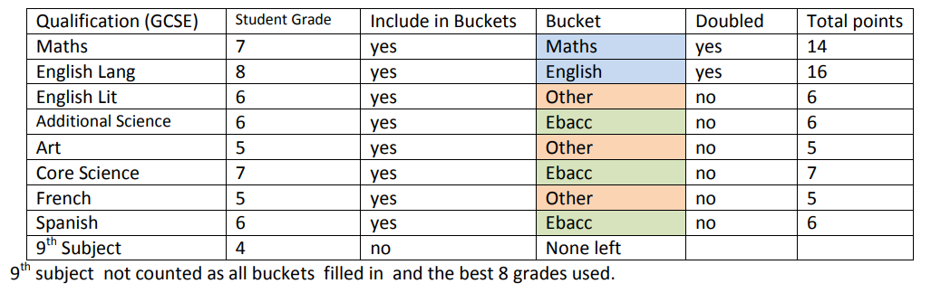
GCSE Attainment: Attainment 8
What is Attainment 8? (an example)

Slide 60
GCSE Attainment: Attainment 8
What is Attainment 8? (an example)

Slide 61
GCSE Attainment: Attainment 8
What is Attainment 8?
Task: Calculate the attainment 8 for this student.

Slide 62
GCSE Attainment: Attainment 8
What is Attainment 8?

Slide 63
Progress 8
What is Progress 8? (an introduction)
Task: Watch the video and make a note of:
The purpose of Progress 8;
What progress is measured against;
How subjects are grouped and weighted;
How school performances are compared against each other using Progress 8.
https://www.youtube.com/watch?v=4IAEgFMSGDY&t=10s

Slide 64
GCSE Progress: Progress 8
Why Progress 8?
The Wolf Report 2011. Alison Wolf made 27 recommendations all of which have been acted upon either in whole or at least part.

Slide 65
GCSE Progress: Progress 8
Why Progress 8?

Slide 66
GCSE Progress: Progress 8
Why Progress 8?
Floor Standard Then
Prior to 2010, a school was “above the floor” if three in ten pupils were awarded 5 of more GCSEs of grade C or better. Schools failing to meet this standard were deemed to be “below the floor”. Such schools would be inspected by Ofsted. Should Ofsted confirm that the school’s performance is poor, a change of management would follow.
This approach encouraged schools to concentrate on C/D borderline pupils only. Getting a pupil from Cs to A*s, or from Fs to Ds gets no credit. It also means that intake, not the quality of teaching, largely determines whether a school is defined as doing well. A grammar school will never be below the floor, whereas some schools have intakes that are much more challenging. This makes jobs in schools with challenging intakes more pressured, and less attractive.

Slide 67
GCSE Progress: Progress 8
Why Progress 8?
Questions from the DfE
Grade D?
Can a school do well, whatever its intake?
Does a school improve its score if any pupil improves their grades?
Are we rewarding schools that do well in English and Maths?
Are we rewarding schools that do well in traditional subjects?
Are we rewarding schools that offer a broad and balanced curriculum?
Are we rewarding schools that achieve A and A* grades?

Slide 68
GCSE Progress: Progress 8
Why Progress 8?
Floor Standard Now
Since 2016 , a school is below the floor standard if its Progress 8 score is below -0.5.
If a school’s performance falls below this floor standard, then the school may come under scrutiny through inspection.
Schools in which pupils make on average one grade more progress than the national average (a Progress 8 score of +1.0 or above) will be exempt from routine inspections by Ofsted in the year following the publication of the final performance tables.

Slide 69
GCSE Progress: Progress 8
How is Progress 8 calculated?
Worked Example:
Pupil has an average KS2 English and Maths score of 4.9.
The National Average Attainment 8 Score for this KS2 score is 54.
The difference is 67 - 54 =13.
So, Progress 8 Score for this Pupil is 13 /10 = 1.3.
The Progress 8 Score for the school is the average of all pupil Progress 8 scores.

Slide 70
GCSE Progress: Progress 8
How is Progress 8 calculated at school level?
Name | KS2 Av | Attainment 8 PROJECTION | Attainment 8 SCORE | P8 Score | P8 Score (Divided by 10)
Student 1 | 5.8 | 76.32 | 65.0 | -11.32 | -1.13
Student 2 | 4.2 | 40.42 | 45.0 | + 4.56 | +0.46
Student 3 | 1.5 | 14.94 | 34.0 | +19.06 | +1.91
Sum: |  |  |  |  | +1.24
Average (Actual Progress 8 Score): |  |  |  |  | +0.41

Slide 71
GCSE Progress: Progress 8
Summary and final considerations.
Each pupil’s GCSE score is compared with that of other pupils who performed equally well at age 11. This gives us a measure of the pupil’s progress relative to reasonable expectations. A school’s progress score is the average of its pupils’ progress scores.
This is the key measure: if pupils in a school average half a grade lower than the same mix of children typically achieve elsewhere, the school is below the floor, and will be inspected. Furthermore, every school must declare their Progress 8 score on their website.
Parents will know the score of their local schools.
It may benefit some less able pupils to work towards good grades (and hence score more points) in fewer subjects, with the emphasis on doing well in English and mathematics, rather than to take more subjects but achieve lower grades overall.

Slide 72
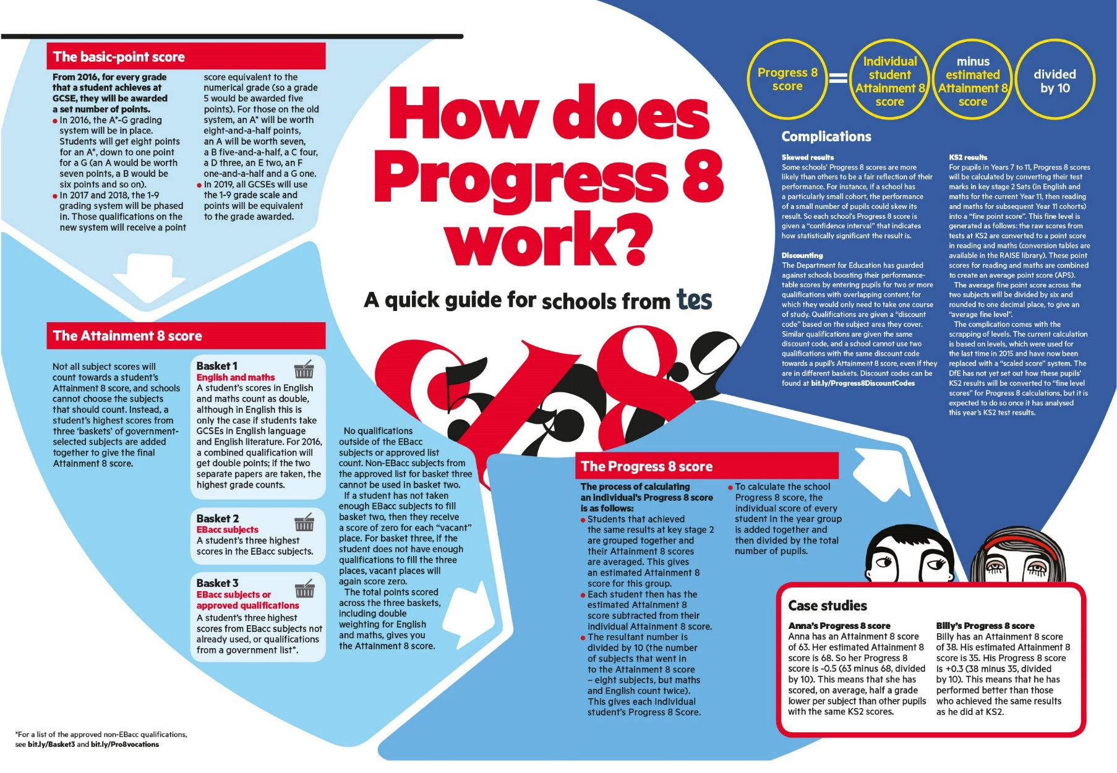
Progress 8
Summary

Slide 73
Central Training: General Professional Studies
Tracking & Monitoring
Section C

Slide 74
Rational: Why do we set targets and track progress?
If children are not learning what they can and are capable of, then they are underachieving.
Tracking helps us to:
know where children are and informs the planning and pitch of lessons so that children are taught effectively;
it helps us to find ‘clues’ about barriers to learning;
it helps us to focus resources for greatest impact.

Slide 75
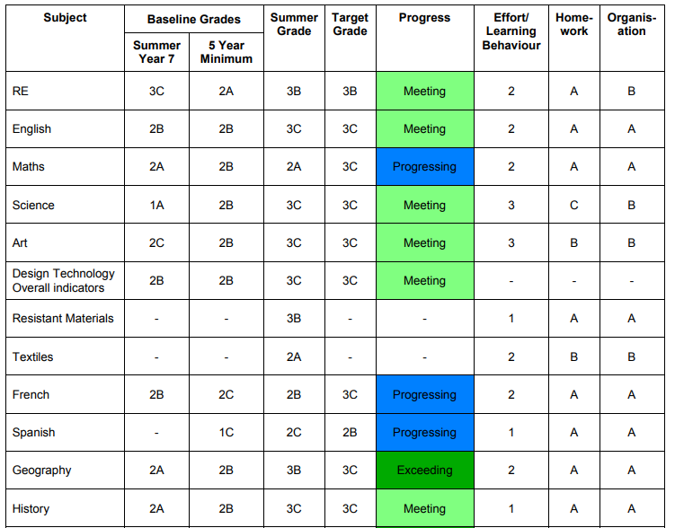
Tracking System
Baseline
Progress
Current
Target
Reflection: What is your experience of tracking in your school? What language is used?
Below / Underperforming / …?
Static / Consolidating / …?
Towards / Progressing / Extended / Developping / …?
Met / Meeting / Secure /…?
Above / Exceeding / …?

Slide 76
5-year Progress Trajectory
Y11
5-year Progress Trajectory
Student targets are set from KS2 SATS results and provide a flight path of expected progress to be made throughout KS3 and KS4.
6
Y10
5
GCSE Target
based on KS2
Y9
4
Y8
3
Y7
Trajectory
2
Y7 Baseline based on KS2
Flight Path
1
Progress Map
Y7
Y8
Y9
Y10
Y11

Slide 77
5-year Progress Trajectory
Y11
5-year Progress Trajectory
A 5-year trajectory allows teachers to address any historic under-achievement.
e.g. This Year 11 student would aim for 2 grades of progress over the year instead of the expected 1 grade in order to meet their target grade.
6
Actual Progress
Y10
5
GCSE Target
based on KS2
Y9
4
Y8
3
Y7
2
1
Y7 Baseline based on KS2
Y7
Y8
Y9
Y10
Y11

Slide 78
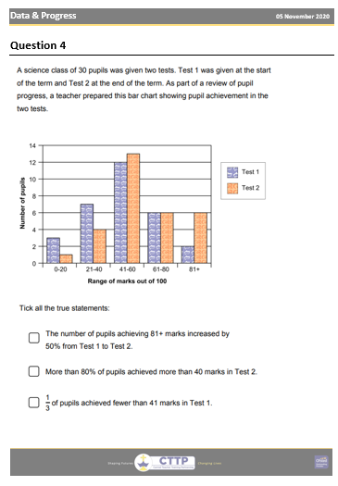
Professional Skills: Numeracy
Data Tracking and Analysis
Task:
Complete the independent Numeracy task to practise tracking and analysing data.

