Slide 1

Central Training: General Professional Studies
Mental Health & Well-Being
Thursday 9th November 2023

Slide 2


Core Content Overview • TS1 & TS7
Evidence Statements: Learn that…
1.1
Teachers have the ability to affect and improve the wellbeing of their pupils.
7.4
Teachers can influence pupils’ resilience and beliefs about their ability to succeed, by ensuring all pupils have the opportunity to experience meaningful success.
See full detail in the ITT Core Content Framework.
https://assets.publishing.service.gov.uk/government/uploads/system/uploads/attachment_data/file/843676/Initial_teacher_training_core_content_framework.pdf

Slide 3
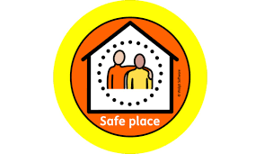
Keeping Safe Today
Mental Health and Emotional Wellbeing are emotive subjects and today’s training may trigger difficult feelings.
Please take time out if needed or leave training at any time if you need a few minutes
Notes:
I’d just like to acknowledge before we start that attachment and trauma can be an emotive subject- The content isn’t particularly “heavy” but could potentially trigger difficult feelings.
Support each others or draw on your own support networks if needed. We’ll be online for a bit after the session if there is anything you want to discuss with us.

Slide 4

Learning Objectives
To increase awareness of the impact of Mental Health and Emotional Wellbeing and how this may affect children and young people when they are in school.
To promote an informed approach within schools to help children to feel safe and able to learn.
To help you to support children and young people who have attachment difficulties and/or have experienced trauma in their learning, social relationships and emotional well-being
Notes:
quickly point out the learning objectives. Explain that we are going to introduce relevant theoretical ideas and what neuroscience tells us out the impact of attachment and trauma but also focus on practical strategies. Reminder of the resources that have been sent out.
Highlight the second point

Slide 5
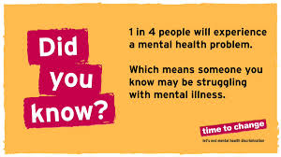
The Facts
Mental and physical health are both important.
1 in 10 children and young people will experience a mental health problem before the age of 16. That is three students in an average-sized class.
1 in 4 adults will experience a mental health problem in any year.
Even if a young person does not experience mental health problems directly, the statistics above suggest they are likely to know someone who is affected.

Slide 6
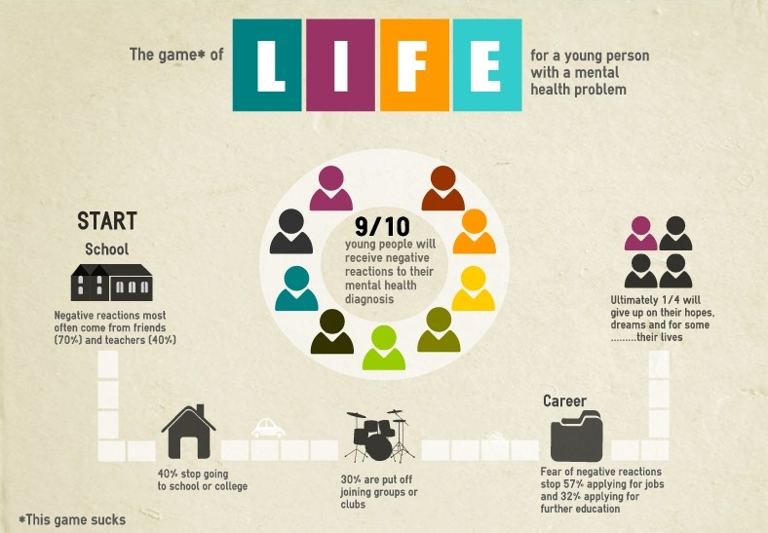
Mental Health Stigma
9 in 10 of young people who experience mental health problems say they have experienced stigma and discrimination as a result.
Nearly 3 in 4 young people
with mental health problem
fear the reaction of friends.
Stigma often stops young people
seeking.

Slide 7
Being open benefits us all…
It can be an effective preventative strategy; normalising the topic and the experience.
It enables young people to look after their own
mental health and ask for help if they need it.
It also helps them to support their peers or
family members outside school.
Early intervention can have a huge impact and
positively influence a young person’s recovery.
We can make sure people are better able to seek support should they need it and avoid reaching crisis points that inevitably have an impact on progress and learning, or success at work.

Slide 8
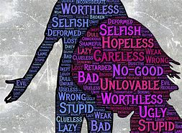
What does Mental Health mean to you?

Slide 9

Risk Factors
Try to identify possible risks in the following categories:
Child e.g. learning difficulties.
Family e.g. young carer.
Community e.g. deprivation.

Slide 10
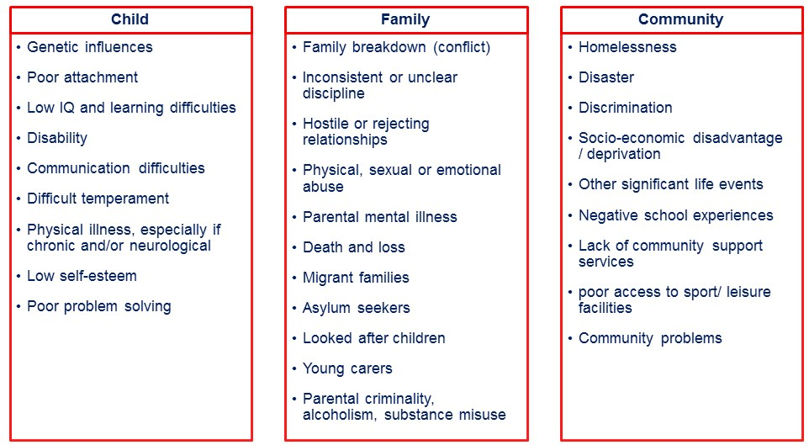
Risk Factors

Slide 11
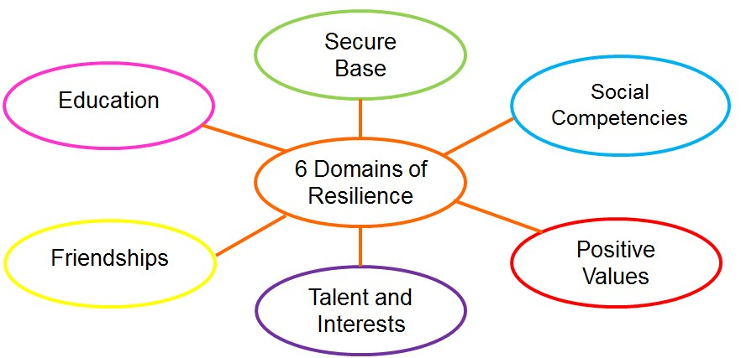
Resilience • Daniel and Wassell (2002)

Slide 12
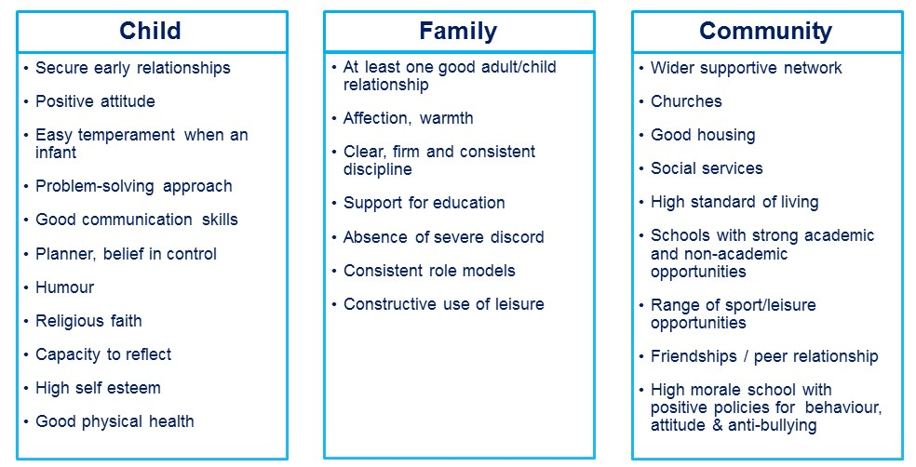
Resilience Factors

Slide 13

Background
Mental health problems are common in young people.
There is a high level of stigma associated with mental health problems and young people.
Many young people are not well informed about mental health problems.
Many young people do not seek help for mental health problems.
A young person may not realise that they need help or that effective help is available.
Action by adults, who they have a good relationship with, may determine how quickly the young person gets helps or recovers.
Mental health problems interfere with adolescent development.

Slide 14
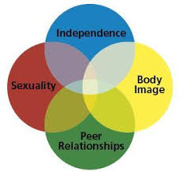
Tasks of Adolescent Development
Physical development
  secondary sex characteristics
  on-going brain development
Cognitive development
  advanced thinking and reasoning
Psycho-social development
  establishing identity and autonomy
  becoming comfortable with sexuality
  achievement (especially educational)
Notes:
Three major tasks of adolescence are physical development, cognitive development and psycho-social development. Physical development refers mostly to the process of puberty; the development of secondary sex characteristics and gains in height and weight. It also refers to ongoing brain development, which continues until at least the early twenties (some argue they continue until about 30). Cognitive development refers to the development of abstract thinking and advanced reasoning. Psycho-social development refers to establishing a personal identity, autonomy (especially from the family unit) and intimacy (friendships and the beginnings of relationships). It also refers to achievement, particularly educational achievement.

Slide 15
Adolescent Development
Associated physical health problems e.g. drug and alcohol use, poor eating habits etc. can impact on physical development.
Difficulties thinking, lack of concentration and motivation, withdrawal from school and social situations etc. can impact on cognitive and psycho-social development.
The impact on adolescent development can be minimised by ensuring early detection and intervention.
Notes:
Intervening when a mental health problem starts is always important, regardless of the person’s age. However, the impact on whole-of-life functioning is enormous when a mental health problem starts during adolescence. It interferes with adolescent development of all kinds. Drug and alcohol use, which often go along with mental health problems, can particularly interfere with brain development in a permanent way. Therefore, during adolescence, it’s not just a matter of early intervention for its own sake, but for the sake of normal healthy development.

Slide 16
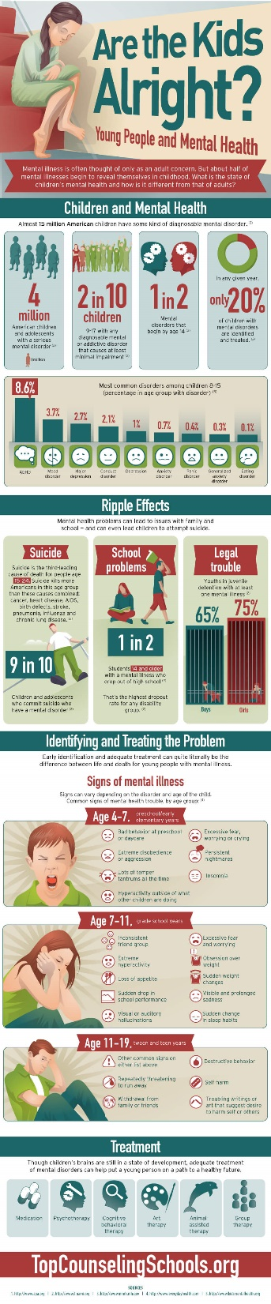
Signs and Indicators
Sudden mood and behaviour changes.
Self-harming.
Unexplained physical changes, such as weight loss or gain.
Sudden poor behaviour or academic performance.
Sleeping problems.
Changes in social habits, such as withdrawal or avoidance of friends and family.
* Chart based on pupils' primary need

Slide 17
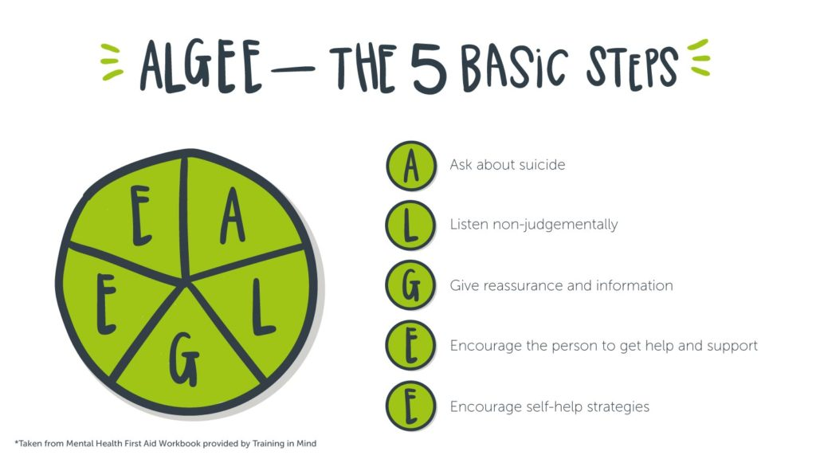
Dealing with an extreme crisis.
ALGEE
Ask about harm and suicide.
Listen non-judgementally.
Give reassurance and information.
Encourage the young person to get appropriate help.
Encourage self-help strategies.
Notes:
Outline and discuss the fivesteps of MHFA. A – Ask about suicide L – Listen non-judgmentally G – Give reassurance and information E – Encourage young person to get appropriate help and support E – Encourage self-help strategies Emphasise the ‘fluidity” of the model; especially in relation to young people. The actions are not necessarily steps to be followed in a fixed order. The helper needs to be flexible and responsive to the situation and the needs of the young person they are helping.

Slide 18
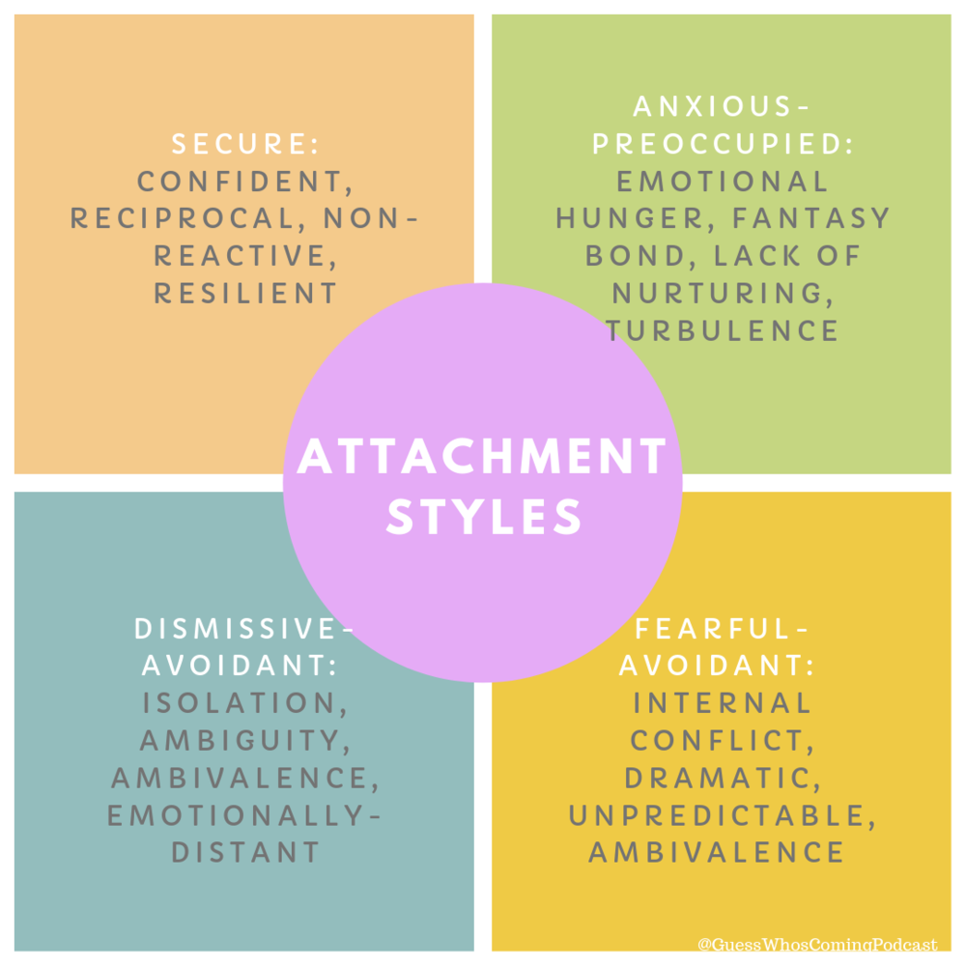
Attachment
A secure attachment provides us with a sense of trust in ourselves, the world and those around us.
It provides the foundations to cope with our emotions and develop resilience but also enables us to use others effectively when the situation calls for it.
When we feel safe we are more likely to feel comfortable to explore and learn.
Developing a secure attachment is a significant protective factor in adulthood and helps us to cope with adversity.
Notes:
Attachment can be thought of as a continuum ranging from securely to insecurely attached.
At one end, we have the securely attached child, who has received that attuned care and responsive parenting, and who therefore has grown up in a world that appears safe and predictable and where adults have shown themselves to be trustworthy and supportive. This provides the foundations for that child to be able to feel safe and secure and to have a positive sense of themselves as lovable and able to interact successfully with others. Essentially they can begin to develop resilience which will allow them to be better able to cope with more difficult situations and challenges when they occur.
Furthermore, the securely attached child is more willing to take risks and explore the world around them- all of which underpin successful learning.
When we think about resilience, we often talk about risk and protective factors and secure attachment is one of those protective factors which can provide a buffer against the impact of later adversity.

Slide 19
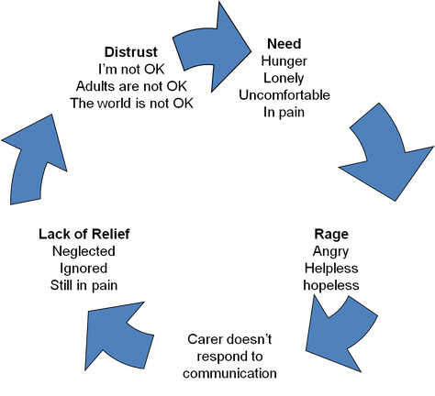
Insecure Attachment
When caregivers are unresponsive or very inconsistent the infant will adapt and do whatever necessary to keep the attachment going, even if it may be detrimental to them.
The behaviour can be seen as a strategy that the child has embedded over time, to keep themself safe and to get their needs met.
These strategies shape aspects of our development and our personalities.
Notes:
At the other end of the spectrum we have insecure attachment. This occurs when caregivers are unresponsive, inconsistent or even frightening in their interactions with the child. However, the infant will continue to try to forge that attachment, even in these adverse circumstances, such is the biological imperative for attachment and connection with others. This can lead to the development of a range of behavioural strategies which the child uses to keep themselves safe and get their needs met. In the circumstances, these strategies are viewed as normal responses, however, as the child develops and moves into different circumstances, such as school, these behaviours can appear maladaptive and unhelpful.
Essentially for the insecurely attached child, they have experienced a world that is unpredictable and unsafe, and where adults are unhelpful, not trustworthy and even frightening. They are not able to develop those essential neural pathways and develop those skills for emotional regulation and they begin to view themselves as unloveable and unworthy. These ways of thinking about the world become embedded and shape their interactions with other people and the world moving forwards.
Their world is characterised by dysregulation and distrust.
At this point it’s important to think back to that idea of a continuum- it’s not a case of securely or insecurely attached and two black and white positions, in reality the picture is likely to be much more complex and depends on the unique experiences of that individual.

Slide 20
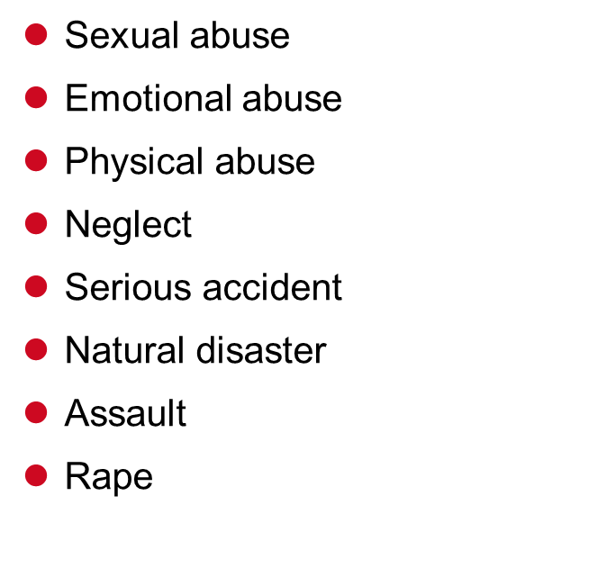
Sources of Trauma
Changes in family dynamic
War/ combat experience
Witnessing/ learning of traumatic event
Hostage/ torture
Horrific death/ loss of a loved one
Serious surgery/ medical diagnosis
Witnessing domestic violence
Drug use in the home
Notes:
Link with ACEs

Slide 21
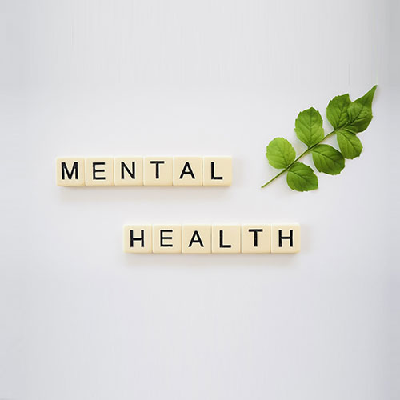
KCSIE (Keeping Children Safe in Education)
“Preventing impairment of children’s mental and physical health or development”
Role of staff
Mental Health as an indicator
Impact of safeguarding concerns on Mental Health

Slide 22
Resources
Notes:
Link to resources – why do teachers need to consider these factors?

Slide 23
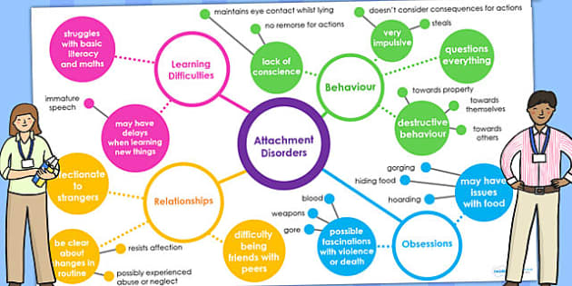
Attachment and Learning
Our brains prioritise feeling safe and secure above our cognitive functions. Therefore a child who feels unsafe is not ready to learn. In this way our emotions are inextricably linked to our capacity to learn. To engage well in their learning, you are asking a child to:
be willing to take risks/explore;
to trust you;
have the capacity to tolerate frustration and uncertainty;
to ask for help when they need it.
Notes:
So what impact does this have on learning? Clear now that it is not possible to make a clear distinction or separation between learning and social/emotional development- we need to look at the whole child.
When we ask a child to engage with learning in fact we are asking them to:
If we think about that insecurely attached child who is living in world characterised by distrust and lack of safety (in their minds at least) – these are the very features which they have learned to avoid. They have learned to avoid risks and to look after themselves- they can’t trust someone else to do it for them. They generally aren’t therefore able to tolerate the chance of getting something wrong, or appearing vulnerable in asking for help. They don’t have the emotional regulation skills to be able to tolerate the feelings of frustration (which may seem mild to you or I, but can be intolerable for them) that learning something new brings about.
This is the child who is unwilling to try, who rips up or destroys their work, who creates a diversion to avoid having to complete a task, or who alternatively is adept at keeping you involved in a conversation about something else to avoid having to start a task. Alternatively you may have the child who only feels safe when they know exactly where you are- ideally right next to them, and they use a whole range of strategies (remember both aversive and attractive) to make that happen.

Slide 24
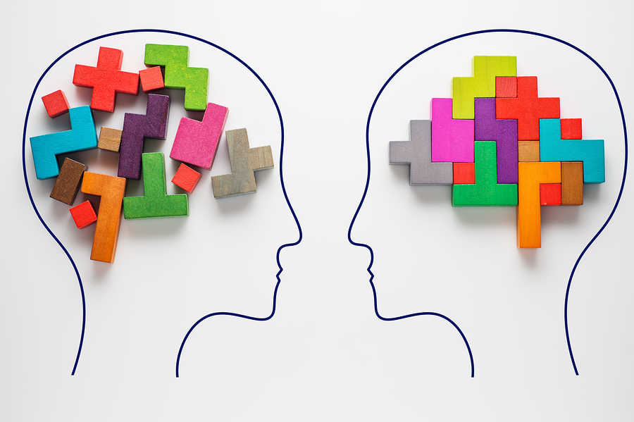
What can Trauma look like?
Signs, symptoms (the way children and young people may act)
  Anxiety, hypervigilance, anger, challenging, oppositional, provocative behaviour, out of control, ‘bizarre’ behaviours, friendship/peer type challenges, reports that the child can only get on with adults, repetitive behaviours
  Problems at home and school.
  Problems only at home or only at school.
  Many of these symptoms look and feel similar to neurodevelopmental disorders like ADHD and autism.
Notes:
Symptoms the way people act.
The signs and symptoms of trauma can be varied as listed here, many of these may seem familiar to you. A couple of important points to note:
Pupils with attachment difficulties or trauma often ‘miscue’ – that is the behaviour they display is at odds with the feelings that are underpinning that behaviour – for example, anxiety or sense of vulnerability is masked through appearing angry or tough on the outside- not needing anyone. Feeling out of control can come across as being very manipulative or controlling. This means that it is easy to misinterpret or misunderstand what is happening for these students.
Problems can occur both at home and at school or in one context only. So it is possible to believe parents when they tell you there are no problems at home- this doesn’t minimise in any way the challenges that may be experienced in school or vice versa. Being able to cope in one context does not imply choice in behaviour in another setting.
Many of these signs and symptoms can be easily mislabelled as other disorders. For example, children may experience difficulties managing change, social relationships, struggle with others agenda- similar to a YP with ASD.

Slide 25

What we see
Lying
Self harm
Clinginess
Stealing
Lack of eye contact
Only gets on with adults
Repetitive behaviours
Bizarre behaviour
Aggression
Impulsivity
Self-injury
Anger
Violence
Difficulties making & keeping friends
Not trusting of others
Provocative behaviour
Notes:
Signs, symptoms ……….. ?
Anger, challenging, provocative behaviour, out of control, ‘bizarre’ behaviours, friendship/peer type challenges, reports that the child can only get on with adults, repetitive behaviours
Problems at home and/or school
Will the young person receive the right support?
Many of these symptoms are similar to neurodevelopmental disorders – e.g. ASD, ADHD
Behavioural responses are often not effective but they can be our first response

Slide 26

What lies beneath?
Frightened
Unable to trust others
Afraid
Abused
Vulnerable
Neglected
Unsafe
Not worthy
Low self-esteem
Notes:
Symptoms the way people act.

Slide 27

Creating Connections
Relationships can help us recover from trauma and provide a safe base to manage times of stress.
Provide a key adult for consistent support.
Be mindful that children manage anxiety and proximity in relationships differently.
Demonstrate that you can “hold them in mind”.
Everyone in school has a role to play in contributing to a sense of belonging and safety.
Notes:
SO the most important thing you can do in school is think about connections and relationships.
-who is an appropriate key adult
They are empathetic and warm, consistent and calm
They may already have the beginnings of a relationship with the child
They are available both physically and emotionally
(you can involve the child in the choice but make sure it is from a selection of appropriate individuals)
-some children will thrive from closeness and physical contact- others may find that intolerable- you need to take the lead from the child.
Children who have experienced difficult relationships often haven’t had the feeling of being ‘held in mind’- of someone who thinks about them when they are not physically there, who is making sure they are safe (so they don’t have to do it themselves). How can we demonstrate this? Take note of the child’s interests and mention these (e.g. did you watch the football? How was the match at the weekend? I saw this and thought of you?) Be reliable- when you say you will do something, make sure you do it.
Not just the key person- think about whether everyone in school is on the same page on this and how can you develop this sense of belonging and safety for all children in school?

Slide 28
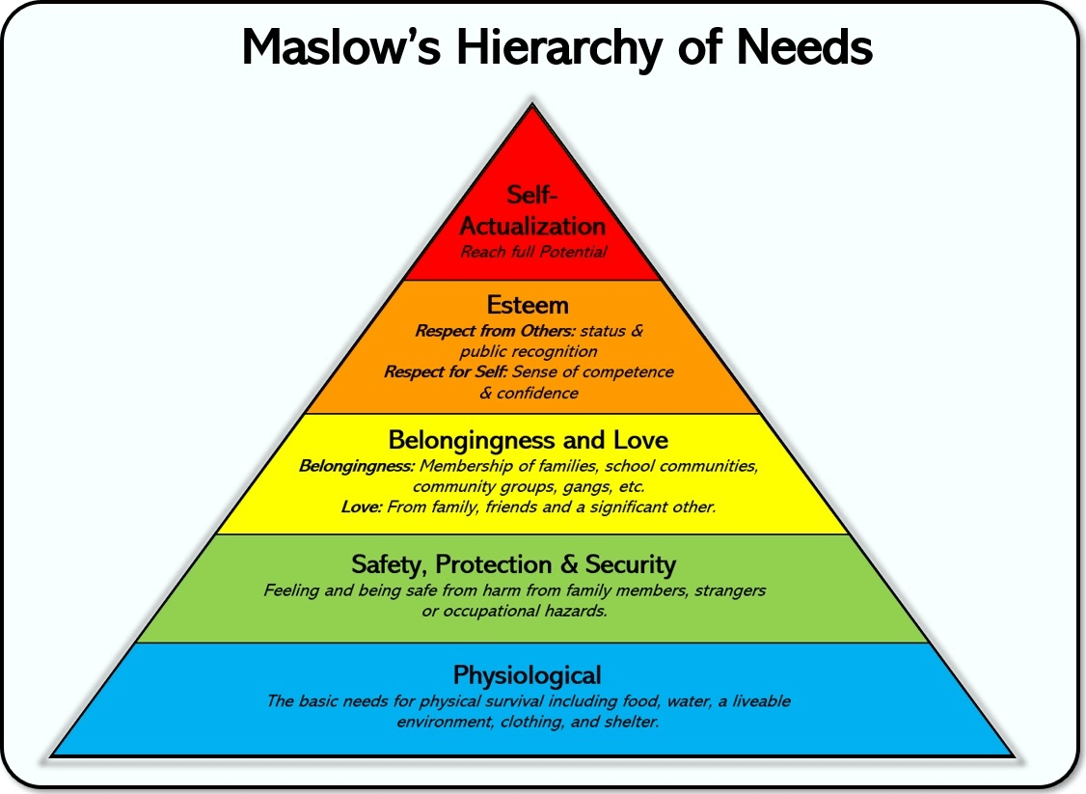
Secure Base and Key Adult
Physical Secure Base “I need somewhere to return to”.
Emotional Secure Base “I need someone to keep me in mind”.
Provide ‘emotional scaffolding’.
Check-in opportunities.
Relationships characterised by warmth and fun.
Key adults (and all staff) need time to reflect and seek advice from outside professionals.
Key adults need emotional support and supervision.

Slide 29
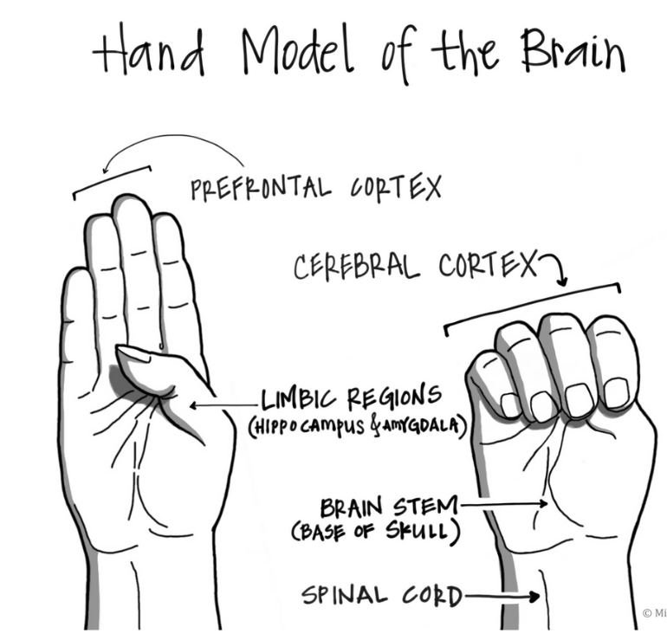
Emotional Regulation
When the safety system is activated (when we sense danger), access to the ‘upstairs’ brain (cortex) is disrupted.
So, we are stuck in survival mode (‘fight, flight or freeze’) and unable to access the parts of the brain required for emotional regulation, reasoning etc.
We call this ‘flipping your lid’.
Some people flip their lid very easily and for some young people it can be as if the lid is constantly flipping.
Need a calm and regulated adult (with their lid down) to help them to co-regulate and put the lid back on.
Not only will behaviour be a problem, but there is no capacity for learning.

Slide 30
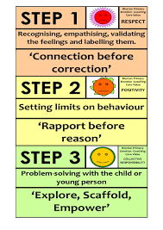
Diffusing Conflict: Emotion Coaching
Through repetitive, consistent and empathetic Emotion Coaching, the ability of a child to regulate their emotions is promoted.
Emotion Coaching involves:
becoming aware of the child's emotions;
recognising the emotion as an opportunity for teaching;
listening empathetically, validating the child's feelings;
helping the child find words to label the emotion;
setting limits and explore strategies to solve the problem at hand.
Connection before correction
Emotion Coaching UK
Notes:
A strategy which can be helpful in dealing with those challenging moments is emotion coaching. It is a method which is built on the evidence from neuroscience discussed earlier- we know that what adults do shapes brain development- so lets deal with situations in a way that will strengthen brain development.
Recognises that emotional regulation is not possible for young people alone. Their feelings are too big – primitive (downstairs) brain is in the driving seat – threat response, fight flight. Young people need support to move upstairs. This is CO-REGULATION. Emotion coaching is a kind of ‘how to’ of co-regulation.
All feelings are ok – no shame or judgement
Helping the child to label the emotion- helps to engage the cortex- cognitive aspects of the brain- creates a sense of distance between the child and the emotion. Begins by you labelling it for them.
Emotion coaching suggests a approach which includes high levels of empathy but also high levels of guidance and support. As opposed to lots of guidance, but no empathy or lots of empathy but no support, or a lack of either, which can come across to the child as disapproving or dismissive of their feelings and experiences or suggest to them that there is no hope for a way forwards.

Slide 31
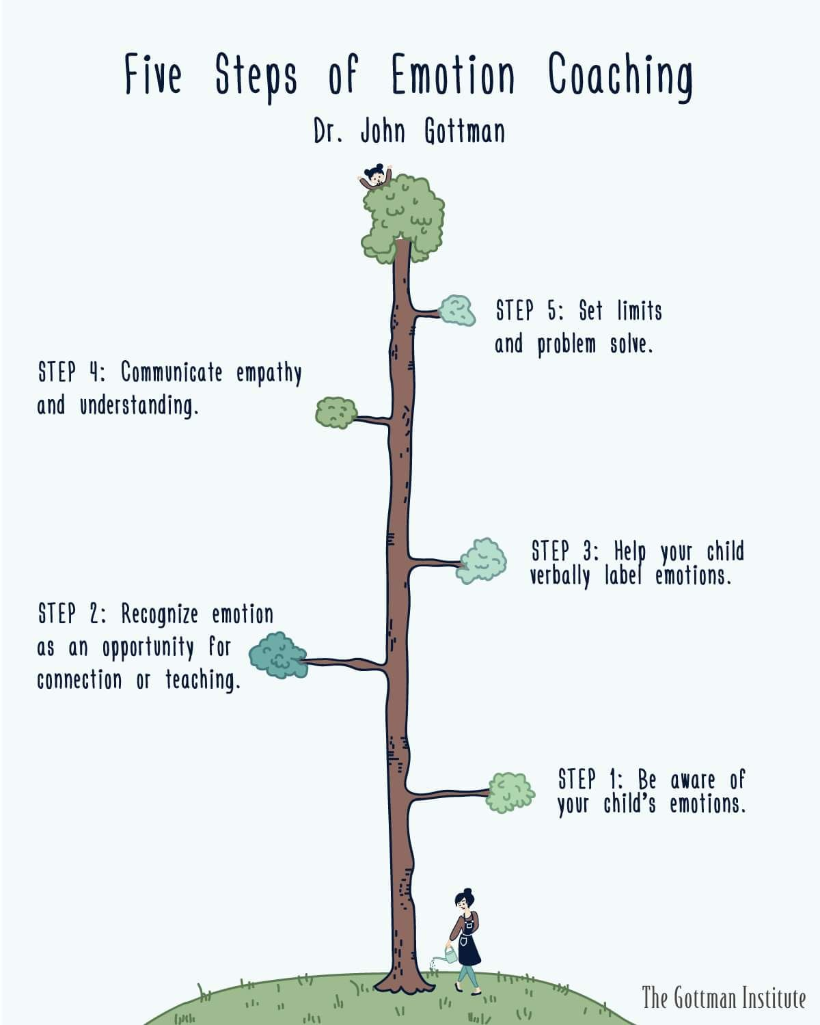
Emotion Coaching: 5 Steps
Step 1: Be aware of emotions and tune into the child’s emotions and your own.
Step 2: Connect with the child. Use emotional moments as opportunities to connect.
Step 3: Listen to the child. Respect the child’s feelings by taking time to listen carefully.
Step 4: Name emotions. Help the child identify and name emotions.
Step 5: Find good solutions. Setting limits while helping the child problem solve.
Notes:
The Five Essential Steps of Emotion Coaching.
Step 1 – Be aware of emotions and tune in to the child’s emotions and your own
pay attention to your own emotions, from happiness to sadness to angerN
understand that emotions are a natural and valuable part of life
observe, listen and learn how your child expresses different emotions
watch for changes in facial expressions, body language, posture and tone of voice.
Step 2- Connect with the child. Use emotional moments as opportunities to connect
pay close attention to the child’s emotions
try not to dismiss or avoid them
see emotional moments as opportunities for teaching.
recognise feelings and encourage the child to talk about his or her emotions
provide guidance before emotions escalate into misbehaviour
Step 3 – Listen to the child. Respect the child’s feelings by taking time to listen carefully
take the child’s emotions seriously
show the child that you understand what he or she is feeling
avoid judging or criticising the child’s emotions
Step 4 – Name emotions. Help the child identify and name emotions
identify the emotions the child is experiencing instead of telling the child how he or she should feel
naming emotions helps soothe a child
set a good example by naming your own emotions and talking about them
help the child to build a vocabulary for different feelings
Step 5 - Find good solutions. Explore solutions to problems together
redirect misbehaving children for what they do, not what they feel
when children misbehave, help them to identify their feelings and explain why their behaviour was inappropriate
encourage emotional expression but set clear limits on behaviour
help children think through possible solutions
don’t expect too much too soon
be aware of potentially difficult settings and be prepared to help the child through them
create situations where the child can explore without hearing lots of ‘don’ts’
catch the child doing lots of things right and praise them
make tasks as fun as possible e.g. with a young child, tidying up together

Slide 32
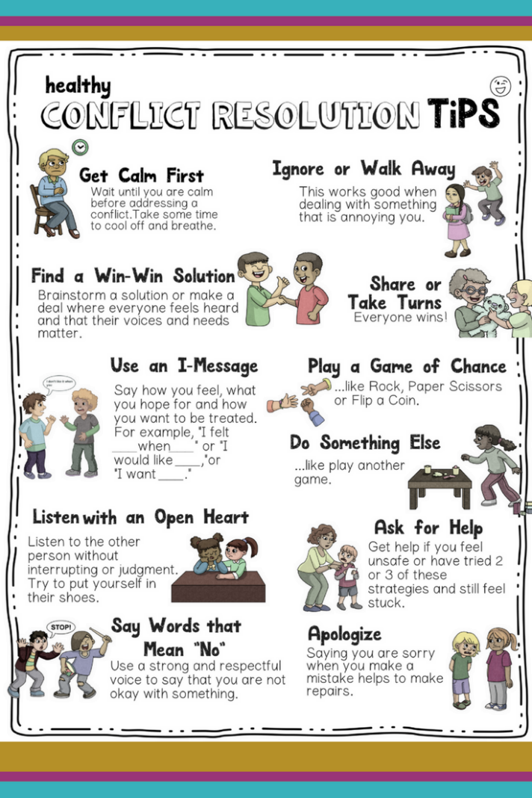
Creating Connection and Diffusing Conflict
Be in control of the relationship without being controlling!
Understand the child.
  Is their developmental age lower than their chronological age?
  Develop empathy by understanding the reasons behind the behaviour.
Manage your own reactions.
  Ask yourself, ‘Am I regulated’ before intervening or helping.
‘I see you need help with …. ’
  It is likely something has triggered shame - avoid asking why? They are unlikely to know.
Notes:
The challenge here is to be in control of the relationship without being controlling or directive- these are students who do not respond well to strict, inflexible approaches such as zero tolerance. Even use of behavioural strategies such as rewards can be interpreted as an attempt to control or manipulate.
We can start by understanding the child. Once we have empathy and understanding for the behaviour, we can respond in more attuned ways. We need to be able to communicate this to others too (especially for those of you in secondary environments, this can be a real challenge).
As noted above, important to start from a position of being regulated and calm yourself.
A good starting point can be to try to reflect the needs you are seeing e.g. ‘I see you need help with…’. Most students won’t be able to answer ‘why’ in response to their behaviours- not usually helpful and run the risk of triggering further feelings of shame. Need to be non-judgemental in our approach.

Slide 33
6 tips for our own wellbeing
Connection
Self Care
Boundaries
Flow
Signs
Ask for help
Maintain a connection with others – even when you don’t feel like it!
Dedicate time for things that make you feel good.
Take control – recognise your limits.
Get to know yourself – look out for signs your own mental health is deteriorating.
It’s OK not to have all the answers – get another perspective and ask for help.

Slide 34
Resources
https://www.annafreud.org/schools-and-colleges/
https://beaconhouse.org.uk/resources/
https://www.nes.scot.nhs.uk/education-and-training/by-discipline/psychology/multiprofessional-psychology/national-trauma-training-framework/trauma-informed-resources-opening-doors-and-sowing-seeds-animations.aspx
https://www.recoverycollegeonline.co.uk/young-people/

