Slide 1
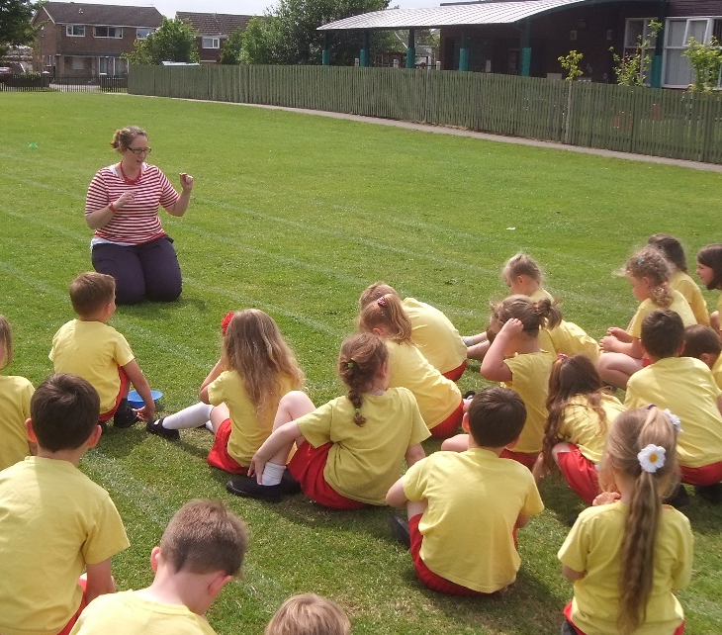
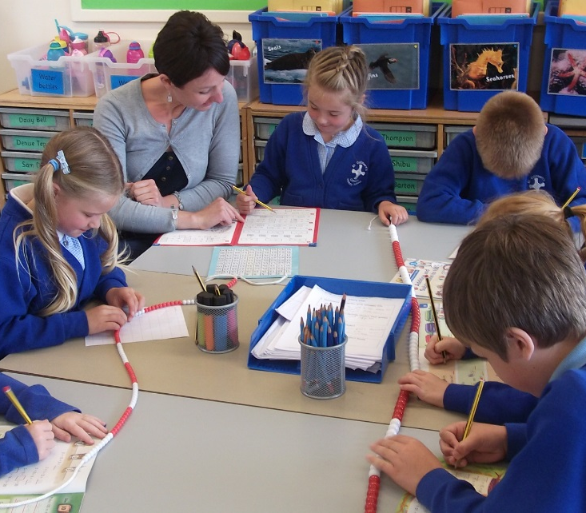
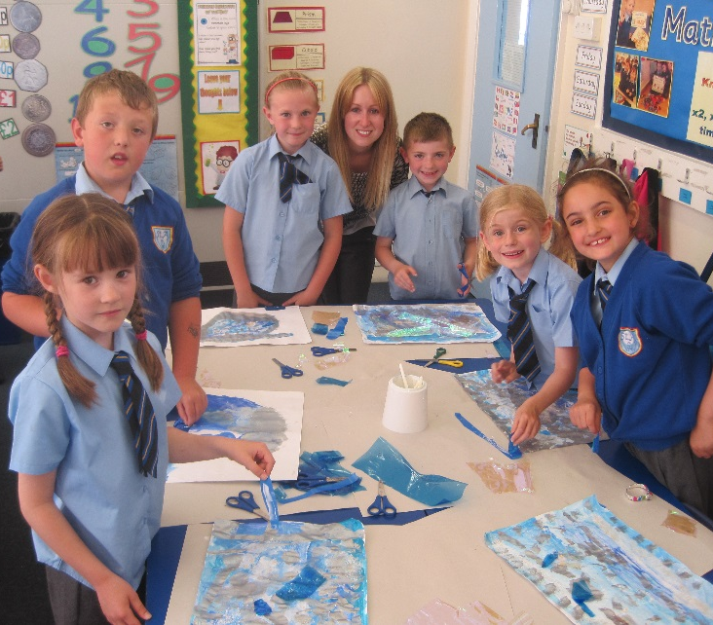
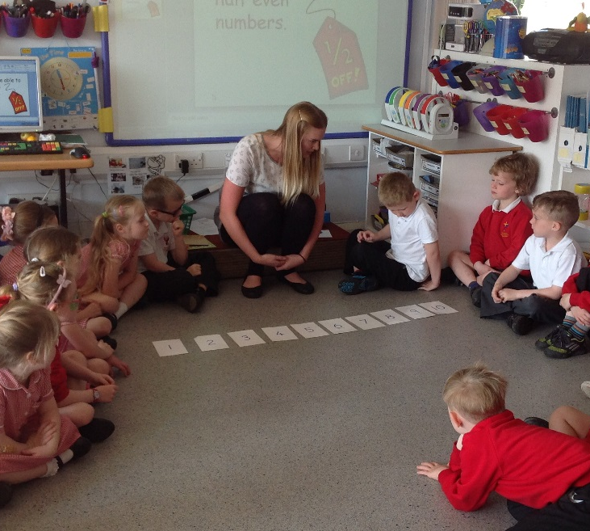
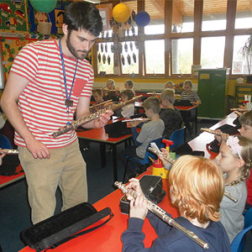
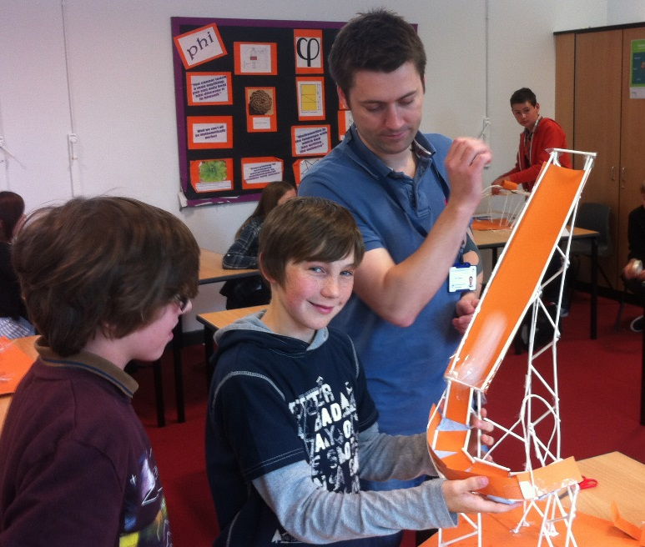
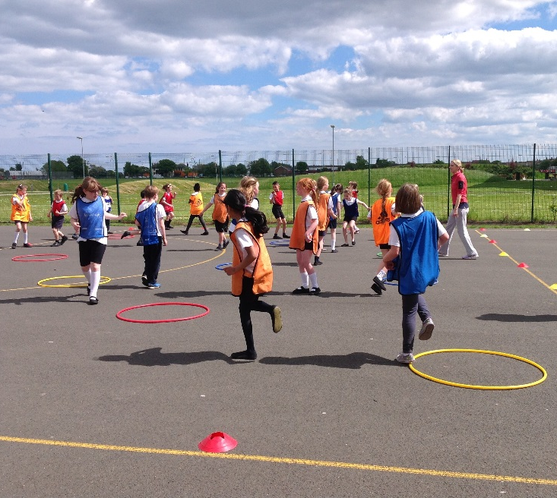
Primary Training 2023/24
www.inspiringteachers.me

Slide 2
English Training
Carmel College
Brigit Kinsey
Friday 10th November
www.inspiringteachers.me

Slide 3
Today
Reading Revision
Writing
Outcomes and planning
Assessing and progress
Audience and purpose
Skills and modelling
Transcription
Spelling
Handwriting

Slide 4
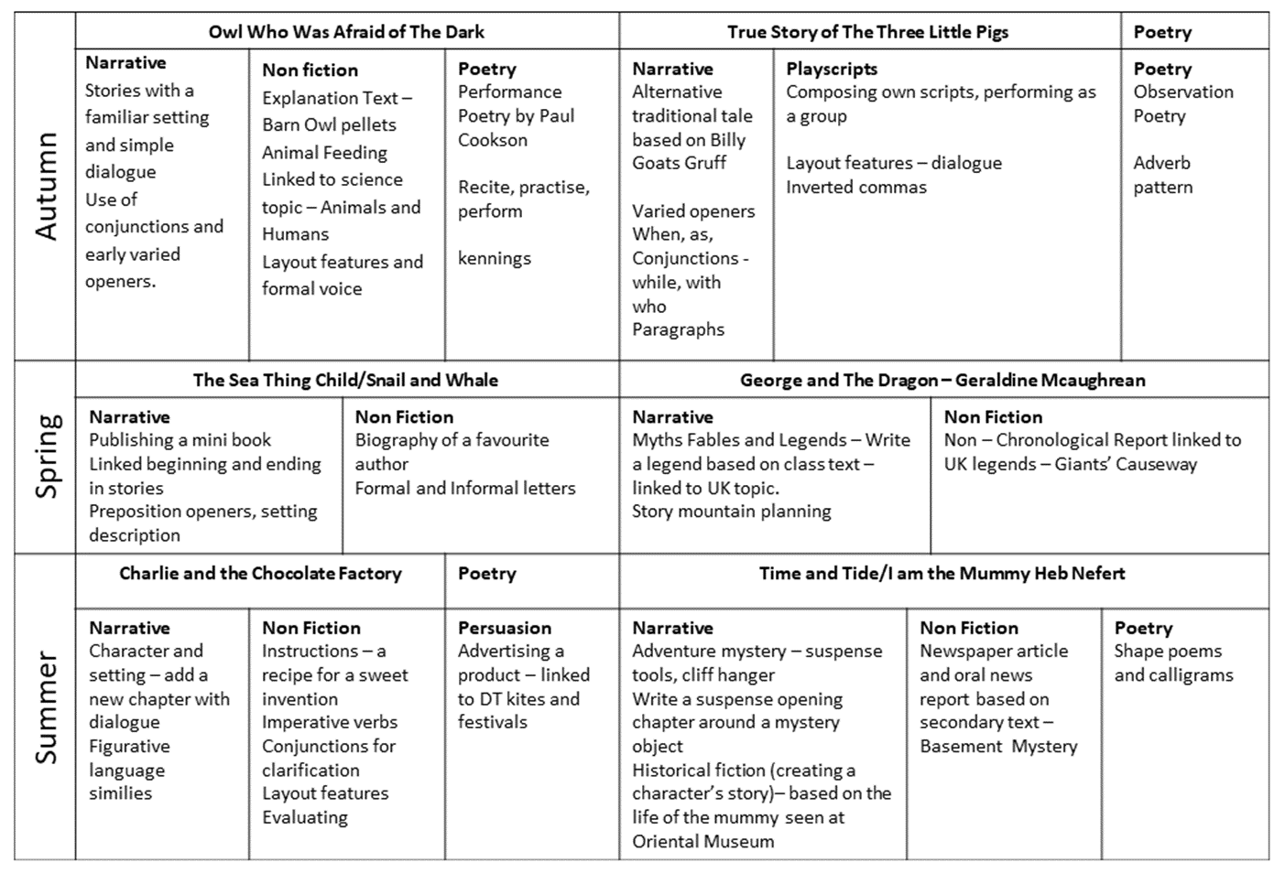
Reading Revision
Choose texts
Subject lead/scheme
Topic
Reading objectives and writing outcomes
Genre or author
Resources available?
Organise into timetable
Plan shared, guided and independent reading activities
Base on NC objectives
VIPERS/domain skills
Writing outcomes (WAGOLL)

Slide 5
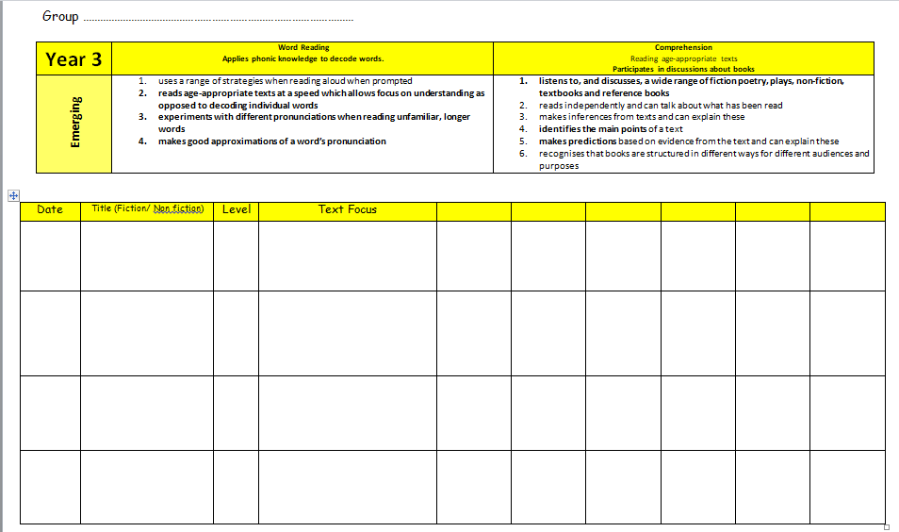
Short story with chapters (picture book for LA)
Compliments science topic
Lots of secondary texts and resources
Writing outcomes: Narrative - Overcoming fear bme, Explanation - How do barn owls eat?

Slide 7
Before During After
Book Talk Explore the cover or title Predict characters, setting plot Pre read (them or modelled), and point out tricky V Outline the story Make links with other stories Model fluency and expression | Book Talk Monitor understanding, using all of the strategies mentioned Keep updating predictions Record CEW or expected words they find difficult (CUL) Model fluency and expression – rehearse and reread (reading theatre FFT F into C) Model answering questions (R, I) Sequence/summarise | Book Talk Clarify their understanding Revisit predictions Visit phonic or CEW words they found difficult Discuss preferences Make links to real life/experiences or other texts Summarise
Make the point NF is essential – what would we be inc/changing layout, tense, sentence struc, V

Slide 8
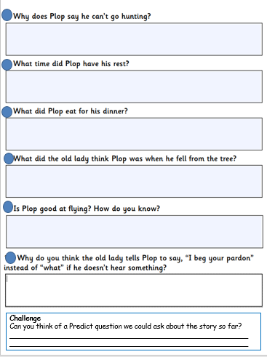
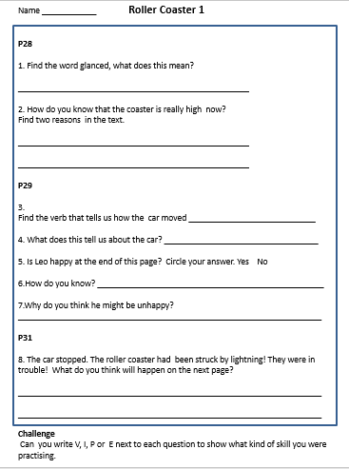
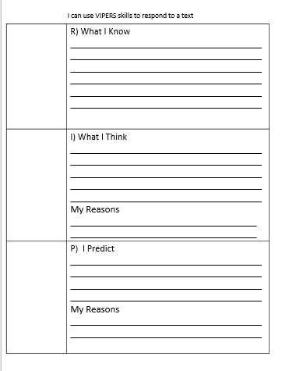

Slide 9
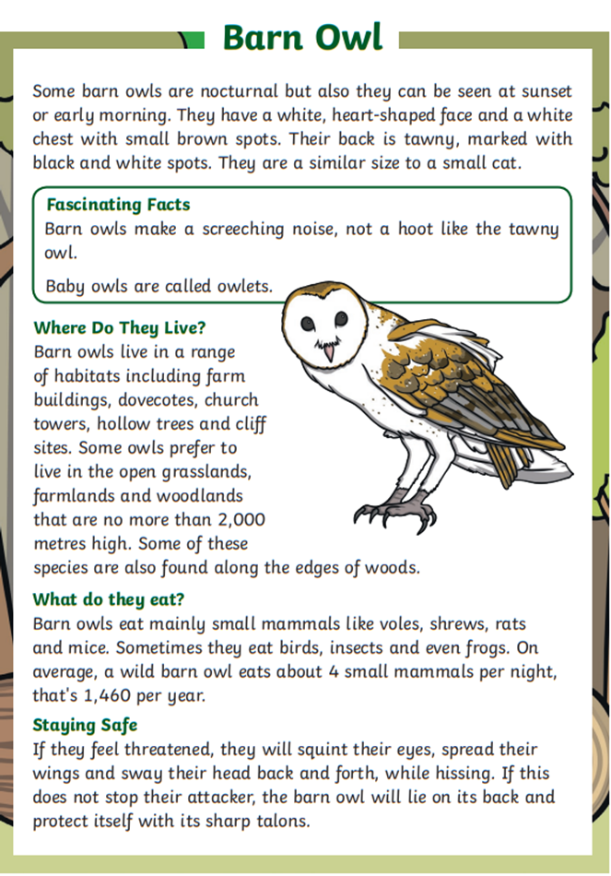
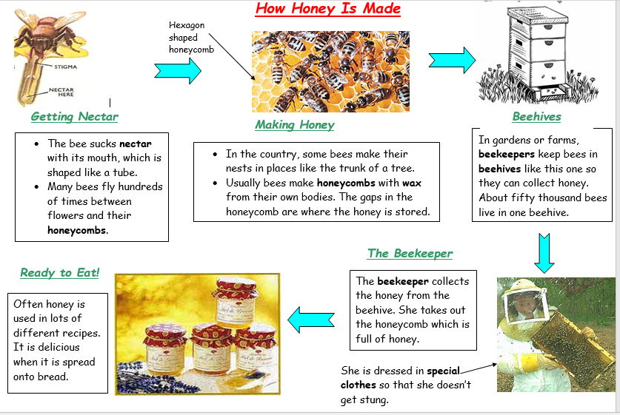

Slide 10
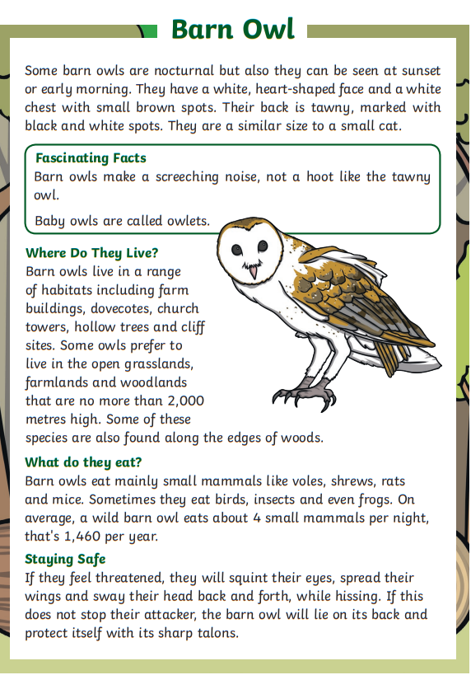
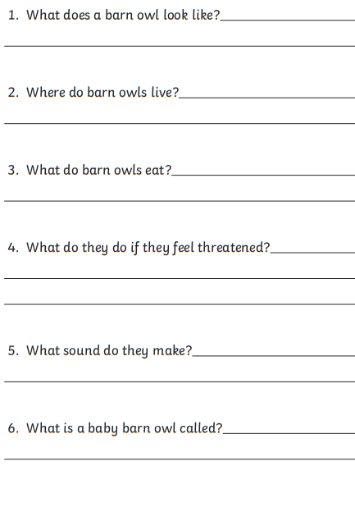
What type of writing?
What would we expect to learn?
Can you point to where we would find the answer to…
Where do barn owls live?
What food does a barn owl eat?
What would they do if they felt threatened?
Why did you think that?
Subheadings!
Let’s check – children volunteer to read the sections/sentences that provide the answers – maybe give pairs a section each to read and retrieve or summarise.
Identify technical V in their section.
Now – read the first paragraph yourselves – any V you don’t know. Clarify meaning of V (remind what is a paragraph if needed) What subheading would we give the first paragraph – summarise main points. Would you split the paragraph?

Slide 11
Writing

Slide 12
Daily Lessons
Writing is an amazingly complex activity. The writer has to deal with many skills simultaneously:
thinking what to write about
selecting appropriate content, supporting information and detail
linking it all together
layout of the text
grammar
spelling
punctuation
letter formation and legibility
Even skilled and talented writers find it challenging to control all these aspects simultaneously.
Break it down!

Slide 13
Choosing writing outcomes………..
Ask what we know already? discuss

Slide 14
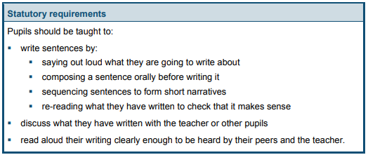
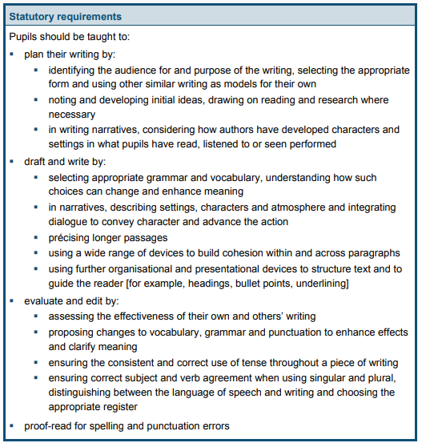
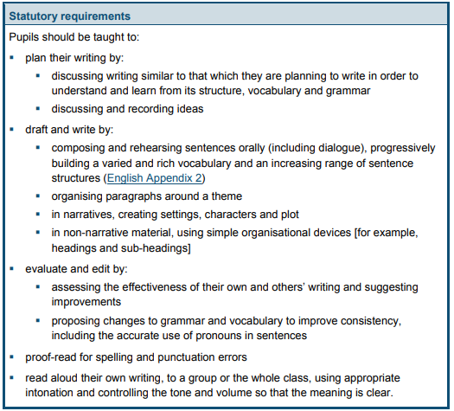
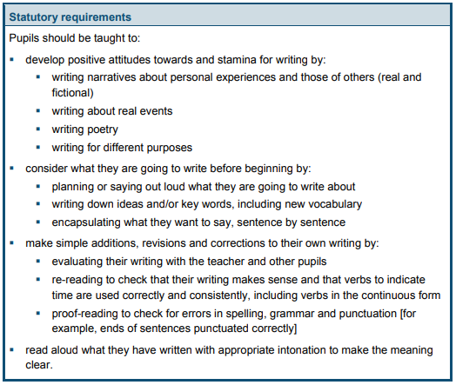

Slide 15
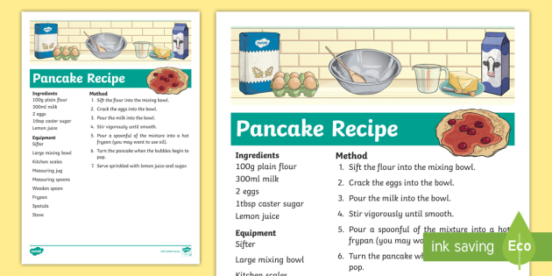
Read as writers – our reading need to feed inti
The writing outcome

Slide 16
 | Year 1 | Year 2 | Year 3 | Year 4 | Year 5 | Year 6
Instructions A recipe An instruction poster (e.g. instructions on how to make a computer) An instruction leaflet (e.g. how to make something or safety procedures) Instructions for a game Map directions These are ones that do not to be in order: A list of school rules or guidelines A poster showing general advice on an issue (e.g. water safety)
Report An information leaflet A newspaper or magazine article A letter A non-fiction book An encyclopaedia entry A catalogue A school website
Discussion An leaflet explaining both sides of an issue A newspaper article Information in non fiction books A write up of a debate

Slide 17
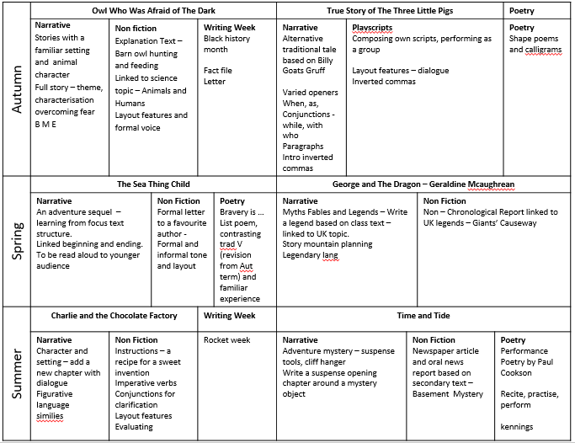

Slide 18
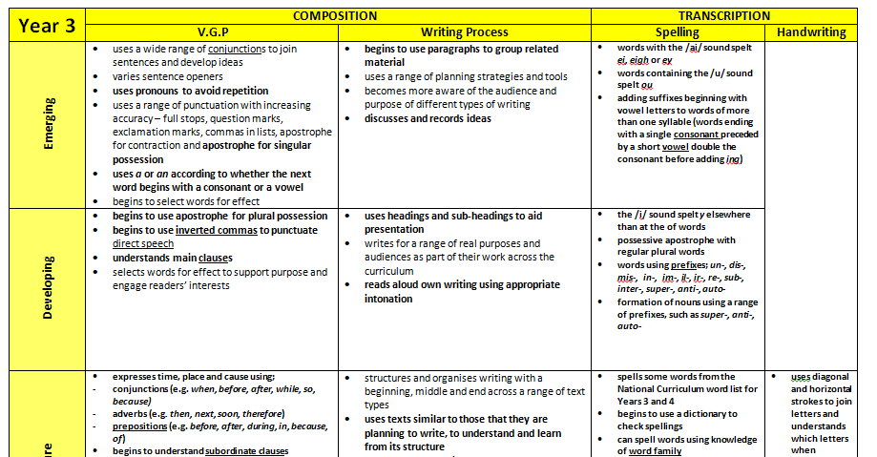
Assessment and Planning materials in practice – Writing
Maybe add in Pie Corbett here too.

Slide 19
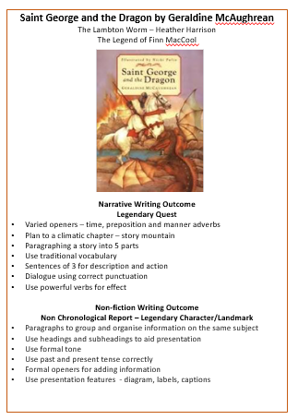
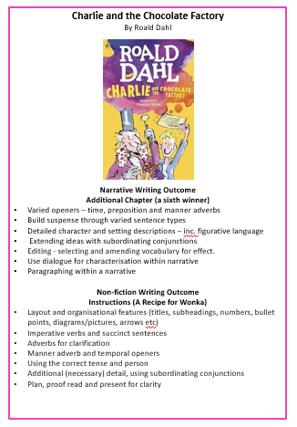
Can you see the links between the skills within the planning and the NC progression document?
Note – narrative FIRST!

Slide 20
Short Term Planning (Daily Lessons)
Will be part of a unit: Fiction/non fiction/poetry (from medium term plan)
Each unit will last 2 or 3 weeks (occasionally more – less for poetry maybe)
Builds skills through a lesson and across a series of lesson (practice)
Must have clear objectives and outcomes (the purpose of the lesson and learning)
Must have success criteria (what the children need to do to be successful )
Learning may be scaffolded (set them up for success).
Differentiated activities for different ability groups.
Remember – You are the best resource……you need to model/guide/support their learning.
Marking or feedback must be prompt, to the point and contain achievable targets.
Feedback must match the teaching and learning (non-negotiables)
Give a flip
Assess a piece of writing

Slide 21
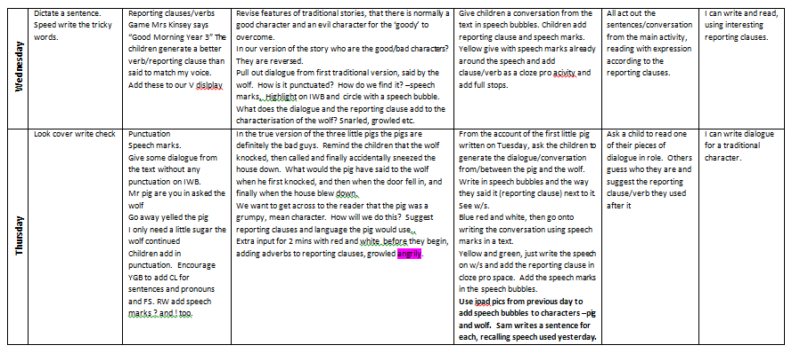

Slide 22
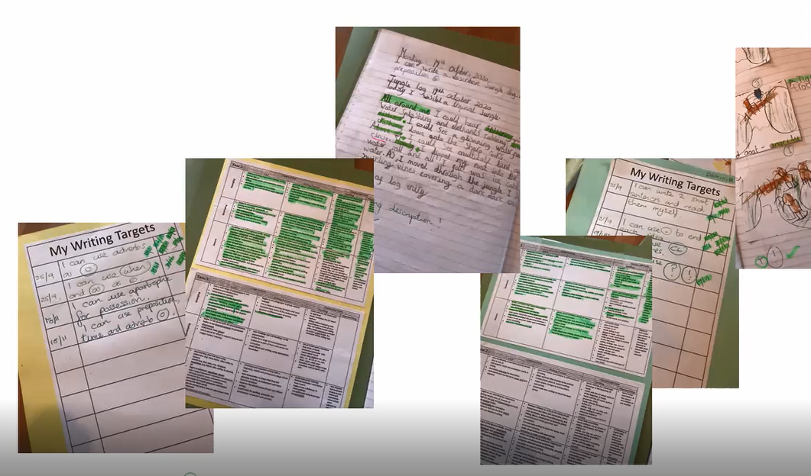

Slide 23
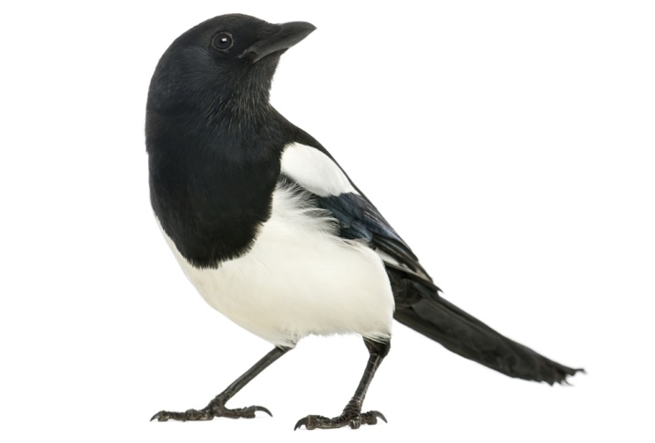
Read as writers
Write as readers
Choosing a good text is key!

Slide 24
Audience and Purpose Why and who for?
 | Reading | Writing
fiction | Entertain Suspense Frighten Adventure Escape Empathise
Non-fiction | Inform Retell Instruct Explain Persuade Discuss

Slide 25
Audience and Purpose Why and who for?
 | Reading | Writing
fiction | Entertain Suspense Frighten Adventure Escape Empathise
Non-fiction | Inform Retell Instruct Explain Persuade Discuss

Slide 26
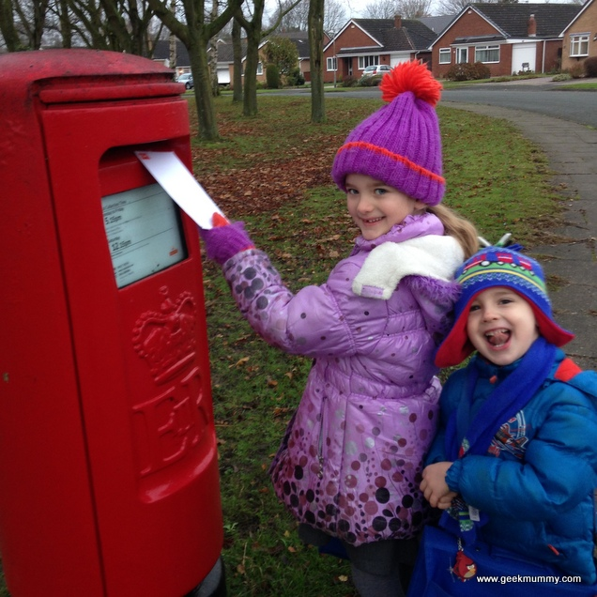
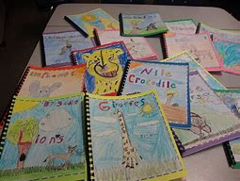
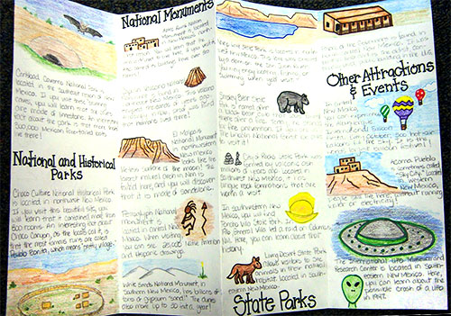
Giving Purpose to children’s writing from the start! – Why and Who?
Publish it
Share it
Display it
Post it

Slide 27
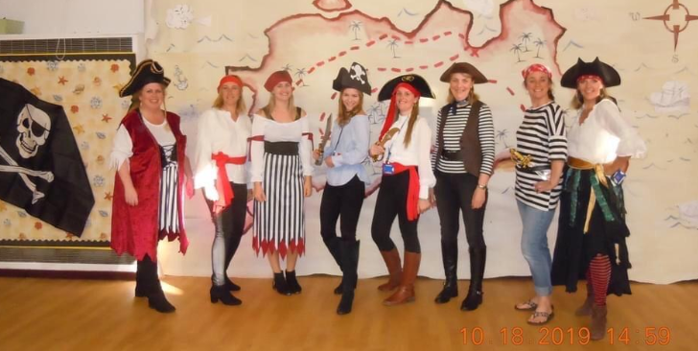
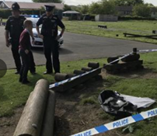
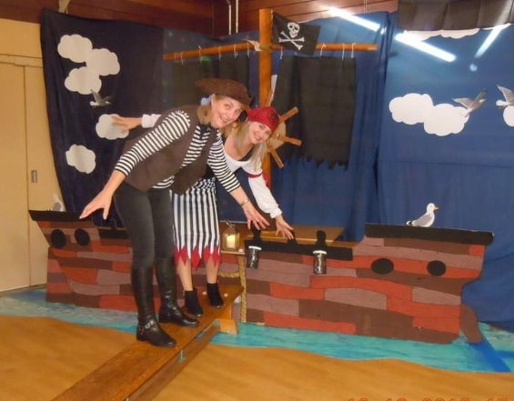
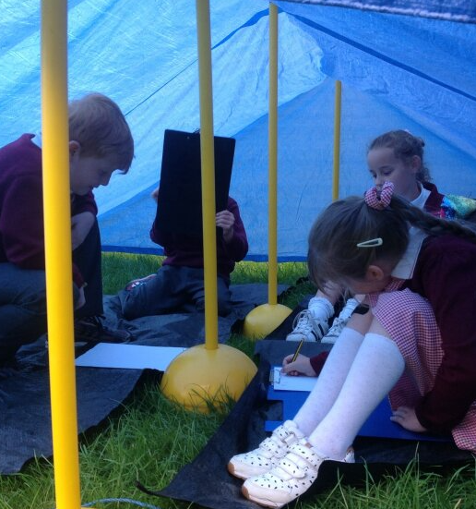
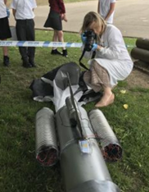
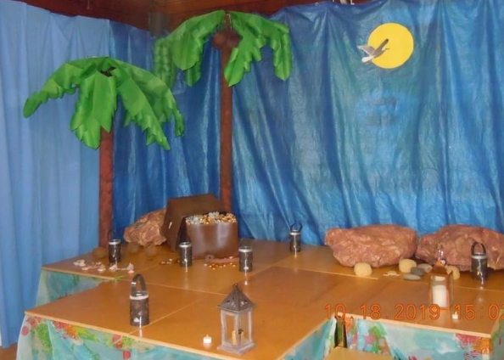
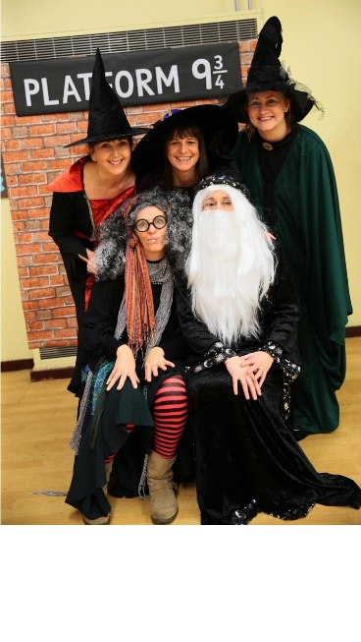
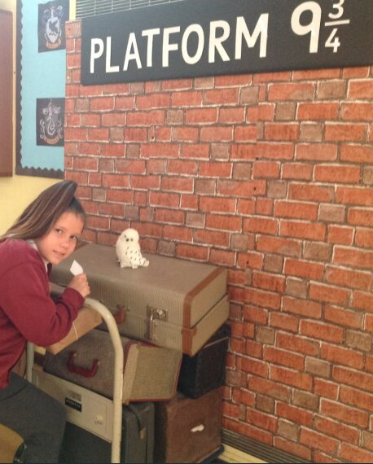
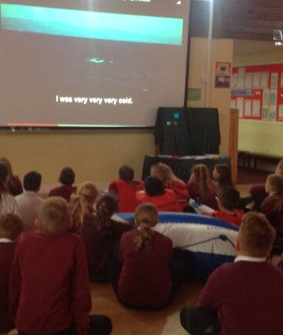
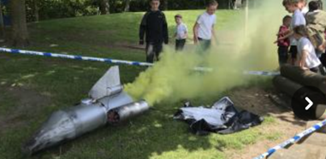
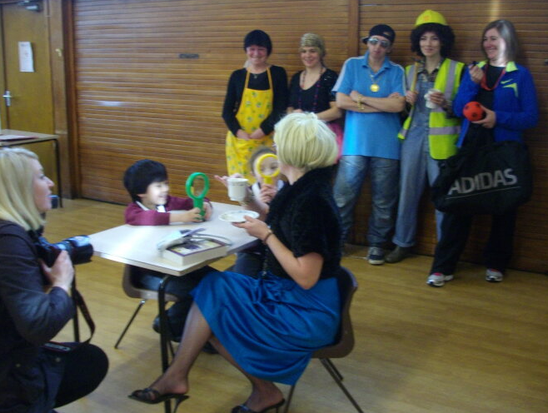
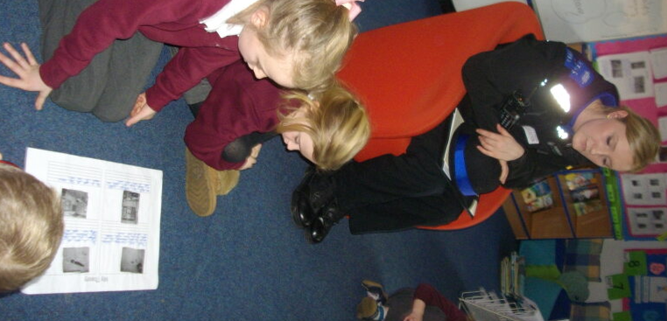
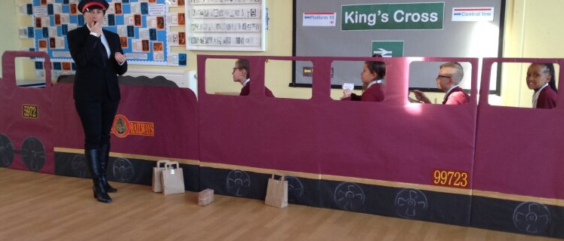
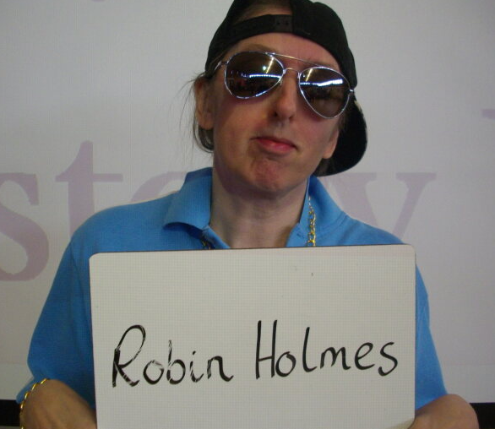
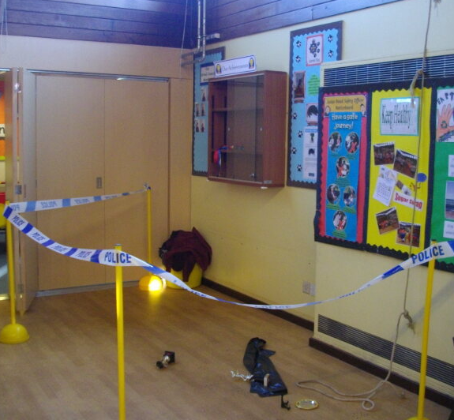
Purpose – going that bit further to inspire

Slide 28
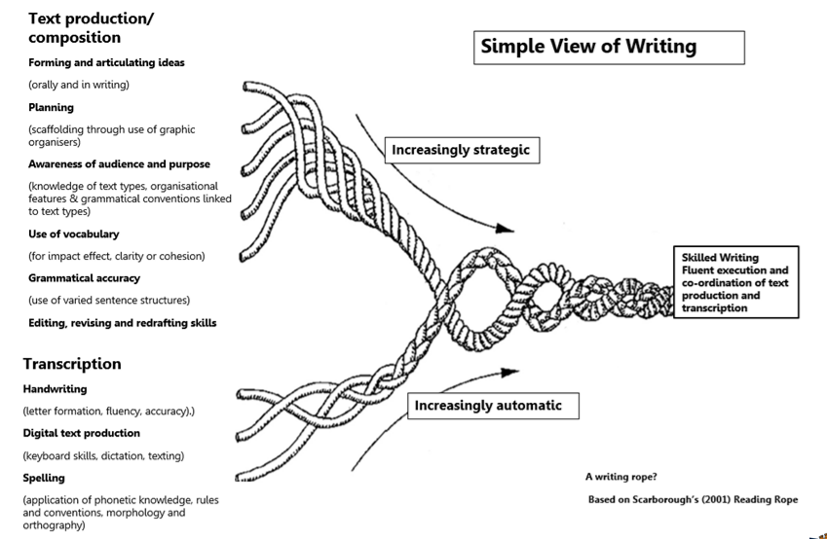

Slide 29
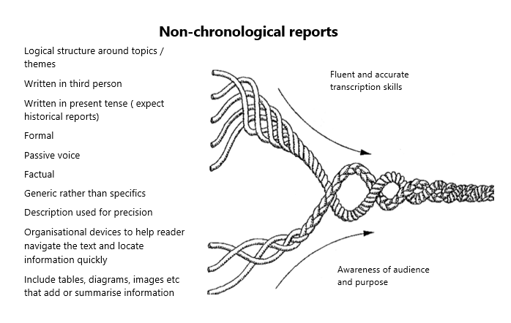
Task – choose a text type. What features would you expect

Slide 30
Read as writers
Write as readers
Analyse/respond a text first! WAGOLL

Slide 31
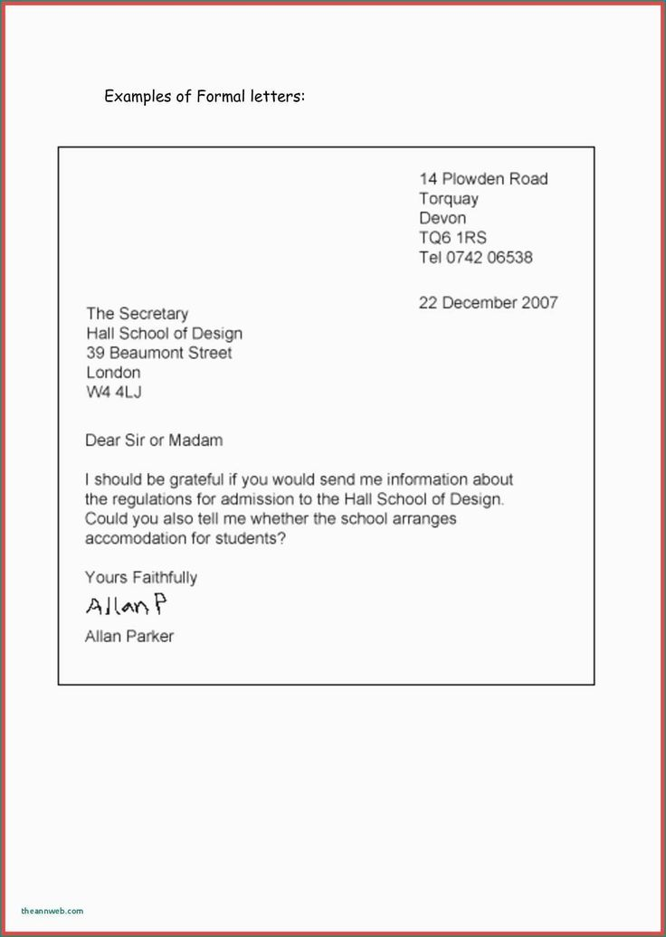
Giving them the opp to identify what makes a good one successful – sc in practice

Slide 32
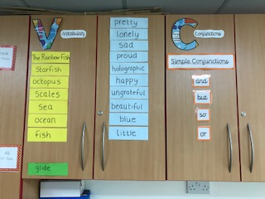
Same for narrative – maybe give a text

Slide 33
VCOP – working Display to teach VGP and improve Writing
Vocabulary – New words, effective words
Pull out words and phrases from the text that work really well – display, sort into N, V, A
Give a passage and ask children to change or add the V from the display
Conjunctions – ways of adding detail and extending ideas
Build these up according to the order you want to teach them (and, then, but, because etc_
Identify their use in texts in reading sessions, get children to practise extending sentences.
Openers – ways of starting sentences
Identify how these are used in reading and display them
Group them. Great for identifying adverbs – how, when, where etc.
Uplevel sentences by adding/changing the first word
Punctuation
Like conjunctions, build the bank as you teach/discover it.
Select the target punctuation to work on that day
Make up actions for each
Correct a teacher’s/puppet’s/piece of work
MAKE A SENTENCE – USE IT TO EDIT - JUMPSTART GRAMMAR

Slide 34
Let’s practise uplevelling/make a sentence
Add a word V
Add an O
Extend with a C
Change a word
Add a simile
Alliterate
Add parenthesis
The wolf banged at the door.
gingerly
while
crept
Jumpstart Grammar – so many!
Make drills or games that match the class text/outcome.

Slide 35
Here’s a piece of text. What would you want to pull out for the children’s writing? What would you be putting on your working wall?

Slide 36
Model it!
Ask for ideas
Share your thinking
Make amendments
Use your working wall
Include class targets
Apply taught and practised skills
Metacogn b and forth

Slide 37
Task - model it, a cave setting. You are going to model writing a setting description. The things we’ve been looking at are: preposition openers and manner adverb o, sentences of 3 we’ve been practising subordinating conjunctions: with, while, when, as V we’ve collected from our texts along the way (here’s the wordbank} Can you model a WAGOLL for the children – taking their ideas? Have a go! This is where metacognition comes in. You’ve practised using adverb and prep o You’ve practised completing sentences with c You’ve made lists of 3 You’ve collected v from texts. Now you’re asking children to call on that to write a setting description

Slide 38
Transcription

Slide 39
Transcription – Spelling and Handwriting
Statutory – appendix 1
What and when
Strategies
Useful resources and sources

Slide 40
Why do we need to know these?

Slide 42
Programme versus Need
Task to have a go

Slide 43
Have a go

Slide 44
Speech issue?
Reversals b/d and numbers 21/12
High frequency words – was , could , when , with, my, out, have
Past tense endings

Slide 45
Key Stage 1 spellings (CEW, adding suffixes, homophones and incorrect grapheme selection)are the areas where our children make most mistakes
This is what should be constantly revisited throughout KS2

Slide 46
Drip Feed
During register – write three words with ……
Modelling writing….. Thinking aloud
Add to target flips or give as mini word banks
Display
Look for these and highlight during all reading activities
Have group spelling banks on tables and update them
Self correct selected words (or parts of words) as part of marking policy

Slide 47
Phonics Never Ends
Phonics can continue through KS2 – whatever your age range, know your SSP!
Use the phonic clues to build and segment longer words
Use your spelling voice to hear the phonemes
Look for alternative graphemes – even up in UKS2 iou spells u (3 letters one sound) This is a chance to practise u ou oo
Continue SSP intervention with children who need it

Slide 48
How many spelling strategies do you know?
How many different strategies do you teach?

Slide 50
Segmenting is key
impossible
Use your spelling voice
Break the word into syllables
Unpick each syllable – other examples for tricky syllables
Write in syllables on lines (phonics policy)
Write and say each syllable, and then the whole word.

Slide 51
Mnemonics
What would be the benefit of getting children to create their own mnemonics?
My – my yo-yo
All – all labradors lick
Some – some old monkey explodes

Slide 52
Make the implicit explicit
Have you taught
children
how to do this?

Slide 53
Selecting, Searching and Sorting
Splat the correct spelling (in or im tion or sion)
Wordsort ai ay ei a-e
Wordsearch
aboutfurtanssgemothereonepicwhere

Slide 54
Dictation
Context and meaning
Within text
How much to record?
Cloze pro?

Slide 55
Right and wrong
Quick-fire 2 minute starter
wos woz was whas
Use words that are often mis-spelt for your spelling focus e.g.
tomorrow, they, with, because,
Put these into sentences too – use a puppet to get children to correct passages with key spellings
Notes:
55

Slide 56
Around the Classroom
Phonics display
VCOP
Current convention display
Table prompts
Wordbanks
Curriculum V

Slide 57
Quick Fire Activities

Slide 58
A Summary
Timetable it in
Teach the rule/convention, not a list of words.
Review previously learnt sounds/rules regularly. Include the modelling of spelling when modelling writing.
Engage in daily spelling activities.
Practise spelling rules during handwriting.
Display spelling rules/conventions in classrooms. Refer to these in teaching, marking and feedback and encourage interaction
Give children a chance to correct their own work –make it clear in the marking policy
Write around spellings – test?

Slide 60
Remember left handers! Think about where they sit as well as how they sit.
Remind the children of these key elements in every session.

Slide 61
Tackling issues
Identify the problem, break it down and start with one thing.
Size
Shape
Sitting
Spacing
Speed - Pace of the pen/pencil
On a class list, make a very simple note of each child’s issue.
Share it – with child and adults
Refer to it in marking and feedback - Positively too!
Use handwriting as a target.
Be specific! Choose a letter, a group of letters, a join, ascenders. This will show progress.
Show an example of their very best as an example. Challenge to make it match.

Slide 62
Intervention programme
Finger spacer
Pencil grip/shaped pencils
Weights
Additional time/Adapted expectation
Writing slope
Muscle tone or Fine motor?

Slide 63
Dot-dot
Hama beads
Jigsaws
Grips
Pick up sticks
Threading
Tracing patterns/letters
Play dough

Slide 64
Key points to remember
Provide reading opportunities everywhere.
Link reading and writing
VCOP or working walls
A chance to practise skills in VGP or shorter tasks
Model, model, model in reading and writing!
Give purpose – who and why?
Timetable the basics
Have fun!

Slide 65
Some useful websites
https://educationendowmentfoundation.org.uk/http://www.oxfordowl.co.uk/
https://clpe.org.uk/
https://assets.publishing.service.gov.uk/government/uploads/system/uploads/attachment_data/file/1000986/Reading_framework_Teaching_the_foundations_of_literacy_-_July-2021.pdf
www.classroomsecrets.com
www.literacyshed.com
www.spellingshed.com
www.dkfindout.com
www.twinkl.co.uk

