Slide 1
A Great Calamity: The Great Fire of Gateshead & Newcastle
6th October 1854

Slide 2
Gateshead Observer 7th October 1854
“We have been visited by one of the most destructive and most appalling disasters on record… our two towns were shivered”
“No death has, so far as we are aware, resulted directly from the fire…”

Slide 4
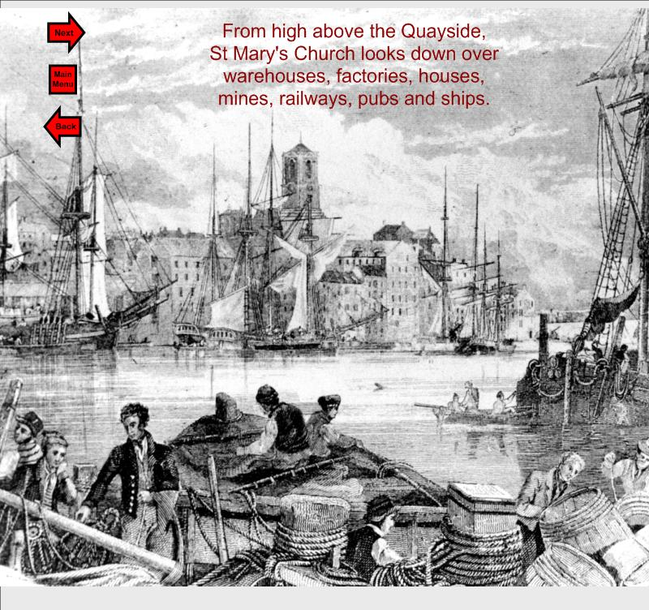

Slide 5
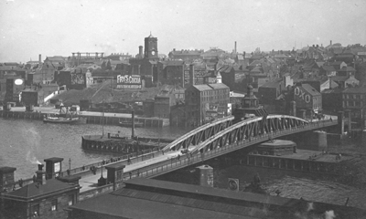

Slide 7
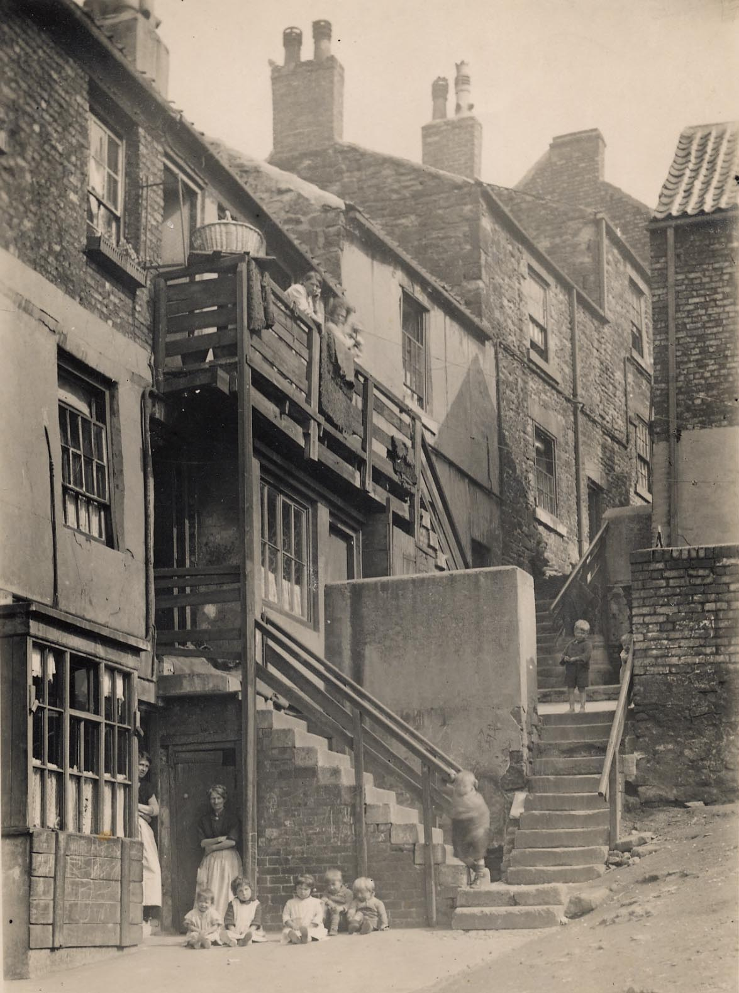

Slide 8
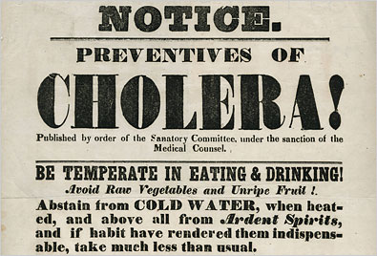

Slide 9
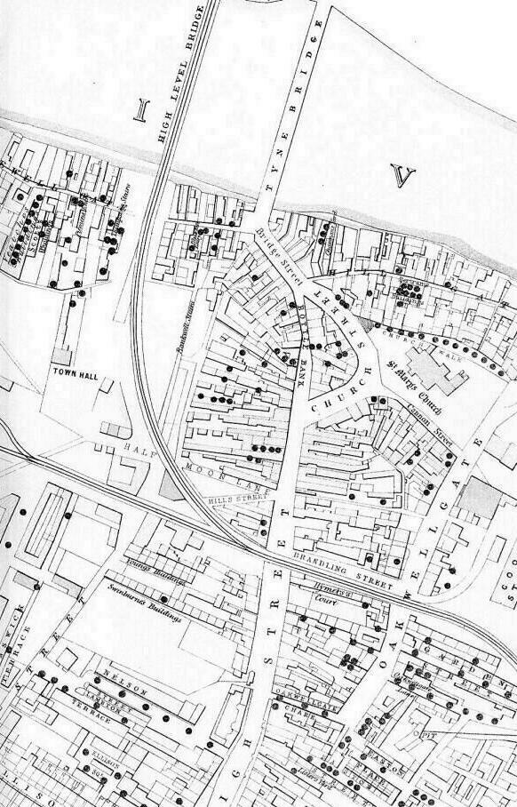

Slide 10
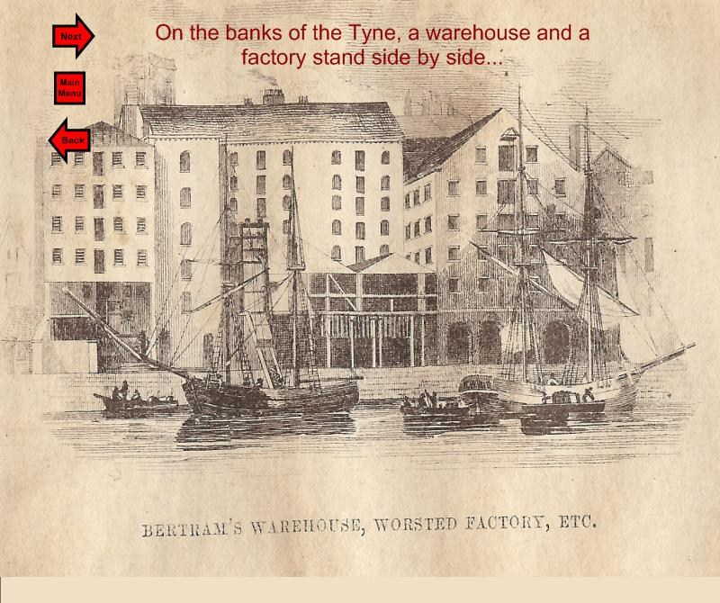

Slide 11
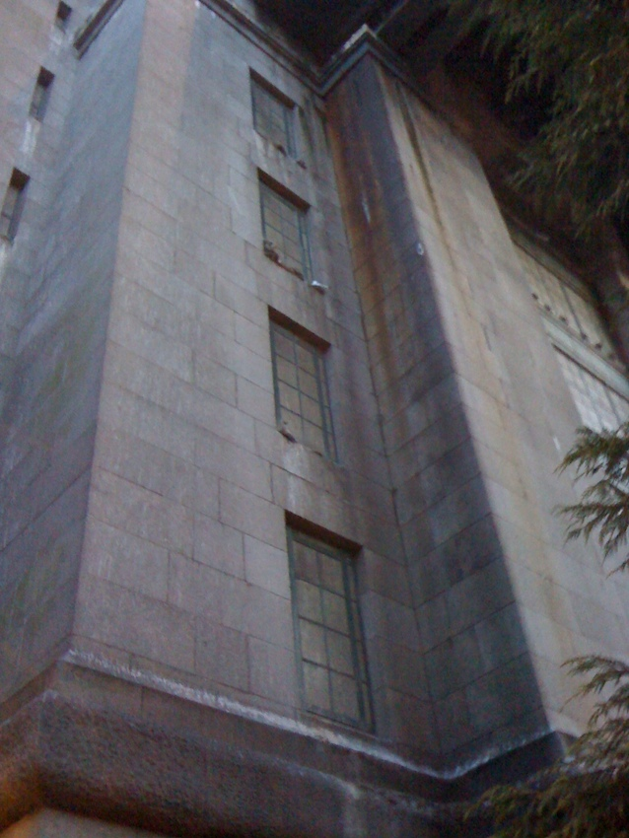

Slide 12
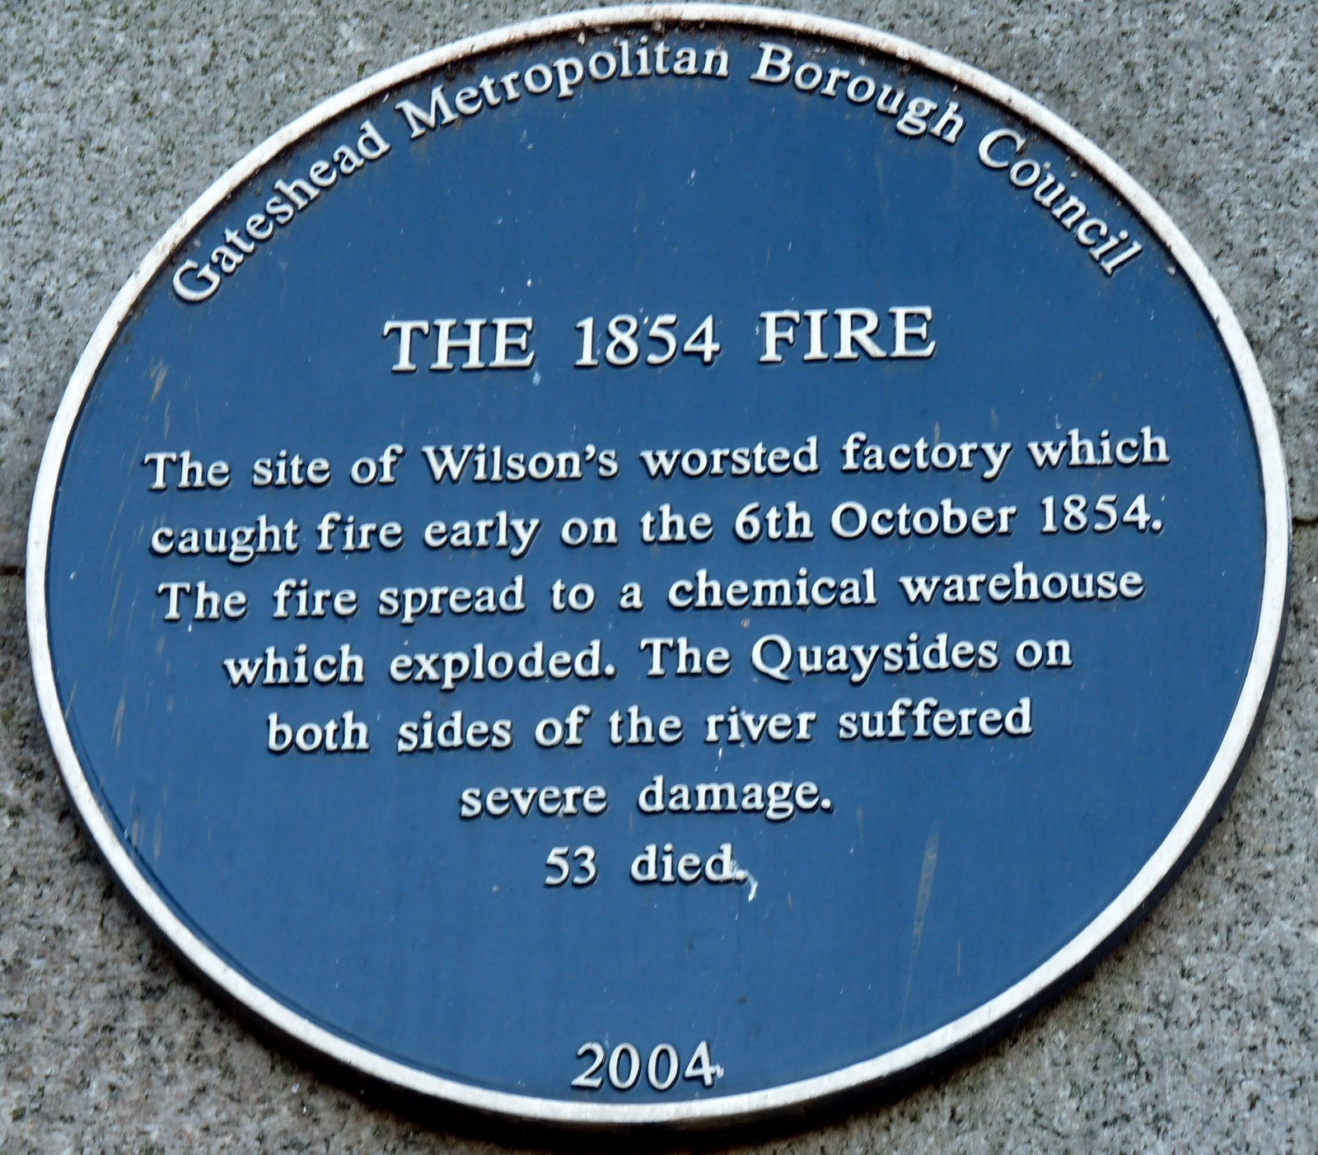

Slide 18
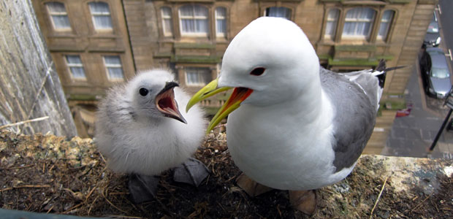

Slide 20
Newcastle Courant 6th October 1854
“…An elevated wooden erection, formerly used as a coal staith, added fuel to the fire, and for a time shared with the warehouse the attention of the astonished and wondering multitude…
…as the flames progressed, the excitement amounted to intense anxiety … a slight concussion warned the thickly gathering crowd that there was something more perilous than sulphur alone in the burning pile… It is to be regretted that a second slight explosion .. did not immediately warn of the numerous firemen and the surrounding crowd but none foreboded the awful calamity that was about to follow. ”.

Slide 22
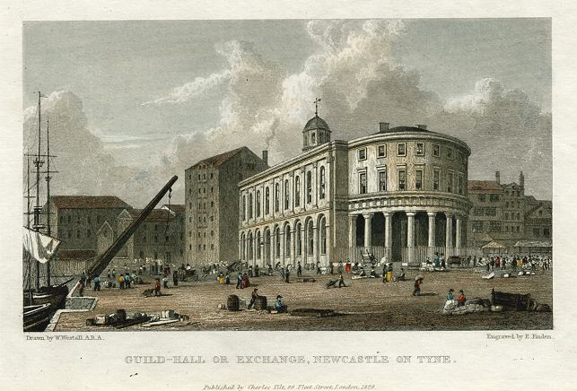

Slide 24
Newcastle Courant 6th October 1854
“About a quarter past three o’clock, almost every inhabitant of the town, and for a considerable distance in the outskirts, was aroused by a terrible shock, which shook the buildings to their very foundation, and left people in breathless excitement.”

Slide 26
“ the iron-bound High Level, as it met the force of the convulsion, quivered on its lofty piers, as in a mighty struggle for a prolonged existence”

Slide 28
David Haggie, Mayor of Gateshead
“…his Worship… had been in Hillgate from the earliest commencement of the fire, actively exerting himself… in directing the operations for the suppression of the flames. … he had no sooner reached the Church Walk than the explosion took place… he threw himself under the fire engine for shelter and safety, but he was driven from his lodging-place by the stroke of a heavy beam, and was rescued by a policemen dragging him into a passage”

Slide 29
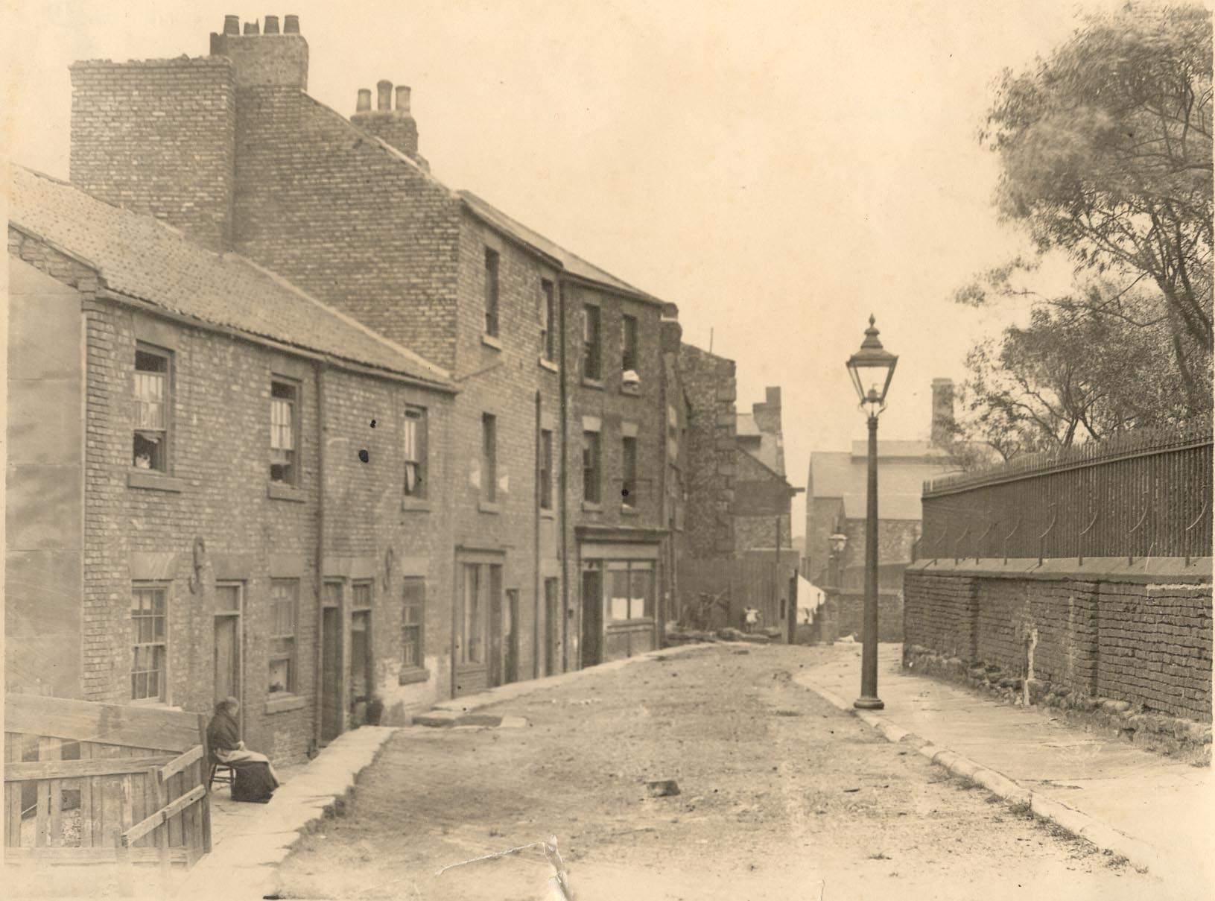

Slide 30
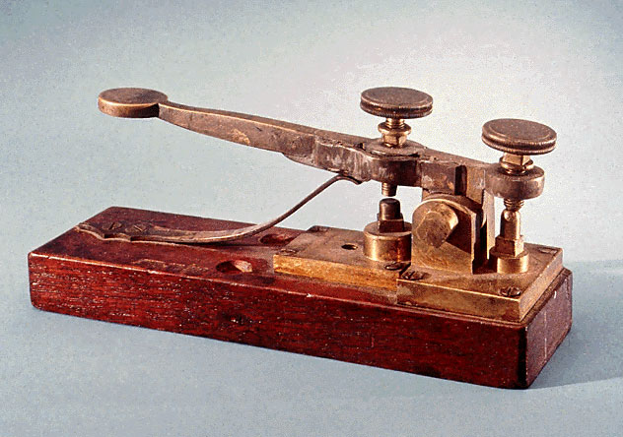
“About 4 o’clock a telegraphic message was sent down for the engines”

Slide 31
Destruction on the Tyne
The frontage of the Quayside, … is entirely levelled … as a whole, the buildings have fallen into a shapeless mass of smoking debris”
“The sight at the Gateshead station is most horrifying…on the Newcastle side, the fire still rages
“In the lower part of Gateshead it is almost impossible to make way through the streets, so overpowering is the vapour of burning sulphur”

Slide 32
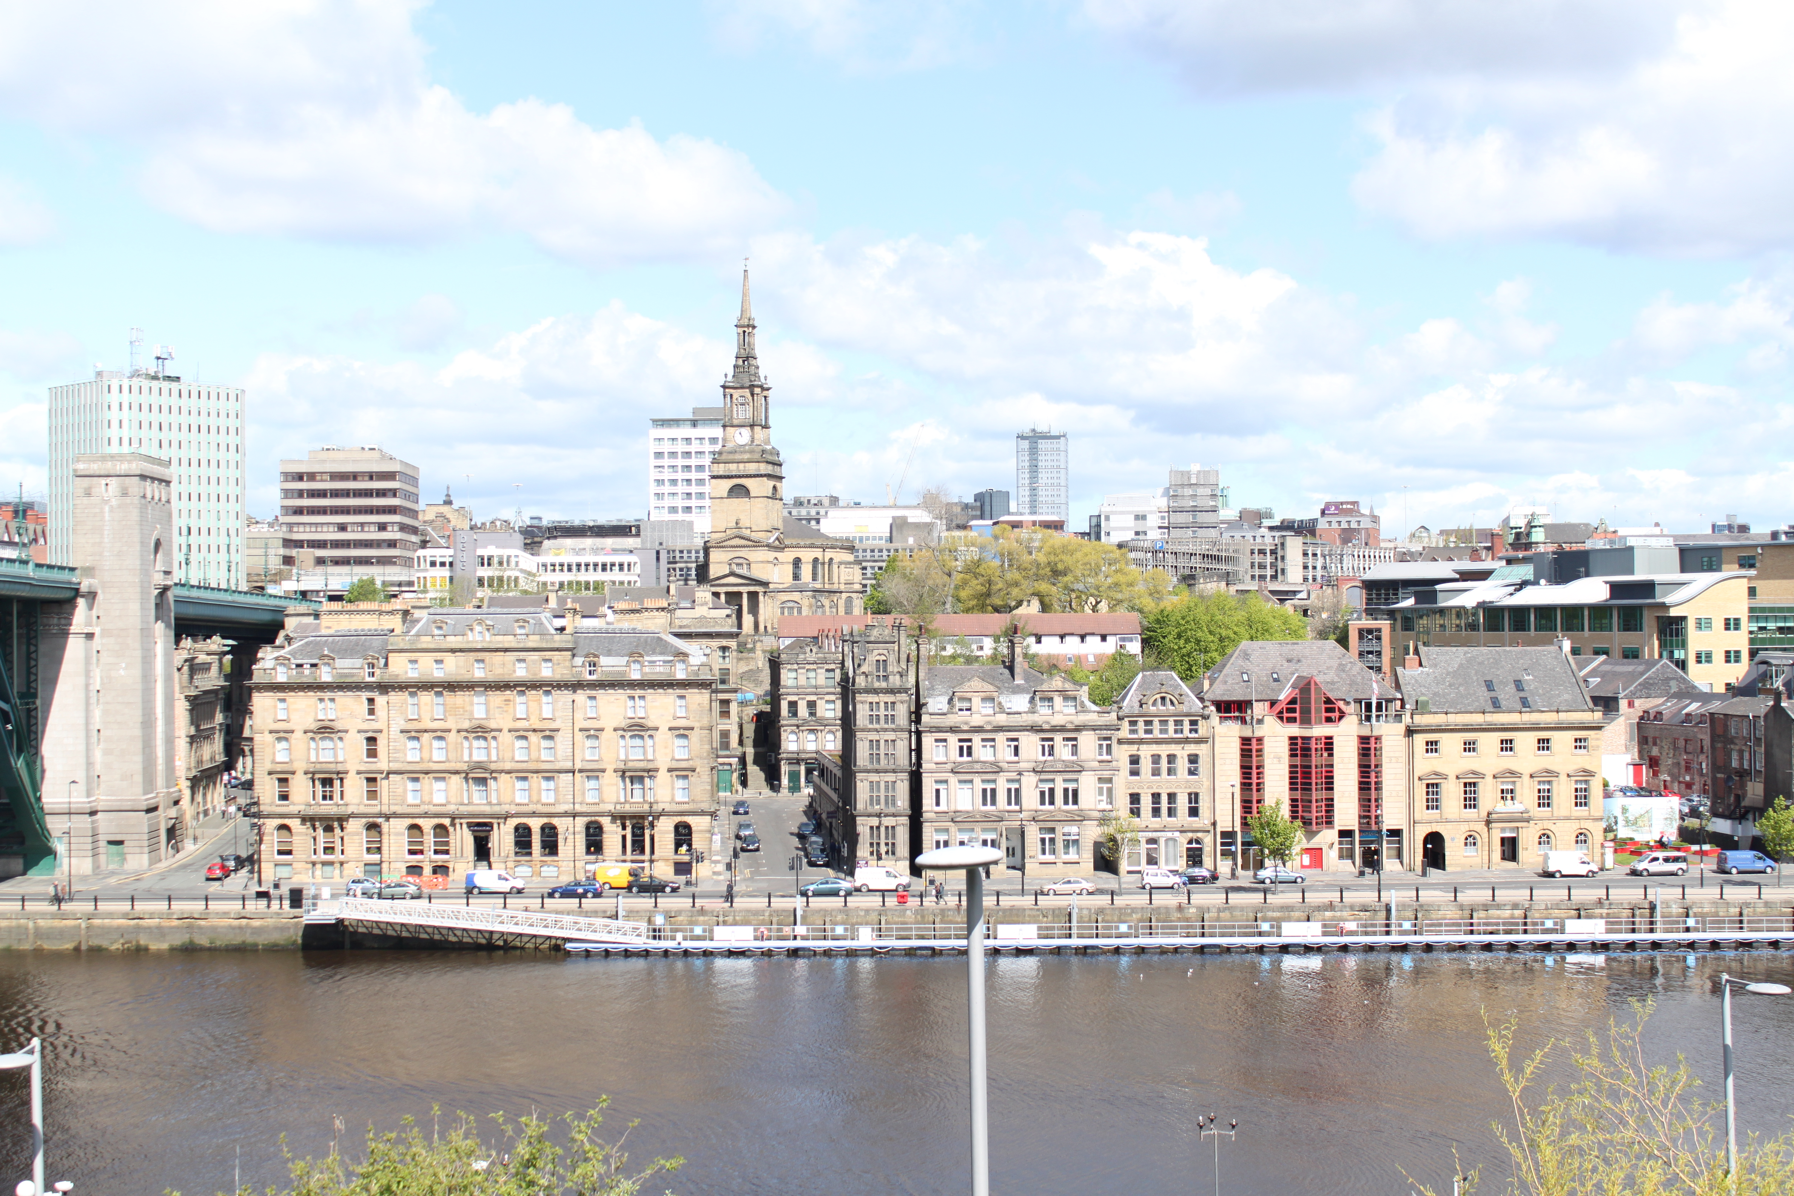

Slide 33
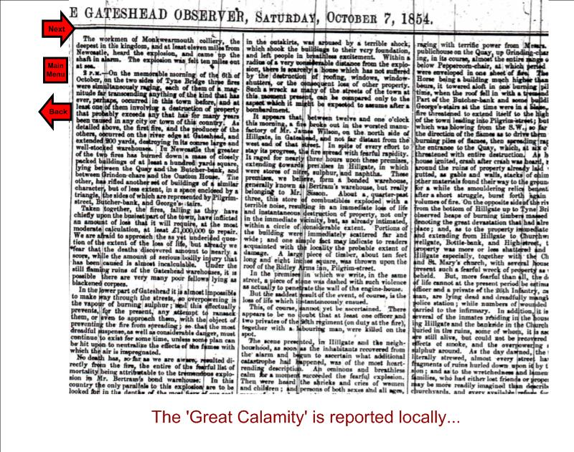

Slide 36
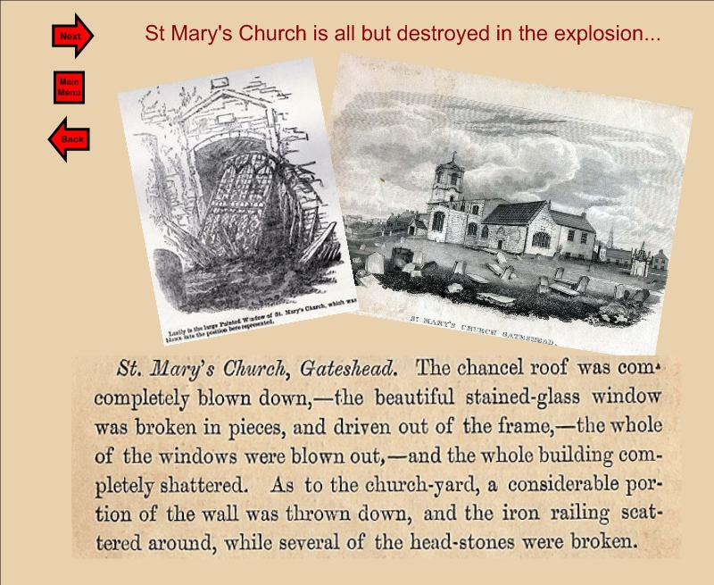

Slide 38
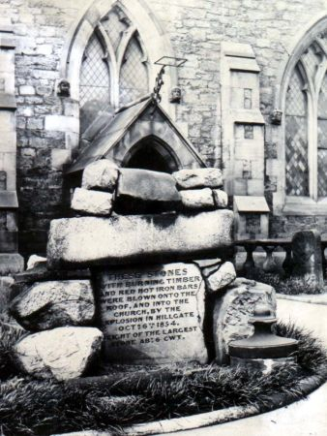

Slide 39
The Victims
Charles Bertram - past owner of the bonded warehouse. Merchant and magistrate
Ensign Cranbourne Hastings Paynter (19) Ensign of the 26 Cameronians
Alexander Ralph Dobson (25) architect, son of John Dobson, architect
William Davidson, jn (22) miller (body not found until Tuesday)
… + a further 49

Slide 40
Charles Bertram J.P.
“Well, lets have a pinch first”
last reported words of
Charles Bertram
“ all that has been discovered of his remains are a few bones, his snuff box, and a key. His snuff box was of silver and marked “C.B”

Slide 41
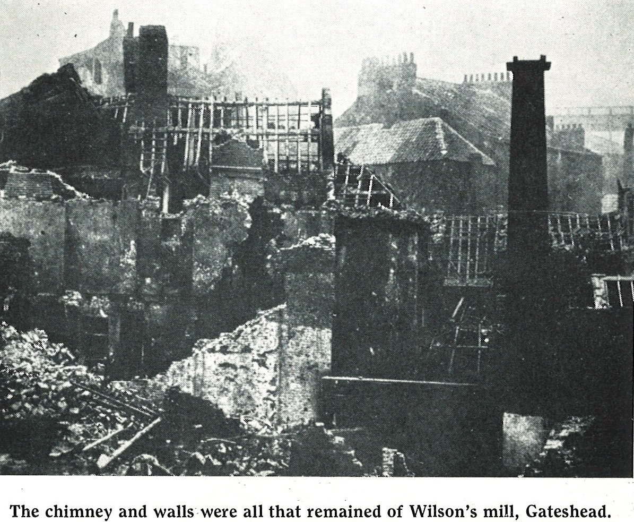

Slide 43
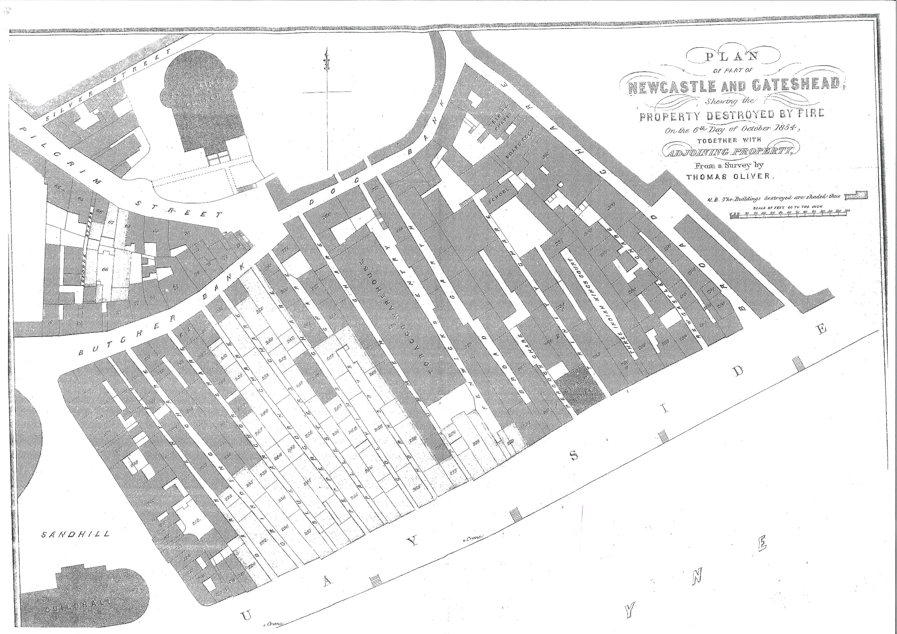

Slide 44
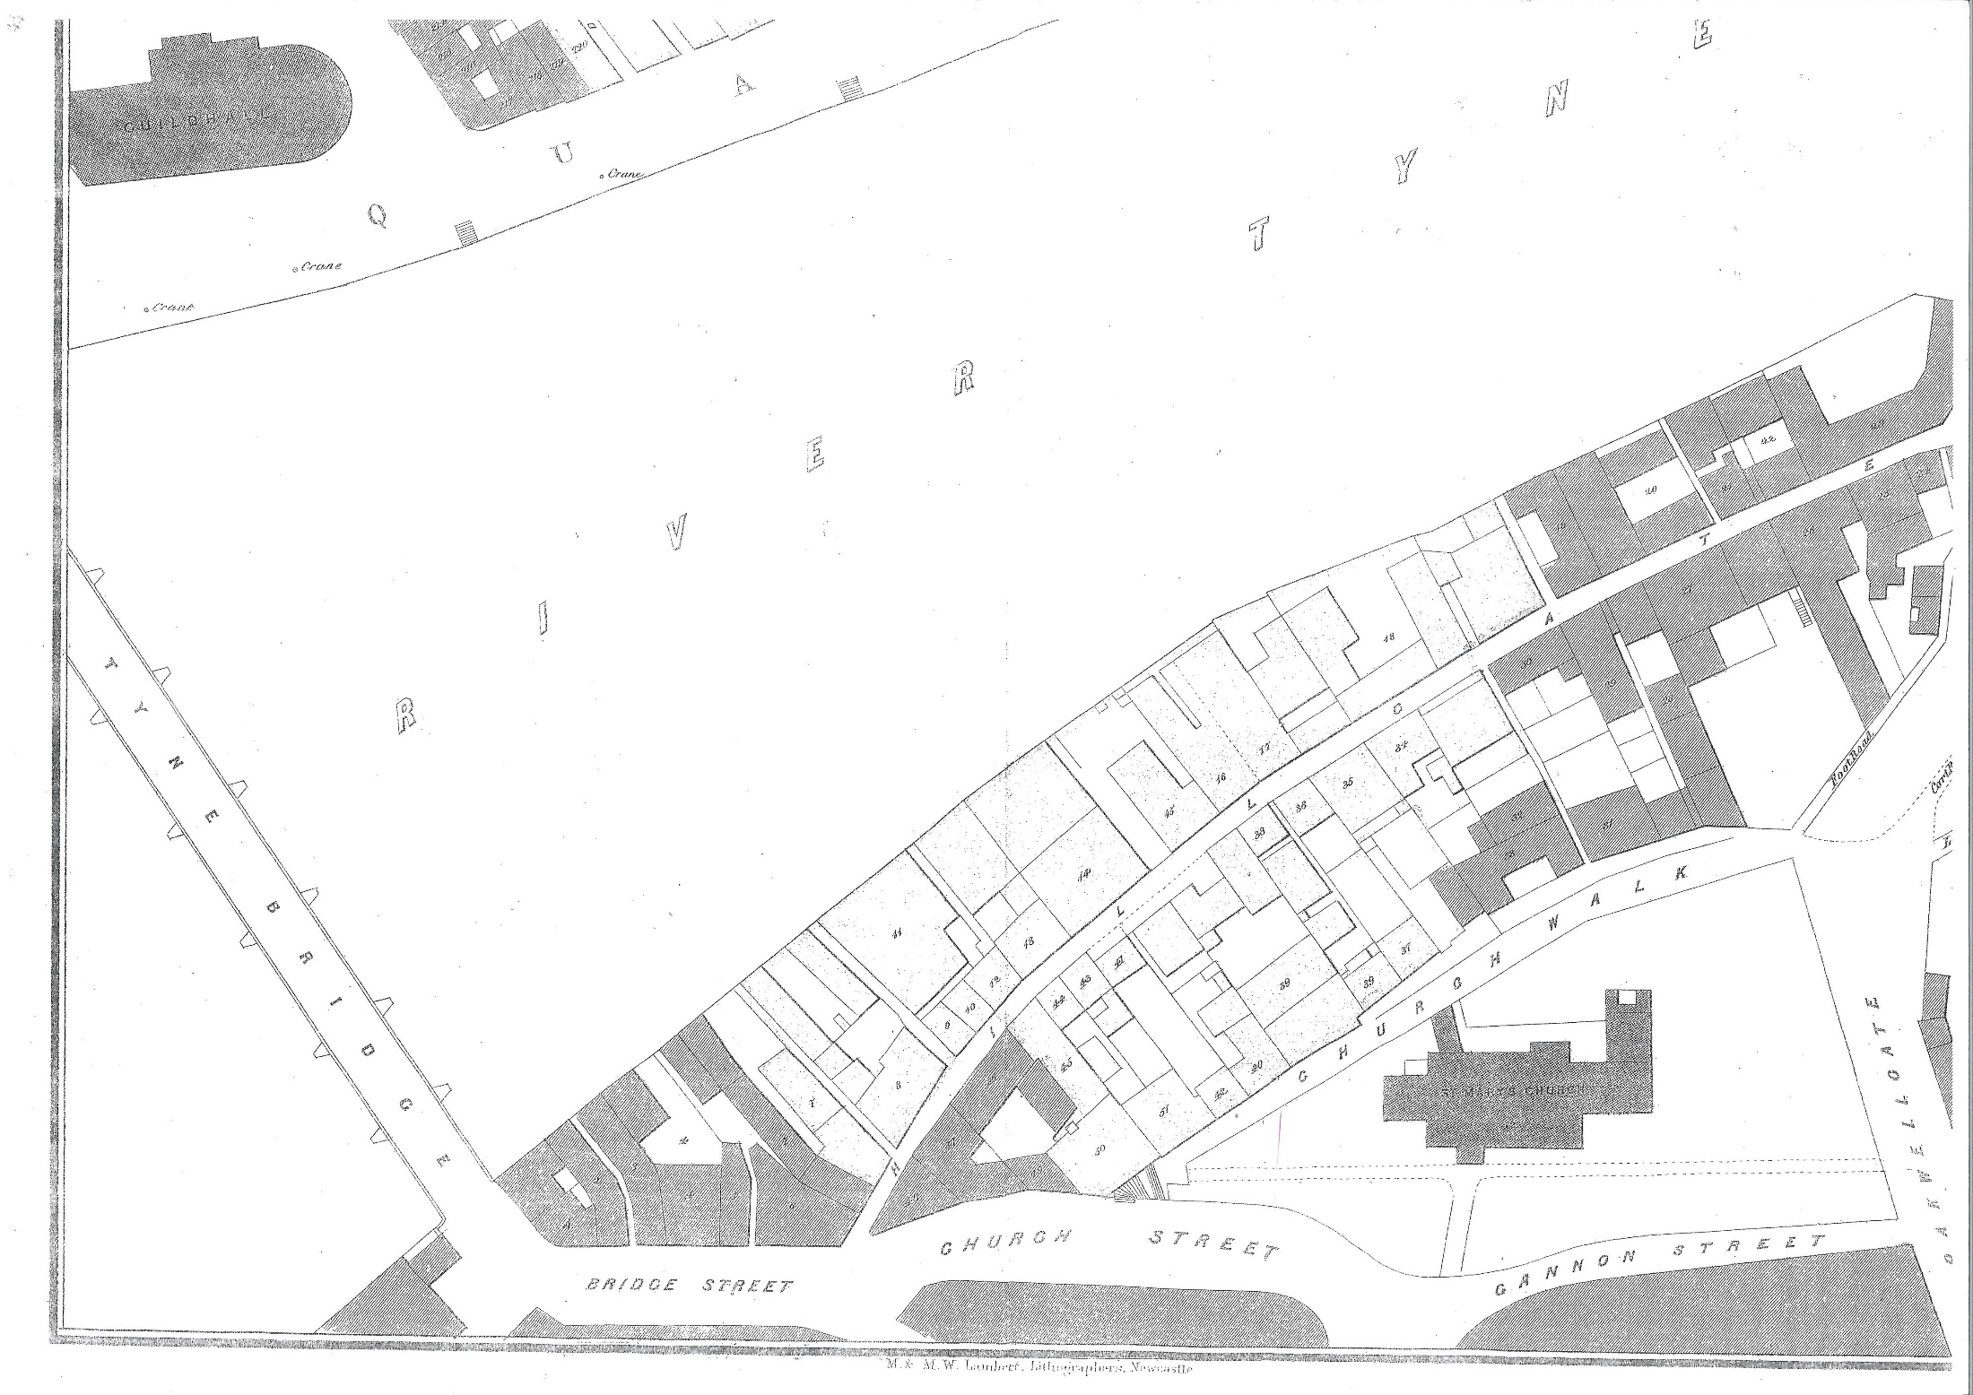

Slide 45
Collateral Damage
Total damage estimated at £500,000 9equivalent of £39 million today
Total insurance payouts of around £150,00
200 family homes completely destroyed
£50 compensation let many families considerably better off.

Slide 46
Relief Fund
“… That this meeting, deploring the great calamity with which Newcastle and Gateshead have been visited by the fire and explosion in this borough, resolves to join in a public subscription for the relief of the necessitous sufferers”
Dr John Davies Rector of Gateshead

Slide 47
Subscriptions to the relief fund
Cuthbert Ellison £450
Alnwick – nearly £300
Mrs Marllion of Paris £200
Hawks, Crawshay & Sons £200
Bishop of Durham £150
Queen Victoria £100
Mayor of Gateshead £100
R S Newall £50
Haggie Brothers £50

Slide 48
The Royal travellers passed slowly along the High Level Bridge and viewed with great interest and sympathy the havock made in the two towns by the fire and explosion”
“This has been a most calamitous occurrence. I feel exceedingly sorry for Gateshead” Queen Victoria 13 October 1854

Slide 49
The Enquiry

Slide 50
Hugh Lee Pattinson
“I have given my mind to chemistry during nearly the whole of my life – 40 years …. The contents of the warehouse alone would not explode …We want therefore another element – and that element is water… the explosion would be caused by the conversion into steam of the water which got access to the chamber”

Slide 51
The Verdict
“Having thus placed the Evidence of the Enquiry in as clear and perspicuous light as we have been able, we are not disposed to intrude further remark; except the brief observations that, the origin of the fire appears plainly unascertainable, - and that the evidence against their being Gunpowder in the warehouse is so clearly demonstrative as to banish all doubt from the minds of the intelligent…
we have done what we could to place the chief points of the evidence fully and fairly before our readers, and each one must decide for himself…”

Slide 52
Rising from the ashes

Slide 53
Gateshead Observer
“it appears to us however, that there is no help for it, and that old St. Mary’s after her long, and we trust useful reign, must give way to a new dynasty…..”
“The Bishop of Durham, we are glad to find, views the matter precisely in the same light as ourselves….”

Slide 54
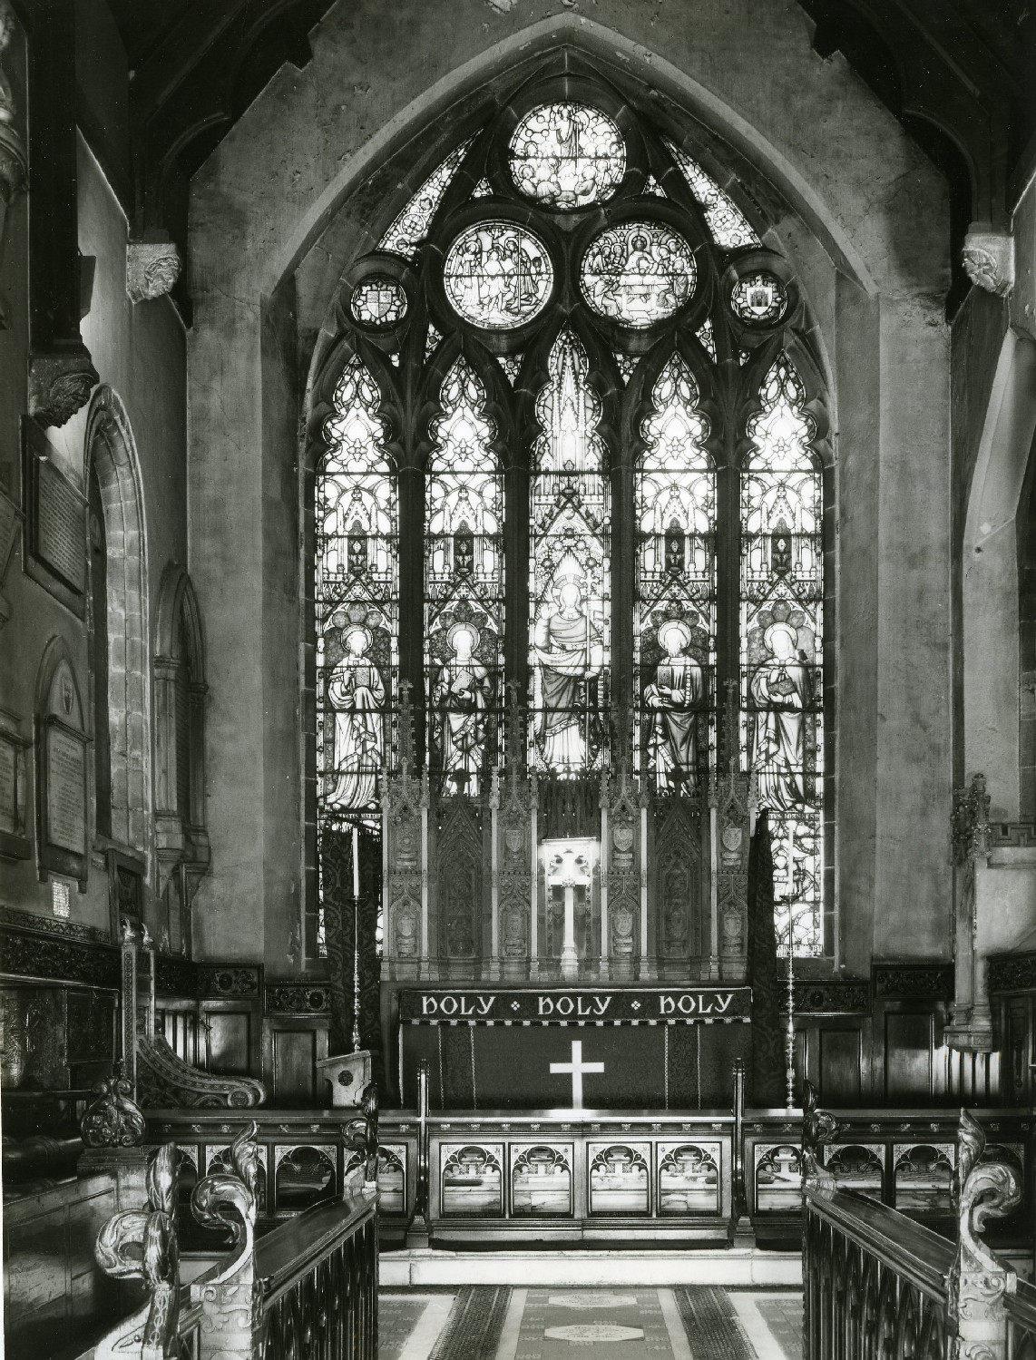

Slide 55
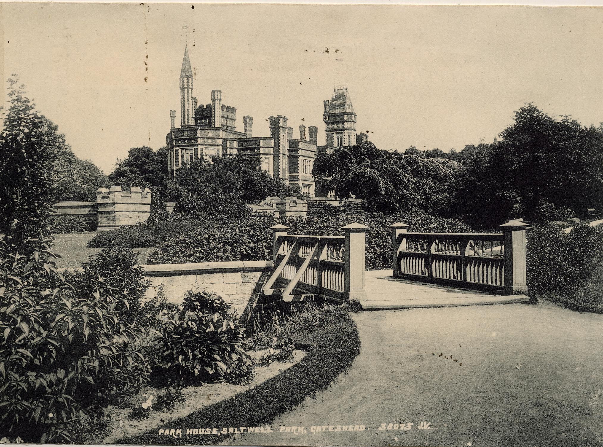

Slide 56
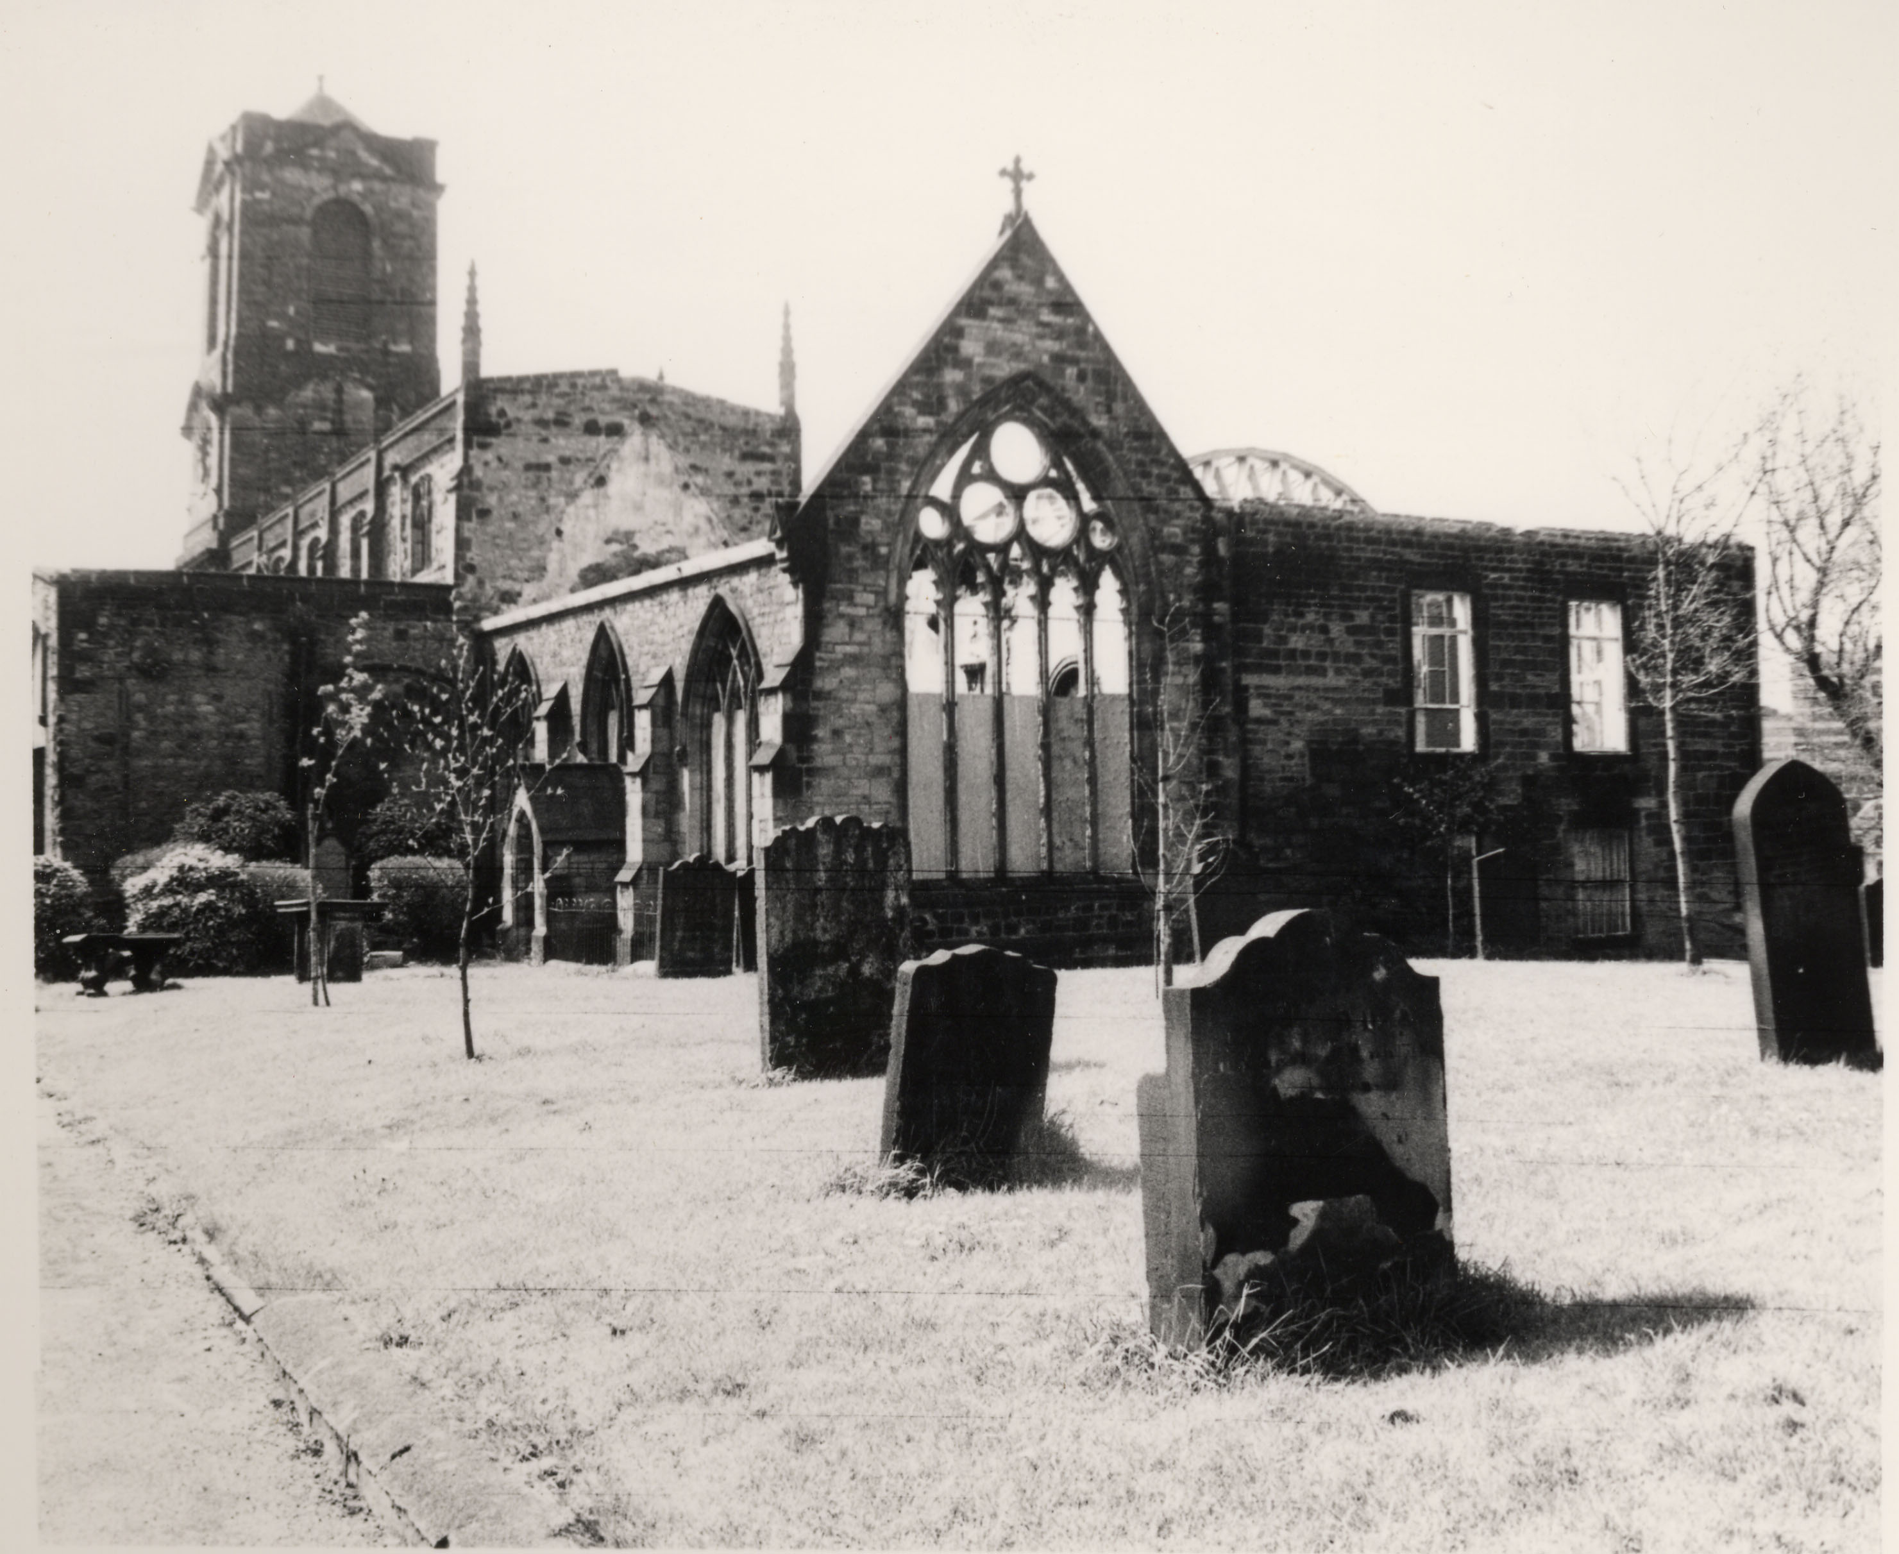

Slide 57
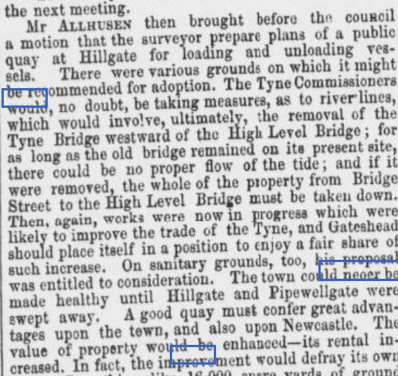
A more sinister explanation?
Newcastle Courant, Friday 13th January 1854
“The town (Gateshead) could never be made healthy until Hillgate & Pipewellgate were swept away.”

Slide 58
The Gateshead Improvement Committee
Newcastle Courant, Friday 27th October 1854
“The late fire had laid the most valuable part of Hillgate in ruins, and removed obstacles which the Council had been unable to remove”

Slide 59
