Slide 1
History

Slide 2
Training Overview
This session will aim to…
Introduction - To understand the core aims and expectations of the EYFS/KS1 and KS2 Programmes of Study for History.
Research & Recommendations - To introduce trainees to the national context of history Teaching from R-Y6.
Subject Knowledge and Development – To empower trainees to deliver engaging and purposeful history lessons by developing their historical and pedagogical knowledge from Reception to Year 6.
Pedagogy Planning and Progression – To equip trainees with a range of teaching and learning strategies to implement in their history lessons.
1
2
3

Slide 3
Training Overview
Outline of the Day
1. National Curriculum, Theory & Research
2. Subject Knowledge Development
3. Pedagogy & Planning
4. Progression from Early Years to KS3
5. Use of historical sources of information
6. Use of local area and educational visits
History

Slide 4
Core Content Overview • High Expectations (TS1)
Evidence Statements: Learn that…
Setting clear expectations can help communicate shared values that improve classroom and school culture.
1.1
Teachers have the ability to affect and improve the behaviour and motivation of their pupils.
1.4
Teachers are key role models.
1.5
A culture of mutual trust and respect supports effective relationships.
1.2
Teacher expectations can affect pupil outcomes.
1.3
High-quality teaching has a long-term positive effect on pupil’s life chances.
1.6

Slide 5
Core Content Overview • How Pupils Learn (TS2)
Evidence Statements: Learn that…
Working memory is where information that is being actively processed is held but is limited.
2.1
Learning involves a lasting change in pupils’ capabilities and understanding.
2.4
2.5
Long-term memory is a store of knowledge that changes as pupils learn.
Prior knowledge plays an important part in how pupils learn.
2.2
2.6
Where prior learning is weak, pupils are more likely to develop misconceptions.
2.3
An important factor in learning is memory: working memory and long-term memory.

Slide 6
Core Content Overview • How Pupils Learn (TS2)
Evidence Statements: Learn that…
Worked examples that take pupils through each step of a new process are also likely to support pupils to learn.
2.7
Regular purposeful practice of what has previously been taught can help consolidate learning.
2.9
Requiring children to retrieve information from memory and spacing so that pupils revisit learning after a gap are also likely to strengthen recall.
2.8

Slide 7
Core Content Overview • Curriculum (TS3)
Evidence Statements: Learn that…
A school curriculum sets out its vision for the knowledge, skills and values that pupils learn.
Explicitly teaching knowledge and skills pupils need is beneficial.
3.1
3.5
3.2
Secure subject knowledge helps teachers to motivate pupils and teach effectively.
To think critically, pupils must have secure understanding of knowledge.
3.6
3.3
Ensuring pupils master foundational concepts and knowledge before moving on is likely to build confidence
Pupils learn new ideas by linking those ideas to existing knowledge.
3.7
3.4
Anticipating common misconceptions is important aspect of curricular knowledge.

Slide 8
Core Content Overview • Curriculum (TS3)
Evidence Statements: Learn that…
3.8
Pupils are likely to struggle to transfer what has been learnt in one discipline to a new or unfamiliar context.
3.9
Reading is key to learning in the rest of the curriculum.
3.10
Every teacher can improve pupils’ literacy

Slide 9
Core Content Overview • Classroom Practice (TS4)
Evidence Statements: Learn that…
Effective teaching can transform pupils’ knowledge, capabilities and beliefs about knowledge.
Explicitly teaching pupils metacognitive strategies support independence and academic success.
4.1
4.5
4.2
Effective teachers introduce new material in steps, explicitly linking new ideas to what has previously been learned.
Questioning used to check prior knowledge, assess understanding and break down problems.
4.6
4.3
Modelling helps pupil understand new processes and ideas
4.7
High-quality classroom talk can support pupils.
4.4
Guides, scaffolds and worked examples can help to apply new ideas.

Slide 10
Core Content Overview • Classroom Practice (TS4)
Evidence Statements: Learn that…
Ensuring pupils have repeated opportunities to practise increases success.
4.8
4.9
Paired and group activities can increase pupil success, but to work effectively pupils need guidance and support.
Care should be taken to monitor the impact of groupings on pupil attainment, behaviour and motivation.
4.10
4.11
Homework can improve pupil outcomes

Slide 11
Core Content Overview • Adaptive Teaching (TS5)
Evidence Statements: Learn that…
Pupils are likely to learn at different rates and require different levels of support from teachers to succeed.
Flexibly grouping pupils within a class can be effective, but care should be taken to monitor impact on engagement.
5.1
5.5
5.2
Seeking to understand pupils’ different, including different levels of prior knowledge and potential barriers to learning is essential.
It is a common misconception that pupils have distinct and identifiable learning styles.
5.6
5.3
Adapting teaching in a responsive way is likely to increase success.
Pupils with SEND are likely to require additional or adapted support
5.4
Adaptive teaching is less likely to succeed if teachers set lower expectations for particular pupils
5.7

Slide 12
Core Content Overview • Assessment (TS6)
Evidence Statements: Learn that…
Effective assessment provides teacher with information about pupils’ understanding and needs.
High-quality feedback can be written or verbal, encourages further effort and provides specific guidance on how to improve.
6.1
6.5
6.2
Good assessment helps teachers avoid being over-influenced by potentially misleading factors.
Over time, feedback should support pupils to monitor and regulate their own learning.
6.6
6.3
Teachers should be clear about how assessment informs decisions.
Teachers used information from assessments to inform decisions they make.
Working with colleagues to identify efficient approaches to assessment is important.
6.4
6.7

Slide 13
Core Content Overview • Behaviour Management (TS7)
Evidence Statements: Learn that…
Routines can help create an effective learning environment.
Building effective relationships is easier when pupils believe that their feelings will be considered and understood.
7.1
7.5
7.2
A predictable and secure environment benefits all pupils, but particularly SEN.
Pupils are motivated by intrinsic and extrinsic factors.
7.3
The ability to self-regulate affects pupils’ ability to learn, success in school and future lives.
7.6
Pupils’ investment in learning is also driven by their prior experiences and perceptions of success and failure.
7.7
7.4
Teachers can influence pupils’ resilience and beliefs about their ability to succeed.

Slide 14
Core Content Overview •
Practice Statements: Learn how to…
1
Demonstrate consistently high behavioural expectations.
4
Plan effective lessons.
Communicate a belief in the academic potential of all pupils.
5
Provide opportunity for all pupils to experience success.
1
2
Build on pupils’ prior knowledge.
6
Check prior knowledge and understanding during lessons.
3
Deliver a carefully sequenced and coherent curriculum.
6
Provide high-quality feedback.

Slide 15
Core Content Overview •
Practice Statements: Learn how to…
7
Develop a positive, predictable and safe environment for all pupils.
8
Develop as a professional.
7
Motivate pupils.
See full detail in the ITT Core Content Framework.
https://assets.publishing.service.gov.uk/government/uploads/system/uploads/attachment_data/file/843676/Initial_teacher_training_core_content_framework.pdf

Slide 16
Core Academic Reading • Assigned Bibliography
Pre Reading
Follow-Up Reading
Early Years Foundation Stage Framework 2021: Understanding the World
https://assets.publishing.service.gov.uk/government/uploads/system/uploads/attachment_data/file/974907/EYFS_framework_-_March_2021.pdf
History programmes of study: key stages 1 and 2, DfE, 2013 https://assets.publishing.service.gov.uk/government/uploads/system/uploads/attachment_data/file/23 9035/PRIMARY_national_curriculum_-_History.pdf
Learning To Teach History In The Primary School, Rosie Turner-Bisset, 2004
Carmel LRC: SR 372.89 TUR ISBN-13: 9781843121152
Primary History : Using The Evidence Of The Historic Environment, English Heritage, 1999 Carmel LRC: SR 372.89 ENG ISBN-13: 9781850746508
Good practice in primary history: celebrating outstanding history teaching through the Quality Mark scheme, Bev Forrest and Mel Jones (Historical Association), 2018
https://www.history.org.uk/files/download/20260/1540545669/PH80GoodpracticeQMBForrestMJones.pdf
Primary Subjects History: Making every child matter, Subject Associations, 2008 https://www.subjectassociations.org.uk/wp-content/uploads/2018/07/PS-History.pdf

Slide 17
Session 1: Rationale, Context and National Curriculum

Slide 18
Discuss: Why teach primary history?
‘Engaging children and young people in investigating questions about people and events in the past helps them to better understand their lives today, the contested nature of knowledge and prepares them for the future as more informed citizens.’
Independent Review of the Primary Curriculum 2009

Slide 19
Inspires children to see the world through the eyes of young historians, enabling them to understand how events in the past have contributed to shaping the world in which we live in today
Promotes the children’s understanding of the process of change, the diversity of societies, people’s lives and the challenges that have been faced and overcome in their society and wider world
Develops children’s understanding of core historical concepts such as cause and consequence, continuity and change, and significance
Engages pupils in investigating questions about people and events in the past in order to enable them to better understand their lives today and for a future as more informed and enlightened citizens.
Develops a wide range of critical thinking skills, which enable them to understand the contested nature of knowledge
Enables children to distinguish between ‘fact’ and subjectivity when it comes to reaching conclusions and making judgements
Develops knowledge and skills that are transferable to other curriculum areas
Promotes their spiritual, moral, social and cultural development
As history is by nature an investigative and enquiry-based subject, develops an understanding of concepts, knowledge and skills.

Slide 20
What are the benefits and drawbacks of teaching history in a chronological way?

Slide 21
Reflection Point:
- Is chronology always appropriate when teaching EYFS and KS1?

Slide 22
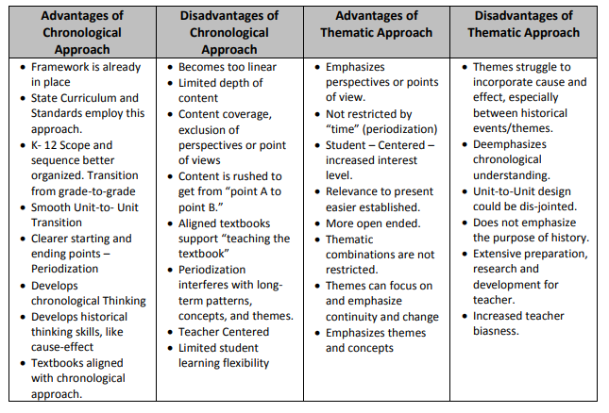
What are the benefits and drawbacks of teaching in a chronological way?
Tew, D. J. (2014, June). Pedagogy of Teaching History: Comparing the Chronologic and Thematic Approaches (2014). Retrieved from Digital Commons @ Western Oregon University: http://digitalcommons.wou.edu/honor_thesis

Slide 23
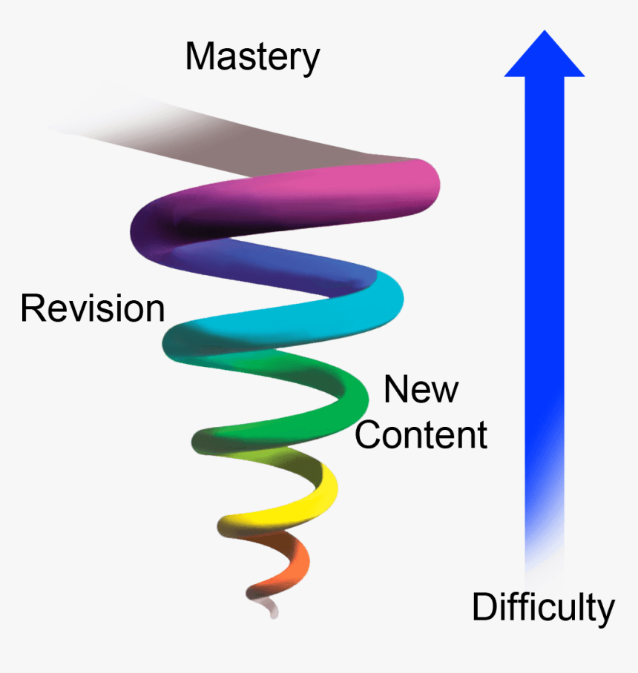
A knowledge-rich curriculum focused on long-term retention of knowledge
Focus on children knowing more and remembering more…
Bruner’s Spiral Curriculum

Slide 24
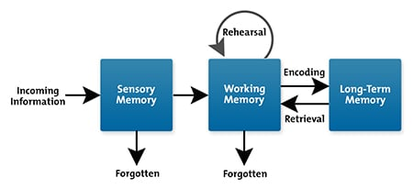

Slide 25
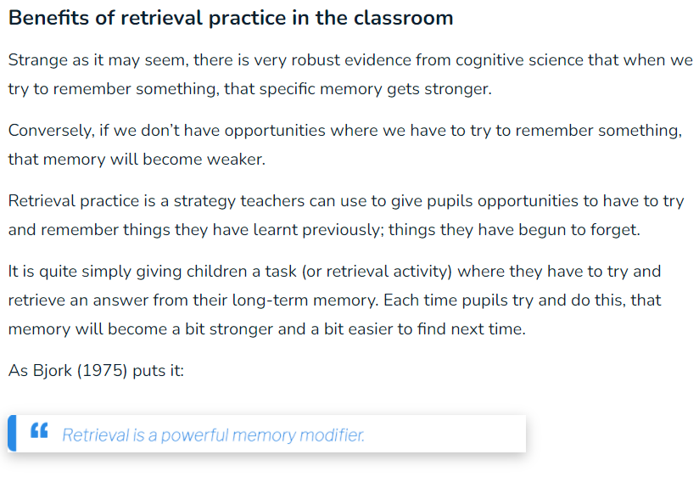

Slide 26
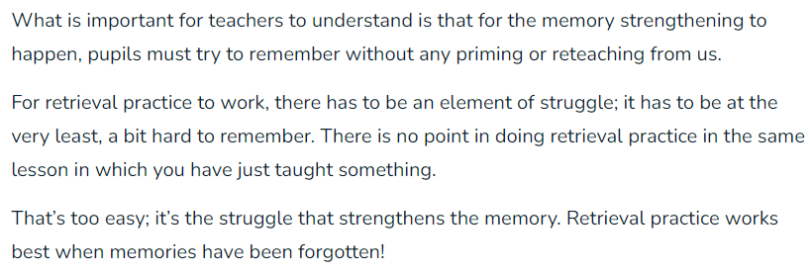

Slide 27
Retrieval Practice Activities and Strategies
Retrieval Practice Activity 1 – Sharing in Pairs
This simple task can be used at any time throughout the day to encourage students to recall information and cement knowledge, and the joy is that it can be used across subjects, not just history!
All you have to do is ask a simple, open-ended question to the class such as:
“Name one thing you learned yesterday in our lesson about Ancient Egyptians.”
Retrieval Practice Activity 2 – Quick Low-Stakes Quizzes
Nothing too complicated is needed here! Simple quizzes as a starter activity can help to cement subject knowledge. 5 questions on a worksheet will work perfectly fine, but if you have access to technology, you can use Kahoot!

Slide 28
Retrieval Practice Activities and Strategies
Retrieval Practice Activity 3 – It’s Brain Dump Time!
Another simple, yet effective task, brain dumps are perfectly suited to retrieval practice.
Ask your pupils to write down everything they remember about a history topic on a piece of paper in five minutes.
After this, you can get them to pair up and compare what they have written down or create a whole class brain dump. This gives pupils a great chance to see what they may have missed from their own sheet and make corrections and additions as needed!
Retrieval Practice Activity 4 - Using Working Memory Challenge Grids
Working Memory Challenge Grids are a table with prompts for retrieval practice where pupils work at their own pace to answer colour-coded questions. They're ideal for laminating for reuse with a whiteboard pen.

Slide 29
Retrieval Practice Activities and Strategies
Retrieval Practice Activity 5 – Flashcards
A powerful retrieval tool that you'll find in most primary classrooms is flashcards. These are tasks where cards are displayed containing a word or a picture. Then, students are asked to retrieve their knowledge on what they are shown, recalling facts aloud.

Slide 31
Importance of Historical Vocabulary
1 It improves reading comprehension. Research has shown that children need to understand 98% of the words they read to understand what they are reading. Improving vocabulary skills will improve their understanding of novels and textbooks.
2 It’s important to Language Development. Children who develop a rich vocabulary tend to be deeper thinkers, express themselves better and read more. Improving language and literacy skills early in life will help them be more successful academically and communicatively.
3 Communicating Ideas. Successful communication or “saying what you mean” is dependent upon a good vocabulary base. Using the right words when talking, makes you a more effective communicator.
4 Expressing Yourself in Writing. Having a good vocabulary to draw from can help you write more effectively.
5 Occupational Success. Researcher Johnson O’Connor found that “a person’s vocabulary level is the best single predictor of occupational success.”

Slide 32
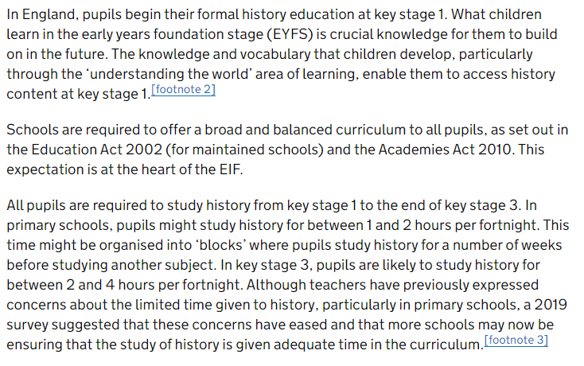
The National Context of History in Primary Schools
https://www.gov.uk/government/publications/research-review-series-history/research-review-series-history

Slide 33
The National Context of History in Primary Schools
https://www.gov.uk/government/publications/research-review-series-history/research-review-series-history

Slide 34
Aims of the Early Years Foundation Stage Framework
Understanding the World
Understanding the world involves guiding children to make sense of their physical world and their community. The frequency and range of children’s personal experiences increases their knowledge and sense of the world around them – from visiting parks, libraries and museums to meeting important members of society such as police officers, nurses and firefighters. In addition, listening to a broad selection of stories, non-fiction, rhymes and poems will foster their understanding of our culturally, socially, technologically and ecologically diverse world. As well as building important knowledge, this extends their familiarity with words that support understanding across domains. Enriching and widening children’s vocabulary will support later reading comprehension.

Slide 35
ELG: Past and Present Children at the expected level of development will:
Talk about the lives of the people around them and their roles in society;
Know some similarities and differences between things in the past and now, drawing on their experiences and what has been read in class;
Understand the past through settings, characters and events encountered in books read in class and storytelling.
ELG: People, Culture and Communities
ELG: The Natural World

Slide 36
History in the Early Years

Slide 37
The purpose and value of studying History
Engaging children and young people in investigating questions about people and events in the past helps them to better understand their lives today, the contested nature of knowledge and prepares them for the future as more informed citizens.

Slide 38
Emigration from Ireland to the USA 1800-1890

Slide 39
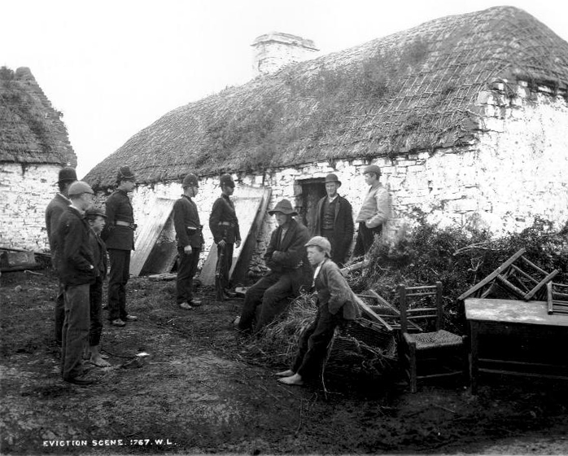

Slide 40
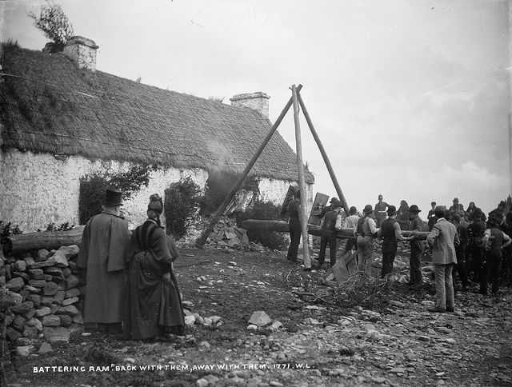

Slide 41
Historical concepts
Change
Continuity
Causation
Significance
Similarity and difference
Perspective
Sources
Chronology
Empathy

Slide 42
History in Development Matters ( Reception aged children)
Artefacts (Sources)
Similarity and Difference
Accounts from the past
Historical importance
Past and present
Basic Chronology

Slide 43
History in the EYFS
Knowledge building
Concept formulation
Language acquisition
The characteristics of effective teaching and learning underpin and support the development of historical thinking through:
Playing and exploring
Active learning
Creating and thinking critically

Slide 44
Statutory framework for the EYFS
The Learning and Development requirements cover:
The seven areas of learning and development (all areas of learning and development are important and inter-connected).
The Educational Programmes (statutory overview of each area of learning)
The Early Learning Goals (the level of development children should be expected to have attained by the end of the EYFS)
Assessment arrangements ( for measuring progress and reporting to parents)

Slide 45
The seven Areas of Learning and Development
3 Prime Areas:
Communication and Language (C&L)
Physical development(PD)
Personal, social and emotional(PSED)
4 Specific Areas:
Literacy
Maths
Understanding the World(UtW)
Expressive arts and design (EAD)

Slide 46
The new Educational Programme for UtW
Understanding the world involves guiding children to make sense of their physical world and their community. The frequency and range of children’s personal experiences increases their knowledge and sense of the world around them – from visiting parks, libraries and museums to meeting important members of society such as police officers, nurses and firefighters. In addition, listening to a broad selection of stories, non-fiction, rhymes and poems will foster their understanding of our culturally, socially, technologically and ecologically diverse world. As well as building important knowledge, this extends their familiarity with words that support understanding across domains. Enriching and widening children’s vocabulary will support later reading comprehension.

Slide 47
New Early Learning Goals for Understanding the World
The early learning goals, summarise the knowledge, skills and understanding that all young children should have gained by the end of the Reception year.
ELG: Past and Present
ELG: People, Culture and Communities
ELG: The Natural World

Slide 48
ELG: Past and Present
Talk about the lives of the people around them and their roles in society;
Know some similarities and differences between things in the past and now, drawing on their experiences and what has been read in class;
Understand the past through settings, characters and events encountered in books read in class and storytelling.
The ELGs should not be used as a curriculum or in any way to limit the wide variety of rich experiences that are crucial to child development.

Slide 49
Development Matters: Non statutory curriculum guidance for the EYFS
Seven key features of effective practice (new)
Characteristics of effective teaching and learning
What children will be learning in the age bands:
Birth to three
3&4 year olds
Reception

Slide 50
Nursery aged children
Three and four year olds will be learning to:
Make sense of their own life-story and family's history
Examples of how to support this:
Spend time with children talking about photos, memories
Encourage children to retell what their parents told them about their life story and family

Slide 51
The World to an EYFS child
Being in the world – learning about who and what is in their world – parents/carers, family members, friends and familiar places
A sense of belonging – once a child knows who they are, who is important to them, where they feel safe and happy, children will feel confident to begin to explore their world – first the immediate, the toys/objects presented to them (or within their reach) but then the wider world, much of which will be the natural world
Thinking about the world – exploration of the world leads to critical thinking, further development of a sense of self and that not everyone is the same. Beginning to understand how the world works, similarities and differences, cause and effect, how things change( most importantly themselves) and the passing of time

Slide 52
Three characteristics of Effective Teaching and Learning
In planning and guiding what children learn, practitioners must reflect on the different rates at which children are developing and adjust their practice appropriately.
• playing and exploring - children investigate and experience things, and ‘have a go’
• active learning - children concentrate and keep on trying if they encounter difficulties, and enjoy achievements
• creating and thinking critically - children have and develop their own ideas, make links between ideas, and develop strategies for doing things

Slide 53
Key points to consider
The value and purpose of learning History in the EY (and the curriculum)
Understanding the past to better understand the present – at any stage of learning
Familiar to unfamiliar/known to unknown
Talk is central to the learning of History – language acquisition and the learning of new vocabulary
It’s History! – not activity or display driven – outcomes of learning not just outputs or products of learning

Slide 54
Preparing for exploring the past – resourcing the Continuous Provision
Artefacts
Collections
Nursery rhymes
Knowledge/images/use of the local area
Photographs, pictures and postcards of the past
Story collections
Historical stimuli

Slide 55
History in the early years
Broaden children’s experiences beyond the immediate – ‘Awe and Wonder’
Importance of first hand experiences– experiential learning
Talk is essential to History
Story – sequence, perspective, illustration, character behaviour
Questions – used by children to seek meaning in the world
Curiosity – the desire to understand how the world works
Helps to develop a sense of self

Slide 56
Considerations for EYFS teachers
What do you need to do/change to meet the expectations for Past and Present?
Who do you need to talk to?
Are there any resource implications?
How confident are you that your provision provides opportunities for understanding the past?
What will you be observing and assessing – how will you track progress towards the ELG?

Slide 57
Implications for whole school History provision
Sequencing
Continuity
Areas of study
Pedagogy – working as young historians
Assessment
Progression
Knowledge and understanding
Skills
Language

Slide 58
Progress in History EYFS – Year 6
Greater knowledge – knowing more
Greater understanding of the significance and meaning of new knowledge –so that it becomes ‘sticky’ ‘long lasting’ and ‘retrievable’
Mastery of increasingly more complex subject skills which enable children to make meaning from and comprehend the significance of new knowledge
Increasing grasp of concepts
Expansion of subject vocabulary – basic, appropriate and specialised

Slide 59
Assessment What will tracking of progress towards the ELG in the summer term look like?
Children at the expected level of development will:
Talk about the lives of the people around them and their roles in society
Know some similarities and differences between things in the past and now, drawing on their experiences and what has been read in class
Understand the past through settings, characters and events in encountered books read in class and story telling

Slide 60
History in the statutory framework (educational programme)
Visits – ‘the frequency and range of children’s personal experiences’
Stories – ‘foster understanding of our culturally, socially and ecologically diverse world’
Words – ‘support knowledge and understanding and widen vocabulary’

Slide 61
Planning a visit

Slide 62
The importance of story
Through stories children:
Gain knowledge of ‘past’
Build conceptual understanding
Explore different view points and interpretations of ‘past’ (perspective)
Extract information from illustrations and historical sources
Understand character behaviour and motive (empathy)
Experience new places and locations
Have opportunities to wonder and use imagination
Understand sequence (chronology) and cause and effect (causation)
Develop critical thinking – reason, predict and anticipate

Slide 63
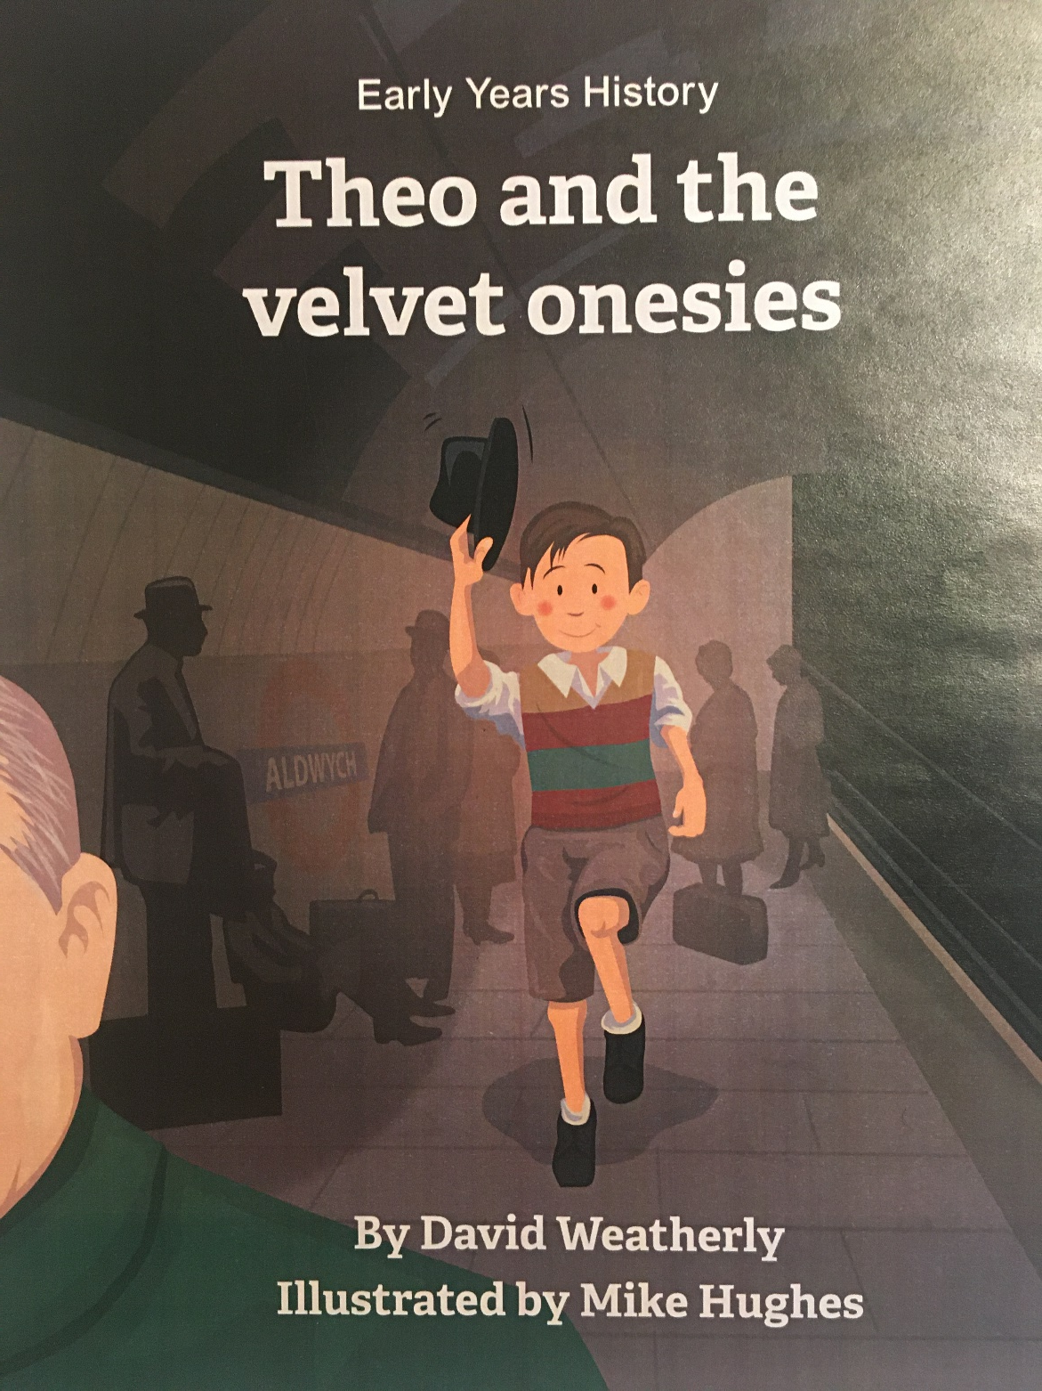

Slide 65
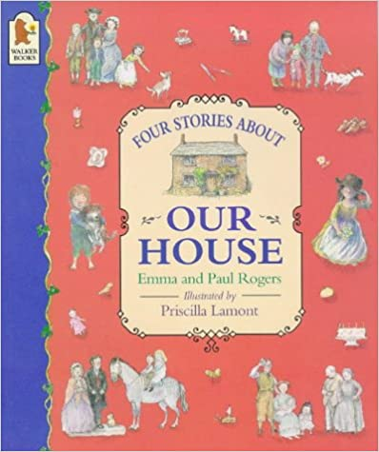
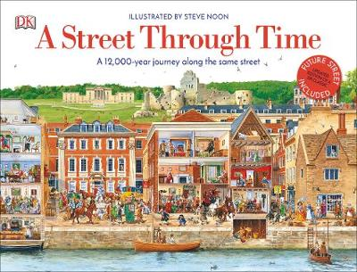
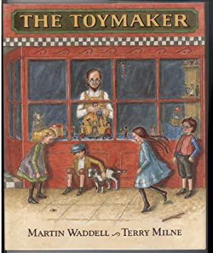

Slide 66
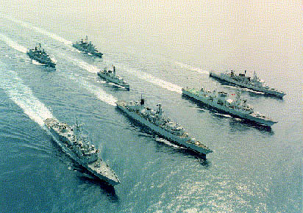
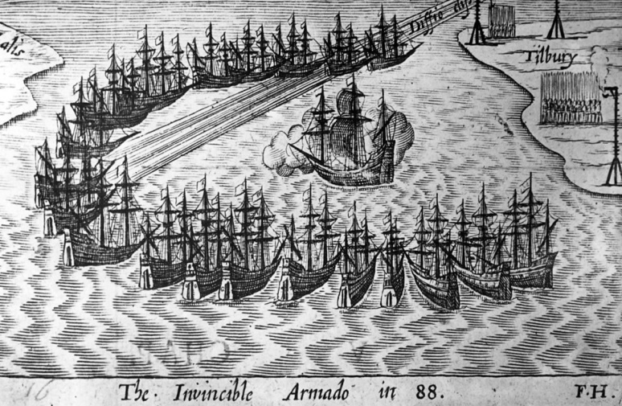
Boat/Ship Fleet Armada
Basic Appropriate Specialised

Slide 67
vocabulary
Monarch
Blitz
Uniform
Statue
Ancient
Lighthouse
Coronation
Climate
The Crown Jewels
Coal
Hazard

Slide 68
Developing understanding of chronology through the language of time
Visual time tables
Calendars
Routines
Recall
Story starters - Once upon a time, a long time ago
Following instructions
Key times of the day
Days of the week
Learning journals
Birthdays
Sequencing activities
Photographs
Seasons
Celebrations and events

Slide 69
Artefacts

Slide 70
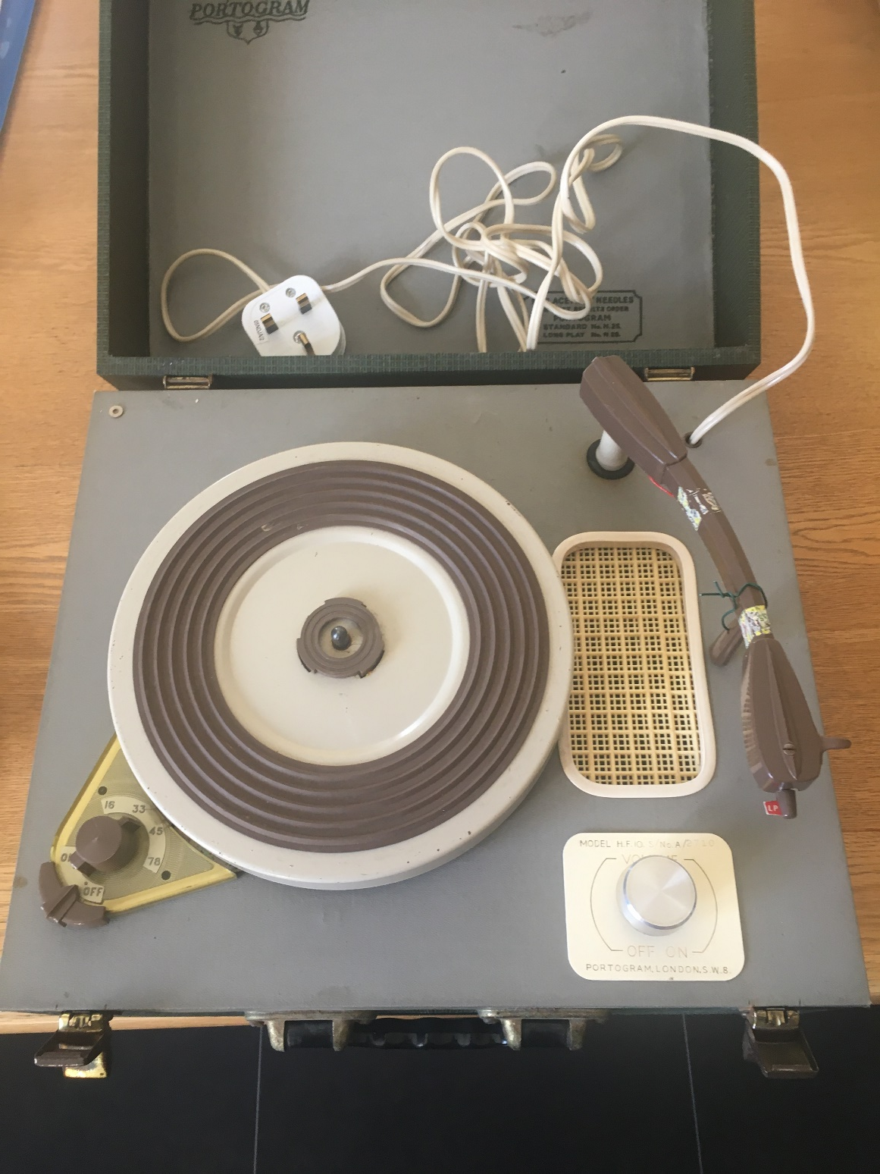

Slide 71
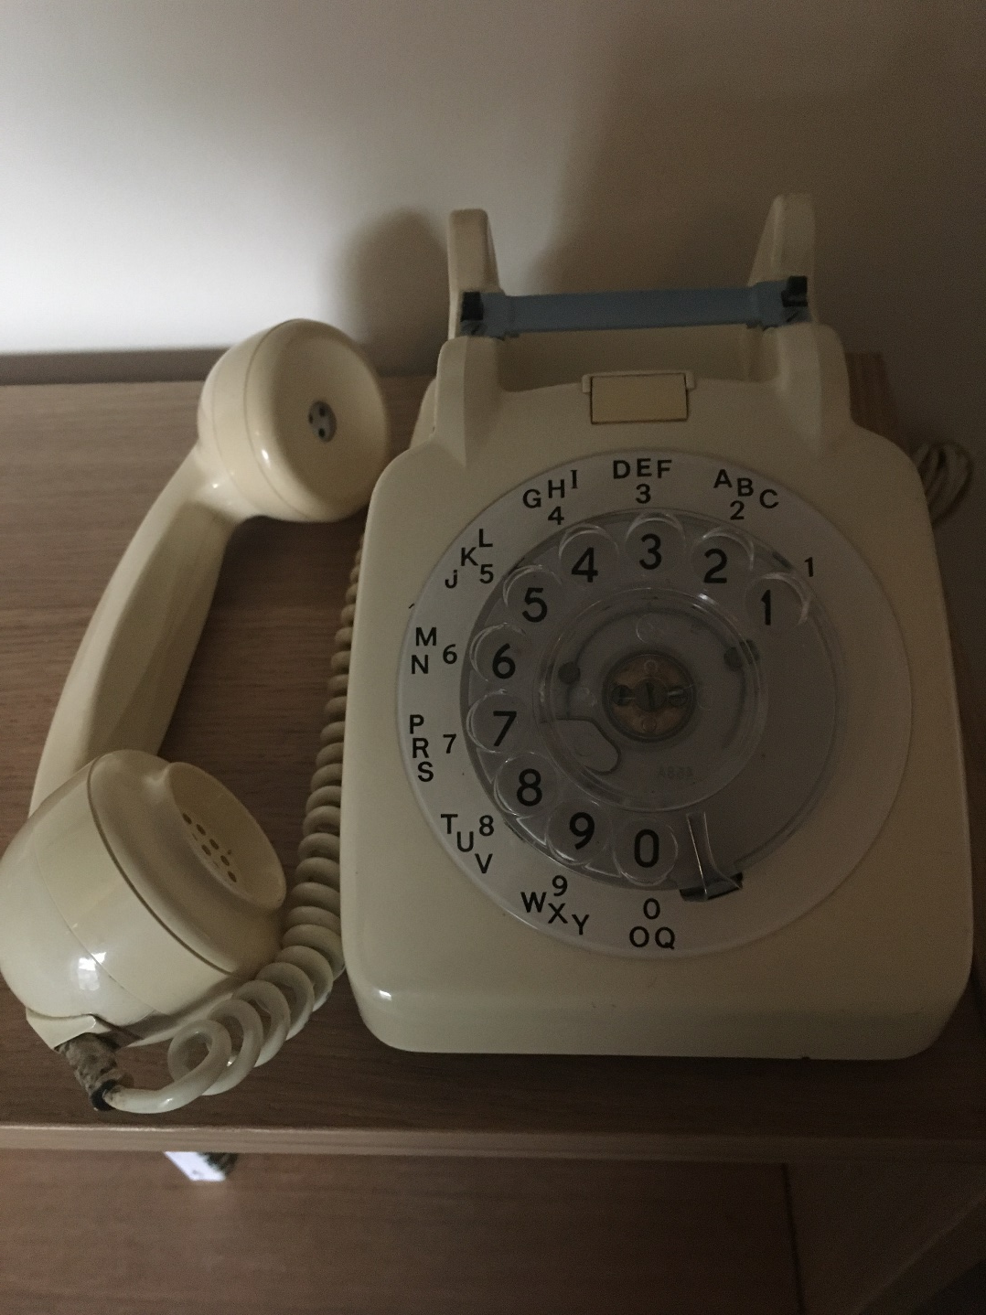

Slide 72
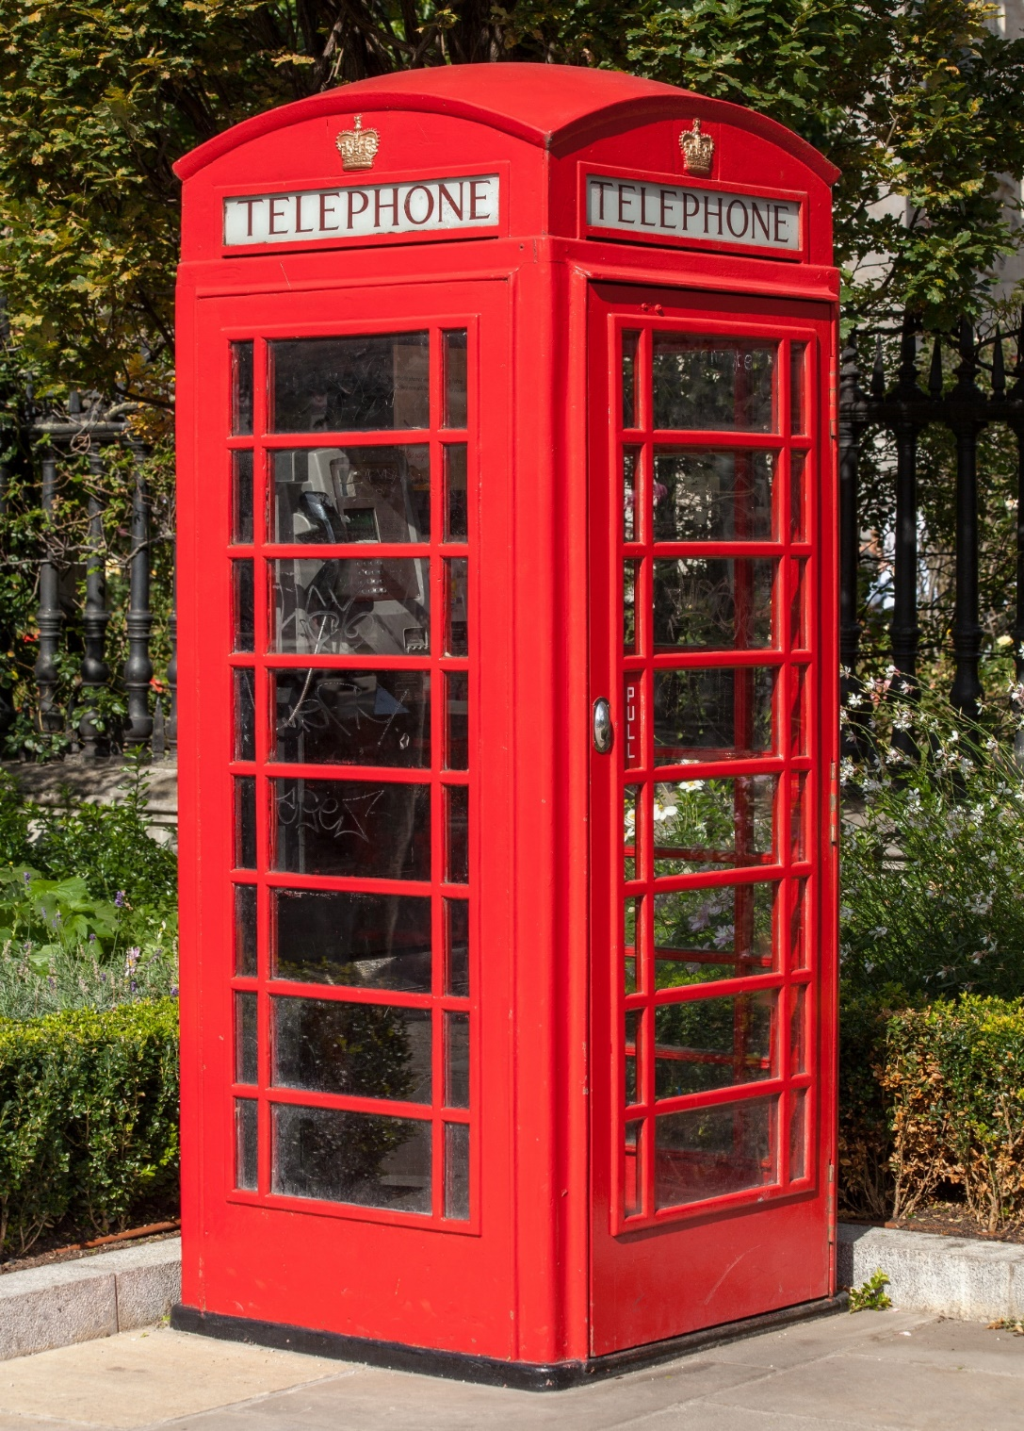

Slide 73
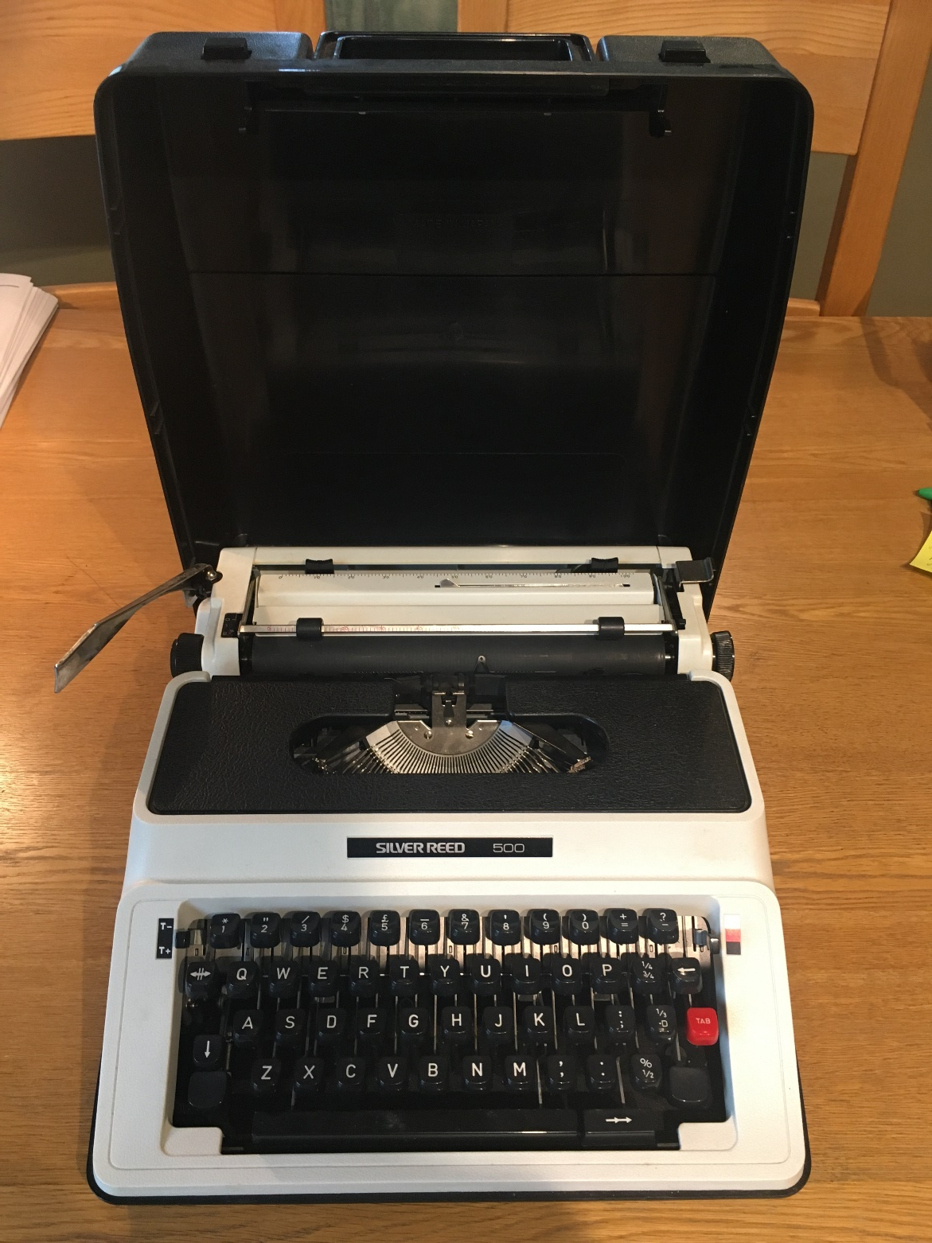

Slide 74
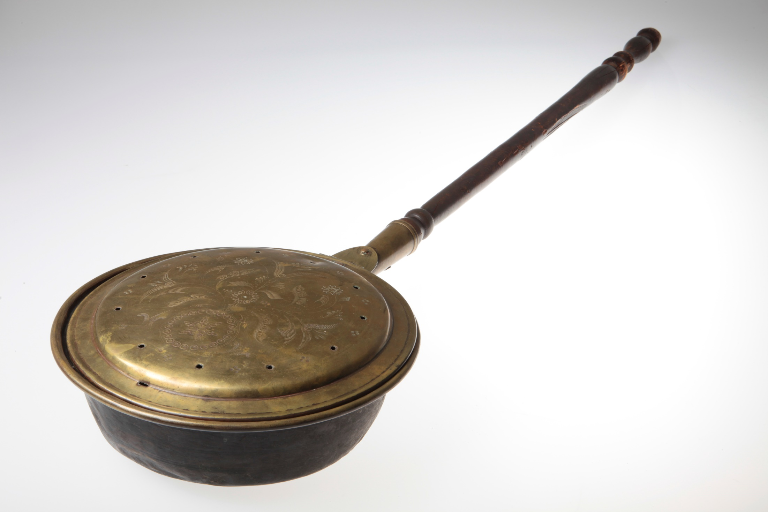

Slide 75
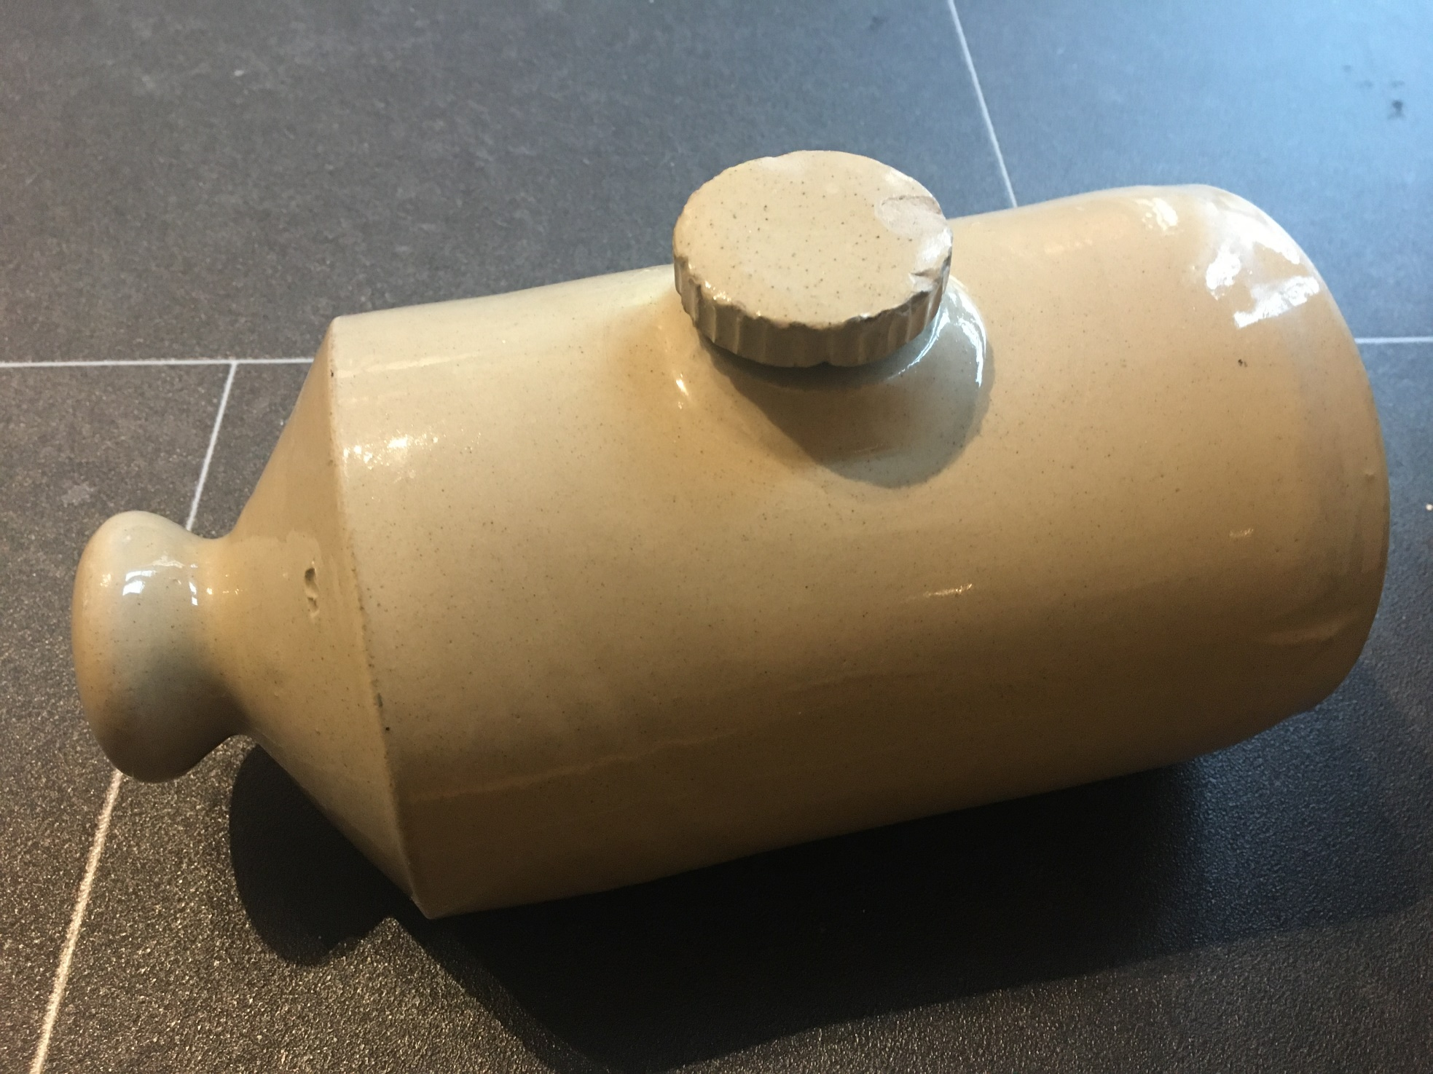

Slide 76
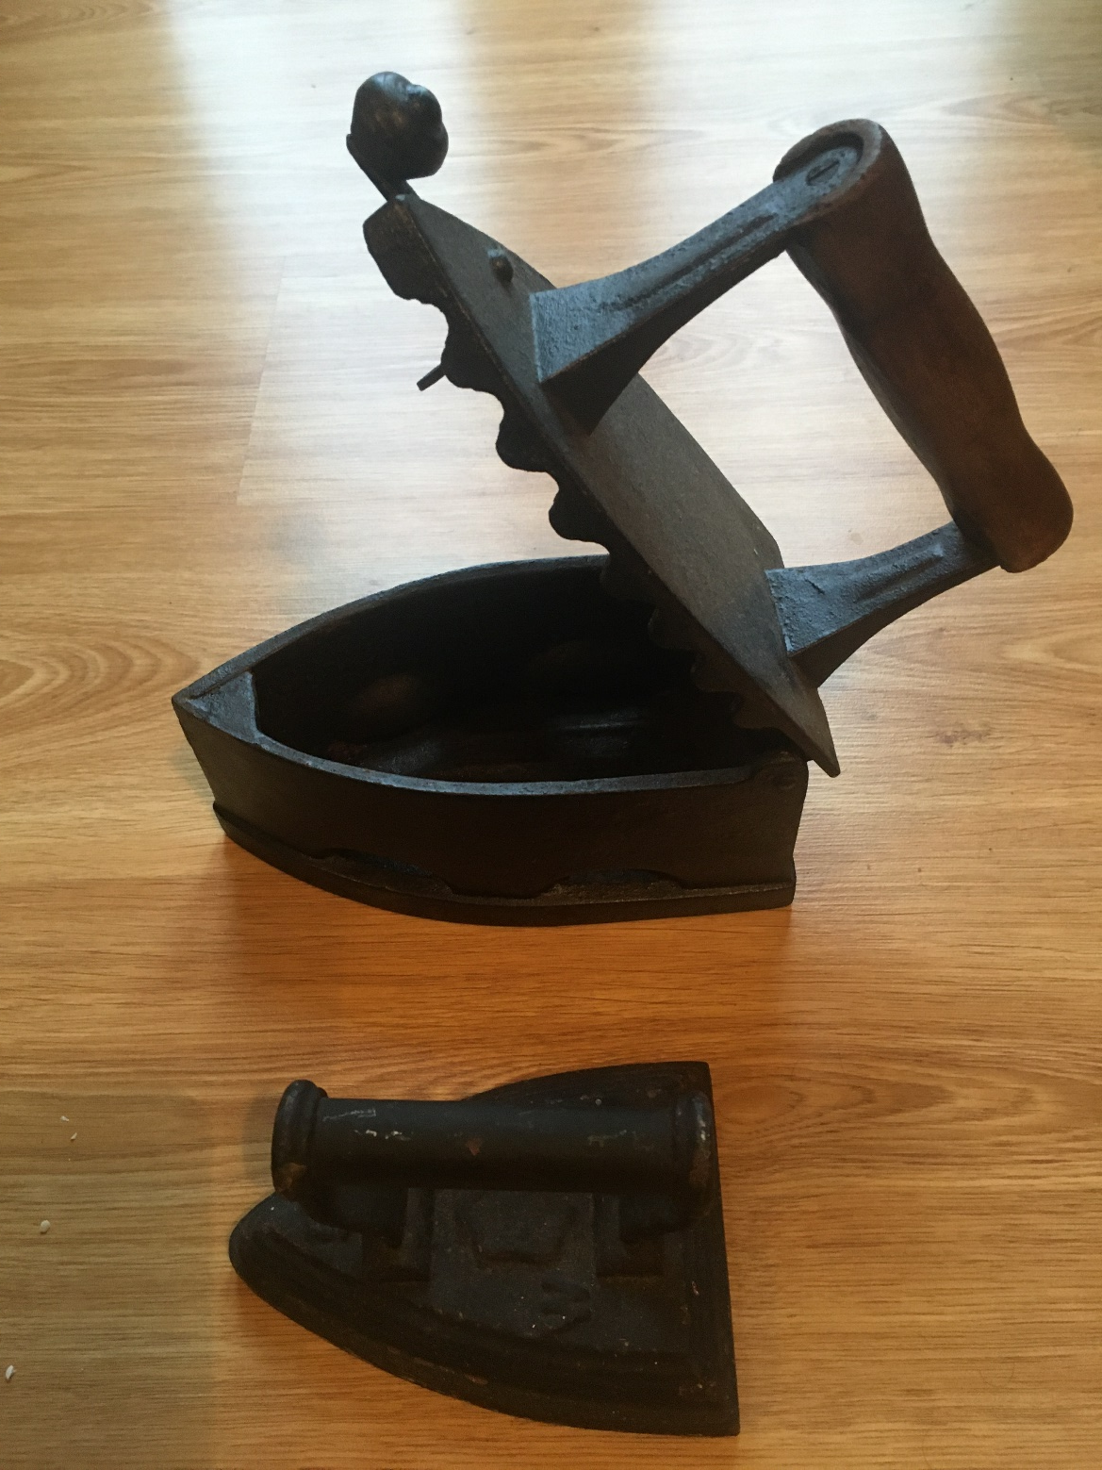

Slide 77
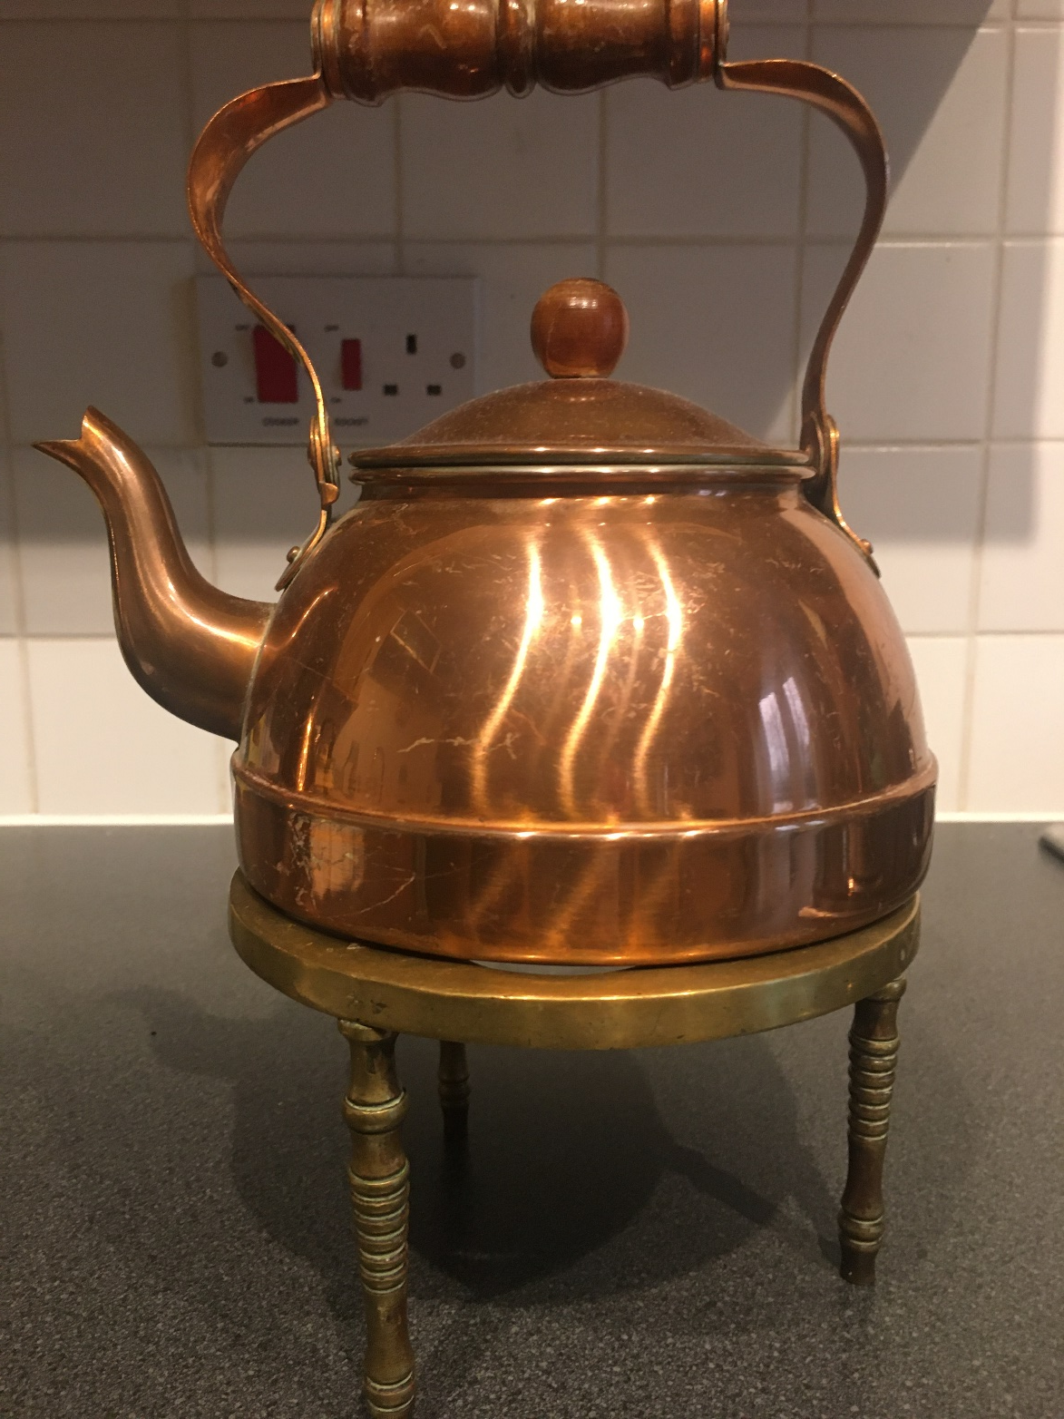

Slide 78
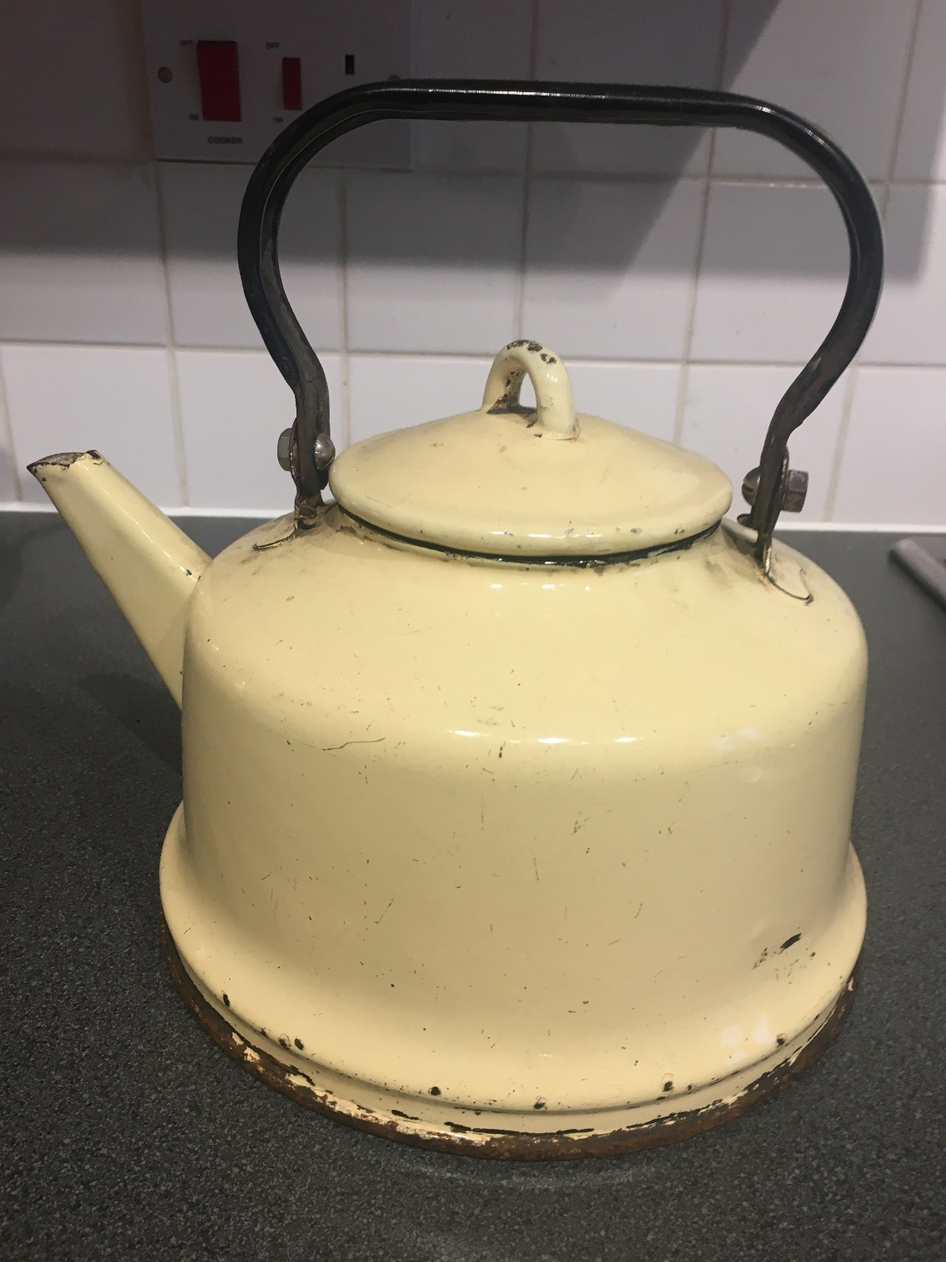

Slide 79
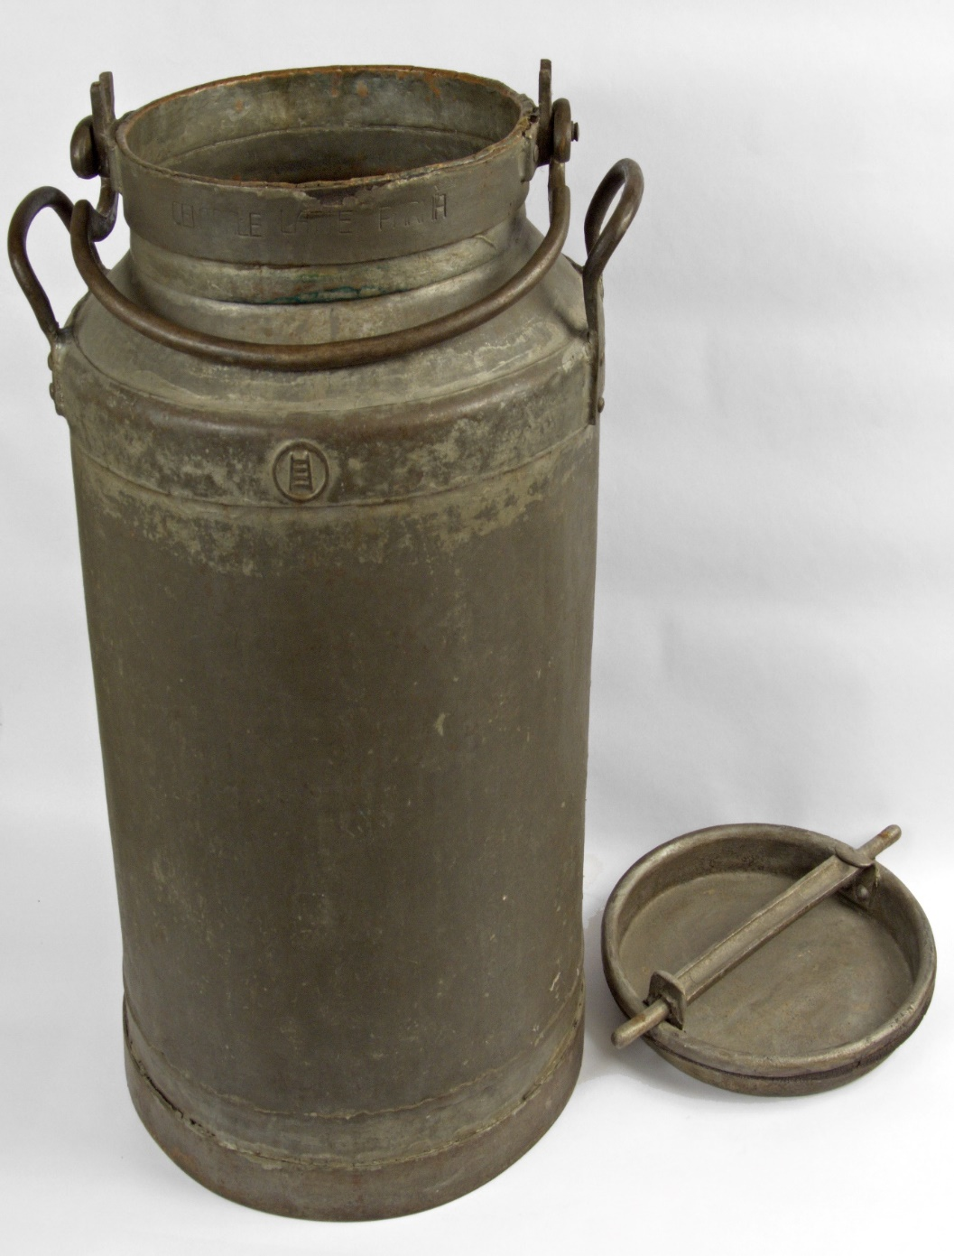

Slide 80
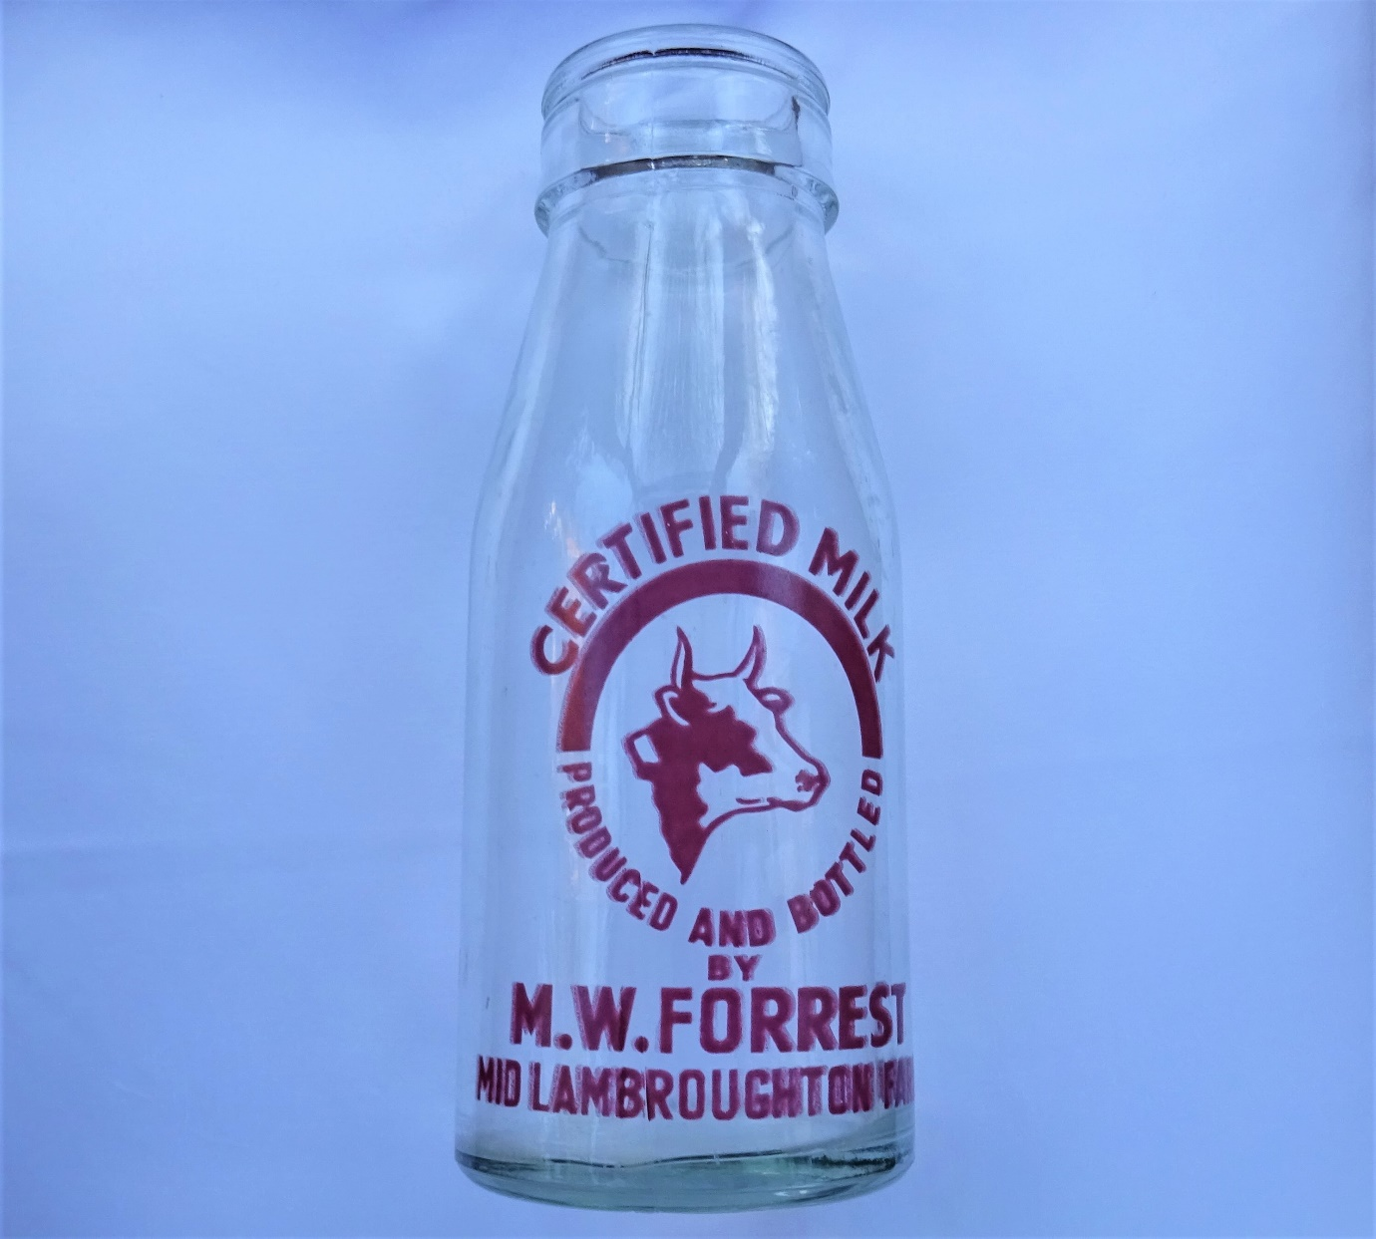

Slide 81
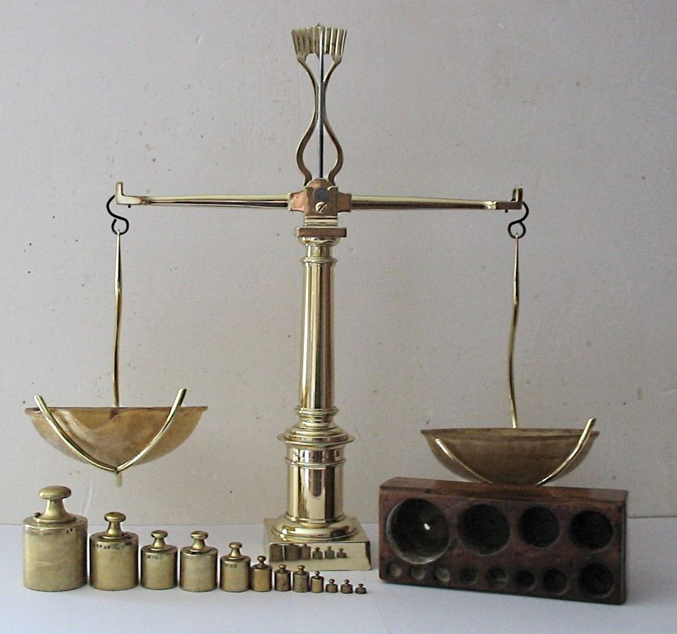

Slide 82
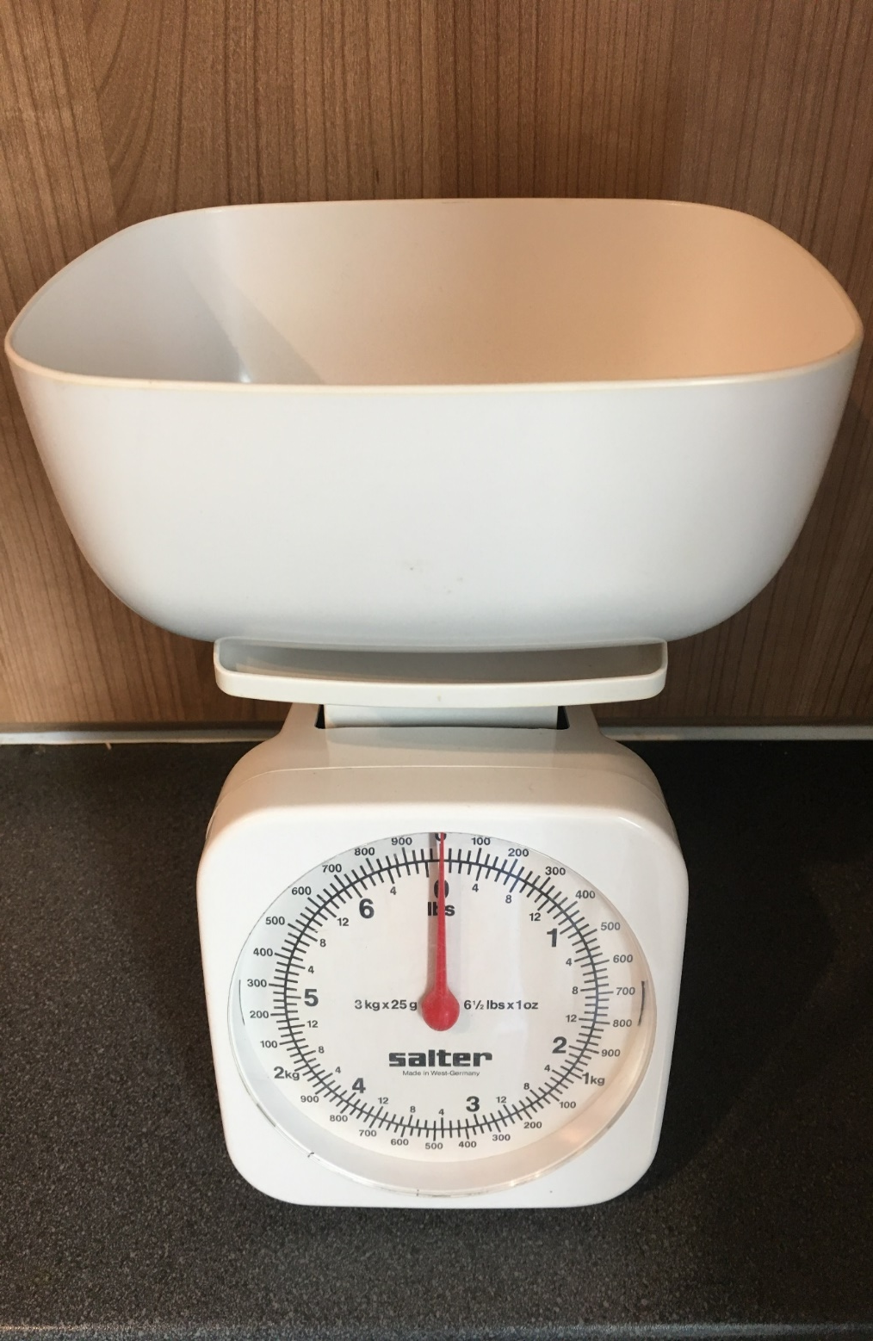

Slide 83
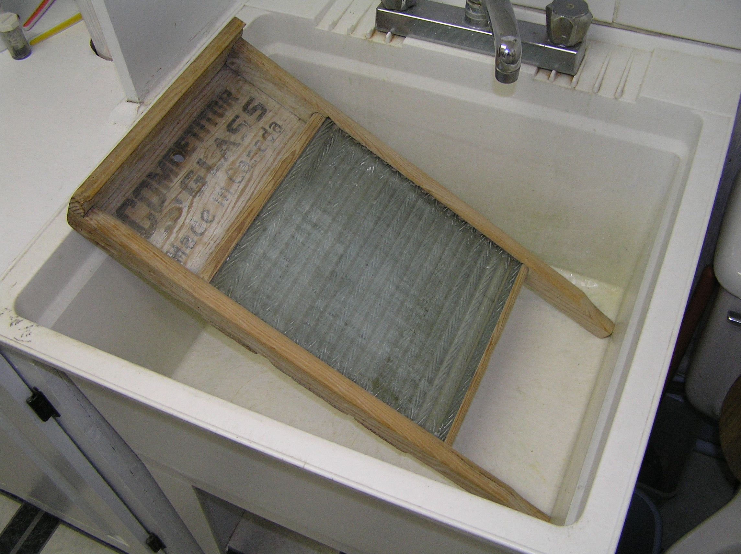

Slide 84
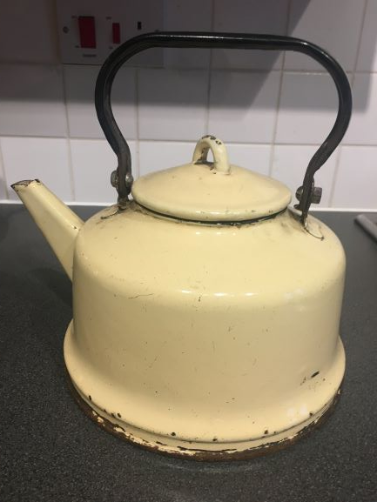
History Chat Mat
old oldest very old | newer more recent quite old | new newest modern

Slide 85
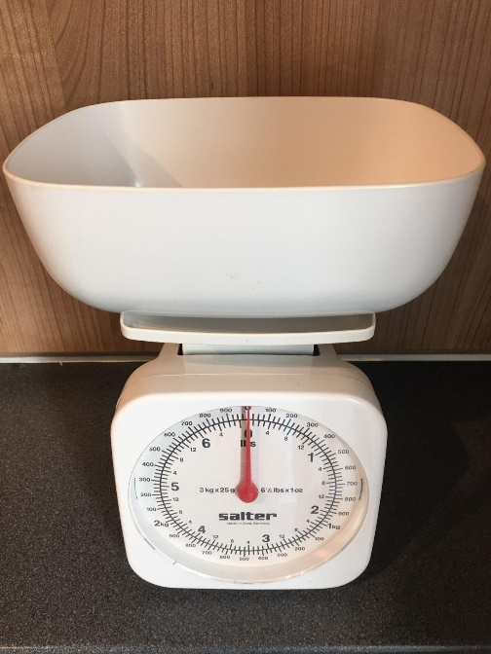
History Chat Mat
old oldest very old long ago | newer more recent quite old older | new newest modern present-day

Slide 86
History Chat Mat
Ceramic Texture Weigh Copper
Stopper Heavy Balance Brass
Handle Shiny Scrub Handle
Warm Smooth Wash Heat

Slide 87
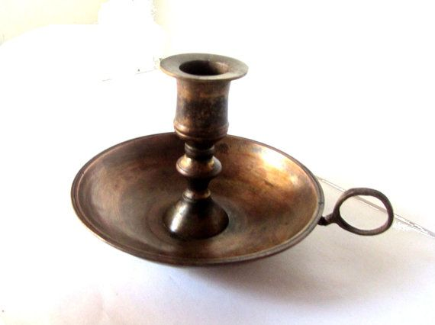

Slide 89
Currently, the two terms used are ????????? and ???????????? concepts.
OFSTED have actively stated we do not need to use these terms but understanding the differences between them is important:

Slide 90
Disciplinary knowledge – this is how we make use of the facts that are learned. Simply, these are the concepts that term a list of facts into historicised knowledge.

Slide 91
Substantive knowledge – the historical facts we teach that form the narratives of the curriculum.

Slide 93
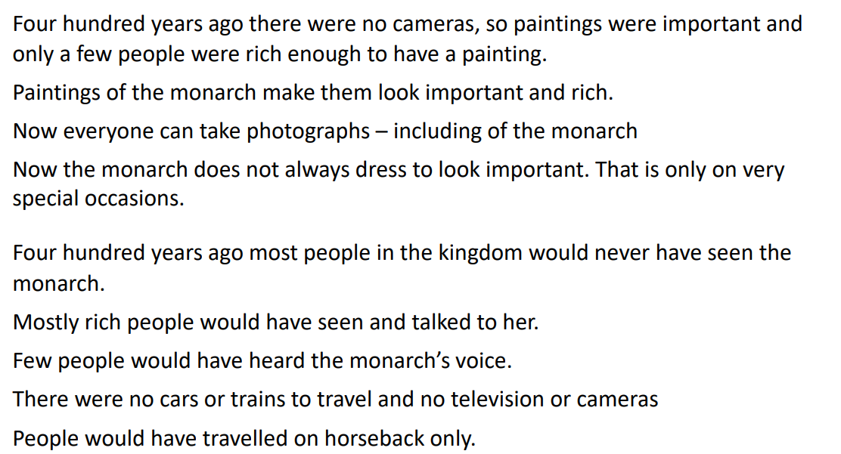

Slide 95
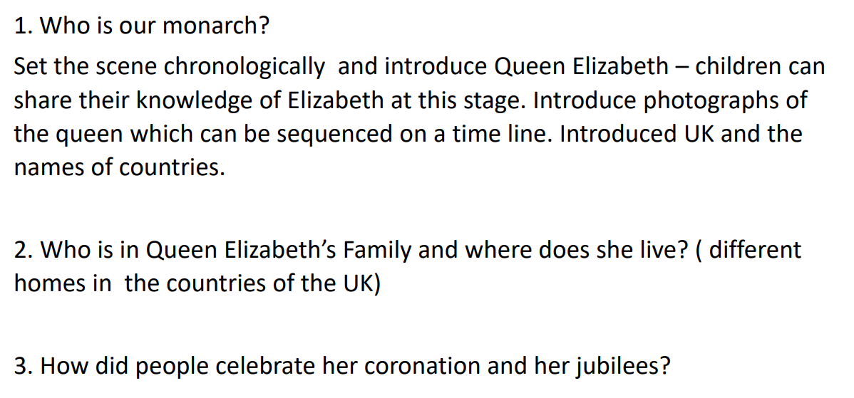

Slide 96
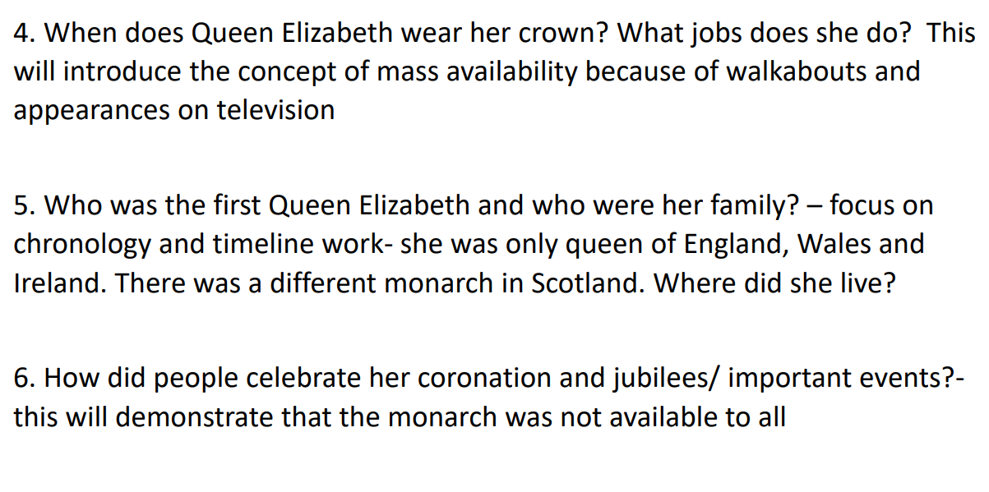

Slide 97
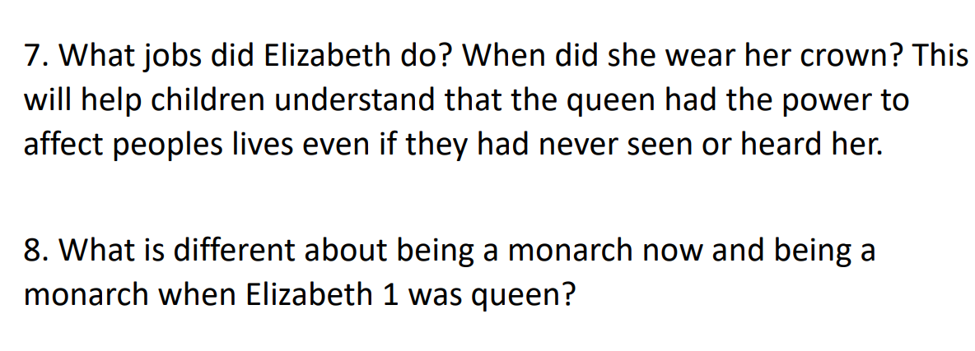

Slide 98
Making meaningful links
How could a focus on London ( within a history topic) link to other popular themes such as buildings/people who help us/holidays/travel/British values?
‘Beyond the castle’ – how would you do this without focusing on castles, fairy tales or burglars
Making ravens - Output (product) and outcome ( learning)

Slide 99
Skills
Recognise
Identify
Describe
Observe
Select
Categorise
Classify
Sequence
Compare and contrast
Recall
Reason/speculate

Slide 100
Aims of the National Curriculum for History
know and understand the history of these islands as a coherent, chronological narrative, from the earliest times to the present day: how people’s lives have shaped this nation and how Britain has influenced and been influenced by the wider world
know and understand significant aspects of the history of the wider world: the nature of ancient civilisations; the expansion and dissolution of empires; characteristic features of past non-European societies; achievements and follies of mankind
gain and deploy a historically grounded understanding of abstract terms such as ‘empire’, ‘civilisation’, ‘parliament’ and ‘peasantry’

Slide 101
Aims of the National Curriculum for History
understand historical concepts such as continuity and change, cause and consequence, similarity, difference and significance, and use them to make connections, draw contrasts, analyse trends, frame historically-valid questions and create their own structured accounts, including written narratives and analyses
understand the methods of historical enquiry, including how evidence is used rigorously to make historical claims, and discern how and why contrasting arguments and interpretations of the past have been constructed
gain historical perspective by placing their growing knowledge into different contexts, understanding the connections between local, regional, national and international history; between cultural, economic, military, political, religious and social history; and between short- and long-term timescales.

Slide 102
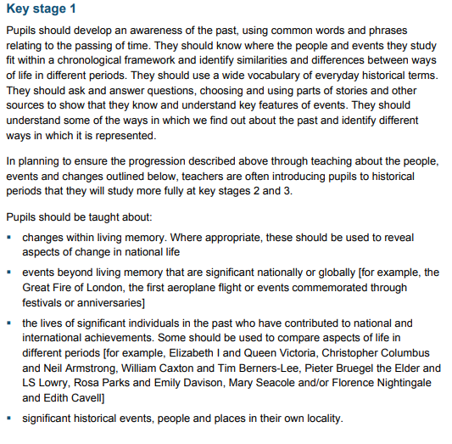

Slide 103
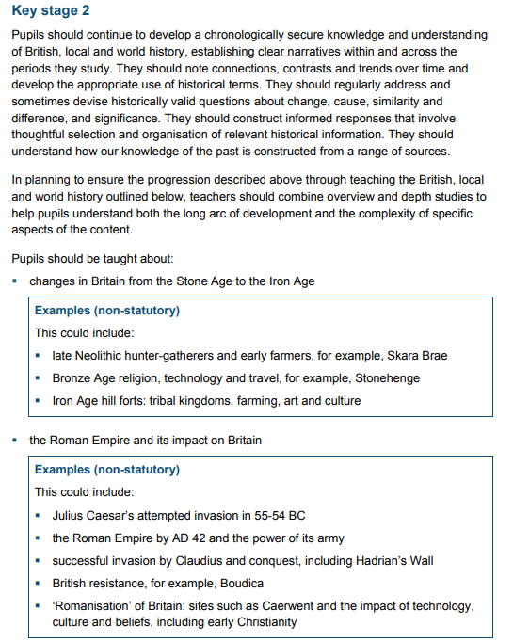
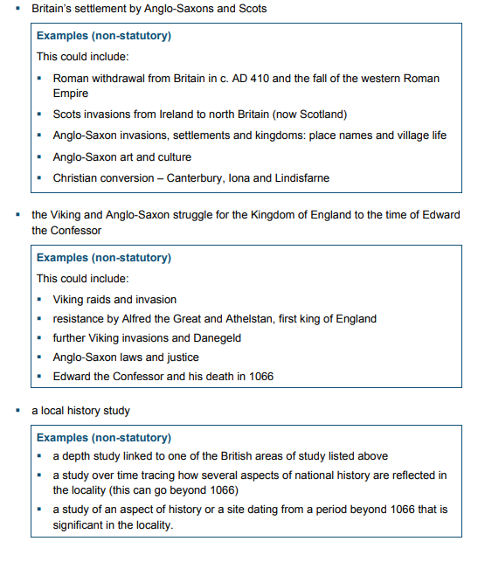

Slide 104
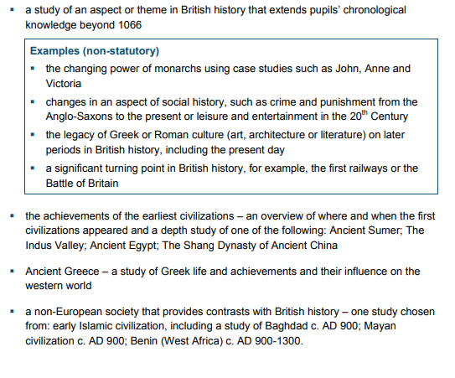

Slide 105
Key Historical Concepts:
Chronology, continuity and change
Cause and consequence
Using historical evidence
Significance

Slide 106
Session 2: Subject-Knowledge Development

Slide 107
The Victorians
The Vikings
The Romans
The Anglo-Saxons
Stone Age
Iron Age
Bronze Age
World War I
World War II
The Tudors
Ancient Egypt
Ancient Maya
Can you order these historical periods of time in chronological order?
Could you place these on a timeline?

Slide 110
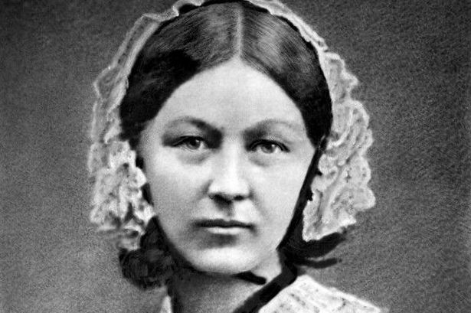
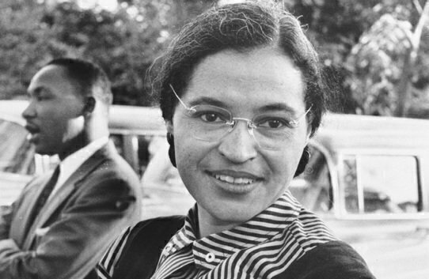
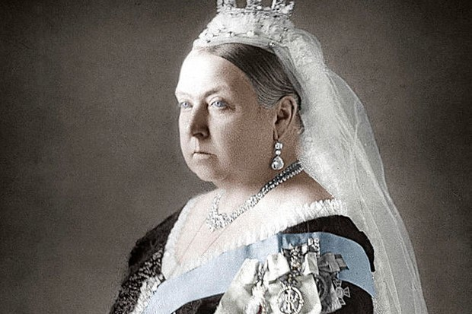
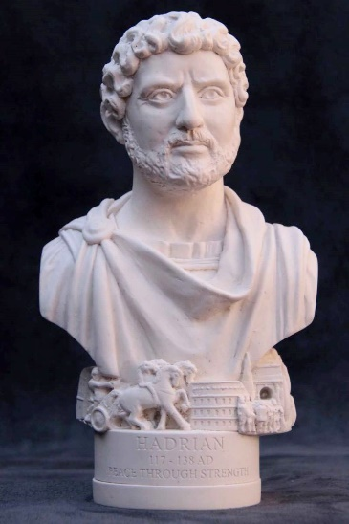
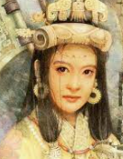
1.
2.
3.
4.
5.
6.

Slide 111
When did the First World War begin and end?
What did Howard Carter discover in 1924?
Name an ancient civilisation who believed in the afterlife.
When was the Battle of Hastings?
Name a place where the Vikings raided.
Name one of the saints that first brought Christianity to England.
Why is Grace Darling remembered?
Which war did Florence Nightingale help soldiers in?
How did the Ancient Greeks have an impact on how the UK is run today?
What does this Victorian object do?

Slide 112
When did the First World War begin and end? 1914-1918
What did Howard Carter discover in 1924? Tutankhamun’s tomb
Name an ancient civilisation who believed in the afterlife. Ancient Egyptians, Shang Dynasty of Ancient China, Ancient Maya
When was the Battle of Hastings? 1066
Which island in the North East of England did the Vikings raid? Lindisfarne
Name one of the saints that first brought Christianity to England. St Aidan, St Columba or St Augustine
Why is Grace Darling remembered? She saved people from a shipwreck SS Forfarshire off the coast of Bamburgh
Which war did Florence Nightingale help soldiers in? The Crimean War
How did the Ancient Greeks have an impact on how the UK is run today? Democracy
What does this Victorian object do? Carpet beater

Slide 113
Reflecting on the subject knowledge that is needed for KS1 and KS2 History, complete your Autumn History audit if you have not done so already.
Consider:
What subject knowledge do you need to improve on?
What subject knowledge do you need for your current placement?
What subject knowledge will you need on future placements?
How can you improve this?

Slide 114
Suggested Resources to Improve your Subject Knowledge

Slide 115
Session 3: Planning

Slide 116
Key Points
Our History curriculum is:
Aspirational
Logical, relevant, broad and balanced
Largely chronologically sequenced to allows opportunities to evaluate both change and progress from one historical period to another and to build on previous knowledge and understanding as they tackle more complex and demanding enquiries
Progressive
Inclusive
Our Curriculum Rationale is set out in our History Intent Statement.
Please take some time to read this in more detail.

Slide 117
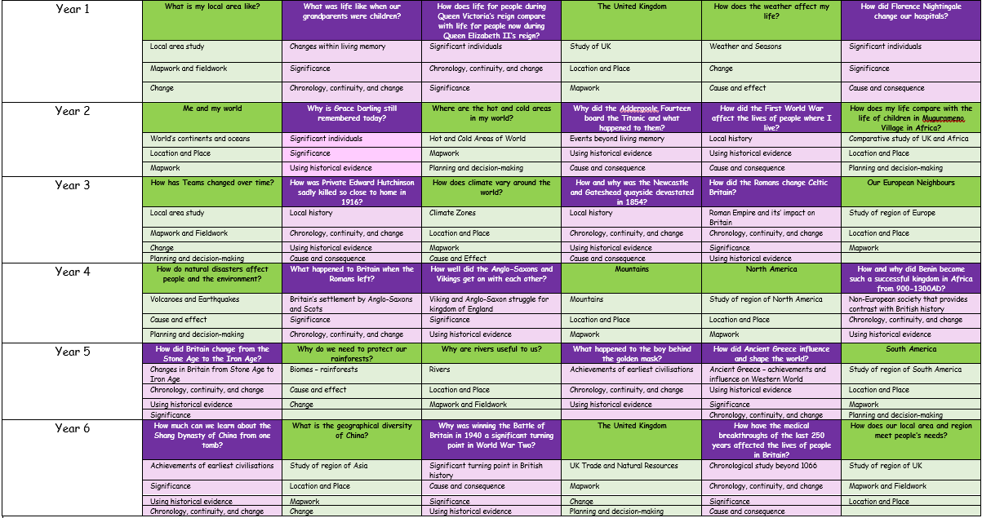
SPOT THE ERROR ON THE PLANNING

Slide 118
- Where is knowledge being revisited and built upon?
Where are historical concepts being revisited and built upon?

Slide 119
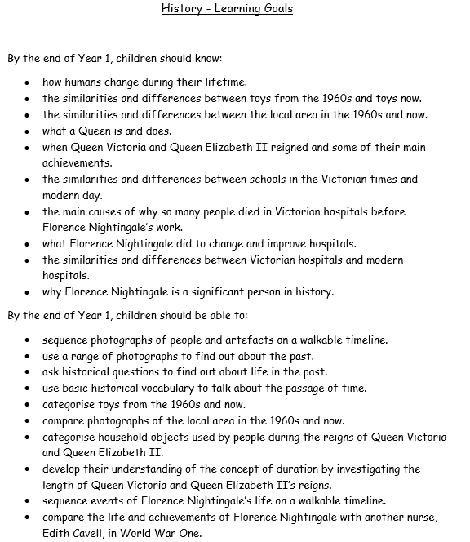
The process of planning must begin with consideration of what you want the children to know and be able to do by the end of the topic.
All activities should build towards children achieving these LEARNING GOALS.
Children’s learning must be at the heart of everything you plan.

Slide 123
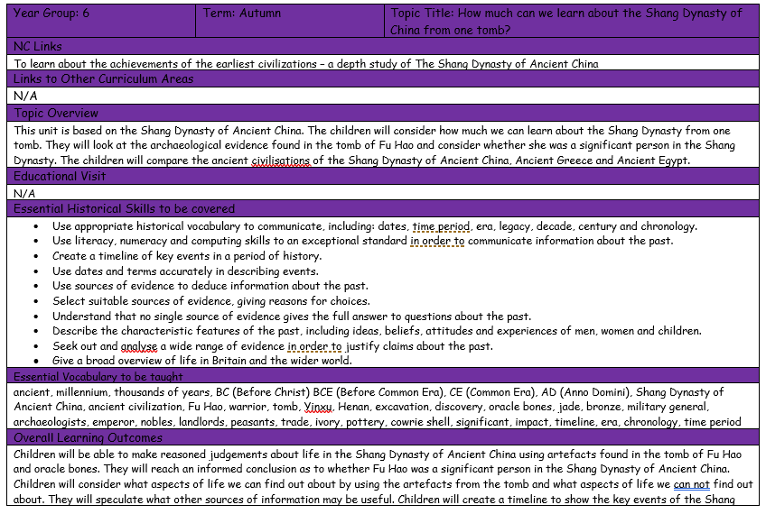

Slide 125
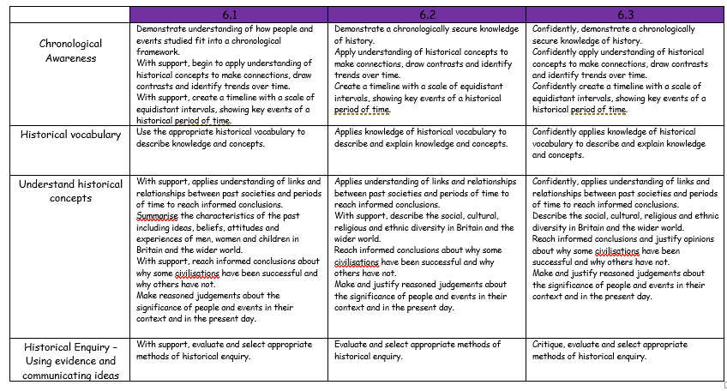

Slide 126
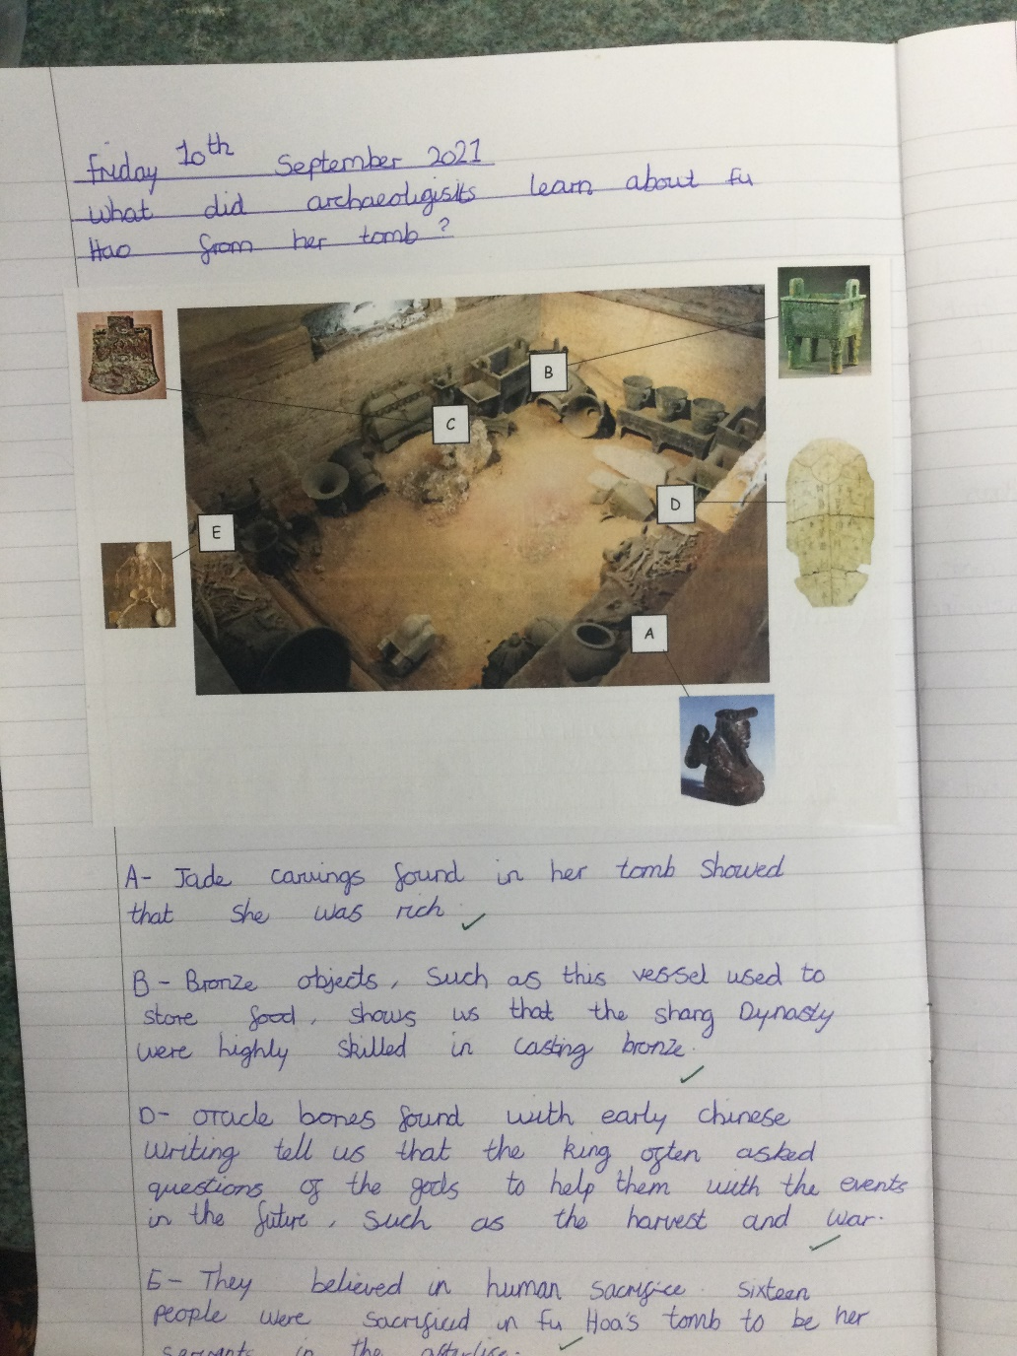
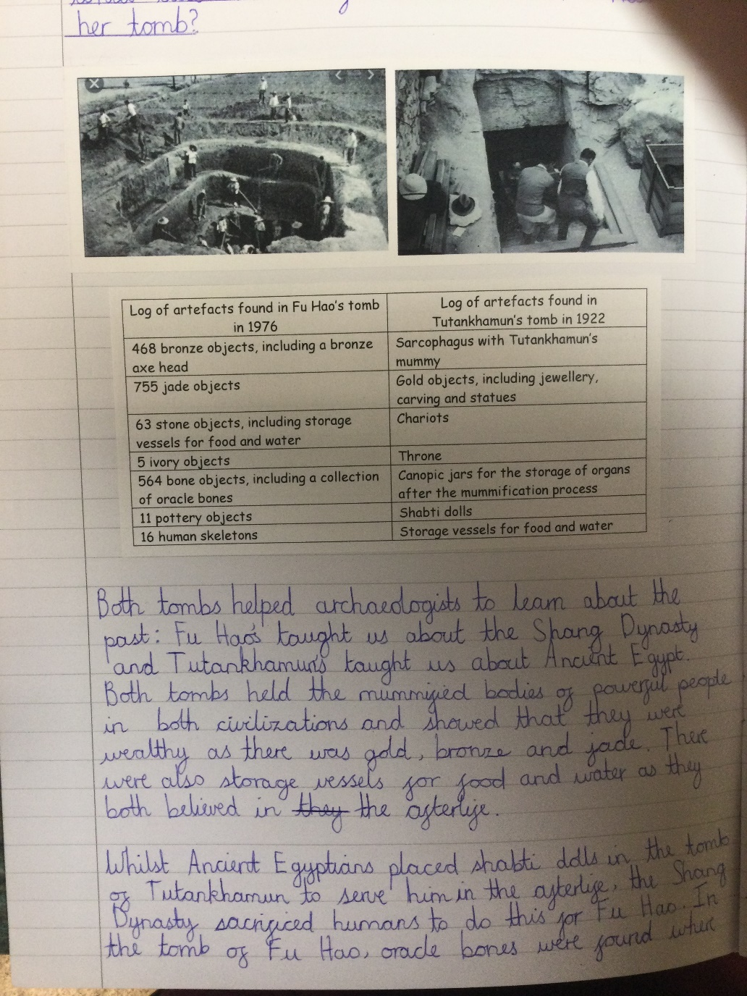
Knowledge, skills and vocabulary are revisited throughout the topic and built upon as the children progress towards the end of the topic.

Slide 132
Choose a topic from the board or think about a topic you may be teaching at the moment. Use the planning format to draft out a sequence of lessons with intended learning objectives.
Consider which key vocabulary you will need to teach.
Consider which pre-existing children knowledge will need to have to build upon.
Consider which topics within the History curriculum this could link to from the past/future.
Consider which historical concepts you could cover.
Be prepared to feedback!

Slide 134
Suggested Resources to Support Planning
https://www.hamilton-trust.org.uk/

Slide 135
Session 4: Progression from Early Years to KS3

Slide 136
Progression from Early Years to KS1

Slide 137
Change and continuity
Chronology
Cause and consequence

Slide 138
Similarity and difference
Perspective
Significant individuals and events
- Hopscotch Histories

Slide 139
As a Trust, we decided upon 4 ‘Threshold Concepts’ and looked at how these would be developed through each of the primary phases and into KS2.
Progression from KS1 to KS2

Slide 140
Progression from EYFS – Y6

Slide 141
Progression from EYFS – Y6

Slide 142
Progression from EYFS – Y6

Slide 143
Progression from EYFS – Y6

Slide 144
Progression across the primary school
Significant event study
EYFS
NURSERY
RECEPTION

Slide 145
Progression in Historical Concepts

Slide 174
Progression of timelines from EYFS to Year 6
EYFS – Now/next boards for Plan, Do, Review
- Story sequencing
- Sorting old and new
KS1 – Sequencing pictures from old to new
- Placing key events on a timeline of a single event
LKS2 – Placing key events on a timeline with pre-existing equidistant intervals across a period of time
UKS2 – Placing key events on a timeline with pre-existing equidistant intervals across a period of time
(To be drawn by children)

Slide 175
Session 5: Use of historical sources of information

Slide 176
Discuss: Why do you think it is important to use historical sources of information to learn about the past?

Slide 177
“A key cornerstone of history is historical enquiry. Quality history provision has historical enquiry at its heart. Through historical enquiry children can be shown how to ask questions, select and evaluate evidence and to make judgments about the past. It can also be a vital way of showing them that there is often more than one side to a story and that history is multi-perspective. Historical enquiry is all about asking questions or hypothesising about the past that we hope the evidence will help us to answer, but getting the enquiry question right is not always easy. In this section you will find resources and guidance that will help you to plan challenging enquiries for your children that will help them to develop as historians.”
Historical Association

Slide 178
Reasons to Use Historical Sources
Historical sources can be used as evidence to back up your claims of what the past was like. They allow you to say that something happened, whether it’s a battle, or the existence of a famous figure. You can then use them to create your own interpretations of the finer details.
They’re also great for showing children how bias can affect a source. It’s said that ‘history is written by the victors’. Compare different primary historical sources to see what other people of the time thought. A newspaper might print biased reporting of a war or an election, while people’s private journals disagree.
You can also compare primary sources to someone’s analysis of them in a secondary source to fact-check their claims about the past and make sure they’re accurate.

Slide 179
Advantages
You know that the historical source hasn’t been changed, altered, or paraphrased by anyone else. It’s “straight from the horse’s mouth” and ready for you to apply your own interpretation.
If a source was not ever meant to be read by other people (for example, diaries or journals) then it might be more candid and direct than other sources from the past and present.
It provides evidence that can be linked back to an original source or author – someone who was alive at the time of the event. This is usually more convincing than guessing or making unconfirmed claims would be.

Slide 180
Disadvantages
Some historical sources might cause problems when it comes to understanding them – especially the written ones! Language changes over time. The English in use today is not the same as the one that was used even 400 years ago, which can make it difficult to interpret.
Older historical sources can be fragile, and have to be kept in museums or special collections. This means they are difficult to access for ordinary people, requiring special permission – if you can even access them at all!
You don’t know if a historical source is telling the truth or not. It could be true or untrue, it could be leaving out key pieces of information to create a biased account, or it could be based on false beliefs and prejudices that the writer had at the time.

Slide 181
www.timemaps.com

Slide 182
www.mozaweb.com/mozaik3D

Slide 183
www.mozaweb.com/mozaik3D

Slide 184
www.mozaweb.com/mozaik3D

Slide 185
http://northumbriaworldwarone.co.uk/northumbria-ww1-project-database/
https://www.ancestry.co.uk/
http://www.gatesheadlocalstudies.com/
https://www.britishmuseum.org/collection
https://twamschools.org.uk/boxes-of-delight
Charity shops/Facebook Marketplace

Slide 186
Reflection Point
- Why should we use historical sources of information in History?
- How do these skills link with other areas of the curriculum?
- Think about a topic that you may have taught this half term. Did you exploit the opportunities for historical enquiry? If not, what could you have done?

Slide 187
Session 6: Use of local history and educational visits

Slide 188
Discuss: Why do you think it is important to study local history?

Slide 189
Why study local history?

Slide 190
Year 1
Year 2

Slide 191
Year 3
Year 4

Slide 192
Educational Visits to enhance history learning

Slide 193
Reflection Point
- How do educational visits enhance history learning?
- Which areas of the History curriculum would lend themselves well to educational visits?
- Think about a topic that you may have taught this half term. Did you exploit the opportunities for local history or educational visits? If not, what could you have done?

Slide 194
Next Steps…
Focused Observations | Directed Tasks
Observe a history lesson and consider the following: History National Curriculum or EYFS content What skills did the teacher teach? What resources did the teacher and children use in the lesson? Modelling and adapting teaching to meet the needs of the learners Grouping of pupils How did the teacher engage the learners? How did the teacher assess what the children knew before and could do after the lesson? | Speak to the school’s history leader regarding:- the curriculum resources available in school; assessment and reporting for history in the school; KS2-KS3 Transition strategies in place for history. 2. Carry out post training task - plan and deliver a series of lessons in history.

Slide 195
Any questions?
If you have any further questions, please feel free to email me!
helenbullerwell@gatedu.org

Slide 196
Evaluation

