Slide 1
Science CTTP Training
Day Two
Ailidh McAllister Williams

Slide 2
Updates
Have you taught any more science lessons?
What have you observed?
Have you used any of the CPD or resource websites?

Slide 3
Overview of the Day:
Science in EYFS
Carry out investigations with children
Opportunity to observe science lessons at St. Aidan’s
Health and Safety

Slide 4
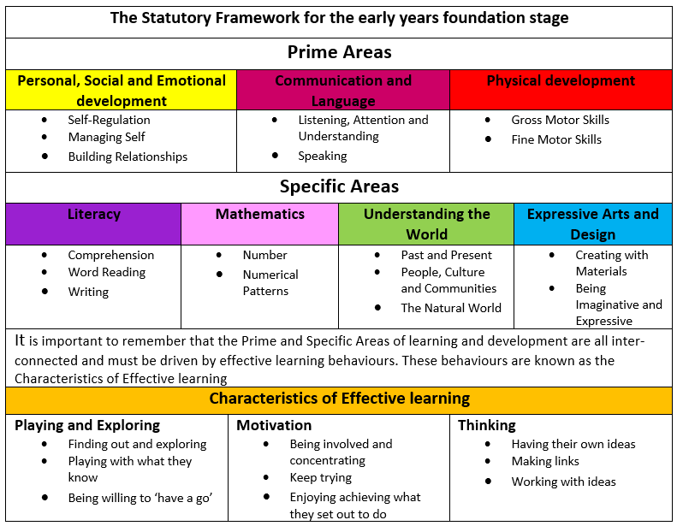
EYFS

Slide 5
Science in the EYFS framework

Slide 6
Science in EYFS

Slide 7
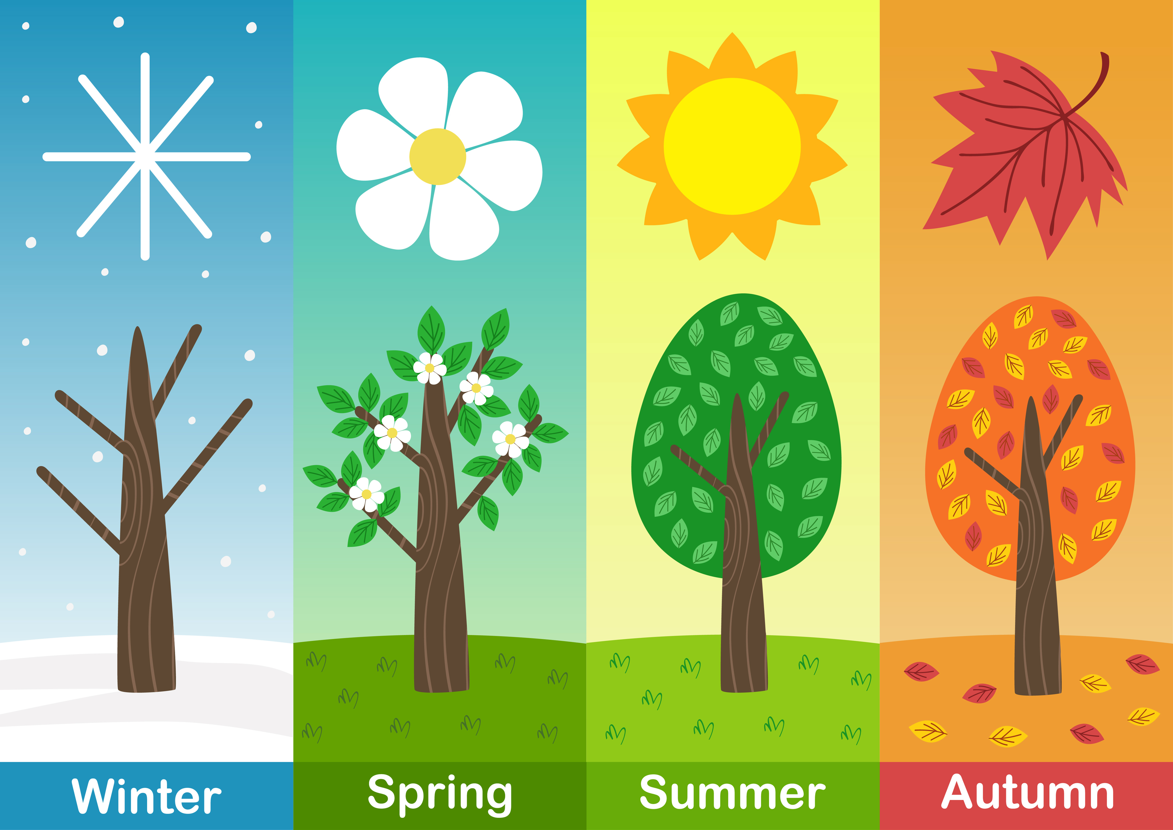

Slide 8
Science in EYFS

Slide 9
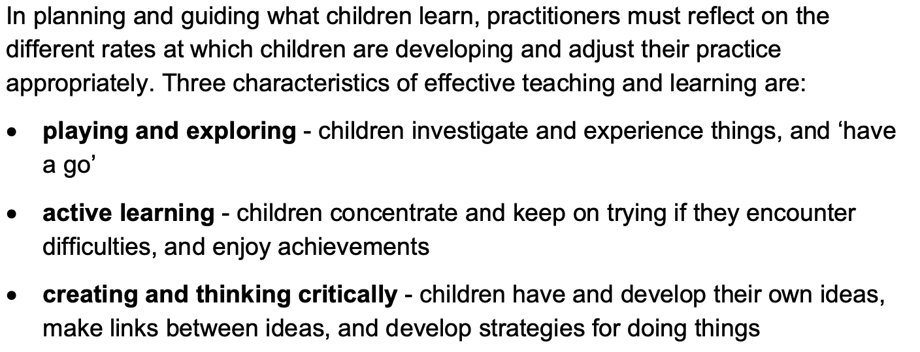
Characteristics of effective teaching and learning

Slide 10
Working Scientifically Progression
PLAN website

Slide 11
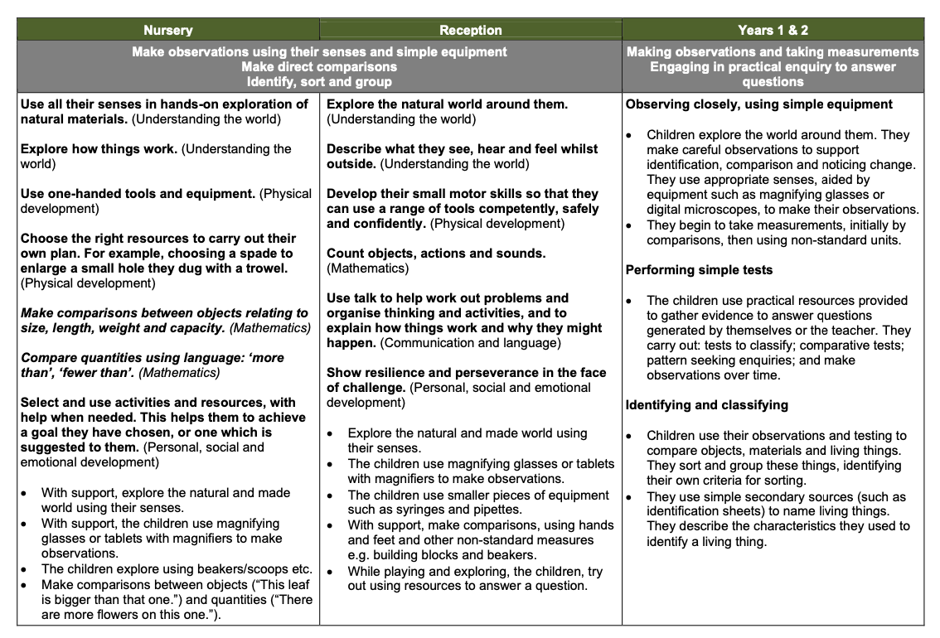

Slide 12
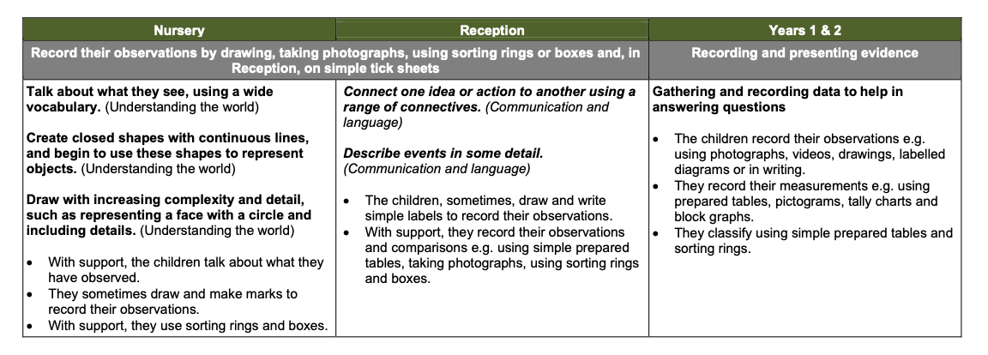

Slide 14
Let’s take a break

Slide 15
Carrying out a Scientific Investigation
Year 1
Everyday Materials
Year 2
Animals Including Humans
Year 3
Forces
Year 4
States of Matter
Year 5
Properties and Changes of Materials
Year 6
Electricity

Slide 16
Health and Safety

Slide 17
Observing Science at St. Aidan’s
Class | Time | Students (Groups of 5) | Time | Students (Groups of 5)
Year 2 | 1:30 – 1:45 | Group A | 1:45 – 2:00 | Group D
Year 3 |  | Group B |  | Group E
Year 4 |  | Group C |  | Group A
Year 5 |  | Group D |  | Group B
Year 6 |  | Group E |  | Group C

Slide 18
Observing Science at St. Aidan’s
Was prior learning recapped?
What did you observe?
Was scientific vocabulary made explicit?
What scientific skills were the children going to be practicing?

