Slide 1


Objective: Today we are going to solve a problem
_ _x_ =_ _
The five digits are all different and none of them is 0.

Slide 2
Maths Across the Curriculum
21st December 2023
Rose-Marie Rochester
Maths Hub Lead/ BHCET Director of Maths
rochesterr@carmel.bhcet.org.uk

Slide 3
Objectives:
To demonstrate the importance and relevance of maths across the curriculum.
To consider all subjects as ways to “think like a mathematician” and improve mathematical literacy and communication across the curriculum.

Slide 4
ITT Core Content Framework Foci:
High Expectations (Standard 1 – ‘Set high expectations’)
How Pupils Learn (Standard 2 – ‘Promote good progress’)
Subject and Curriculum (Standard 3 – ‘Demonstrate good subject and curriculum knowledge’)
Professional Behaviours (Standard 8 – ‘Fulfil wider professional responsibilities’)

Slide 5
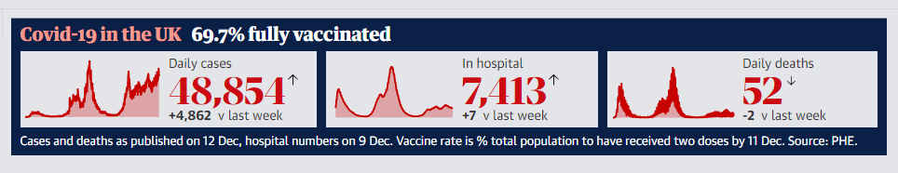
The importance of maths………
“The remorseful logic of exponential growth”

Slide 6
It is recognized that mathematics is “an excellent vehicle for the development and improvement of a person’s intellectual competence in logical reasoning, spatial visualization, analysis and abstract thought”
Ministry of Education Singapore 2006

Slide 7
Why do all teachers need maths?
Statistics: mean, median, upper quartile, standard deviation
Interpreting results for individuals/ classes- box plots
Value added and Progress 8
Rankings, CAGs, TAGs
Number work in general: planning, monitoring
Working out test results, making comparisons
Weightings of coursework and different exams
Form Tutor
PSHE
Cover
Budgets
PDRs
Some subjects use mathematical concepts and ideas specifically: science, geography, psychology.

Slide 9
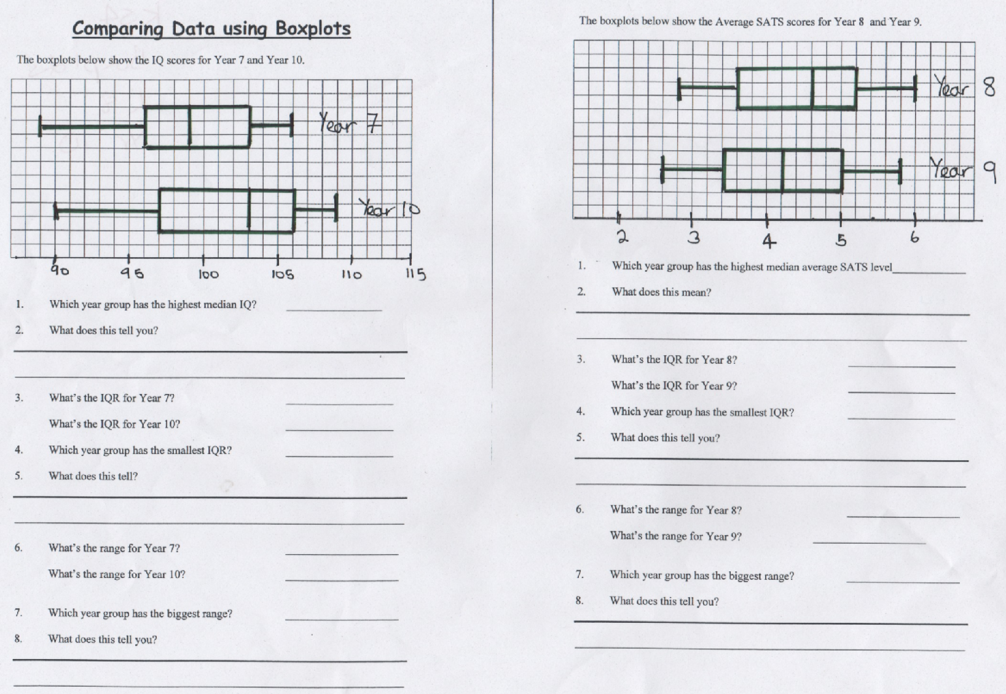

Slide 10
All subjects use maths: how?

Slide 11
Specific Links to Other Subjects
Creative Approaches to Mathematics Across the Curriculum (maths.org)
https://nrich.maths.org/public/topic.php?group_id=48
https://www.educationworld.com/a_curr/curr146.shtml

Slide 12
Maths Test!
Numeracy Across the Curriculum Test
Please show/keep all your working - (correct) answers are not important here - it is (more) important to have attempted each question and to have thought about and recorded how you attempted it.

Slide 13
Issues for Teachers related to Numeracy and Mathematics
1. Axes -Data horizontally, frequency vertically, so do not use or allow horizontal bar charts - perhaps with exception of proportional bar charts.
2. Scales and ratio sign: "1cm represents 1 km" is fine, i.e. 1:100000, but never 1cm = 1 km (i.e. NOT ‘equals’). Especially avoid £1 = 1cm or such nonsense. Generally be careful of abuse of equals signs!
3. Reinforce England, (Eastings and Northings); x before y on coordinates and maps, latitude and longitude – all in alphabetical order too!
4. If discrete data then separate bars on bar or chart, e.g. countries' GDP, but for continuous data e.g. rainfall in months of the year can have adjacent bars - though on line graphs not connected dots as it implies smooth changes.
5. Both axes need to be shown with their origin - if either scale does not start at zero then "break" must be shown. Axes need to be labelled with what they are measuring and in what units.
6. Pupils may need teaching about bar charts, line graphs, pie charts, box and whisker plots, and how to interpret them.
7. Amount v Number - Ma3 v Ma2, ‘Amount’ is answering ‘How much’? versus Number is answering ‘How many’? So it is not "an amount of people", "an amount of times", but ‘a number of ’. Amounts usually have units attached.
8. Decimal points do not move! Numbers move to become bigger or smaller (easier and more sensible than left or right). - refer to tens and units separated by decimal point from tenths etc.

Slide 14
9. "Multiply by 10" is not always solved by "adding a 0 on the end".
10. Decimals need reading properly - e.g. not 3 point "fourteen" (3.14 < 3.2)
11. Calculator use should not just be "allowed" - don't assume they can use them appropriately or accurately; they may need teaching, including use of calculator memory. Valid if used to make calculations easier to make learning a topic the focus, so number problem doesn't get in the way, but pupils should be given time to work out tables if can’t remember.
12. Remember number facts, tables, percentages etc. may be remembered but not well enough understood to be applied and some children don’t use long multiplication but prefer the grid method.
13. Never say "I was never any good at maths" or set maths activities as a punishment.
14. Never talk about “THE average”; pupils should know about at least three: the mean, the median and the mode; and should know which is the most appropriate in the context.
15. When solving linear equations, treat it as a balance, doing the same thing to both sides. Don’t do spiritualist maths–‘taking things over to the other side’
16. Use correct mathematical language: avoid ‘plusing or minusing’ but use adding or subtracting/taking away. Be careful with not calling a cube a square; or a cylinder, a circle, and 3-D prism with just the shape of its most obvious surface. Remember all squares are (also) rectangles: a rectangle which is not a square is an oblong. A square balanced on a vertex could still be a square not a diamond or rhombus. All equilateral triangles are also isosceles.
17. A demonstration some process works is not necessarily a proof. Because it works once, it may not always work!

Slide 15
Views of mathematics
Views of mathematics
Mathematics is ...
• an important subject
• nothing to do with real life
• a male subject
• something you can either do or you can’t
• about learning rules
• about right and wrong answers
………

Slide 16
Thinking Like a Mathematician

Slide 17
David Didau
Blog http://www.mrbartonmaths.com/blog/david-didau-making-kids-cleverer/
Podcast with Craig Barton 8-11 mins

Slide 18
Brainteaser 1
Solve the following brainteaser, without discussing it.
In a mathematics test, no two pupils scored the same. Brian scored less than 4 and Julie scored more than 6, but did not get full marks. Simon’s score was the sum of Brian’s and David’s. Rachel scored three times as many as Brian. Brian, Julie and Rachel all scored even numbers, while Simon’s and David’s scores were both odd. David’s score was half of Rachel’s.
What did each pupil score out of 10?

Slide 19
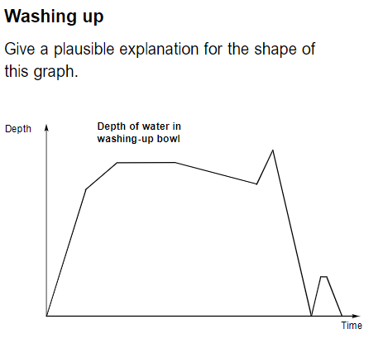
Washing Up

Slide 20
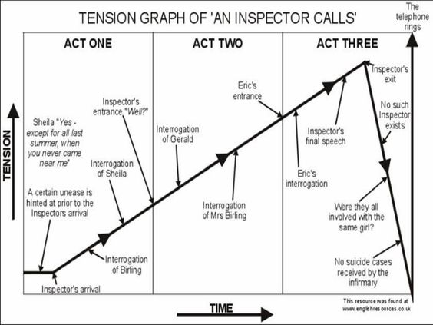

Slide 21
Changes to the Maths Curriculum
Fluency
Reasoning
Problem Solving

Slide 22
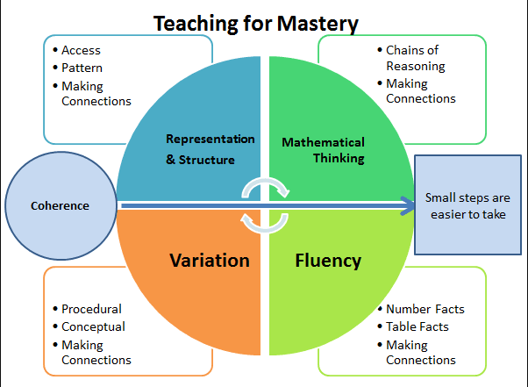

Slide 23
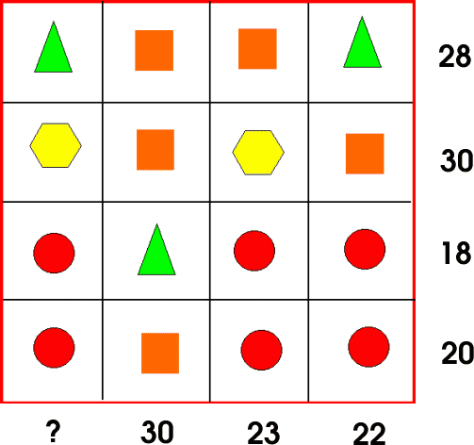
What’s it Worth?
Each symbol has a numerical value.
The total for the symbols is written at the end of each row and column.
Can you find the missing total that should go where the question mark has been put?

Slide 24
Keys to success
Visualisation
Number sense
Generalisation
Metacognition
Communication

Slide 25
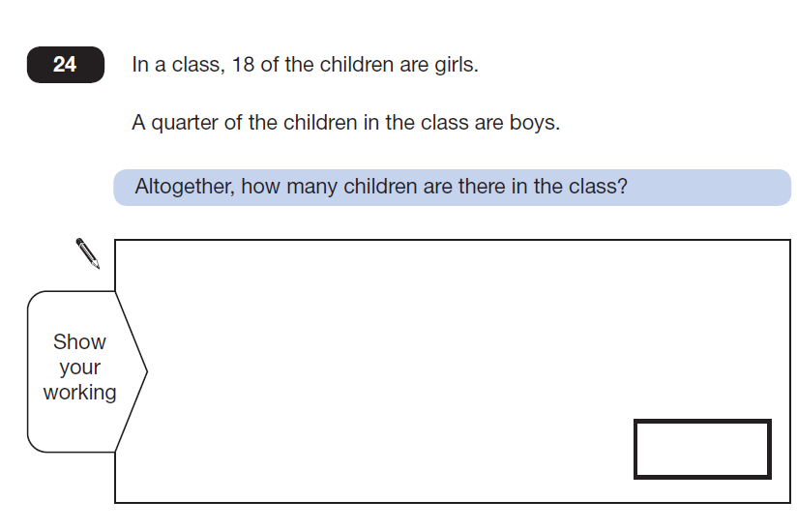
Bar Modelling

Slide 26
Farmer Brown has a third of the sheep that Farmer Giles has.
After 12 of farmer Giles’ sheep escape into Farmer Brown’s field they have the same amount.
How many sheep do they have in total?
FB
12
12
Total =
12 x 4 = 48
FG
12
12
Notes:
Give TTs time to read

Slide 27
Mathematical Thinking
Generic Structures:
hide and reveal
sequencing

Slide 28
Hide and reveal
reasoning activity
Girls
How children travel to school
Boys
10
8
Number of children
6
4
2
0
walk
train
car
bus
other
Mode of transport
Slide 7.4
Notes:
A possible optional starter to get some reasoning in pairs.
Bar graph Hide and reveal – simple way to generate reasoning from even a context/image of limited interest?
Follow each question below by clicking on mouse to reveal the titles
What could this be about (clue typical maths class survey)
Reveal title
What could the horizontal and vertical categories be about?
In pairs discuss and then suggest categories carefully justifying using possible conjectures for red and green bars etc.
Note: hide and reveal is a strategy from the generic activities list given in workshop 1

Slide 29
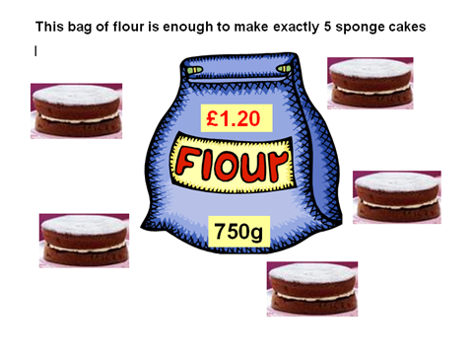
Have ago at the sequencing activity below
The shop now sells the same flour from large sacks at a rate of £1.20 for 750g. As an introductory offer the shop is currently offering a discount of ___ % on all sales of flour.
The working out a student used to answer a problem related to this information is shown mixed up below.
Can you find out the particular problem the student was working on and rearrange the working out into the order you think the student might have done it? Write a reason explaining the meaning of each line of working out in relation to the problem. What was the discount on offer?
14.40 x 0.25 = 3.60
14.40 – 3.60 = 10.80
12 x 1.20 = 14.40
60 ÷ 5 = 12
Notes:
Now look at the handout of sequencing problem related to this bag of flour context
In pairs have ago – 5+ mins
Take feedback 5 + mins

Slide 30
Have ago at the sequencing activity below
The shop now sells the same flour from large sacks at a rate of £1.20 for 750g. As an introductory offer the shop is currently offering a discount of 25 % on all sales of flour.
The working out a student used to answer a problem related to this information is shown mixed up below.
Can you find out the particular problem the student was working on and rearrange the working out into the order you think the student might have done it? Write a reason explaining the meaning of each line of working out in relation to the problem. What was the discount on offer?
60 ÷ 5 = 12
Number of bags of flour needed to make 60 cakes
The student has worked out that the cost of flour needed to make 60 cakes is £10.80 given that the cost of the flour is being discounted by 25%
12 x 1.20 = 14.40
Cost of 12 bags of flour
14.40 x 0.25 = 3.60
25% of the cost of 12 bags of flour
14.40 – 3.60 = 10.80
The cost of 12 bags of flour after a 25% discount
Notes:
Show solution
Discuss –
in what way did this generate reasoning?
In what sense is this task ‘generic’? -How applicable would the idea of sequencing to other areas of the curriculum?

Slide 31
Mathematical reasoning may be regarded rather schematically as the exercise of a combination of two facilities, which we may call intuition and ingenuity.
Alan Turing

Slide 32
Mathematical Reasoning
‘Reasoning’ - the action of thinking about something in a logical, sensible way.
What do you think mathematical reasoning is?
Why is mathematical reasoning important?
What does mathematical reasoning look like for students?
How do we develop mathematical reasoning in students?
Mathematical Reasoning is a key feature of the National Curriculum
Mathematical Reasoning aids deep understanding of concepts and helps to develop fluency and mastery
There are variety of techniques which can be used in different circumstances

Slide 33
NRICH 5 Steps
Step 1 – Describing: simply tells what they did.
Step 2 – Explaining: offers some reasons for what they did. These may or may not be correct. The argument may yet not hang together coherently. This is the beginning of inductive reasoning.
Step 3 – Convincing: confident that their chain of reasoning is right and may use words such as, ‘I reckon’ or ‘without doubt’. The underlying mathematical argument may or may not be accurate yet is likely to have more coherence and completeness than the explaining stage. This is called inductive reasoning.
Step 4 – Justifying: a correct logical argument that has a complete chain of reasoning to it and uses words such as ‘because’, ‘therefore’, ‘and so’, ‘that leads to’ ...
Step 5 – Proving: a watertight argument that is mathematically sound, often based on generalisations and underlying structure. This is also called deductive reasoning.

Slide 34
So for our students now there are 3 “tiers of reasoning”
Explain how you know, give reasons for your answer…
You must show how you get your answer, you must show your working, explain your reasoning …
Evaluate, show, prove …
These are not always distinct

Slide 35
In your lessons……..

Slide 36
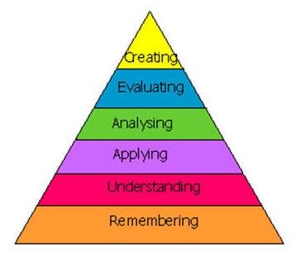
Planning for Student Responses
• Why do you think that …?
• Can you explain why that is right?
• How do you know?
• How did you reach that conclusion?
• What might explain that …?
• How is that possible?
• Can you show me …?
• Is there another way …?
• What explanation do you think is best …?
• Have you tried all the possible cases?
• Does it always work? Why?
• What do you notice when …?

Slide 39
Mathematical Literacy and Communication

Slide 40
Introduction to literacy in Mathematics (education.vic.gov.au)

Slide 41

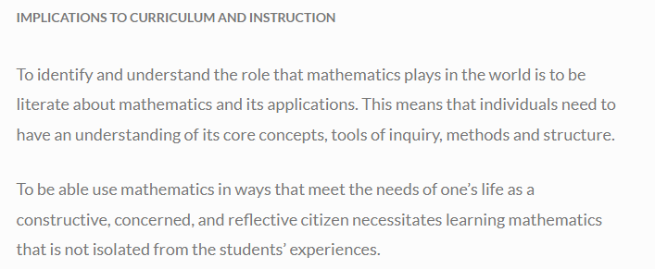

Slide 42
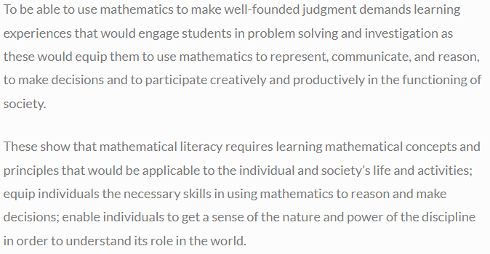
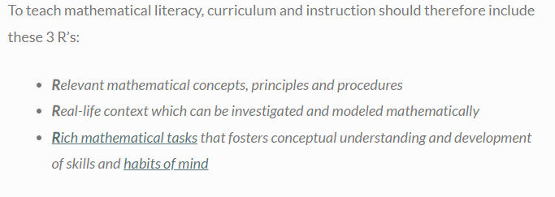
Math4teaching.com

Slide 43
Literacy Tasks
Developing communication of reasoning and problem solving

Slide 44
Literacy Task - Scatter Graphs
×
×
×
Describe the relationship
1. The less alcohol consumed the slower your reaction time score.
2. Negative.
3. If you have a faster reaction time you drink less alcohol.
4. As the amount of alcohol consumed increases the reaction time decreases.
Reaction time
×
×
×
×
×
Amount of alcohol consumed

Slide 45
Convincing, justifying…..
Three friends rent a go-kart and agree to share the cost.
Annie travels 3 laps, Barry travels 5 laps and Carol travels 8 laps.
The total cost is £3.20.
How much should each person pay for it to be fair?

Slide 46
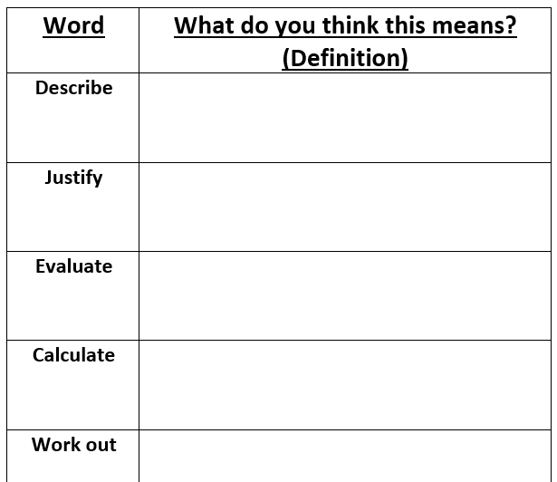
Activity 1: Word Families
Part A: Finding the definition
Using the definition sheet, can you explain the meaning of each of the tier 2 words in a mathematical context that you have been given?
Write your own definition for each of the words on the sheet provided.

Slide 47
Activity 2: Naming your Word Families
Now you are in your word families please decide on the name of the family based on similarities with the definitions of these words. On the pieces of paper that are stuck around your classroom, write the name of the word family at the top and stick your words under the heading.

Slide 48
Activity 2: Sorting Word Families Grid
Figure out
Solve
Calculate
Work out
Evaluate
Express
Algebra questions
Simplify
Expand
Factorise
Explain
Explain
Describe
Justify
Identify
Find
Complete
How many
Write
Estimate
Estimate
Approximate
Proof
Demonstrate
Show
Prove
Estimate
Estimate
Approximate
Notes:
These are suggested answers and answers may vary due to interpretation, this is something you may need to discuss as a class.

Slide 49
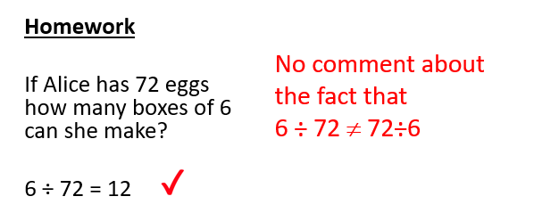
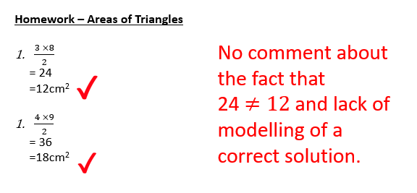
Syntax and Notation

Slide 50
What do we want to see . . .?
Work out
12 x 3 – 17
= 36 – 17
= 19
Equal signs
Correct syntax
12 x 3 –17
= 36
= 19
Working down the page

Slide 51
Sally was given a cake, she ate a sixth and then gave a fifth to her sister. How much cake was left?

Slide 52
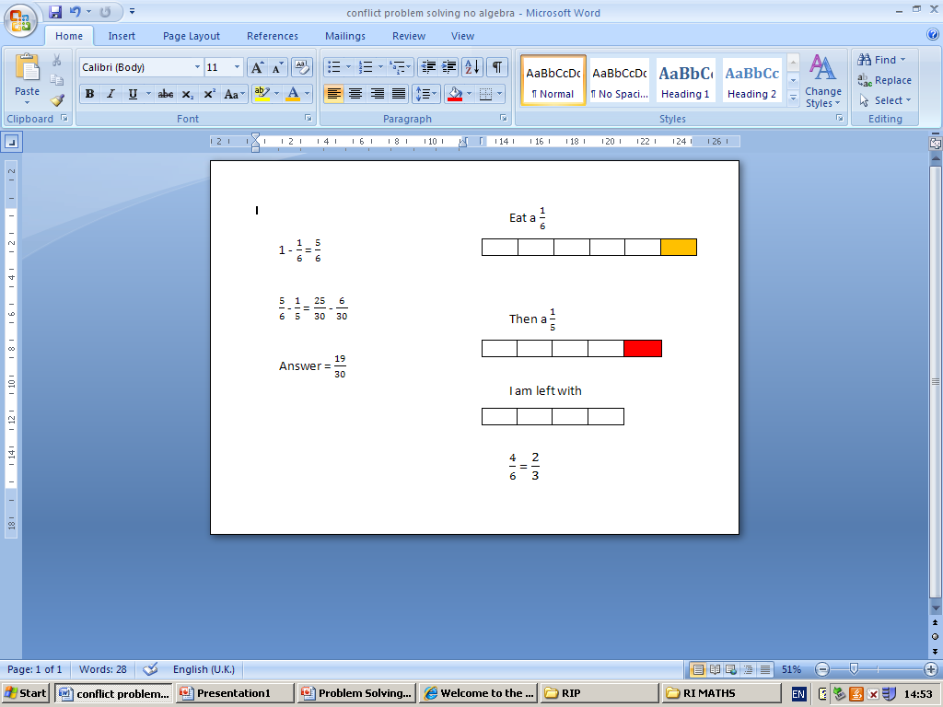

Slide 53
To improve accuracy in calculation, measurement and graphical work | To improve interpretation and presentation of graphs, charts and diagrams | To improve reasoning and problem solving | Other

