Slide 1
Notes:
Welcome 1 – 1:05

Slide 2
Core Content Overview • High Expectations (TS1)
Evidence Statements: Learn that…
1.1
Teachers have the ability to affect and improve the behaviour and motivation of their pupils.
1.4
Setting clear expectations can help communicate shared values that improve classroom and school culture.
1.2
Teachers are key role models.
1.5
A culture of mutual trust and respect supports effective relationships.
Teacher expectations can affect pupil outcomes.
1.3

Slide 3
Core Content Overview • Behaviour Management (TS7)
Evidence Statements: Learn that…
Routines can help create an effective learning environment.
Building effective relationships is easier when pupils believe that their feelings will be considered and understood.
7.1
7.5
7.2
A predictable and secure environment benefits all pupils, but particularly SEN.
Pupils are motivated by intrinsic and extrinsic factors.
7.3
The ability to self-regulate affects pupils’ ability to learn, success in school and future lives.
7.6
Pupils’ investment in learning is also driven by their prior experiences and perceptions of success and failure.
7.7
7.4
Teachers can influence pupils’ resilience and beliefs about their ability to succeed.

Slide 4
Core Content Overview • Classroom Practice (TS4), TS8
Evidence Statements: Learn that…
4.9
Paired and group activities can increase pupil success, but to work together effectively pupils need guidance, support and practice.
Building effective relationships with parents, carers and families can improve pupils’ motivation, behaviour and academic success.
8.4
How pupils are grouped is also important.
4.10
See full detail in the ITT Core Content Framework.
https://assets.publishing.service.gov.uk/government/uploads/system/uploads/attachment_data/file/843676/Initial_teacher_training_core_content_framework.pdf

Slide 5
Core Content Overview • High Expectations (TS1), TS7
Practice Statements: Learn how to…
1
Demonstrate consistently high behavioural expectations.
7
Develop a positive, predictable and safe environment for pupils.
1
Communicate a belief in the academic potential of all pupils.
7
Build trusting relationships.
7
Establish effective routines and expectations.
7
Motivate pupils.

Slide 6
Core Content Overview • Professional Behaviours (TS8)
Practice Statements: Learn how to…
8
Build effective working relationships.
8
Manage wellbeing by understanding the importance of the right to support.
See full detail in the ITT Core Content Framework.
https://assets.publishing.service.gov.uk/government/uploads/system/uploads/attachment_data/file/843676/Initial_teacher_training_core_content_framework.pdf

Slide 7
Core Content Overview • Professional Behaviours (TS8)
What is culture ?

Slide 8
Core Content Overview • Professional Behaviours (TS8)
The meaning of culture
Behaviours of a society that form a way of life
The way we speak, the traditions we have and the knowledge and beliefs that are communicated or passed down from one generation to another.

Slide 9
Core Content Overview • Professional Behaviours (TS8)
What is cultural capital?
Who has cultural capital?

Slide 10
Core Content Overview • Professional Behaviours (TS8)
What is cultural capital?
Coined by French sociologist Pierre Bourdieu, the concept of cultural capital builds on the ideas of Karl Marx to define factors other than economic wealth that influence a child’s educational success. Bourdieu believed that these factors included knowledge, life experiences, language, behaviours, tastes and habits, which pass through the family over many generations.
Who has cultural capital?
Bourdieu said that the middle classes had the most cultural capital, while the lower or working classes had less. Cultural capital, habits, behaviours, and so on were passed down through the family, thus perpetuating the division between the different classes.
In more recent research, The Sutton Trust’s Parent Power 2018 report provides evidence that even today, middle-class children have more cultural capital than their less advantaged peers. Consequently, the children of middle-class families are still much more likely to succeed at school, have a university education and succeed in their adult life. With all the tremendous efforts of schools to redress the balance of such inequalities, it remains frustrating that this is the case.

Slide 11
Core Content Overview • Professional Behaviours (TS8)
How will your children benefit from good cultural capital?
The role of your school

Slide 12
Core Content Overview • Professional Behaviours (TS8)
How will your children benefit from good cultural capital?
Research indicates that children will find life more challenging without adequate cultural capital, from everyday social interactions to future job interviews.
The better language, social skills and knowledge a child has when entering the school system, the better they can fit into the school habitus. On the other hand, if children come to school with a poorer vocabulary, less knowledge, limited experiences and a poorer understanding of how to behave in the school setting, they are already at a disadvantage compared to their peers. Therefore, for many, helping all children to develop their cultural capital is a matter of equality and social justice.
The role of your school
While Bourdieu acknowledged that the family primarily influences a child’s cultural capital, he also acknowledged that schools are essential in filling the gaps they might have in their cultural capital. Therefore, the schools’ role is to provide all children with the knowledge, experiences, language and social skills they need to have the best chances possible. With the widening of social and economic circumstances today, schools have never been more critical in filling the gaps that some children have in their cultural capital.

Slide 13
Core Content Overview • Professional Behaviours (TS8)
What does Ofsted say about cultural capital?
For the inspectorate, cultural capital is defined as the acquisition of knowledge.
“It is the essential knowledge that pupils need to be educated citizens, introducing them to the best that has been thought and said, and helping to engender an appreciation of human creativity and achievement”
School inspection update, January 2019 | Special edition And while we know that knowledge is important, this definition certainly misses the point: true cultural capital is much a broader being than simply knowledge. The problem is, if we as primary teachers only focus on teaching children knowledge, we are in danger of narrowing the curriculum and excluding many other essential aspects that make a well-rounded child.
I have yet to meet anyone in the primary sector who wants their school to become a knowledge factory. This approach would create a complete disengagement for many children, turning them off from an education they cannot access. It would result in an education failing to recognise their needs and potential.

Slide 14
Core Content Overview • Professional Behaviours (TS8)
Cultural Capital
How ?

Slide 15
Core Content Overview • Professional Behaviours (TS8)
1. Know your community well – tailor your curriculum
2. Teach more than just knowledge – the whole child, the hidden curriculum
3. Make time for talking
4. Embed a variety of cultural experiences and educational visits
5. Know or research – don’t assume

Slide 16
Core Content Overview • Professional Behaviours (TS8)

Slide 17
Core Content Overview • Professional Behaviours (TS8)
British Values
How ?

Slide 18
Curriculum themes and topics
A curriculum that prepares children for life in British Society; this includes developing the understanding and use of money, effective reading and writing skills, collaboration and discussion to research ideas and concepts.
Daily acts of collective worship/ whole school assembly
Assemblies to promote and uphold core values.
PSHE
Mutual respect as a core value. It should be taught within formal PSHE lessons and on an informal nature throughout the school day. Encourage pupils to know, understand and exercise their rights and personal freedoms and advised how to exercise these safely - E-Safety policy and PSHE work on keeping myself safe.
RE
Respect for all faiths and beliefs promoted through the teaching of RE as children gain a greater understanding of religious diversity and practices for those religions represented in school and the UK. Children encouraged to talk about their faith and learn about different festivals through the year.
PE
Promotion of the concept of “fair play”, following and developing rules, celebrating and rewarding success, accepting defeat and participating in activities that promote cooperation with others and inclusion for all form an integral part of the PE curriculum, and extra curricular sporting calendar.
Pupil Voice
Promotion of democratic processes through the election of school councillors, house captains etc. This fosters the concept of freedom of speech and group action to address need and concerns. Children see how they are listened to and how their actions can produce results when the processes are followed

Slide 19
PLT 3
Evidence from progress summary SSP and 1st Term
Professional discussion with PLT
Support from PT/Mentor to identify evidence
Discussion with PLT - how to complete evidence sheets for PLT 4 and 5
Evidence into ongoing portfolio

Slide 21
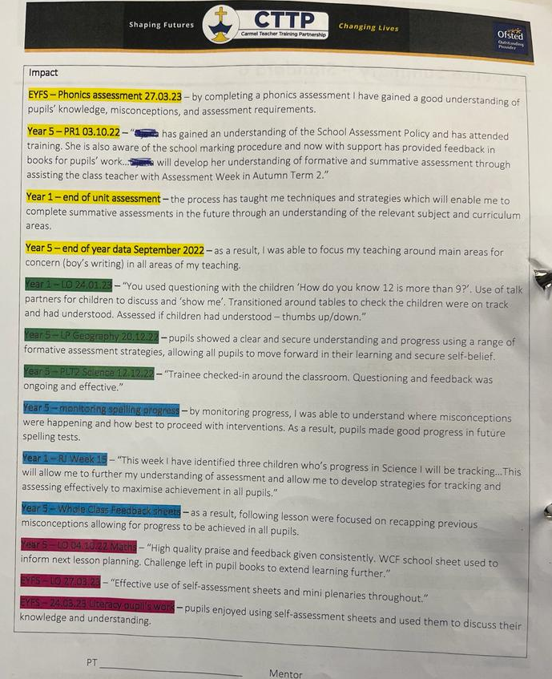
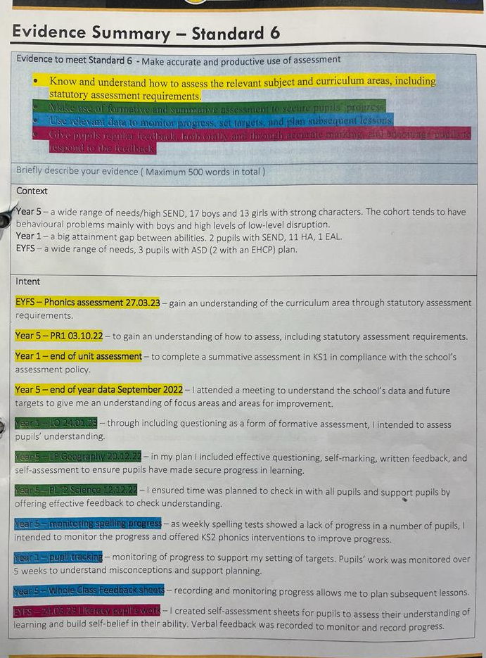

Slide 22
Areas of Focus
PLT 4
Values
Evidence from progress summary
Continued Professional Discussion with PLT – follow up from PLT3
Evidence sheet completed
PT/Mentor review evidence and evidence sheet
Ongoing portfolio added to
Initial discussion around AOF 5 linked to PGCE
Part 2
Personal and Professional Conduct

Slide 23
PLT 5
Evidence from final placement
Continued Professional Discussion with PLT – follow up from PLT3 and PLT 4
Evidence sheet completed
PT/Mentor review evidence and evidence sheet
Ongoing portfolio added to
‘Best teaching cycle’

Slide 24
Core Content Overview • Professional Behaviours (TS8)

