Slide 2
Central Training: General Professional Studies
Social Mobility for All
Closing the Attainment Gap

Slide 3
Links to CCF – learn that...
High Expectations.
Learn that
High quality teaching has a long-term positive effect on pupil' life chances, particularly for children from disadvantaged backgrounds.
Managing behaviour.
Learn that
Teachers can influence pupils' resilience and beliefs about their ability to succeed, by ensuring all pupils have the opportunity to experience meaningful success.
Pupil' investment in learning is also driven by their prior experiences and perceptions of success and failure.

Slide 4
Links to CCF – learn how to...
How pupils learn.
Learn how to
By discussing and analysing with expert colleagues how to design, practice, generation and retrieval tasks that provide just enough support so that pupils experience a high success rate when attempting challenging work.
Balancing exposition, repetition, practice and retrieval of critical knowledge and skills.
Increasing challenge with practice and retrieval as knowledge become more secure.

Slide 5
“
”
Social Mobility
Social mobility is the link between a person’s occupation or income and the occupation or income of their parents. Where there is a strong link, there is a lower level of social mobility. Where there is a weak link, there is a higher level of social mobility.
Social Mobility Commission
Notes:
Think about your own experience – how many generations in your family have been to university? How do we change that culture? How can we tackle 3 and 4 generations of unemployed?

Slide 6
Social Mobility in the UK ● pre-pandemic
Degree
71% of those from higher professional backgrounds achieve 2:1 and 1 class degrees compared with just over a quarter (27%) of those from lower working class backgrounds (2023).
Truth
Truth
Truth
Truth
Employment
Those from better off backgrounds are almost 80 per cent more likely to be in a professional job than their working class peers (2019).
Migration
Moving regions can often help social mobility, but those from working class backgrounds move regions less and are less likely to move to London, where the largest proportion of new jobs are created (2019).
Income (1)
Those from working class backgrounds earn 24 per cent less a year than those from professional backgrounds, predominantly due to the jobs they end up in (2019).
Income (2)
Even when those from working-class backgrounds are successful in entering professional occupations, they earn on average 17 per cent less than their more privileged colleagues (2019).
Wellbeing
Individuals from more disadvantaged areas are more likely to suffer from lower levels of wellbeing (2019).
Living Standards
71% of people whose parents were homeowners became owners themselves in comparison to 46% of people whose parents were renters. (2023).
Unemployment
People from working class backgrounds still face higher levels of unemployment, despite overall increases in employment (2019).
Gender Gap
Even within professional jobs, women from working class backgrounds are paid 35 per cent less than men from more affluent backgrounds (2019).
Double Disadvantage
Just 21 per cent of people with disabilities from working class backgrounds enter the highest occupations (2019).
Truth
Truth
Truth
Truth
Truth
Social Mobility Commission, 2019, State of the Nation 2019 (and 2023): Social Mobility in Great Britain
Notes:
Activity T?F marl on it

Slide 7
Definition of disadvantaged

Slide 8
Definition of disadvantaged
Free School Meals - ever 6
Looked after Children
Post Looked after children
Service Children – ever 6
Adopted
Notes:
Important to remember SEND

Slide 9
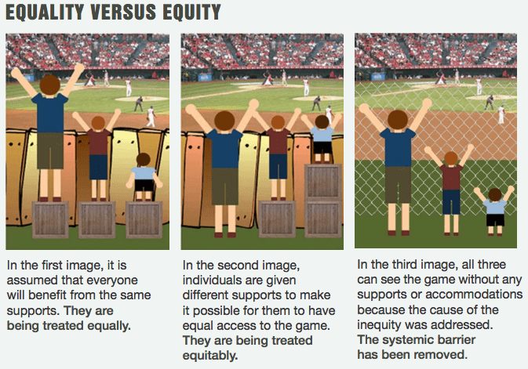
Support the drive for greater equity…
‘Everyone should be able to make what they can of themselves, and where they end up should not be dictated by where they began. This should be the case for every single young person.’
The Rt Hon Damian Hinds MP

Slide 10
Notes:
Teaching point – typed in class cartoon image on the right – what is wrong with it? Diversity? Inclusion, raising aspiration. Thinking about your classes – what issues are you facing with PP students/disadvantaged students? What strategies are you using?

Slide 11
The headline figures from the State of the nation Document
Notes:
State of the Nation document

Slide 12
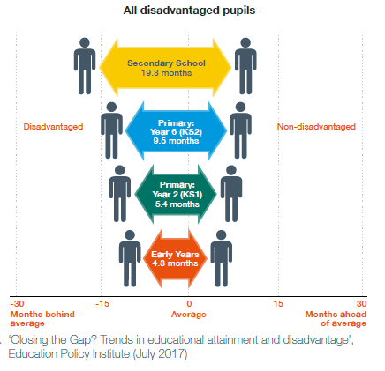
The National Context
a) Know what is expected and what will be gained from completing the programme
b) Understand the context of educational disadvantage, both nationally and locally
c) Baseline the key areas related to Pupil Premium in your school to ensure a focus on monitoring & evaluation from the outset
d) Begin establishing the conditions needed to implement a Pupil Premium strategy in your school

Slide 13
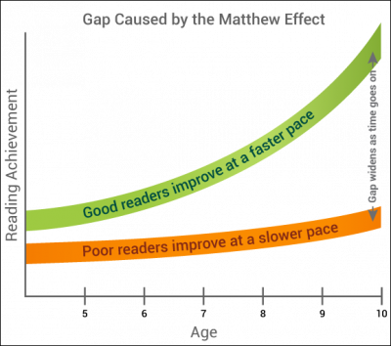
1986, Stanovich.
a) Know what is expected and what will be gained from completing the programme
b) Understand the context of educational disadvantage, both nationally and locally
c) Baseline the key areas related to Pupil Premium in your school to ensure a focus on monitoring & evaluation from the outset
d) Begin establishing the conditions needed to implement a Pupil Premium strategy in your school
Schools currently have an explicit focus on reading?
What programmes are available in your schools?
What are you doing in your lessons?
“The concept of Matthew effects springs from findings that individuals who have advantageous early educational experiences are able to utilize new educational experiences more efficiently” p381 Reading Research Quarterly, xxi/4
Notes:
This is a model proposed by Stanovich, relating to reading development, coming from St Mathews gospel = the rich get richer. It describes the effect that children who have strong early reading skills can build on those. Those without move at a slower pace. The early intervention argument suggests that we need to intervene in order help children ‘get back on track’. This applies to early intervention (not structured intervention, but changing the way we do things) in order to support the progress of children. These might be different to general classroom practice, they might be the same but with more emphasis, or they might be tightly targeted and focused.
Snowballs – fragility of inmplementation

Slide 14
The Reading Route is a new and exciting opportunity for our students to encounter a variety of texts across a range of genres, with the aim of developing a true passion for reading. All of the texts have been specifically chosen to reflect our College Virtues, as well as celebrating the diversity of the world we live in. Each pupil will be allocated to a particular route depending on their reading ability and will read a number of books across the academic year. There will also be opportunities for pupils to build on this by reading non-fiction texts linked to the fiction stories they are reading. We believe this is a fantastic opportunity to create a culture of reading in College which will encourage all students to discover a life-long passion for reading.

Slide 15
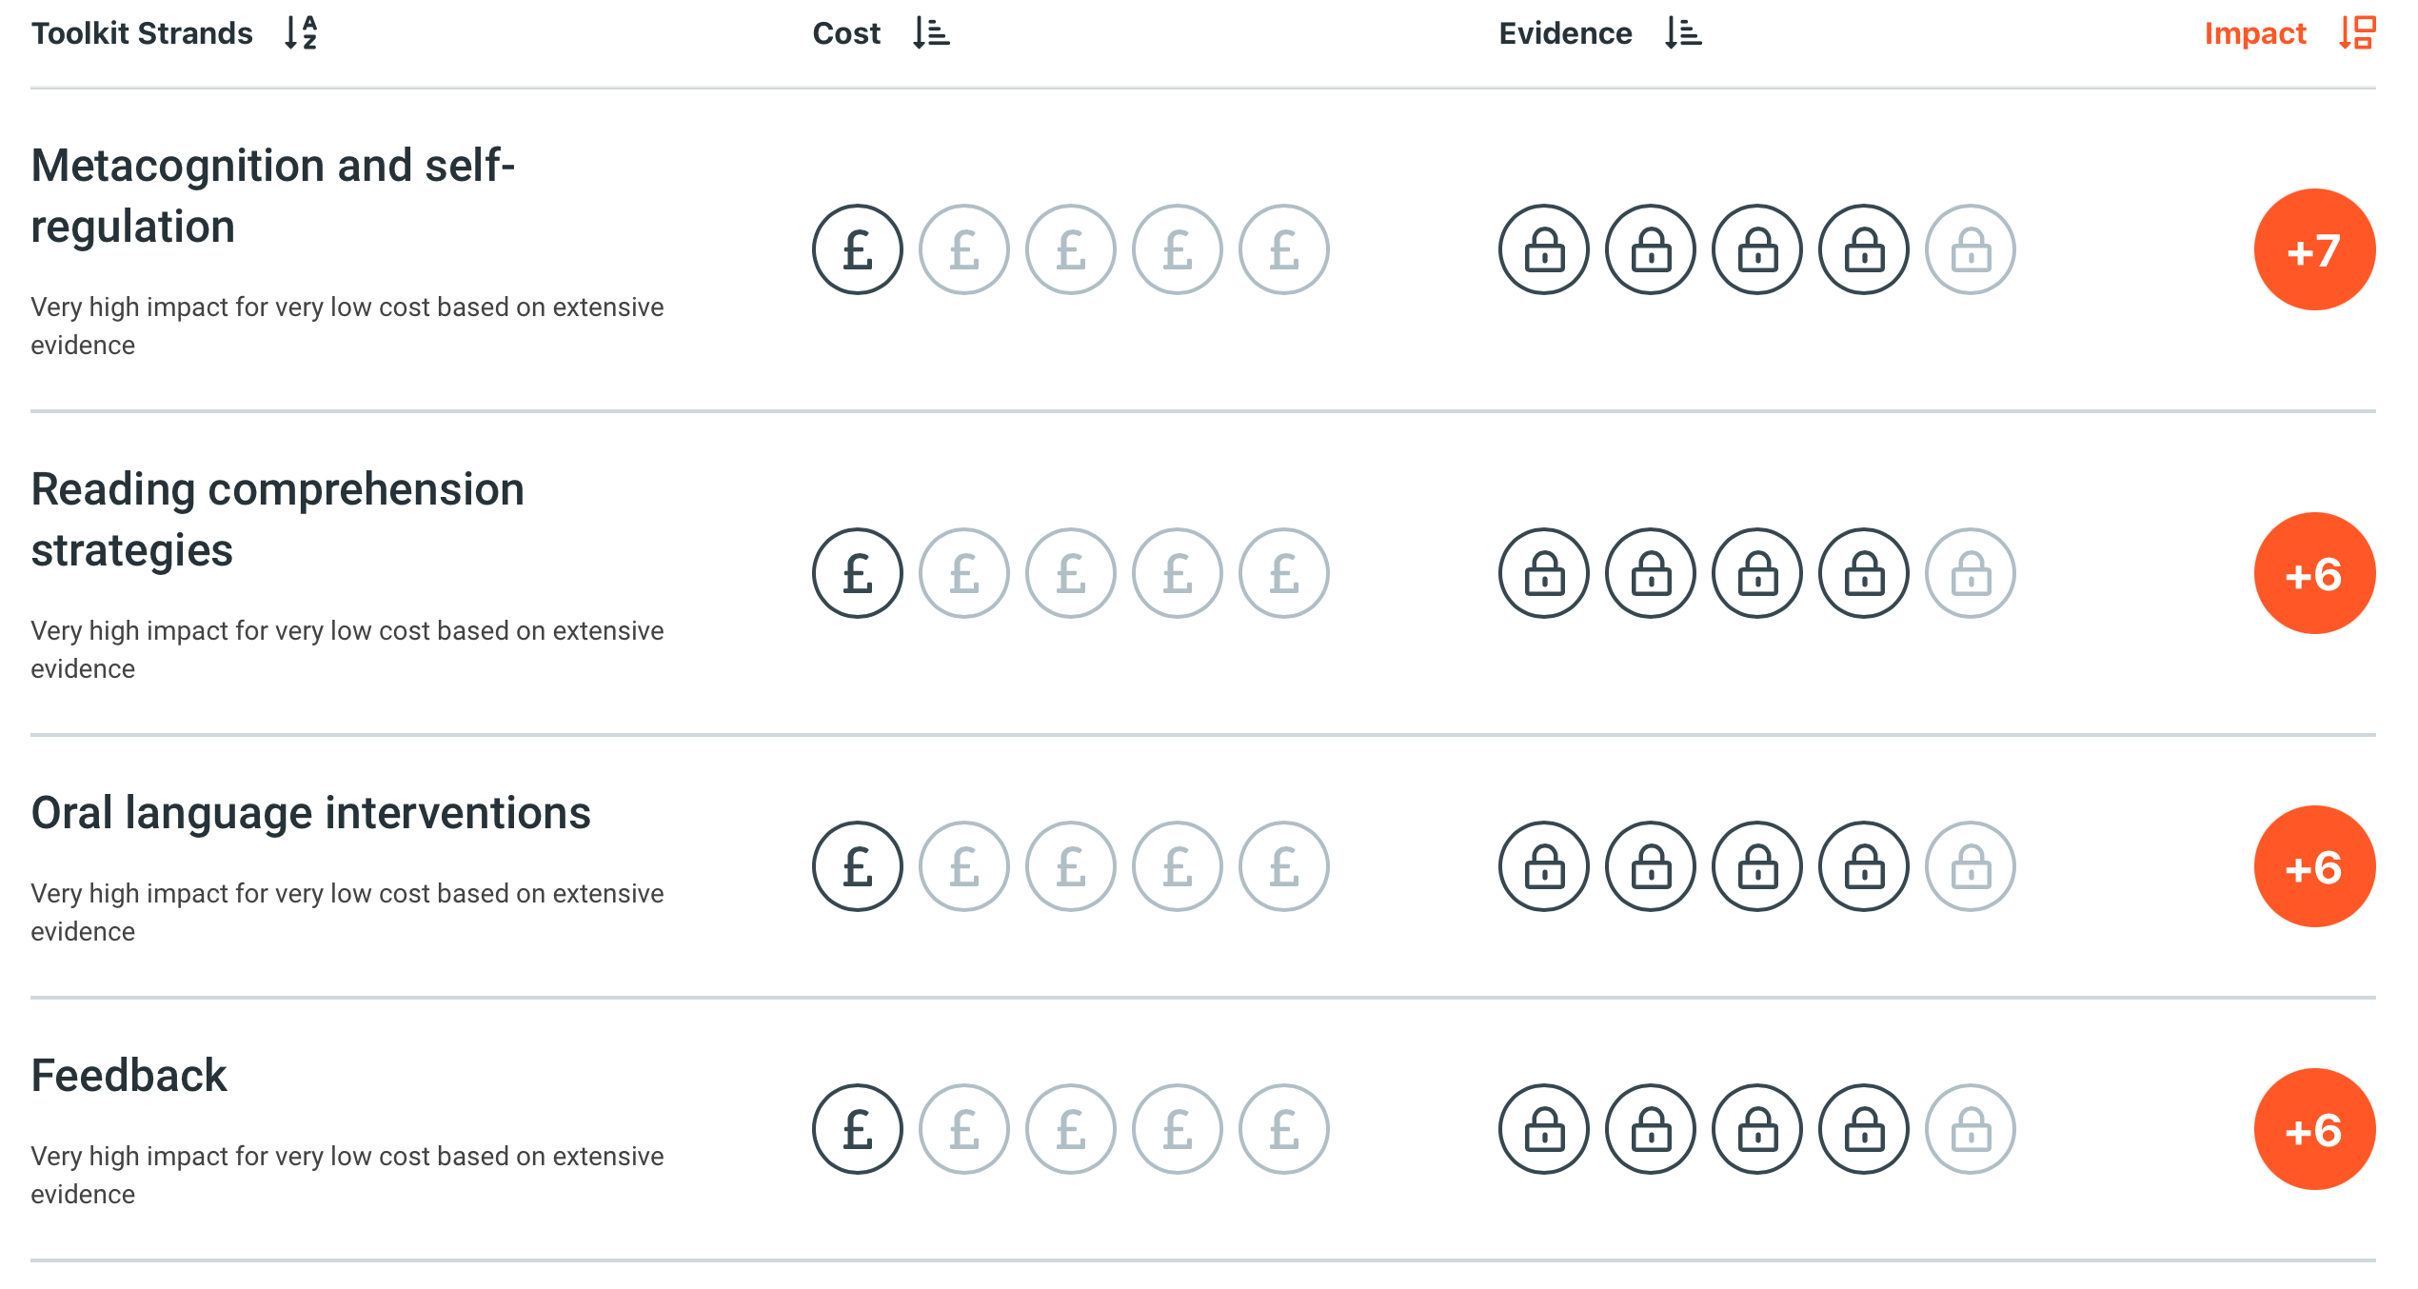
a) Dispel common myths associated with the Pupil Premium
b) Understand the EEF Toolkit and how to avoid surface level compliance with evidence
c) Describe the tiered approach for developing a Pupil Premium strategy
d) Using data to accurately identify priorities
Teaching makes the biggest difference

Slide 16
Why is there the need to focus on the disadvantaged?
Notes:
Across measures of socio-economic position, countries, school systems, curricula and performance indicators, young people from disadvantaged backgrounds tend to perform poorly in assessments compared to their more privileged peers.
In England, despite some progress over the last two decades in closing this gap, the relationship between family socio-economic position and attainment remains particularly strong compared to many other OECD countries.

Slide 17
Evidence
Disadvantaged children start school behind their more advantaged peers, and the gap in performance widens as they progress through the education system.
Analysis shows that, on average, disadvantaged pupils are 4.3 months behind in the early years phase, 9.4 months behind in primary school, and 18.4 months behind at Key Stage 4, with persistently disadvantaged pupils 23.4 months behind at KS4.
Notes:
https://epi.org.uk/wp-content/uploads/2018/07/EPI-Annual-Report-2018-Lit-review.pdf

Slide 18
Data Analysis
Most schools will have had their mocks – what is the disadvantaged gap in your schools?
Thinking of your classes – do you have an attainment gap – is disadvantaged – non-disadvantaged, SEND, Gender, Ethnicity

Slide 19
Barriers to learning and achivement

Slide 20
Multi-faceted Problem
Perinatal Studies
Material Deprivation
Attachment Disorder
Adverse Childhood Experiences
Maternal Psychological
Home Learning Environment
Concerted cultivation Enrichment Activities
Private Tuition
Quality of Teaching
Unconscious bias

Slide 21
Teacher Character
Gatekeeper to success
Respect
Expert
Subject Knowledge
Enthusiasm for subject
Justice
Rewards
Inclusion
Fair Play
Loyalty
Caring who they are
Personal
By Name
Model of virtues
Mentor
Action
Effective timely feedback
Purposeful
Additional out of lesson support
Extra Curricular
Notes:
We all know some children will work and behave for some staff but not other! Why?
Connected to virtues and role modelling
It is not about well they are good for me...teamwork and consistency amongst colleagues

Slide 22
Teacher / Student Relationships
Culture
Financial background
Race
Gatekeeper to success
Identified Gender
Subject Knowledge
Respect
Expert
Enthusiasm for subject
Caring who they are
Sexual Orientation
Rewards
Justice
Inclusion
Model of virtues
Loyalty
Fair Play
By Name
Music / TV / film
Personal
Mentor
Effective timely feedback
Purposeful
Sports and Hobbies
Action
Additional out of lesson support
Extra Curricular
Out of School Achievements
Attitudes / politics /
Notes:
It is about caring who they are.
Having Loyalty and Commitment. Is built on that relationship. Some are visible some are not. Some will be shared with you some will not.
Its only through understanding the complex nature of who we are.
Knowing that we as a school need to understand the make up of our community. That as teachers we need to know who is in our classes.
We may choose to act differently, to meet the ever-changing society we are part of. We may decide not to.
Remember its our responsibility to treat everyone with equity, to celebrate difference and not treat everyone the same.

Slide 23
Supporting pupils to prepare for an assessment – this can be achieved through focused revision sessions and completed knowledge organisers
Identifying any learning needs early – so targeting support with personnel or strategies can be used in lessons by all staff
Personal education programme on self-belief – building resilience – staying safe and healthy behaviours
Develop specific behaviour support for some pupils e.g anger management, bereavement and staying safe

Slide 24
Monitoring.
Identify learning needs early and target support with personnel or strategies that can be used in lessons by all staff.
Monitor any attendance gap in attendance and an effective catch-up arrangement
Monitor the gap in progress between disadvantaged and non-disadvantaged of similar abilities
Monitor the gap in attainment between disadvantaged and non-disadvantaged of similar abilities
Monitor the impact of the various strategies i.e. what works in your class, department or school
Create trends through time linked to the impact of the various strategies

Slide 25
Build relationships.
At the heart of all strategies are positive relationships between staff and students and this is reliant on staff knowing their pupils well and being able to co0nnect with them.

Slide 26
High quality teaching and support for all.
Subject knowledge.
Pedagogy.
Staff development.
Preparation for assessment through focused revision sessions and completed knowledge organisers.
Personal education programme linked to self-belief e.g. building resilience, staying safe and healthy behaviours.
Develop specific behaviour support for some pupils e.g. anger management, bereavement and staying safe.
Small group tuition or 1-1 support.

Slide 27
Assistance with organisation.
Provide a place in school or college where they can keep all their books – some children have a chaotic home life.
Provide a safe place in school/college where they can access support to complete homework – very important for consolidation of acquired knowledge and can help avoid disfluency in learning.

Slide 28
Links with families.
Develop effective lines of communication with families – ensure contact for both positive and negative reasons .
Engaging parents to raise attainment to foster relationships and allow the parents to realise the role they play in their child’s progress and attainment.

Slide 29
Equipment.
Ensure all students are given the necessary equipment
pens
Pencils
planners
books
folders
calculators
mathematical or other specialist equipment

Slide 30
Mentor.
Designated responsible mentor.
Manageable targets.
Regular meetings to check on progress.

Slide 31
Examination preparation.
Catch up (absentees).
Preparation for exams provide pupils with revision support guides.
Revision timetables.
Revision techniques.
Preparation staged – year before....month, week, day before, before the exam etc.
Supporting pupils to prepare for an assessment – this can be achieved through focused revision sessions and completed knowledge organisers.
Identifying any learning needs early – so targeting support with personnel or strategies can be used in lessons by all staff.

Slide 32
Option choices.
Designing t/t around the option choices?
Choosing options for subjects to be examined in is very important.
Meet with one teacher/tutor to discuss choices before they are made.
Ensure that they are aspirational for the pupil in question.
Subjects studied can open or close doors linked to possible career paths.

Slide 33
Cultural opportunities.
Cultural opportunities
pay for theatre visits
pay for gallery visits
pay for museum visits
pay for tuition
pay for costs linked to tuition

Slide 34
Literacy, numeracy and oracy.
Reading – identifying reading age of pupils.
Providing a reading route.
A regular teacher/adult to read to/support numeracy.
Older pupils to listen to younger pupils to read or assist with numeracy.
Opportunities for reading in class, in public, events, shows etc.

Slide 35
Lifestyle.
Provide PHSE lessons linked to healthy lifestyles – diet, exercise and sleep.
Provide free schools meals and healthy options.
Provide breakfast/Breakfast Club.
Provide refreshments linked to after school events.
Encouraging taking part, trying new things, self-belief etc.

Slide 36
Classroom.
Regular recall and retrieval activities built into each lesson.
Feedback linked to pupil work should be focused and concise.
Pupils should be given time to act on the feedback.
Materials for homework should be available and accessible.

Slide 37
Behaviour support.
Develop specific behaviour support for some pupils from this cohort who MAY have particular issues linked to
anger management
Illness
bereavement
staying safe

Slide 38
Agency support.
Liaise with additional agencies to holistically support families.
Team Around the Family

Slide 39
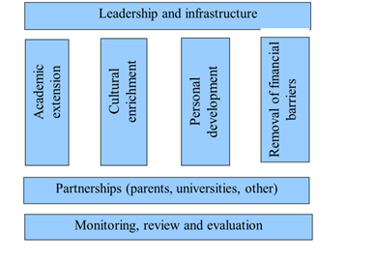
Research to understand successful approaches to supporting the most academically able disadvantaged pupils.
EEF Research Report November 2018.

Slide 40
“
”
Social Mobility in the UK ● Post-Pandemic
The economic impact of coronavirus is likely to increase poverty and the disadvantage gap.
Social Mobility Commission, 2021, Against the Odds

Slide 41
Child poverty has an important influence on social mobility, as children living in poverty can often have worse health, worse education outcomes and start school developmentally behind their more advantaged peers.
Social Mobility & Education ● Attainment Gap
Social Mobility Commission, 2019, State of the Nation 2018-19: Social Mobility in Great Britain
KS5
Only 16 per cent of those on free school meals attain at least two A levels compared to 39 per cent of all other pupils.
By the end of Key Stage 5
By eleven
(end of Key Stage 2)
KS2
Less than half (46 per cent) of pupils entitled to free school meals reach the standards expected for reading, writing and mathematics, compared to 68 per cent of all other pupils.
By seven
(end of Key Stage 1)
KS1
Larger gaps are evident in reading (18 percentage points), writing (20 percentage points) and mathematics (18 percentage points).
By the age of six (Year 1)
Y1
There is a 14 percentage point gap in phonics attainment between children entitled to free school meals and their more advantaged peers.

Slide 42
Closing the Attainment Gap
Strategies
Boosting students’ cultural capital
Improving everyday life and well-being for students
Closing prior attainment gaps
Raising aspirations
Supporting self-esteem & confidence

Slide 43
Closing the Attainment Gap
Social Mobility Commission, 2021, Against the Odds
Know your school context
School contexts will impact on their approach to tackling socio- economic disadvantage & can be a strong predictive factor of their PP students’ progress.
Contextual Advantages
Contextual Disadvantages
Strong reputation
High levels of parental engagement
Active alumni networks
15/20% of mainstream state secondary schools
High level of student mobility (school transfers)
High proportions of students having experiences trauma or in long-term care
Strong absence rate
Hidden Resources

Slide 44
What strategies can be used to reduce the disadvantaged gap?

Slide 45
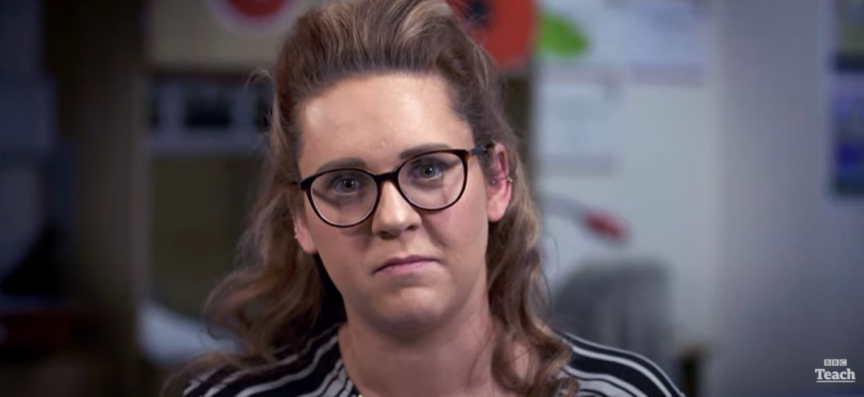
Closing the Attainment Gap
Social Mobility Commission, 2021, Against the Odds
Strategies
There is no single approach to reduce the progress gap that can be implemented in all schools, or even the majority of them.
Pupil Premium
Mechanisms for listening to students in schools
Post-16 Guidance
Quality of teaching
Personalisation (resources tailored to students needs)
Accessible pastoral system
Person in charge of Pupil Premium students
Vertical tutoring
Mixed attainment classes at KS3
Staff school culture

Slide 46
The importance of high expectations cannot be underestimated – students raise their game to meet those standards, so sharing examples of high level work will show all learners what is expected of them.
Notes:
Moral purpose – support for the vulnerable in our schools and communities. Linked to expectations – are our standards different for different pupils? How do you know?

Slide 47
Closing the Attainment Gap
Social Mobility Commission, 2021, Against the Odds
There is no single approach to reduce the progress gap that can be implemented in all schools, or even the majority of them.
Pupil-Premium-Strategy-Statement-2021-22.pdf (bhcet.org.uk)
Pupil Premium
Pupil eligibility criteria | Amount of funding for each primary-aged pupil per year | Amount of funding for each secondary-aged pupil per year | Funding is paid to
Pupils who are eligible for free school meals, or have been eligible in the past 6 years | £1,345 | £955 | School
Pupils who have been adopted from care or have left care | £2,345 | £2,345 | School
Children who are looked after by the local authority | £2,345 | £2,345 | Local authority
What is Pupil Premium?

Slide 48
Closing the Attainment Gap
Pupil Premium
A strong staff culture regarding the pupil premium is an important factor in tackling socio-economic disadvantage.
Discussion:
In some schools, as many as a quarter of staff have reservations about the pupil premium. What do YOU think?
Social Mobility Commission, 2021, Against the Odds
Effective?
Ineffective?
Fair?
Discriminatory?

Slide 49
Closing the Attainment Gap
Listening to Students
Having systems to listen to students can give important insight into how effective or appropriate approaches to pupil premium are likely to be.
Social Mobility Commission, 2021, Against the Odds

Slide 50
Closing the Attainment Gap
Social Mobility Commission, 2021, The Road not Taken: the Drivers of Course Selection
Post-16 Guidance
Implementation of the Gatsby principles
Extra careers guidance and support for target groups (disadvantaged women with low or average prior attainment; disadvantaged Black Caribbeans; disadvantaged White British women)
Development of students’ knowledge of nonacademic routes & new T levels.
Presenting students with data on the returns for different qualifications
Challenging gender norms and importance of role models?
Work experience for technical occupations?

Slide 51
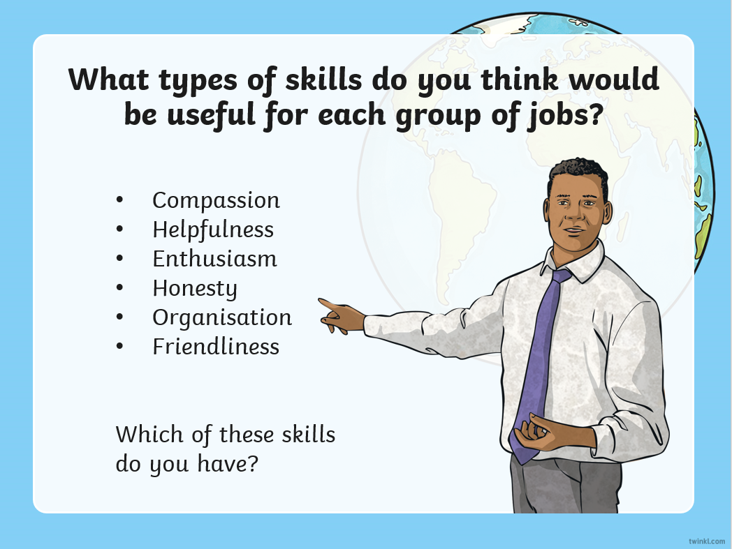
Closing the Attainment Gap
Post-16 Guidance Gatsby
Discussion:
What interventions, initiatives, policies, activities, etc. have you observed in your school to meet the 8 Gatsby Benchmarks?
How does your school ensure disadvantaged pupils benefit from it?
As a subject
Within other subjects
Help students:
identify the skills that they need to develop;
understand the potential career pathways that they might lead to;
Promote good standard of English and maths to build firm foundations for a variety of careers.

Slide 52
Closing the Attainment Gap
Post-16 GuidanceT-Level introduction
New courses which follow GCSEs
Equivalent to 3 A levels
2-year courses
Launched September 2020
In collaboration with employers and businesses
A mixture of classroom learning and ‘on-the-job’ experience during an industry placement of at 45 days
accounting
agriculture, land management and production
animal care and management
building services engineering for construction
catering
craft and design
design and development for engineering and manufacturing
design, surveying and planning for construction
digital business services
digital production, design and development
digital support and services
education and childcare
finance
hair, beauty and aesthetics
health
healthcare science
legal
maintenance, installation and repair for engineering and manufacturing
management and administration
engineering, manufacturing, processing and control
media, broadcast and production
onsite construction
science
Discussion:
Look at the subjects available, which ones link to the skills & knowledge covered by your subject at KS3 & 4?

Slide 53
Closing the Attainment Gap
Post-16 Guidance - Advanced British Standard Consultation 2024
"Over the next decade, we are seeking to introduce the Advanced British Standard (ABS), a new Baccalaureate-style qualification framework for 16-19 year-olds.
The ABS will:
Bring together technical and academic routes into a single framework, taking the best of A levels and T Levels.
Increase the number of taught hours for all students.
Require students to study mathematics and English to the age of 18.
Offer greater breadth, increasing the average number of subjects students take post 16, with students able to choose a combination of bigger and smaller subjects, called ‘majors’ and ‘minors’.
Have a clear offer for all students." DfE January 2024.

Slide 56
EEF responds to EPI (Education Policy Institute) report on the disadvantage gap in education.
Press Release •0 minutes •10 February, 2022
Professor Becky Francis, Chief Executive of the Education Endowment Foundation (EEF), said:
“Today’s new research from EPI is an important reminder that education inequality remains firmly entrenched in our system. Even before the onset of the pandemic, young people from disadvantaged backgrounds struggled to match the academic achievement of their classmates. The hard-won progress that teachers have made towards closing these attainment gaps has stalled, likely as a direct result of the increasing child poverty, combined with the disruptions to learning we’ve seen over the past two years.
“It is our collective responsibility to make sure that disadvantaged students – in every region of the country – are supported to achieve their potential. The pupil premium is arguably the most important tool we have for addressing this challenge. It is more important than ever that we redouble our efforts to make sure that these vital resources are used in ways that make the biggest difference to children and young people.”

Slide 57
Social Mobility Commission State of the Nation Report 2023
Read the 'Education' section of this report.
Summarise the key findings in your Reflective Journal.
Is education contributing to social mobility?
What is the position in NE England?

Slide 58
The New Stateman. Article about the independent school system.
Read the article from the New Statesman, republished in The Sunday Times January 2023, regarding the future of the independent school system.
Summarise the key findings in Your Reflective Journal.
What are the key arguments in favour and against the independent school system.

