Slide 1
PGCert/Level7 2023/24 Assessment & Planning for Pupil Progress in the Primary Classroom 2
2023/24
Leeds Trinity University
Judy Clarke
Ju.Clarke@leedstrinity.ac.uk

Slide 2
Outcomes
An introduction to the differences between summative and formative assessment.
An introduction to the principles of good feedback.
Securing a recognition of the value of feedback in closing gaps in learning.

Slide 3
National Assessments
Summative Assessments
High Stake Assessments
Only type of assessment?
Most effective type of assessment?
Notes:
As discussed this morning.
Is this the only type?
Should this dominate your thoughts?
Does it suggest that assessment only relevant intermittently at key points?
Can you suggest an example of another type of summative assessment activity?
Y4 Times Table Test = summative
Preparation for the test may involve regular, routine formative assessment activities.

Slide 4
Classroom Teacher Led Assessments
Formative Assessments
Low Stake Assessments
Examples?
Notes:
Low Stake:
Across the curriculum: Follow Mes, digital quizzes – low stake checks on prior learning. Must assess what has been taught.
Check you are teaching from the correct starting point.

Slide 5
The Power of Effective Feedback: Consider the impact when associated with low stake assessment… Effective feedback closes the gap between where pupils are and where they are aiming to be…
Notes:
Recent research suggests single most effective strategy for securing learning.
Across the curriculum, not just in English and maths.
Focus during CPD with subject leads: history & geography & undergraduates. Importance of subject specific feedback.
Regular, routine low stake assessments complements the process.

Slide 6
5 Minute Group Discussion Please nominate another spokesperson
What does good feedback/marking look like?
What is important?
What is the purpose?
Discuss…
Notes:
Discuss on table.
Jot down response and definition.
Spokesperson….
Break

Slide 7
Validated by Research
Significant pieces of research discuss the importance of the immediacy of formative assessment. Authors include:
Dylan Wiliam
Hattie and Timperley
Shirley Clarke
Education Endowment Foundation
Notes:
Also Ofsted Research Reviews – not looking at geography but report contains useful pedagogy – transferable across subjects.

Slide 8
Research indicates:
Poor feedback is:
an abstract mark
Generalised:
This is a poor/good piece of writing is a value judgement.
Please use more paragraphs is advice, not constructive feedback.
Notes:
Have all done this and received!
Written comment is expected so we do, particularly when pressed for time.
Routine response but of no value so why waste the time? Mary Myatt – Moodle.

Slide 9
Research indicates:
Good feedback has the power to improve teaching and learning. It must:
address the learning context, relating specifically to the task. How to do the task more effectively?
address faulty interpretations, not a total lack of understanding. Therefore, restructures understanding, enabling pupil to progress
target students at the correct level
create a supportive evidence trail.
Hattie, J and Timperley, H (2007) The Power of Feedback. Review of Educational Research, Vol 77, No. 1, pp. 81 -112
Notes:
Do you have to wait until books are handed in to do this?

Slide 10
Effective Feedback:
Research indicates that good feedback is timely and given as soon as possible
So, plan to feedback sooner, rather than later! Whole Class Marking = immediate:
Live Marking. Comments and observations to individuals/groups. Highlights = praise!
Mini plenaries to check understanding
Supplemented with individualised, written feedback, as required
Notes:
Secures significant reduction in workload – marking identified as significant reason for teachers leaving the profession.
Good use of mini plenaries will allow pupils to explain to each other – rather than you!
If within school Live Mark with specific coloured highlighter to acknowledge good/interesting work. Student: Why? What am I doing well?
Values Individual work and shows an interest in work as being created – important.
Use good examples to prompt mini plenaries, as well as misconceptions.
Use good examples of work to introduce the next lesson.
Address needs of one immediately – catch more!

Slide 11
Dylan Wiliam Educational Researcher: Former Teacher.
Material from Dylan Wiliam widely available on YouTube.
Dylan Wiliam: Formative assessment – YouTube
An accessible introduction….
Website, including published papers:
Welcome to Dylan Wiliam’s website
Notes:
Often secondary but transferable….
Intro to NC – CC journal

Slide 12
So:
How often should teachers assess?
Minute by minute, day by day…
Use evidence about learning to adapt what happens in the classroom to meet student needs.
Dylan Wiliam
FormativeAssess.indd (ascd.org)
Notes:
Link to article.

Slide 13
Next Session
Preparing for A2: Academic Writing Reminders
Towards Dialogic Teaching: Robin Alexander
Developing Formative Assessment:
Self and Peer Assessment. Students as learning resources for one another, Dylan Wiliam
Summative and Formative Assessment.

Slide 14
Post Session Tasks 1
Investigate your school’s marking and feedback strategies
Audit forms of classroom feedback
Identify tracking and reporting systems
Discuss value of moderation with class teacher/subject lead/mentor/link tutor
Begin to plan for, record and evaluate formative assessment: AFL
Check Moodle regularly for updates
Read!

Slide 15
Post Session Tasks 2
What is Metacognition and Self-Regulated Learning?
Identify research to support your arguments, including:
EEF Guidance Report and References.
Writers and advisers: Alex Quigley, Dylan Wiliam, Robin Alexander
Chartered College: Impact Journal, Issue 14.
But how and why does it work? A primary school study Into the impact of metacognitive strategies in disadvantaged learners, Kathryn Atkins and Jonathan Doherty
Activating Thinking: Rob Coe: A Model for Great Teaching:
A Model for Great Teaching - Evidence Based Education

Slide 16
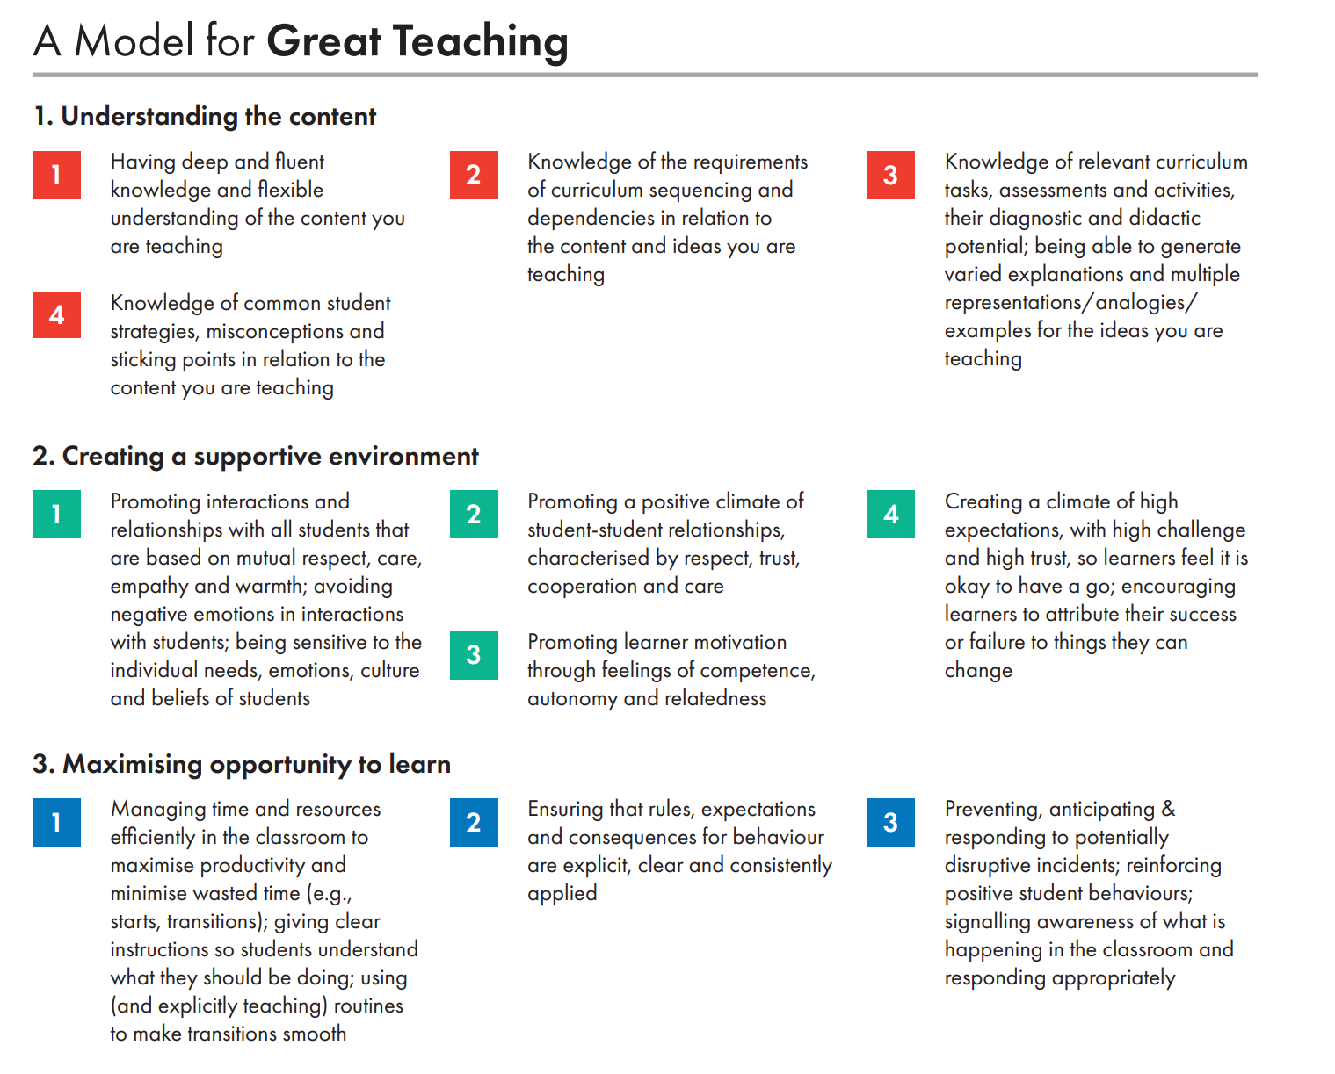
Model for Great Teaching 1 A Model for Great Teaching - Evidence Based Education

Slide 17
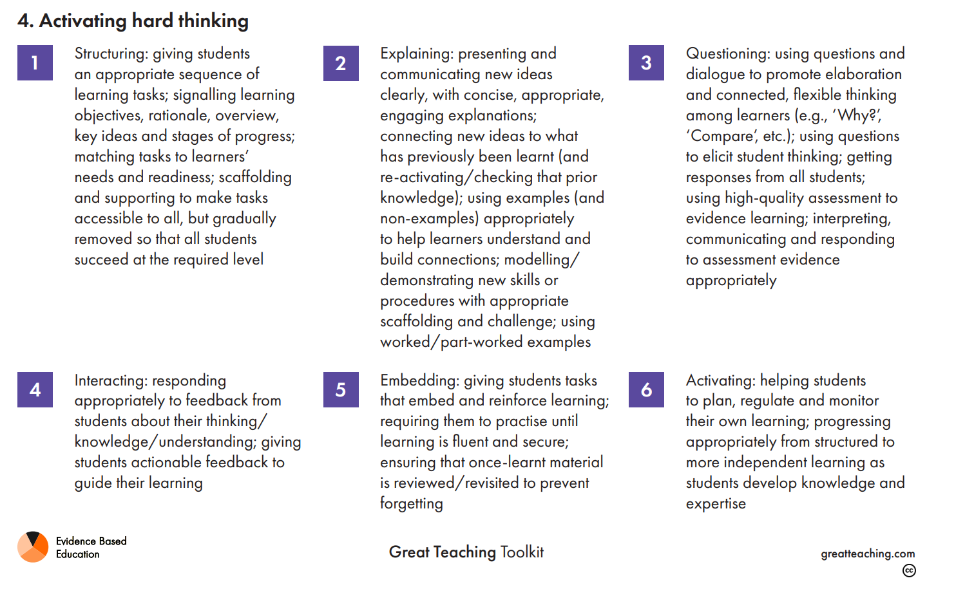
Model for Great Teaching 1 A Model for Great Teaching - Evidence Based Education

Slide 18
Leeds Trinity Moodle and E Mails
As previously:
Check Moodle, at least, weekly (Monday)
Announcements, including Moodle resource alerts, are delivered to LTU e mails
IT Issues: Contact Leeds Trinity IT Helpdesk helpdesk@leedstrinity.ac.uk directly

