Slide 1
Central Training: General Professional Studies
PE

Slide 2
Training Overview
This session will aim to…
Introduction - To understand the core aims and expectations of the EYFS/KS1 and KS2 Programmes of Study for PE.
Research & Recommendations - To introduce trainees to the national context of PE Teaching from R-Y6.
Subject Knowledge and Development – To empower trainees to deliver engaging and purposeful PE lessons by developing their knowledge from Reception to Year 6.
Pedagogy Planning and Progression – To equip trainees with a range of teaching and learning strategies to implement in their PE lessons.
1
2
PE
3

Slide 3
Training Overview
Outline of the Day
1. National Curriculum, Theory & Research
2. Subject Knowledge Development
3. Pedagogy, Planning & Progression
4. Practical ideas – planning a lesson
PE

Slide 4
Core Content Overview • High Expectations (TS1)
Evidence Statements: Learn that…
Setting clear expectations can help communicate shared values that improve classroom and school culture.
1.1
Teachers have the ability to affect and improve the behaviour and motivation of their pupils.
1.4
Teachers are key role models.
1.5
A culture of mutual trust and respect supports effective relationships.
1.2
Teacher expectations can affect pupil outcomes.
1.3
High-quality teaching has a long-term positive effect on pupil’s life chances.
1.6

Slide 5
Core Content Overview • How Pupils Learn (TS2)
Evidence Statements: Learn that…
Working memory is where information that is being actively processed is held but is limited.
2.1
Learning involves a lasting change in pupils’ capabilities and understanding.
2.4
2.5
Long-term memory is a store of knowledge that changes as pupils learn.
Prior knowledge plays an important part in how pupils learn.
2.2
2.6
Where prior learning is weak, pupils are more likely to develop misconceptions.
2.3
An important factor in learning is memory: working memory and long-term memory.

Slide 6
Core Content Overview • How Pupils Learn (TS2)
Evidence Statements: Learn that…
Worked examples that take pupils through each step of a new process are also likely to support pupils to learn.
2.7
Regular purposeful practice of what has previously been taught can help consolidate learning.
2.9
Requiring children to retrieve information from memory and spacing so that pupils revisit learning after a gap are also likely to strengthen recall.
2.8

Slide 7
Core Content Overview • Curriculum (TS3)
Evidence Statements: Learn that…
A school curriculum sets out its vision for the knowledge, skills and values that pupils learn.
Explicitly teaching knowledge and skills pupils need is beneficial.
3.1
3.5
3.2
Secure subject knowledge helps teachers to motivate pupils and teach effectively.
To think critically, pupils must have secure understanding of knowledge.
3.6
3.3
Ensuring pupils master foundational concepts and knowledge before moving on is likely to build confidence
Pupils learn new ideas by linking those ideas to existing knowledge.
3.7
3.4
Anticipating common misconceptions is important aspect of curricular knowledge.

Slide 8
Core Content Overview • Curriculum (TS3)
Evidence Statements: Learn that…
3.8
Pupils are likely to struggle to transfer what has been learnt in one discipline to a new or unfamiliar context.
3.9
Reading is key to learning in the rest of the curriculum.
3.10
Every teacher can improve pupils’ literacy

Slide 9
Core Content Overview • Classroom Practice (TS4)
Evidence Statements: Learn that…
Effective teaching can transform pupils’ knowledge, capabilities and beliefs about knowledge.
Explicitly teaching pupils metacognitive strategies support independence and academic success.
4.1
4.5
4.2
Effective teachers introduce new material in steps, explicitly linking new ideas to what has previously been learned.
Questioning used to check prior knowledge, assess understanding and break down problems.
4.6
4.3
Modelling helps pupil understand new processes and ideas
4.7
High-quality classroom talk can support pupils.
4.4
Guides, scaffolds and worked examples can help to apply new ideas.

Slide 10
Core Content Overview • Classroom Practice (TS4)
Evidence Statements: Learn that…
Ensuring pupils have repeated opportunities to practise increases success.
4.8
4.9
Paired and group activities can increase pupil success, but to work effectively pupils need guidance and support.
Care should be taken to monitor the impact of groupings on pupil attainment, behaviour and motivation.
4.10
4.11
Homework can improve pupil outcomes

Slide 11
Core Content Overview • Adaptive Teaching (TS5)
Evidence Statements: Learn that…
Pupils are likely to learn at different rates and require different levels of support from teachers to succeed.
Flexibly grouping pupils within a class can be effective, but care should be taken to monitor impact on engagement.
5.1
5.5
5.2
Seeking to understand pupils’ different, including different levels of prior knowledge and potential barriers to learning is essential.
It is a common misconception that pupils have distinct and identifiable learning styles.
5.6
5.3
Adapting teaching in a responsive way is likely to increase success.
Pupils with SEND are likely to require additional or adapted support
5.4
Adaptive teaching is less likely to succeed if teachers set lower expectations for particular pupils
5.7

Slide 12
Core Content Overview • Assessment (TS6)
Evidence Statements: Learn that…
Effective assessment provides teacher with information about pupils’ understanding and needs.
High-quality feedback can be written or verbal, encourages further effort and provides specific guidance on how to improve.
6.1
6.5
6.2
Good assessment helps teachers avoid being over-influenced by potentially misleading factors.
Over time, feedback should support pupils to monitor and regulate their own learning.
6.6
6.3
Teachers should be clear about how assessment informs decisions.
Teachers used information from assessments to inform decisions they make.
Working with colleagues to identify efficient approaches to assessment is important.
6.4
6.7

Slide 13
Core Content Overview • Behaviour Management (TS7)
Evidence Statements: Learn that…
Routines can help create an effective learning environment.
Building effective relationships is easier when pupils believe that their feelings will be considered and understood.
7.1
7.5
7.2
A predictable and secure environment benefits all pupils, but particularly SEN.
Pupils are motivated by intrinsic and extrinsic factors.
7.3
The ability to self-regulate affects pupils’ ability to learn, success in school and future lives.
7.6
Pupils’ investment in learning is also driven by their prior experiences and perceptions of success and failure.
7.7
7.4
Teachers can influence pupils’ resilience and beliefs about their ability to succeed.

Slide 14
Core Content Overview •
Practice Statements: Learn how to…
1
Demonstrate consistently high behavioural expectations.
4
Plan effective lessons.
Communicate a belief in the academic potential of all pupils.
5
Provide opportunity for all pupils to experience success.
1
2
Build on pupils’ prior knowledge.
6
Check prior knowledge and understanding during lessons.
3
Deliver a carefully sequenced and coherent curriculum.
6
Provide high-quality feedback.

Slide 15
Core Content Overview •
Practice Statements: Learn how to…
7
Develop a positive, predictable and safe environment for all pupils.
8
Develop as a professional.
7
Motivate pupils.
See full detail in the ITT Core Content Framework.
https://assets.publishing.service.gov.uk/government/uploads/system/uploads/attachment_data/file/843676/Initial_teacher_training_core_content_framework.pdf

Slide 16
Core Academic Reading • Assigned Bibliography
Pre Reading
Follow-Up Reading
PE programmes of study: key stages 1 and 2, DfE, 2013 https://assets.publishing.service.gov.uk/government/uploads/system/uploads/attachment_data/file/239040/PRIMARY_national_curriculum_-_Physical_education.pdf
Including pupils with SEN and/or disabilities in primary PE (ioe.ac.uk)

Slide 17
Session 1: National Curriculum, Theory & Research

Slide 18
Psychological benefits
Improves physical health
Social & emotional benefits
Why is PE important?
Improved sleep
Helps with anxiety and lowering stress
Improved cognition & academic performance

Slide 19
Sports Premium
Following the London Olympics all schools receive:
£17,000+ £10 per pupil to spend on PE
Aim is to improve standards of PE in schools
Only subject which receives funding
Accountability – each year school’s need to produce report on their school website to show how they have spent Sport Premium funding

Slide 20
Sports Premium
Schools can use the funding to:
Provide staff with professional development, mentoring, training and resources to help them teach PE and sport more effectively
Hire qualified sports coaches to work with teachers to enhance or extend current opportunities
Support and involve the least active children
Increase pupils’ participation in the School Games
Encourage pupils to take on leadership or volunteer roles that support sport and physical activity within the school
Provide additional swimming provision targeted to pupils not able to meet the swimming requirements of the national curriculum
Embed physical activity into the school day through active travel to and from school, active playgrounds and active teaching
Increase participation in competitive sport

Slide 21
Sports Premium
Schools should not use the funding to:
Employ coaches or specialist teachers to cover planning preparation and assessment (PPA) arrangements
Teach the minimum requirements of the national curriculum – apart from top-up swimming lessons, after pupils’ completion of core lessons

Slide 22
Aims of the Early Years Foundation Stage Framework
The areas of learning and development
1.4 There are seven areas of learning and development that set out what providers must
teach the children in their settings. All areas of learning and development are
important and inter-connected.
1.5 Three prime areas are particularly important for learning and forming relationships.
They build a foundation for children to thrive and provide the basis for learning in all
areas.
These are the prime areas:
• Communication and language
• Physical development
• Personal, social and emotional development

Slide 23
Physical Development
Physical activity is vital in children’s all-round development, enabling them to pursue happy, healthy and active lives. Gross and fine motor experiences develop incrementally throughout early childhood, starting with sensory explorations and the development of a child’s strength, co-ordination and positional awareness through tummy time, crawling
and play movement with both objects and adults.
By creating games and providing opportunities for play both indoors and outdoors, adults can support children to develop their core strength, stability, balance, spatial awareness, co-ordination and agility.
Gross motor skills provide the foundation for developing healthy bodies and social and emotional well-being.
Fine motor control and precision helps with hand-eye co-ordination, which is later linked to early literacy.
Repeated and varied opportunities to explore and play with small world activities, puzzles, arts and crafts and the practice of using small tools, with feedback and support from adults, allow children to develop proficiency, control and confidence.

Slide 24
Physical Development
ELG: Gross Motor Skills
Children at the expected level of development will:
• Negotiate space and obstacles safely, with consideration for themselves and others.
• Demonstrate strength, balance and coordination when playing.
• Move energetically, such as running, jumping, dancing, hopping, skipping and climbing.
ELG: Fine Motor Skills
Children at the expected level of development will:
• Hold a pencil effectively in preparation for fluent writing – using the tripod grip in almost all cases.
• Use a range of small tools, including scissors, paint brushes and cutlery.
• Begin to show accuracy and care when drawing.

Slide 25
Gross versus Fine motor development
Is one more important than the other?
Research shows that the development of fine motor skills depends on the development of gross motor skills and that a joined-up approach to physical development is important. Young children need many opportunities to develop fine motor skills alongside gross motor skills so they can become confident to explore the world around them.

Slide 26
Left hand is an EYFS aged child
Right hand is an older child’s hand
What do you notice?
Why might this have an impact on the activities we give children in EYFS?

Slide 27
PE in EYFS
At this stage, the aim of PE is to improve skills of coordination, control, manipulation and movement, with the majority of it taking place through free or lightly structured activity alongside more structured PE sessions.
Gross motor skills can be developed through jumping, hopping, skipping, climbing and running, or through playing with pedal and push-and-pull toys. Children should have the opportunity to participate freely in these kinds of activities both indoors and outdoors.
Fine motor skills can be developed through activities or experiences throughout a setting. Cooking, gardening, sewing, fixing and making things are all good examples of activities that involve using tools and small movements with accuracy and precision. Small hand movements can also be developed by stirring a magic potion, pegging washing on a line or exploring wet or dry sand.

Slide 28
PE in EYFS
"Although motor development is age-related and not age dependent, it can be argued that fundamental movement skills are best developed between 3 and 8 years old.
Therefore, developing careful progression through Reception and primary school is vitally important."
Research Review Series: PE, Ofsted, 2022

Slide 29
National Curriculum for PE
Purpose of study
A high-quality physical education curriculum inspires all pupils to succeed and excel in competitive sport and other physically-demanding activities. It should provide opportunities for pupils to become physically confident in a way which supports their health and fitness.
Opportunities to compete in sport and other activities build character and help to embed values such as fairness and respect.
Aims
The national curriculum for physical education aims to ensure that all pupils:
develop competence to excel in a broad range of physical activities
are physically active for sustained periods of time
engage in competitive sports and activities
lead healthy, active lives.
Is this enough information for an ECT?

Slide 30
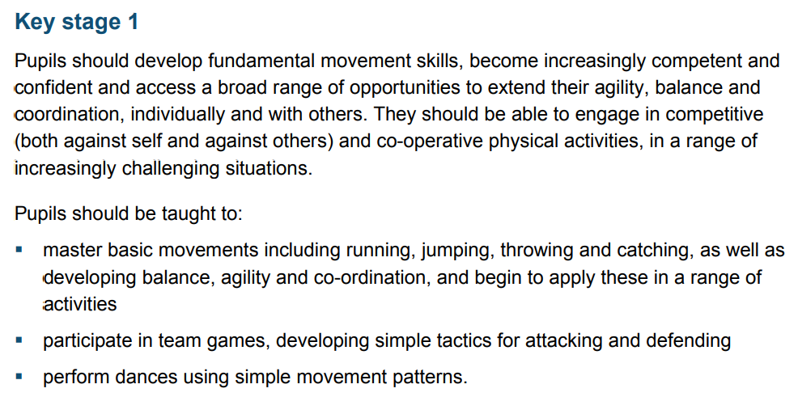
Thoughts?

Slide 31
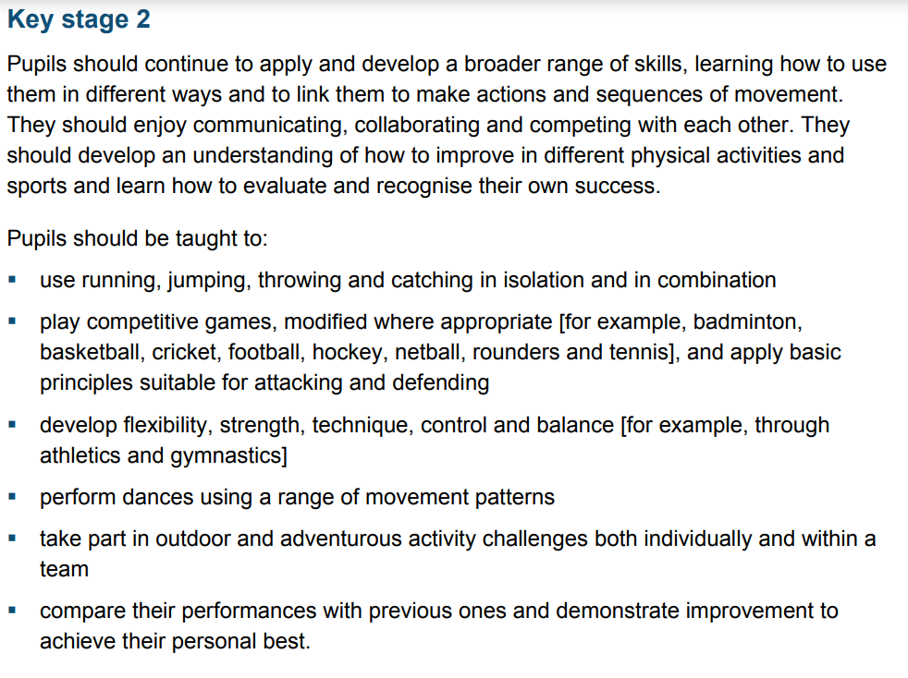
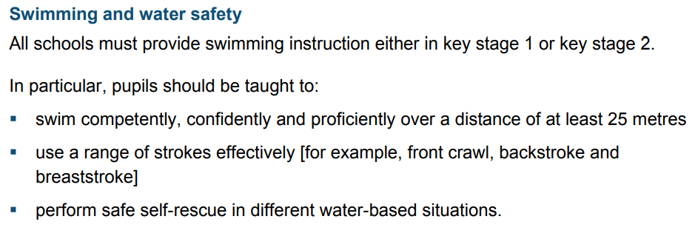
Thoughts?

Slide 32
Session 2: Subject Knowledge Development

Slide 33
PE Units
Activities within PE are broken down into the following units:
Gymnastics
Dance
Outdoor and Adventurous (OAA)
Swimming
Athletics
Invasion Games
Net / Wall Games
Striking & Fielding
Notes:
We don’t teach individual sports - e.g. we don’t teach football – we teach transferable skills that can be used across a range of sports.

Slide 34
PE Units
Invasion Games
Team games where the purpose is to:
invade the opponent’s territory or zone to score goals or points;
protect your own territory to prevent the opposition from scoring goals or points.
They are played within a certain period of time, with an equal number of players on each team. Invasion games are usually fast-paced, and focus on teamwork, keeping possession, attacking, and defending.

Slide 35
PE Units
Net / Wall Games
Games in which players send an object (ball or shuttlecock) towards a court or target area that an opponent is defending.
The aim of net and wall games is to cause that object to land in the target area while making it difficult for the opponent to return the object.

Slide 36
PE Units
Striking & Fielding Games
Games in which players score points by striking an object, and running to designated playing areas.
Or, they try to stop their opponents from scoring by catching the object and returning it to stop the play.

Slide 37
PE Units
Invasion Games | Net / Wall Games | Striking & Fielding
American Football Badminton Baseball Basketball
Cricket Dodgeball Football Golf Handball
Hockey Lacrosse Netball Rounders
Rugby (Union & League) Softball Squash
Table Tennis Tennis Volleyball
Notes:
A3 paper - In groups, organise the sports into each category.

Slide 38
PE Units
Invasion Games | Net / Wall Games | Striking & Fielding
American Football Baseball Basketball Dodgeball Football Handball Hockey Lacrosse Netball Rugby (Union & League) | Badminton Squash Table Tennis Tennis Volleyball | Cricket Golf Rounders Softball

Slide 39
PE Units
Key stage 1
Pupils should develop fundamental movement skills, become increasingly competent and confident and access a broad range of opportunities to extend their agility, balance and coordination, individually and with others. They should be able to engage in competitive (both against self and against others) and co-operative physical activities, in a range of increasingly challenging situations.
Pupils should be taught to:
master basic movements including running, jumping, throwing and catching, as well as developing balance, agility and co-ordination, and begin to apply these in a range of activities
participate in team games, developing simple tactics for attacking and defending
perform dances using simple movement patterns.
Which of these skills could be taught through…
Invasion Games
Gymnastics
Dance

Slide 40
PE Units
Key stage 2
Pupils should continue to apply and develop a broader range of skills, learning how to use them in different ways and to link them to make actions and sequences of movement. They should enjoy communicating, collaborating and competing with each other. They should develop an understanding of how to improve in different physical activities and sports and learn how to evaluate and recognise their own success.
Pupils should be taught to:
use running, jumping, throwing and catching in isolation and in combination
play competitive games, modified where appropriate and apply basic principles suitable for attacking and defending
develop flexibility, strength, technique, control and balance
perform dances using a range of movement patterns
take part in outdoor and adventurous activity challenges both individually and within a team
compare their performances with previous ones and demonstrate improvement to
achieve their personal best.
Which of these skills could be taught through…
Outdoor and adventurous
Net / Wall Games
Gymnastics
Dance
Invasion Games
Notes:
What do you notice – same skills being taught across a range of sports and avtivities

Slide 41
Session 3: Pedagogy, Planning & Progression

Slide 42
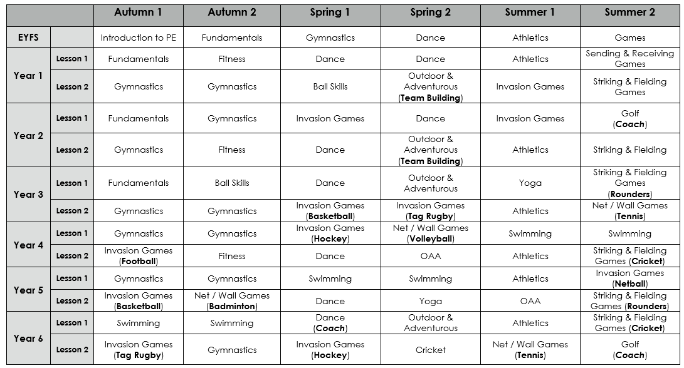
Long Term Planning
Notes:
Coverage? What might determine the order of units?

Slide 43
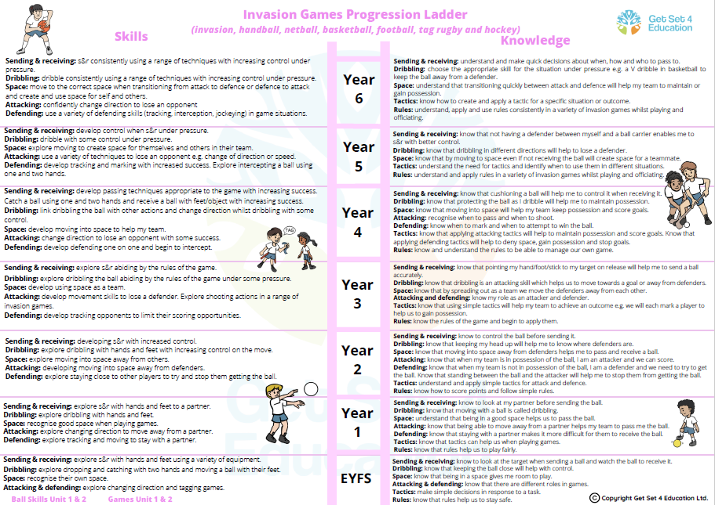
Notes:
What are the significant changes between each age?

Slide 44
PE Planning – Year 4 Invasion Games
Developing a medium-term plan for a half term: where would you start?

Slide 45
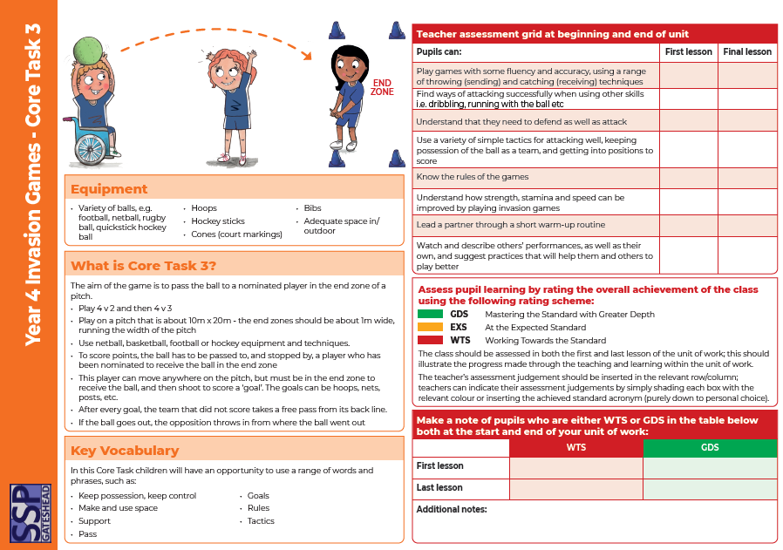
PE Planning – Year 4 Invasion Games
Core Tasks
Assess at start and end of unit
Assess against pupil can statements
RAG rate pupils as a class against statements
Make a note of pupils who are working towards statements or identify as greater depth
Use these assessments to inform your weekly plans

Slide 46
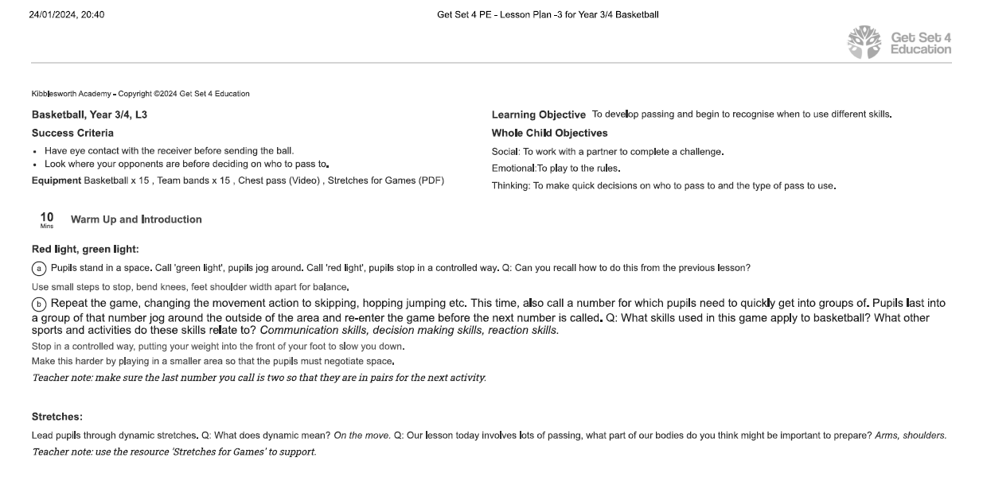
PE Lesson Planning – Year 4 Invasion Games

Slide 47
PE Lesson Planning – Year 4 Invasion Games

Slide 48
PE Lesson Planning – Differentiation (STEP)

Slide 49
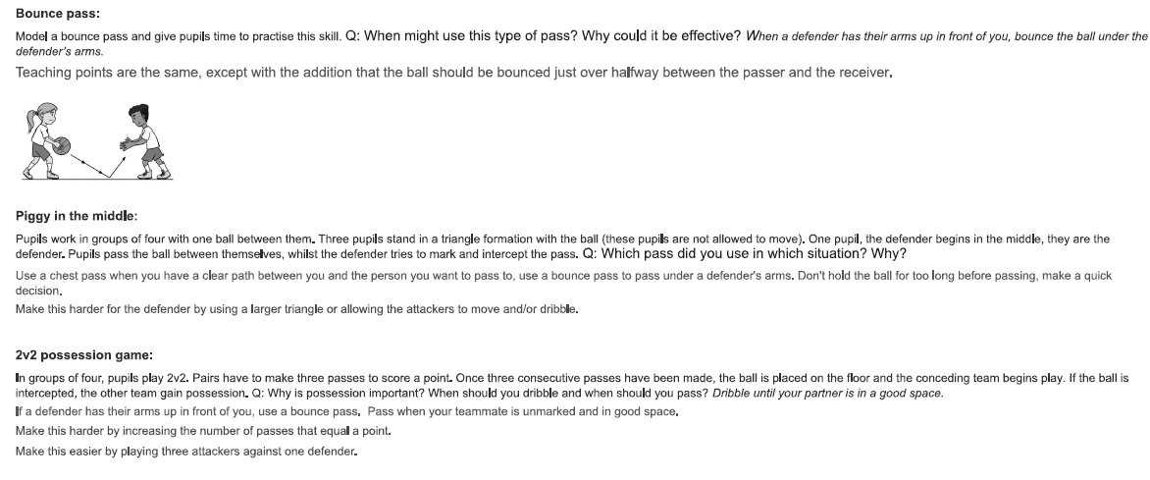
PE Lesson Planning – Year 4 Invasion Games

Slide 50
PE Lesson Planning – Year 4 Invasion Games

Slide 52
Session 4: Practical ideas – planning a lesson

Slide 53
PE Planning – Group Task
Focusing on a specific skill, work in small groups to plan a lesson. Assume that the initial assessment / Core Task has already happened and has identified no major issues but did show some children who were working towards the targets and some who showed potential to be greater depth.
When planning, remember to consider:
Learning objective that focuses on one skill
Success criteria that assesses the ‘whole child’
A warm-up that prepares pupils for the lesson
Skill development in small steps
Differentiation and challenge (STEP)
Small-sided game / activity to consolidate skills
Notes:
Knowledge organisers, Core Tasks, Vocabulary List, STEP, Assessment Document for their Unit

Slide 54
Any questions?
If you have any further questions, please feel free to email me!
andrewridley@kibblesworthacademy.org.uk

Slide 55
Evaluation

