Slide 1
Special Needs and Disabilities (2)
Carmel College SEN Team
7th March 2024

Slide 3
Links to the Core Content Framework for ITT
The following six slides give some examples linked to providing quality SEND education links to the CCF and the Teacher’s Standards.​
Good/Outstanding teaching teaching should be available for all pupils/students.​

Slide 4
Standard 1 – Learn that…
Learn that “teachers have the ability to affect and improve the well-being, motivation and behaviour of their pupils”​
​
Learn that “ teachers expectations can affect pupil outcomes; setting goals that challenge and stretch pupils is essential”​
​
Learn that “ high-quality teaching has a long-term positive effect on pupils’ life chances, particularly for children from disadvantaged backgrounds”​
​
Learn that “… worked examples that take pupils through each step….. Are likely to support pupils to learn”​
Learn how to communicate a belief in the academic potential of all pupils “Creating a positive environment where making mistakes and learning from them and the need for effort and perseverance are part of the daily routine….”​

Slide 5
Standard 2 – Learn that …
Learn that “learning involves a lasting change in pupils’ capabilities”​
Learn that “ prior knowledge plays an important role in how pupils learn….”​
Learn that “where knowledge is weak, pupils are more likely to develop misconceptions…..”​
Learn how to avoid overloading working memory by “breaking down complex material into smaller steps….”​

Slide 6
Standard 4 – Learn that…
Learn that “effective teachers introduce new material in steps…”​
Learn that “ good models make abstract ideas concrete and accessible….”​
Learn that “guides and scaffolds and worked examples can help pupils apply new ideas…..”​
​
Learn how to plan effective lessons by “removing scaffolding only when pupils are achieving a high degree of success….”​
Learn how to plan effective lessons by “starting expositions at the point of current pupil understanding….”​

Slide 7
Standard 5 – Learn that…
Learn that “pupils are likely to learn at different rates…”​
Learn that “seeking to understand pupil differences. …. is an essential part of teaching”​
Learn that “targeted support to pupils who are struggling is likely to increase pupil success…..”​
Learn that “pupils with SEND are likely to require additional or adapted support…. Working closely with families and pupils… is essential”​
Learn how to “make use of well-designed resources….”​
Learn how to “apply high expectations to all groups….ensuring all pupils access a rich curriculum”​
​

Slide 8
Standard 7 – Learn that …
Learn that “a predictable and secure environment benefits all pupils, but is particularly valuable for pupils with SEND…”​
Learn that “the ability to self-regulate … emotions affects ability to learn”​
Learn how to “establish a supportive and inclusive environment….”​
Learn how to give ”manageable, specific and sequential instructions”​

Slide 9
Standard 8 – Learn that …
Learn that “reflective practice…. Is likely to support improvement…”​
Learn that “building effective relationships with parents, carers and families can improve pupils’ motivation, behaviour and academic success.”​
Learn that “…teaching assistants can support pupils more effectively when they are prepared for lessons by teachers, and when TA’s supplement rather than replace support from teachers…..”​

Slide 10
Links to prior learning
During the last SEND (1) session we learnt about:
The CCF, Teacher’s Standards and links with SEN​
The SEND Code of Practice (2014)​
The four broad areas of SEND​
The role of the school and the local authority​
The assessment of SEND​
The role of the SENDCo and specialists​
EHCP’s​
Home-school links​
Top Tips

Slide 11
Part 1. Working with parents and other adults to support SEND pupils.
Discuss within your group your involvement in each the following the date:
1. Parents’ evening.
2. Drafting reports to parents.
3. Planning with other adults who work with pupils in the classroom.
4. Work with other adults who work with pupils outside the classroom.

Slide 12
Other adults: working with Teaching Assistants.
1. Develop a rapport with the TA’s supporting lessons.
Initiate and maintain regular contact.
Share information in a timely manner.

Slide 13
EEF Research about the use of TA’s (1).
The Education Endowment Foundation’s,
“Making best use of Teaching Assistants Guidance Report”
draws on the recent research.
Recent research findings from the,
“Maximising the impact of Teaching Assistants”
programme is evident in this report.
It also provides practical, evidence-based guidance to help all schools make the best use of TA’s.

Slide 14
EEF Research about the use of TA’s (2).
TA’s should be adding value to the work of the teacher, not replacing them.
Quality teaching should be the objective of the class teacher.
Excessive or unnecessary TA proximity can have detrimental impact such as separation from peers and over-dependence.
Poor quality TA involvement can have a detrimental impact.

Slide 15
Strategies to consider in your groups:
1. One teaches and one observes.
2. Station teaching – class divided into six “stations”.
3. Parallel teaching.
4. Alternative teaching.
5. Team teaching.
6. One teaches and one assists.
7. Other?
Note the advantages and disadvantages of each.

Slide 16
Help from TA versus independence.

Slide 17
Working with other adults: the school counsellor.
What did you learn this morning about the role of the school counsellor?
Note key points.

Slide 18
Working with parents.
Case Study.
“My son was in Year 1 when the SENCO asked me if it would be OK to put him on the SEND register. She spoke to me in the playground at morning drop-off. Even though I already had a child with autism and my son had been seeing an Occupational Therapist, it still came as a total shock. I had to work hard to hold back the tears. I think it’s easy to underestimate just what a blow it can be to a parent to hear those words – even one already in the system. Knowing earlier that the school had developing concerns might have softened the way; being told privately with anticipation that this might be hard news to hear would also have helped”.

Slide 19
The “baggage” families may be carrying.
Our past experiences can transfer into the present moment.
This can result in families presenting possibly more intensely than might seem appropriate to the actual situation – past emotional experiences may be colouring the present moment.
As teachers it is in our power to come from a position of empathy and understanding.
When teachers understand the ‘emotional rucksack’ that families are likely to be carrying alongside the profound love for their child, then a more effective partnership can be achieved – a partnership that benefits all.

Slide 20
The emotions faced by families.
Grief - seeing your child not having the life you might have expected them to have, or the life you think other people are leading.
Experience of the journey to diagnosis – not always being believed or heard by professionals.
Trauma of appointments and the responsibility of making medical decisions.
Feeling overburdened by the workload involved in the management of the administration linked to all the appointments and other aspects of support.
Fear of the future – will their child be able to manage independently?
Families may experience loneliness when their child’s developmental path is acutely different from that of their peers. A separation from other families may occur.

Slide 21
A “joined up” approach.

Slide 22
12 top tips for effective partnership with parents.
Be aware of unconscious bias (from both parties).
Avoid judgment.
Avoid assumptions.
Make contact before you ‘have to’ and establish a positive relationship with the family.
Listen to and engage with the contributions of families.
Be mindful that some pupils present very differently at home to school.

Slide 23
12 top tips for effective partnership with parents.
7. Be open, honest and transparent with families. Parents and carers have a right to know.
8. Be sensitive when sharing concerns and seek advice from the SENDCO, as appropriate.
9. Respect professional boundaries e.g. we are not health professionals and do not have the expertise to diagnose!
10.Be mindful of perceived imbalance between the institution of school and the family.
11.Be mindful of any specialist language or jargon.
12. Always act and communicate in the best interests of the pupil.

Slide 24
Class teacher concern?

Slide 25
Consider an example from your class.
How did you assess?
What did you plan?
What did you do?
How did you review?

Slide 26
My communication with parents and other adults to date - audit.
To reach the Teacher’s Standards you must show evidence of working with parents and other adults.
Note your work with these two groups to date in your Reflective Journal.
Note any gaps in evidence and your plans to evidence these going forward.
You may work in groups.

Slide 27
LUNCH BREAK

Slide 28
Part 2. Learning how we learn.

Slide 29
This afternoon we are focusing upon “how we learn” to enhance teaching and learning for all pupils including our SEND pupils.
SEND pupils benefit from quality teaching and learning just like any other group of pupils.
As with all pupils you need to understand the start point and the next steps and what the research tells us about learning.

Slide 30
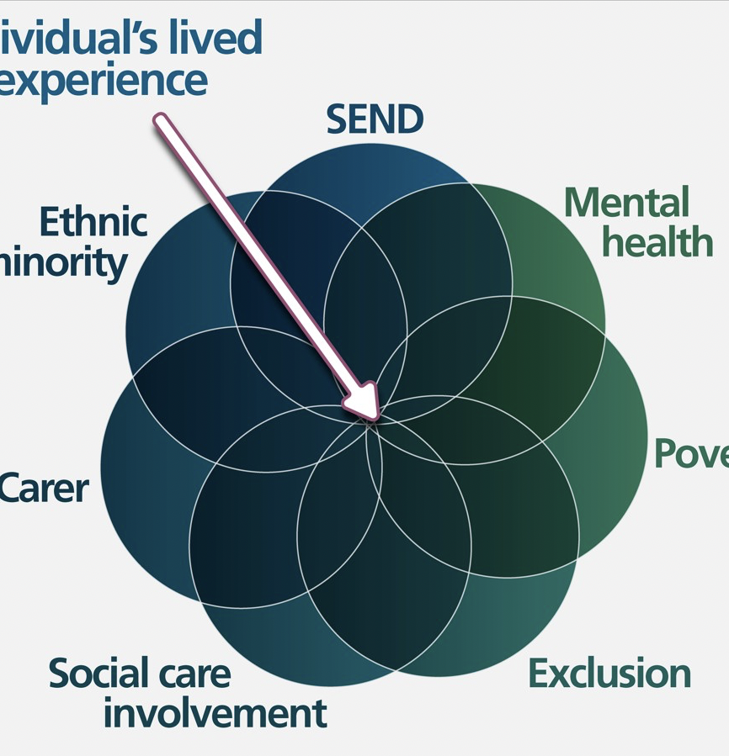
Understanding the lived experience: intersectionality varies for each pupil.

Slide 31
Curiosity and openness
Each learner with a special educational need is an individual.
The lived experience and overlap of multiple vulnerabilities will be equally individual, complex and dynamic.
Two of our greatest tools as teachers when meeting the needs of our learners are curiosity and openness.
We move away from assumption and move towards aspiration.
However, this can only be done in partnership with the pupil and their family. Their voice and views are extremely important in determining the support they receive to ensure they can effectively engage with the curriculum and meet their goals.
We also need a clear understanding about how we learn.

Slide 32
Create your own Venn diagram for an anonymised SEND pupil in your class. Discuss with group.
Which factors should you include in your diagram. Start with SEND.
Carer?
Minority ethnic?
Mental health?
Involvement of external services?
Track record of exclusion?
Poverty?
Factors not mentioned above (please name)?

Slide 33
Learning about each individual.
The lived experience may be a major barrier to learning.
We may need specialized support from others (internally and externally) to try to overcome some barriers to learning.
However, we also need to understand “how we learn” so that we can learn to support all pupils.
Understanding “how we learn” is particularly important when addressing the needs of SEND pupils.
“Learning how we learn” can also help teachers overcome some barriers SEND pupils face.

Slide 34
How we learn – the key focus for today.

Slide 35
What does the research tell us?
We learn:
1. In relationship with others
2. By interacting with our environment
3. By using cognitive and thinking skills
o Schema
o Working memory
o Cognitive load theory
o Attention
o Shallow versus deep processing
o Mastery learning
4. By learning to be a learner
o Metacognition
o Mindset theory

Slide 36
1. We learn in relationship with others.

Slide 37
Learning in relationship with others (1).
Children and young people learn when they feel safe, secure and have positive, trusting relationships with their teachers and peers.
The child or young person’s relationship with teachers and support staff, and the sense of belonging created by a whole school ethos, acts as a secure base. N.B. Link to prior learning regarding ethos.
From here, the child or young person can explore their learning, knowing they can return to where they feel safe if something is challenging.
Close and supportive relationships with teachers have the potential to mitigate the risk of negative outcomes for children and young people who may otherwise have had difficulty succeeding in school.

Slide 38
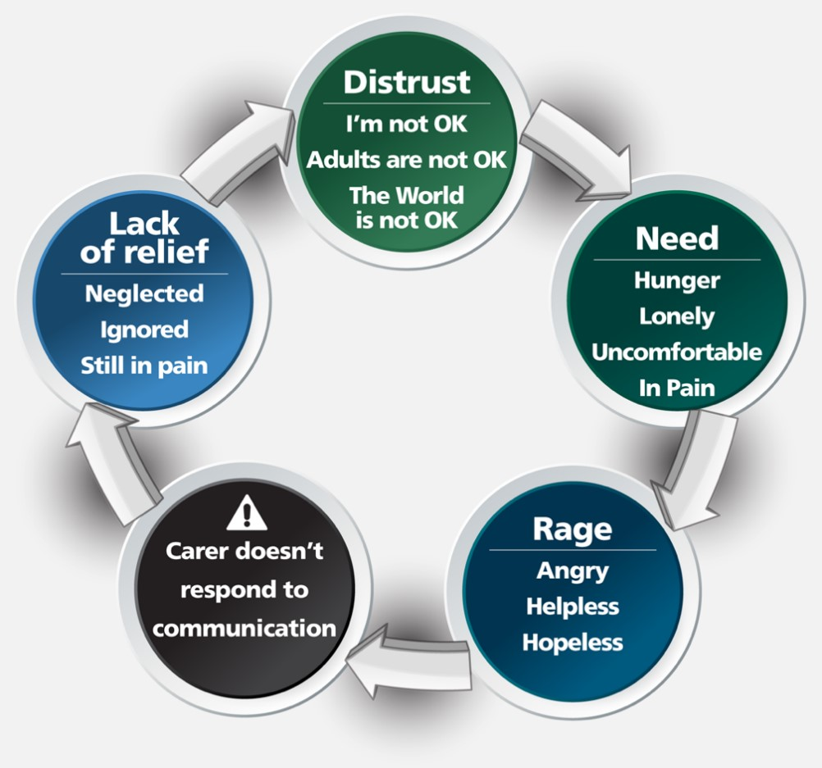
Learning in relationship with others (2). Attachment theory. N.B. Link to prior learning.

Slide 39
Learning in relationship with others (2). Attachment theory. N.B. Link to prior learning.
We may be a significant support to significant adults i.e. the parents and carers
or
we may be the only significant adult or role model that a SEND pupil learns in relationship with

Slide 40
2. We learn by interacting with the environment.

Slide 41
Learning by interacting with our environment (1).
Pupils observe behaviours that they see in their environment and try them out.
How can you demonstrate to your class that it is okay to get things wrong when learning? Role model.
How do you demonstrate good listening? Role model.
Do you demonstrate how to tolerate uncertainty in knowledge when you do not know an answer immediately? Role model.
How can you demonstrate perseverance with a task or building effective rapport? Role model.

Slide 42
Learning by interacting with our environment (2).
Teachers who can create a learner-centred environment where opportunities for all to succeed outweigh failure.
How?
Knowing prior knowledge.
Teaching the knowledge needed to be successful in the next stage of education.
Setting tasks with appropriate challenge and scaffolding to enable success.
This is the assess, plan, do, review cycle required for all learners.

Slide 43
3. We learn using cognitive and thinking skills.

Slide 44
Learning by using cognitive and thinking skills. Schema (1)
Chris Athey directed the Froebel Early Education Project over a five-year period during the early 1970s and published findings in her seminal text published in 1990.
Athey demonstrated that, rather than ‘flitting’ from one activity to another, young children were ‘fitting’ ideas together through their repeated actions.
Athey’s definition of schema is:
“a pattern of repeatable behaviour into which experiences are assimilated and that are gradually co-ordinated. Co-ordinations lead to higher level and more powerful schemas”.

Slide 45
Learning by using cognitive and thinking skills. Schema (2).
Schemas are biological and some cannot be taught. Here are some commonly observed examples:
Trajectory/line – moving in or representing straight lines, arcs or curves
Transporting – moving objects or oneself from one place to another
Enclosing – enclosing oneself, objects or space
Enveloping – enveloping or covering oneself, objects or space
Rotating – turning, twisting or rolling oneself or objects
Ordering – placing objects, people or events in order
Going through a boundary – causing oneself or material to go through a boundary and emerge at the other side
Connecting – connecting oneself to objects and objects to each other
One-to-one correspondence – placing objects in a one-to-one correspondence.

Slide 46
Learning by using cognitive and thinking skills. Schema (3).
Schemas can be developed in different ways:
Sensory motor (through actions).
Functional dependency relationships (if I do this, then that
happens).
Symbolically (using one thing to stand for another, as in role play
and language).
Thinking as something spoken about in the absence of concrete reminders however, we now know that babies can demonstrate thinking although they cannot articulate their thoughts.

Slide 47
Learning by using cognitive and thinking skills. Working memory (and long-term memory) (1).
Working memory holds a limited amount of information for a short amount of time whilst mental effort is given to work on that information.
Information in working memory can be lost when a person is distracted or they are over-loaded information.
The working memory component, called the central executive, gives attention to and co-ordinates visual and verbal short- term memory information.
To reduce cognitive load, ensure domain-specific knowledge before asking the person to solve problems.

Slide 48
Learning by using cognitive and thinking skills. Working memory (and long-term memory) (2).
Once knowledge and skills such as riding a bike or reading are learned to automaticity and can be accessed without much mental effort.
This is because these ‘items’ of knowledge are stored in long-term memory.
Long-term memory is distinct from working memory, but it is a vital resource that has the potential to protect and free-up working memory capacity.
Long-term memories form part of the complex, web- like schemas we build over time.

Slide 49
Learning by using cognitive and thinking skills. Cognitive load theory.
Cognitive Load Theory was proposed by John Sweller.
This theory is based on the limited capacity of working memory to work on new information and existing information at any one time
If we ask pupils to consider too many pieces of information at once to do a task, they will not be able to.
Picture a learner given the task of tidying up all the PE equipment and putting it in the cupboard; they cannot hold all the balls and sticks and cones in their arms at once and items will fall off.

Slide 50
Learning by using cognitive and thinking skills. Attention (1).
There are different types of attention, many of which are still developing throughout childhood and into early adulthood.
How can we make learning relatable and meaningful for a learner to ensure their best attention?
How can distractions be limited in your classroom to help learners sustain their attention?
How can your lessons be structured so that learners are focussing solely on one aspect and not having to divide their attention between multiple tasks?

Slide 51
Learning by using cognitive and thinking skills. Attention (2).

Slide 52
Learning by using cognitive and thinking skills. Shallow v deep processing (1).

Slide 53
Learning by using cognitive and thinking skills. Shallow v deep processing (2).
Craik and Lockhart proposed that what a learner retains is dependent on how deeply the information has been processed.
Firstly, we analyse the physical and sensory features, such as lines, pitch, tone, brightness.
Next, we match new input with what is already known, searching our memory (schema).
If we recognise something, the new information then undergoes some more processing called ‘enrichment’ or ‘elaboration’(when we assimilate or make accommodations to our schema).
So, what the learner remembers depends on how deeply they have processed the information.
When the learner has analysed only the physical features (for example, sounds in a word, or letters in a word, or the shape of the word), we call this shallow processing. It leads to short-term retention.
However, if the word is encoded for its meaning, the meaning may trigger associations already known about that word and lead to deep processing and better retention.

Slide 54
Learning by using cognitive and learning skills. Mastery learning.
Benjamin Bloom worked in the 1960s and 1970s thinking how best to teach so mastery is achieved in subjects by all pupils.
He noticed that pupils needed to be given the time they needed on learning concepts to be able to achieve to the level required. This meant that some pupils needed longer than others.
As well as being given more time to master topics, Bloom advocated for formative testing along the way to mastery, to ensure that gaps in knowledge were picked up and feedback was used to support next steps.
More detail can be found in the Education Endowment Foundation’s Toolkit on Mastery Learning.

Slide 55
4. We learn by learning how to be a learner.

Slide 56
4.Learning by learning how to be a learner.
How do you demonstrate mindset thinking in your classroom?
How does feedback help children and young people manage their own learning?
How can children and young people develop different mindsets?

Slide 57
4.Learning by learning how to be a learner. Metacognition – thinking about thinking (1)
This refers to a learner’s understanding of their own abilities and their attitudes towards learning (myself as a learner);
what strategies are available to them that they know to be effective (my knowledge of strategies);
and their knowledge about specific kinds of tasks (my knowledge of this task).

Slide 58
4.Learning by learning how to be a learner. Metacognition – thinking about thinking (2)
When confronted with a maths problem a learner will think:
What is my approach to maths problems?
What do I know about this kind of maths problem?
What strategies can I use?
The learner needs to plan how to carry out the task, monitor how they are doing it and evaluate their performance.
Most learners will self-regulate by finding ways of persevering when they become stuck. This ability will mature over time and can support further motivation because of the success felt.

Slide 59
4.Learning by learning how to be a learner. Mindset theory
Carol Dweck proposed that learners can develop a ‘growth mindset’ or a ‘fixed mindset’ dependent on their response to challenge, which is in turn dependent on the feedback and response of others.
Learners with a ‘growth mindset’ do not perceive challenge as failure. Learners with a ‘growth mindset’ persevere with new challenges and show more engagement. As a result, they exert more effort and spend more time over tasks and develop neural pathways and skills.
Learners with a ‘fixed mindset’, when presented with a challenge, may believe that their abilities are fixed and avoid feelings of failure by giving up easily. These learners will show less perseverance and are likely to experience a decline in performance over time.
The Education Endowment Foundation guide on feedback shows that it can have a very powerful effect on learners when it is linked to the process of the activity or pupil’s management of their learning or self-regulation.

Slide 60
In conclusion:
Openness and curiosity is required alongside an understanding the lived experience of the SEND pupil. We also need to understand how to work with significant others in the lives of SEND pupils (both internally and externally).
However, we must also understand relationships, how we interact with the environment, how we learn and how to become a learner.

