Slide 1
Central Training: General Professional Studies
Art & Design and Design Technology

Slide 2
Training Overview
This session will aim to…
Introduction - To understand the core aims and expectations of the EYFS/KS1 and KS2 Programmes of Study for Art and DT
Research & Recommendations - To introduce trainees to the national context of Art and DT Teaching from EY-Y6.
Subject Knowledge and Development – To empower trainees to deliver engaging and purposeful Art and DT lessons by developing their subject specific and pedagogical knowledge from EY to Year 6.
Pedagogy Planning and Progression – To equip trainees with a range of teaching and learning strategies to implement in their Art and Design Technology lessons.
1
2
Art and DT
3

Slide 3
Training Overview
Outline of the Day
Pedagogy – Curriculum, progression and principles in Art and DT​
Subject specific knowledge ​
Planning and implementing curriculum
Core skills masterclass​
Resourcing, researching , further CPD
Reflection and evaluation
Art and DT

Slide 4
Core Content Overview • High Expectations (TS1)
Evidence Statements: Learn that…
Setting clear expectations can help communicate shared values that improve classroom and school culture.
1.1
Teachers have the ability to affect and improve the behaviour and motivation of their pupils.
1.4
Teachers are key role models.
1.5
A culture of mutual trust and respect supports effective relationships.
1.2
Teacher expectations can affect pupil outcomes.
1.3
High-quality teaching has a long-term positive effect on pupil’s life chances.
1.6

Slide 5
Core Content Overview • How Pupils Learn (TS2)
Evidence Statements: Learn that…
Working memory is where information that is being actively processed is held but is limited.
2.1
Learning involves a lasting change in pupils’ capabilities and understanding.
2.4
2.5
Long-term memory is a store of knowledge that changes as pupils learn.
Prior knowledge plays an important part in how pupils learn.
2.2
2.6
Where prior learning is weak, pupils are more likely to develop misconceptions.
2.3
An important factor in learning is memory: working memory and long-term memory.

Slide 6
Core Content Overview • How Pupils Learn (TS2)
Evidence Statements: Learn that…
Worked examples that take pupils through each step of a new process are also likely to support pupils to learn.
2.7
Regular purposeful practice of what has previously been taught can help consolidate learning.
2.9
Requiring children to retrieve information from memory and spacing so that pupils revisit learning after a gap are also likely to strengthen recall.
2.8

Slide 7
Core Content Overview • Curriculum (TS3)
Evidence Statements: Learn that…
A school curriculum sets out its vision for the knowledge, skills and values that pupils learn.
Explicitly teaching knowledge and skills pupils need is beneficial.
3.1
3.5
3.2
Secure subject knowledge helps teachers to motivate pupils and teach effectively.
To think critically, pupils must have secure understanding of knowledge.
3.6
3.3
Ensuring pupils master foundational concepts and knowledge before moving on is likely to build confidence
Pupils learn new ideas by linking those ideas to existing knowledge.
3.7
3.4
Anticipating common misconceptions is important aspect of curricular knowledge.

Slide 8
Core Content Overview • Curriculum (TS3)
Evidence Statements: Learn that…
3.8
Pupils are likely to struggle to transfer what has been learnt in one discipline to a new or unfamiliar context.
3.9
Reading is key to learning in the rest of the curriculum.
3.10
Every teacher can improve pupils’ literacy

Slide 9
Core Content Overview • Classroom Practice (TS4)
Evidence Statements: Learn that…
Effective teaching can transform pupils’ knowledge, capabilities and beliefs about knowledge.
Explicitly teaching pupils metacognitive strategies support independence and academic success.
4.1
4.5
4.2
Effective teachers introduce new material in steps, explicitly linking new ideas to what has previously been learned.
Questioning used to check prior knowledge, assess understanding and break down problems.
4.6
4.3
Modelling helps pupil understand new processes and ideas
4.7
High-quality classroom talk can support pupils.
4.4
Guides, scaffolds and worked examples can help to apply new ideas.

Slide 10
Core Content Overview • Classroom Practice (TS4)
Evidence Statements: Learn that…
Ensuring pupils have repeated opportunities to practise increases success.
4.8
4.9
Paired and group activities can increase pupil success, but to work effectively pupils need guidance and support.
Care should be taken to monitor the impact of groupings on pupil attainment, behaviour and motivation.
4.10
4.11
Homework can improve pupil outcomes

Slide 11
Core Content Overview • Adaptive Teaching (TS5)
Evidence Statements: Learn that…
Pupils are likely to learn at different rates and require different levels of support from teachers to succeed.
Flexibly grouping pupils within a class can be effective, but care should be taken to monitor impact on engagement.
5.1
5.5
5.2
Seeking to understand pupils’ different, including different levels of prior knowledge and potential barriers to learning is essential.
It is a common misconception that pupils have distinct and identifiable learning styles.
5.6
5.3
Adapting teaching in a responsive way is likely to increase success.
Pupils with SEND are likely to require additional or adapted support
5.4
Adaptive teaching is less likely to succeed if teachers set lower expectations for particular pupils
5.7

Slide 12
Core Content Overview • Assessment (TS6)
Evidence Statements: Learn that…
Effective assessment provides teacher with information about pupils’ understanding and needs.
High-quality feedback can be written or verbal, encourages further effort and provides specific guidance on how to improve.
6.1
6.5
6.2
Good assessment helps teachers avoid being over-influenced by potentially misleading factors.
Over time, feedback should support pupils to monitor and regulate their own learning.
6.6
6.3
Teachers should be clear about how assessment informs decisions.
Teachers used information from assessments to inform decisions they make.
Working with colleagues to identify efficient approaches to assessment is important.
6.4
6.7

Slide 13
Core Content Overview • Behaviour Management (TS7)
Evidence Statements: Learn that…
Routines can help create an effective learning environment.
Building effective relationships is easier when pupils believe that their feelings will be considered and understood.
7.1
7.5
7.2
A predictable and secure environment benefits all pupils, but particularly SEN.
Pupils are motivated by intrinsic and extrinsic factors.
7.3
The ability to self-regulate affects pupils’ ability to learn, success in school and future lives.
7.6
Pupils’ investment in learning is also driven by their prior experiences and perceptions of success and failure.
7.7
7.4
Teachers can influence pupils’ resilience and beliefs about their ability to succeed.

Slide 14
Core Content Overview •
Practice Statements: Learn how to…
1
Demonstrate consistently high behavioural expectations.
4
Plan effective lessons.
Communicate a belief in the academic potential of all pupils.
5
Provide opportunity for all pupils to experience success.
1
2
Build on pupils’ prior knowledge.
6
Check prior knowledge and understanding during lessons.
3
Deliver a carefully sequenced and coherent curriculum.
6
Provide high-quality feedback.

Slide 15
Core Content Overview •
Practice Statements: Learn how to…
7
Develop a positive, predictable and safe environment for all pupils.
8
Develop as a professional.
7
Motivate pupils.
See full detail in the ITT Core Content Framework.
https://assets.publishing.service.gov.uk/government/uploads/system/uploads/attachment_data/file/843676/Initial_teacher_training_core_content_framework.pdf

Slide 16
Core Academic Reading • Assigned Bibliography
Pre Reading
Follow-Up Reading
Early Years Foundation Stage Framework 2021: Understanding the World and Expressive Art and Design
Statutory framework for the early years foundation stage (publishing.service.gov.uk)
Primary National Curriculum in Art and Design and Design Technology
National Curriculum - Art and design key stages 1 to 2 (publishing.service.gov.uk)
National Curriculum - Design and technology key stages 1 to 2 (publishing.service.gov.uk)
The Art, Craft and Design Rapid Evidence Review (RER) is a survey of published scholarly literature on art, craft and design in education.
Art, Craft and Design Rapid Evidence Review (RER) | NSEAD
Bloomsbury Curriculum Basics: Teaching Primary Art and Design
ISBN-10 147294593X
The Really Useful Primary Design and Technology Book: Subject knowledge and lesson ideas (The Really Useful)
ISBN13:9781138927834

Slide 17
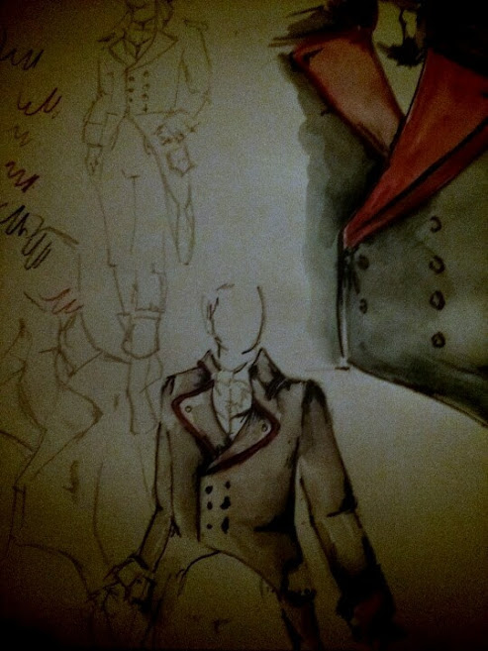
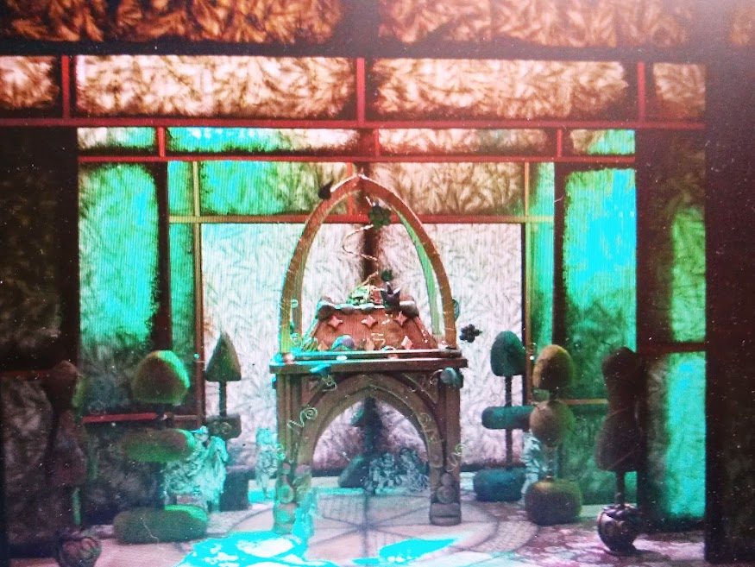
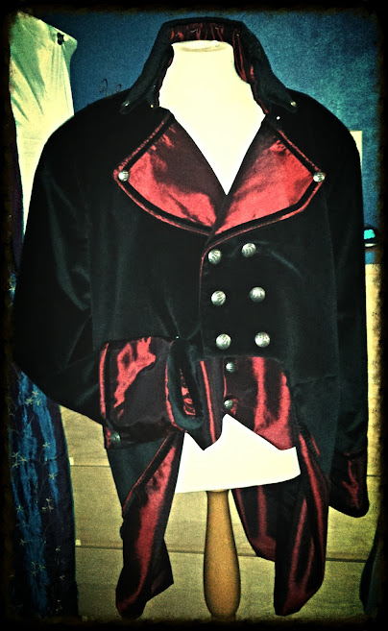
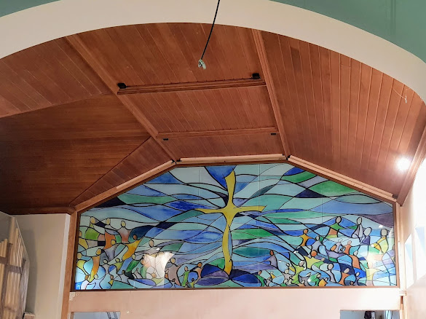
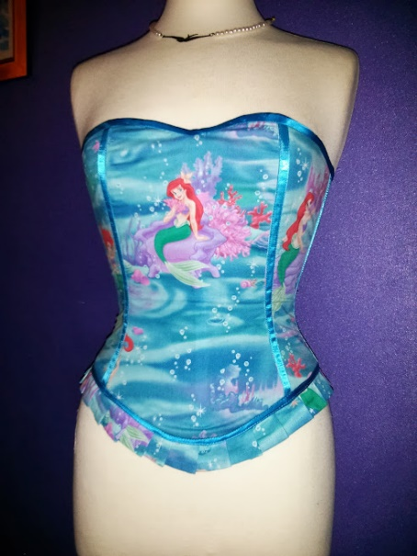
Context- Who am I?

Slide 18
I can’t draw to save my life.
How do I fit it all in?
How well do you know your Art and Design/ DT ?
How do you make that?
I don’t know many artists.
Personal evaluation. Score each out of 10. 1- low 10- high
Basic art skills – drawing/ painting Knowledge of the art curriculum
Knowledge of artists Ideas generation
Confidence in executing ideas Applying art and DT in the curriculum
Notes:
For a minute just think about the headings and score yourself out of ten
How confident are you at teaching Art and Design?
How well do you know NC expectations of this topic?

Slide 19
“Let their outcomes differ. They are not robots. Art is expressive, creative and individual. Let them get messy and explore, don’t do it for them.” – Donna Levin SEN Teacher Priory Woods .

Slide 20
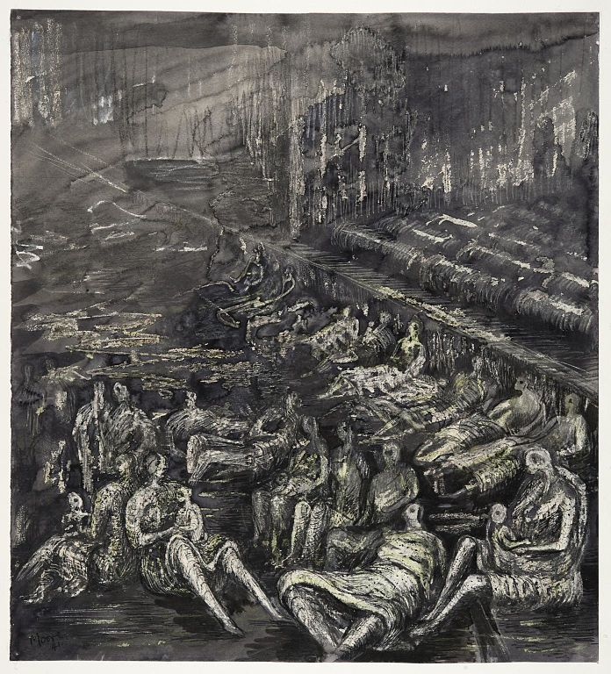
Art as a jumping off point
This Photo by Unknown Author is licensed under CC BY-SA
Notes:
Use images / Art as a jumping off point, a hook to a lesson.
Use them in all subjects. Don’t restrict them to just ART and DT
Use an enriched approach to spark discussion / debate etc…

Slide 21
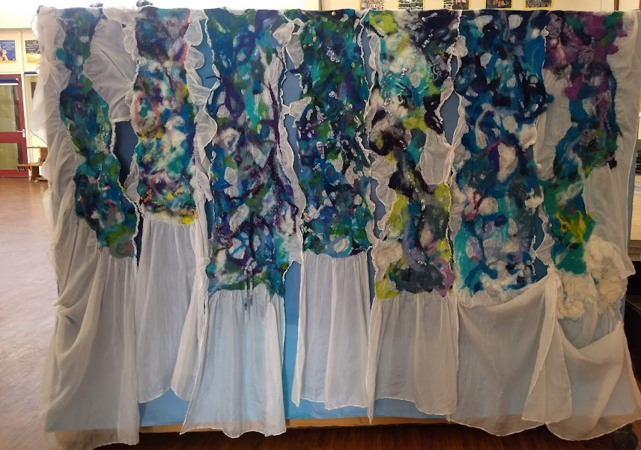
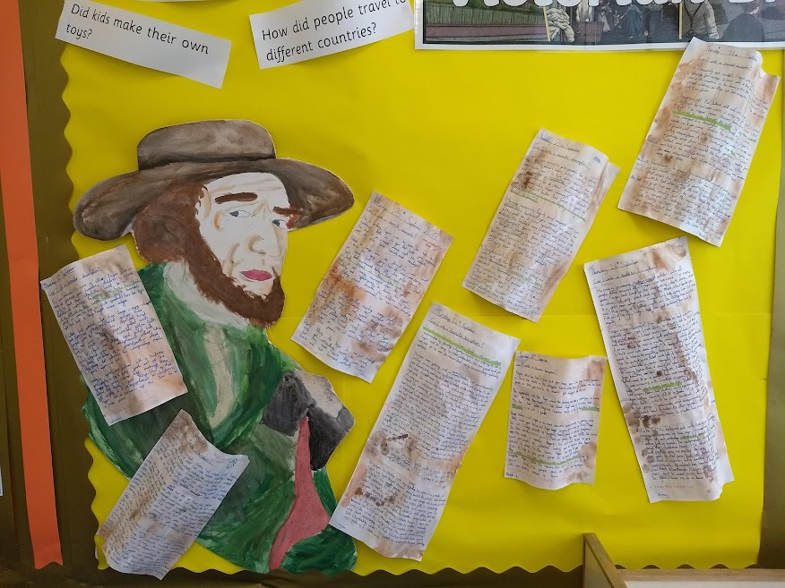
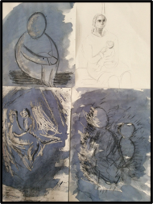
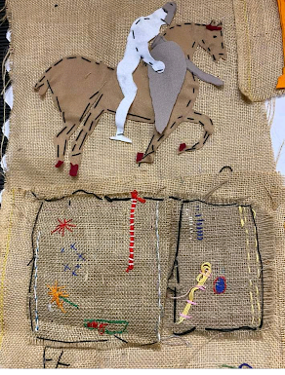
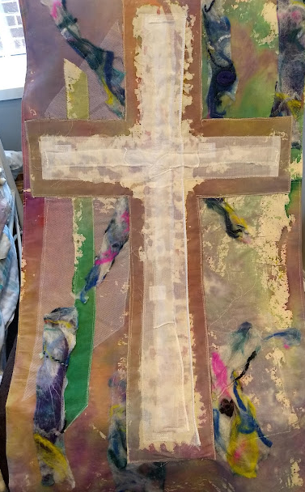
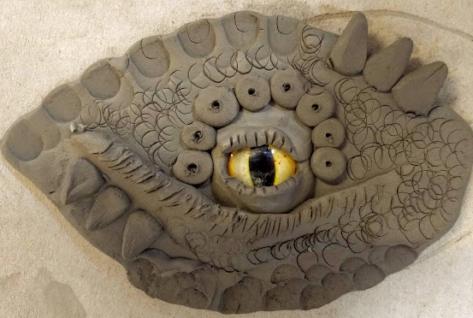
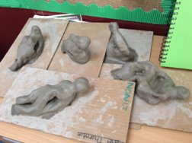

Slide 22
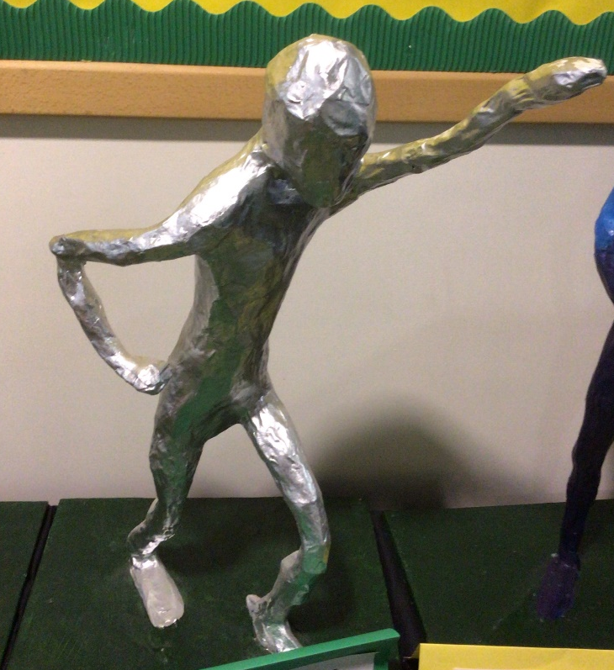
How familiar are you with the National Curriculum for Art and Design?
Notes:
Have any of you taught Art and Design yet?

Slide 23
Art and design programmes of study: key stages 1 and 2
National curriculum in England
Purpose of study
Art, craft and design embody some of the highest forms of human creativity. A high-quality art and design education should engage, inspire and challenge pupils, equipping them with the knowledge and skills to experiment, invent and create their own works of art, craft and design. As pupils progress, they should be able to think critically and develop a more rigorous understanding of art and design. They should also know how art and design both reflect and shape our history, and contribute to the culture, creativity and wealth of our nation.
Notes:
Let’s look at the purpose of study.
What is meant by embody some of the highest forms of creativity?
Have a discussion about what this means to you as teachers?
CHILDREN TO TAP INTO THEIR CREATIVE SIDE, WHETHER OR NOT THEY HAVE A TALENT – EVERYONE IS UNIQUE AND WHATEVER THEY COMPLETE IS SPECIAL TO THEM
ART AND DESIGN CAN HELP THOSE WHO ARE NOT GIFTED ACADEMICALLY – SEND ARE USUALLY VERY GIFTED CREATIVELY – CAN PRODUCE SOME AMAZING PIECES OF ART
What does engage, inspire and challenges in Art and Design look like?
High quality – needs work to show progression to embed knowledge and skills.
Think Critically - Five key critical thinking skills to have in the workplace are observation, analysis, inference, communication and problem-solving.

Slide 25
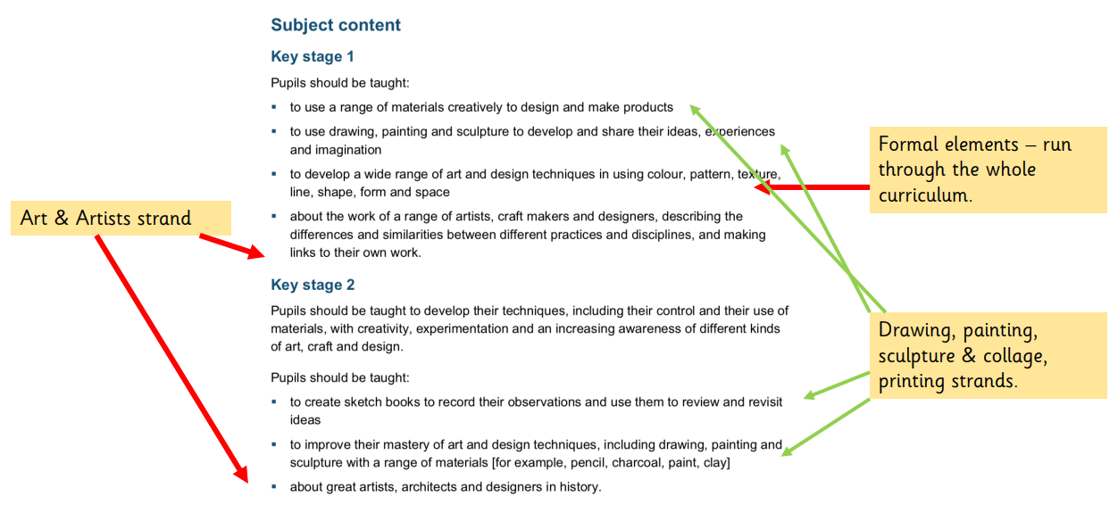
Notes:
Key – mastery of art and design techniques
What does this look like?
Not just about artists,
Architecting designers too

Slide 26
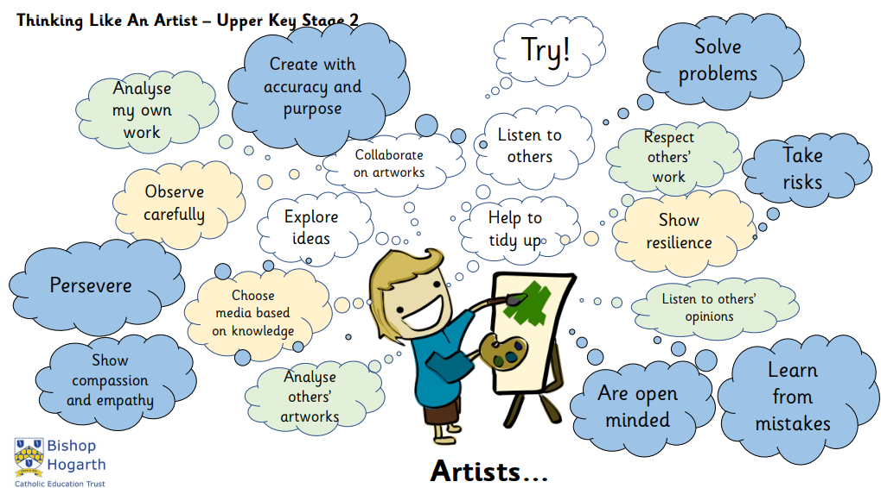
What do You See? Episode 3 | Tate Kids

Slide 27
What does progression look like in Art and Design?
How do I ensure coverage?

Slide 29
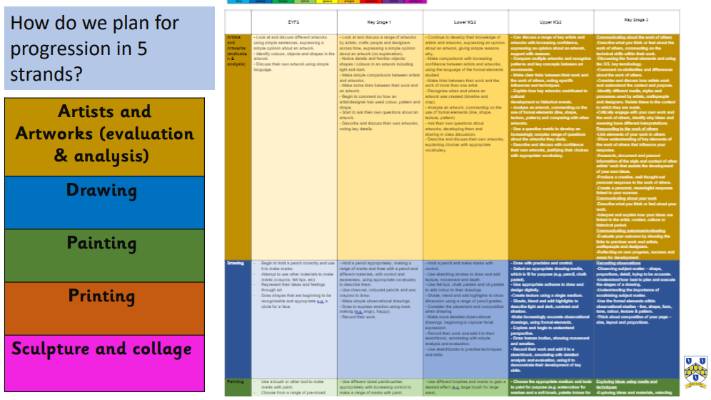

Slide 30
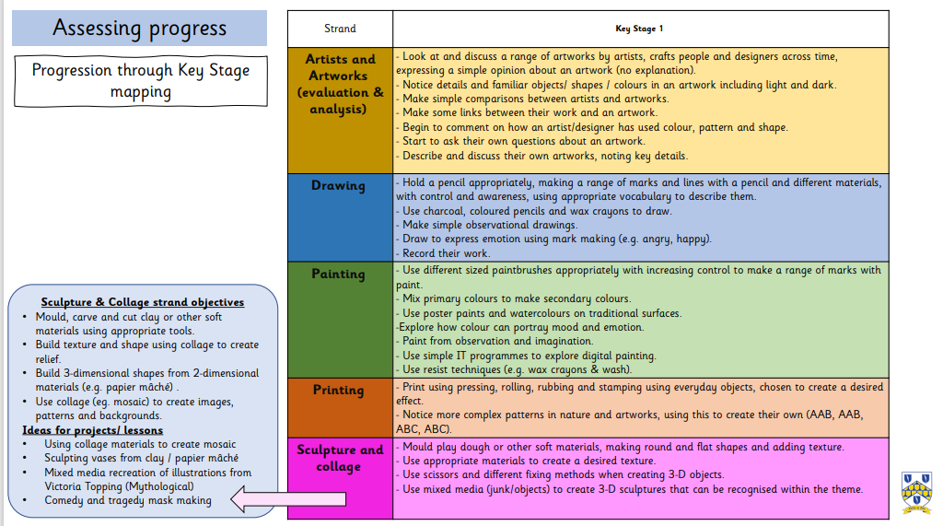

Slide 31
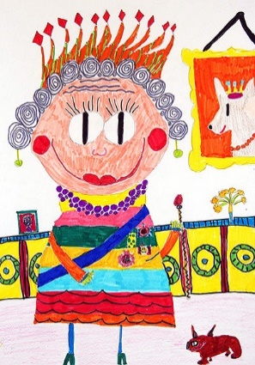
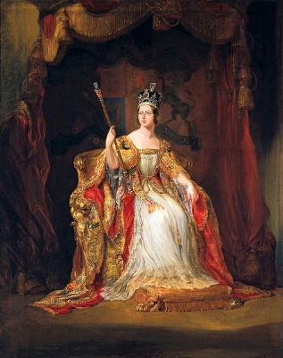
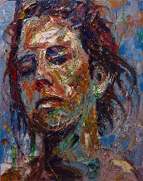
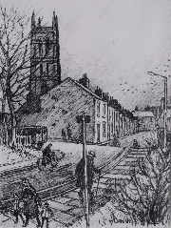
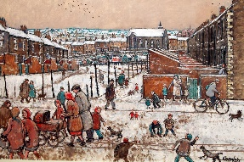
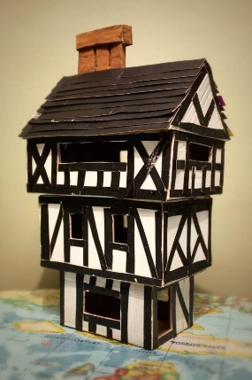
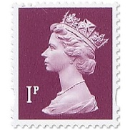
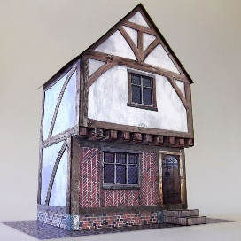
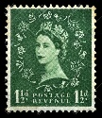
Art – Topic Web Teaching Ideas
Painting strand objectives
-Explore how colour can portray mood and emotion.
-Paint from observation and imagination.
Ideas for projects/ lessons
-Portraits of queens – incorporate elements of expressionism
to portray the personality of the queens.
Formal elements
- Colour, shade
History KS1
Comparing Queens
Drawing strand objectives
- Hold a pencil appropriately, making a range of marks and lines with a pencil and different materials, with control and awareness, using appropriate vocabulary to describe them.
- Use charcoal, coloured pencils and wax crayons to draw.
Make simple observational drawings.
Ideas for projects/ lessons
- Street scenes across time – look at drawn street scenes and either: draw from historical sources linked to queen, OR draw homes from local area.
Formal Elements
Line, shape, texture
Sculpture & Collage strand objectives
- Use scissors and different fixing methods when creating 3-D objects.
- Use mixed media (junk/objects) to create 3D sculptures that can be recognised within the theme.
Ideas for projects/ lessons
Architecture – create sculptures of Tudor homes and/or contemporary homes
Formal elements
Shape
Possible Artists / Artworks
Expressionists
Postage stamps
Norman Cornish Street scenes
Portraits – see national portrait gallery
Printing strand objectives
- Print using pressing, rolling, rubbing and stamping using everyday objects, chosen to create a desired effect.
Ideas for projects/ lessons
- Postage stamp prints – use simple stamps
(cut from thin foam or pre-made) based on
different queens
Formal elements

Slide 32
Design Technology
Design technology, or D.T., is the study, design, development, application, implementation, support and management of computer and non-computer based technologies for the express purpose of communicating product design intent and constructability

Slide 33
5 Strands of coverage
Design Process
Products & Designers
Textiles
Resistant Materials
Food & Nutrition

Slide 34
Why is teaching DT important?
Problem Solving
Science & Maths skills
Fine & Gross Motor skills
Cross curricular links
Questioning, investigating, observing skills

Slide 36
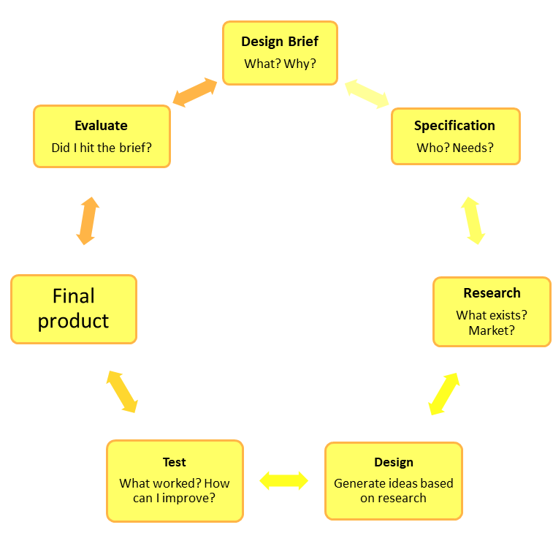
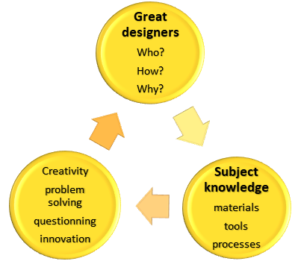
Golden Threads of Design Technology
The foundation of your planning / lesson sequence

Slide 37
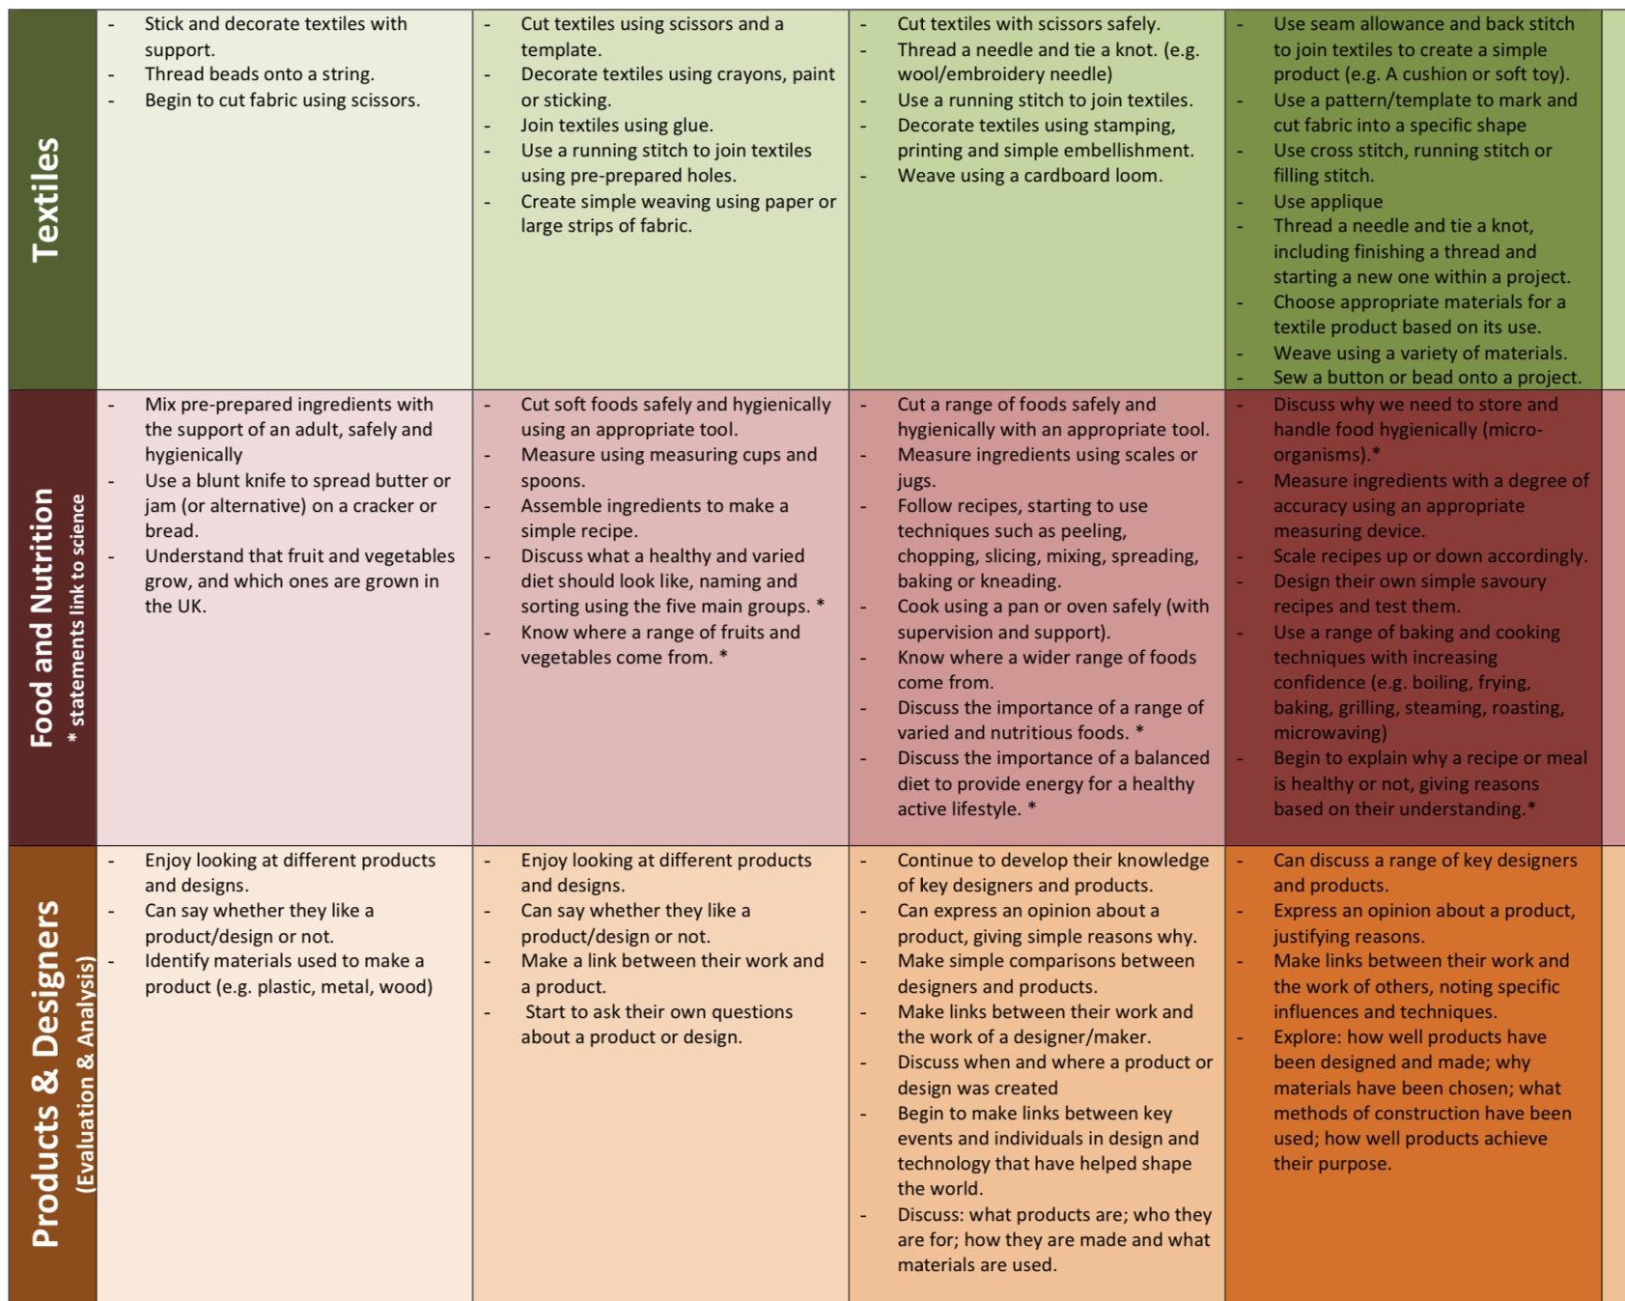
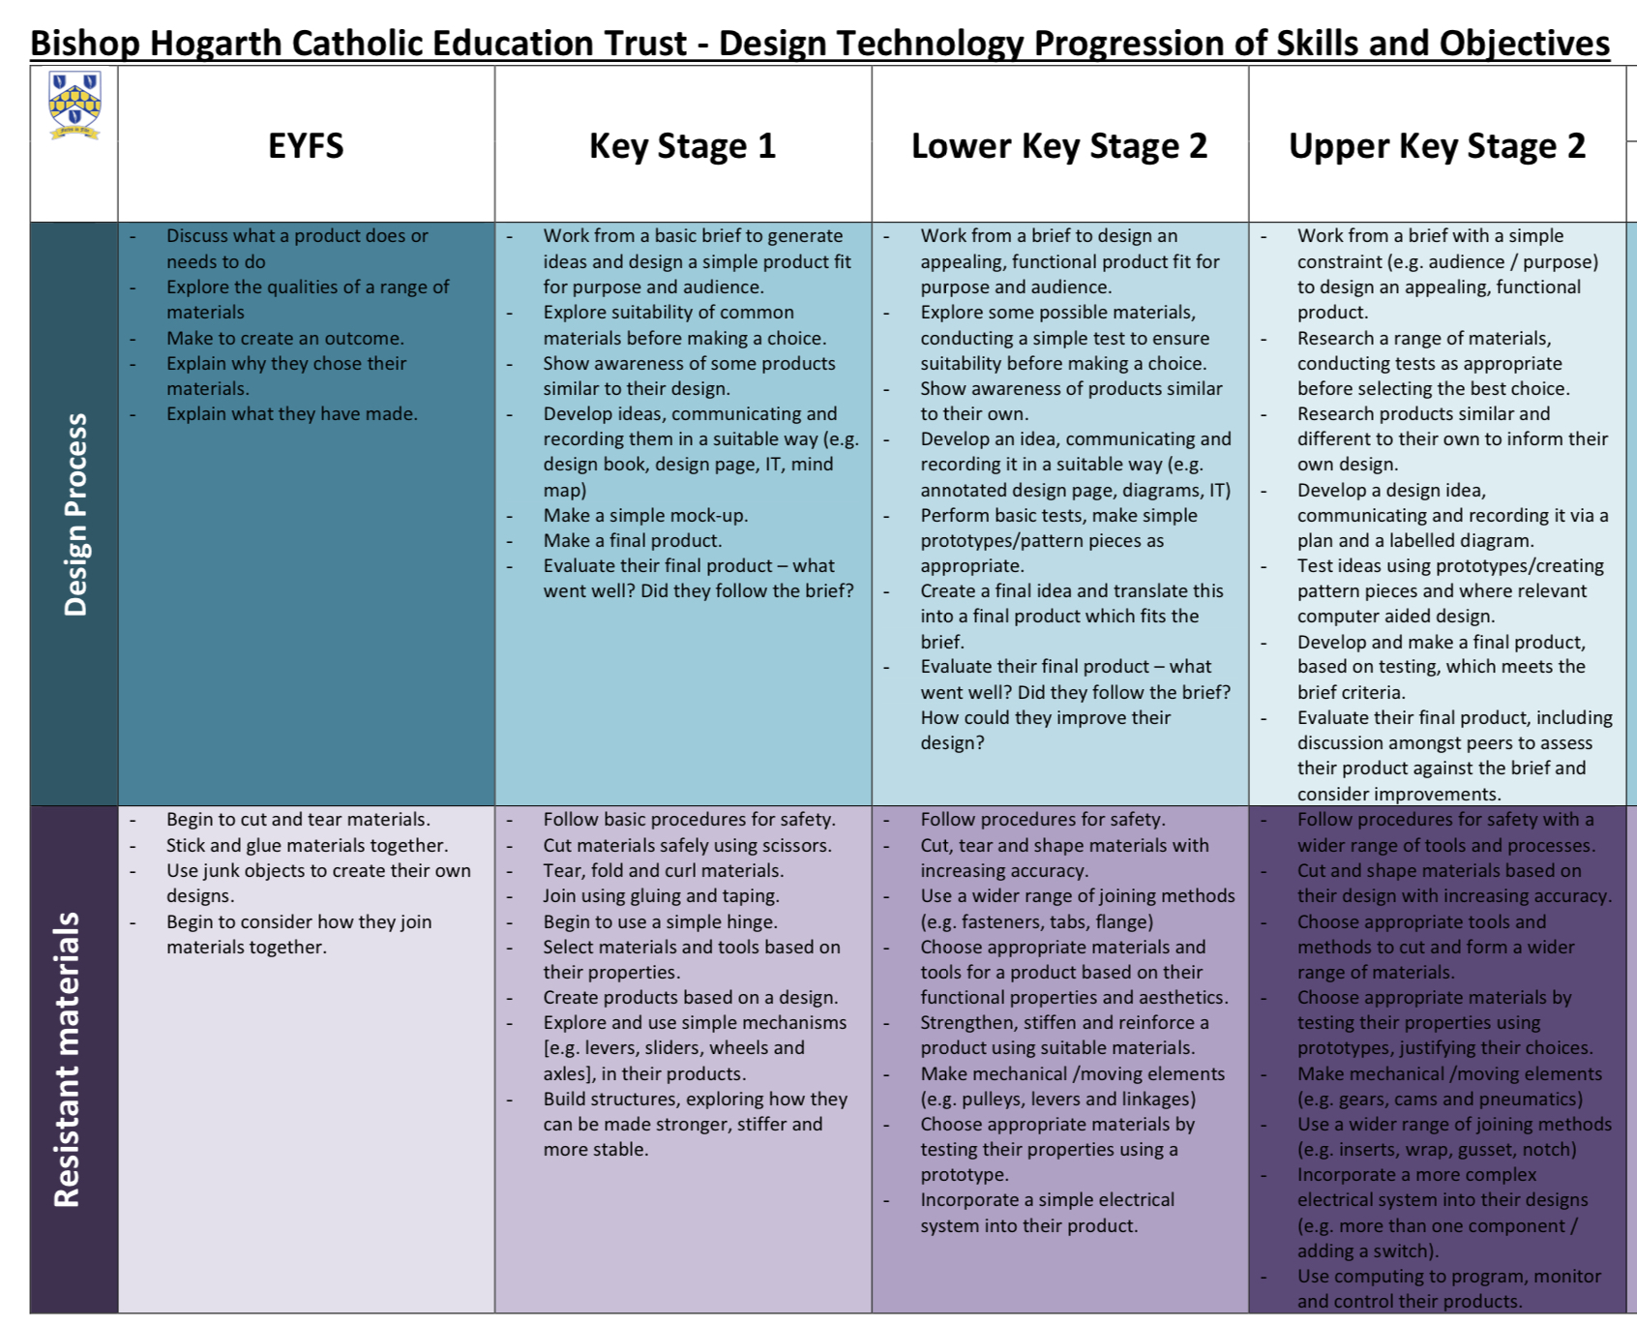
Progression of skills overview - whole curriculum
Underpins delivery
Woven through lesson content
Explicit
Resistant Materials
Textiles
Food and Nutrition
Underpinning
Design Process
Products and Designers
5 strands of skills progression

Slide 38
Topic Web Teaching Ideas
Links to BHCET
History
Geography
Science
KS1
KS2
Topic themes differ from art topic webs
Example ideas

Slide 39
Meet the Artists
Who are you familiar with?
Any favourite pieces, artists, medium?
Notes:
This is a quick whistle stop tour of artists that we have used in our school.
The photos are a mixture of children’s work / displays / real life examples of how they were used.
Ask any questions as we go through. Hopefully you may pick up some ideas along the away – you may have other ideas to share as e go along too.
NationL gallery

Slide 40
Are your artists and designers diverse?
Local context multi cultural gender modern masters newcomers
traditional masters

Slide 41
Think about your local and social context
What local artists are thereto celebrate?
Historical / classical heroes?
Culture?
Working document of artists resources

Slide 42
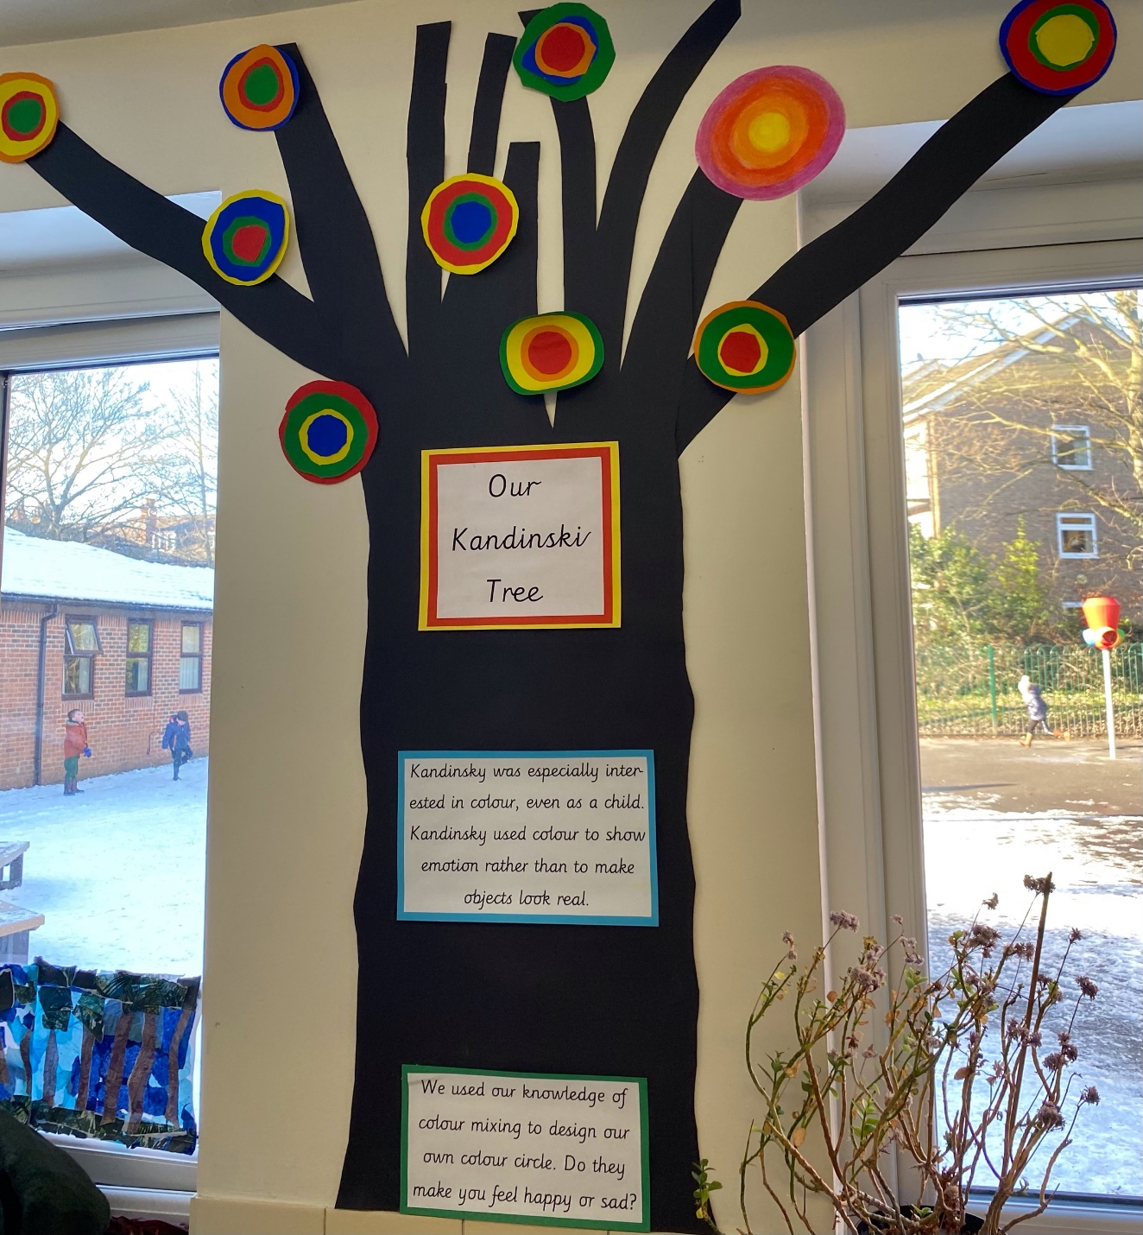
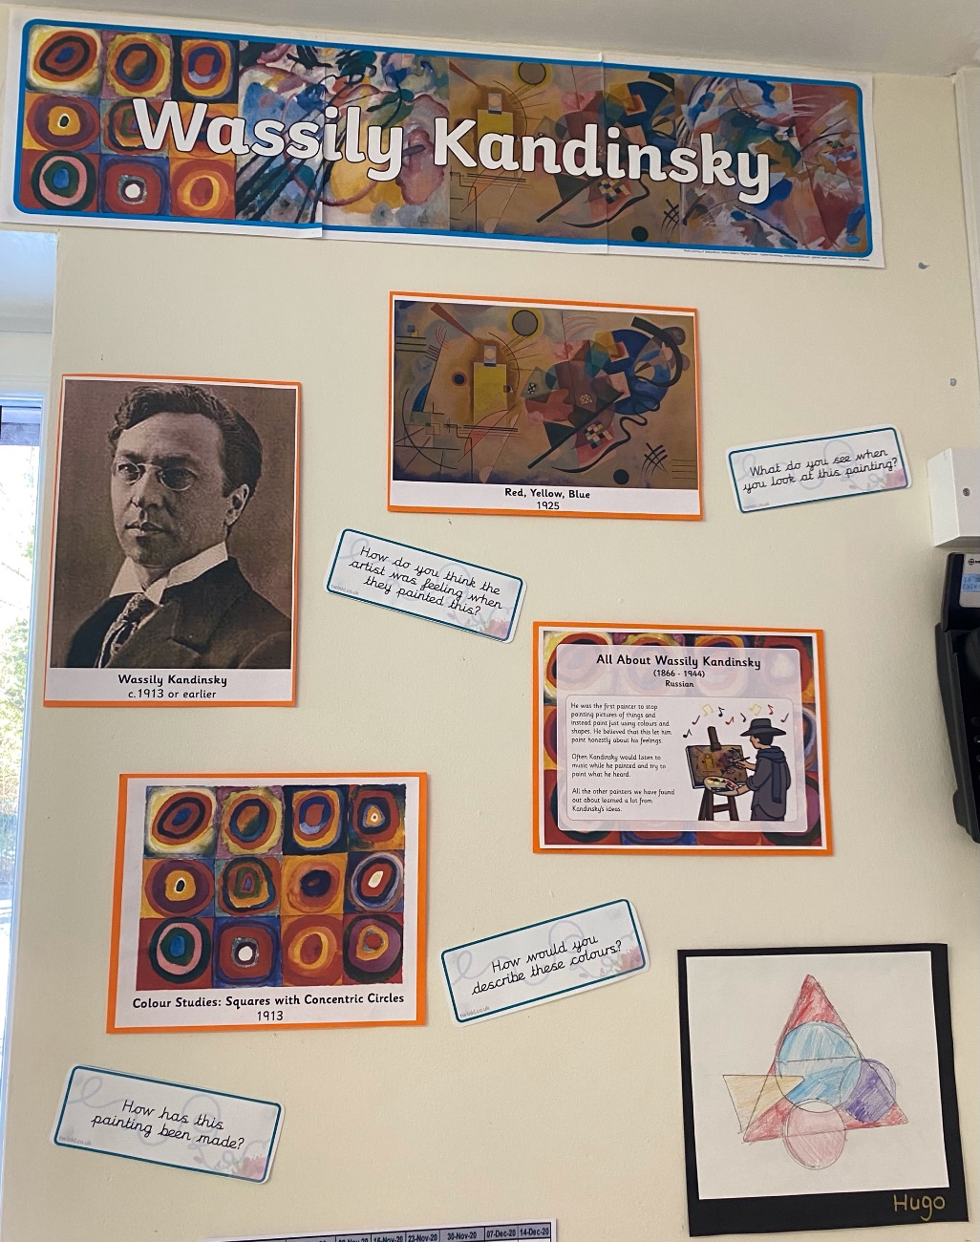
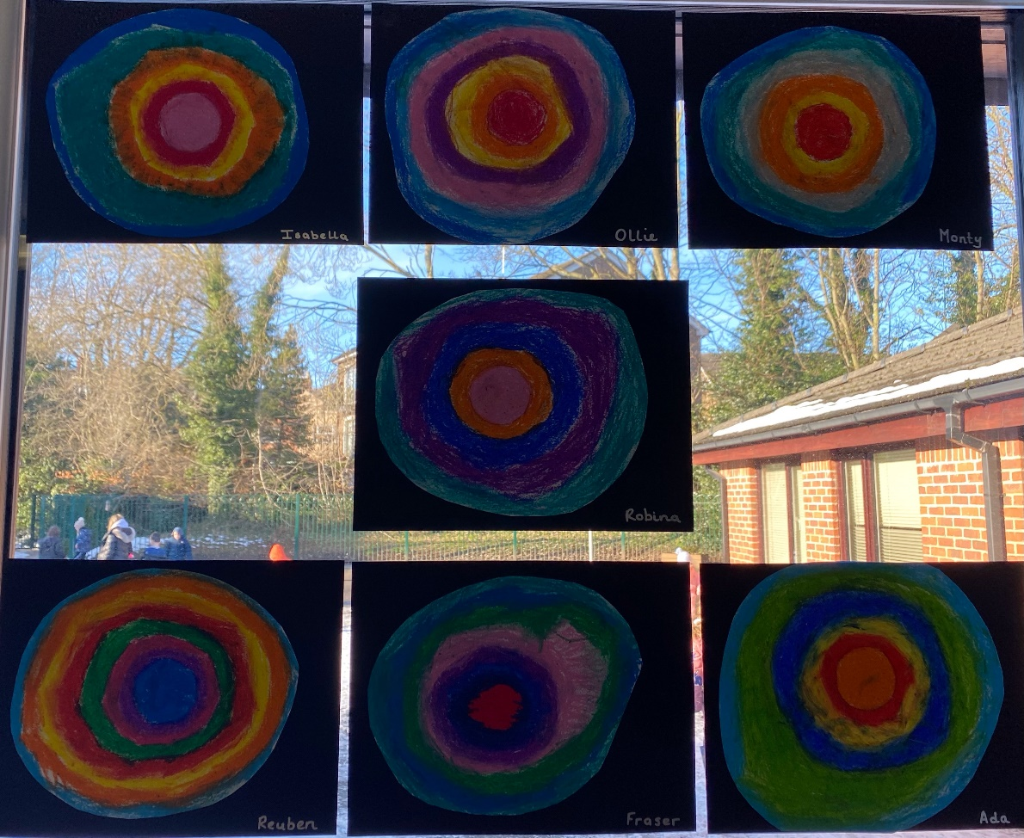
Key Stage 1
Notes:
Year 1 – Kandinsky
Linked to shape in Maths too
What skills can you see here?
Linked to colour mixing - talked about happy colour palettes, warm and cold colours

Slide 43
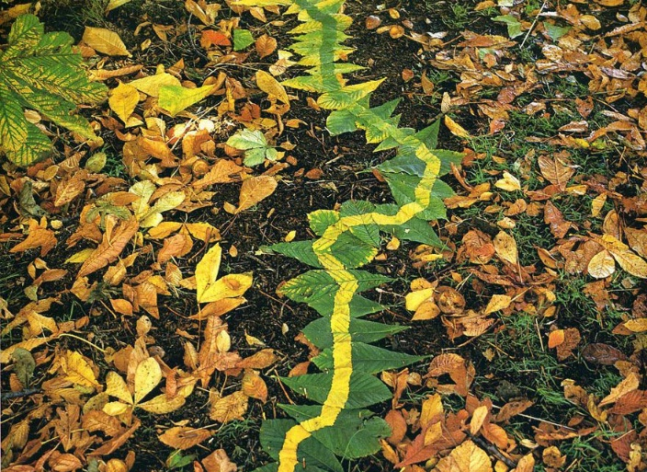
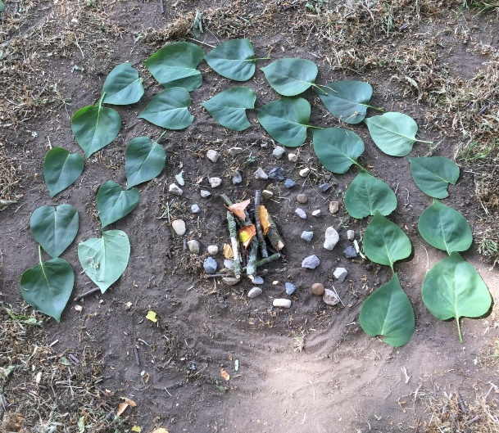
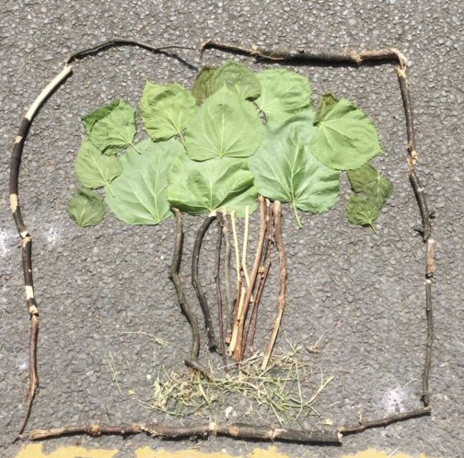
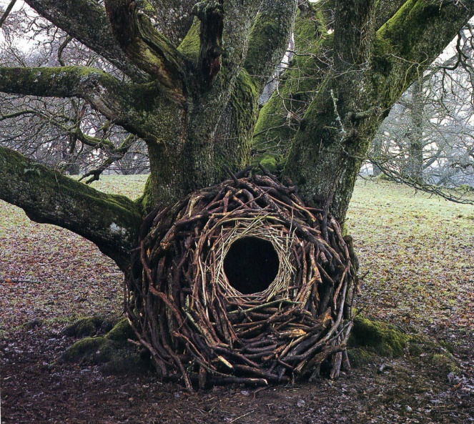
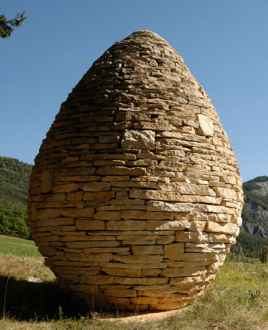
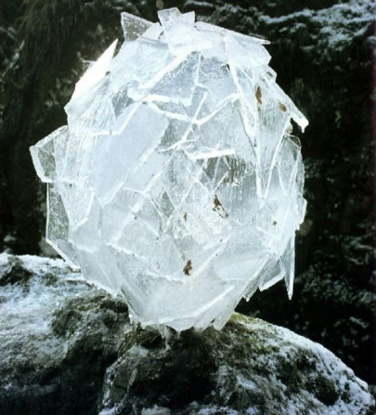
Andy Goldsworthy
Sculpture – art in the environment
Notes:
Creating Art in the Environment
Children’s works of art were created by Key work children during first lockdown
Talk about taking iPads out with children to look at tone, texture, pattern for sculpture topic.
Sculpture

Slide 44
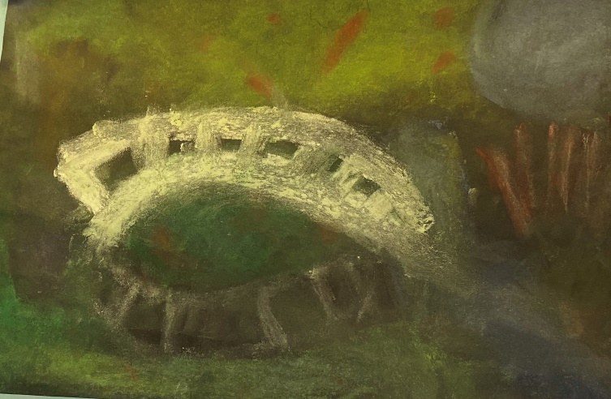
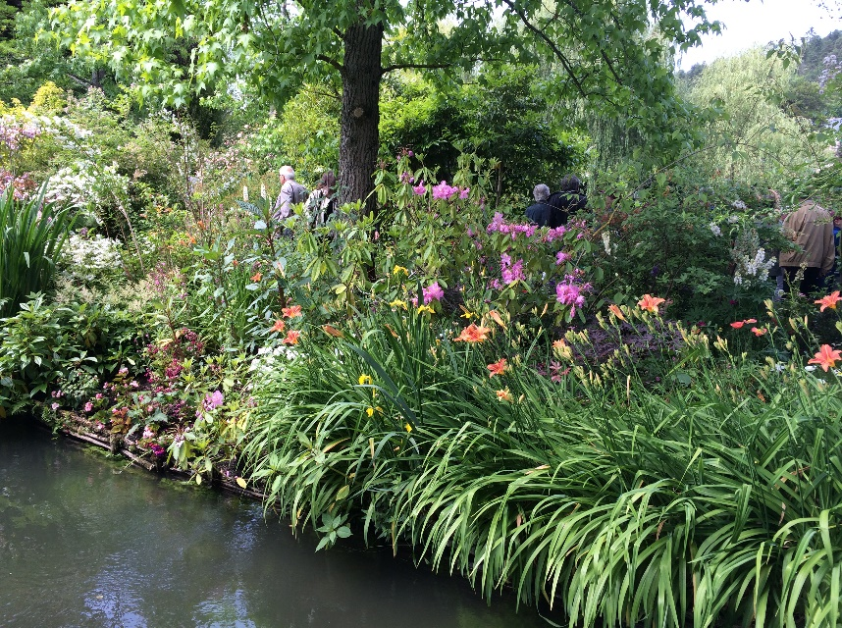
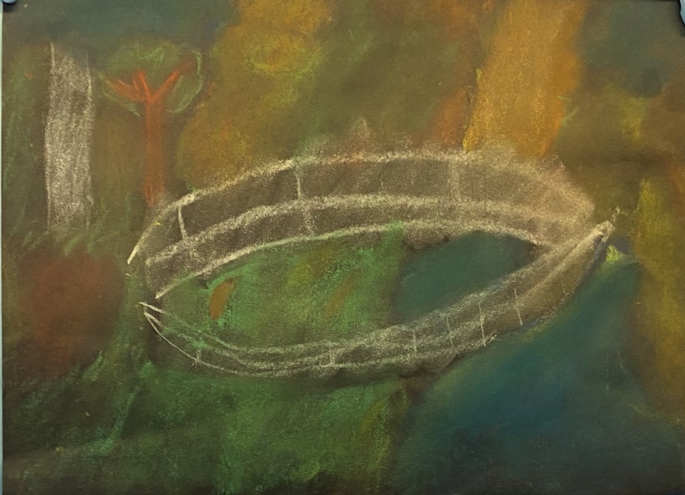
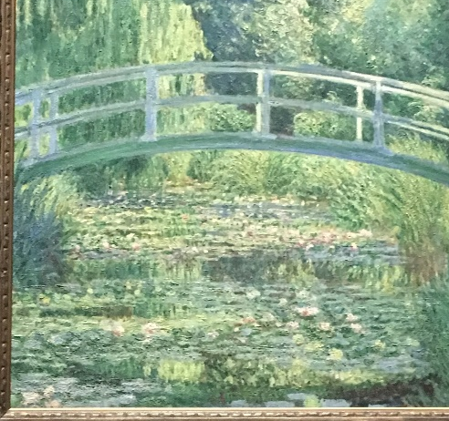
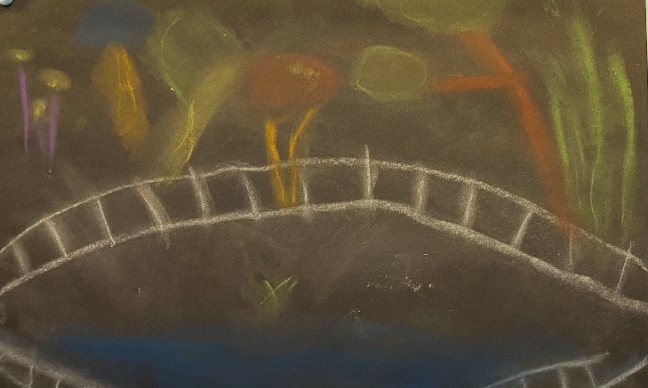
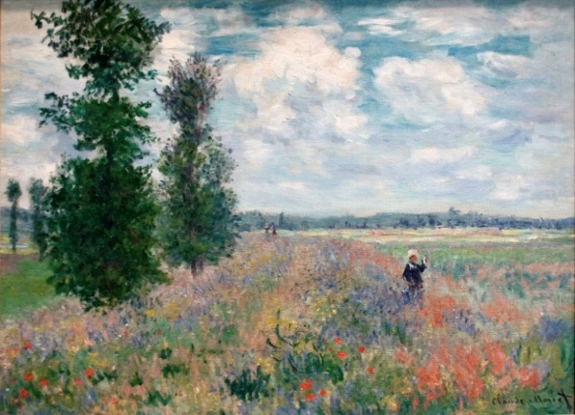
Notes:
This was used in Y5
Begun with a trip to Giverny with my year 5 children – looked at Monet’s house and gardens
Laorigniarie in Paris to see his works on the wall.
Saw the real life behind the artist.
Research of the man followed by works of art.
Children used pastels to create
I have lots of photos if anyone wants me to share just ask.

Slide 45
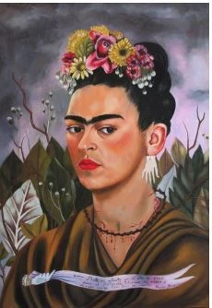
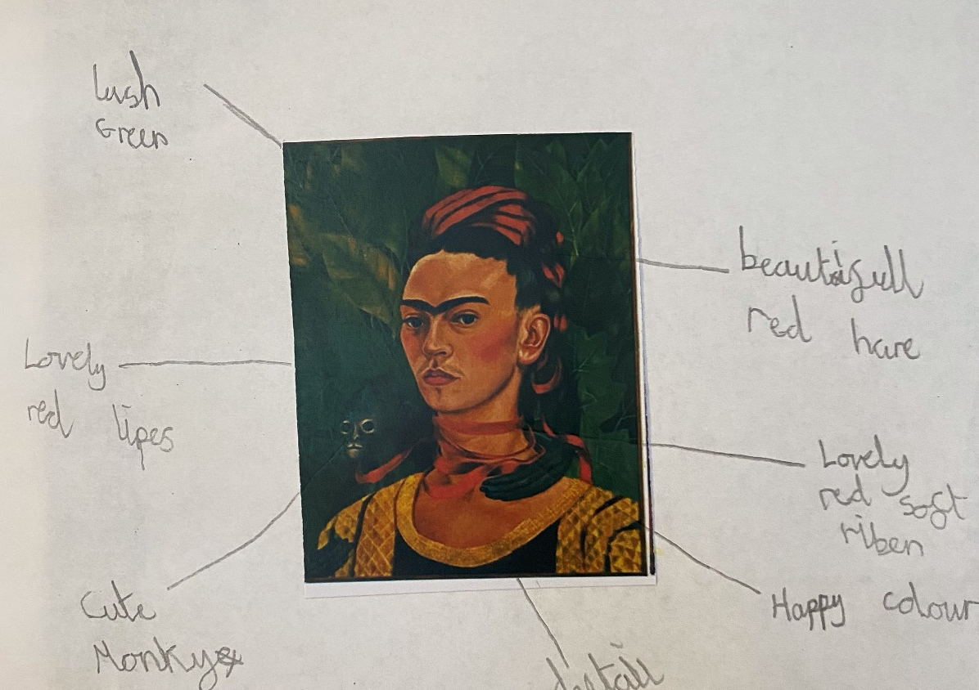
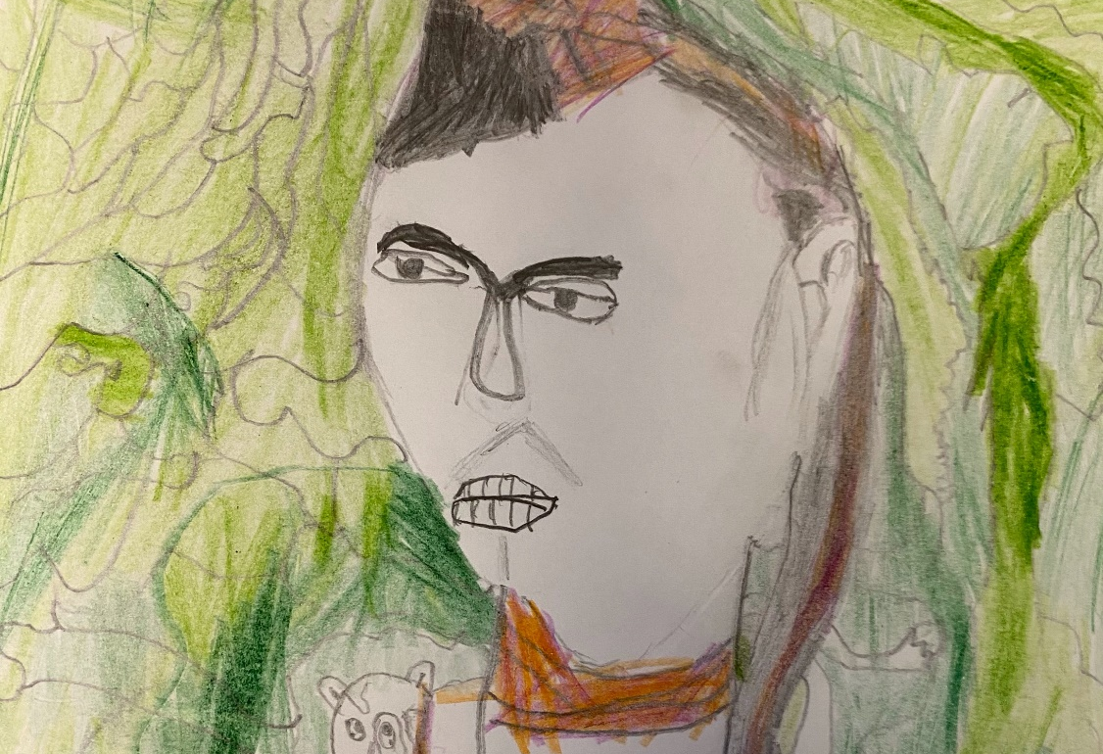
Frida Kahlo
Frida Kahlo
Notes:
Her colours had different meant to her. Happy memories, sad colours etc..
Could link to PHSCE
Philosophy for children
Frida Kahol
Kahlo is best known for her brilliantly coloured and unapologetic self-portraits in which she appears elaborately clothed in traditional Tehuana costumes. Her roots and relationships were explored extensively in her work, which was also haunted by physical pain following a bus accident which resulted in more than 30 operations

Slide 46
Mondrian

Slide 47
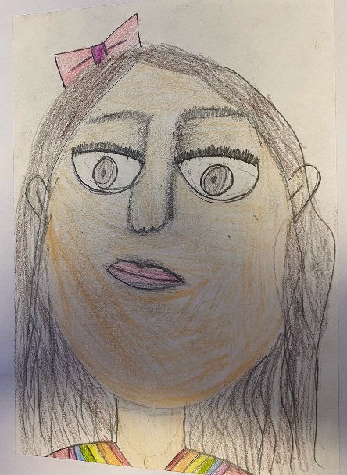
Sketch book examples
Notes:
Sketch books are a celebration of their work
Show be their jottings, ideas, and build up a picture.

Slide 48
Planning
What artists/ designer can I look at? Are these wide ranging?
What skills do I want the children to develop ?
Can I make meaningful cross curricular links to strengthen context?
What skills do they already know?

Slide 49
Process over product
What skills do I want the children to develop ?
LKS2
Skills areas ?
Specific skills?

Slide 51
Planning activity
Key Stage 1 | Lower Key Stage 2 | Upper Key Stage 2
Art
Design Technology
Drawing | Painting |  | Sculpture
Collage | Printing | Printing
Artists and craftspeople
Resistant Materials | Textiles | Food and Nutrition
Designers | Printing | Artists

Slide 52
Planning activity
World War 2 | Ancient Greece | Anglo Saxons
Living things and their habitats | The Romans | Victorians
Electricity | Rocks, fossils and soil | Rainforest
Guy Fawkes | Explorers | Antarctica
America | Biomes | Earthquakes and Volcanoes

Slide 54
Planning activity
Artists/ designers
Skills exploration
Outcome
Skills refinement
Designers
Design brief
Design ideas
Exploration of materials/ processed
outcome
What do I want my children to learn ? How will they learn this?

Slide 55
Year group: | Topic | Theme:
Artists and artwork / Designers | Skills |  | Outcomes

Slide 57
The Theory behind the practice
Balancing Observational & Experimental Drawing (accessart.org.uk)
When children (and adults) say they can’t draw, or that their drawing isn’t going well, they are often making that judgement because they imagine drawing is about accurate representation. Drawing is also about experimentation and expression, but to help those who would like to develop observational drawing skills, we need to teach skills in developing how they see the world about them. Seeing and drawing are so closely linked and we need to help children to slow down and really see, to enable them to draw.
https://youtu.be/NEIiUs7eg7c Why drawing is crucial

Slide 58
Practical – fundamental skills

Slide 59
Printing
Colour theory
Drawing
Painting
Fine motor skills

Slide 60
Lesson
What planning elements can you spot ?
How could you adapt this ?
How can this encompass SEN ?
How does this build upon prior knowledge?
What can be done to take these skills further?

Slide 61
L.O To explore line, texture and pattern with a pencil to use as a mono print
- Hold a pencil and make marks with control.
- Use sketching strokes to draw and add texture, movement and depth.

Slide 62
Mark making - warm up – show me
Quick lines
Slow lines
Angry
Flowing
Calm
Soft
Hard

Slide 63
Practical – fundamental skills
Timed drawing | Continuous line | Opposite hand | Blind drawing
Without blinking | Holding the top of the pencil | Blind continuous Line | Unconventional materials Stick and ink Leaves Feathers Chunky pencils Crayons – older children Rubbings

Slide 64
Quick Sketch
Using line drawing, draw the building in 30 seconds!
Using line drawing, draw the building using continuous line

Slide 65
Quick Sketch
Using line drawing, draw the building below in 30 seconds!

Slide 66
Quick Sketch
Using line drawing, draw the building below in 4 minutes!

Slide 67
Quick Sketch
Using line drawing, draw the building below in 1 minute!
Now try continuous line

Slide 71
Mono printing

Slide 72
Mono Printing
Use the ‘How to Mono Print Guide’ to begin creating your own building print. Begin with black ink.

Slide 73
Refining a unit of work to take away
Design Process
Products & Designers
Textiles
Resistant Materials
Food & Nutrition
Artists and artwork
Sculpture
Collage
Drawing
Painting
Printing

Slide 74
Year group: | Topic | Theme:
Artists and artwork / Designers | Skills |  | Outcomes

Slide 75
Cross curricular opportunities
Science Week- observational drawing
World Book Day – illustrators
Christmas- gift and craft
Easter – card and craft
Summer Term
British Values
Black History Month – artist study
Mothers’ Day
Key Events (Coronation)
Maths week – pattern, tessellation, symmetry
Bonfire Night

Slide 76
Resourcing and ideas
Free Art Teacher Resources (studentartguide.com)
https://www.studentartguide.com/resources/free-art-teacher-resourcescom)
Tate Kids – Ideas, artists by theme
Tate Kids
NSEAD – Free membership. Good curriculum advice and resources
https://www.nsead.org
Access Art – subscription based but has freebies
https://www.accessart.org.uk
Plan Bee – subscription based but good for free overviews
https://planbee.com/
Pinterest – Blocked at school but good for ideas
TWINKL – worth it for all curriculum areas
STEM.org.uk
DT lesson packs – Free to sign up
Choose the artwork carefully
Watch out for wobbly bits

Slide 77
I can’t draw to save my life.
How do it fit it all in?
How well do you know your Art and Design?
How do you make that?
I don’t know many artists.
Personal evaluation. Score each out of 10. 1- low 10- high
Basic art skills – drawing/ painting Knowledge of the art curriculum
Knowledge of artists Ideas generation
Confidence in executing ideas Applying art in the curriculum
Notes:
For a minute just think about the headings and score yourself out of ten

Slide 79
Contact details: amanda.Lankford@stpauls.bhcet.org.uk

Slide 80
Evaluation

